Slide 1
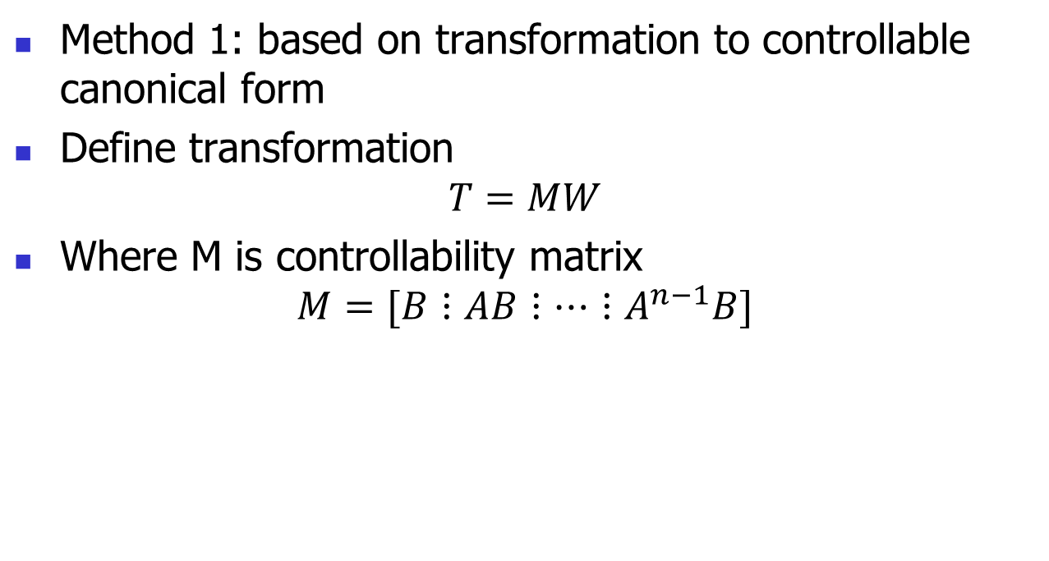
Pole Placement Algorithm – Method 1
Method 1: based on transformation to controllable canonical form
Define transformation
$$T=MW$$
Where M is controllability matrix
$$M=[B⋮AB⋮⋯⋮A^{n−1}B]$$

Slide 2
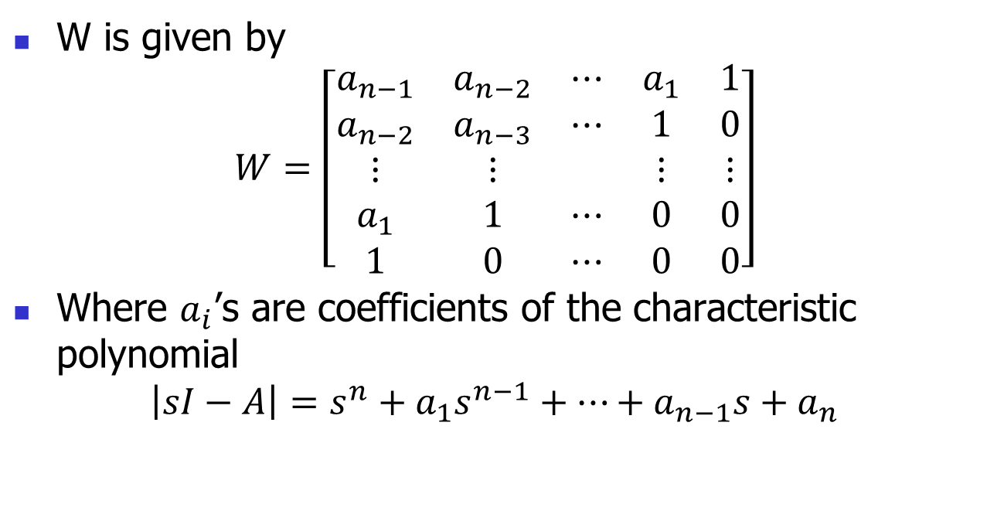
Pole Placement Algorithm
W is given by
$$W=\left[\begin{matrix}a_{n−1} & a_{n−2} & ⋯ & a_{1} & 1 \\ a_{n−2} & a_{n−3} & ⋯ & 1 & 0 \\ ⋮ & ⋮ & & ⋮ & ⋮ \\ a_{1} & 1 & ⋯ & 0 & 0 \\ 1 & 0 & ⋯ & 0 & 0\end{matrix}\right]$$
Where $a_{i}$’s are coefficients of the characteristic polynomial
$$\left|sI−A\right|=s^{n}+a_{1}s^{n−1}+⋯+a_{n−1}s+a_{n}$$

Slide 3
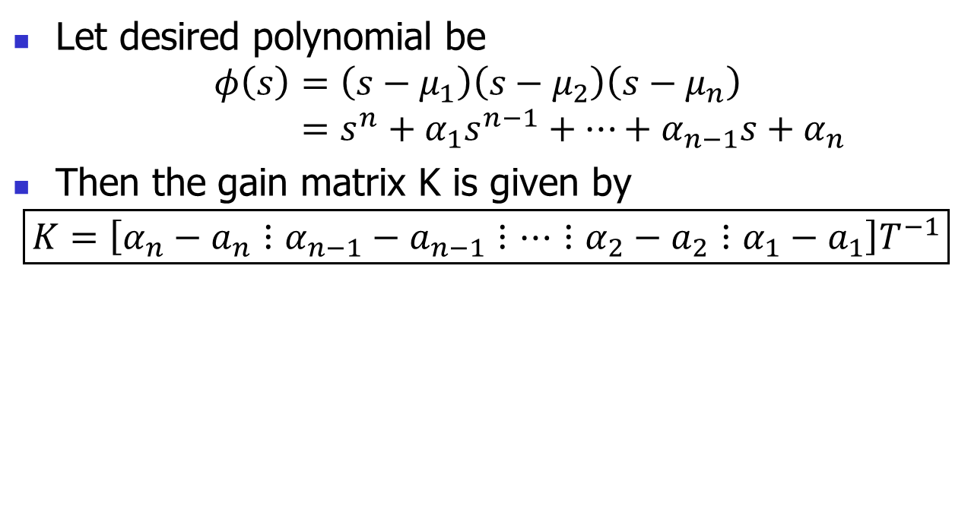
Pole Placement Algorithm
Let desired polynomial be
$$φ\left(s\right)=\left(s−μ_{1}\right)\left(s−μ_{2}\right)\left(s−μ_{n}\right) \\ =s^{n}+α_{1}s^{n−1}+⋯+α_{n−1}s+α_{n}$$
Then the gain matrix K is given by
$$\boxed{K=\left[α_{n}−a_{n}⋮α_{n−1}−a_{n−1}⋮⋯⋮α_{2}−a_{2}⋮α_{1}−a_{1}\right]T^{−1}}$$

Slide 4
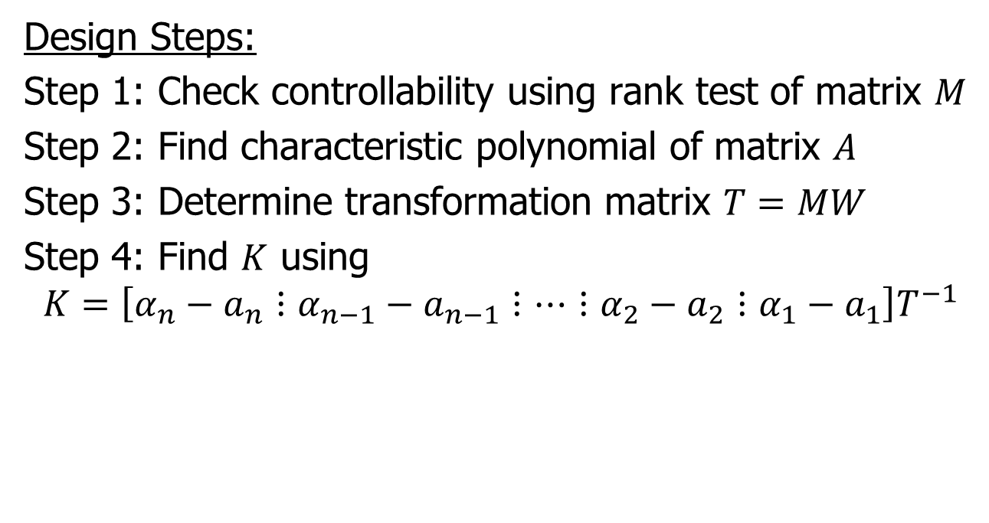
Pole Placement Algorithm
Design Steps:
Step 1: Check controllability using rank test of matrix $M$
Step 2: Find characteristic polynomial of matrix $A$
Step 3: Determine transformation matrix $T=MW$
Step 4: Find $K$ using
$$K=\left[α_{n}−a_{n}⋮α_{n−1}−a_{n−1}⋮⋯⋮α_{2}−a_{2}⋮α_{1}−a_{1}\right]T^{−1}$$

Slide 5

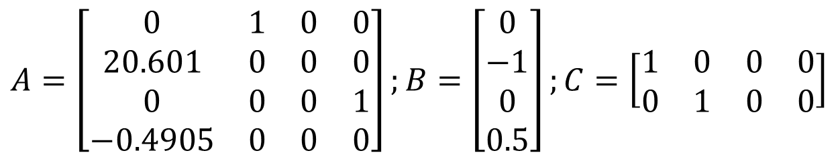



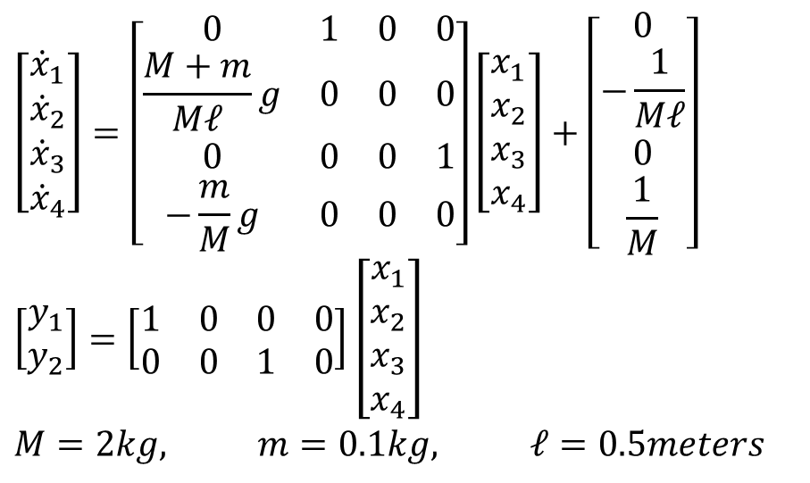






Example – Inverted Pendulum
$$y$$
$$\left[\begin{matrix}{\dot{x}}_{1} \\ {\dot{x}}_{2} \\ {\dot{x}}_{3} \\ {\dot{x}}_{4}\end{matrix}\right]=\left[\begin{matrix}0 & 1 & 0 & 0 \\ \frac{M+m}{Mℓ}g & 0 & 0 & 0 \\ 0 & 0 & 0 & 1 \\ −\frac{m}{M}g & 0 & 0 & 0\end{matrix}\right]\left[\begin{matrix}x_{1} \\ x_{2} \\ x_{3} \\ x_{4}\end{matrix}\right]+\left[\begin{matrix}0 \\ −\frac{1}{Mℓ} \\ 0 \\ \frac{1}{M}\end{matrix}\right]$$
$$\left[\begin{matrix}y_{1} \\ y_{2}\end{matrix}\right]=\left[\begin{matrix}1 & 0 & 0 & 0 \\ 0 & 0 & 1 & 0\end{matrix}\right]\left[\begin{matrix}x_{1} \\ x_{2} \\ x_{3} \\ x_{4}\end{matrix}\right]$$
$$M=2kg, m=0.1kg, ℓ=0.5meters$$
$$x$$
$$ℓ\sin{θ}$$
$$m$$
$$mg$$
$$ℓ\cos{θ}$$
$$ℓ$$
$$x$$
$$u$$
$$M$$
$$A=\left[\begin{matrix}0 & 1 & 0 & 0 \\ 20.601 & 0 & 0 & 0 \\ 0 & 0 & 0 & 1 \\ −0.4905 & 0 & 0 & 0\end{matrix}\right];B=\left[\begin{matrix}0 \\ −1 \\ 0 \\ 0.5\end{matrix}\right];C=\left[\begin{matrix}1 & 0 & 0 & 0 \\ 0 & 1 & 0 & 0\end{matrix}\right]$$

Slide 6
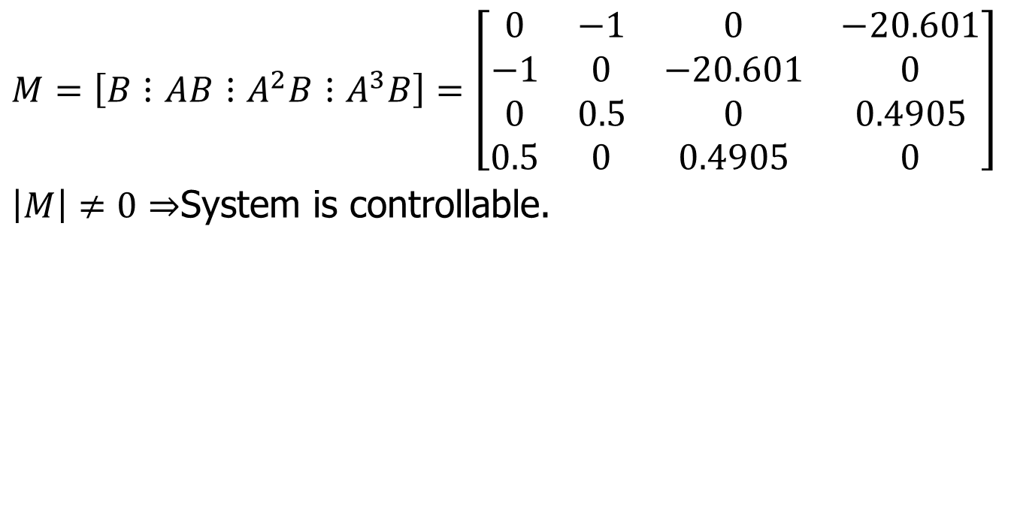
Step 1 – Check Controllability
$$M=\left[B⋮AB⋮A^{2}B⋮A^{3}B\right]=\left[\begin{matrix}0 & −1 & 0 & −20.601 \\ −1 & 0 & −20.601 & 0 \\ 0 & 0.5 & 0 & 0.4905 \\ 0.5 & 0 & 0.4905 & 0\end{matrix}\right]$$
$\left|M\right|≠0⇒$System is controllable.

Slide 7
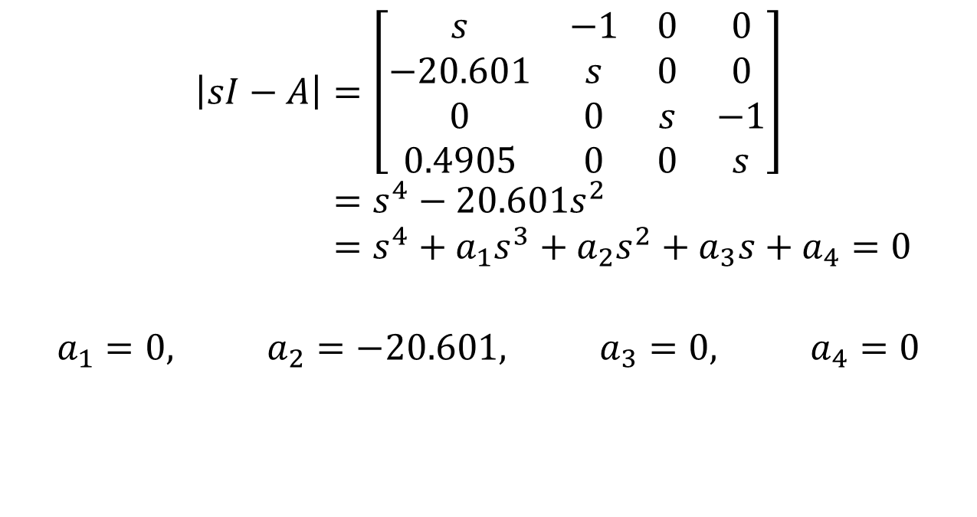
Step 2 – For the characteristic equation
$$\left|sI−A\right|=\left[\begin{matrix}s & −1 & 0 & 0 \\ −20.601 & s & 0 & 0 \\ 0 & 0 & s & −1 \\ 0.4905 & 0 & 0 & s\end{matrix}\right] \\ =s^{4}−20.601s^{2} \\ =s^{4}+a_{1}s^{3}+a_{2}s^{2}+a_{3}s+a_{4}=0$$
$$a_{1}=0, a_{2}=−20.601, a_{3}=0, a_{4}=0$$

Slide 8
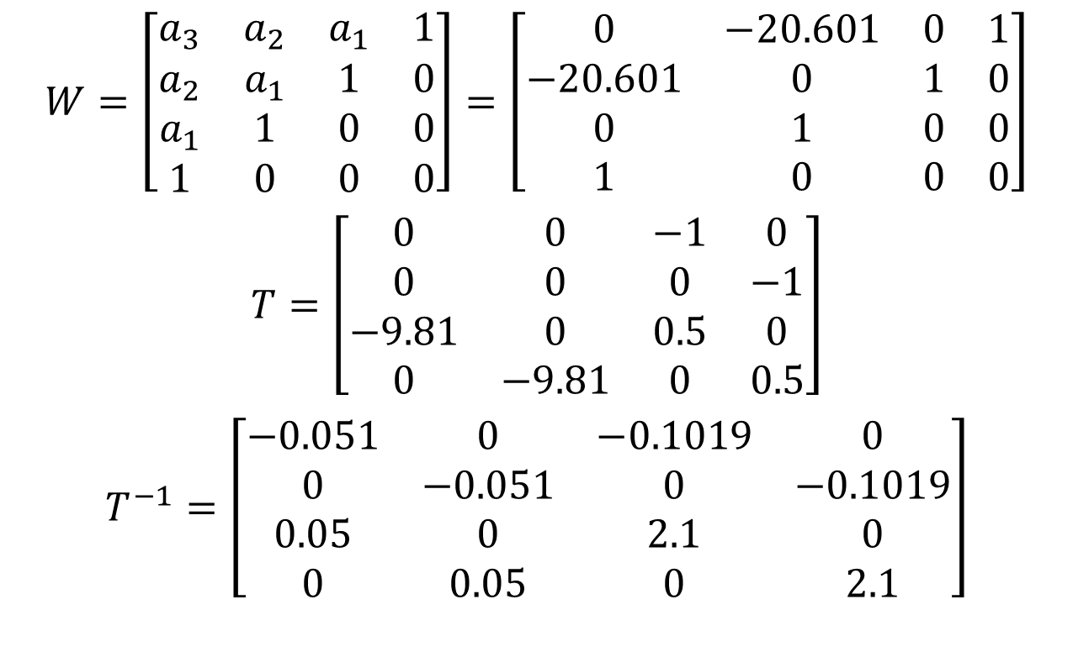
Step 3 – Find T=MW
$$W=\left[\begin{matrix}a_{3} & a_{2} & a_{1} & 1 \\ a_{2} & a_{1} & 1 & 0 \\ a_{1} & 1 & 0 & 0 \\ 1 & 0 & 0 & 0\end{matrix}\right]=\left[\begin{matrix}0 & −20.601 & 0 & 1 \\ −20.601 & 0 & 1 & 0 \\ 0 & 1 & 0 & 0 \\ 1 & 0 & 0 & 0\end{matrix}\right]$$
$$T=\left[\begin{matrix}0 & 0 & −1 & 0 \\ 0 & 0 & 0 & −1 \\ −9.81 & 0 & 0.5 & 0 \\ 0 & −9.81 & 0 & 0.5\end{matrix}\right]$$
$$T^{−1}=\left[\begin{matrix}−0.051 & 0 & −0.1019 & 0 \\ 0 & −0.051 & 0 & −0.1019 \\ 0.05 & 0 & 2.1 & 0 \\ 0 & 0.05 & 0 & 2.1\end{matrix}\right]$$

Slide 9
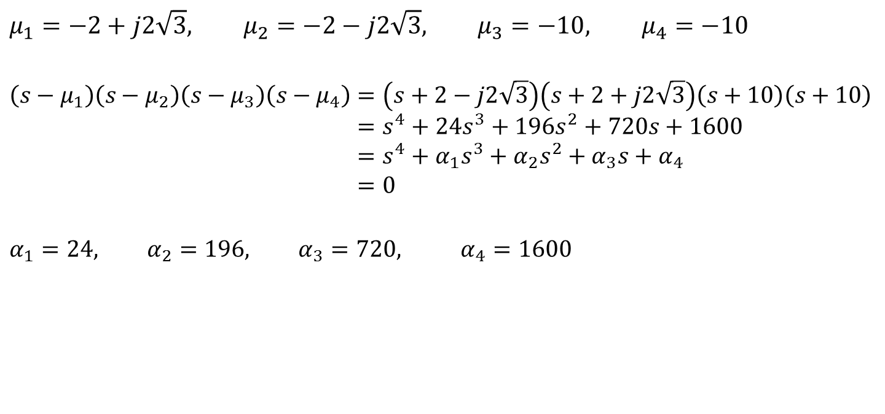

Step 4 – Find $α_{i}s$ from desired poles
$$μ_{1}=−2+j2\sqrt{3}, μ_{2}=−2−j2\sqrt{3}, μ_{3}=−10, μ_{4}=−10$$
$$\left(s−μ_{1}\right)\left(s−μ_{2}\right)\left(s−μ_{3}\right)\left(s−μ_{4}\right)=\left(s+2−j2\sqrt{3}\right)\left(s+2+j2\sqrt{3}\right)\left(s+10\right)\left(s+10\right) \\ =s^{4}+24s^{3}+196s^{2}+720s+1600 \\ =s^{4}+α_{1}s^{3}+α_{2}s^{2}+α_{3}s+α_{4} \\ =0$$
$$α_{1}=24, α_{2}=196, α_{3}=720, α_{4}=1600$$

Slide 10
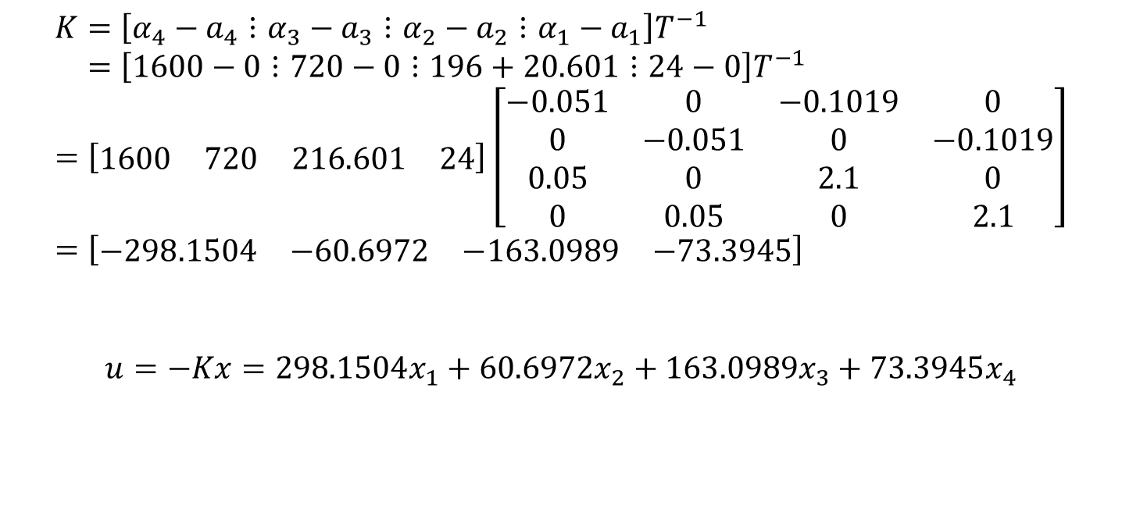

Step 5 – Find State Feedback Matrix $K$ and input $u$
$$K=\left[α_{4}−a_{4}⋮α_{3}−a_{3}⋮α_{2}−a_{2}⋮α_{1}−a_{1}\right]T^{−1} \\ =\left[1600−0⋮720−0⋮196+20.601⋮24−0\right]T^{−1} \\ =\left[\begin{matrix}1600 & 720 & 216.601 & 24\end{matrix}\right]\left[\begin{matrix}−0.051 & 0 & −0.1019 & 0 \\ 0 & −0.051 & 0 & −0.1019 \\ 0.05 & 0 & 2.1 & 0 \\ 0 & 0.05 & 0 & 2.1\end{matrix}\right] \\ =\left[\begin{matrix}−298.1504 & −60.6972 & −163.0989 & −73.3945\end{matrix}\right]$$
$$u=−Kx=298.1504x_{1}+60.6972x_{2}+163.0989x_{3}+73.3945x_{4}$$

Slide 11
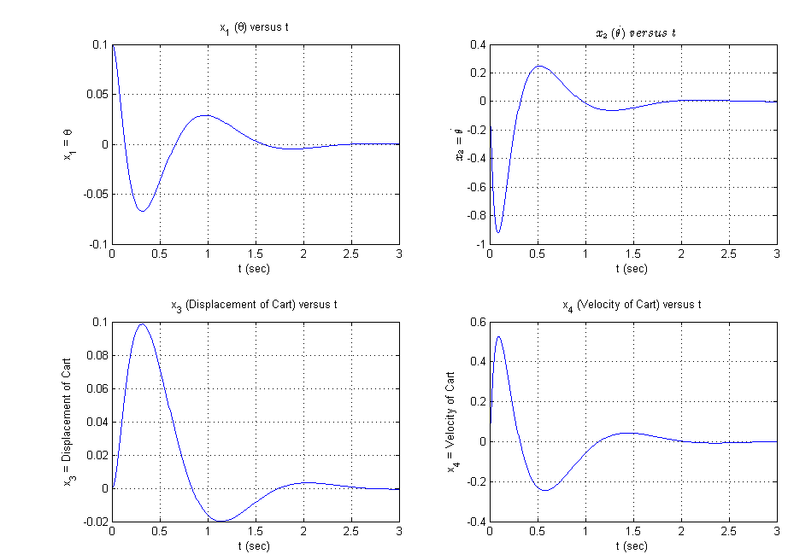
Simulation

Slide 12
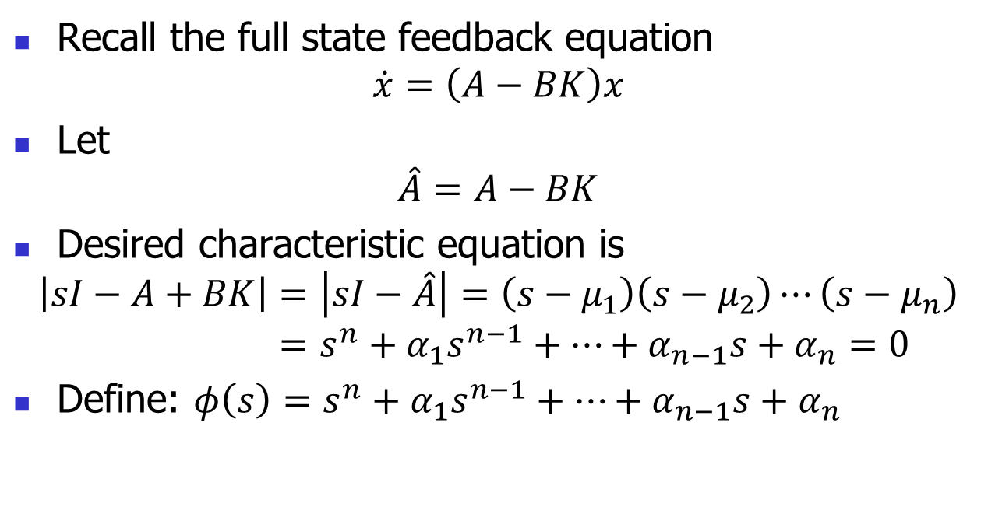
Method 2: Ackermann’s Formula
Recall the full state feedback equation
$$\dot{x}=\left(A−BK\right)x$$
Let
$$\hat{A}=A−BK$$
Desired characteristic equation is
$$\left|sI−A+BK\right|=\left|sI−\hat{A}\right|=\left(s−μ_{1}\right)\left(s−μ_{2}\right)⋯\left(s−μ_{n}\right) \\ =s^{n}+α_{1}s^{n−1}+⋯+α_{n−1}s+α_{n}=0$$
Define: $φ\left(s\right)=s^{n}+α_{1}s^{n−1}+⋯+α_{n−1}s+α_{n}$

Slide 13
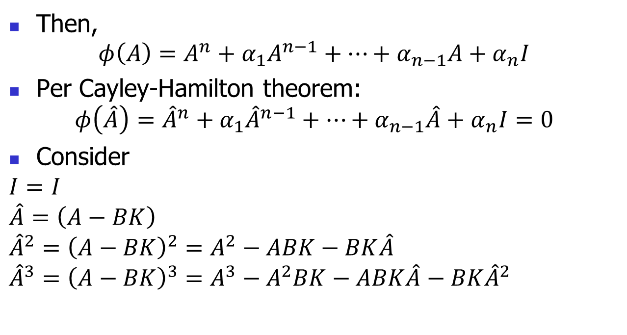
Ackermann’s Formula (continued)
Then,
$$φ\left(A\right)=A^{n}+α_{1}A^{n−1}+⋯+α_{n−1}A+α_{n}I$$
Per Cayley-Hamilton theorem:
$$φ\left(\hat{A}\right)={\hat{A}}^{n}+α_{1}{\hat{A}}^{n−1}+⋯+α_{n−1}\hat{A}+α_{n}I=0$$
Consider
$$I=I$$
$$\hat{A}=\left(A−BK\right)$$
$${\hat{A}}^{2}={\left(A−BK\right)}^{2}=A^{2}−ABK−BK\hat{A} \\ {\hat{A}}^{3}={\left(A−BK\right)}^{3}=A^{3}−A^{2}BK−ABK\hat{A}−BK{\hat{A}}^{2}$$

Slide 14
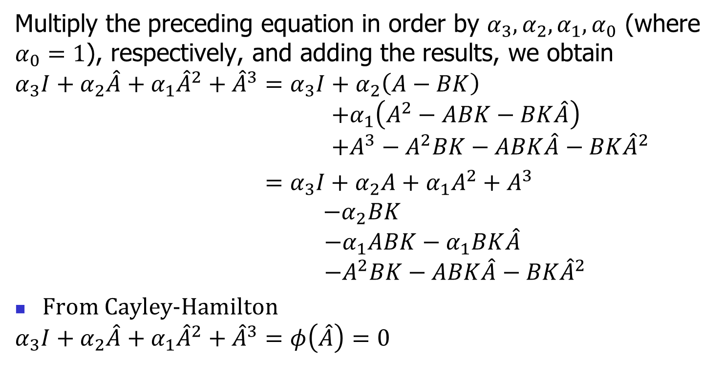
Ackermann’s Formula (continued)
Multiply the preceding equation in order by $α_{3}, α_{2}, α_{1}, α_{0}$ (where $α_{0}=1$), respectively, and adding the results, we obtain
$$α_{3}I+α_{2}\hat{A}+α_{1}{\hat{A}}^{2}+{\hat{A}}^{3}=α_{3}I+α_{2}\left(A−BK\right) \\ +α_{1}\left(A^{2}−ABK−BK\hat{A}\right) \\ +A^{3}−A^{2}BK−ABK\hat{A}−BK{\hat{A}}^{2}$$
$=α_{3}I+α_{2}A+α_{1}A^{2}+A^{3}$
$−α_{2}BK$
$−α_{1}ABK−α_{1}BK\hat{A}$
$−A^{2}BK−ABK\hat{A}−BK{\hat{A}}^{2}$
From Cayley-Hamilton
$$α_{3}I+α_{2}\hat{A}+α_{1}{\hat{A}}^{2}+{\hat{A}}^{3}=φ\left(\hat{A}\right)=0$$

Slide 15
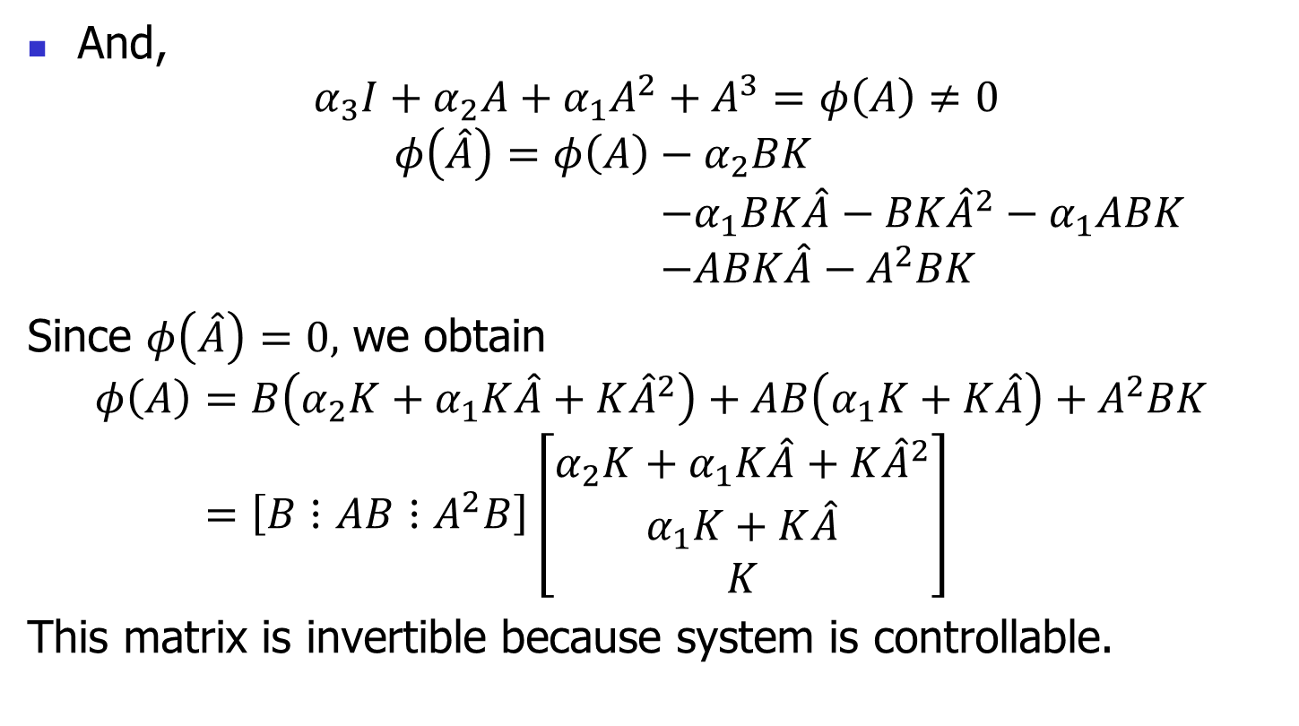
Ackermann’s Formula (continued)
And,
$$α_{3}I+α_{2}A+α_{1}A^{2}+A^{3}=φ\left(A\right)≠0$$
$$φ\left(\hat{A}\right)=φ\left(A\right)−α_{2}BK \\ −α_{1}BK\hat{A}−BK{\hat{A}}^{2}−α_{1}ABK \\ −ABK\hat{A}−A^{2}BK$$
Since $φ\left(\hat{A}\right)=0,$ we obtain
$$φ\left(A\right)=B\left(α_{2}K+α_{1}K\hat{A}+K{\hat{A}}^{2}\right)+AB\left(α_{1}K+K\hat{A}\right)+A^{2}BK \\ =\left[B⋮AB⋮A^{2}B\right]\left[\begin{matrix}α_{2}K+α_{1}K\hat{A}+K{\hat{A}}^{2} \\ α_{1}K+K\hat{A} \\ K\end{matrix}\right]$$
This matrix is invertible because system is controllable.

Slide 16
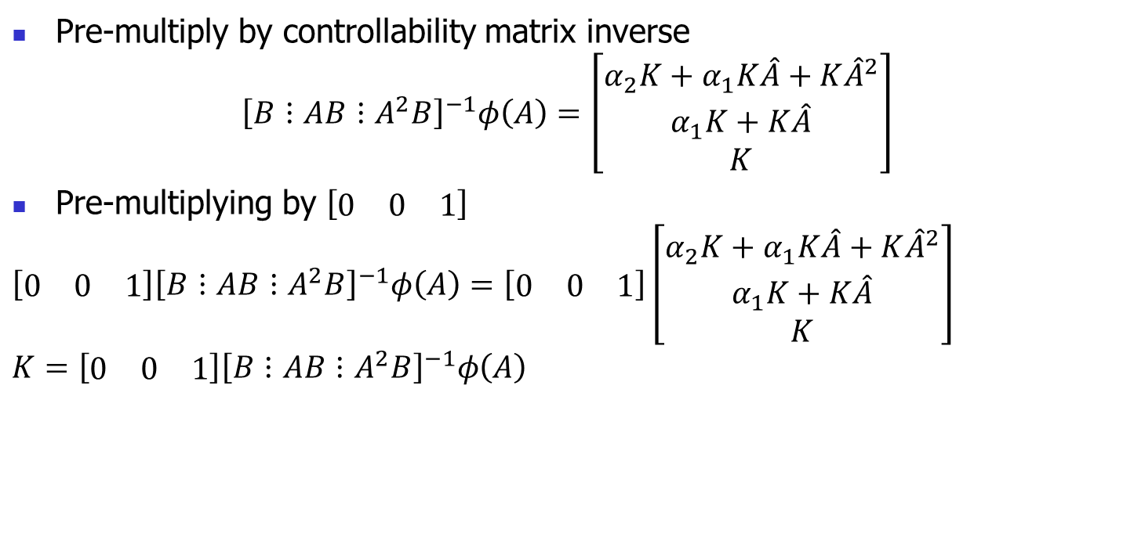
Ackermann’s Formula (continued)
Pre-multiply by controllability matrix inverse
$${\left[B⋮AB⋮A^{2}B\right]}^{−1}φ\left(A\right)=\left[\begin{matrix}α_{2}K+α_{1}K\hat{A}+K{\hat{A}}^{2} \\ α_{1}K+K\hat{A} \\ K\end{matrix}\right]$$
Pre-multiplying by $\left[\begin{matrix}0 & 0 & 1\end{matrix}\right]$
$$\left[\begin{matrix}0 & 0 & 1\end{matrix}\right]{\left[B⋮AB⋮A^{2}B\right]}^{−1}φ\left(A\right)=\left[\begin{matrix}0 & 0 & 1\end{matrix}\right]\left[\begin{matrix}α_{2}K+α_{1}K\hat{A}+K{\hat{A}}^{2} \\ α_{1}K+K\hat{A} \\ K\end{matrix}\right]$$
$$K=\left[\begin{matrix}0 & 0 & 1\end{matrix}\right]{\left[B⋮AB⋮A^{2}B\right]}^{−1}φ\left(A\right)$$

Slide 17

Ackermann’s Formula (continued)
General case,
$$\boxed{K=\left[\begin{matrix}0 & 0 & ⋯ & 0 & 1\end{matrix}\right]{\left[B⋮AB⋮⋯⋮A^{n−1}B\right]}^{−1}φ\left(A\right) }$$

Slide 18
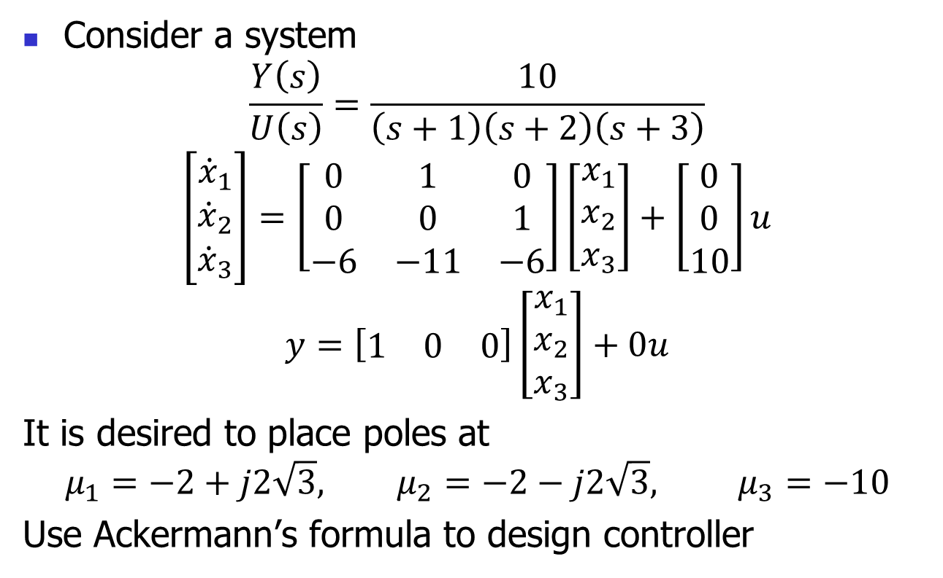
Example
Consider a system
$$\frac{Y\left(s\right)}{U\left(s\right)}=\frac{10}{\left(s+1\right)\left(s+2\right)\left(s+3\right)}$$
$$\left[\begin{matrix}{\dot{x}}_{1} \\ {\dot{x}}_{2} \\ {\dot{x}}_{3}\end{matrix}\right]=\left[\begin{matrix}0 & 1 & 0 \\ 0 & 0 & 1 \\ −6 & −11 & −6\end{matrix}\right]\left[\begin{matrix}x_{1} \\ x_{2} \\ x_{3}\end{matrix}\right]+\left[\begin{matrix}0 \\ 0 \\ 10\end{matrix}\right]u$$
$$y=\left[\begin{matrix}1 & 0 & 0\end{matrix}\right]\left[\begin{matrix}x_{1} \\ x_{2} \\ x_{3}\end{matrix}\right]+0u$$
It is desired to place poles at
$$μ_{1}=−2+j2\sqrt{3}, μ_{2}=−2−j2\sqrt{3}, μ_{3}=−10$$
Use Ackermann’s formula to design controller

Slide 19
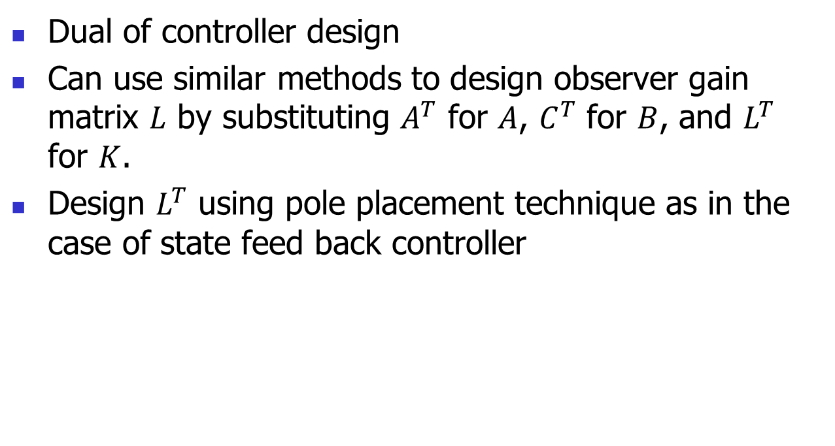
Observer Design
Dual of controller design
Can use similar methods to design observer gain matrix $L$ by substituting $A^{T}$ for $A$, $C^{T}$ for $B$, and $L^{T}$ for $K$.
Design $L^{T}$ using pole placement technique as in the case of state feed back controller

Slide 20
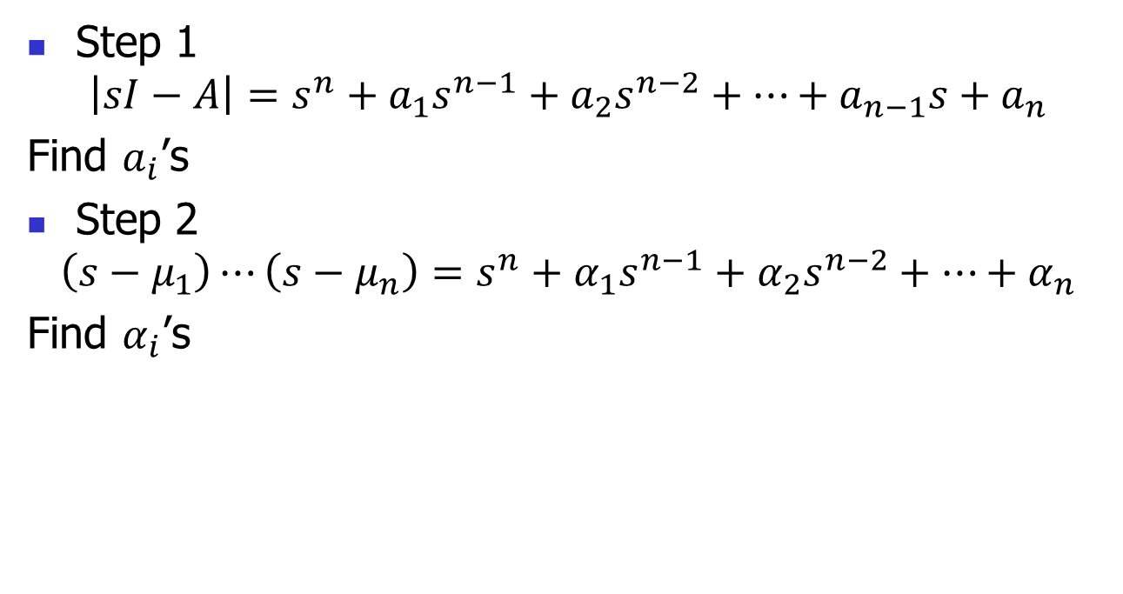
Design Process – Method 1
Step 1
$$\left|sI−A\right|=s^{n}+a_{1}s^{n−1}+a_{2}s^{n−2}+⋯+a_{n−1}s+a_{n}$$
Find $a_{i}$’s
Step 2
$$\left(s−μ_{1}\right)⋯\left(s−μ_{n}\right)=s^{n}+α_{1}s^{n−1}+α_{2}s^{n−2}+⋯+α_{n}$$
Find $α_{i}$’s

Slide 21
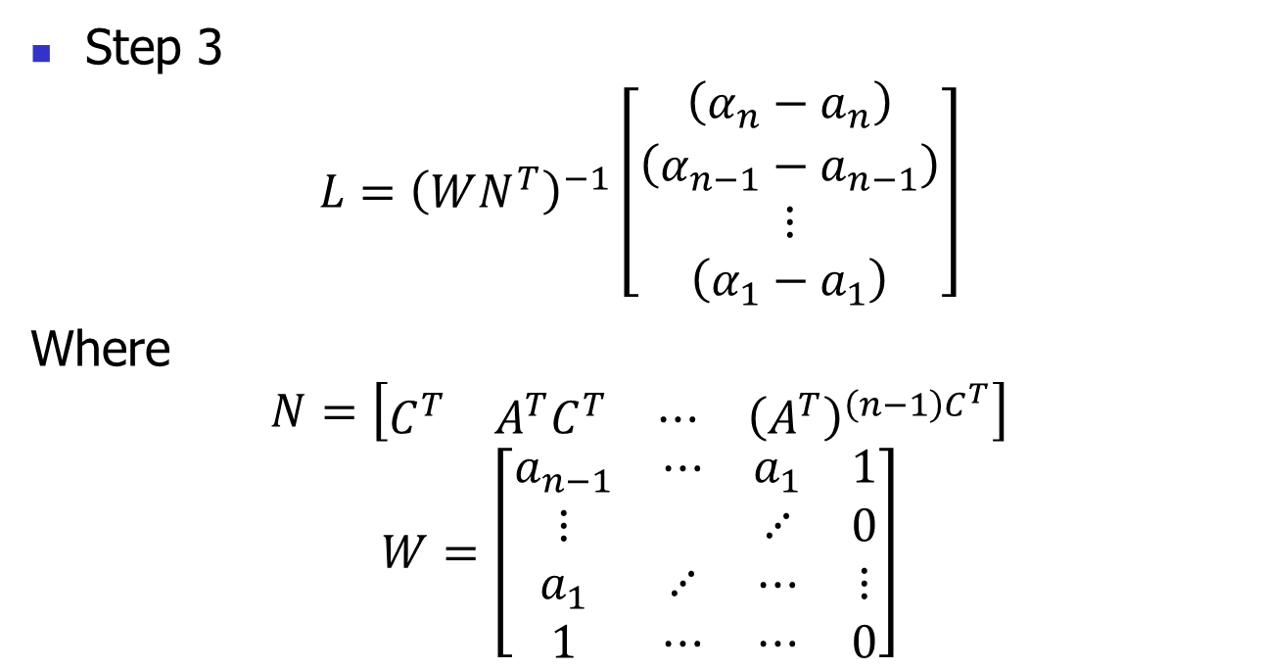
Method 1
Step 3
$$L={\left(WN^{T}\right)}^{−1}\left[\begin{matrix}\left(α_{n}−a_{n}\right) \\ \left(α_{n−1}−a_{n−1}\right) \\ ⋮ \\ \left(α_{1}−a_{1}\right)\end{matrix}\right]$$
Where
$$N=\left[\begin{matrix}C^{T} & A^{T}C^{T} & ⋯ & {\left(A^{T}\right)}^{\left(n−1\right)C^{T}}\end{matrix}\right]$$
$$W=\left[\begin{matrix}a_{n−1} & ⋯ & a_{1} & 1 \\ ⋮ & & ⋰ & 0 \\ a_{1} & ⋰ & ⋯ & ⋮ \\ 1 & ⋯ & ⋯ & 0\end{matrix}\right]$$

Slide 22
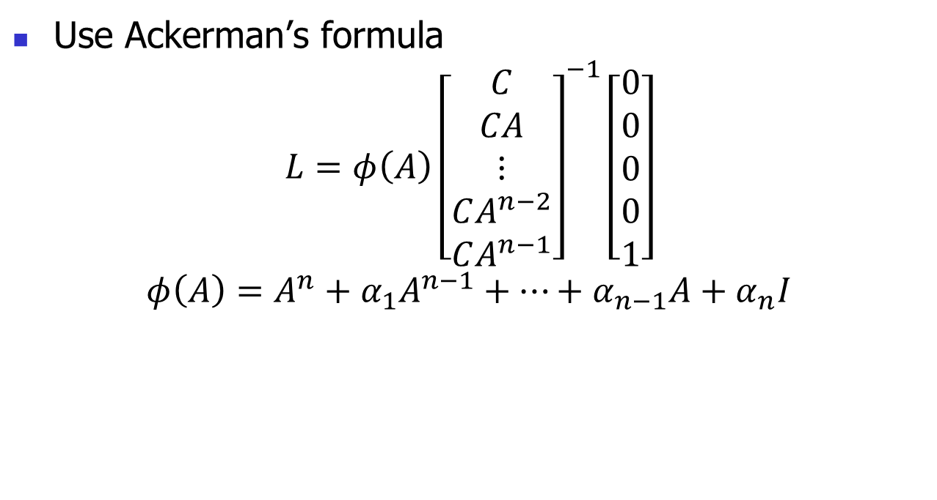
Method 2
Use Ackerman’s formula
$$L=φ\left(A\right){\left[\begin{matrix}C \\ CA \\ ⋮ \\ CA^{n−2} \\ CA^{n−1}\end{matrix}\right]}^{−1}\left[\begin{matrix}0 \\ 0 \\ 0 \\ 0 \\ 1\end{matrix}\right]$$
$$φ\left(A\right)=A^{n}+α_{1}A^{n−1}+⋯+α_{n−1}A+α_{n}I$$

Slide 23
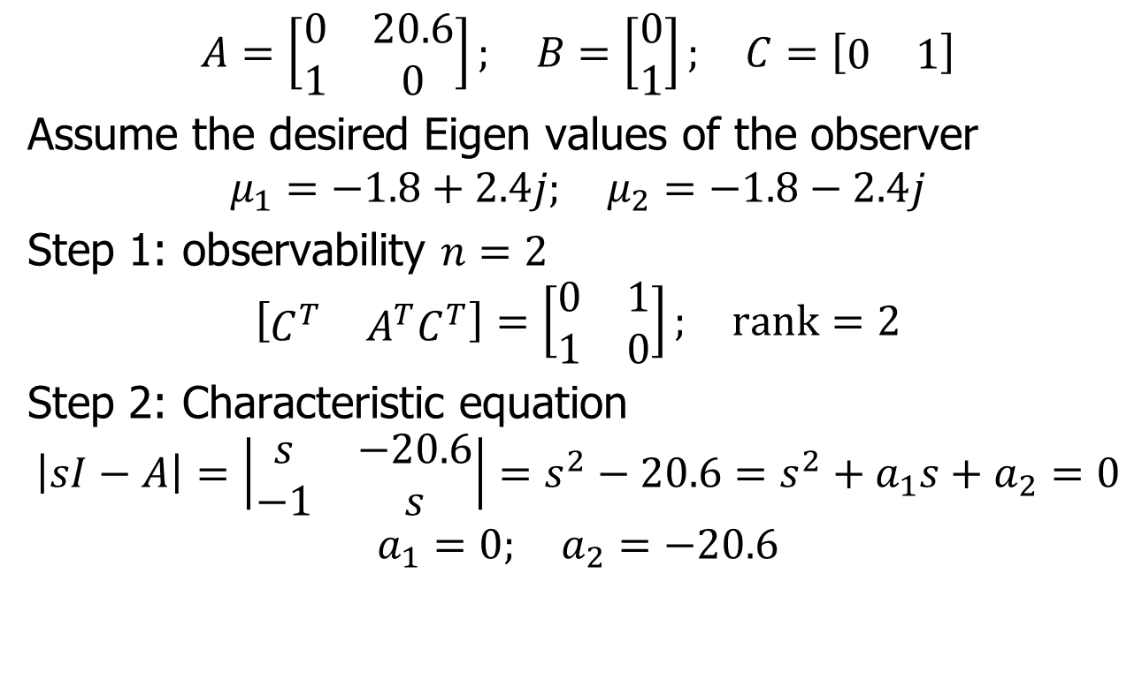
Example
$$A=\left[\begin{matrix}0 & 20.6 \\ 1 & 0\end{matrix}\right]; B=\left[\begin{matrix}0 \\ 1\end{matrix}\right]; C=\left[\begin{matrix}0 & 1\end{matrix}\right]$$
Assume the desired Eigen values of the observer
$$μ_{1}=−1.8+2.4j; μ_{2}=−1.8−2.4j$$
Step 1: observability $n=2$
$$\left[\begin{matrix}C^{T} & A^{T}C^{T}\end{matrix}\right]=\left[\begin{matrix}0 & 1 \\ 1 & 0\end{matrix}\right]; rank=2$$
Step 2: Characteristic equation
$$\left|sI−A\right|=\left|\begin{matrix}s & −20.6 \\ −1 & s\end{matrix}\right|=s^{2}−20.6=s^{2}+a_{1}s+a_{2}=0$$
$$a_{1}=0; a_{2}=−20.6$$

Slide 24
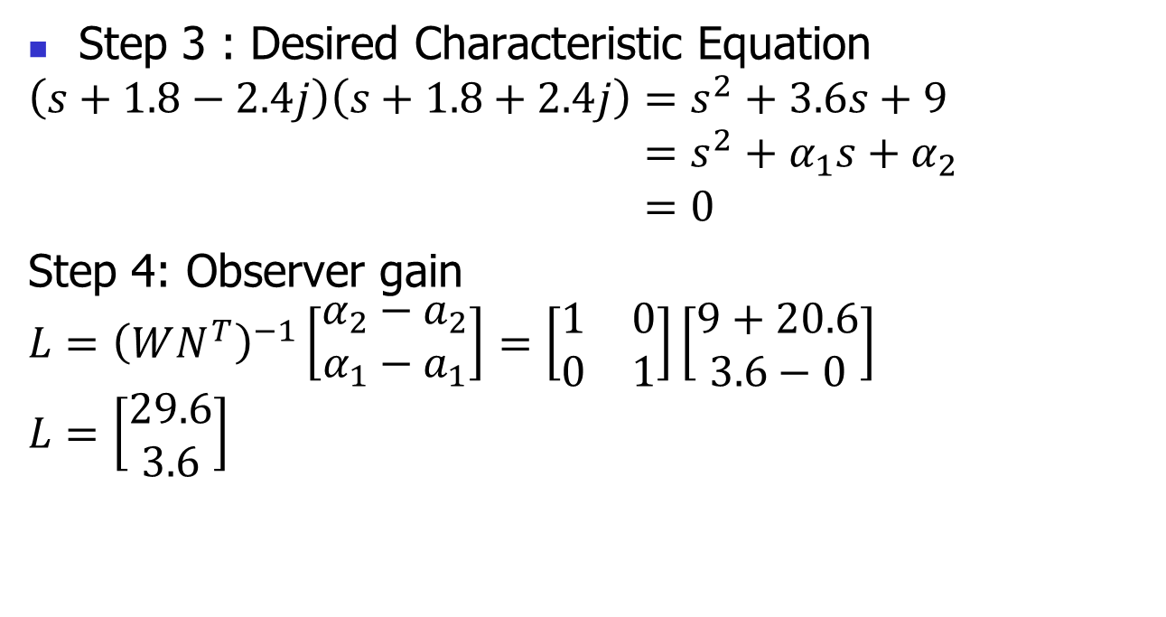
Example (continued)
Step 3 : Desired Characteristic Equation
$$\left(s+1.8−2.4j\right)\left(s+1.8+2.4j\right)=s^{2}+3.6s+9 \\ =s^{2}+α_{1}s+α_{2} \\ =0$$
Step 4: Observer gain
$$L={\left(WN^{T}\right)}^{−1}\left[\begin{matrix}α_{2}−a_{2} \\ α_{1}−a_{1}\end{matrix}\right]=\left[\begin{matrix}1 & 0 \\ 0 & 1\end{matrix}\right]\left[\begin{matrix}9+20.6 \\ 3.6−0\end{matrix}\right]$$
$$L=\left[\begin{matrix}29.6 \\ 3.6\end{matrix}\right]$$

Slide 25








Closed-loop System
$$u$$
$$x$$
$$y$$
B
+
$$∫$$
C
+
A
$$\tilde{x}$$
-K
$$\tilde{y}$$
B
+
+
$$∫$$
C
$$−$$
+
+
+
A
L

Slide 26
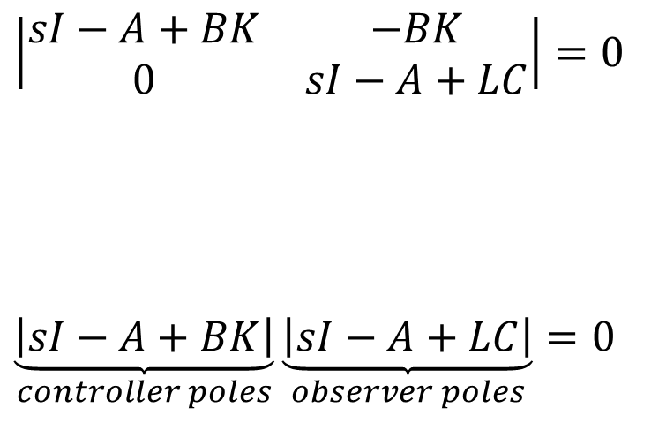
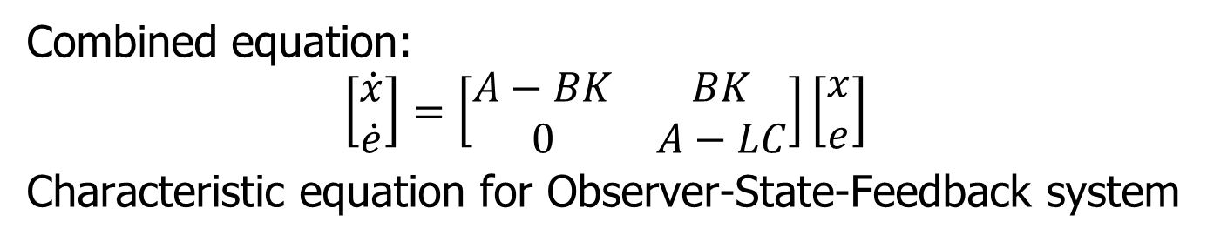
Recap – Closed-loop State Equation
Combined equation:
$$\left[\begin{matrix}\dot{x} \\ \dot{e}\end{matrix}\right]=\left[\begin{matrix}A−BK & BK \\ 0 & A−LC\end{matrix}\right]\left[\begin{matrix}x \\ e\end{matrix}\right]$$
Characteristic equation for Observer-State-Feedback system
$$\left|\begin{matrix}sI−A+BK & −BK \\ 0 & sI−A+LC\end{matrix}\right|=0$$
$$\underset{controller poles}{\underbrace{\left|sI−A+BK\right|}}\underset{observer poles}{\underbrace{\left|sI−A+LC\right|}}=0$$
Hence observer design and pole placement are independent of each other!
This is known as “Separation Theorem.”

Slide 27
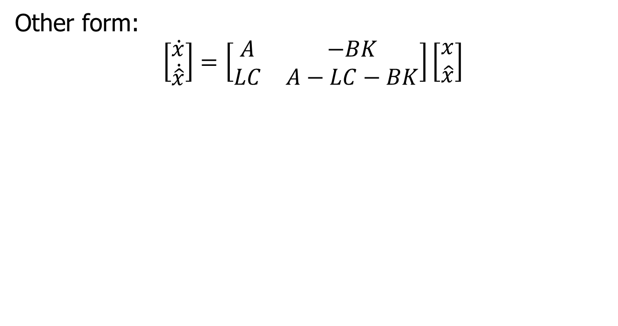
Closed-loop Equation
Other form:
$$\left[\begin{matrix}\dot{x} \\ \dot{\hat{x}}\end{matrix}\right]=\left[\begin{matrix}A & −BK \\ LC & A−LC−BK\end{matrix}\right]\left[\begin{matrix}x \\ \hat{x}\end{matrix}\right]$$

