Slide 1
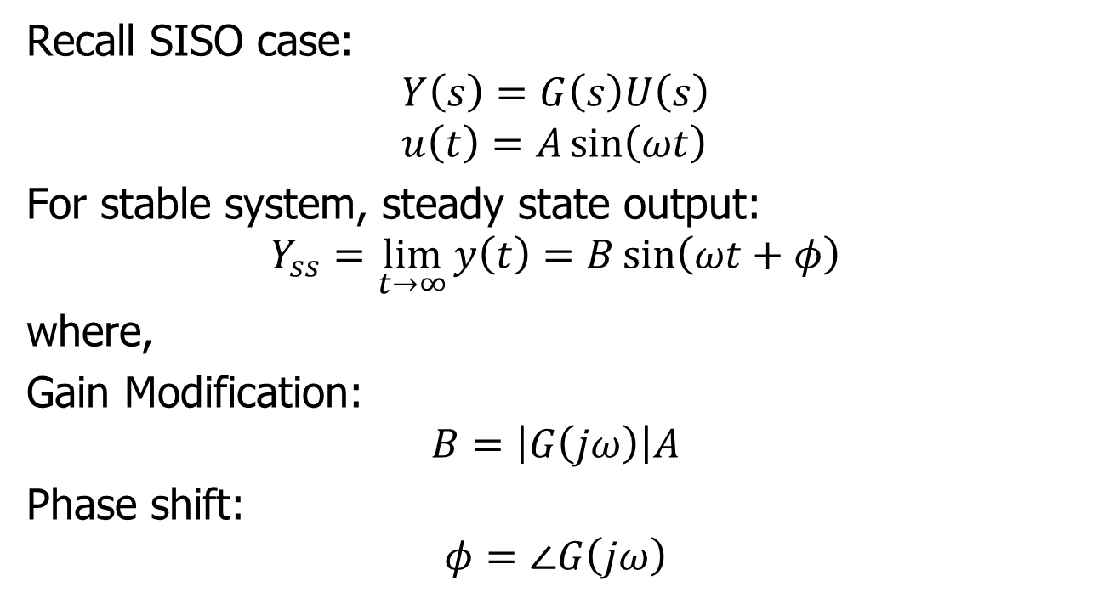
Frequency Response of MIMO Systemps
Recall SISO case:
$$Y\left(s\right)=G\left(s\right)U\left(s\right) \\ u\left(t\right)=A\sin\left(ωt\right)$$
For stable system, steady state output:
$$Y_{ss}=\lim_{t→∞}{y\left(t\right)}=B\sin\left(ωt+φ\right)$$
where,
Gain Modification:
$$B=\left|G\left(jω\right)\right|A$$
Phase shift:
$$φ=∠G\left(jω\right)$$

Slide 2
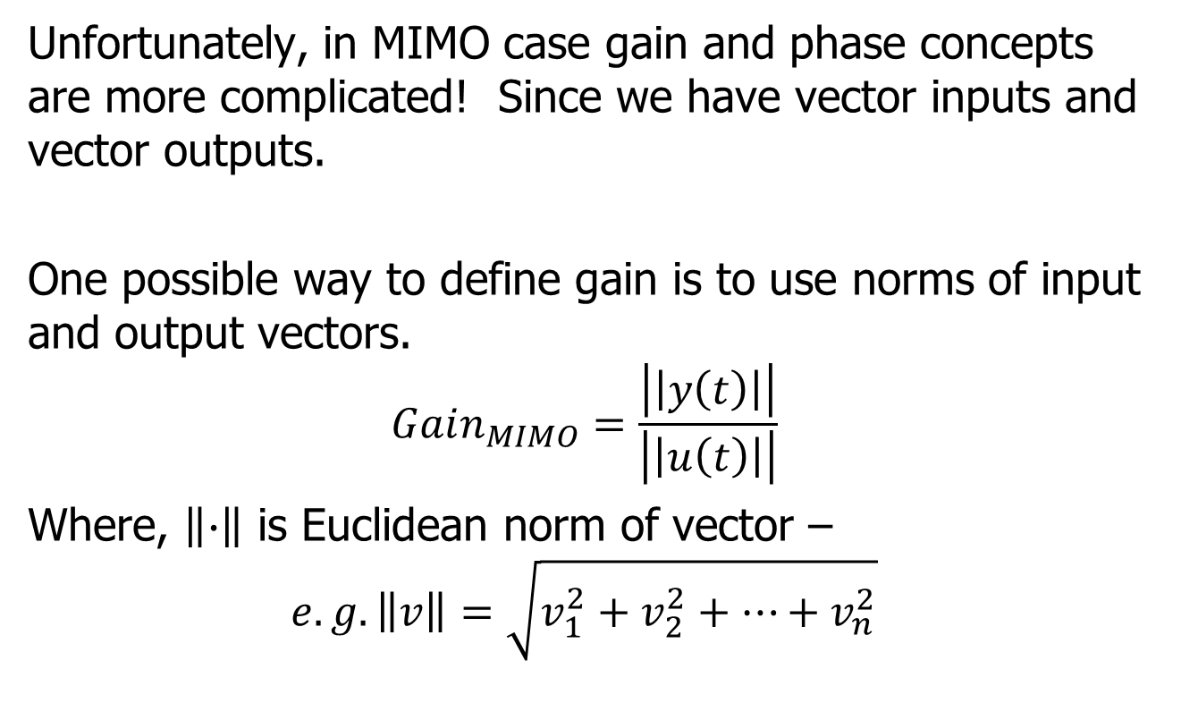
MIMO Frequency Response
Unfortunately, in MIMO case gain and phase concepts are more complicated! Since we have vector inputs and vector outputs.
One possible way to define gain is to use norms of input and output vectors.
$$Gain_{MIMO}=\frac{\left|\left|y\left(t\right)\right|\right|}{\left|\left|u\left(t\right)\right|\right|}$$
Where, $\left\|∙\right\|$ is Euclidean norm of vector –
$$e.g. \left\|v\right\|=\sqrt{v_{1}^{2}+v_{2}^{2}+…+v_{n}^{2}}$$

Slide 3
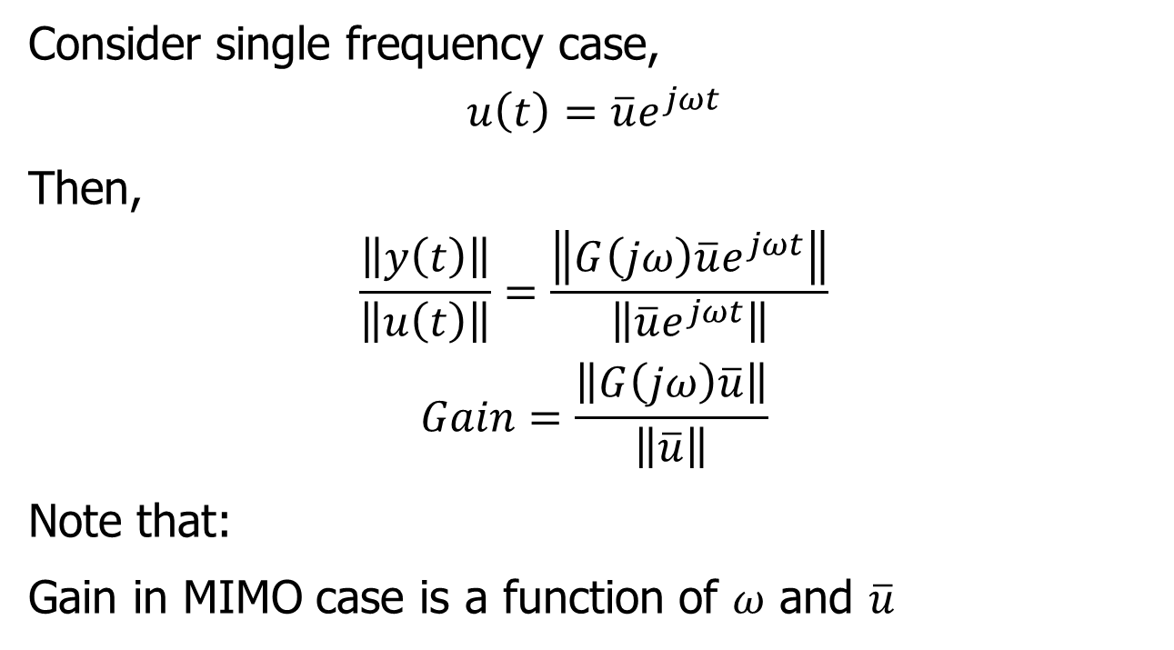
MIMO Frequency Response
Consider single frequency case,
$$u\left(t\right)=\overline{u}e^{jωt}$$
Then,
$$\frac{\left\|y\left(t\right)\right\|}{\left\|u\left(t\right)\right\|}=\frac{\left\|G\left(jω\right)\overline{u}e^{jωt}\right\|}{\left\|\overline{u}e^{jωt}\right\|}$$
$$Gain=\frac{\left\|G\left(jω\right)\overline{u}\right\|}{\left\|\overline{u}\right\|}$$
Note that:
Gain in MIMO case is a function of $ω$ and $\overline{u}$

Slide 4
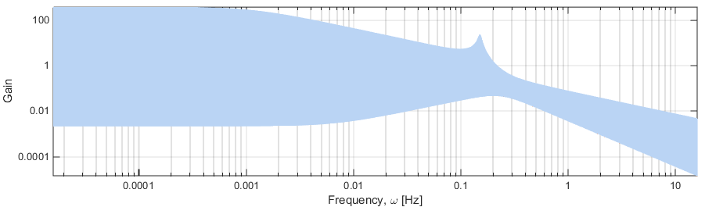
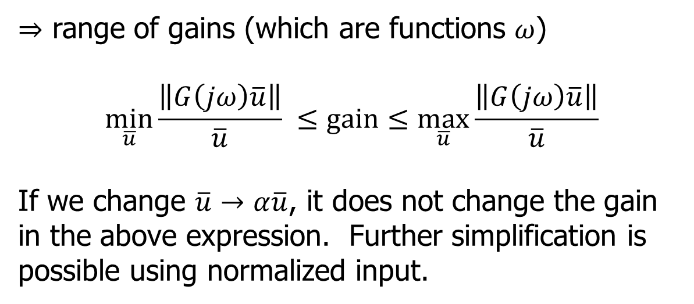
MIMO Frequency Response
$⇒$ range of gains (which are functions $ω$)
$$\min_{\overline{u}}{\frac{\left\|G\left(jω\right)\overline{u}\right\|}{\overline{u}} }≤gain≤\max_{\overline{u}}{\frac{\left\|G\left(jω\right)\overline{u}\right\|}{\overline{u}}}$$
If we change $\overline{u}→α\overline{u}$, it does not change the gain in the above expression. Further simplification is possible using normalized input.

Slide 5
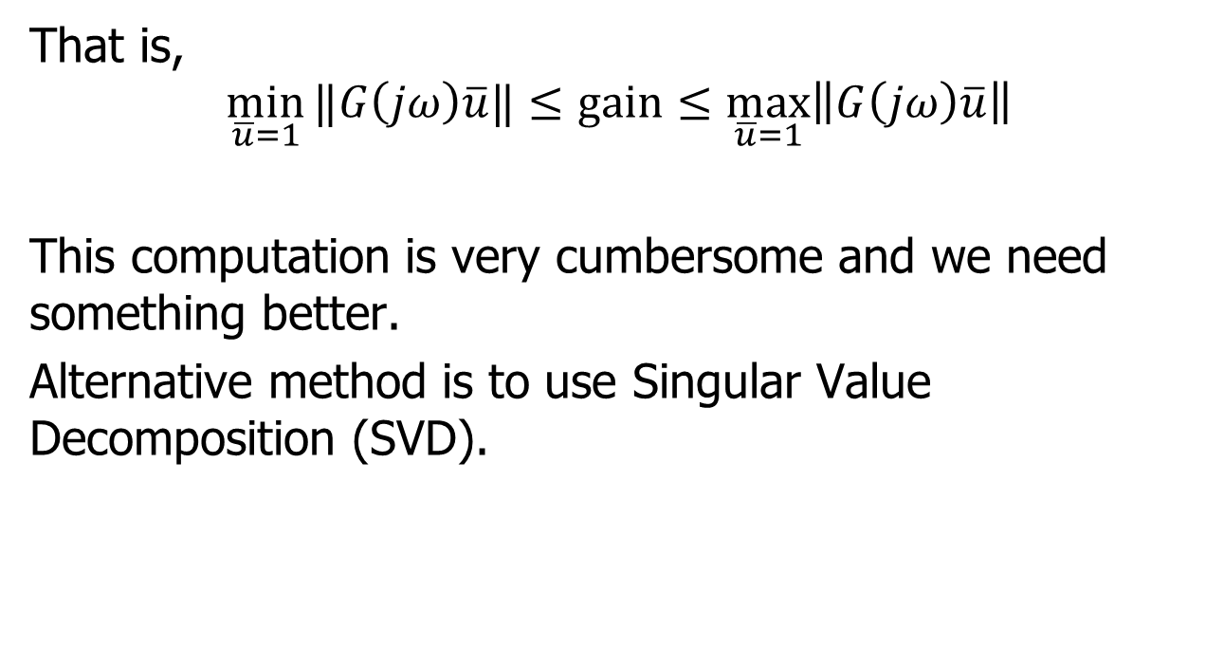
MIMO Frequency Response
That is,
$$\min_{\overline{u}=1}{‖G\left(jω\right)\overline{u}‖}≤gain≤\max_{\overline{u}=1}\left\|G\left(jω\right)\overline{u}\right\|$$
This computation is very cumbersome and we need something better.
Alternative method is to use Singular Value Decomposition (SVD).

Slide 6
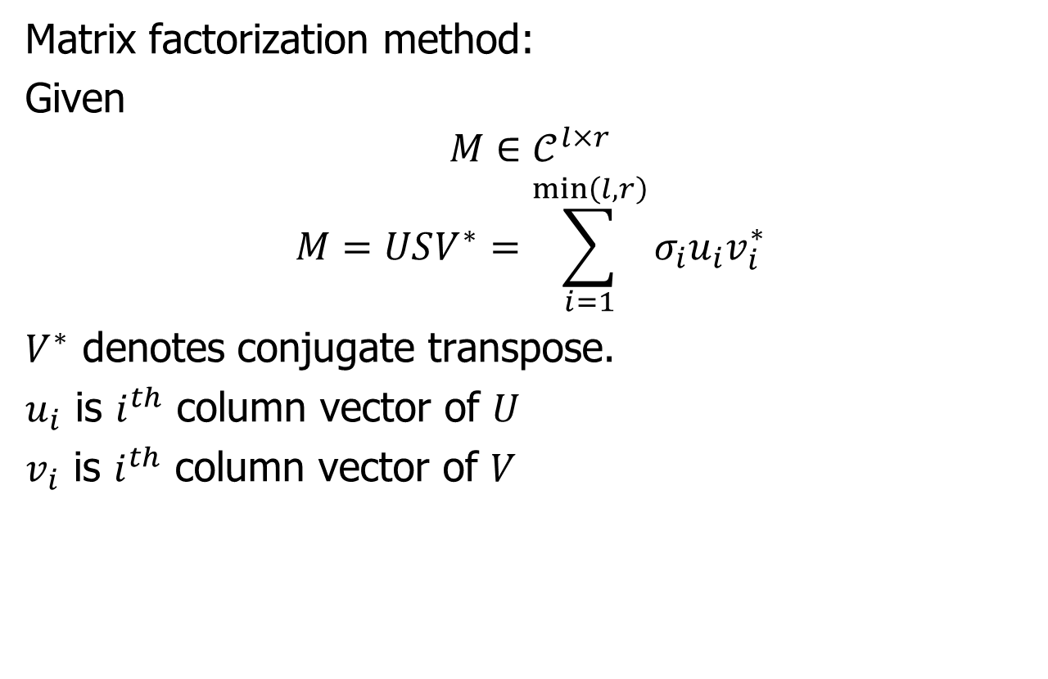
What is SVD??
Matrix factorization method:
Given
$$M∈𝒞^{l×r}$$
$$M=USV^{∗}=\sum_{i=1}^{\min\left(l,r\right)}{σ_{i}u_{i}v_{i}^{∗}}$$
$V^{∗}$ denotes conjugate transpose.
$u_{i}$ is $i^{th}$ column vector of $U$
$v_{i}$ is $i^{th}$ column vector of $V$

Slide 7
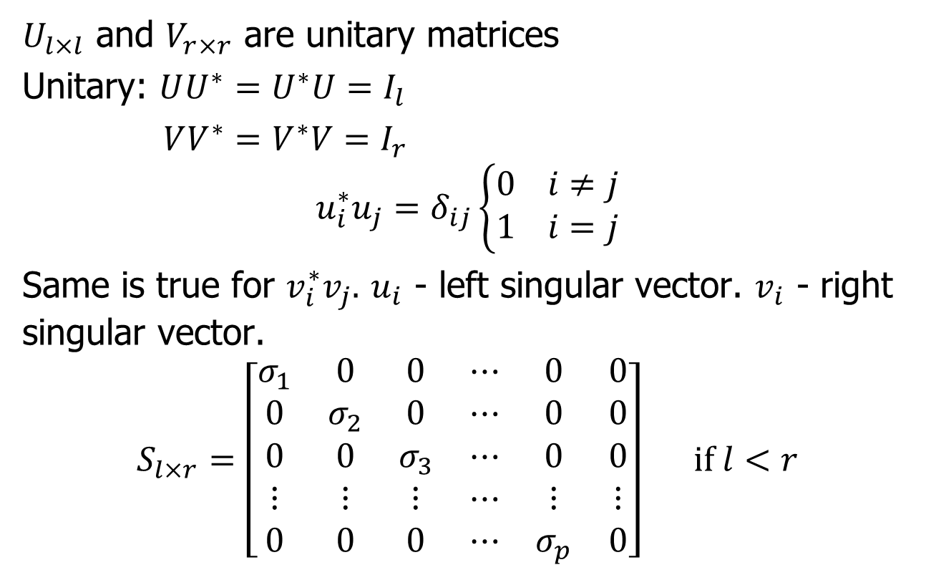
SVD
$U_{l×l}$ and $V_{r×r}$ are unitary matrices
Unitary: $UU^{∗}=U^{∗}U=I_{l}$
$VV^{∗}=V^{∗}V=I_{r}$
$$u_{i}^{∗}u_{j}=δ_{ij}\left\{\begin{aligned}0 i≠j \\ 1 i=j\end{aligned}\right.$$
Same is true for $v_{i}^{∗}v_{j}.$ $u_{i}$ - left singular vector. $v_{i}$ - right singular vector.
$$S_{l×r}=\left[\begin{matrix}σ_{1} & 0 & 0 & ⋯ & 0 & 0 \\ 0 & σ_{2} & 0 & ⋯ & 0 & 0 \\ 0 & 0 & σ_{3} & ⋯ & 0 & 0 \\ ⋮ & ⋮ & ⋮ & ⋯ & ⋮ & ⋮ \\ 0 & 0 & 0 & ⋯ & σ_{p} & 0\end{matrix}\right] if l<r$$

Slide 8
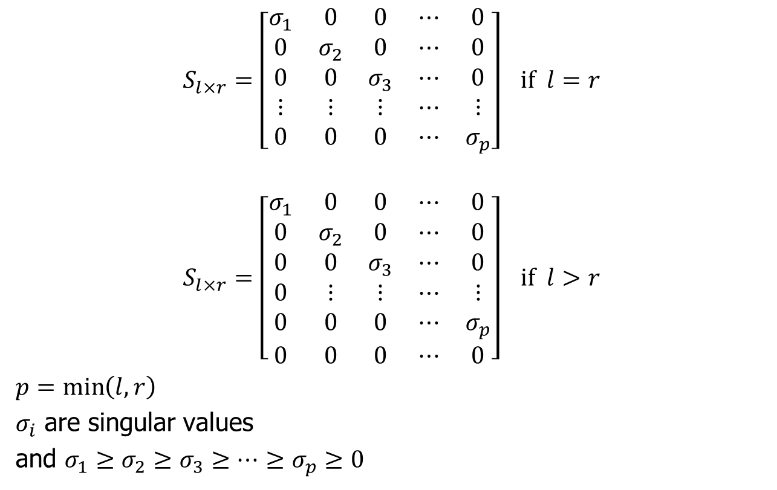
SVD (continued)
$$S_{l×r}=\left[\begin{matrix}σ_{1} & 0 & 0 & ⋯ & 0 \\ 0 & σ_{2} & 0 & ⋯ & 0 \\ 0 & 0 & σ_{3} & ⋯ & 0 \\ ⋮ & ⋮ & ⋮ & ⋯ & ⋮ \\ 0 & 0 & 0 & ⋯ & σ_{p}\end{matrix}\right] if l=r$$
$$S_{l×r}=\left[\begin{matrix}σ_{1} & 0 & 0 & ⋯ & 0 \\ 0 & σ_{2} & 0 & ⋯ & 0 \\ 0 & 0 & σ_{3} & ⋯ & 0 \\ 0 & ⋮ & ⋮ & ⋯ & ⋮ \\ 0 & 0 & 0 & ⋯ & σ_{p} \\ 0 & 0 & 0 & ⋯ & 0\end{matrix}\right] if l>r$$
$p=\min\left(l,r\right)$
$σ_{i}$ are singular values
and $σ_{1}≥σ_{2}≥σ_{3}≥⋯≥σ_{p}≥0$

Slide 9
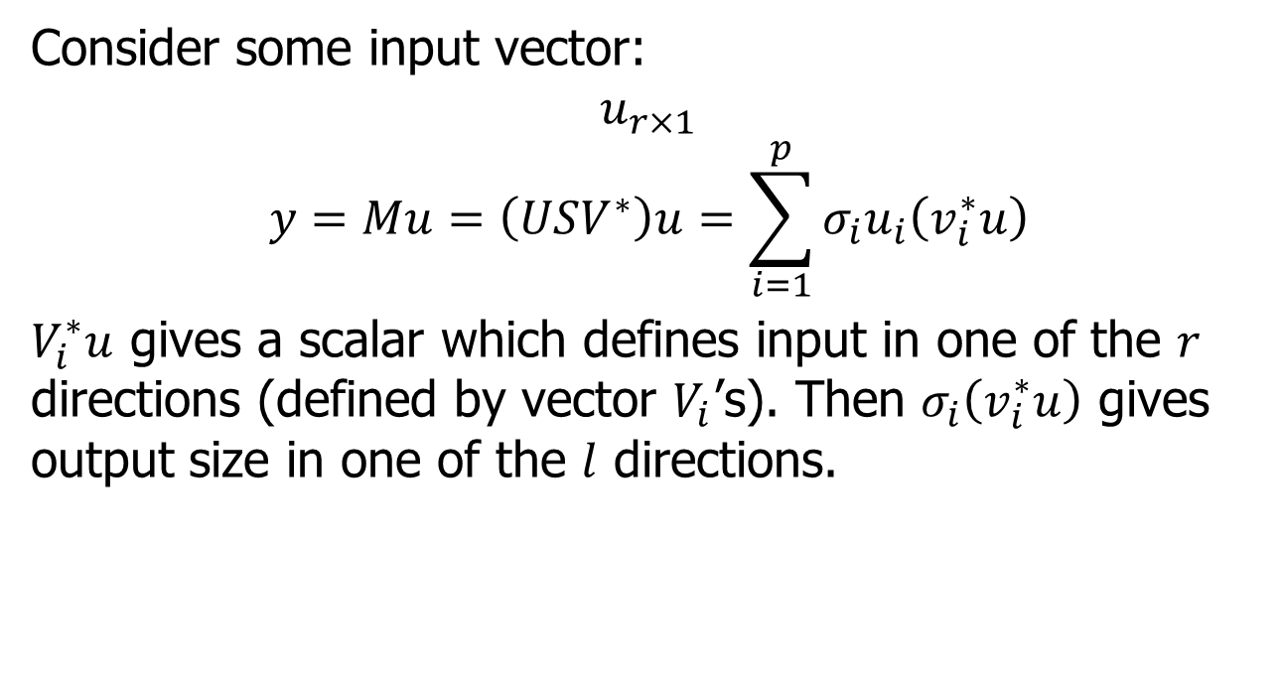
SVD (continued)
Consider some input vector:
$$u_{r×1}$$
$$y=Mu=\left(USV^{∗}\right)u=\sum_{i=1}^{p}{σ_{i}u_{i}\left(v_{i}^{∗}u\right)}$$
$V_{i}^{∗}u$ gives a scalar which defines input in one of the $r$ directions (defined by vector $V_{i}$’s). Then $σ_{i}\left(v_{i}^{∗}u\right)$ gives output size in one of the $l$ directions.

Slide 10
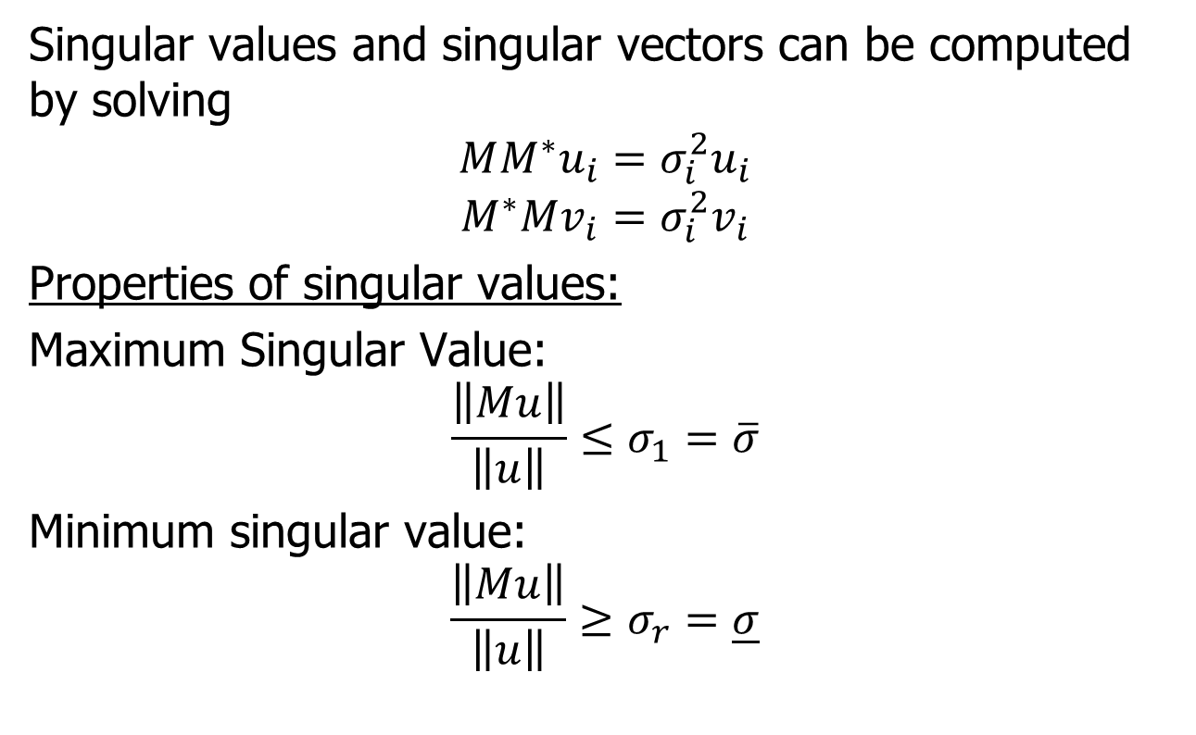
SVD (continued)
Singular values and singular vectors can be computed by solving
$$MM^{∗}u_{i}=σ_{i}^{2}u_{i}$$
$$M^{∗}Mv_{i}=σ_{i}^{2}v_{i}$$
Properties of singular values:
Maximum Singular Value:
$$\frac{\left\|Mu\right\|}{\left\|u\right\|}≤σ_{1}=\overline{σ}$$
Minimum singular value:
$$\frac{\left\|Mu\right\|}{\left\|u\right\|}≥σ_{r}=\underline{σ}$$

Slide 11
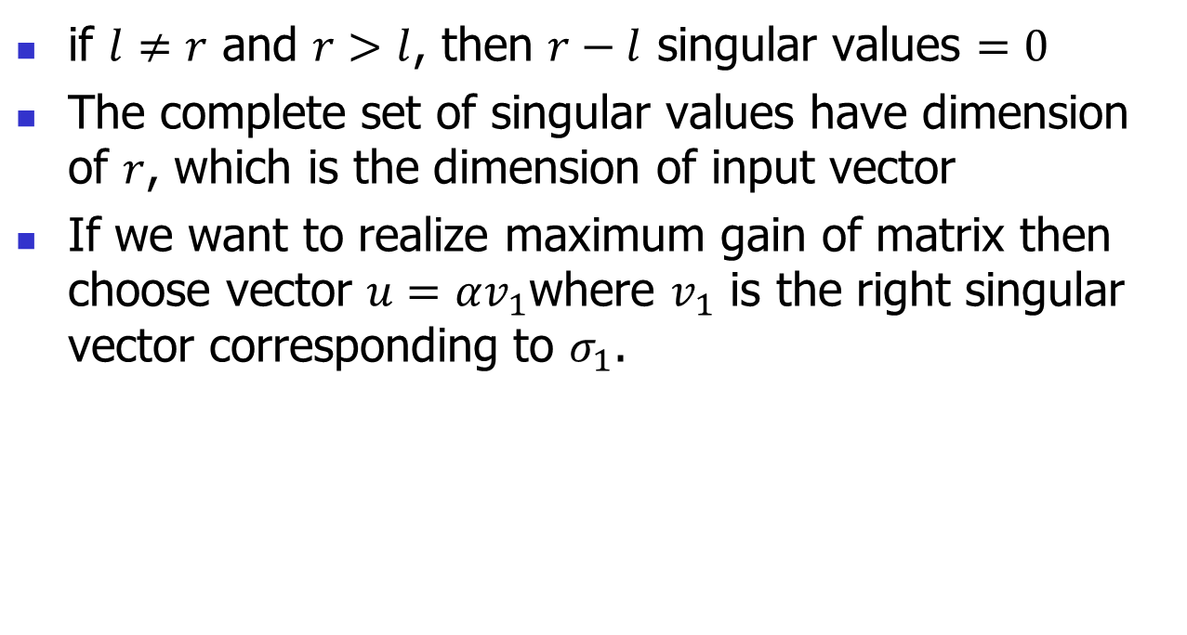
SVD (continued)
if $l≠r$ and $r>l$, then $r−l$ singular values $=0$
The complete set of singular values have dimension of $r$, which is the dimension of input vector
If we want to realize maximum gain of matrix then choose vector $u=αv_{1}$where $v_{1}$ is the right singular vector corresponding to $σ_{1}$.

Slide 12
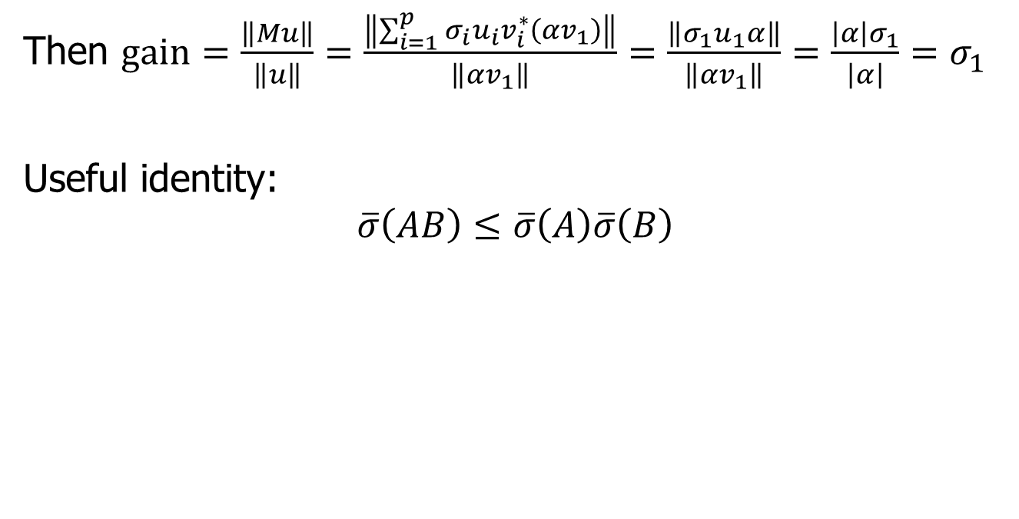
SVD (continued)
Then $gain=\frac{\left\|Mu\right\|}{\left\|u\right\|}=\frac{\left\|\sum_{i=1}^{p}{σ_{i}u_{i}v_{i}^{∗}\left(αv_{1}\right)}\right\|}{\left\|αv_{1}\right\|}=\frac{\left\|σ_{1}u_{1}α\right\|}{\left\|αv_{1}\right\|}=\frac{\left|α\right|σ_{1}}{\left|α\right|}=σ_{1}$
Useful identity:
$$\overline{σ}\left(AB\right)≤\overline{σ}\left(A\right)\overline{σ}\left(B\right)$$

Slide 13
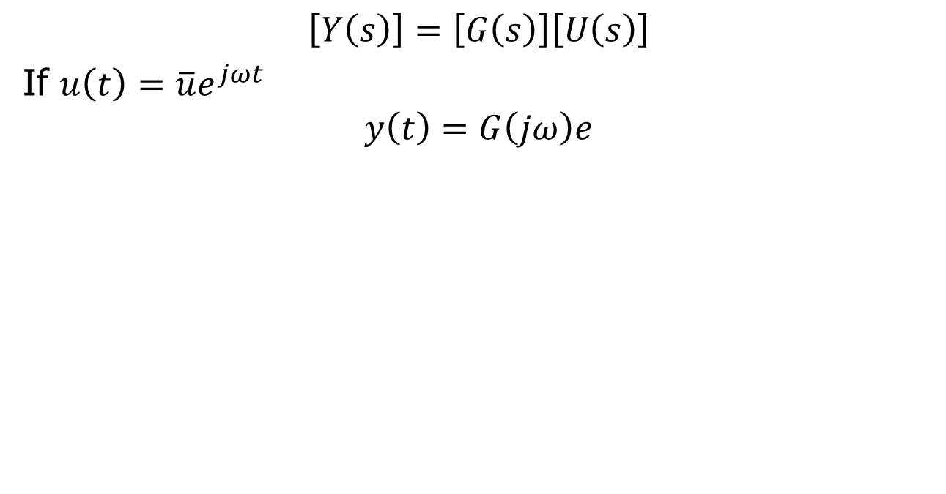
SVD of Transfer Function Matrix
$$\left[Y\left(s\right)\right]=\left[G\left(s\right)\right]\left[U\left(s\right)\right]$$
If $u\left(t\right)=\overline{u}e^{jωt}$
$$y\left(t\right)=G\left(jω\right)e$$

