Slide 1
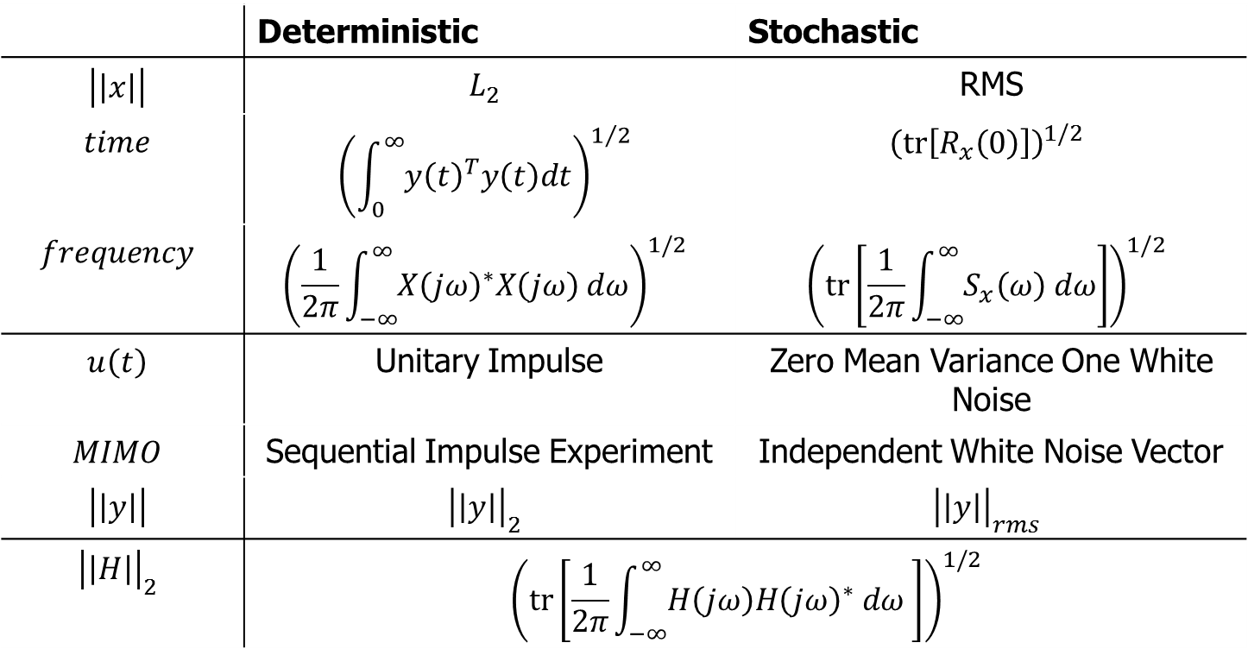
System Norms
Recall:
 | Deterministic | Stochastic
$$\left|\left|x\right|\right|$$ | $$L_{2}$$ | RMS
$$time$$ | $${\left(\int_{0}^{∞}{y{\left(t\right)}^{T}y\left(t\right)dt}\right)}^{1/2}$$ | $${\left(tr\left[R_{x}\left(0\right)\right]\right)}^{1/2}$$
$$frequency$$ | $${\left(\frac{1}{2π}\int_{−∞}^{∞}{X{\left(jω\right)}^{∗}X\left(jω\right) dω}\right)}^{1/2}$$ | $${\left(tr\left[\frac{1}{2π}\int_{−∞}^{∞}{S_{x}\left(ω\right) dω}\right]\right)}^{1/2}$$
$$u\left(t\right)$$ | Unitary Impulse | Zero Mean Variance One White Noise
$$MIMO$$ | Sequential Impulse Experiment | Independent White Noise Vector
$$\left|\left|y\right|\right|$$ | $${\left|\left|y\right|\right|}_{2}$$ | $${\left|\left|y\right|\right|}_{rms}$$
$${\left|\left|H\right|\right|}_{2}$$ | $${\left(tr\left[\frac{1}{2π}\int_{−∞}^{∞}{H\left(jω\right)H{\left(jω\right)}^{∗} dω }\right]\right)}^{1/2}$$

Slide 2
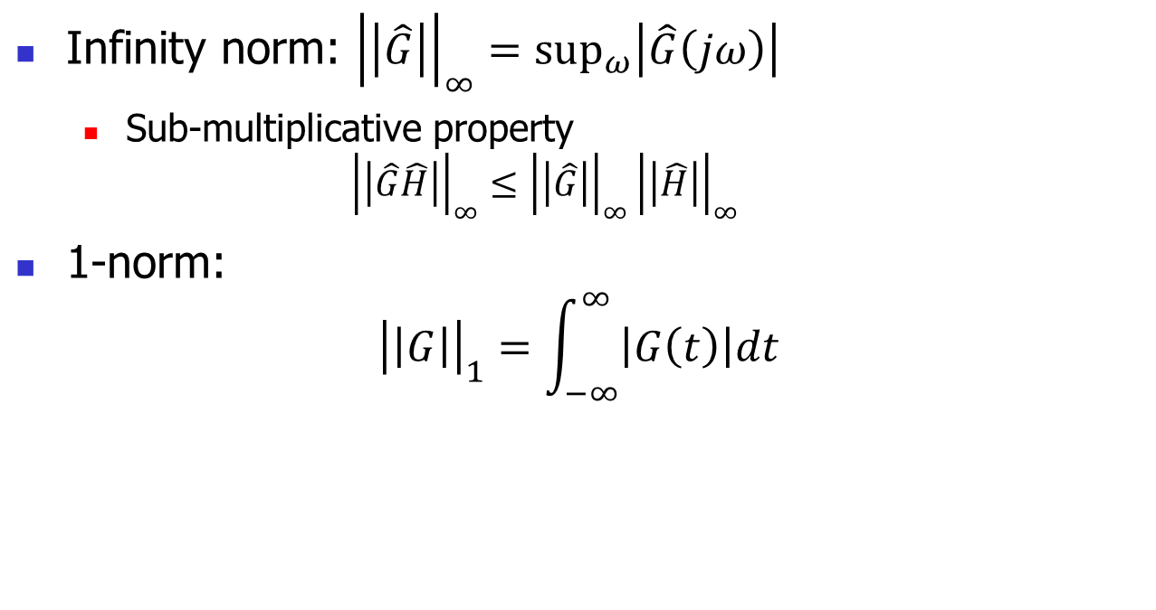
System Norms (continued)
Infinity norm: ${\left|\left|\hat{G}\right|\right|}_{∞}=\sup_{ω}\left|\hat{G}\left(jω\right)\right|$
  Sub-multiplicative property
  $${\left|\left|\hat{G}\hat{H}\right|\right|}_{∞}≤{\left|\left|\hat{G}\right|\right|}_{∞}{\left|\left|\hat{H}\right|\right|}_{∞}$$
1-norm:
$${\left|\left|G\right|\right|}_{1}=\int_{−∞}^{∞}{\left|G\left(t\right)\right|dt}$$

Slide 3
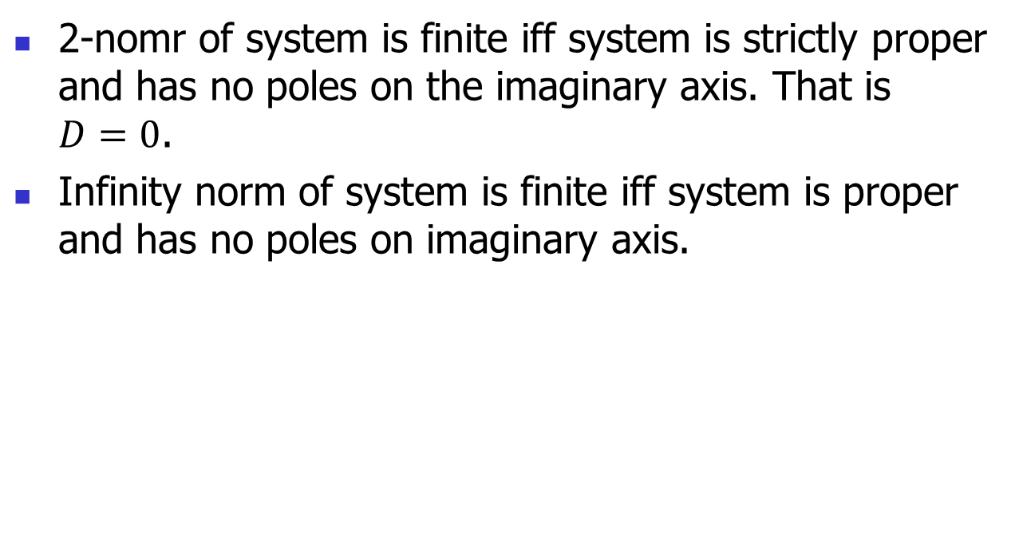
System Norms (continued)
2-nomr of system is finite iff system is strictly proper and has no poles on the imaginary axis. That is $D=0$.
Infinity norm of system is finite iff system is proper and has no poles on imaginary axis.

Slide 4
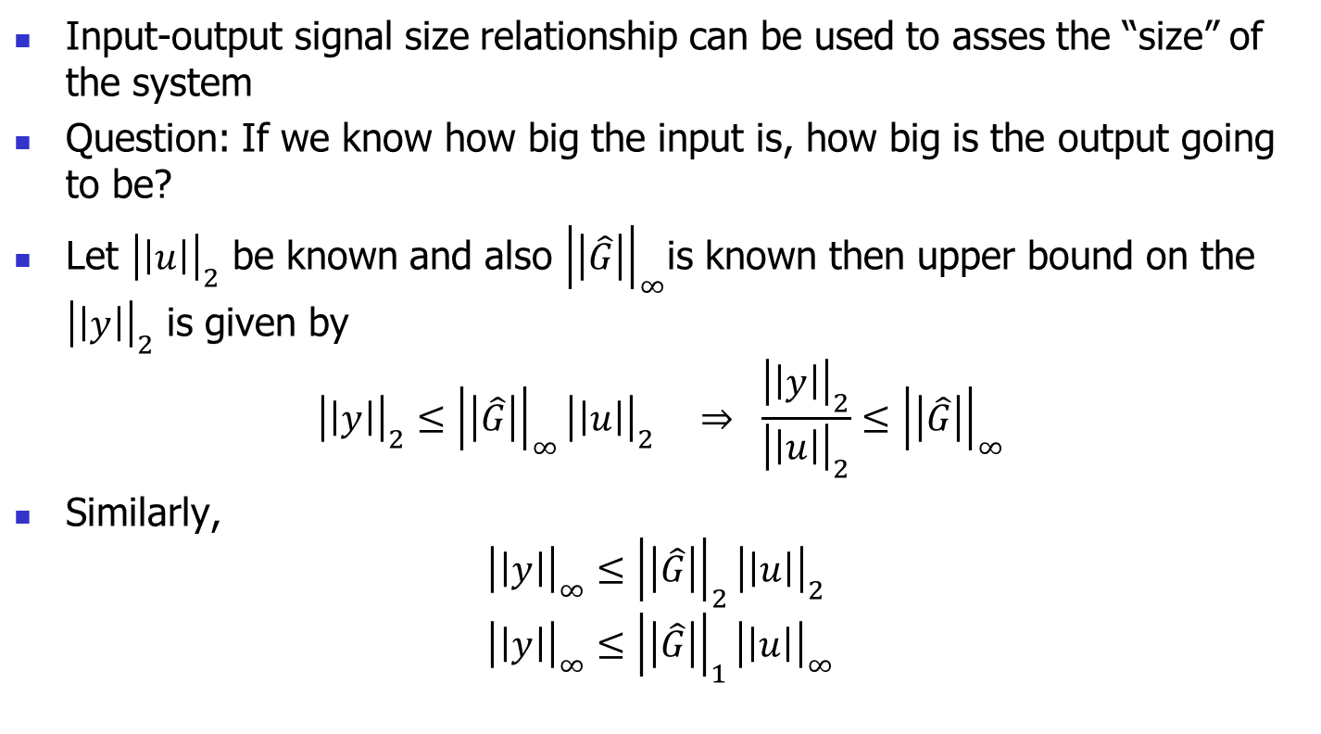
System Size
Input-output signal size relationship can be used to asses the “size” of the system
Question: If we know how big the input is, how big is the output going to be?
Let ${\left|\left|u\right|\right|}_{2}$ be known and also ${\left|\left|\hat{G}\right|\right|}_{∞}$is known then upper bound on the ${\left|\left|y\right|\right|}_{2}$ is given by
$${\left|\left|y\right|\right|}_{2}≤{\left|\left|\hat{G}\right|\right|}_{∞}{\left|\left|u\right|\right|}_{2} ⇒ \frac{{\left|\left|y\right|\right|}_{2}}{{\left|\left|u\right|\right|}_{2}}≤{\left|\left|\hat{G}\right|\right|}_{∞}$$
Similarly,
$${\left|\left|y\right|\right|}_{∞}≤{\left|\left|\hat{G}\right|\right|}_{2}{\left|\left|u\right|\right|}_{2} \\ {\left|\left|y\right|\right|}_{∞}≤{\left|\left|\hat{G}\right|\right|}_{1}{\left|\left|u\right|\right|}_{∞}$$

Slide 5
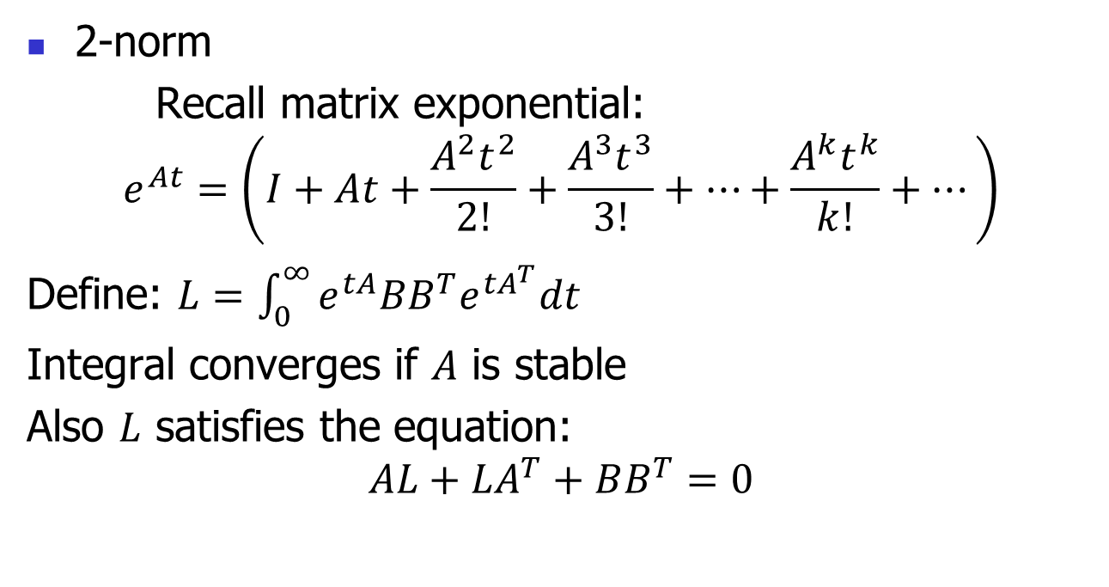
Computing Norms by State Space Methods
2-norm
Recall matrix exponential:
$$e^{At}=\left(I+At+\frac{A^{2}t^{2}}{2!}+\frac{A^{3}t^{3}}{3!}+…+\frac{A^{k}t^{k}}{k!}+…\right)$$
Define: $L=\int_{0}^{∞}{e^{tA}BB^{T}e^{tA^{T}}dt}$
Integral converges if $A$ is stable
Also $L$ satisfies the equation:
$$AL+LA^{T}+BB^{T}=0$$

Slide 6
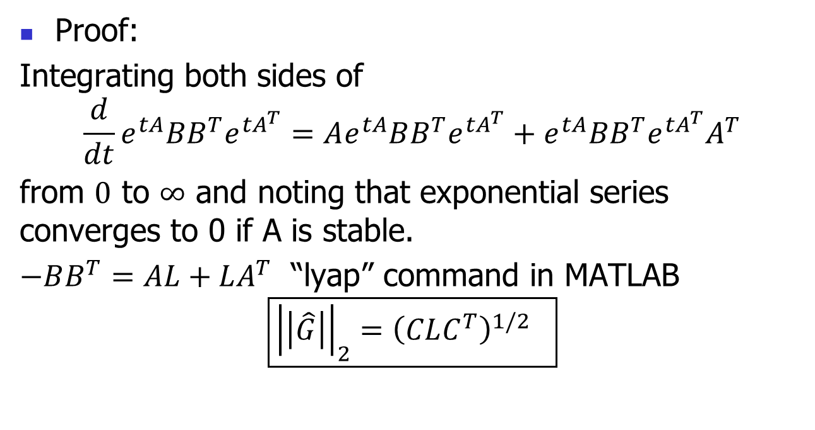
2-norm Computation
Proof:
Integrating both sides of
$$\frac{d}{dt}e^{tA}BB^{T}e^{tA^{T}}=Ae^{tA}BB^{T}e^{tA^{T}}+e^{tA}BB^{T}e^{tA^{T}}A^{T}$$
from $0$ to $∞$ and noting that exponential series converges to 0 if A is stable.
$−BB^{T}=AL+LA^{T}$ “lyap” command in MATLAB
$$\boxed{{\left|\left|\hat{G}\right|\right|}_{2}={\left(CLC^{T}\right)}^{1/2} }$$

Slide 7
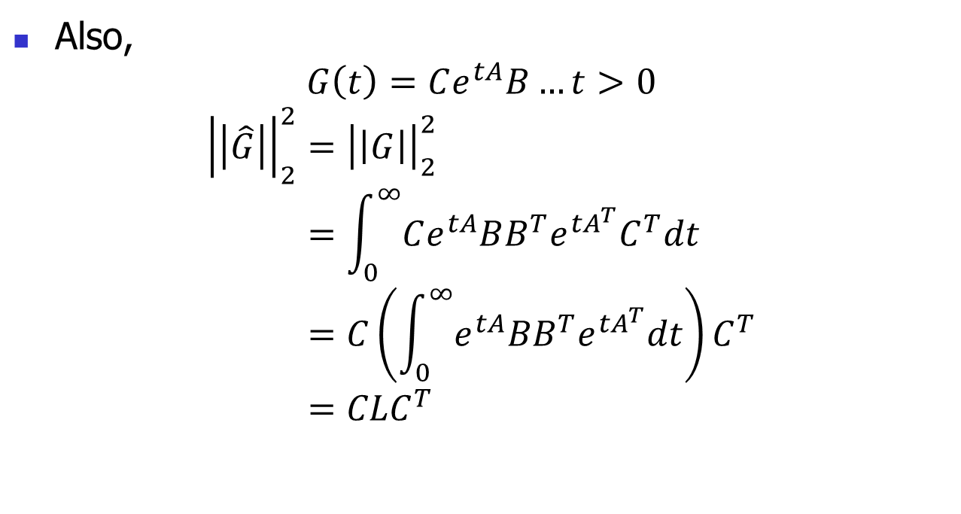
2-norm (continued)
Also,
$$G\left(t\right)=Ce^{tA}B…t>0$$
$${\left|\left|\hat{G}\right|\right|}_{2}^{2}={\left|\left|G\right|\right|}_{2}^{2} \\ =\int_{0}^{∞}{Ce^{tA}BB^{T}e^{tA^{T}}C^{T}dt} \\ =C\left(\int_{0}^{∞}{e^{tA}BB^{T}e^{tA^{T}}dt}\right)C^{T} \\ =CLC^{T}$$

Slide 8
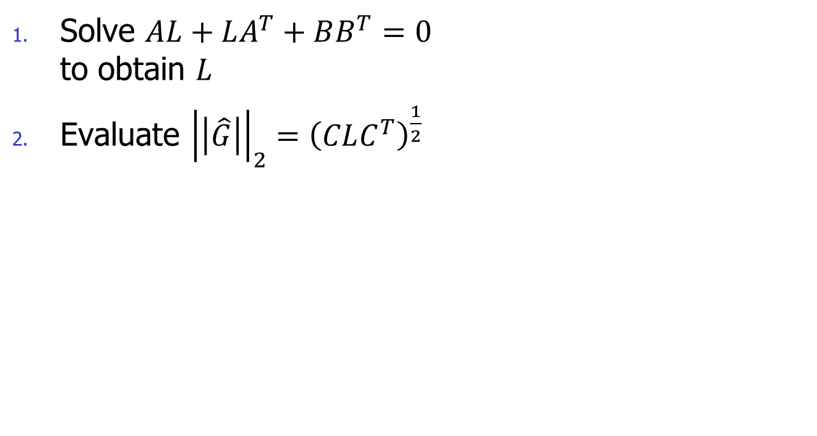
Steps to Compute 2-norm
Solve $AL+LA^{T}+BB^{T}=0$
to obtain $L$
Evaluate ${\left|\left|\hat{G}\right|\right|}_{2}={\left(CLC^{T}\right)}^{\frac{1}{2}}$

Slide 9
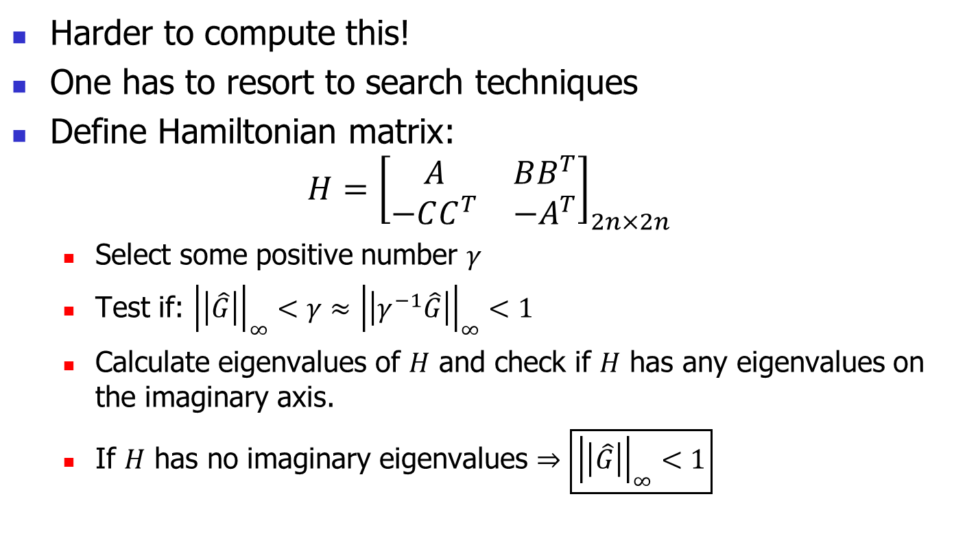

Steps to Compute $∞$-norm
Harder to compute this!
One has to resort to search techniques
Define Hamiltonian matrix:
$$H={\left[\begin{matrix}A & BB^{T} \\ −CC^{T} & −A^{T}\end{matrix}\right]}_{2n×2n}$$
  Select some positive number $γ$
  Test if: ${\left|\left|\hat{G}\right|\right|}_{∞}<γ≈{\left|\left|γ^{−1}\hat{G}\right|\right|}_{∞}<1$
  Calculate eigenvalues of $H$ and check if $H$ has any eigenvalues on the imaginary axis.
  If $H$ has no imaginary eigenvalues $⇒$ $\boxed{{\left|\left|\hat{G}\right|\right|}_{∞}<1}$

