Slide 1
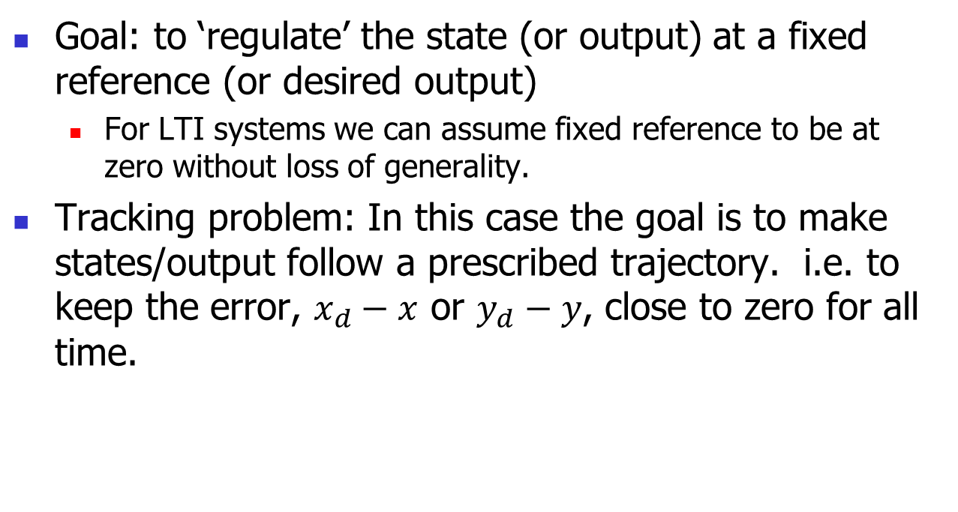
Optimal Control – Cost Function
Goal: to ‘regulate’ the state (or output) at a fixed reference (or desired output)
  For LTI systems we can assume fixed reference to be at zero without loss of generality.
Tracking problem: In this case the goal is to make states/output follow a prescribed trajectory. i.e. to keep the error, $x_{d}−x$ or $y_{d}−y$, close to zero for all time.

Slide 2
Optimal Control
In both cases, achieving the goal requires some control energy. Typically, higher control energy is required for better performance and minimization of control energy leads to deterioration of performance.
So, there is a trade-off between performance and control energy!

Slide 3
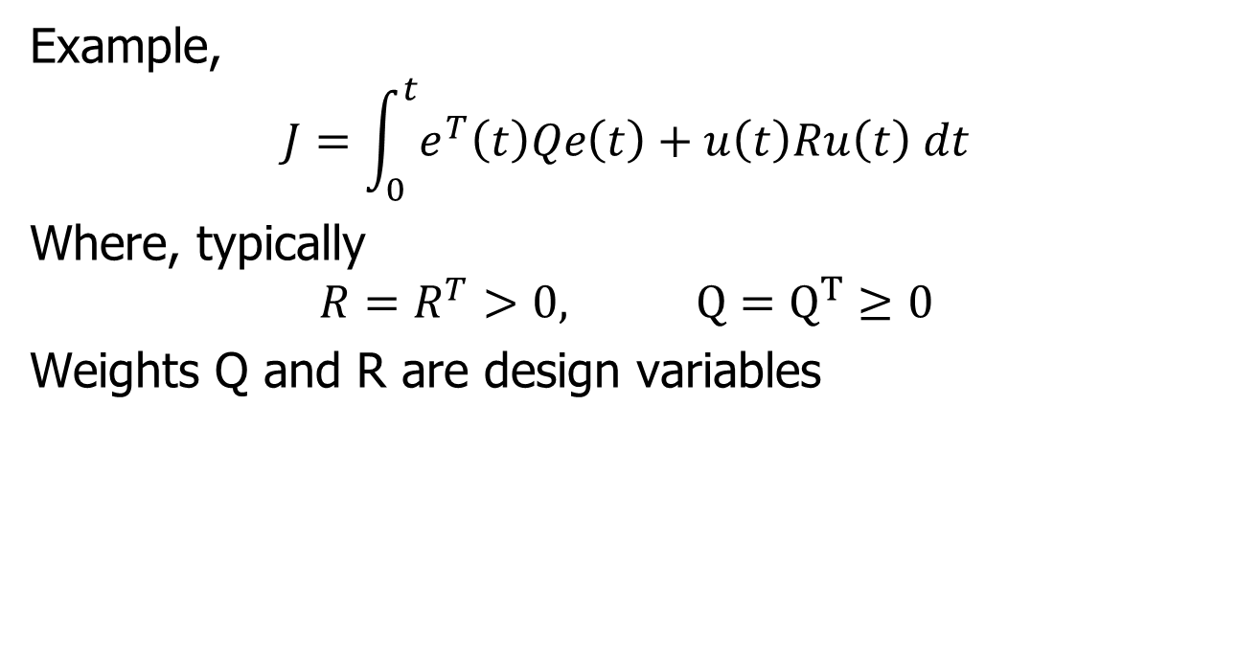
Trade-offs
Example,
$$J=\int_{0}^{t}{e^{T}\left(t\right)Qe\left(t\right)+u\left(t\right)Ru\left(t\right) dt}$$
Where, typically
$$R=R^{T}>0, Q=Q^{T}≥0$$
Weights Q and R are design variables

Slide 4
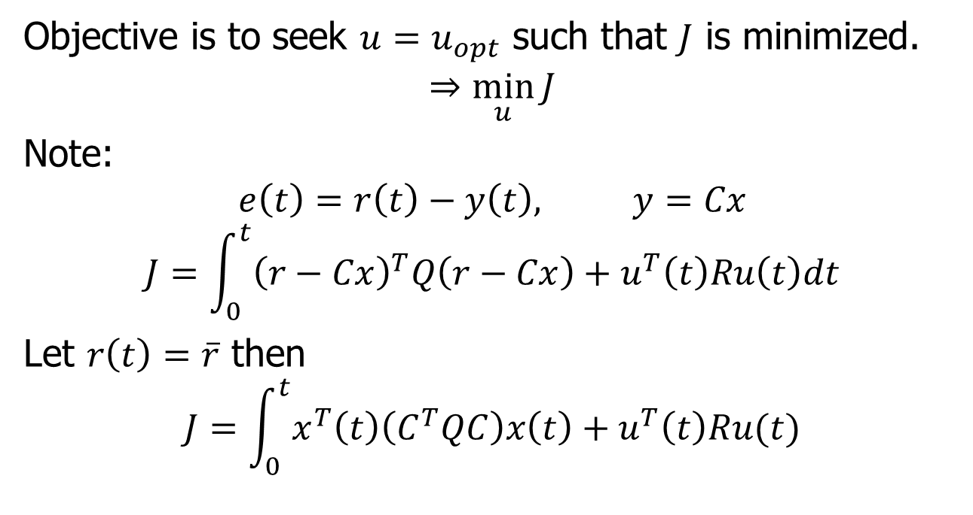
Optimal Control
Objective is to seek $u=u_{opt}$ such that $J$ is minimized.
$$⇒\min_{u}{J}$$
Note:
$$e\left(t\right)=r\left(t\right)−y\left(t\right), y=Cx$$
$$J=\int_{0}^{t}{{\left(r−Cx\right)}^{T}Q\left(r−Cx\right)+u^{T}\left(t\right)Ru\left(t\right)dt}$$
Let $r\left(t\right)=\overline{r}$ then
$$J=\int_{0}^{t}{x^{T}\left(t\right)\left(C^{T}QC\right)x\left(t\right)+u^{T}\left(t\right)Ru(t)}$$

Slide 5
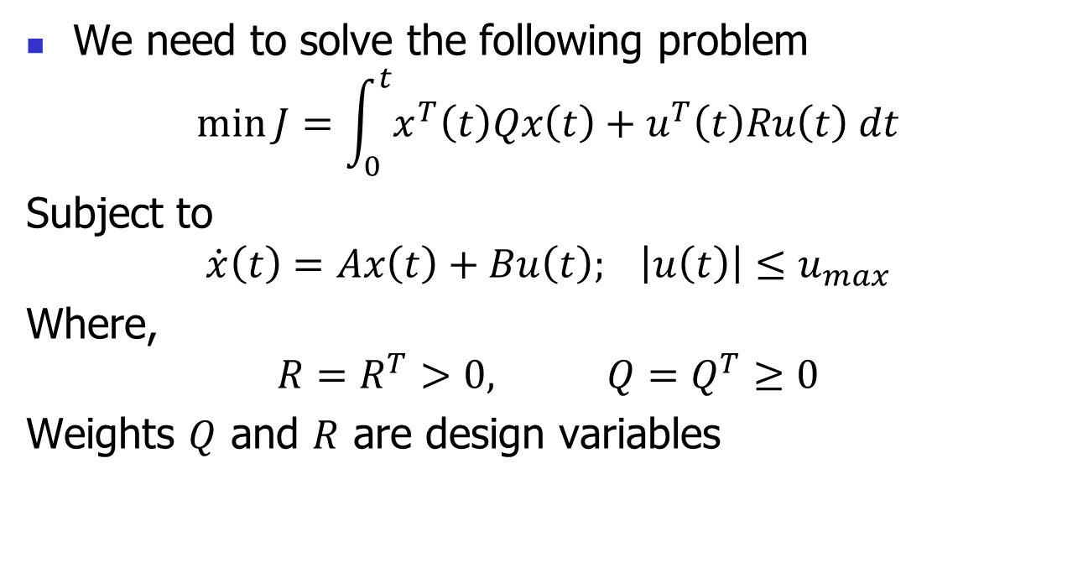
Optimal Control Problem
We need to solve the following problem
$$\min{J}=\int_{0}^{t}{x^{T}\left(t\right)Qx\left(t\right)+u^{T}\left(t\right)Ru\left(t\right) dt}$$
Subject to
$$\dot{x}\left(t\right)=Ax\left(t\right)+Bu\left(t\right); \left|u\left(t\right)\right|≤u_{max}$$
Where,
$$R=R^{T}>0, Q=Q^{T}≥0$$
Weights $Q$ and $R$ are design variables

