Slide 1


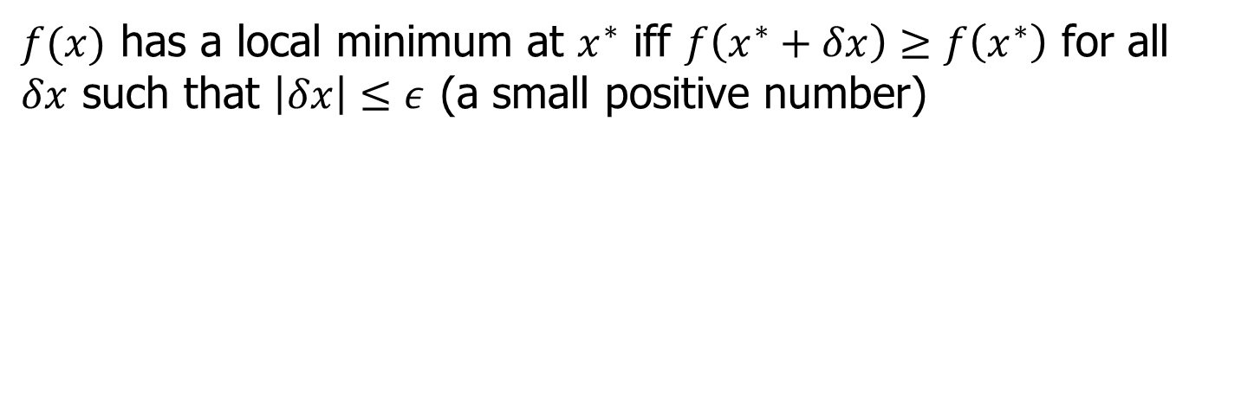
Basics of Optimization
$x^{∗}$-global minima
$x^{∗}$-local minima
$f(x)$ has a local minimum at $x^{∗}$ iff $f\left(x^{∗}+δx\right)≥f\left(x^{∗}\right)$ for all $δx$ such that $\left|δx\right|≤ε$ (a small positive number)

Slide 2
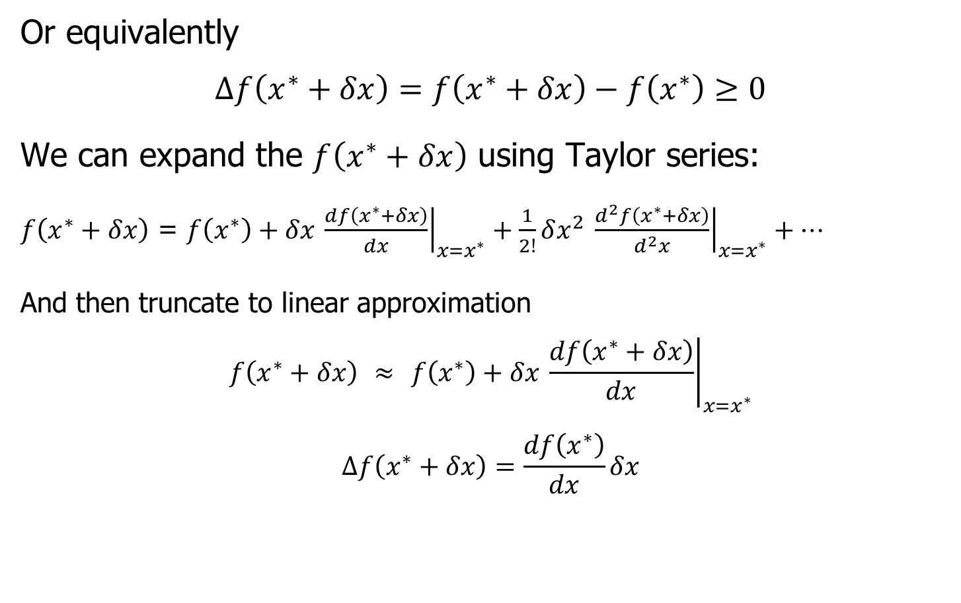
Optimization Continued
Or equivalently
$$Δf\left(x^{∗}+δx\right)=f\left(x^{∗}+δx\right)−f\left(x^{∗}\right)≥0$$
We can expand the $f\left(x^{∗}+δx\right)$ using Taylor series:
$f\left(x^{∗}+δx\right)$ = $f\left(x^{∗}\right)+δx{\left.​\frac{df\left(x^{∗}+δx\right)}{dx}\right|}_{x=x^{∗}}+\frac{1}{2!}δx^{2}{\left.​\frac{d^{2}f\left(x^{∗}+δx\right)}{d^{2}x}\right|}_{x=x^{∗}}+⋯$
And then truncate to linear approximation
$$f\left(x^{∗}+δx\right) ≈ f\left(x^{∗}\right)+δx{\left.​\frac{df\left(x^{∗}+δx\right)}{dx}\right|}_{x=x^{∗}}$$
$$Δf\left(x^{∗}+δx\right)=\frac{df\left(x^{∗}\right)}{dx}δx$$

Slide 3
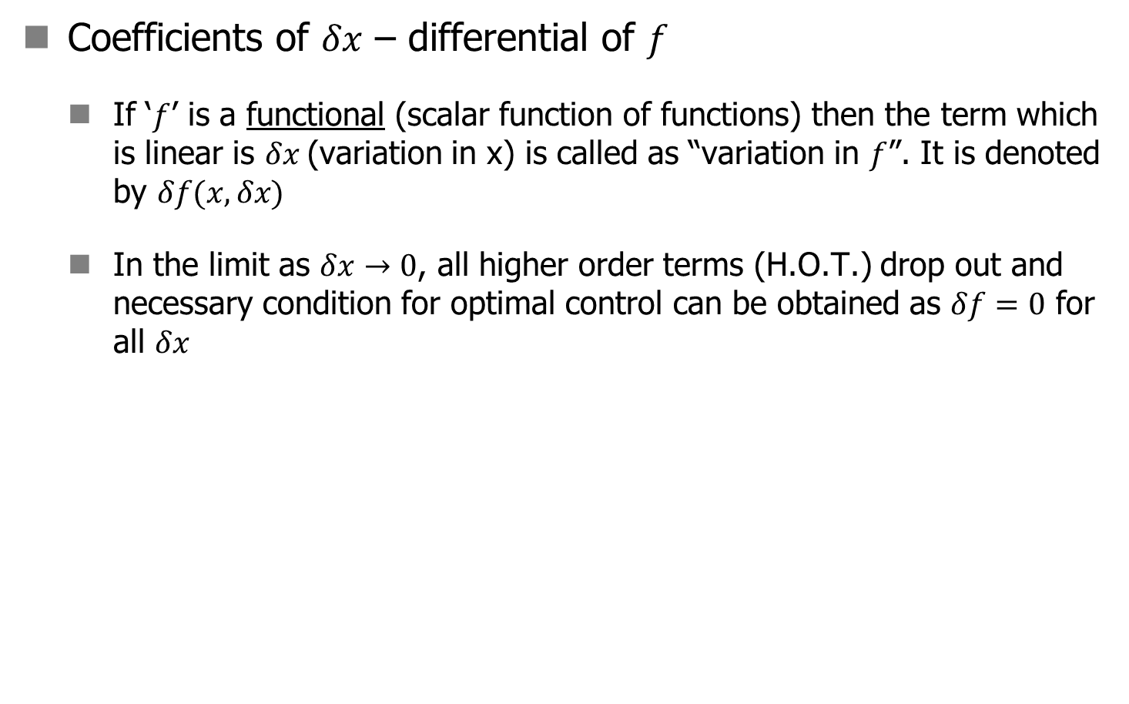
Optimization Continued
Coefficients of $δx$ – differential of $f$
  If ‘$f$’ is a functional (scalar function of functions) then the term which is linear is $δx$(variation in x) is called as “variation in $f$”. It is denoted by $δf(x,δx)$
  In the limit as $δx→0$, all higher order terms (H.O.T.) drop out and necessary condition for optimal control can be obtained as $δf=0$ for all $δx$

Slide 4
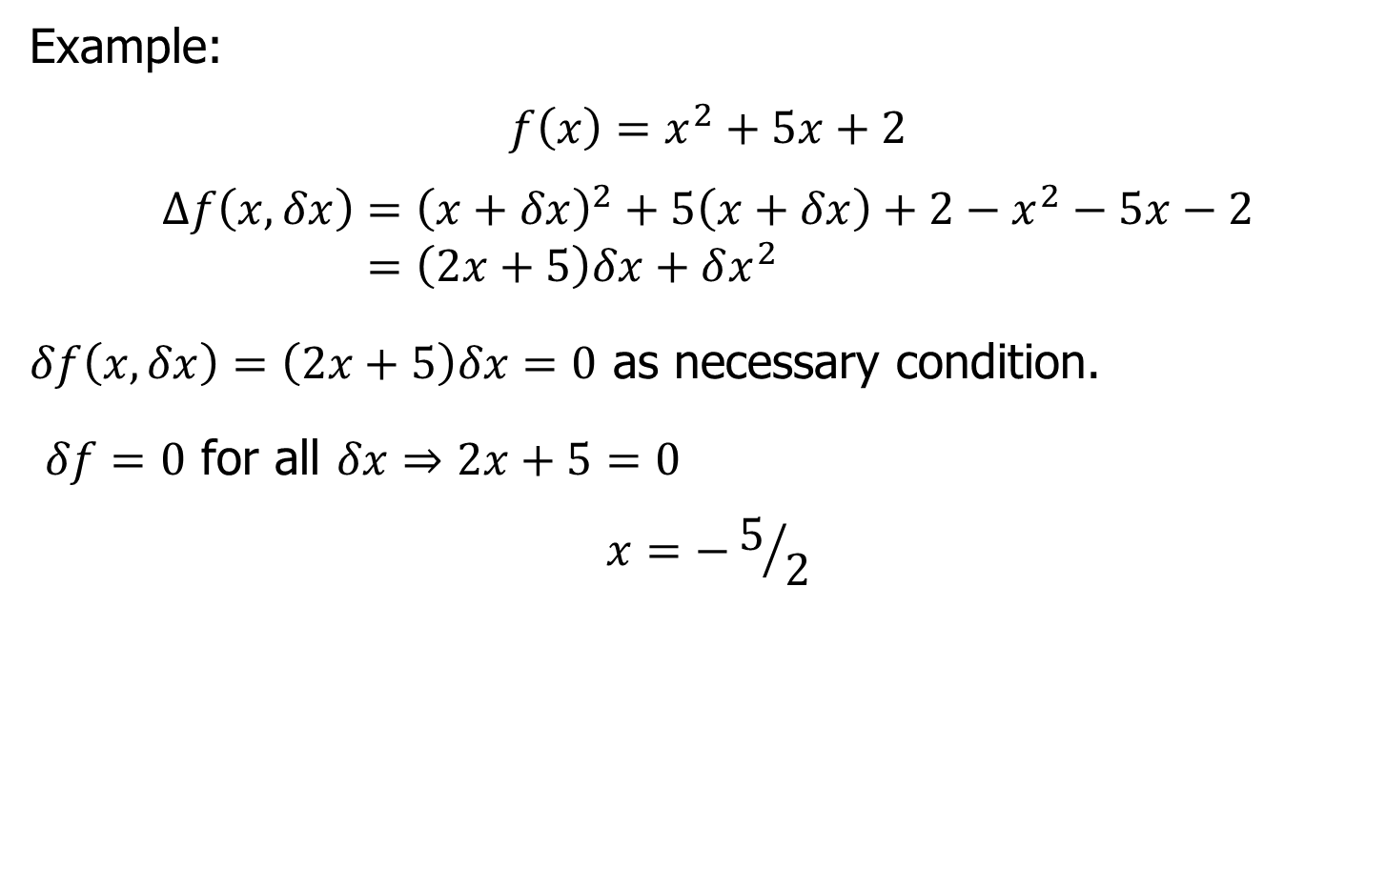
Optimization Continued
Example:
$$f\left(x\right)=x^{2}+5x+2$$
$$Δf\left(x,δx\right)={\left(x+δx\right)}^{2}+5\left(x+δx\right)+2−x^{2}−5x−2 \\ =\left(2x+5\right)δx+δx^{2}$$
$δf\left(x,δx\right)=\left(2x+5\right)δx=0$ as necessary condition.
$δf=0$ for all $δx⇒2x+5=0$
$$x=−5/2$$

Slide 5
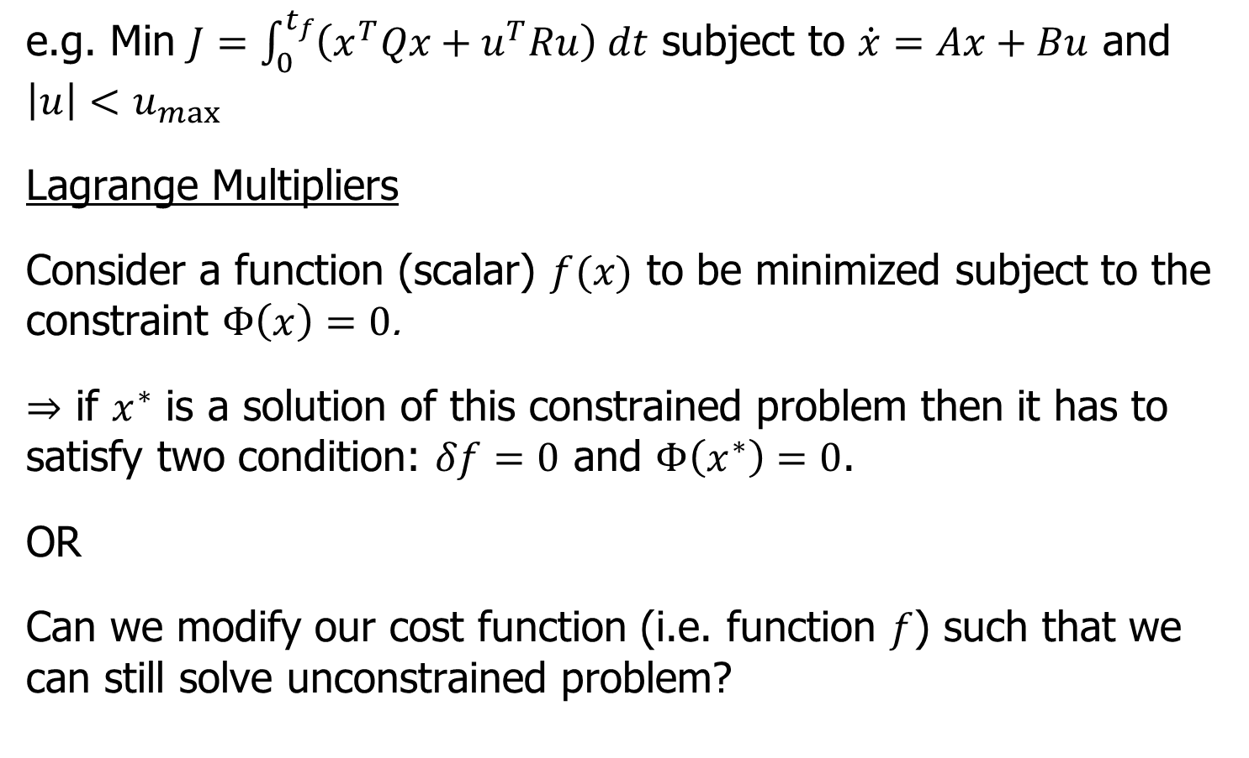
Constrained Minimization
e.g. Min $J=\int_{0}^{t_{f}}{\left(x^{T}Qx+u^{T}Ru\right) dt}$ subject to $\dot{x}=Ax+Bu$ and $\left|u\right|<u_{max}$
Lagrange Multipliers
Consider a function (scalar) $f(x)$ to be minimized subject to the constraint $Φ\left(x\right)=0$.
$⇒$ if $x^{∗}$ is a solution of this constrained problem then it has to satisfy two condition: $δf=0$ and $Φ\left(x^{∗}\right)=0$.
OR
Can we modify our cost function (i.e. function $f$) such that we can still solve unconstrained problem?

Slide 6
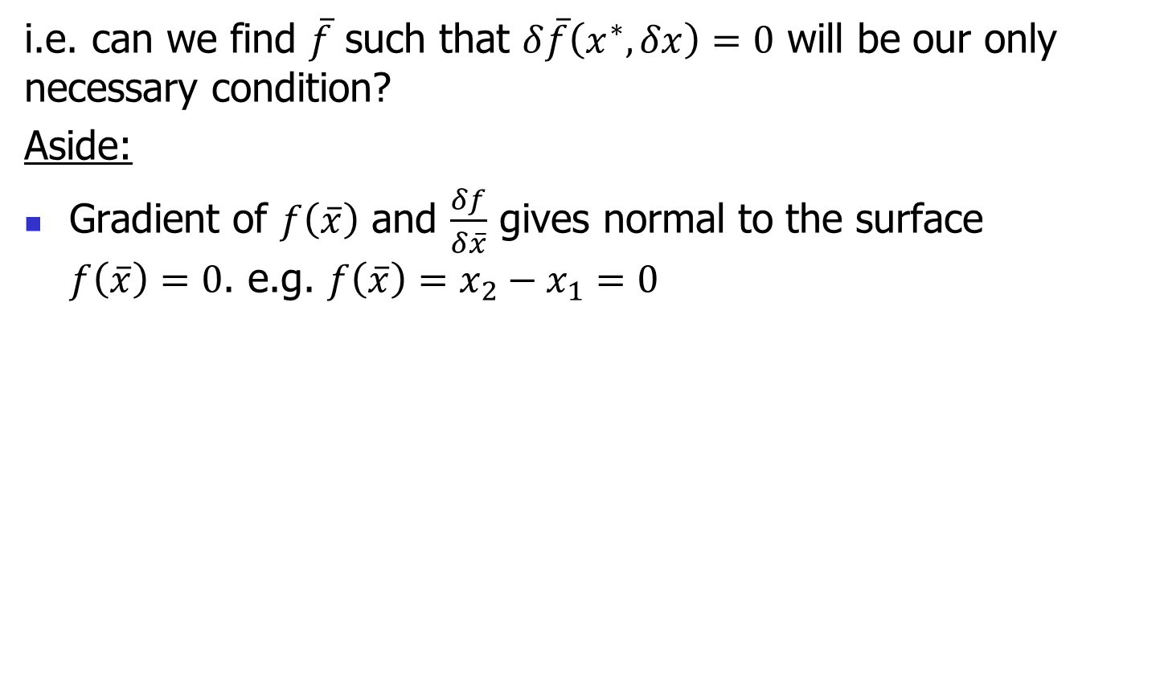
Constrained Minimization
i.e. can we find $\overline{f}$ such that $δ\overline{f}\left(x^{∗},δx\right)=0$ will be our only necessary condition?
Aside:
Gradient of $f\left(\overline{x}\right)$ and $\frac{δf}{δ\overline{x}}$ gives normal to the surface $f\left(\overline{x}\right)=0$. e.g. $f\left(\overline{x}\right)=x_{2}−x_{1}=0$

Slide 7
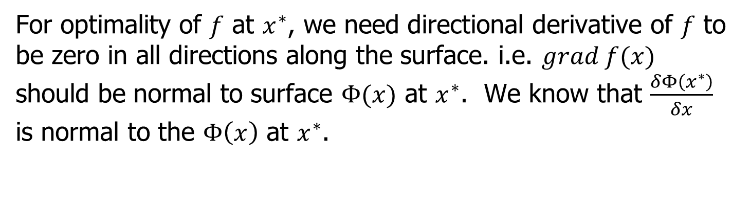
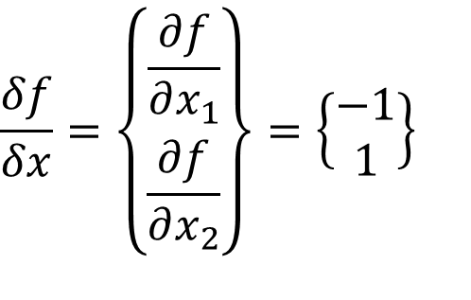
Constrained Minimization
$$\frac{δf}{δx}=\left\{\begin{matrix}\frac{∂f}{∂x_{1}} \\ \frac{∂f}{∂x_{2}}\end{matrix}\right\}=\left\{\begin{matrix}−1 \\ 1\end{matrix}\right\}$$
For optimality of $f$ at $x^{∗}$, we need directional derivative of $f$ to be zero in all directions along the surface. i.e. $grad f(x)$ should be normal to surface $Φ(x)$ at $x^{∗}$. We know that $\frac{δΦ\left(x^{∗}\right)}{δx}$ is normal to the $Φ\left(x\right)$ at $x^{∗}$.

Slide 8
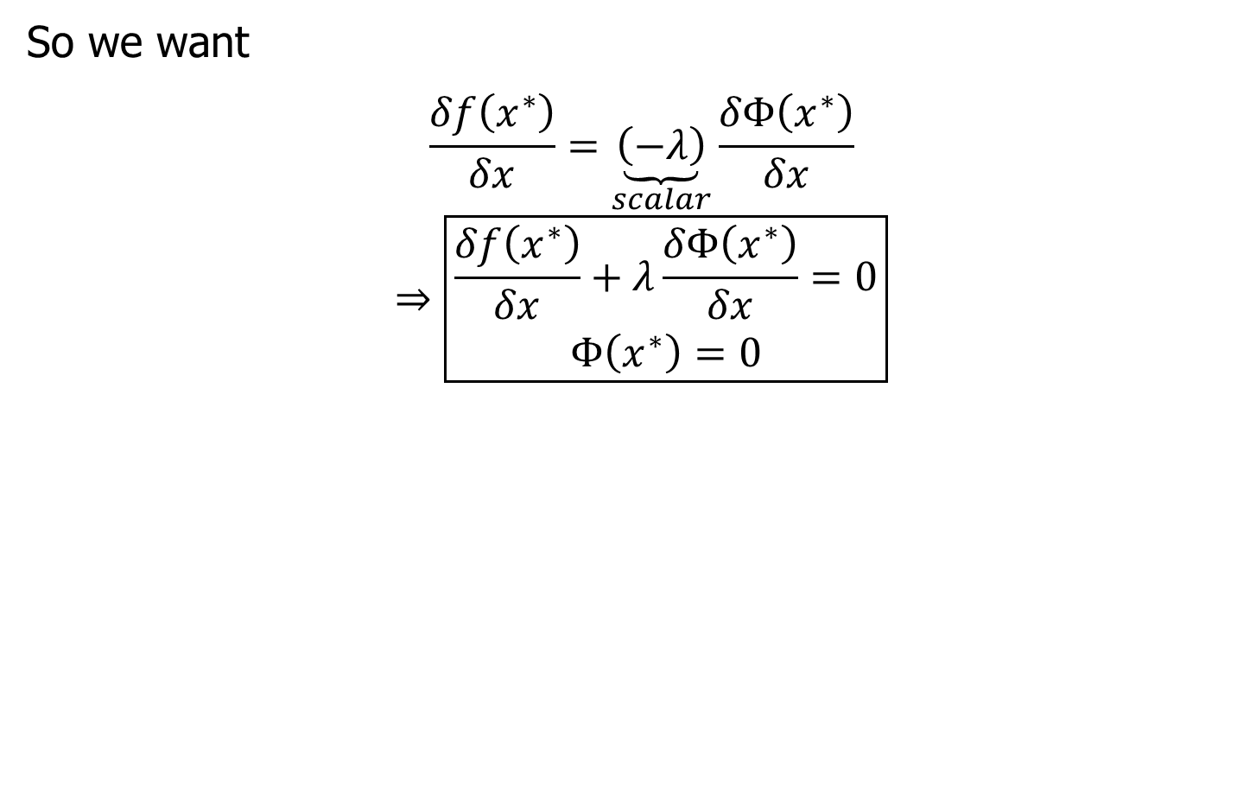
Conditions
So we want
$$\frac{δf\left(x^{∗}\right)}{δx}=\underset{scalar}{\underbrace{\left(−λ\right)}}\frac{δΦ\left(x^{∗}\right)}{δx}$$
$$⇒\boxed{\begin{aligned}\frac{δf\left(x^{∗}\right)}{δx}+λ\frac{δΦ\left(x^{∗}\right)}{δx}=0 \\ Φ\left(x^{∗}\right)=0\end{aligned}}$$

Slide 9
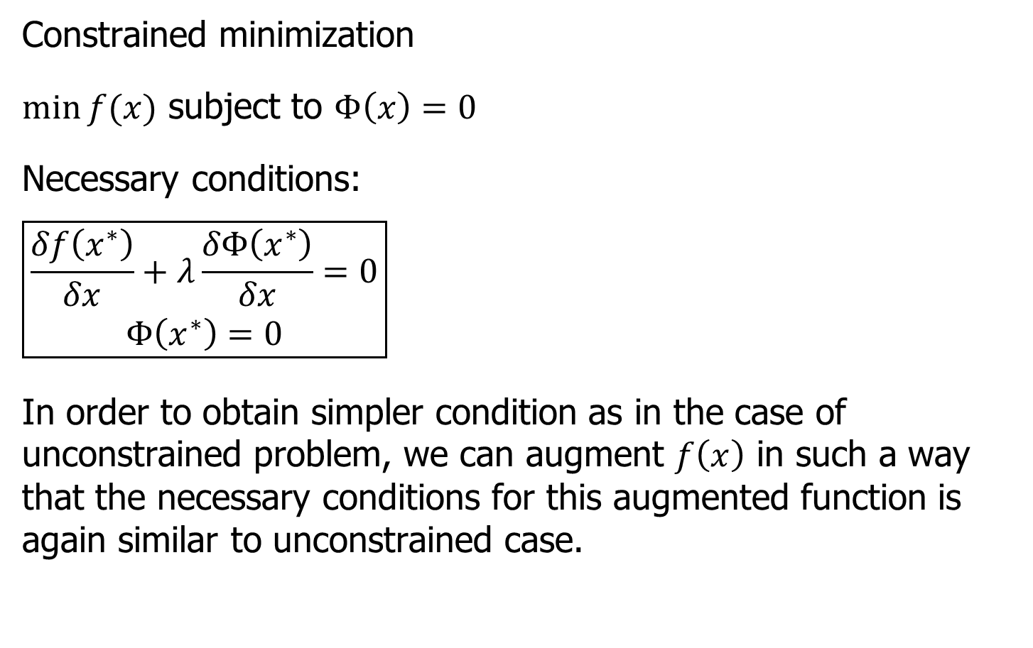
Necessary Conditions
Constrained minimization
$\min{f(x)}$ subject to $Φ\left(x\right)=0$
Necessary conditions:
$$\boxed{\begin{aligned}\frac{δf\left(x^{∗}\right)}{δx}+λ\frac{δΦ\left(x^{∗}\right)}{δx}=0 \\ Φ\left(x^{∗}\right)=0\end{aligned}}$$
In order to obtain simpler condition as in the case of unconstrained problem, we can augment $f\left(x\right)$ in such a way that the necessary conditions for this augmented function is again similar to unconstrained case.

Slide 10
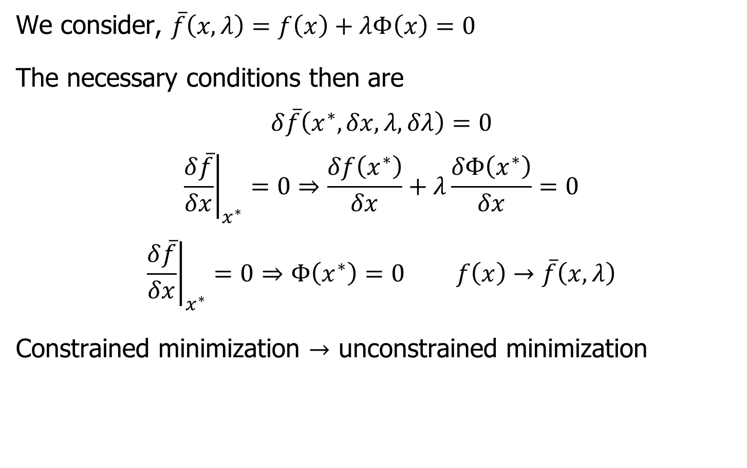
Necessary Conditions
We consider, $\overline{f}\left(x,λ\right)=f\left(x\right)+λΦ\left(x\right)=0$
The necessary conditions then are
$$δ\overline{f}\left(x^{∗},δx,λ,δλ\right)=0$$
$${\left.\frac{δ\overline{f}}{δx}\right|}_{x^{∗}}=0⇒\frac{δf\left(x^{∗}\right)}{δx}+λ\frac{δΦ\left(x^{∗}\right)}{δx}=0$$
$${\left.\frac{δ\overline{f}}{δx}\right|}_{x^{∗}}=0⇒Φ\left(x^{∗}\right)=0 f\left(x\right)→\overline{f}\left(x,λ\right)$$
Constrained minimization $→$ unconstrained minimization

Slide 11
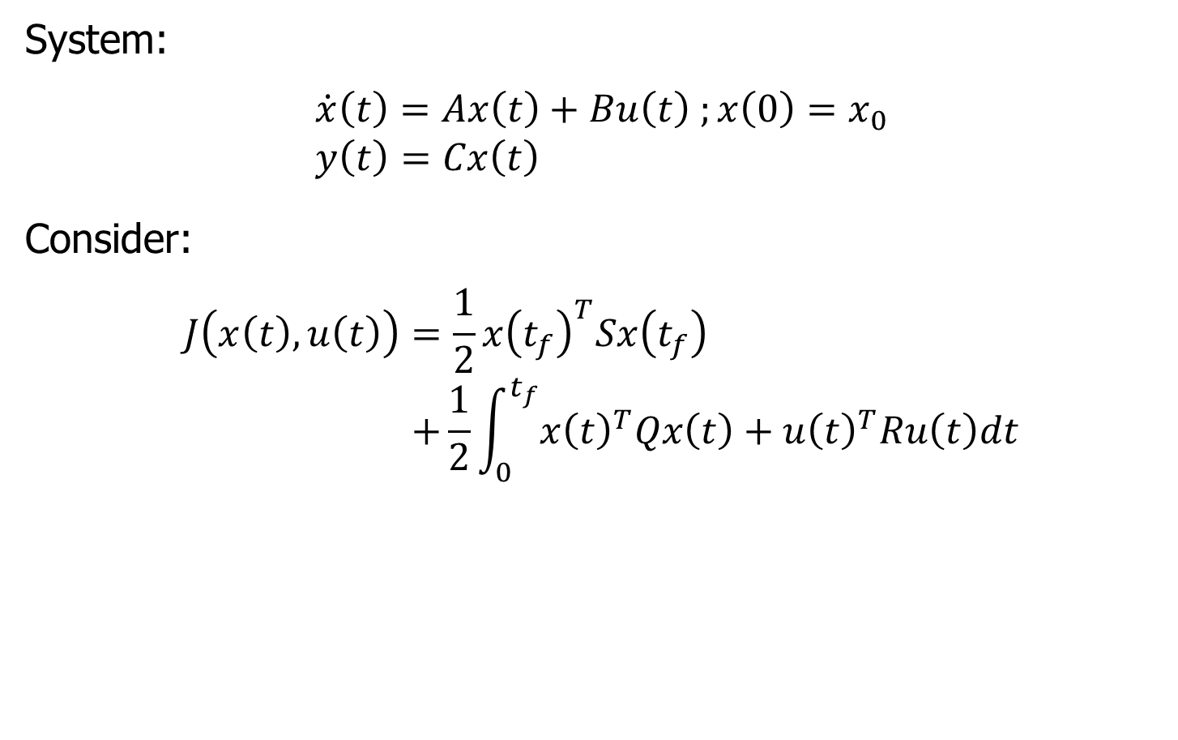
Linear Quadratic Regulator (LQR)
System:
$$\dot{x}\left(t\right)=Ax\left(t\right)+Bu\left(t\right) ;x\left(0\right)=x_{0} \\ y\left(t\right)=Cx\left(t\right)$$
Consider:
$$J\left(x\left(t\right), u\left(t\right)\right)=\frac{1}{2}x{\left(t_{f}\right)}^{T}Sx\left(t_{f}\right) \\ +\frac{1}{2}\int_{0}^{t_{f}}{x{\left(t\right)}^{T}Qx\left(t\right)+u{\left(t\right)}^{T}Ru\left(t\right)dt}$$

Slide 12
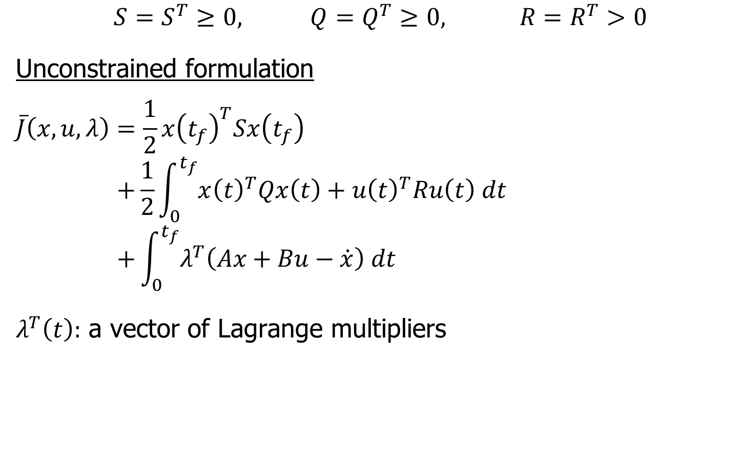
Unconstrained Formulation
$$S=S^{T}≥0, Q=Q^{T}≥0, R=R^{T}>0$$
Unconstrained formulation
$$\overline{J}\left(x,u,λ\right)=\frac{1}{2}x{\left(t_{f}\right)}^{T}Sx\left(t_{f}\right) \\ +\frac{1}{2}\int_{0}^{t_{f}}{x{\left(t\right)}^{T}Qx\left(t\right)+u{\left(t\right)}^{T}Ru\left(t\right) dt } \\ +\int_{0}^{t_{f}}{λ^{T}\left(Ax+Bu−\dot{x}\right) dt}$$
$λ^{T}\left(t\right):$ a vector of Lagrange multipliers

Slide 13
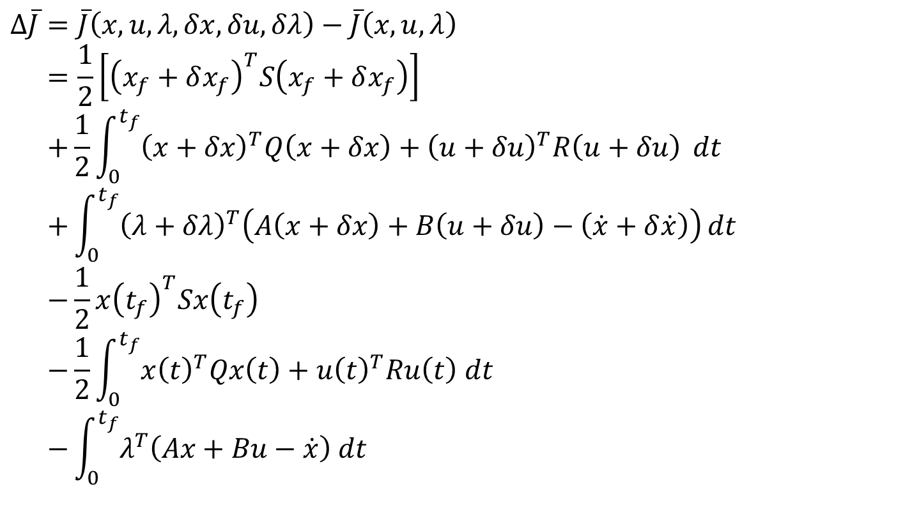
Optimization
$$Δ\overline{J}=\overline{J}\left(x,u,λ,δx,δu,δλ\right)−\overline{J}\left(x,u,λ\right) \\ =\frac{1}{2}\left[{\left(x_{f}+δx_{f}\right)}^{T}S\left(x_{f}+δx_{f}\right)\right] \\ +\frac{1}{2}\int_{0}^{t_{f}}{{\left(x+δx\right)}^{T}Q\left(x+δx\right)+{\left(u+δu\right)}^{T}R\left(u+δu\right)} dt \\ +\int_{0}^{t_{f}}{{\left(λ+δλ\right)}^{T}\left(A\left(x+δx\right)+B\left(u+δu\right)−\left(\dot{x}+δ\dot{x}\right)\right)}dt \\ −\frac{1}{2}x{\left(t_{f}\right)}^{T}Sx\left(t_{f}\right) \\ −\frac{1}{2}\int_{0}^{t_{f}}{x{\left(t\right)}^{T}Qx\left(t\right)+u{\left(t\right)}^{T}Ru\left(t\right) dt } \\ −\int_{0}^{t_{f}}{λ^{T}\left(Ax+Bu−\dot{x}\right) dt}$$

Slide 14
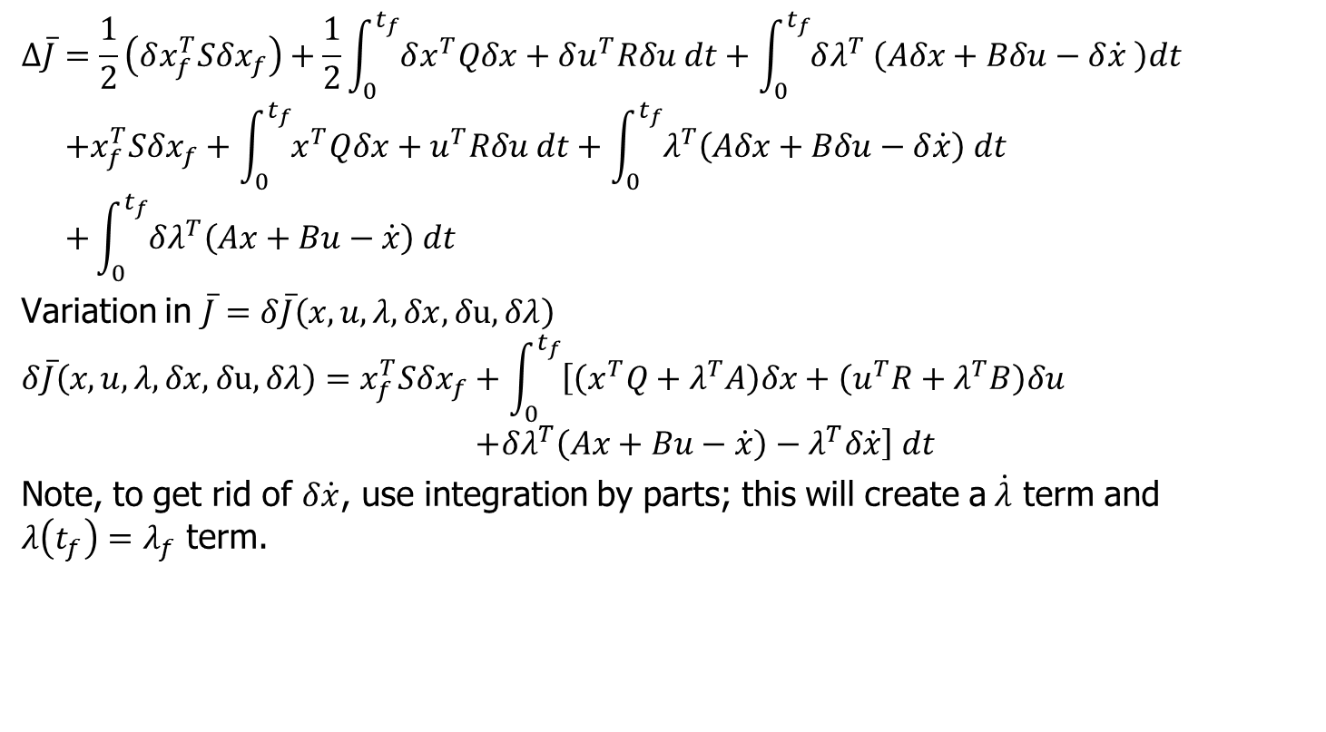
Optimization
$$Δ\overline{J}=\frac{1}{2}\left(δx_{f}^{T}Sδx_{f}\right)+\frac{1}{2}\int_{0}^{t_{f}}{δx^{T}Qδx+δu^{T}Rδu dt}+\int_{0}^{t_{f}}{δλ^{T} \left(Aδx+Bδu−δ\dot{x} \right)dt} \\ +x_{f}^{T}Sδx_{f}+\int_{0}^{t_{f}}{x^{T}Qδx+u^{T}Rδu dt}+\int_{0}^{t_{f}}{λ^{T}\left(Aδx+Bδu−δ\dot{x}\right) dt} \\ +\int_{0}^{t_{f}}{δλ^{T}\left(Ax+Bu−\dot{x}\right) dt}$$
Variation in $\overline{J}=δ\overline{J}\left(x,u,λ,δx,δu,δλ\right)$
$$δ\overline{J}\left(x,u,λ,δx,δu,δλ\right)=x_{f}^{T}Sδx_{f}+\int_{0}^{t_{f}}{\left[\left(x^{T}Q+λ^{T}A\right)δx+\left(u^{T}R+λ^{T}B\right)δu\right.} \\ \left.+δλ^{T}\left(Ax+Bu−\dot{x}\right)−λ^{T}δ\dot{x}\right] dt$$
Note, to get rid of $δ\dot{x}$, use integration by parts; this will create a$\dot{λ}$ term and $λ\left(t_{f}\right)=λ_{f}$ term.

Slide 15
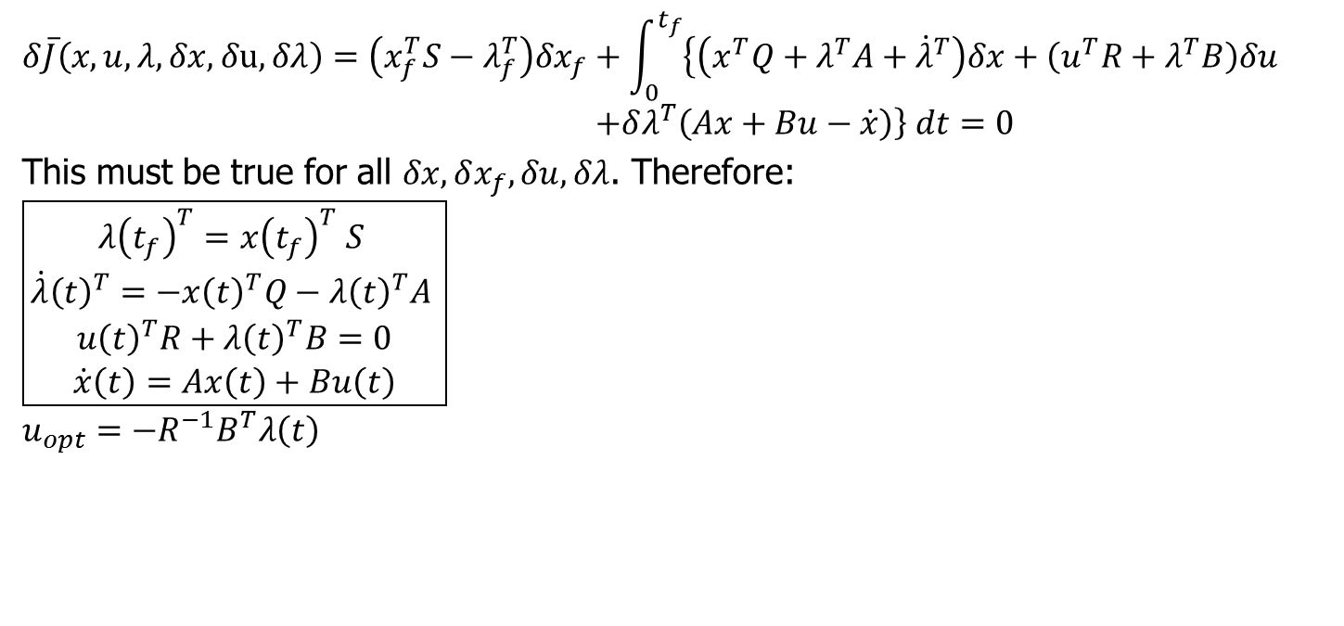
Optimal Control Solution
$$δ\overline{J}\left(x,u,λ,δx,δu,δλ\right)=\left(x_{f}^{T}S−λ_{f}^{T}\right)δx_{f}+\int_{0}^{t_{f}}{\left\{\left(x^{T}Q+λ^{T}A+{\dot{λ}}^{T}\right)δx+\left(u^{T}R+λ^{T}B\right)δu\right.} \\ \left.+δλ^{T}\left(Ax+Bu−\dot{x}\right)\right\} dt=0$$
This must be true for all $δx, δx_{f},δu,δλ$. Therefore:
$$\boxed{\begin{aligned}λ{\left(t_{f}\right)}^{T}=x{\left(t_{f}\right)}^{T} S \\ {\dot{λ}\left(t\right)}^{T}=−{x\left(t\right)}^{T}Q−{λ\left(t\right)}^{T}A \\ u{\left(t\right)}^{T}R+λ{\left(t\right)}^{T}B=0 \\ \dot{x}\left(t\right)=Ax\left(t\right)+Bu\left(t\right)\end{aligned}}$$
$$u_{opt}=−R^{−1}B^{T}λ\left(t\right)$$

Slide 16
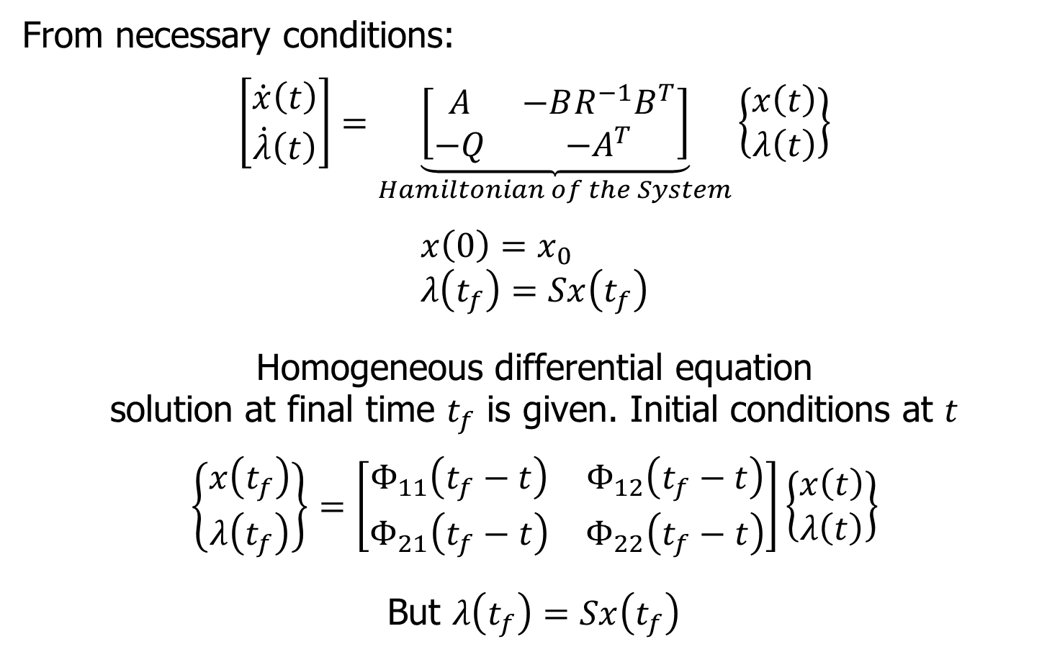
Solution
From necessary conditions:
$$\left[\begin{matrix}\dot{x}\left(t\right) \\ \dot{λ}\left(t\right)\end{matrix}\right]=\underset{Hamiltonian of the System}{\underbrace{\left[\begin{matrix}A & −BR^{−1}B^{T} \\ −Q & −A^{T}\end{matrix}\right]}}\left\{\begin{matrix}x\left(t\right) \\ λ\left(t\right)\end{matrix}\right\}$$
$$x\left(0\right)=x_{0} \\ λ\left(t_{f}\right)=Sx\left(t_{f}\right)$$
Homogeneous differential equation
solution at final time $t_{f}$ is given. Initial conditions at $t$
$$\left\{\begin{matrix}x\left(t_{f}\right) \\ λ\left(t_{f}\right)\end{matrix}\right\}=\left[\begin{matrix}Φ_{11}\left(t_{f}−t\right) & Φ_{12}\left(t_{f}−t\right) \\ Φ_{21}\left(t_{f}−t\right) & Φ_{22}\left(t_{f}−t\right)\end{matrix}\right]\left\{\begin{matrix}x\left(t\right) \\ λ\left(t\right)\end{matrix}\right\}$$
But $λ\left(t_{f}\right)=Sx\left(t_{f}\right)$

Slide 17
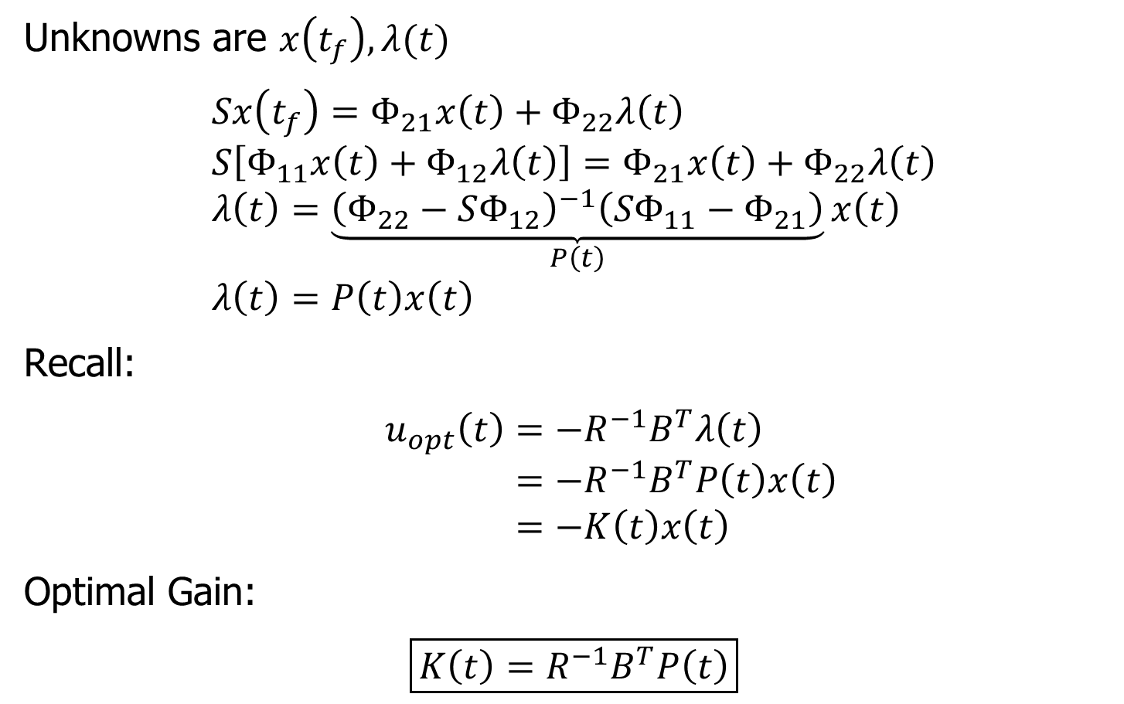
Solution
Unknowns are $x\left(t_{f}\right), λ(t)$
$$Sx\left(t_{f}\right)=Φ_{21}x\left(t\right)+Φ_{22}λ\left(t\right) \\ S\left[Φ_{11}x\left(t\right)+Φ_{12}λ\left(t\right)\right]=Φ_{21}x\left(t\right)+Φ_{22}λ\left(t\right) \\ λ\left(t\right)=\underset{P\left(t\right)}{\underbrace{{\left(Φ_{22}−SΦ_{12}\right)}^{−1}\left(SΦ_{11}−Φ_{21}\right)}}x\left(t\right) \\ λ\left(t\right)=P\left(t\right)x\left(t\right)$$
Recall:
$$u_{opt}\left(t\right)=−R^{−1}B^{T}λ\left(t\right) \\ =−R^{−1}B^{T}P\left(t\right)x\left(t\right) \\ =−K\left(t\right)x\left(t\right)$$
Optimal Gain:
$$\boxed{K\left(t\right)=R^{−1}B^{T}P\left(t\right)}$$

