Slide 1
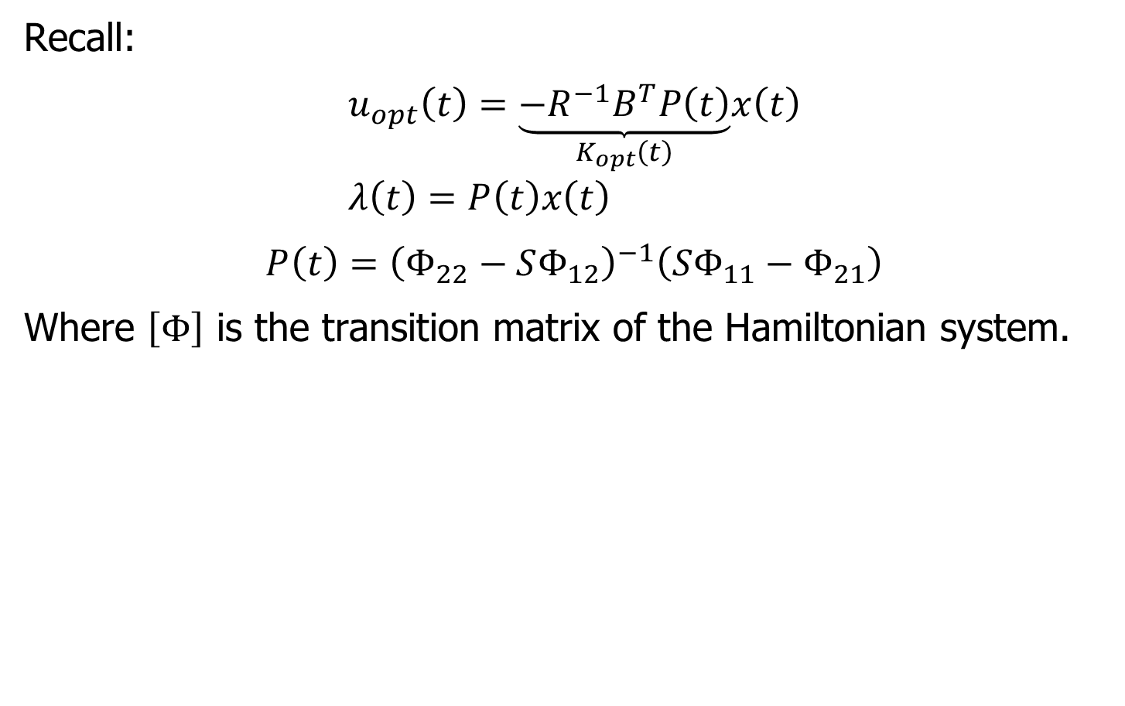
Optimal Control
Recall:
$$u_{opt}\left(t\right)=\underset{K_{opt}\left(t\right)}{\underbrace{−R^{−1}B^{T}P\left(t\right)}}x\left(t\right) \\ λ\left(t\right)=P\left(t\right)x\left(t\right)$$
$$P\left(t\right)={\left(Φ_{22}−SΦ_{12}\right)}^{−1}\left(SΦ_{11}−Φ_{21}\right)$$
Where $\left[Φ\right]$ is the transition matrix of the Hamiltonian system.

Slide 2
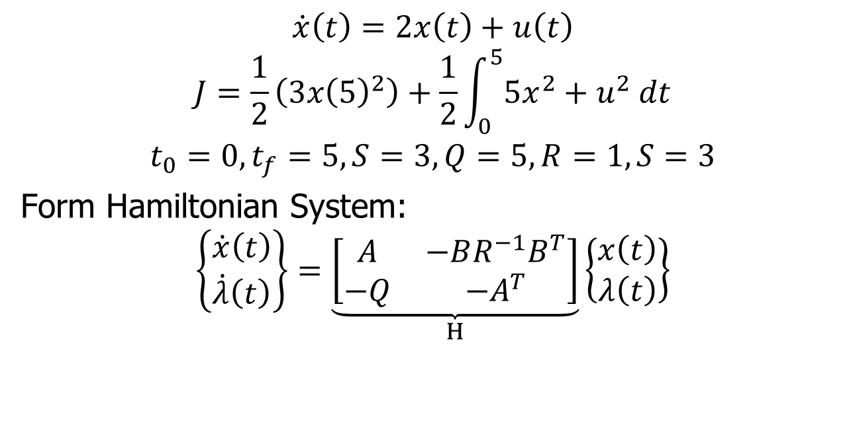
Example
$$\dot{x}\left(t\right)=2x\left(t\right)+u\left(t\right)$$
$$J=\frac{1}{2}\left(3x{\left(5\right)}^{2}\right)+\frac{1}{2}\int_{0}^{5}{5x^{2}+u^{2} dt}$$
$$t_{0}=0, t_{f}=5, S=3, Q=5, R=1, S=3$$
Form Hamiltonian System:
$$\left\{\begin{matrix}\dot{x}\left(t\right) \\ \dot{λ}\left(t\right)\end{matrix}\right\}=\underset{H}{\underbrace{\left[\begin{matrix}A & −BR^{−1}B^{T} \\ −Q & −A^{T}\end{matrix}\right]}}\left\{\begin{matrix}x\left(t\right) \\ λ\left(t\right)\end{matrix}\right\}$$

Slide 3
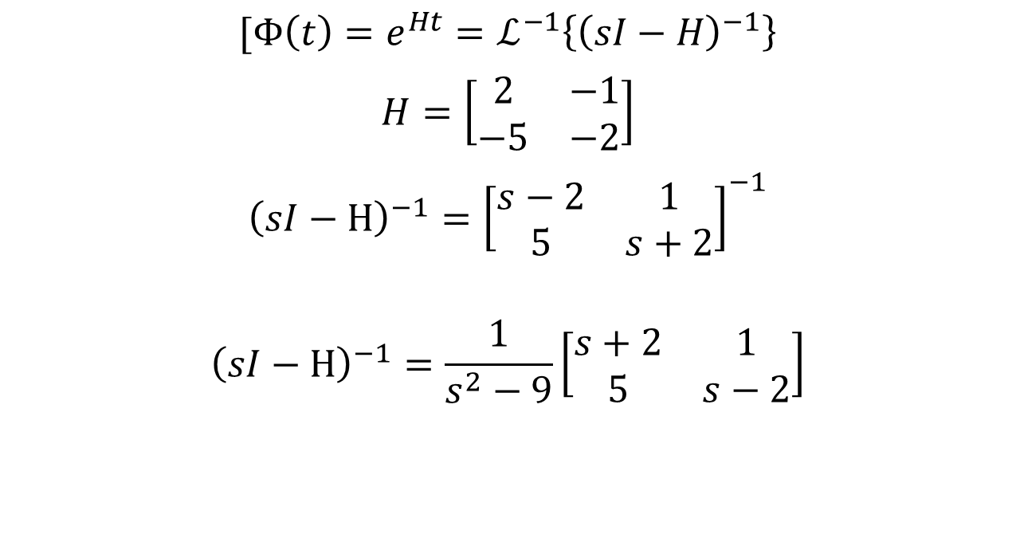
Example
$$[Φ\left(t\right)=e^{Ht}=ℒ^{−1}\left\{{\left(sI−H\right)}^{−1}\right\}$$
$$H=\left[\begin{matrix}2 & −1 \\ −5 & −2\end{matrix}\right]$$
$${\left(sI−H\right)}^{−1}={\left[\begin{matrix}s−2 & 1 \\ 5 & s+2\end{matrix}\right]}^{−1}$$
$${\left(sI−H\right)}^{−1}=\frac{1}{s^{2}−9}\left[\begin{matrix}s+2 & 1 \\ 5 & s−2\end{matrix}\right]$$

Slide 4
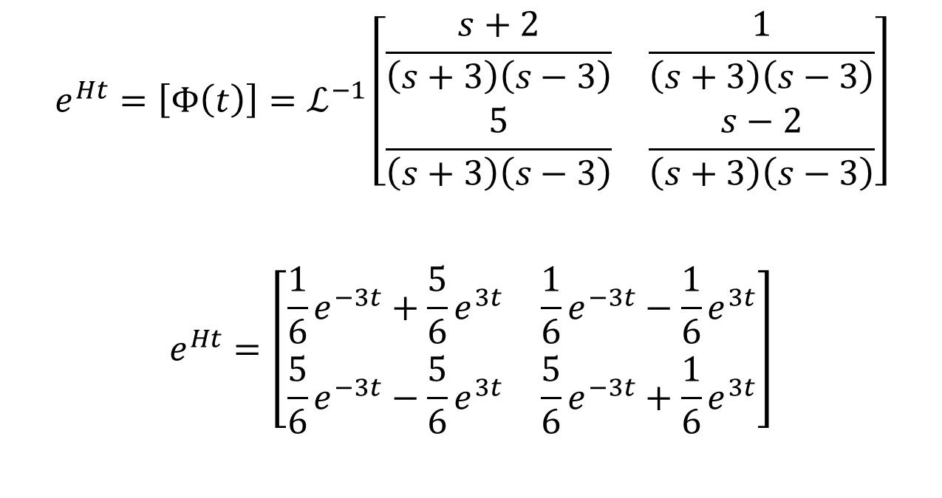
Example
$$e^{Ht}=\left[Φ\left(t\right)\right]=ℒ^{−1}\left[\begin{matrix}\frac{s+2}{\left(s+3\right)\left(s−3\right)} & \frac{1}{\left(s+3\right)\left(s−3\right)} \\ \frac{5}{\left(s+3\right)\left(s−3\right)} & \frac{s−2}{\left(s+3\right)\left(s−3\right)}\end{matrix}\right]$$
$$e^{Ht}=\left[\begin{matrix}\frac{1}{6}e^{−3t}+\frac{5}{6}e^{3t} & \frac{1}{6}e^{−3t}−\frac{1}{6}e^{3t} \\ \frac{5}{6}e^{−3t}−\frac{5}{6}e^{3t} & \frac{5}{6}e^{−3t}+\frac{1}{6}e^{3t}\end{matrix}\right]$$

Slide 5
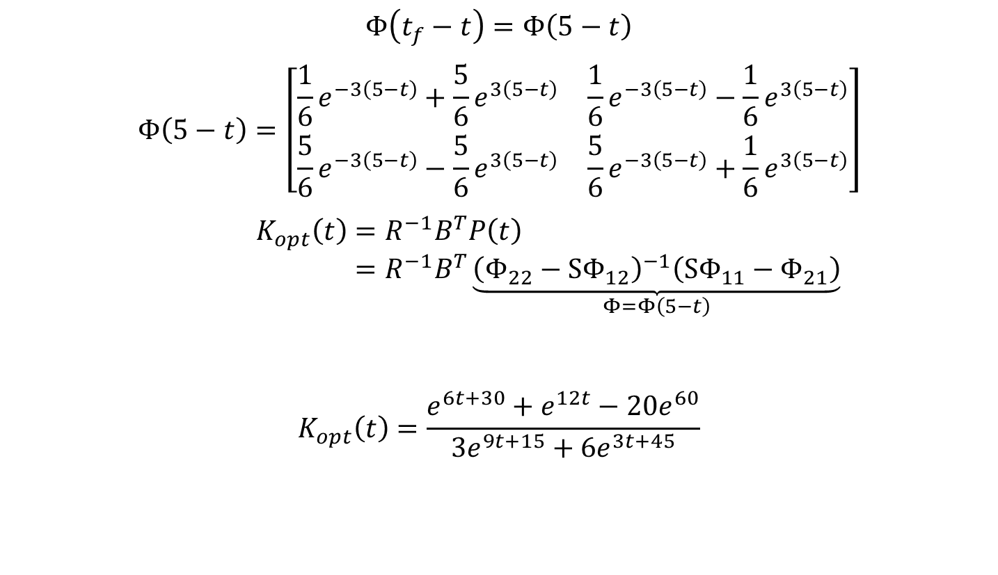
Example
$$Φ\left(t_{f}−t\right)=Φ\left(5−t\right)$$
$$Φ\left(5−t\right)=\left[\begin{matrix}\frac{1}{6}e^{−3\left(5−t\right)}+\frac{5}{6}e^{3\left(5−t\right)} & \frac{1}{6}e^{−3\left(5−t\right)}−\frac{1}{6}e^{3\left(5−t\right)} \\ \frac{5}{6}e^{−3\left(5−t\right)}−\frac{5}{6}e^{3\left(5−t\right)} & \frac{5}{6}e^{−3\left(5−t\right)}+\frac{1}{6}e^{3\left(5−t\right)}\end{matrix}\right]$$
$$K_{opt}\left(t\right)=R^{−1}B^{T}P\left(t\right) \\ =R^{−1}B^{T}\underset{Φ=Φ\left(5−t\right)}{\underbrace{{\left(Φ_{22}−SΦ_{12}\right)}^{−1}\left(SΦ_{11}−Φ_{21}\right)}}$$
$$K_{opt}\left(t\right)=\frac{e^{6t+30}+e^{12t}−20e^{60}}{3e^{9t+15}+6e^{3t+45}}$$

Slide 6
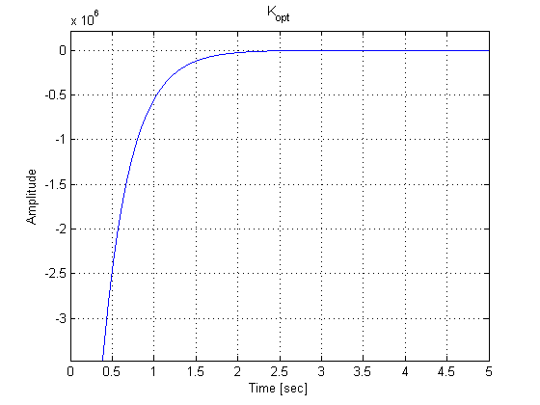

Example
$$K_{opt}\left(t\right)=\frac{e^{6t+30}+e^{12t}−20e^{60}}{3e^{9t+15}+6e^{3t+45}}$$

Slide 7
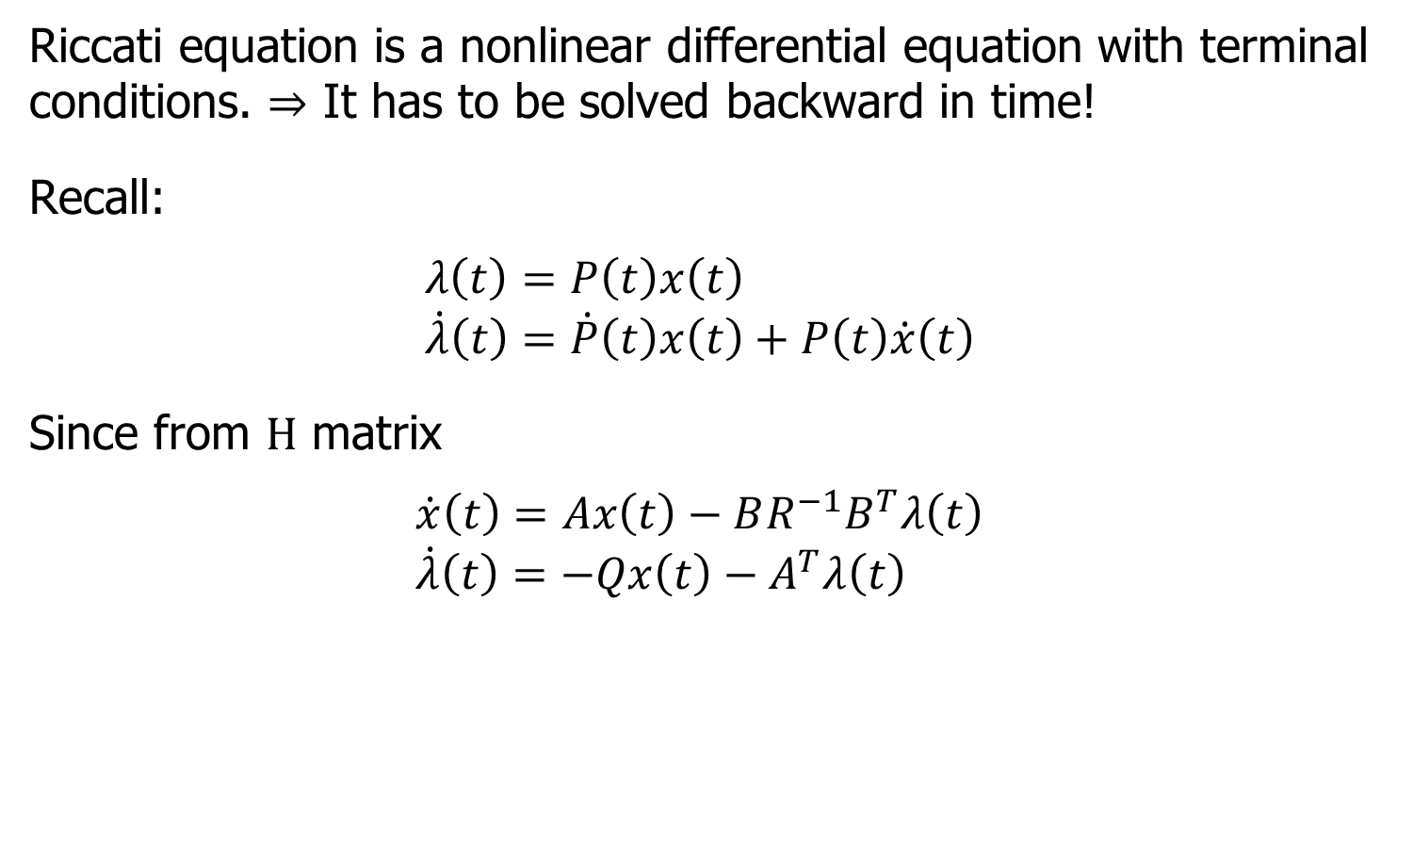
Alternative Way to Find $P(t)$ (Riccati Equation)
Riccati equation is a nonlinear differential equation with terminal conditions. $⇒$ It has to be solved backward in time!
Recall:
$$λ\left(t\right)=P\left(t\right)x\left(t\right) \\ \dot{λ}\left(t\right)=\dot{P}\left(t\right)x\left(t\right)+P\left(t\right)\dot{x}\left(t\right)$$
Since from $H$ matrix
$$\dot{x}\left(t\right)=Ax\left(t\right)−BR^{−1}B^{T}λ\left(t\right) \\ \dot{λ}\left(t\right)=−Qx\left(t\right)−A^{T}λ\left(t\right)$$

Slide 8
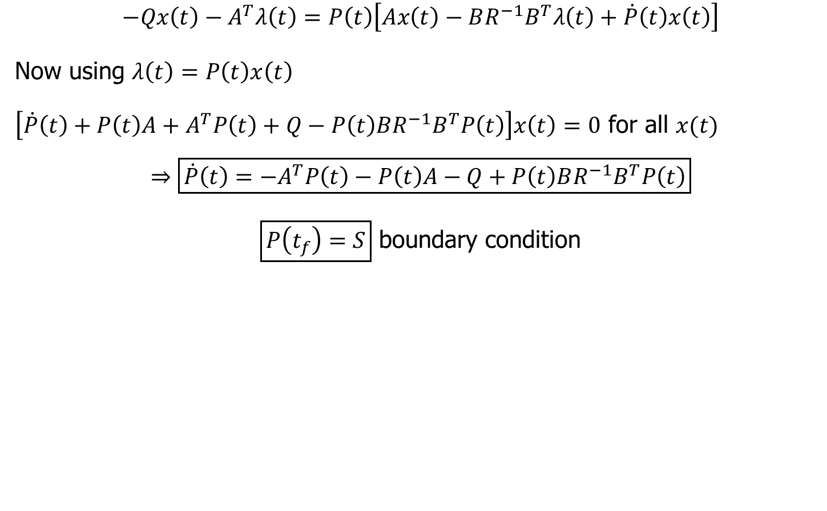
Riccati Solution
$$−Qx\left(t\right)−A^{T}λ\left(t\right)=P\left(t\right)\left[Ax\left(t\right)−BR^{−1}B^{T}λ\left(t\right)+\dot{P}\left(t\right)x\left(t\right)\right]$$
Now using $λ\left(t\right)=P\left(t\right)x\left(t\right)$
$\left[\dot{P}\left(t\right)+P\left(t\right)A+A^{T}P\left(t\right)+Q−P\left(t\right)BR^{−1}B^{T}P\left(t\right)\right]x\left(t\right)=0$ for all $x(t)$
$$⇒\boxed{\dot{P}\left(t\right)=−A^{T}P\left(t\right)−P\left(t\right)A−Q+P\left(t\right)BR^{−1}B^{T}P\left(t\right)}$$
$\boxed{P\left(t_{f}\right)=S}$ boundary condition

Slide 9
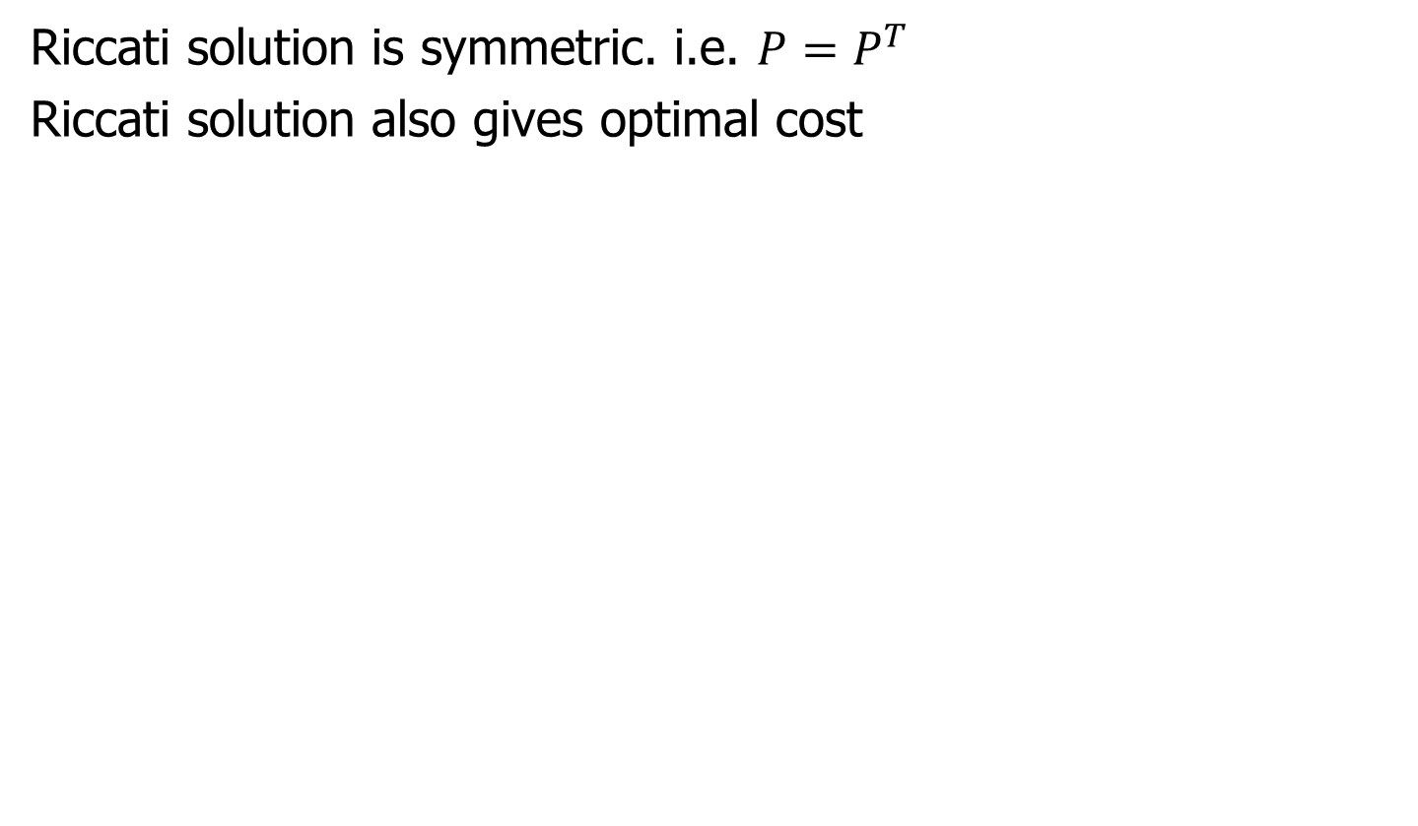
Riccati Equation Properties
Riccati solution is symmetric. i.e. $P=P^{T}$
Riccati solution also gives optimal cost

Slide 10
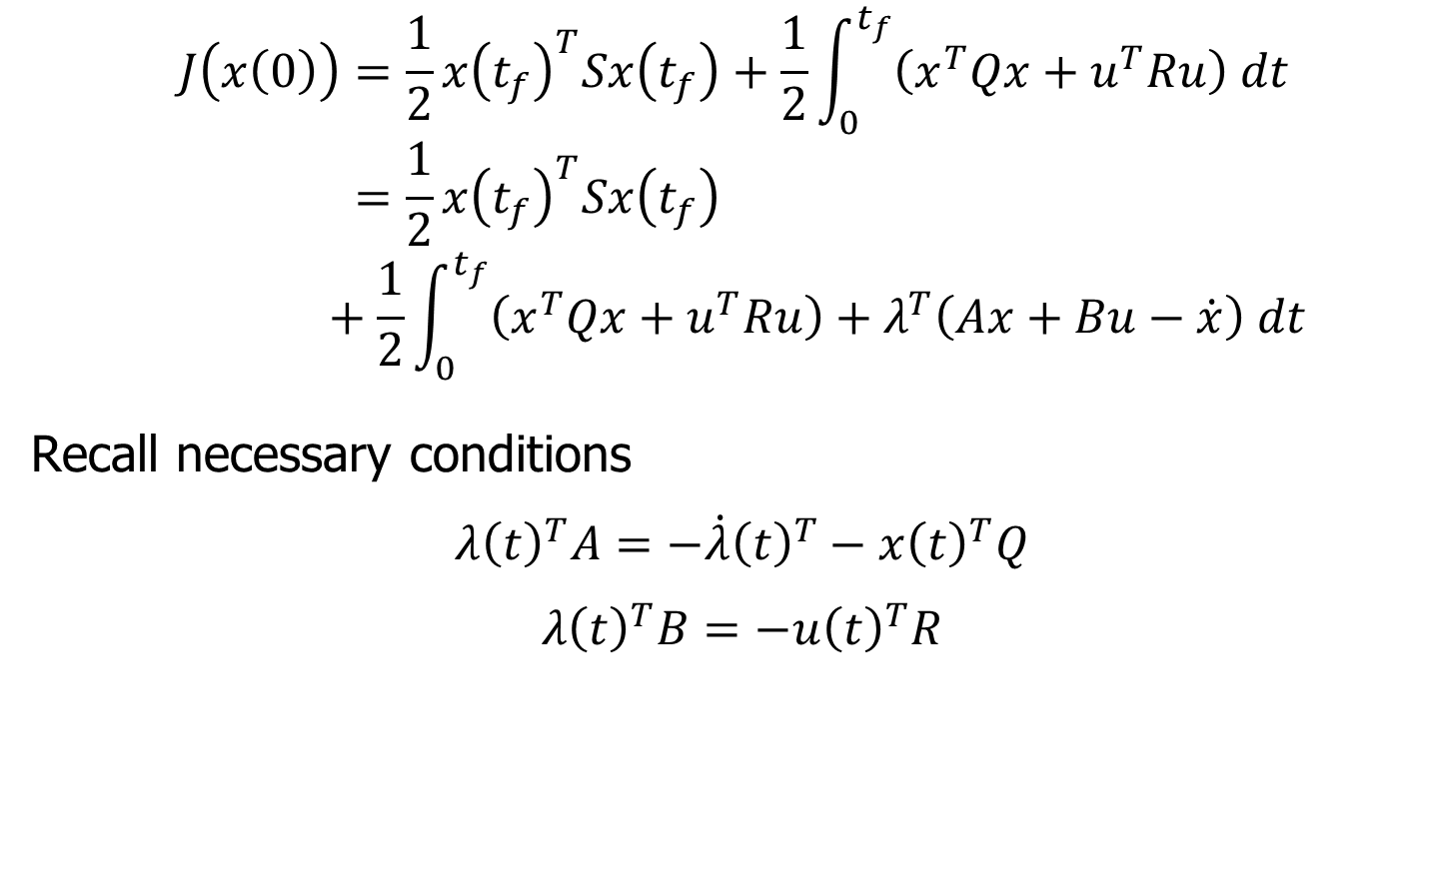
Solving for an Optimal Cost
$$J\left(x\left(0\right)\right)=\frac{1}{2}x{\left(t_{f}\right)}^{T}Sx\left(t_{f}\right)+\frac{1}{2}\int_{0}^{t_{f}}{\left(x^{T}Qx+u^{T}Ru\right) dt} \\ =\frac{1}{2}x{\left(t_{f}\right)}^{T}Sx\left(t_{f}\right)+\frac{1}{2}\int_{0}^{t_{f}}{\left(x^{T}Qx+u^{T}Ru\right)+λ^{T}\left(Ax+Bu−\dot{x}\right) dt}$$
Recall necessary conditions
$$λ{\left(t\right)}^{T}A=−\dot{λ}{\left(t\right)}^{T}−x{\left(t\right)}^{T}Q$$
$$λ{\left(t\right)}^{T}B=−u{\left(t\right)}^{T}R$$

Slide 11
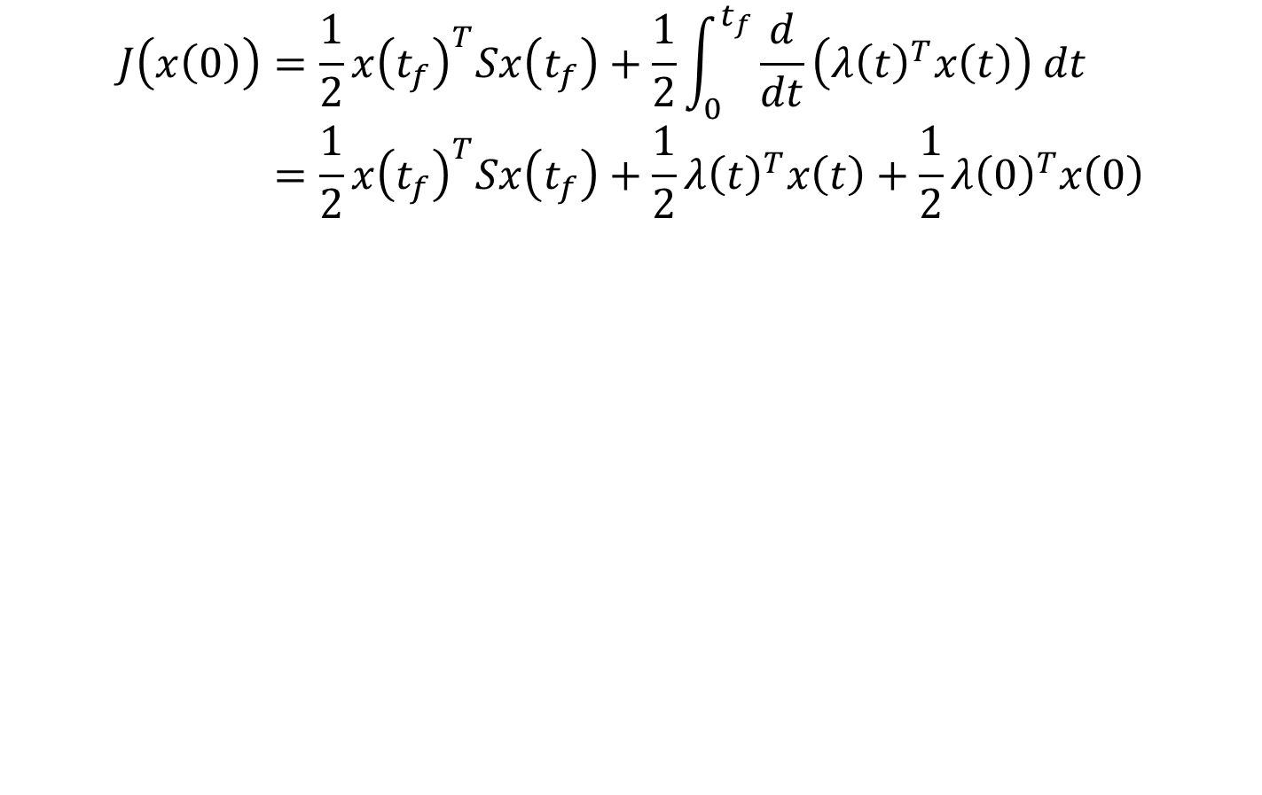
Optimal Cost
$$J\left(x\left(0\right)\right)=\frac{1}{2}x{\left(t_{f}\right)}^{T}Sx\left(t_{f}\right)+\frac{1}{2}\int_{0}^{t_{f}}{\frac{d}{dt}\left(λ{\left(t\right)}^{T}x\left(t\right)\right) dt} \\ =\frac{1}{2}x{\left(t_{f}\right)}^{T}Sx\left(t_{f}\right)+\frac{1}{2}λ{\left(t\right)}^{T}x\left(t\right)+\frac{1}{2}λ{\left(0\right)}^{T}x\left(0\right)$$

Slide 12
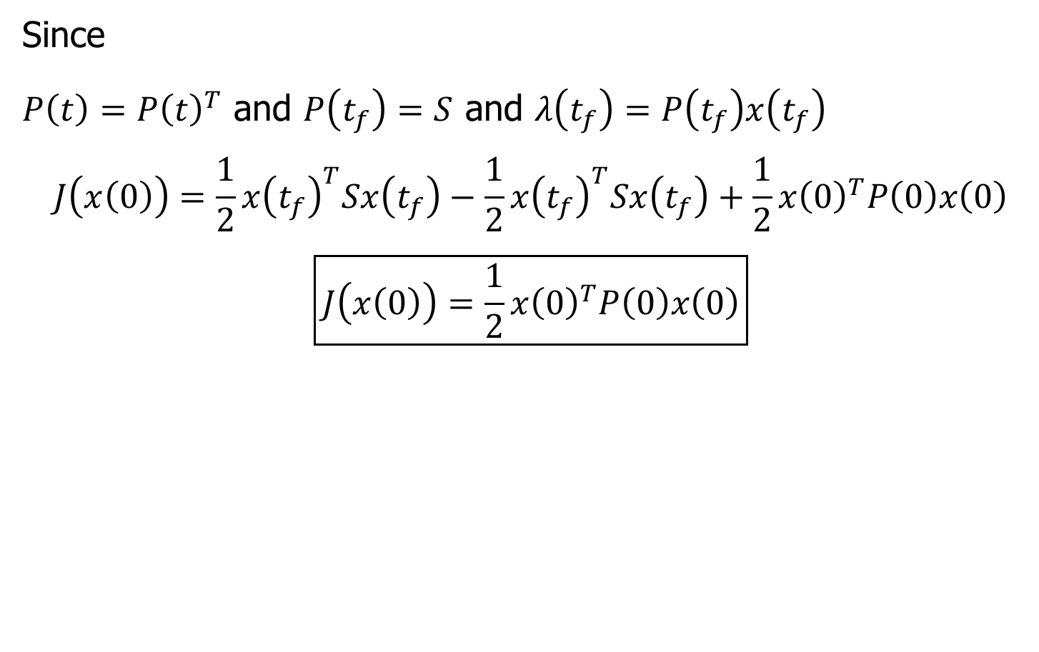
Optimal Cost
Since
$P\left(t\right)=P{\left(t\right)}^{T}$ and $P\left(t_{f}\right)=S$ and $λ\left(t_{f}\right)=P\left(t_{f}\right)x\left(t_{f}\right)$
$$J\left(x\left(0\right)\right)=\frac{1}{2}x{\left(t_{f}\right)}^{T}Sx\left(t_{f}\right)−\frac{1}{2}x{\left(t_{f}\right)}^{T}Sx\left(t_{f}\right)+\frac{1}{2}x{\left(0\right)}^{T}P\left(0\right)x\left(0\right)$$
$$\boxed{J\left(x\left(0\right)\right)=\frac{1}{2}x{\left(0\right)}^{T}P\left(0\right)x\left(0\right)}$$

Slide 13
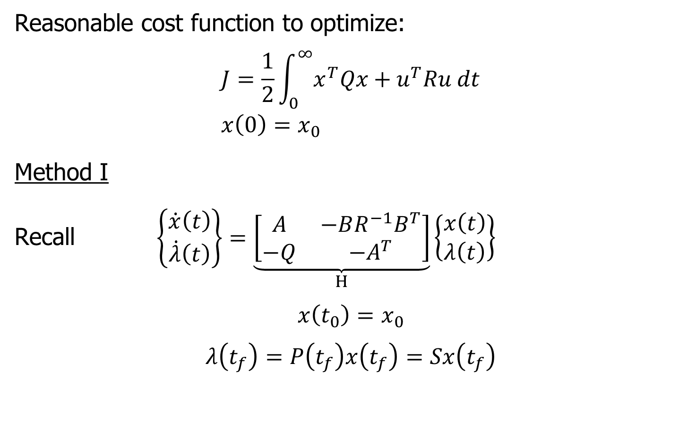
Steady State Optimal Control
Reasonable cost function to optimize:
$$J=\frac{1}{2}\int_{0}^{∞}{x^{T}Qx+u^{T}Ru dt} \\ x\left(0\right)=x_{0}$$
Method I
Recall $\left\{\begin{matrix}\dot{x}\left(t\right) \\ \dot{λ}\left(t\right)\end{matrix}\right\}=\underset{H}{\underbrace{\left[\begin{matrix}A & −BR^{−1}B^{T} \\ −Q & −A^{T}\end{matrix}\right]}}\left\{\begin{matrix}x\left(t\right) \\ λ\left(t\right)\end{matrix}\right\}$
$$x\left(t_{0}\right)=x_{0}$$
$$λ\left(t_{f}\right)=P\left(t_{f}\right)x\left(t_{f}\right)=Sx\left(t_{f}\right)$$

Slide 14
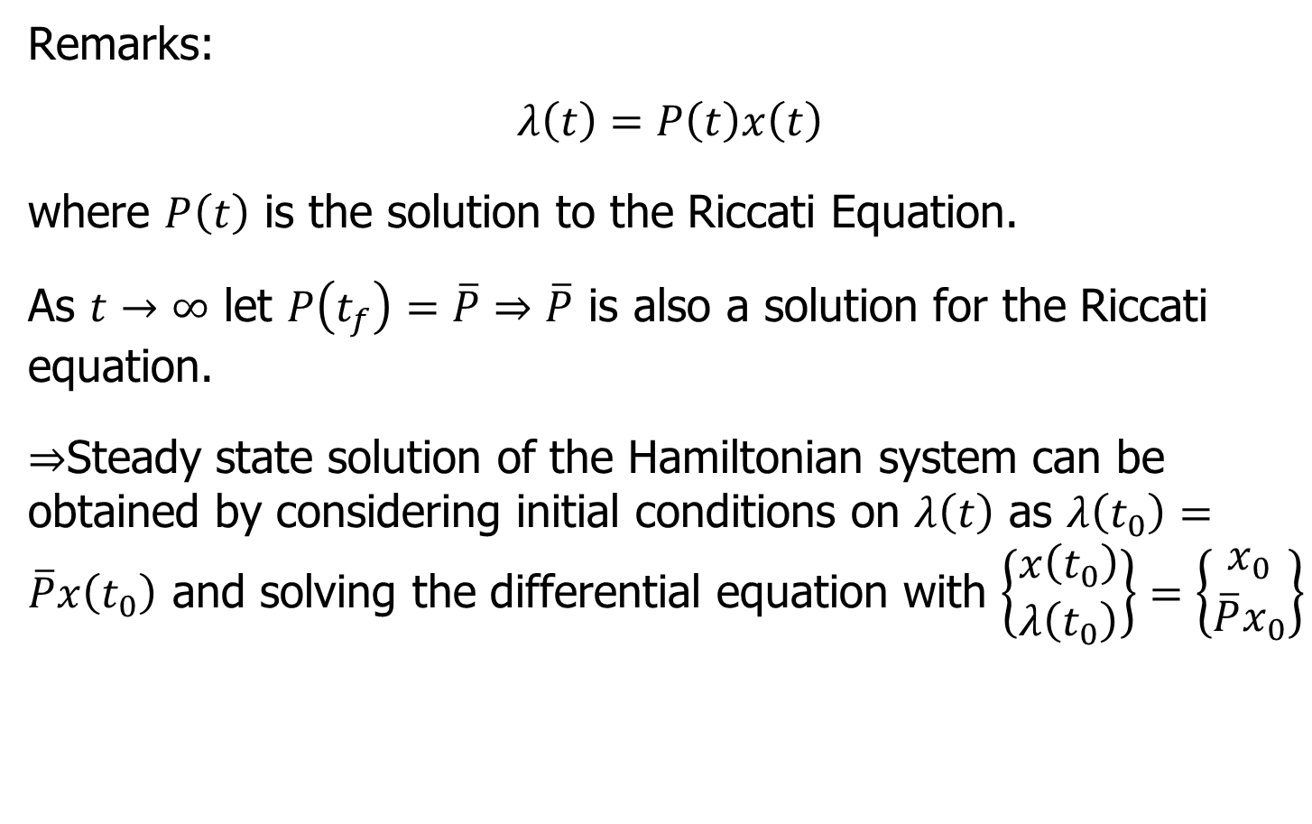
Steady State Optimal Control
Remarks:
$$λ\left(t\right)=P\left(t\right)x\left(t\right)$$
where $P\left(t\right)$ is the solution to the Riccati Equation.
As $t→∞$ let $P\left(t_{f}\right)=\overline{P}⇒\overline{P}$ is also a solution for the Riccati equation.
$⇒$Steady state solution of the Hamiltonian system can be obtained by considering initial conditions on $λ\left(t\right)$ as $λ\left(t_{0}\right)=\overline{P}x\left(t_{0}\right)$ and solving the differential equation with $\left\{\begin{matrix}x\left(t_{0}\right) \\ λ\left(t_{0}\right)\end{matrix}\right\}=\left\{\begin{matrix}x_{0} \\ \overline{P}x_{0}\end{matrix}\right\}$

Slide 15
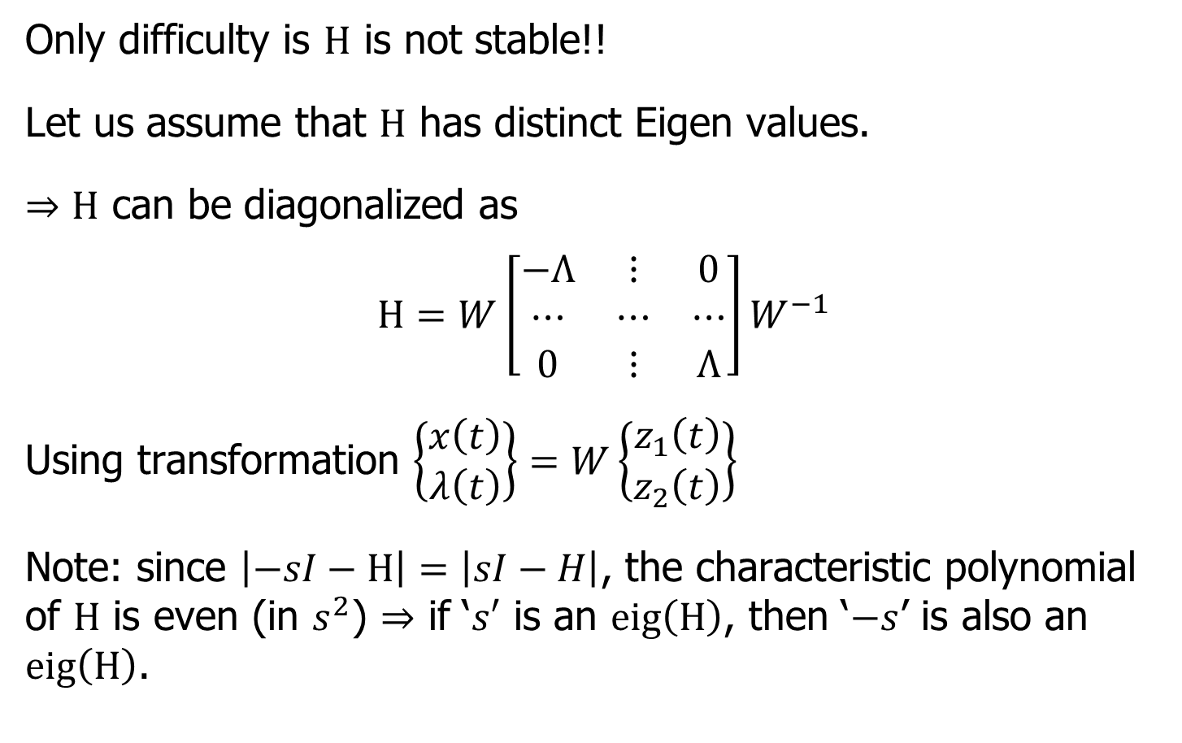
Steady State Optimal Control
Only difficulty is $H$ is not stable!!
Let us assume that $H$ has distinct Eigen values.
$⇒H$ can be diagonalized as
$$H=W\left[\begin{matrix}−Λ & ⋮ & 0 \\ ⋯ & ⋯ & ⋯ \\ 0 & ⋮ & Λ\end{matrix}\right]W^{−1}$$
Using transformation $\left\{\begin{matrix}x\left(t\right) \\ λ\left(t\right)\end{matrix}\right\}=W\left\{\begin{matrix}z_{1}\left(t\right) \\ z_{2}\left(t\right)\end{matrix}\right\}$
Note: since $\left|−sI−H\right|=\left|sI−H\right|$, the characteristic polynomial of $H$ is even (in $s^{2}$) $⇒$ if ‘$s′$ is an $eig\left(H\right)$, then ‘$−s$’ is also an $eig\left(H\right)$.

Slide 16
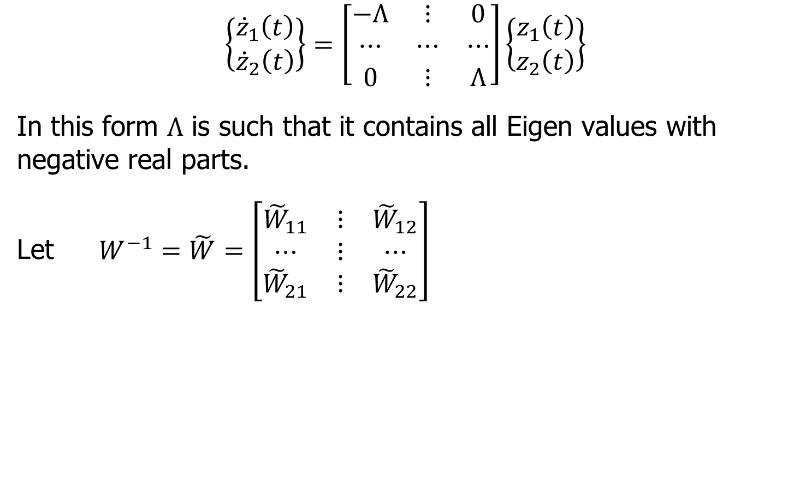
Steady State Optimal Control
$$\left\{\begin{matrix}{\dot{z}}_{1}\left(t\right) \\ {\dot{z}}_{2}\left(t\right)\end{matrix}\right\}=\left[\begin{matrix}−Λ & ⋮ & 0 \\ ⋯ & ⋯ & ⋯ \\ 0 & ⋮ & Λ\end{matrix}\right]\left\{\begin{matrix}z_{1}\left(t\right) \\ z_{2}\left(t\right)\end{matrix}\right\}$$
In this form $Λ$ is such that it contains all Eigen values with negative real parts.
Let $W^{−1}=\tilde{W}=\left[\begin{matrix}{\tilde{W}}_{11} & ⋮ & {\tilde{W}}_{12} \\ ⋯ & ⋮ & ⋯ \\ {\tilde{W}}_{21} & ⋮ & {\tilde{W}}_{22}\end{matrix}\right]$

Slide 17
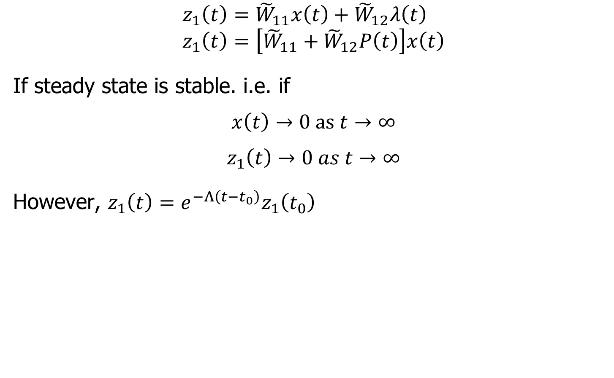
Steady State Optimal Control
$$z_{1}\left(t\right)={\tilde{W}}_{11}x\left(t\right)+{\tilde{W}}_{12}λ\left(t\right) \\ z_{1}\left(t\right)=\left[{\tilde{W}}_{11}+{\tilde{W}}_{12}P\left(t\right)\right]x\left(t\right)$$
If steady state is stable. i.e. if
$$x\left(t\right)→0 as t→∞$$
$$z_{1}\left(t\right)→0 as t→∞$$
However, $z_{1}\left(t\right)=e^{−Λ\left(t−t_{0}\right)}z_{1}\left(t_{0}\right)$

Slide 18
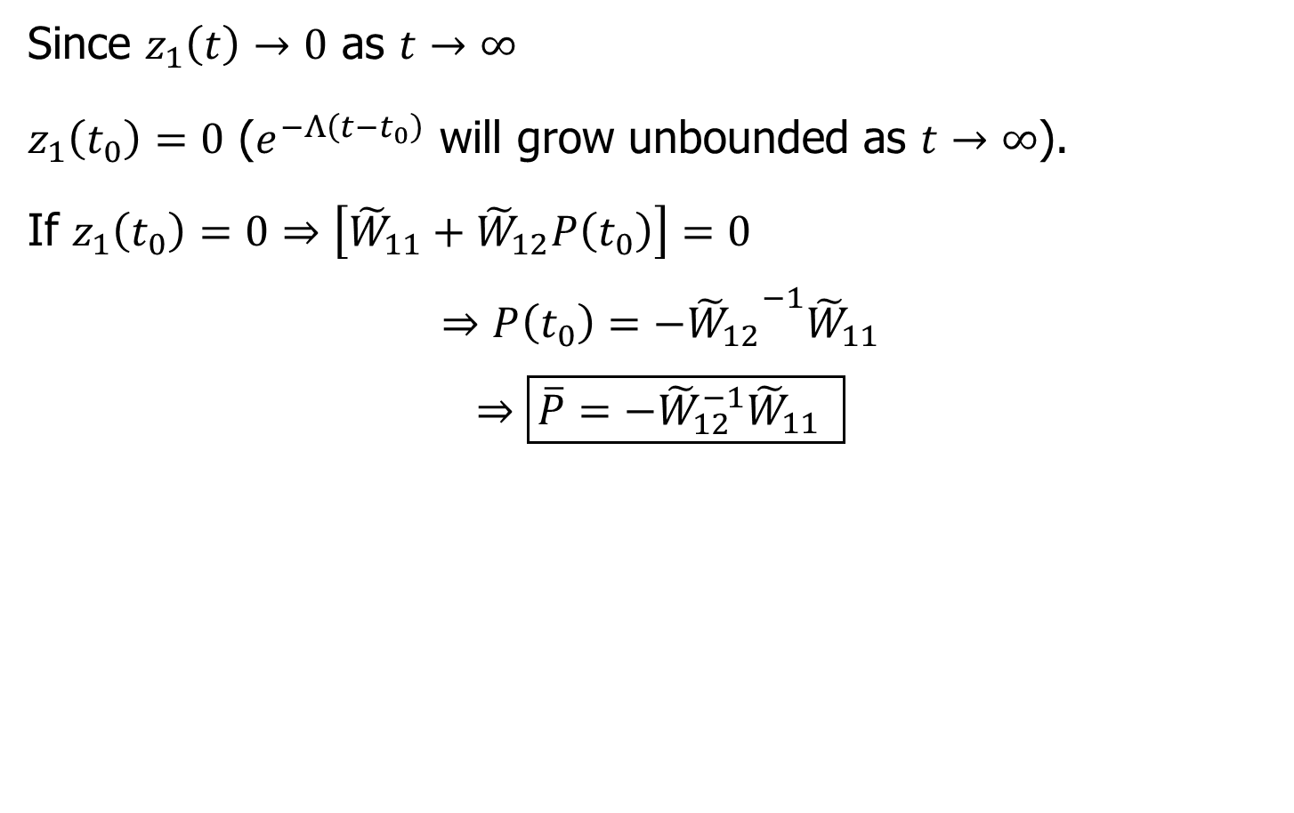
Steady State Optimal Control
Since $z_{1}\left(t\right)→0$ as $t→∞$
$z_{1}\left(t_{0}\right)=0$ ($e^{−Λ\left(t−t_{0}\right)}$ will grow unbounded as $t→∞$).
If $z_{1}\left(t_{0}\right)=0⇒\left[{\tilde{W}}_{11}+{\tilde{W}}_{12}P\left(t_{0}\right)\right]=0$
$$⇒P\left(t_{0}\right)=−{{\tilde{W}}_{12}}^{−1}{\tilde{W}}_{11}$$
$$⇒\boxed{\overline{P}=−{\tilde{W}}_{12}^{−1}{\tilde{W}}_{11} }$$

Slide 19
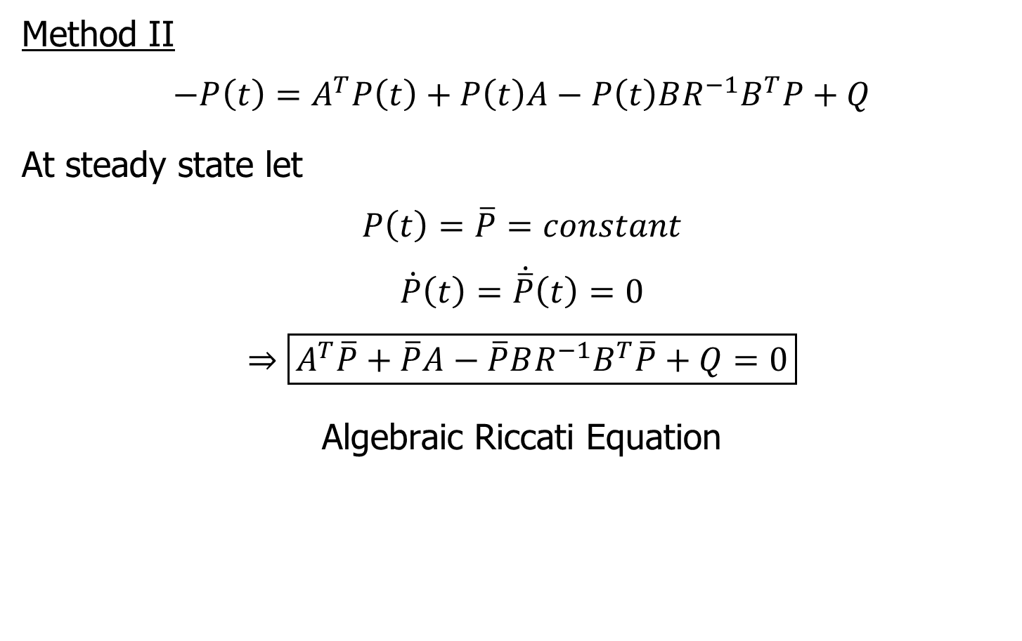
Alternate Method
Method II
$$−P\left(t\right)=A^{T}P\left(t\right)+P\left(t\right)A−P\left(t\right)BR^{−1}B^{T}P+Q$$
At steady state let
$$P\left(t\right)=\overline{P}=constant$$
$$\dot{P}\left(t\right)=\dot{\overline{P}}\left(t\right)=0$$
$$⇒\boxed{A^{T}\overline{P}+\overline{P}A−\overline{P}BR^{−1}B^{T}\overline{P}+Q=0}$$
Algebraic Riccati Equation

