Slide 1
Linear Quadratic Gaussian (LQG) Control Design
Many signals in control systems have randomness and need to be modeled as such.
e.g. actuator/sensor noise.
LQG is an extension of LQR to the case when disturbance input and sensor noise signals are assumed to be white noise. i.e. random processes.

Slide 2
LQG Preliminaries
Since prediction of state of the process in the future can not be done based on current knowledge of the state in case of random processes, one needs to use statistical machinery for analysis and design of control systems with such processes.

Slide 3
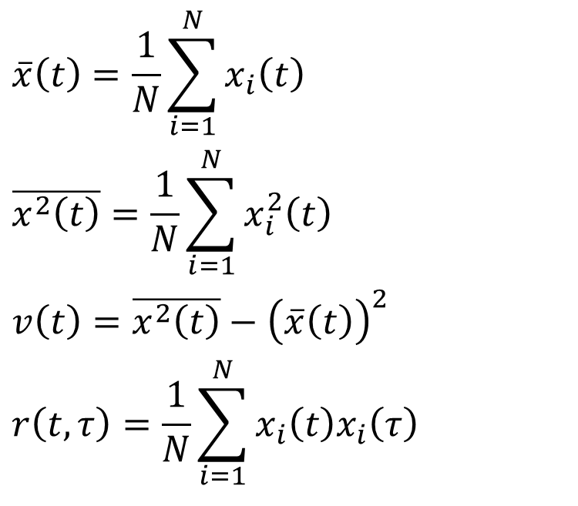
LQG Preliminaries
We define the following empirical statistics on the ensemble of outputs:
$$\overline{x}\left(t\right)=\frac{1}{N}\sum_{i=1}^{N}{x_{i}\left(t\right)}$$
$$\overline{x^{2}\left(t\right)}=\frac{1}{N}\sum_{i=1}^{N}{x_{i}^{2}\left(t\right)}$$
$$v\left(t\right)=\overline{x^{2}\left(t\right)}−{\left(\overline{x}\left(t\right)\right)}^{2}$$
$$r\left(t,τ\right)=\frac{1}{N}\sum_{i=1}^{N}{x_{i}\left(t\right)x_{i}\left(τ\right)}$$
Mean:
Mean square:
Variance:
Correlation Function:

Slide 4
LQG Preliminaries
We simplify our analysis by looking at only first and second order statistics of random processes
Definition of various statistical quantities use what is called Probability Density Functions and Joint Probability Density Functions.

Slide 5
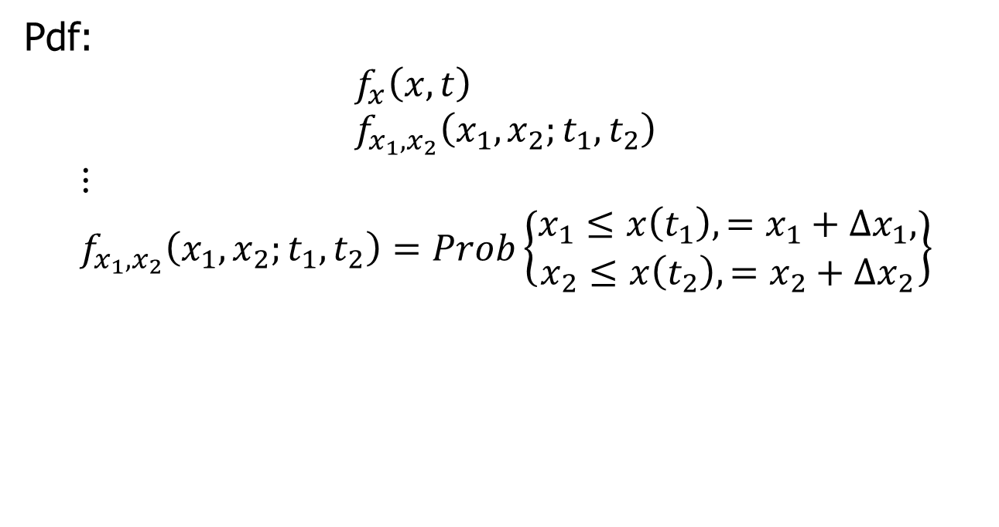
LQG Preliminaries
Pdf:
$$f_{x}\left(x,t\right) \\ f_{x_{1},x_{2}}\left(x_{1},x_{2};t_{1},t_{2}\right)$$
$$⋮ \\ f_{x_{1},x_{2}}\left(x_{1},x_{2};t_{1},t_{2}\right)=Prob\left\{\begin{aligned}x_{1}≤x\left(t_{1}\right),=x_{1}+Δx_{1}, \\ x_{2}≤x\left(t_{2}\right),=x_{2}+Δx_{2}\end{aligned}\right\}$$

Slide 6
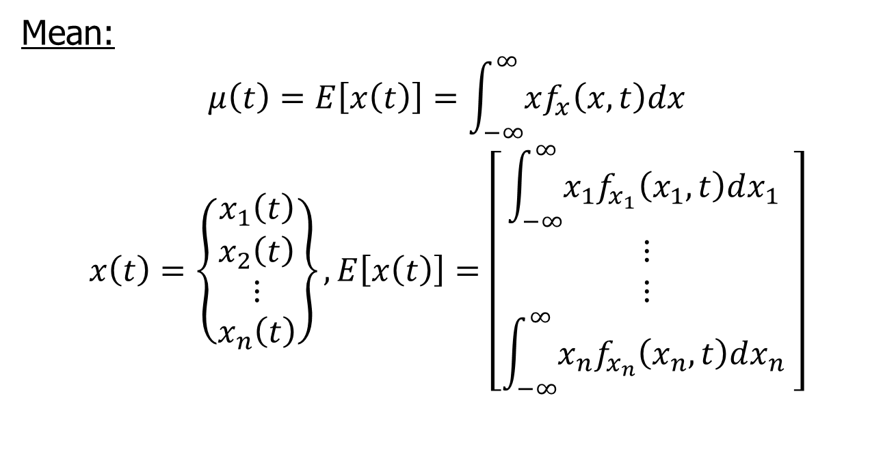
First Order Statistics
Mean:
$$μ\left(t\right)=E\left[x\left(t\right)\right]=\int_{−∞}^{∞}{xf_{x}\left(x,t\right)dx}$$
$$x\left(t\right)=\left\{\begin{matrix}x_{1}\left(t\right) \\ x_{2}\left(t\right) \\ ⋮ \\ x_{n}\left(t\right)\end{matrix}\right\}, E\left[x\left(t\right)\right]=\left[\begin{matrix}\int_{−∞}^{∞}{x_{1}f_{x_{1}}\left(x_{1},t\right)dx_{1} } \\ ⋮ \\ ⋮ \\ \int_{−∞}^{∞}{x_{n}f_{x_{n}}\left(x_{n},t\right)dx_{n} }\end{matrix}\right]$$

Slide 7
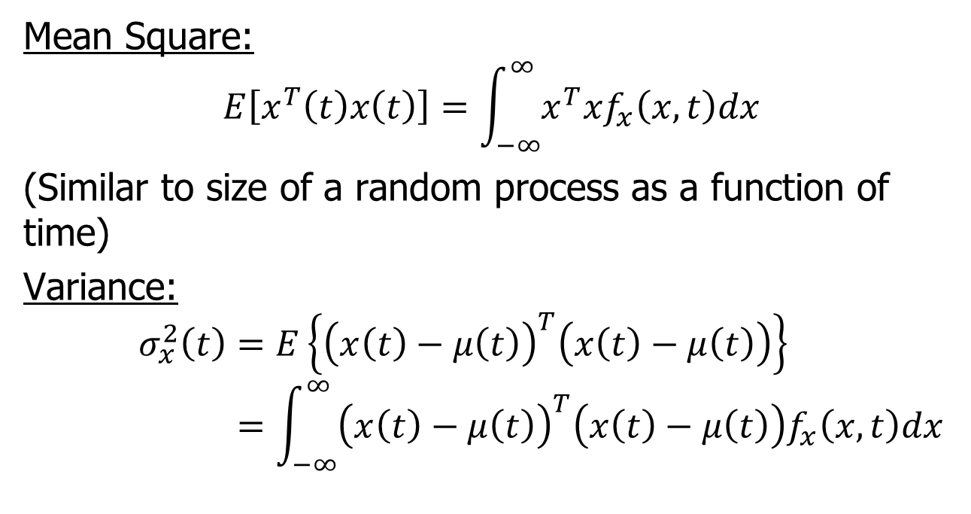
Mean Square
Mean Square:
$$E\left[x^{T}\left(t\right)x\left(t\right)\right]=\int_{−∞}^{∞}{x^{T}xf_{x}\left(x,t\right)dx}$$
(Similar to size of a random process as a function of time)
Variance:
$$σ_{x}^{2}\left(t\right)=E\left\{{\left(x\left(t\right)−μ\left(t\right)\right)}^{T}\left(x\left(t\right)−μ\left(t\right)\right)\right\} \\ =\int_{−∞}^{∞}{{\left(x\left(t\right)−μ\left(t\right)\right)}^{T}\left(x\left(t\right)−μ\left(t\right)\right)f_{x}\left(x,t\right)dx}$$

Slide 8
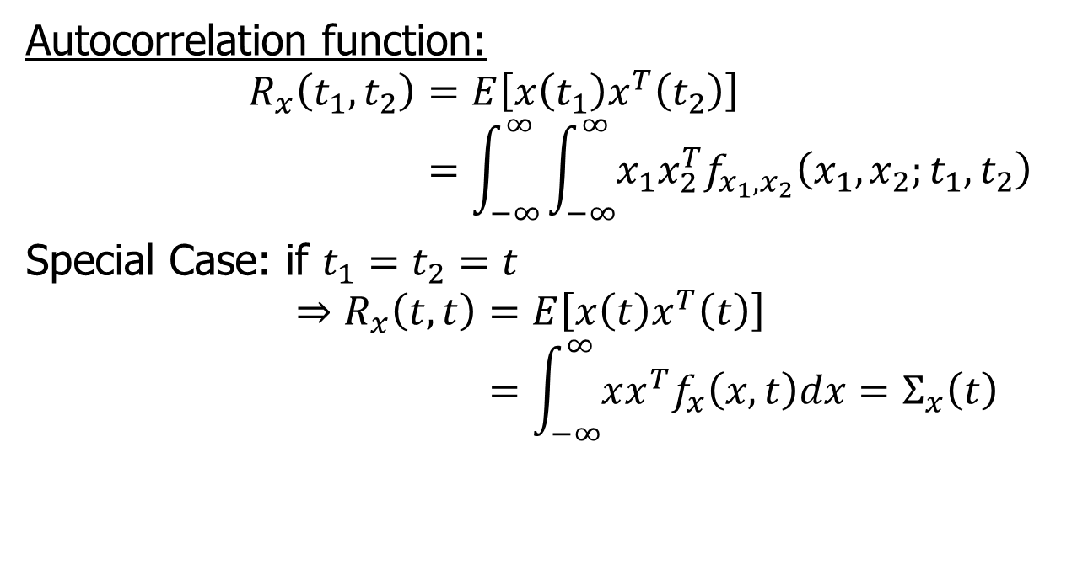
Second Order Statistics
Autocorrelation function:
$$R_{x}\left(t_{1},t_{2}\right)=E\left[x\left(t_{1}\right)x^{T}\left(t_{2}\right)\right] \\ =\int_{−∞}^{∞}{\int_{−∞}^{∞}{x_{1}x_{2}^{T}f_{x_{1},x_{2}}\left(x_{1},x_{2};t_{1},t_{2}\right)}}$$
Special Case: if $t_{1}=t_{2}=t$
$$⇒R_{x}\left(t,t\right)=E\left[x\left(t\right)x^{T}\left(t\right)\right] \\ =\int_{−∞}^{∞}{xx^{T}f_{x}\left(x,t\right)dx=Σ_{x}\left(t\right)}$$

Slide 9
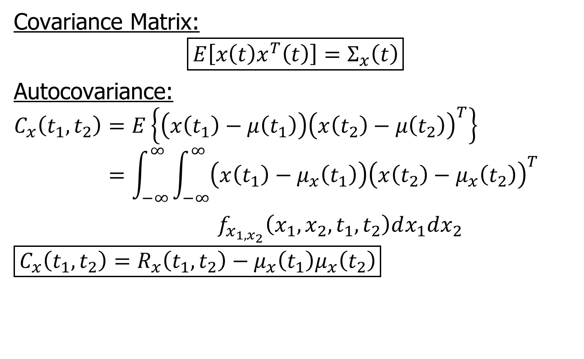
Covariance Matrix
Covariance Matrix:
$$\boxed{E\left[x\left(t\right)x^{T}\left(t\right)\right]=Σ_{x}\left(t\right)}$$
Autocovariance:
$$C_{x}\left(t_{1},t_{2}\right)=E\left\{\left(x\left(t_{1}\right)−μ\left(t_{1}\right)\right){\left(x\left(t_{2}\right)−μ\left(t_{2}\right)\right)}^{T}\right\} \\ =\int_{−∞}^{∞}{\int_{−∞}^{∞}{\left(x\left(t_{1}\right)−μ_{x}\left(t_{1}\right)\right){\left(x\left(t_{2}\right)−μ_{x}\left(t_{2}\right)\right)}^{T}}}$$
$f_{x_{1,x_{2}}}\left(x_{1},x_{2},t_{1},t_{2}\right)dx_{1}dx_{2}$
$$\boxed{C_{x}\left(t_{1},t_{2}\right)=R_{x}\left(t_{1},t_{2}\right)−μ_{x}\left(t_{1}\right)μ_{x}\left(t_{2}\right)}$$

Slide 10
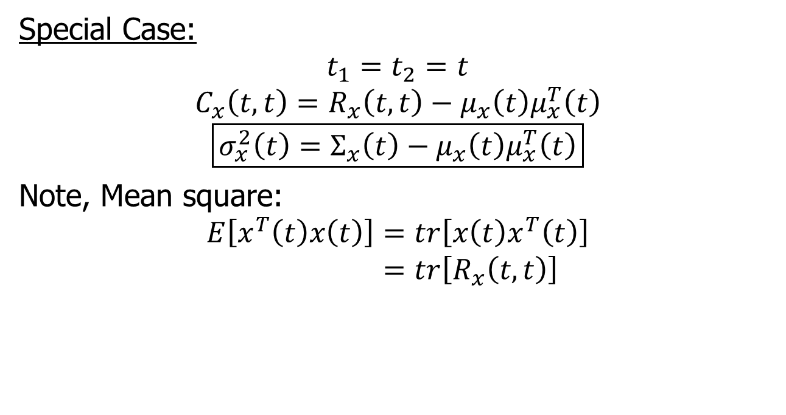
Special Case
Special Case:
$$t_{1}=t_{2}=t$$
$$C_{x}\left(t,t\right)=R_{x}\left(t,t\right)−μ_{x}\left(t\right)μ_{x}^{T}\left(t\right)$$
$$\boxed{σ_{x}^{2}\left(t\right)=Σ_{x}\left(t\right)−μ_{x}\left(t\right)μ_{x}^{T}\left(t\right)}$$
Note, Mean square:
$$E\left[x^{T}\left(t\right)x\left(t\right)\right]=tr\left[x\left(t\right)x^{T}\left(t\right)\right] \\ =tr\left[R_{x}\left(t,t\right)\right]$$

Slide 11
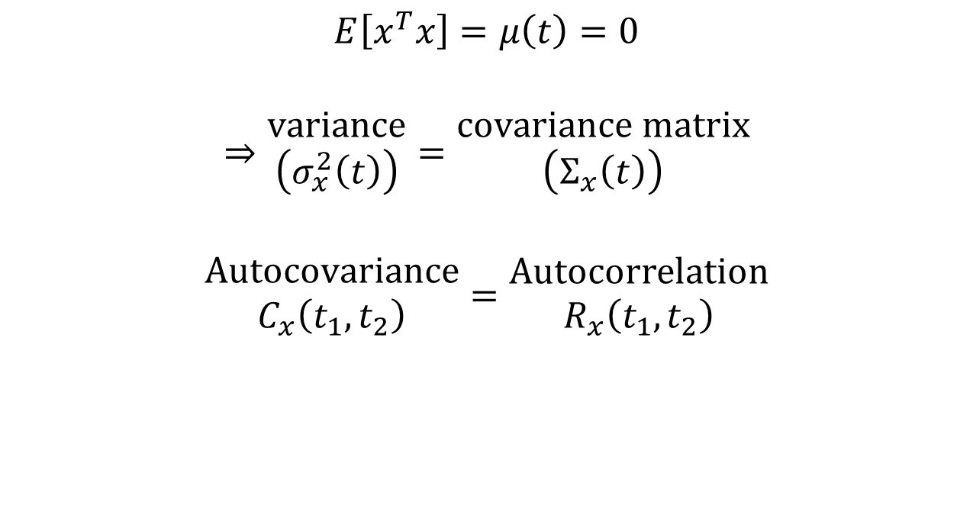
Zero Mean Random Process
$$E\left[x^{T}x\right]=μ\left(t\right)=0$$
$$⇒\begin{matrix}variance \\ \left(σ_{x}^{2}\left(t\right)\right)\end{matrix}=\begin{matrix}covariance matrix \\ \left(Σ_{x}\left(t\right)\right)\end{matrix}$$
$$\begin{matrix}Autocovariance \\ C_{x}\left(t_{1},t_{2}\right)\end{matrix}=\begin{matrix}Autocorrelation \\ R_{x}\left(t_{1},t_{2}\right)\end{matrix}$$

Slide 12
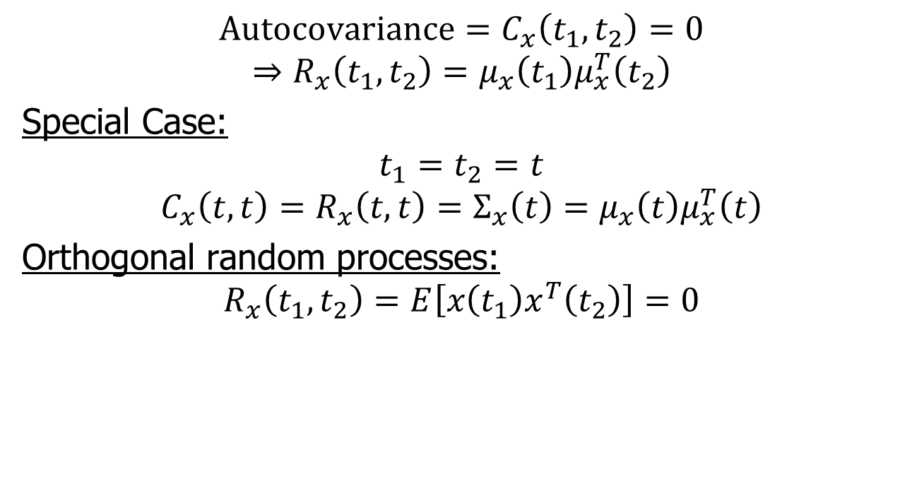
Uncorrelated Random Processes
$$Autocovariance=C_{x}\left(t_{1},t_{2}\right)=0$$
$$⇒R_{x}\left(t_{1},t_{2}\right)=μ_{x}\left(t_{1}\right)μ_{x}^{T}\left(t_{2}\right)$$
Special Case:
$$t_{1}=t_{2}=t$$
$$C_{x}\left(t,t\right)=R_{x}\left(t,t\right)=Σ_{x}\left(t\right)=μ_{x}\left(t\right)μ_{x}^{T}\left(t\right)$$
Orthogonal random processes:
$$R_{x}\left(t_{1},t_{2}\right)=E\left[x\left(t_{1}\right)x^{T}\left(t_{2}\right)\right]=0$$

Slide 13
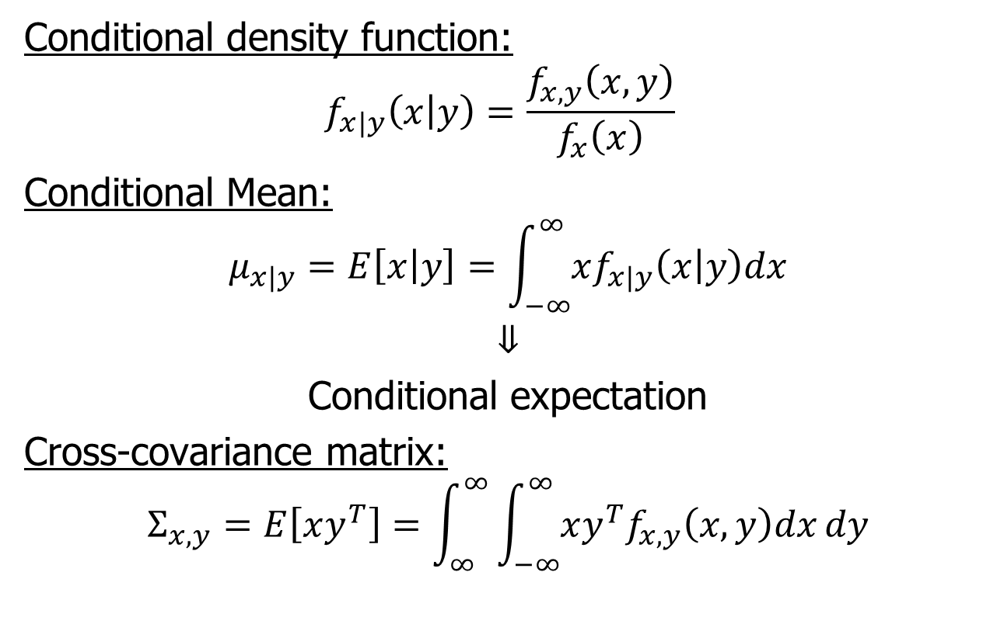
Statistical Characteristics of Two Random Processes
Conditional density function:
$$f_{x|y}\left(x | y\right)=\frac{f_{x,y}\left(x,y\right)}{f_{x}\left(x\right)}$$
Conditional Mean:
$$μ_{x|y}=E\left[x | y\right]=\int_{−∞}^{∞}{xf_{x|y}\left(x | y\right)dx}$$
$$⇓$$
Conditional expectation
Cross-covariance matrix:
$$Σ_{x,y}=E\left[xy^{T}\right]=\int_{∞}^{∞}{\int_{−∞}^{∞}{xy^{T}f_{x,y}\left(x,y\right)dx}dy}$$

Slide 14
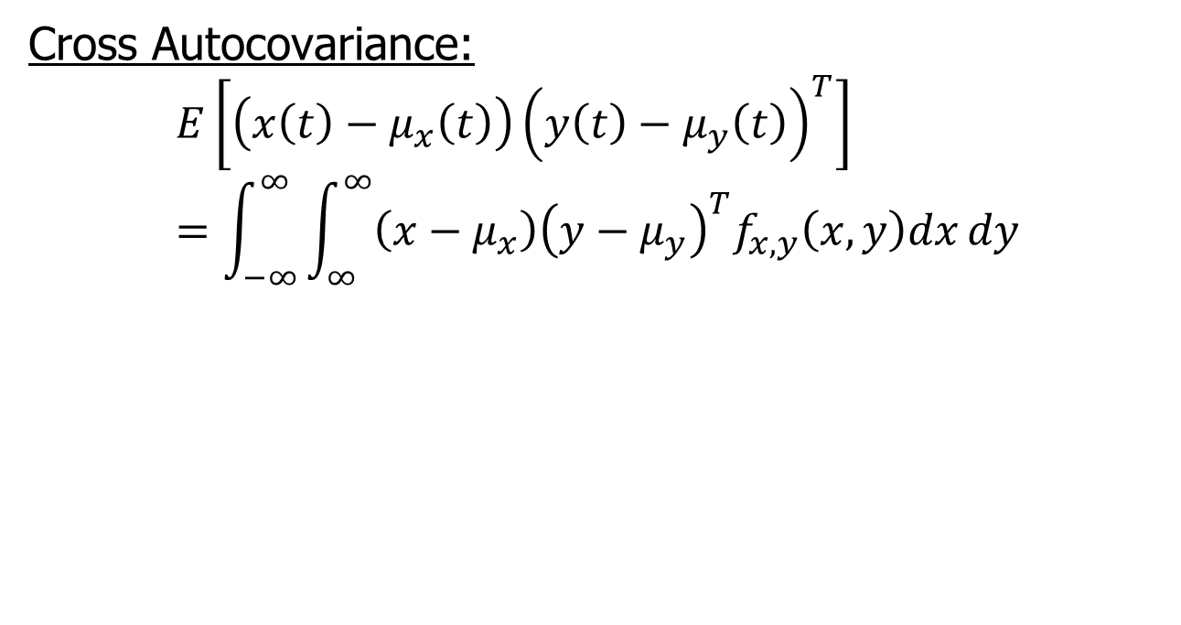
Cross Autocovariance
Cross Autocovariance:
$$E\left[\left(x\left(t\right)−μ_{x}\left(t\right)\right){\left(y\left(t\right)−μ_{y}\left(t\right)\right)}^{T}\right]=\int_{−∞}^{∞}{\int_{∞}^{∞}{\left(x−μ_{x}\right){\left(y−μ_{y}\right)}^{T}f_{x,y}\left(x,y\right)dx}dy}$$

Slide 15
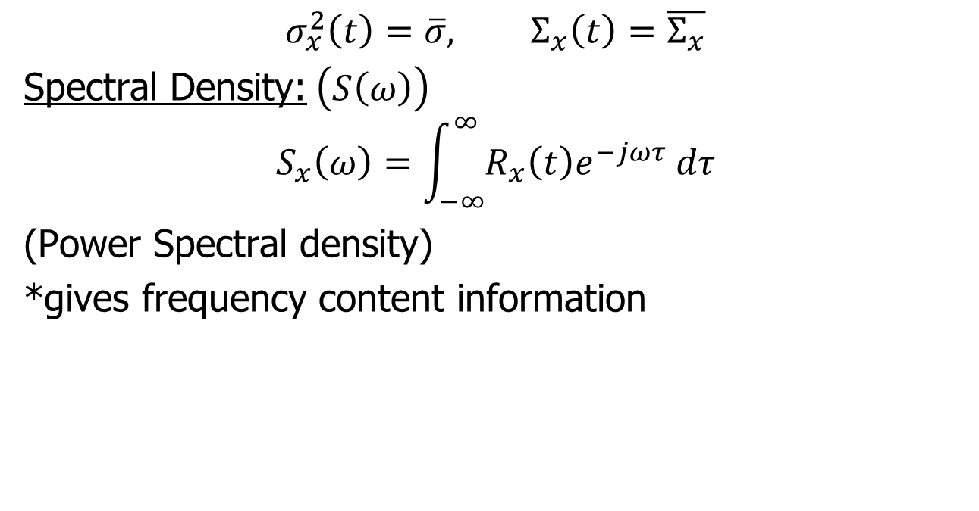
Spectral Density
$$σ_{x}^{2}\left(t\right)=\overline{σ}, Σ_{x}\left(t\right)=\overline{Σ_{x}}$$
Spectral Density:$\left(S\left(ω\right)\right)$
$$S_{x}\left(ω\right)=\int_{−∞}^{∞}{R_{x}\left(t\right)e^{−jωτ} dτ}$$
(Power Spectral density)
*gives frequency content information

Slide 16
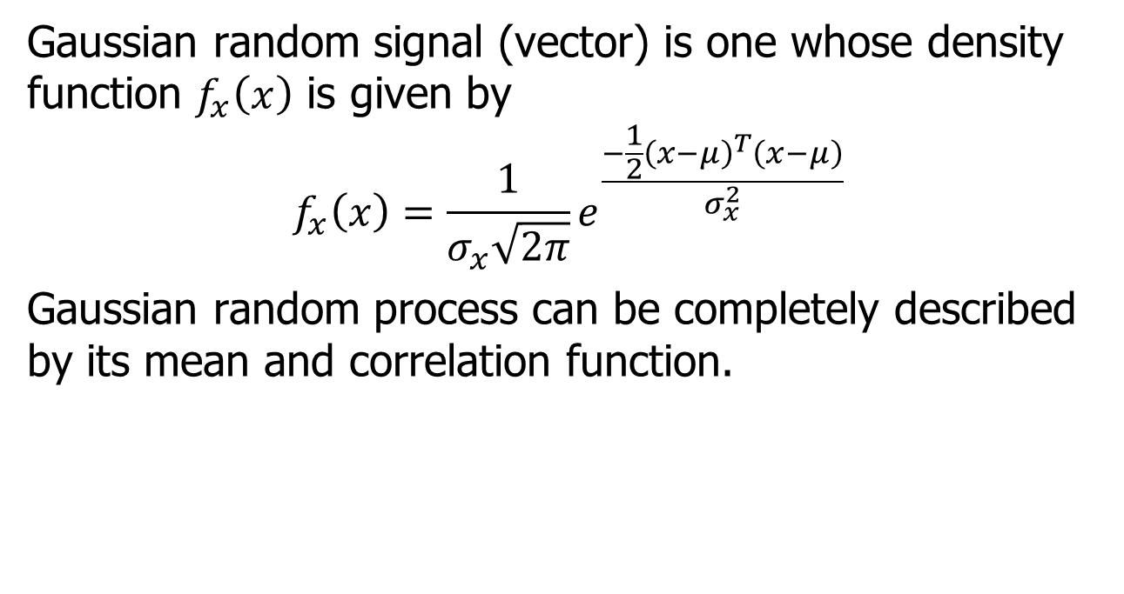
Gaussian Random Process
Gaussian random signal (vector) is one whose density function $f_{x}\left(x\right)$ is given by
$$f_{x}\left(x\right)=\frac{1}{σ_{x}\sqrt{2π}}e^{\frac{−\frac{1}{2}{\left(x−μ\right)}^{T}\left(x−μ\right)}{σ_{x}^{2}}}$$
Gaussian random process can be completely described by its mean and correlation function.

Slide 17
Gaussian Process
Gaussian random process is a good model for signals in control systems.
White Noise:
Random process with zero mean and zero correlation (rapid unpredictable variation).

Slide 18
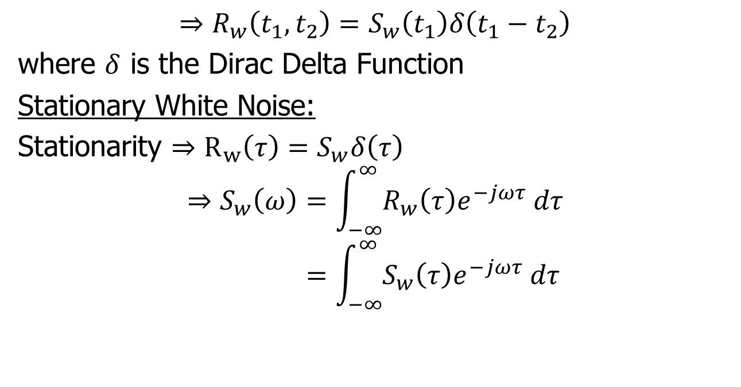
Gaussian Process
$$⇒R_{w}\left(t_{1},t_{2}\right)=S_{w}\left(t_{1}\right)δ\left(t_{1}−t_{2}\right)$$
where $δ$ is the Dirac Delta Function
Stationary White Noise:
Stationarity $⇒R_{w}\left(τ\right)=S_{w}δ\left(τ\right)$
$$⇒S_{w}\left(ω\right)=\int_{−∞}^{∞}{R_{w}\left(τ\right)e^{−jωτ} dτ} \\ =\int_{−∞}^{∞}{S_{w}\left(τ\right)e^{−jωτ} dτ}$$

Slide 19








Spectral Density
$$S_{w}\left(ω\right)=S_{w}=constant over all ω$$
$$S_{y}$$
$$S_{w}$$
$$⇒$$
Linear
System
$$ω$$
$$ω$$
$$ω$$

Slide 20

Response of Linear Systems to White Noise
We will use white noise model for both disturbance input and measurement noise.
Random
signal
Random
Signal
$$P\left(s\right)$$

Slide 21
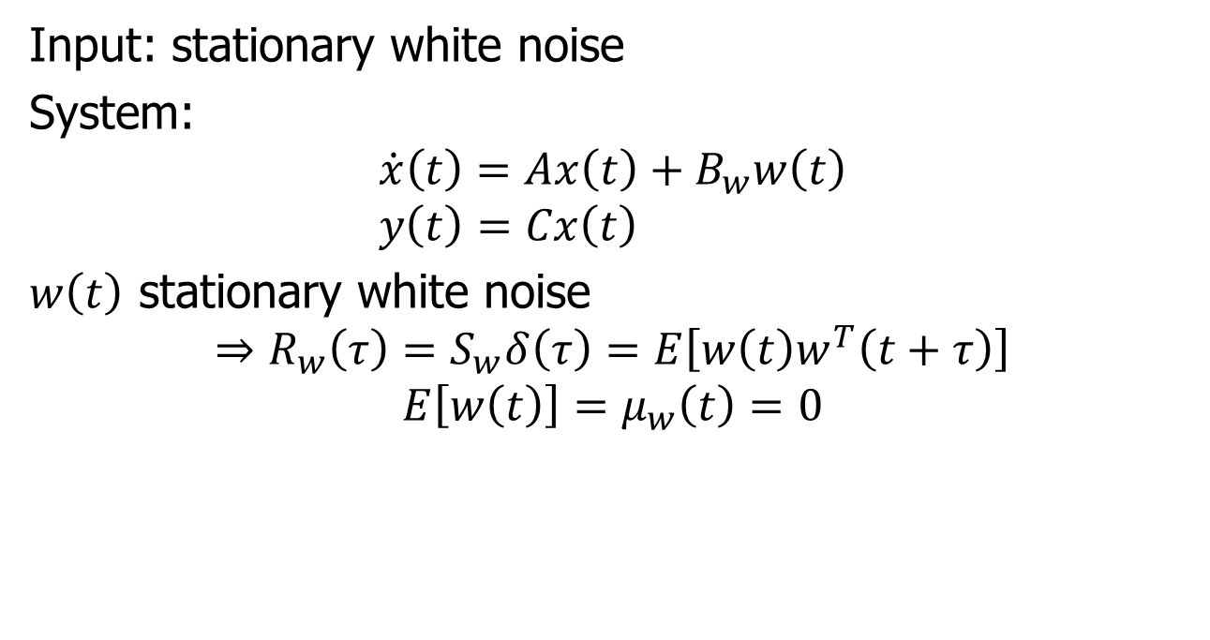
Linear System Response
Input: stationary white noise
System:
$$\dot{x}\left(t\right)=Ax\left(t\right)+B_{w}w\left(t\right) \\ y\left(t\right)=Cx\left(t\right)$$
$w\left(t\right)$ stationary white noise
$$⇒R_{w}\left(τ\right)=S_{w}δ\left(τ\right)=E\left[w\left(t\right)w^{T}\left(t+τ\right)\right]$$
$$E\left[w\left(t\right)\right]=μ_{w}\left(t\right)=0$$

Slide 22
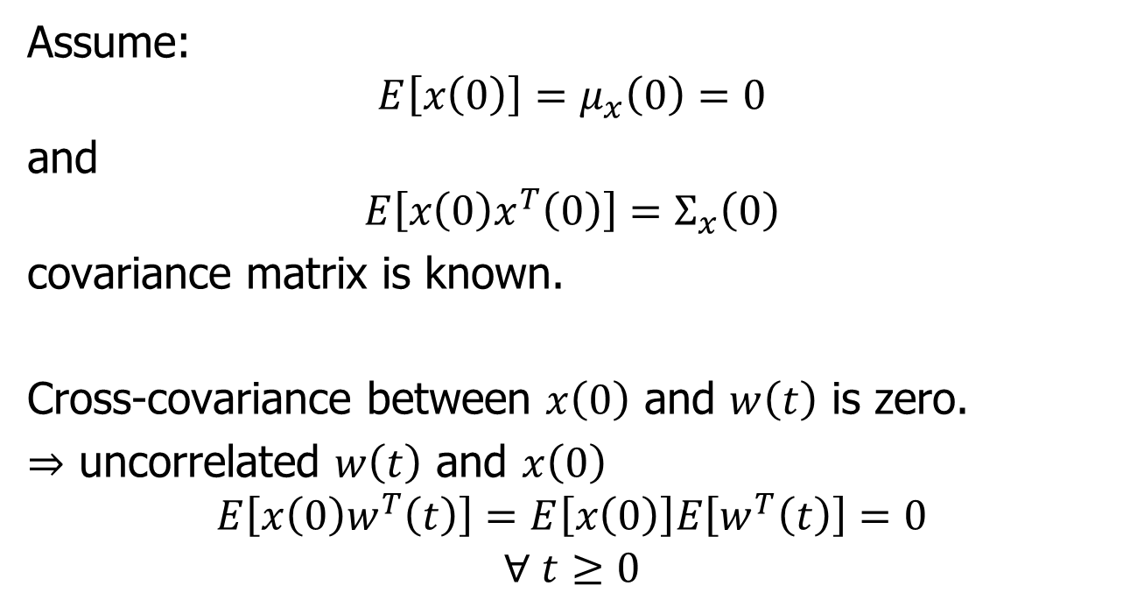
Linear System Response
Assume:
$$E\left[x\left(0\right)\right]=μ_{x}\left(0\right)=0$$
and
$$E\left[x\left(0\right)x^{T}\left(0\right)\right]=Σ_{x}\left(0\right)$$
covariance matrix is known.
Cross-covariance between $x\left(0\right)$ and $w\left(t\right)$ is zero.
$⇒$ uncorrelated $w\left(t\right)$ and $x\left(0\right)$
$$E\left[x\left(0\right)w^{T}\left(t\right)\right]=E\left[x\left(0\right)\right]E\left[w^{T}\left(t\right)\right]=0$$
$$∀ t≥0$$

Slide 23
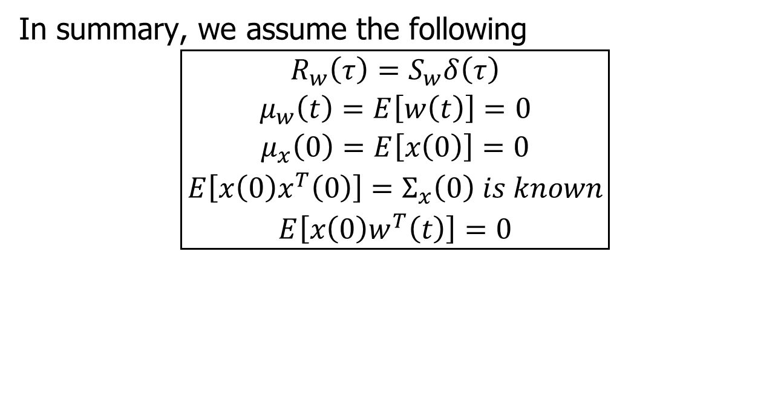
Assumptions
In summary, we assume the following
$$\boxed{\begin{aligned}R_{w}\left(τ\right)=S_{w}δ\left(τ\right) \\ μ_{w}\left(t\right)=E\left[w\left(t\right)\right]=0 \\ μ_{x}\left(0\right)=E\left[x\left(0\right)\right]=0 \\ E\left[x\left(0\right)x^{T}\left(0\right)\right]=Σ_{x}\left(0\right) is known \\ E\left[x\left(0\right)w^{T}\left(t\right)\right]=0\end{aligned}}$$

