Slide 1
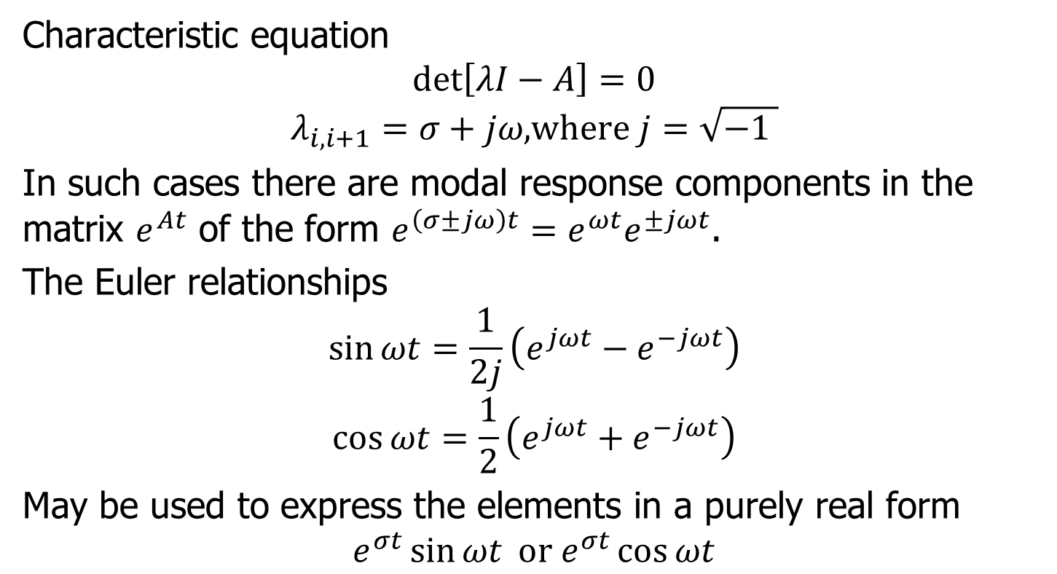
System with Complex Eigenvalues
Characteristic equation
$$\det\left[λI−A\right]=0$$
$$λ_{i,i+1}=σ+jω\text{,}\text{where} j=\sqrt{−1 }$$
In such cases there are modal response components in the matrix $e^{At}$ of the form $e^{\left(σ±jω\right)t}=e^{ωt}e^{±jωt}$.
The Euler relationships
$$\sin{ωt}=\frac{1}{2j}\left(e^{jωt}−e^{−jωt}\right)$$
$$\cos{ωt}=\frac{1}{2}\left(e^{jωt}+e^{−jωt}\right)$$
May be used to express the elements in a purely real form
$$e^{σt}\sin{ωt} \text{or} e^{σt}\cos{ωt}$$

Slide 2



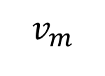
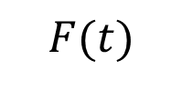
Example
Determine the state transition matrix for the undamped mechanical oscillator, with a mass $m=1kg$ suspended on a spring with stiffness $K=100N/m$, as shown
$$v_{m}$$
$$m$$
$$K$$
$$F(t)$$

