Slide 1
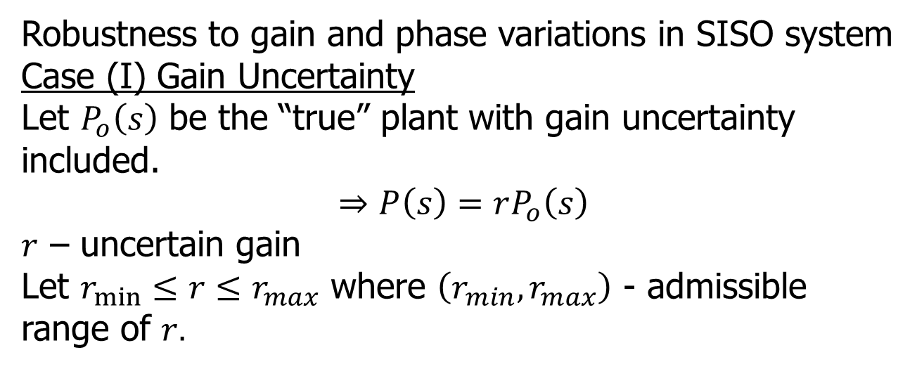
Uncertainty and Robustness
Robustness to gain and phase variations in SISO system
Case (I) Gain Uncertainty
Let $P_{o}\left(s\right)$ be the “true” plant with gain uncertainty included.
$$⇒P\left(s\right)=rP_{o}\left(s\right)$$
$r$ – uncertain gain
Let $r_{min}≤r≤r_{max}$ where $\left(r_{min}, r_{max}\right)$ - admissible range of $r.$

Slide 2

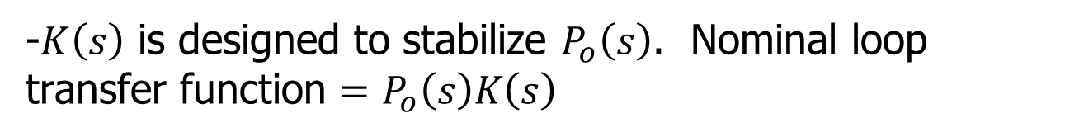
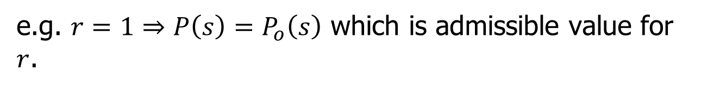



Uncertainty and Robustness
e.g. $r=1⇒P\left(s\right)=P_{o}\left(s\right)$ which is admissible value for $r$.
$$P\left(s\right)$$
+
$$P_{o}\left(s\right)$$
$$r$$
-
$$K\left(s\right)$$
-$K\left(s\right)$ is designed to stabilize $P_{o}\left(s\right)$. Nominal loop transfer function $=P_{o}\left(s\right)K\left(s\right)$

Slide 3
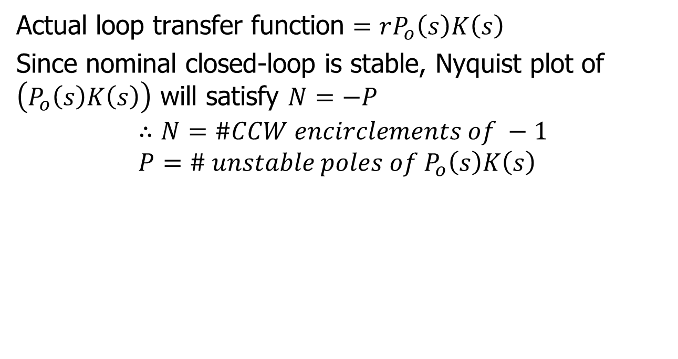
Uncertainty and Robustness
Actual loop transfer function $=rP_{o}\left(s\right)K\left(s\right)$
Since nominal closed-loop is stable, Nyquist plot of $\left(P_{o}\left(s\right)K\left(s\right)\right)$ will satisfy $N=−P$
$$∴N=\#CCW encirclements of −1 \\ P=\# unstable poles of P_{o}\left(s\right)K\left(s\right)$$

Slide 4
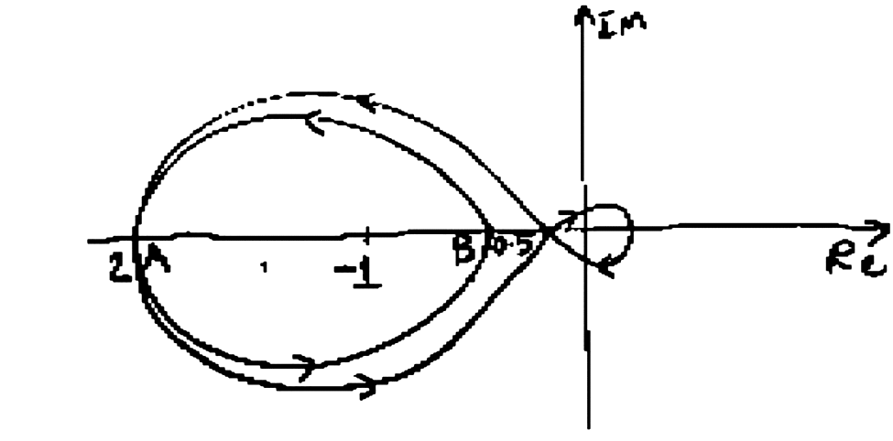
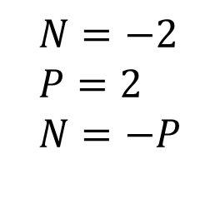
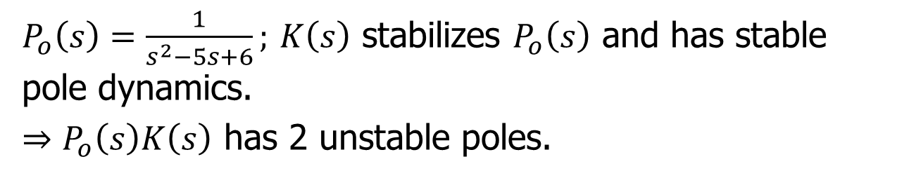
Example
$P_{o}\left(s\right)=\frac{1}{s^{2}−5s+6};$ $K\left(s\right)$ stabilizes $P_{o}\left(s\right)$ and has stable pole dynamics.
$⇒P_{o}\left(s\right)K\left(s\right)$ has 2 unstable poles.
$$N=−2 \\ P=2 \\ N=−P$$

Slide 5
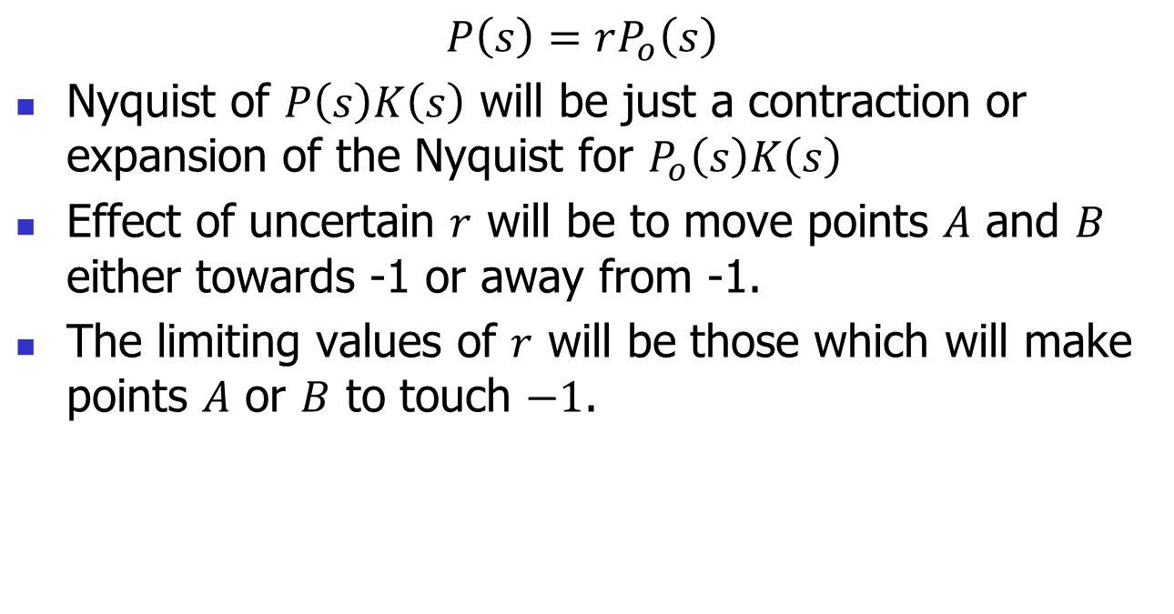
Example (contd.)
$$P\left(s\right)=rP_{o}\left(s\right)$$
Nyquist of $P\left(s\right)K\left(s\right)$ will be just a contraction or expansion of the Nyquist for $P_{o}\left(s\right)K\left(s\right)$
Effect of uncertain $r$ will be to move points $A$ and $B$ either towards -1 or away from -1.
The limiting values of $r$ will be those which will make points $A$ or $B$ to touch $−1$.

Slide 6
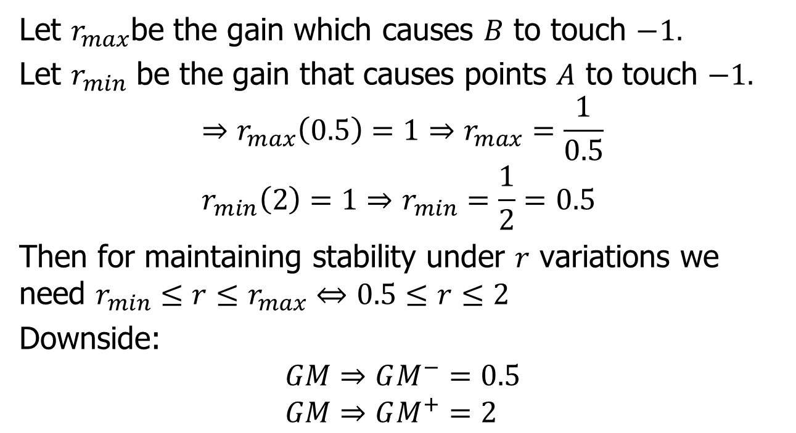
Example (contd.)
Let $r_{max}$be the gain which causes $B$ to touch $−1.$
Let $r_{min}$ be the gain that causes points $A$ to touch $−1.$
$$⇒r_{max}\left(0.5\right)=1⇒r_{max}=\frac{1}{0.5} \\ r_{min}\left(2\right)=1⇒r_{min}=\frac{1}{2}=0.5$$
Then for maintaining stability under $r$ variations we need $r_{min}≤r≤r_{max}⇔0.5≤r≤2$
Downside:
$$GM⇒GM^{−}=0.5 \\ GM⇒GM^{+}=2$$

Slide 7
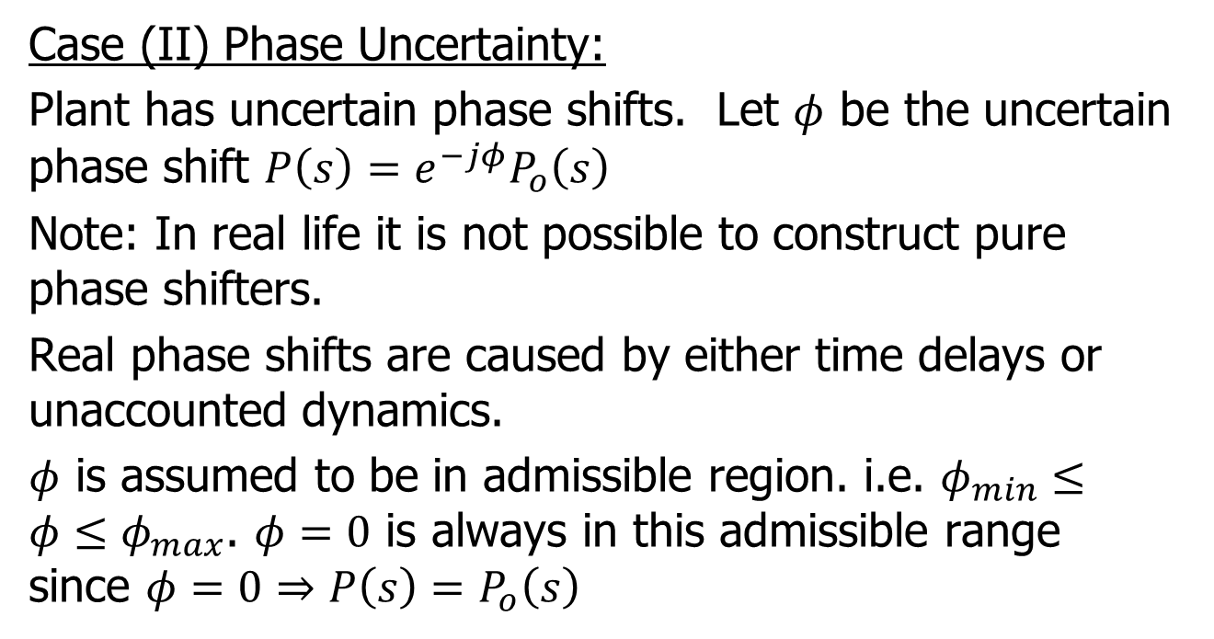
Phase uncertainty
Case (II) Phase Uncertainty:
Plant has uncertain phase shifts. Let $φ$ be the uncertain phase shift $P\left(s\right)=e^{−jφ}P_{o}\left(s\right)$
Note: In real life it is not possible to construct pure phase shifters.
Real phase shifts are caused by either time delays or unaccounted dynamics.
$φ$ is assumed to be in admissible region. i.e. $φ_{min}≤φ≤φ_{max}$. $φ=0$ is always in this admissible range since $φ=0⇒P\left(s\right)=P_{o}\left(s\right)$

Slide 8
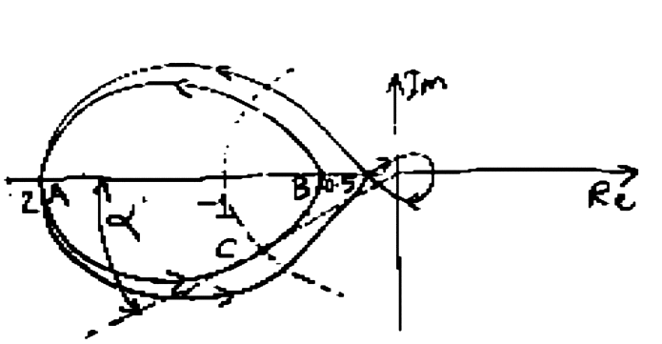

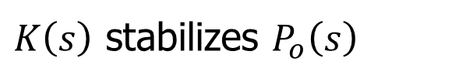



Phase uncertainty
$$P\left(s\right)$$
+
$$P_{o}\left(s\right)$$
$$e^{−jφ}$$
-
$$K\left(s\right)$$
$K\left(s\right)$ stabilizes $P_{o}\left(s\right)$

Slide 9
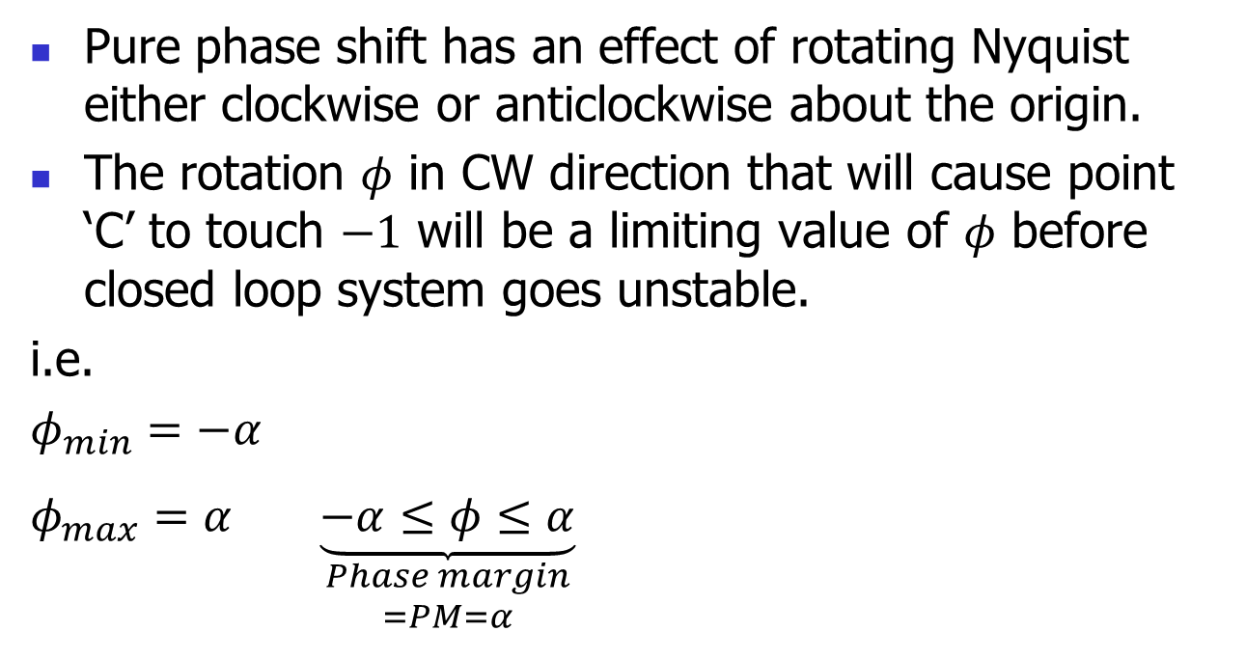
Phase uncertainty
Pure phase shift has an effect of rotating Nyquist either clockwise or anticlockwise about the origin.
The rotation $φ$ in CW direction that will cause point ‘C’ to touch $−1$ will be a limiting value of $φ$ before closed loop system goes unstable.
i.e.
$φ_{min}=−α$
$φ_{max}=α$ $\underset{\begin{aligned}Phase margin \\ =PM=α\end{aligned}}{\underbrace{−α≤φ≤α}}$

Slide 10
Unstructured uncertainty models
Gain and phase changes are a special case of uncertainty.
Another way to model plant uncertainty is to consider a “perturbation” to the nominal plant which can be bounded above by a simple transfer function.

Slide 11
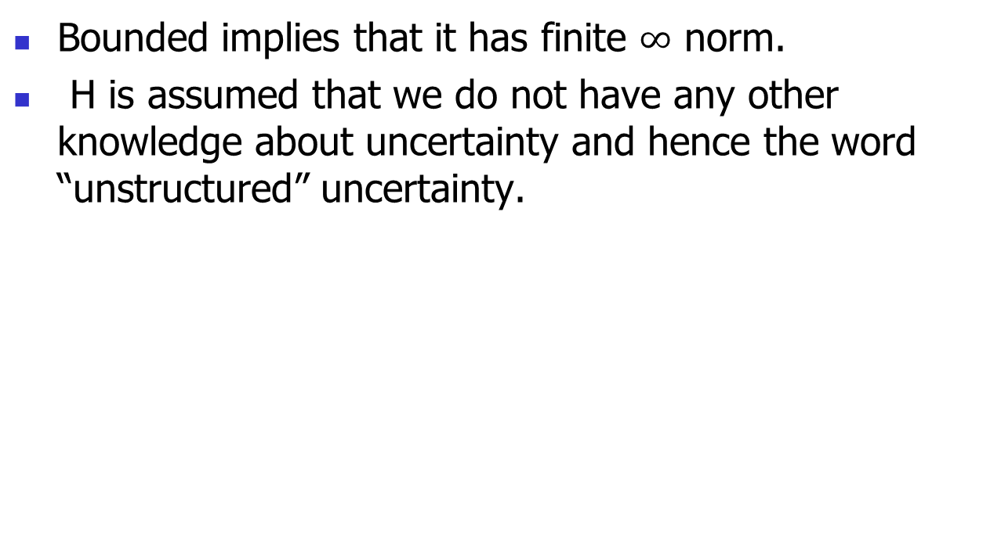
Uncertainty models
Bounded implies that it has finite $∞$ norm.
H is assumed that we do not have any other knowledge about uncertainty and hence the word “unstructured” uncertainty.

Slide 12

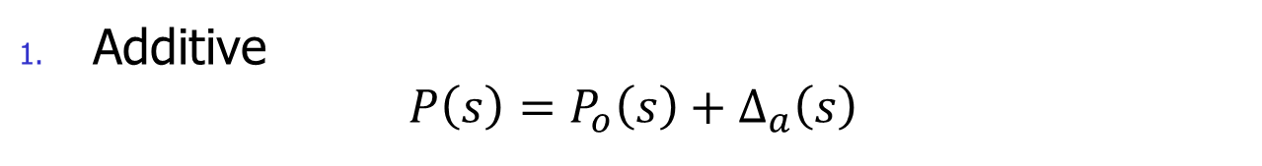



Types of uncertainties
Additive
$$P\left(s\right)=P_{o}\left(s\right)+Δ_{a}\left(s\right)$$
$$Δ_{a}\left(s\right)$$
$$P\left(s\right)$$
+
+
$$P_{o}\left(s\right)$$
+
-
$$K\left(s\right)$$

Slide 13

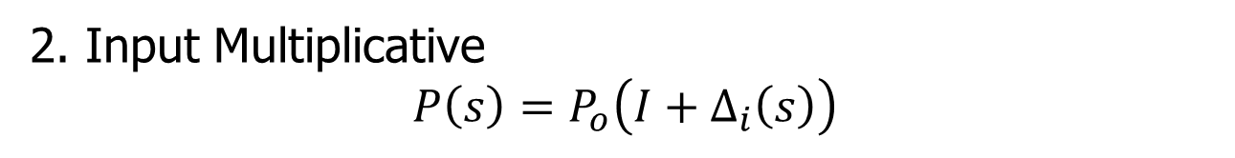



Multiplicative uncertainty
2. Input Multiplicative
$$P\left(s\right)=P_{o}\left(I+Δ_{i}\left(s\right)\right)$$
$$Δ_{i}\left(s\right)$$
$$P\left(s\right)$$
+
+
+
$$P_{o}\left(s\right)$$
-
$$K\left(s\right)$$

Slide 14
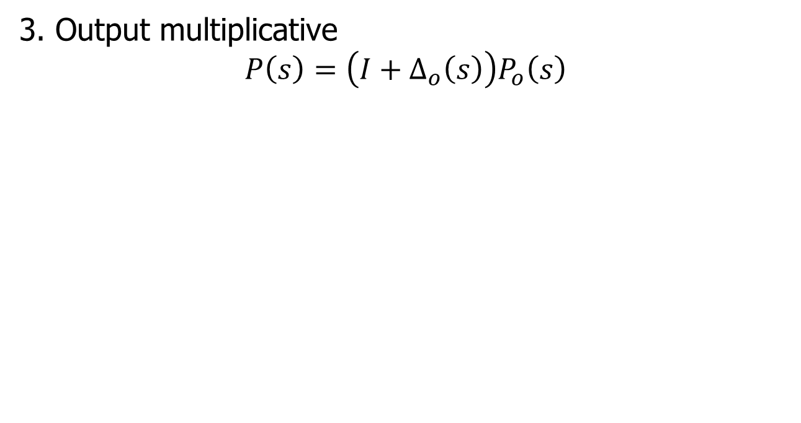



Multiplicative uncertainty
3. Output multiplicative
$$P\left(s\right)=\left(I+Δ_{o}\left(s\right)\right)P_{o}\left(s\right)$$
$$P\left(s\right)$$
$$Δ_{o}\left(s\right)$$
+
+
+
$$P_{o}\left(s\right)$$
-
$$K\left(s\right)$$

Slide 15


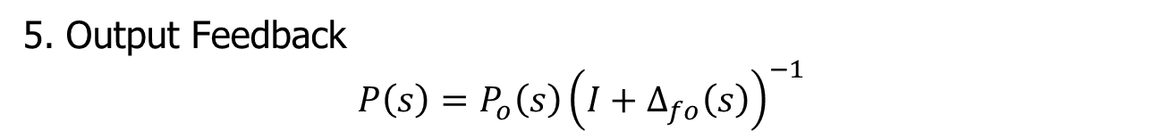
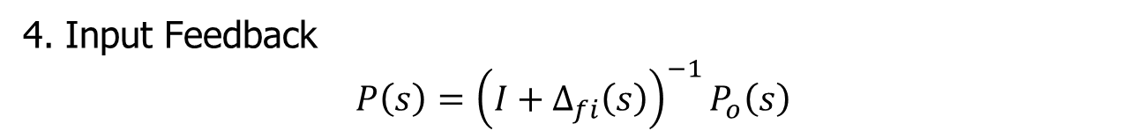






Feedback uncertainty
4. Input Feedback
$$P\left(s\right)={\left(I+Δ_{fi}\left(s\right)\right)}^{−1}P_{o}\left(s\right)$$
$$Δ_{fi}\left(s\right)$$
$$P\left(s\right)$$
+
+
-
$$P_{o}\left(s\right)$$
-
$$K\left(s\right)$$
5. Output Feedback
$$P\left(s\right)={P_{o}\left(s\right)\left(I+Δ_{fo}\left(s\right)\right)}^{−1}$$
$$P\left(s\right)$$
-
$$Δ_{fo}\left(s\right)$$
+
$$P_{o}\left(s\right)$$
+
-
$$K\left(s\right)$$

Slide 16
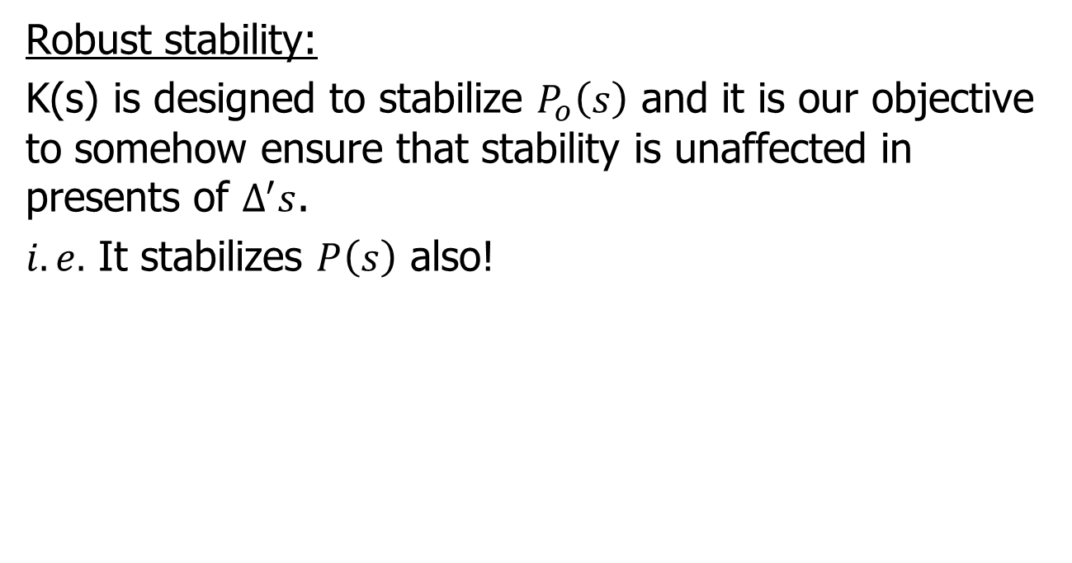
Robust Stability
Robust stability:
K(s) is designed to stabilize $P_{o}\left(s\right)$ and it is our objective to somehow ensure that stability is unaffected in presents of $Δ^{′}s$.
$i.e.$ It stabilizes $P\left(s\right)$ also!

Slide 17
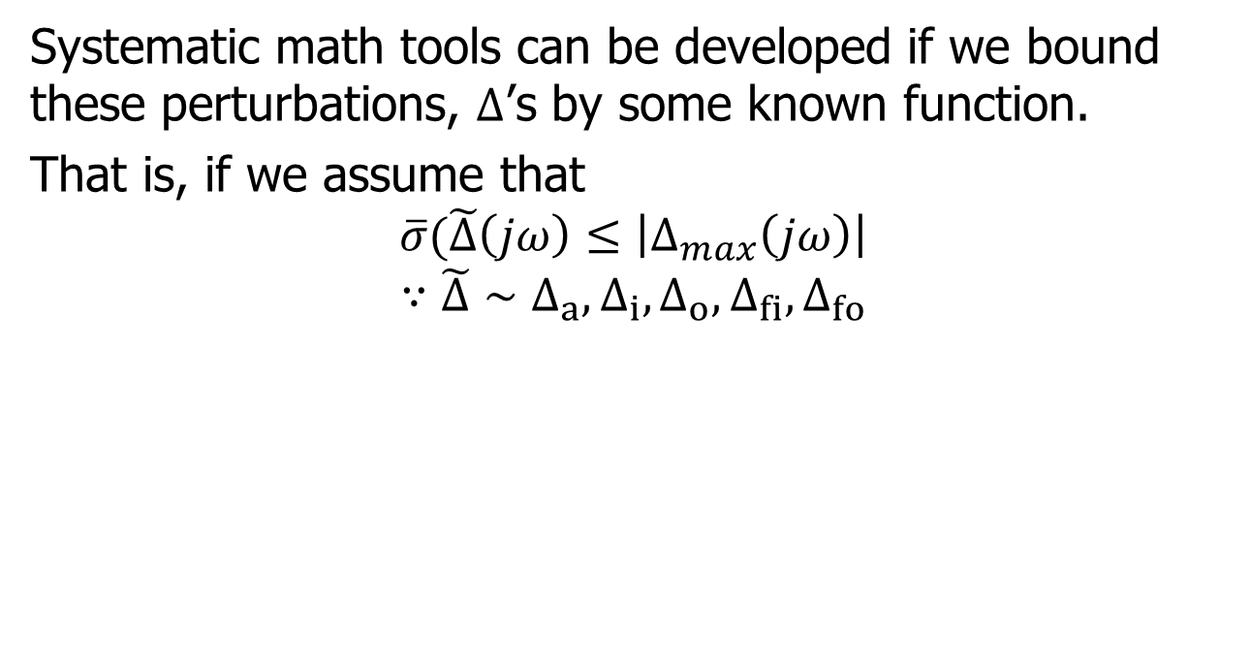
Robust Stability
Systematic math tools can be developed if we bound these perturbations, $Δ$’s by some known function.
That is, if we assume that
$$\overline{σ}(\tilde{Δ}\left(jω\right)≤\left|Δ_{max}\left(jω\right)\right|$$
$$∵\tilde{Δ}∼Δ_{a},Δ_{i},Δ_{o},Δ_{fi},Δ_{fo}$$

Slide 18
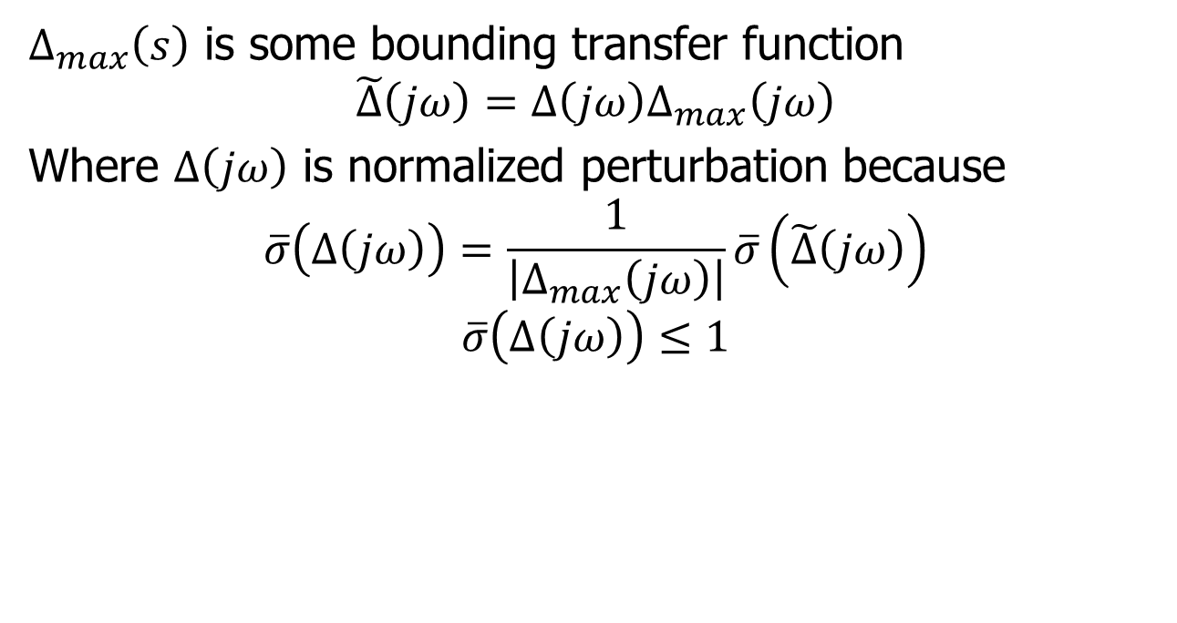
Robust Stability
$Δ_{max}\left(s\right)$ is some bounding transfer function
$$\tilde{Δ}\left(jω\right)=Δ\left(jω\right)Δ_{max}\left(jω\right)$$
Where $Δ\left(jω\right)$ is normalized perturbation because
$$\overline{σ}\left(Δ\left(jω\right)\right)=\frac{1}{\left|Δ_{max}\left(jω\right)\right|}\overline{σ}\left(\tilde{Δ}\left(jω\right)\right)$$
$$\overline{σ}\left(Δ\left(jω\right)\right)≤1$$

Slide 19
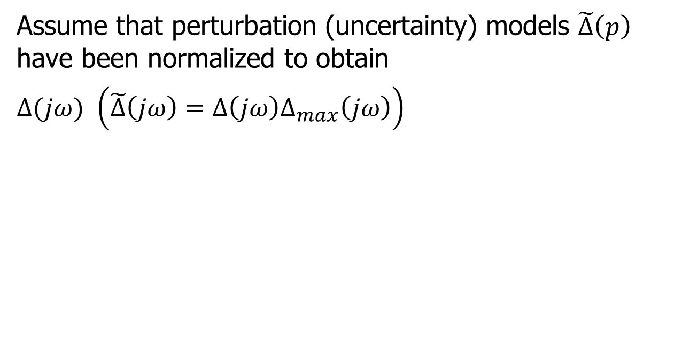
Standard form
Assume that perturbation (uncertainty) models $\tilde{Δ}\left(p\right)$ have been normalized to obtain
$Δ(jω)$ $\left(\tilde{Δ}\left(jω\right)=Δ\left(jω\right)Δ_{max}\left(jω\right)\right)$

Slide 20
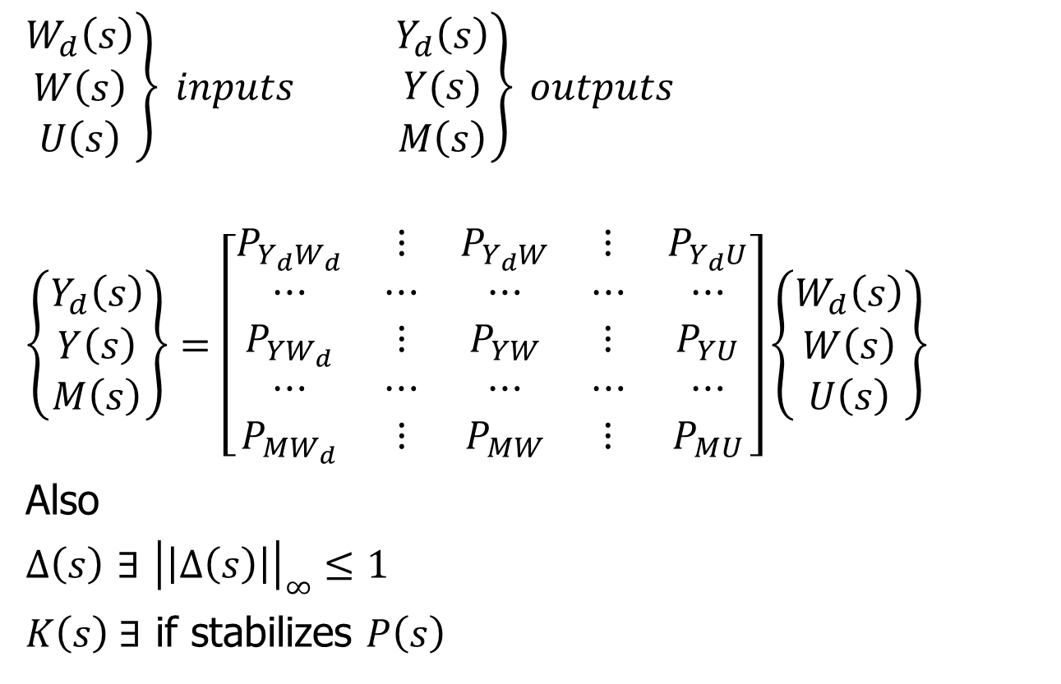
Standard form
$\left.\begin{matrix}W_{d}\left(s\right) \\ W\left(s\right) \\ U\left(s\right)\end{matrix}\right\} inputs$ $\left.\begin{matrix}Y_{d}\left(s\right) \\ Y(s) \\ M\left(s\right)\end{matrix}\right\} outputs$
$$\left\{\begin{matrix}Y_{d}\left(s\right) \\ Y\left(s\right) \\ M\left(s\right)\end{matrix}\right\}=\left[\begin{matrix}P_{Y_{d}W_{d}} & ⋮ & P_{Y_{d}W} & ⋮ & P_{Y_{d}U} \\ ⋯ & ⋯ & ⋯ & ⋯ & ⋯ \\ P_{YW_{d}} & ⋮ & P_{YW} & ⋮ & P_{YU} \\ ⋯ & ⋯ & ⋯ & ⋯ & ⋯ \\ P_{MW_{d}} & ⋮ & P_{MW} & ⋮ & P_{MU}\end{matrix}\right]\left\{\begin{matrix}W_{d}\left(s\right) \\ W\left(s\right) \\ U\left(s\right)\end{matrix}\right\}$$
Also
$Δ\left(s\right)$ $∃$ ${\left|\left|Δ\left(s\right)\right|\right|}_{∞}≤1$
$K\left(s\right) ∃$ if stabilizes $P\left(s\right)$

Slide 21









Standard form
In order to facilitate a uniform approach to robustness analysis, we will use a “standard” form of feedback control system
$$W_{d}\left(s\right)$$
$$Δ\left(s\right)$$
$$Y_{d}\left(s\right)$$
$$W\left(s\right)$$
$$P\left(s\right)$$
$$Y\left(s\right)$$
$$U\left(s\right)$$
$$M\left(s\right)$$
$$K\left(s\right)$$

