Slide 1
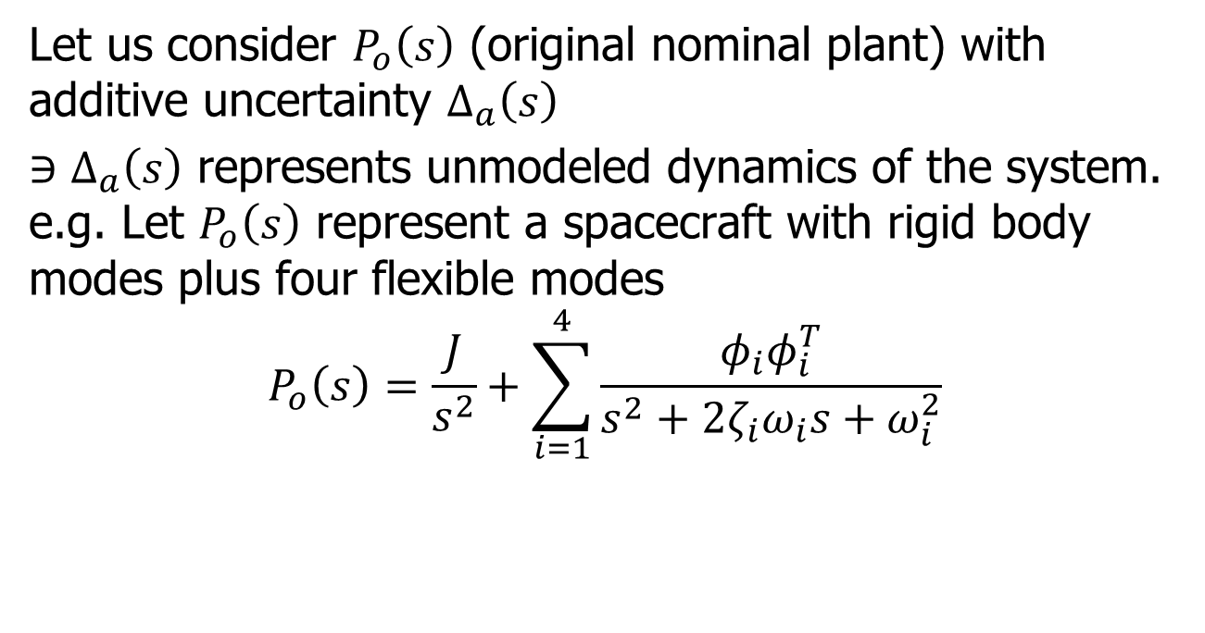
Normalized Uncertainty
Let us consider $P_{o}\left(s\right)$ (original nominal plant) with additive uncertainty $Δ_{a}\left(s\right)$
$∋Δ_{a}\left(s\right)$ represents unmodeled dynamics of the system. e.g. Let $P_{o}\left(s\right)$ represent a spacecraft with rigid body modes plus four flexible modes
$$P_{o}\left(s\right)=\frac{J}{s^{2}}+\sum_{i=1}^{4}{\frac{φ_{i}φ_{i}^{T}}{s^{2}+2ζ_{i}ω_{i}s+ω_{i}^{2}}}$$

Slide 2
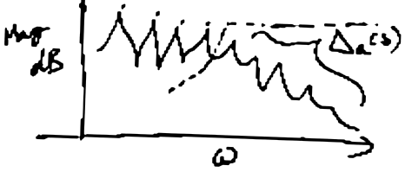

Normalizing Uncertainty
$$Δ_{a}\left(s\right)=\sum_{i=5}^{∞}{\frac{φ_{k}φ_{k}^{T}}{s^{2}+2ζ_{k}ω_{k}s+ω_{k}^{2}}}$$

Slide 3
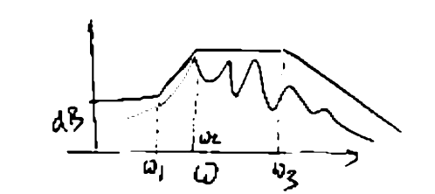
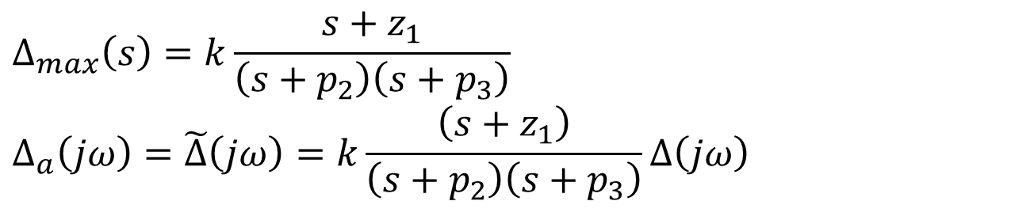


Normalizing Uncertainty
$$\left|Δ_{max}\left(jω\right)\right|$$
$$\left|Δ_{a}\left(jω\right)\right|$$
$$Δ_{max}\left(s\right)=k\frac{s+z_{1}}{\left(s+p_{2}\right)\left(s+p_{3}\right)}$$
$$Δ_{a}\left(jω\right)=\tilde{Δ}\left(jω\right)=k\frac{\left(s+z_{1}\right)}{\left(s+p_{2}\right)\left(s+p_{3}\right)}Δ\left(jω\right)$$

Slide 4














Additive Uncertainty Formulation
$$Δ_{a}\left(s\right)$$
+
+
$$P_{o}\left(s\right)$$
+
-
$$K\left(s\right)$$
$$⇓$$
$$Δ\left(s\right)$$
$$W_{d}\left(s\right)$$
$$Y_{d}\left(s\right)$$
$$Δ_{max}\left(s\right)$$
$$W\left(s\right)$$
+
+
+
$$P_{o}\left(s\right)$$
$$Y\left(s\right)$$
-
$$K\left(s\right)$$
$$U\left(s\right)$$
$$M\left(s\right)$$

Slide 5




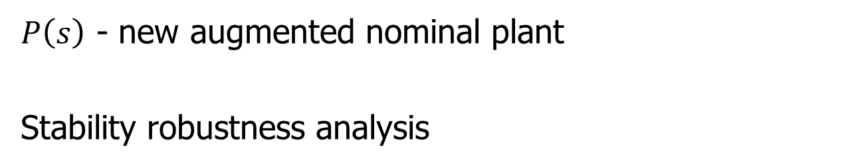





Augmented Plant
$P\left(s\right)$ - new augmented nominal plant
Stability robustness analysis
$$W_{d}$$
$$Δ\left(s\right)$$
$$Y_{d}$$
$$W$$
$$P\left(s\right)$$
$$Y$$
$$U$$
$$K\left(s\right)$$
$$M$$
Assumption $K\left(s\right)$ stabilizes $P\left(s\right)$

Slide 6
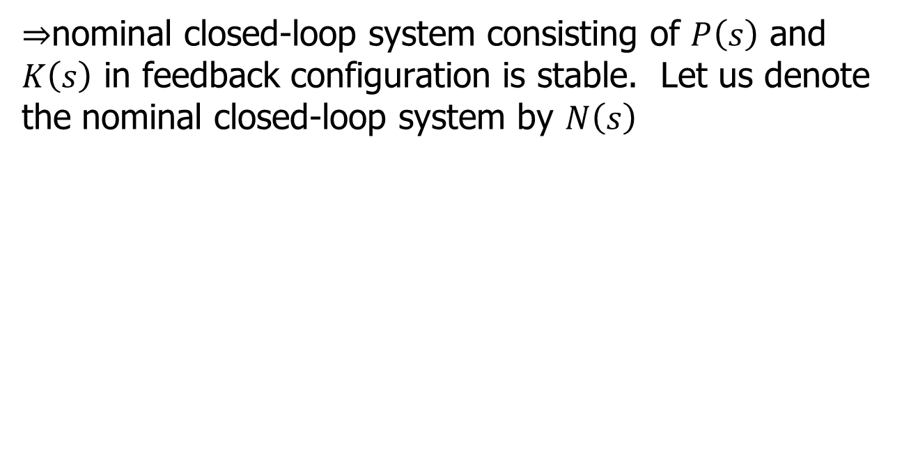
Augmented Plant
$⇒$nominal closed-loop system consisting of $P\left(s\right)$ and $K\left(s\right)$ in feedback configuration is stable. Let us denote the nominal closed-loop system by $N\left(s\right)$

Slide 7
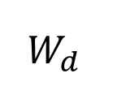
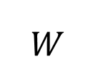

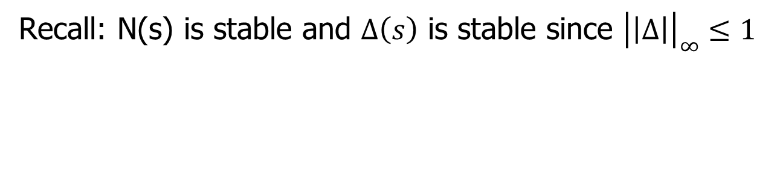
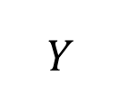

Robustness Condition
$$W_{d}$$
$$Δ\left(s\right)$$
$$Y_{d}$$
$$W$$
$$N\left(s\right)$$
$$Y$$
Recall: N(s) is stable and $Δ\left(s\right)$ is stable since ${\left|\left|Δ\right|\right|}_{∞}≤1$

Slide 8



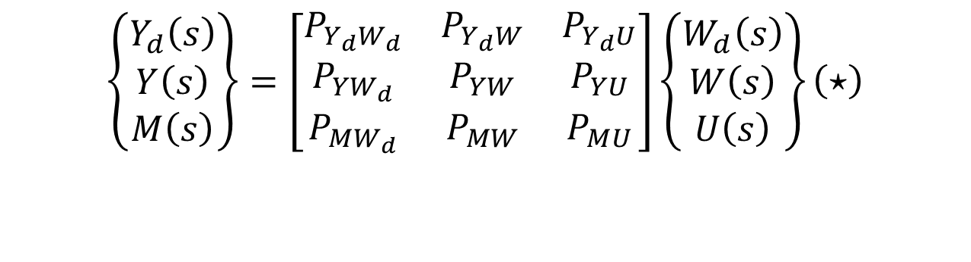






Generic Configuration
$$W_{d}\left(s\right)$$
$$Δ\left(s\right)$$
$$Y_{d}\left(s\right)$$
$$W\left(s\right)$$
$$P\left(s\right)$$
$$Y\left(s\right)$$
$$U\left(s\right)$$
$$M\left(s\right)$$
$$K\left(s\right)$$
$$\left\{\begin{matrix}Y_{d}\left(s\right) \\ Y\left(s\right) \\ M\left(s\right)\end{matrix}\right\}=\left[\begin{matrix}P_{Y_{d}W_{d}} & P_{Y_{d}W} & P_{Y_{d}U} \\ P_{YW_{d}} & P_{YW} & P_{YU} \\ P_{MW_{d}} & P_{MW} & P_{MU}\end{matrix}\right]\left\{\begin{matrix}W_{d}\left(s\right) \\ W\left(s\right) \\ U\left(s\right)\end{matrix}\right\}\left(⋆\right)$$

Slide 9

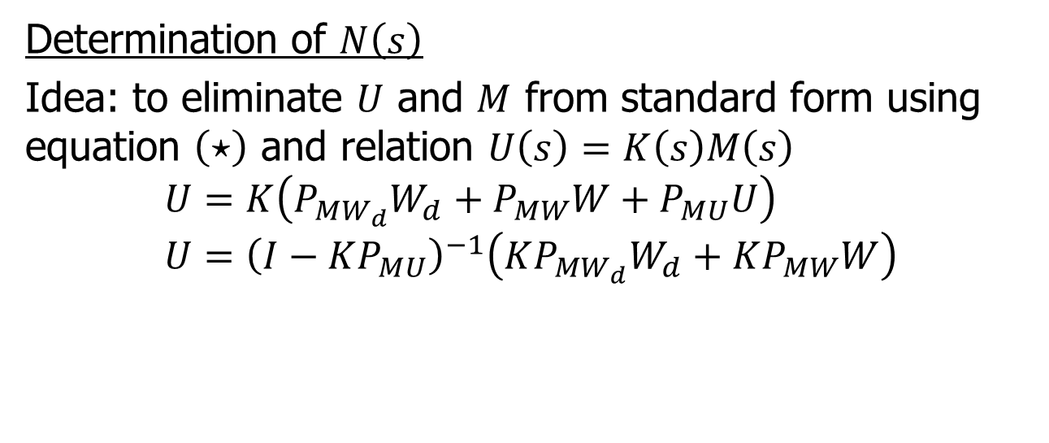





N-$Δ$ Configuration
$$W_{d}$$
$$Δ\left(s\right)$$
$$Y_{d}$$
$$W$$
$$N\left(s\right)$$
$$Y$$
Determination of $N\left(s\right)$
Idea: to eliminate $U$ and $M$ from standard form using equation $\left(⋆\right)$ and relation $U\left(s\right)=K\left(s\right)M\left(s\right)$
$$U=K\left(P_{MW_{d}}W_{d}+P_{MW}W+P_{MU}U\right) \\ U={\left(I−KP_{MU}\right)}^{−1}\left(KP_{MW_{d}}W_{d}+KP_{MW}W\right)$$

Slide 10
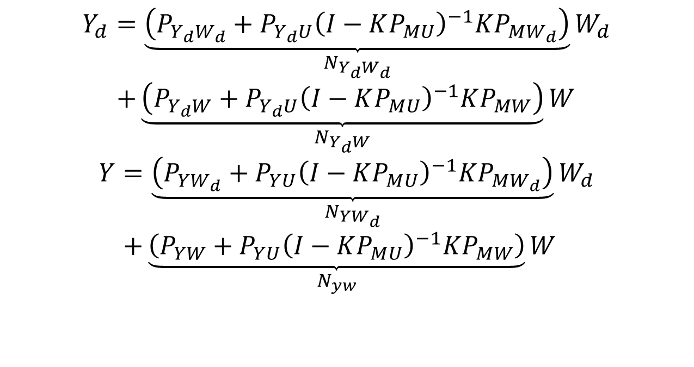
N-$Δ$ Configuration
$$Y_{d}=\underset{N_{Y_{d}W_{d}}}{\underbrace{\left(P_{Y_{d}W_{d}}+P_{Y_{d}U}{\left(I−KP_{MU}\right)}^{−1}KP_{MW_{d}}\right)}}W_{d} \\ +\underset{N_{Y_{d}W}}{\underbrace{\left(P_{Y_{d}W}+P_{Y_{d}U}{\left(I−KP_{MU}\right)}^{−1}KP_{MW}\right)}}W$$
$$Y=\underset{N_{YW_{d}}}{\underbrace{\left(P_{YW_{d}}+P_{YU}{\left(I−KP_{MU}\right)}^{−1}KP_{MW_{d}}\right)}}W_{d} \\ +\underset{N_{yw}}{\underbrace{\left(P_{YW}+P_{YU}{\left(I−KP_{MU}\right)}^{−1}KP_{MW}\right)}}W$$

Slide 11
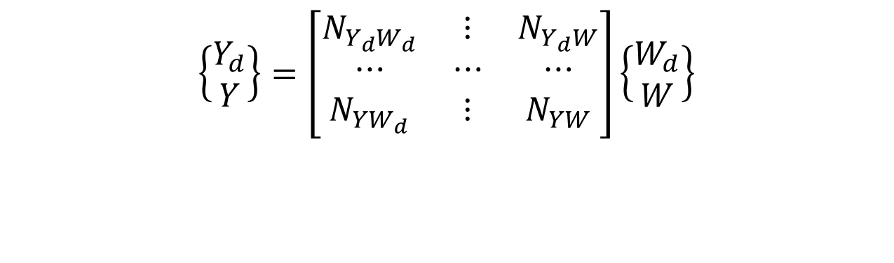
N-$Δ$ Configuration
$$W_{d}$$
$$Δ\left(s\right)$$
$$Y_{d}$$
$$W$$
$$N\left(s\right)$$
$$Y$$
$$\left\{\begin{matrix}Y_{d} \\ Y\end{matrix}\right\}=\left[\begin{matrix}N_{Y_{d}W_{d}} & ⋮ & N_{Y_{d}W} \\ ⋯ & ⋯ & ⋯ \\ N_{YW_{d}} & ⋮ & N_{YW}\end{matrix}\right]\left\{\begin{matrix}W_{d} \\ W\end{matrix}\right\}$$

Slide 12



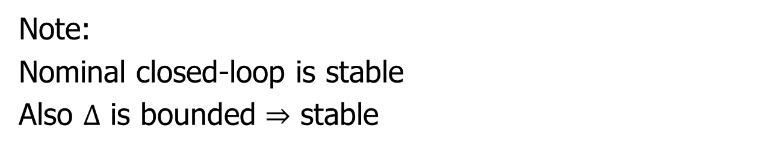














N-$Δ$ Configuration
$$Δ\left(s\right)$$
$$W_{d}$$
$$Y_{d}$$
$$N_{Y_{d},W_{d}}$$
$$+$$
$$Δ$$
$$+$$
$$≈$$
$$N_{Y,W_{d}}$$
$$N$$
$$N$$
$N_{Y_{d},W}$
$$+$$
$$W$$
$$N_{Y,W}$$
$$+$$
$$Y$$
Note:
Nominal closed-loop is stable
Also $Δ$ is bounded $⇒$ stable

Slide 13




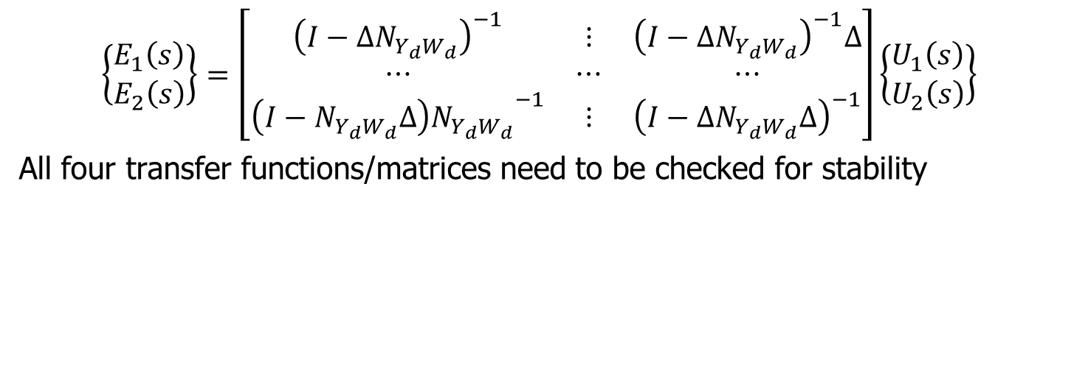






Stability Condition
$$u_{1}$$
$$e_{1}$$
$$+$$
$$N_{Y_{d},W_{d}}$$
$$+$$
$$e_{2}$$
$$+$$
$$Δ\left(s\right)$$
$$u_{2}$$
$$+$$
$$\left\{\begin{matrix}E_{1}\left(s\right) \\ E_{2}\left(s\right)\end{matrix}\right\}=\left[\begin{matrix}{\left(I−ΔN_{Y_{d}W_{d}}\right)}^{−1} & ⋮ & {\left(I−ΔN_{Y_{d}W_{d}}\right)}^{−1}Δ \\ ⋯ & ⋯ & ⋯ \\ {\left(I−N_{Y_{d}W_{d}}Δ\right)N_{Y_{d}W_{d}}}^{−1} & ⋮ & {\left(I−ΔN_{Y_{d}W_{d}}Δ\right)}^{−1}\end{matrix}\right]\left\{\begin{matrix}U_{1}\left(s\right) \\ U_{2}\left(s\right)\end{matrix}\right\}$$
All four transfer functions/matrices need to be checked for stability

Slide 14
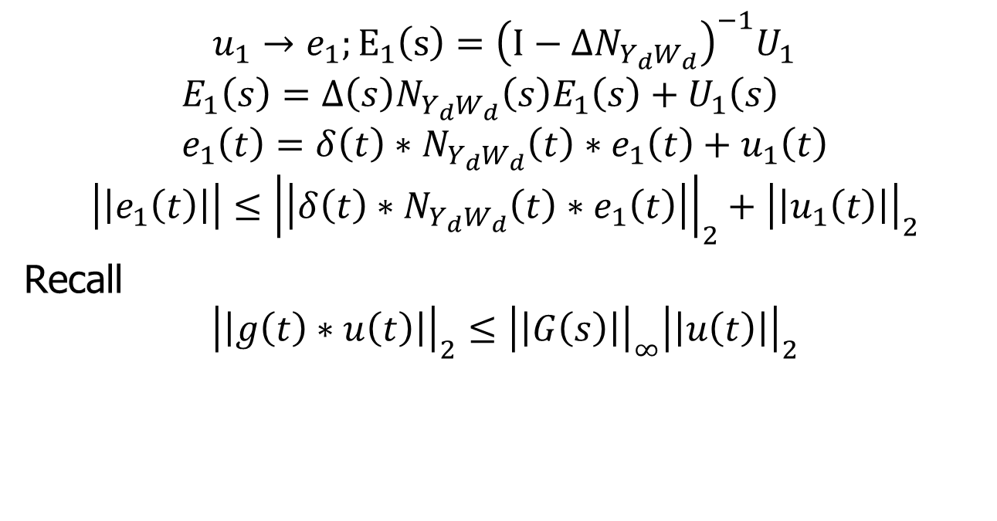
Stability Condition
$$u_{1}→e_{1};E_{1}\left(s\right)={\left(I−ΔN_{Y_{d}W_{d}}\right)}^{−1}U_{1}$$
$$E_{1}\left(s\right)=Δ\left(s\right)N_{Y_{d}W_{d}}\left(s\right)E_{1}\left(s\right)+U_{1}\left(s\right) \\ e_{1}\left(t\right)=δ\left(t\right)∗N_{Y_{d}W_{d}}\left(t\right)∗e_{1}\left(t\right)+u_{1}\left(t\right)$$
$$\left|\left|e_{1}\left(t\right)\right|\right|≤{\left|\left|δ\left(t\right)∗N_{Y_{d}W_{d}}\left(t\right)∗e_{1}\left(t\right)\right|\right|}_{2}+{\left|\left|u_{1}\left(t\right)\right|\right|}_{2}$$
Recall
$${\left|\left|g\left(t\right)∗u\left(t\right)\right|\right|}_{2}≤{\left|\left|G\left(s\right)\right|\right|}_{∞}{\left|\left|u\left(t\right)\right|\right|}_{2}$$

Slide 15
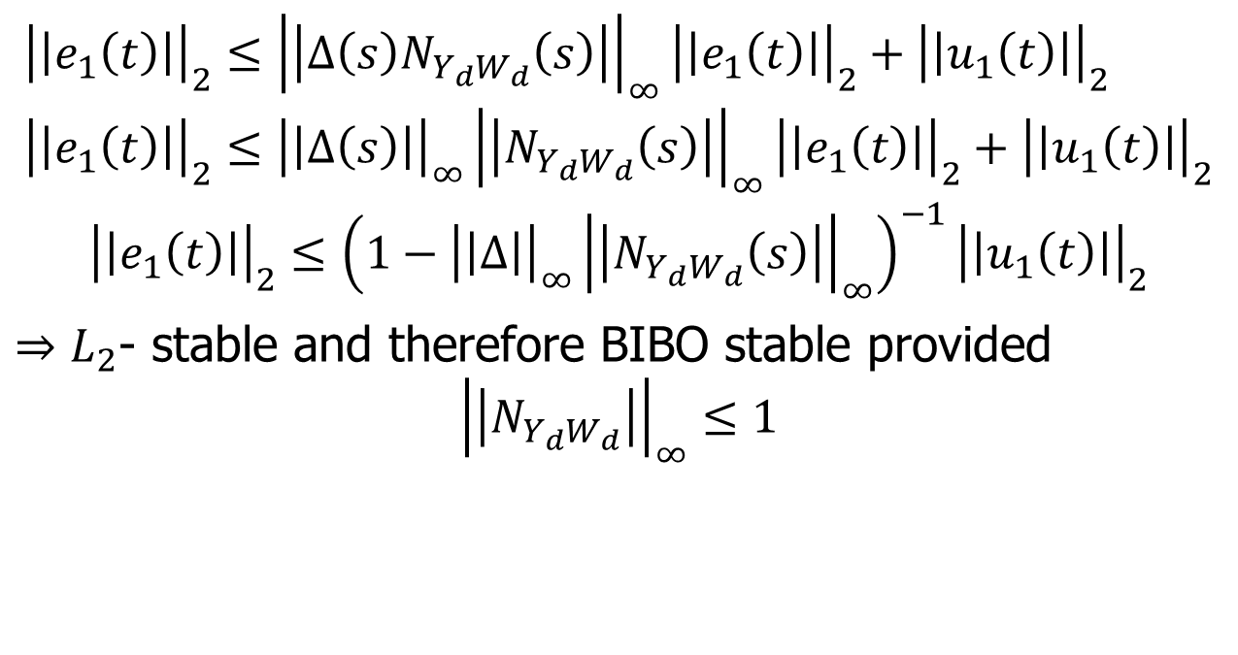
Stability Condition
$${\left|\left|e_{1}\left(t\right)\right|\right|}_{2}≤{\left|\left|Δ\left(s\right)N_{Y_{d}W_{d}}\left(s\right)\right|\right|}_{∞}{\left|\left|e_{1}\left(t\right)\right|\right|}_{2}+{\left|\left|u_{1}\left(t\right)\right|\right|}_{2} \\ {\left|\left|e_{1}\left(t\right)\right|\right|}_{2}≤{\left|\left|Δ\left(s\right)\right|\right|}_{∞}{\left|\left|N_{Y_{d}W_{d}}\left(s\right)\right|\right|}_{∞}{\left|\left|e_{1}\left(t\right)\right|\right|}_{2}+{\left|\left|u_{1}\left(t\right)\right|\right|}_{2}$$
$${\left|\left|e_{1}\left(t\right)\right|\right|}_{2}≤{\left(1−{\left|\left|Δ\right|\right|}_{∞}{\left|\left|N_{Y_{d}W_{d}}\left(s\right)\right|\right|}_{∞}\right)}^{−1}{\left|\left|u_{1}\left(t\right)\right|\right|}_{2}$$
$⇒L_{2}$- stable and therefore BIBO stable provided
$${\left|\left|N_{Y_{d}W_{d}}\right|\right|}_{∞}≤1$$

Slide 16
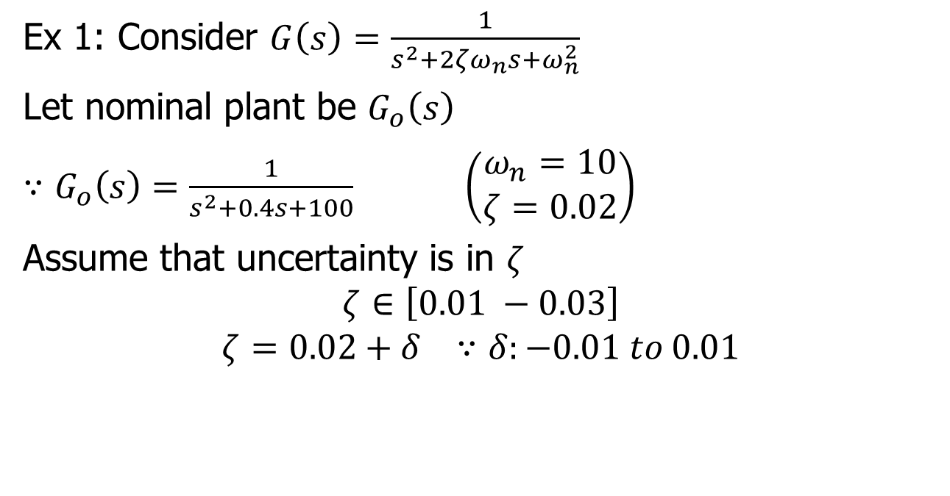

Example of Pulling Out $Δ$s
Ex 1: Consider $G\left(s\right)=\frac{1}{s^{2}+2ζω_{n}s+ω_{n}^{2}}$
Let nominal plant be $G_{o}\left(s\right)$
$∵G_{o}\left(s\right)=\frac{1}{s^{2}+0.4s+100}$ $\left(\begin{matrix}ω_{n}=10 \\ ζ=0.02\end{matrix}\right)$
Assume that uncertainty is in $ζ$
$$ζ∈\left[0.01 −0.03\right]$$
$$ζ=0.02+δ ∵δ:−0.01 to 0.01$$

Slide 17




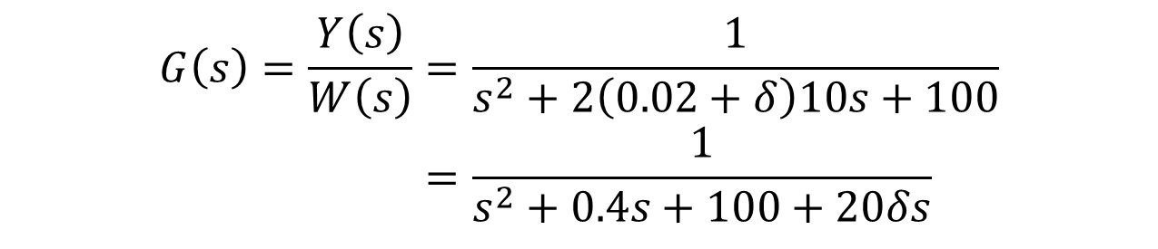






Example of pulling out Δs
$$G\left(s\right)=\frac{Y\left(s\right)}{W\left(s\right)}=\frac{1}{s^{2}+2\left(0.02+δ\right)10s+100} \\ =\frac{1}{s^{2}+0.4s+100+20δs}$$
$$W\left(s\right)$$
$$Y\left(s\right)$$
$$⇒$$
$$W$$
$$+$$
$$Y$$
$$G\left(s\right)$$
$$G_{o}\left(s\right)$$
$$−$$
$$20δs$$

Slide 18

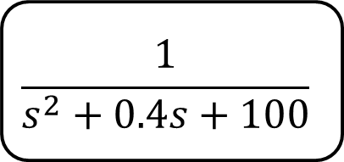







Example of pulling out Δs
Conversion to standard form by pulling out $Δ^{′}s$.
$$\frac{1}{s^{2}+0.4s+100}$$
$$W$$
$$+$$
$$Y$$
$$−$$
$$20s$$
$$W_{d}$$
$$Y_{d}$$
$$δ$$

Slide 19

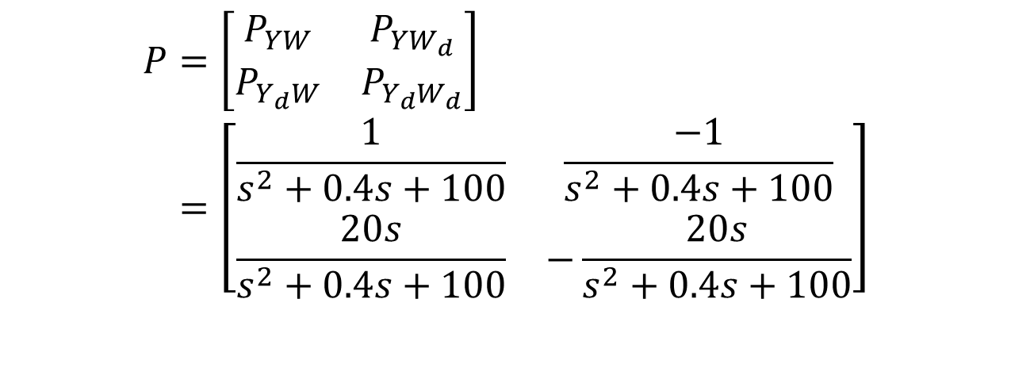


Example of pulling out Δs
$$W_{d}$$
$$Δ$$
$$≈$$
$$Y_{d}$$
$$W$$
$$P$$
$$Y$$
$$P=\left[\begin{matrix}P_{YW} & P_{YW_{d}} \\ P_{Y_{d}W} & P_{Y_{d}W_{d}}\end{matrix}\right] \\ =\left[\begin{matrix}\frac{1}{s^{2}+0.4s+100} & \frac{−1}{s^{2}+0.4s+100} \\ \frac{20s}{s^{2}+0.4s+100} & −\frac{20s}{s^{2}+0.4s+100}\end{matrix}\right]$$

Slide 20
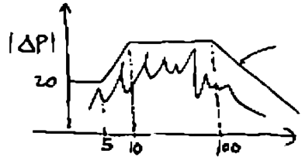
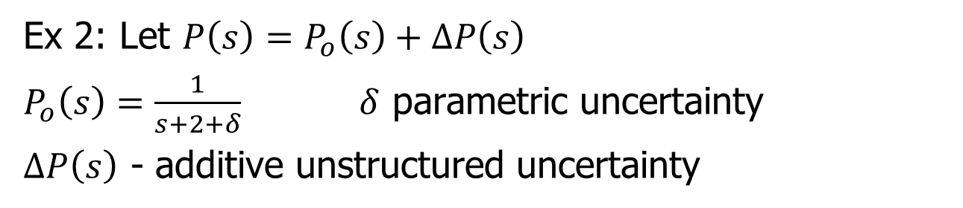

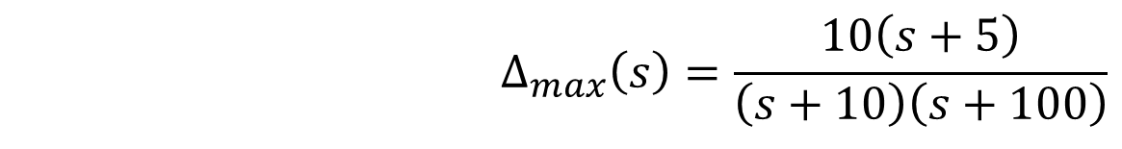
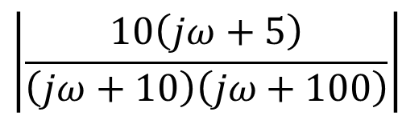
Example 2 – Pulling Out $Δ$s
Ex 2: Let $P\left(s\right)=P_{o}\left(s\right)+ΔP\left(s\right)$
$P_{o}\left(s\right)=\frac{1}{s+2+δ}$ $δ$ parametric uncertainty
$ΔP\left(s\right)$ - additive unstructured uncertainty
$$\left|\frac{10\left(jω+5\right)}{\left(jω+10\right)\left(jω+100\right)}\right|$$
$$Δ_{max}\left(s\right)=\frac{10\left(s+5\right)}{\left(s+10\right)\left(s+100\right)}$$

Slide 21





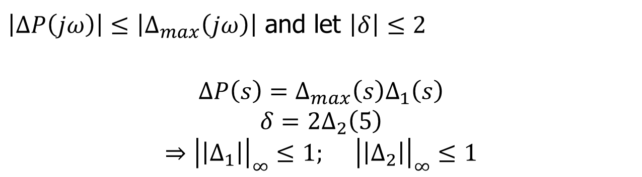






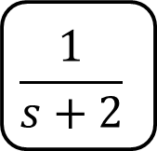

Example 2 – pulling out Δs
$\left|ΔP\left(jω\right)\right|≤\left|Δ_{max}\left(jω\right)\right|$ and let $\left|δ\right|≤2$
$$ΔP\left(s\right)=Δ_{max}\left(s\right)Δ_{1}\left(s\right)$$
$$δ=2Δ_{2}\left(5\right)$$
$$⇒{\left|\left|Δ_{1}\right|\right|}_{∞}≤1; {\left|\left|Δ_{2}\right|\right|}_{∞}≤1$$
$$ΔP\left(s\right)$$
$$W$$
$$Y$$
$$⇒$$
$$\frac{1}{s+2}$$
$$+$$
$$W$$
$$Y$$
$$P\left(s\right)$$
$$+$$
$$+$$
$$−$$
$$δ$$

Slide 22











Example 2 – pulling out Δs
$$Δ_{max}\left(s\right)$$
$$Δ_{1}\left(s\right)$$
$$⇒$$
$$\frac{1}{s+2}$$
$$+$$
$$Y$$
$$W$$
$$+$$
$$+$$
$$−$$
2
$$Δ_{2}$$

Slide 23














Example 2 – pulling out Δs
$$Δ\left(s\right)$$
$$Δ_{2}\left(s\right)$$
$$Δ_{1}\left(s\right)$$
$$Y_{d}$$
$$W_{d}$$
$$Δ_{max}$$
$$W$$
2
$$Y$$
$$−$$
$$\frac{1}{s+2}$$
$$+$$
$$+$$
$$+$$
$$\left\{\begin{matrix}Y \\ Y_{d}\end{matrix}\right\}=\left[\begin{matrix} & & \\ & & \\ & & \end{matrix}\right]\left\{\begin{matrix}W \\ W_{d}\end{matrix}\right\}$$

