Slide 1
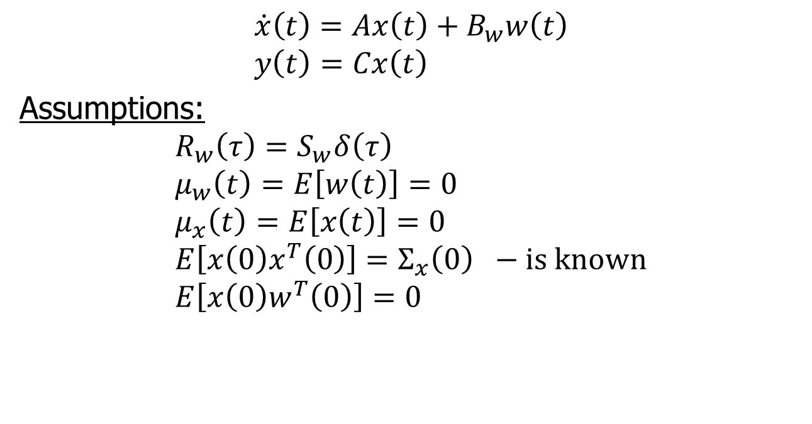
Linear System Excited with White Noise
$$\dot{x}\left(t\right)=Ax\left(t\right)+B_{w}w\left(t\right) \\ y\left(t\right)=Cx\left(t\right)$$
Assumptions:
$$R_{w}\left(τ\right)=S_{w}δ\left(τ\right) \\ μ_{w}\left(t\right)=E\left[w\left(t\right)\right]=0 \\ μ_{x}\left(t\right)=E\left[x\left(t\right)\right]=0 \\ E\left[x\left(0\right)x^{T}\left(0\right)\right]=Σ_{x}\left(0\right) −is known \\ E\left[x\left(0\right)w^{T}\left(0\right)\right]=0$$

Slide 2
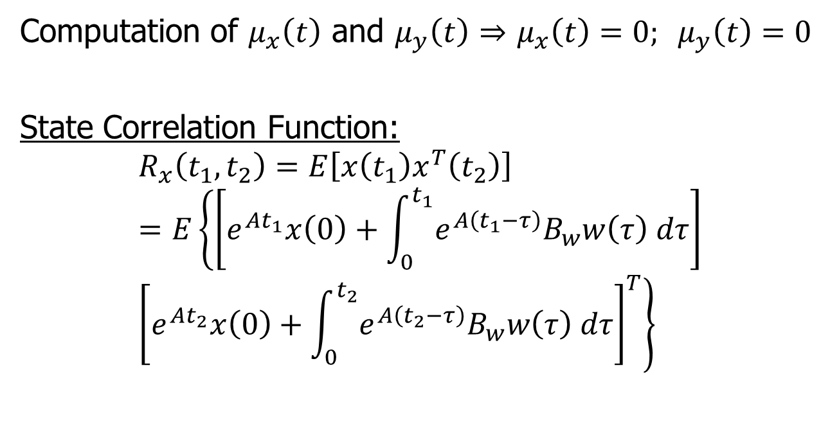
State Correlation
Computation of $μ_{x}\left(t\right)$ and $μ_{y}\left(t\right)$ $⇒$ $μ_{x}\left(t\right)=0; μ_{y}\left(t\right)=0$
State Correlation Function:
$$R_{x}\left(t_{1},t_{2}\right)=E\left[x\left(t_{1}\right)x^{T}\left(t_{2}\right)\right] \\ =E\left\{\left[e^{At_{1}}x\left(0\right)+\int_{0}^{t_{1}}{e^{A\left(t_{1}−τ\right)}B_{w}w\left(τ\right) dτ}\right]\right. \\ \left.{\left[e^{At_{2}}x\left(0\right)+\int_{0}^{t_{2}}{e^{A\left(t_{2}−τ\right)}B_{w}w\left(τ\right) dτ}\right]}^{T}\right\}$$

Slide 3

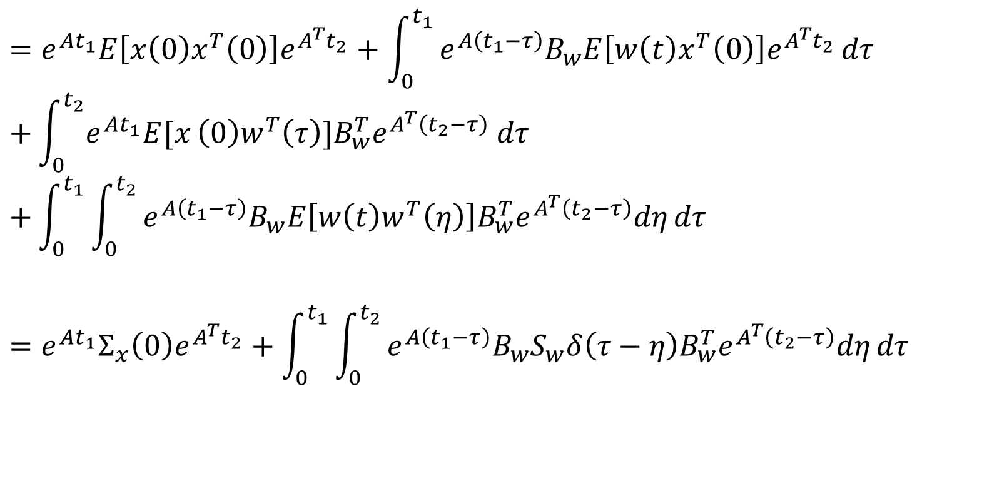

State Correlation
$$0$$
$$=e^{At_{1}}E\left[x\left(0\right)x^{T}\left(0\right)\right]e^{A^{T}t_{2}}+\int_{0}^{t_{1}}{e^{A\left(t_{1}−τ\right)}B_{w}E\left[w\left(t\right)x^{T}\left(0\right)\right]e^{A^{T}t_{2}}}dτ \\ +\int_{0}^{t_{2}}{e^{At_{1}}E[x}\left(0\right)w^{T}\left(τ\right)]B_{w}^{T}e^{A^{T}\left(t_{2}−τ\right)} dτ \\ +\int_{0}^{t_{1}}{\int_{0}^{t_{2}}{e^{A\left(t_{1}−τ\right)}B_{w}E\left[w\left(t\right)w^{T}\left(η\right)\right]B_{w}^{T}e^{A^{T}\left(t_{2}−τ\right)}dη}dτ}$$
$$=e^{At_{1}}Σ_{x}\left(0\right)e^{A^{T}t_{2}}+\int_{0}^{t_{1}}{\int_{0}^{t_{2}}{e^{A\left(t_{1}−τ\right)}B_{w}S_{w}δ\left(τ−η\right)B_{w}^{T}e^{A^{T}\left(t_{2}−τ\right)}dη}dτ}$$
$$0$$

Slide 4
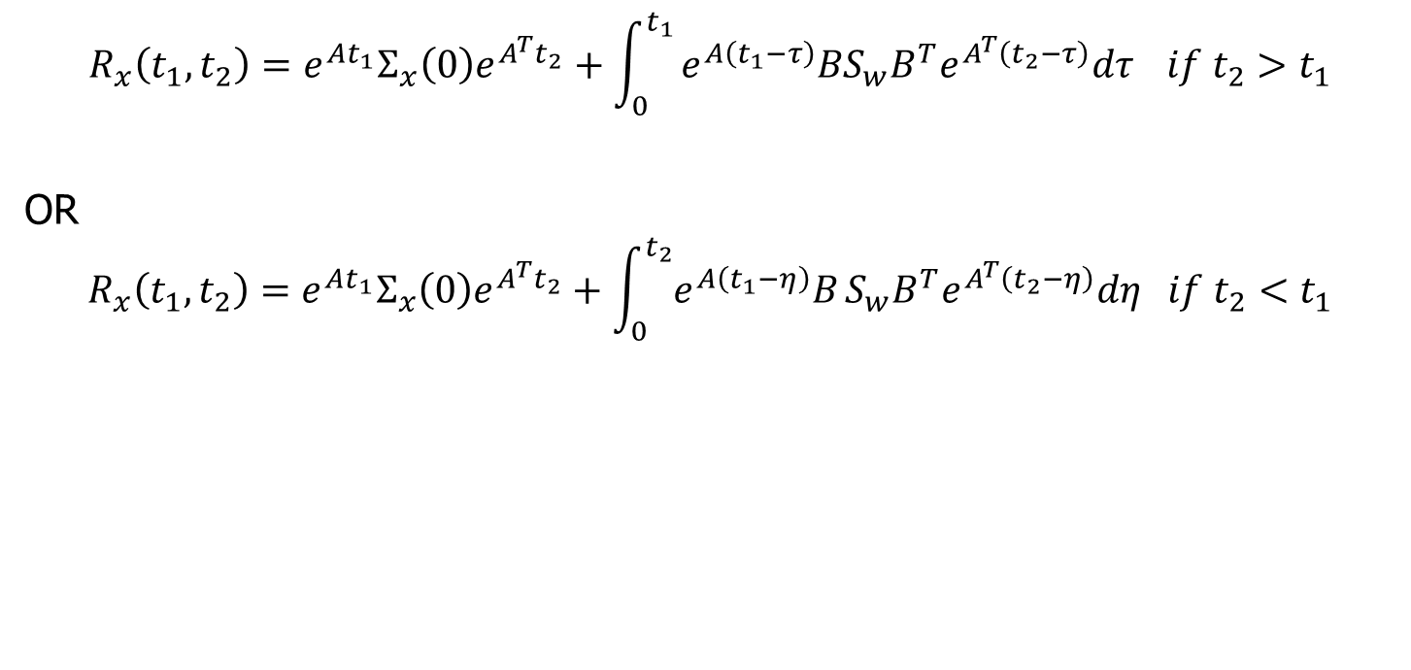
State Correlation
$$R_{x}\left(t_{1},t_{2}\right)=e^{At_{1}}Σ_{x}\left(0\right)e^{A^{T}t_{2}}+\int_{0}^{t_{1}}{e^{A\left(t_{1}−τ\right)}BS_{w}B^{T}e^{A^{T}\left(t_{2}−τ\right)}dτ} if t_{2}>t_{1}$$
OR
$$R_{x}\left(t_{1},t_{2}\right)=e^{At_{1}}Σ_{x}\left(0\right)e^{A^{T}t_{2}}+\int_{0}^{t_{2}}{e^{A\left(t_{1}−η\right)}B}S_{w}B^{T}e^{A^{T}\left(t_{2}−η\right)}dη if t_{2}<t_{1}$$

Slide 5
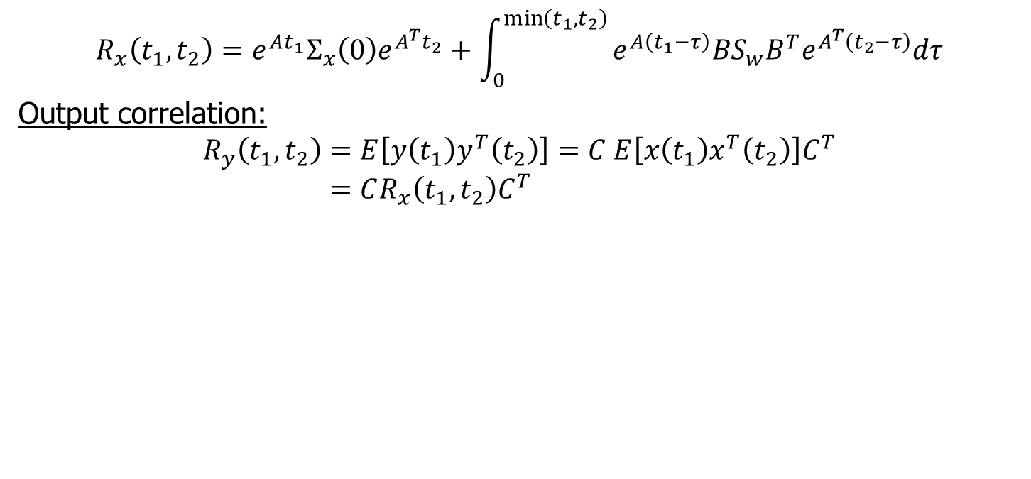
Output Correlation
$$R_{x}\left(t_{1},t_{2}\right)=e^{At_{1}}Σ_{x}\left(0\right)e^{A^{T}t_{2}}+\int_{0}^{\min\left(t_{1},t_{2}\right)}{e^{A\left(t_{1}−τ\right)}BS_{w}B^{T}e^{A^{T}\left(t_{2}−τ\right)}dτ}$$
Output correlation:
$$R_{y}\left(t_{1},t_{2}\right)=E\left[y\left(t_{1}\right)y^{T}\left(t_{2}\right)\right]=C E\left[x\left(t_{1}\right)x^{T}\left(t_{2}\right)\right]C^{T} \\ =CR_{x}\left(t_{1},t_{2}\right)C^{T}$$

Slide 6
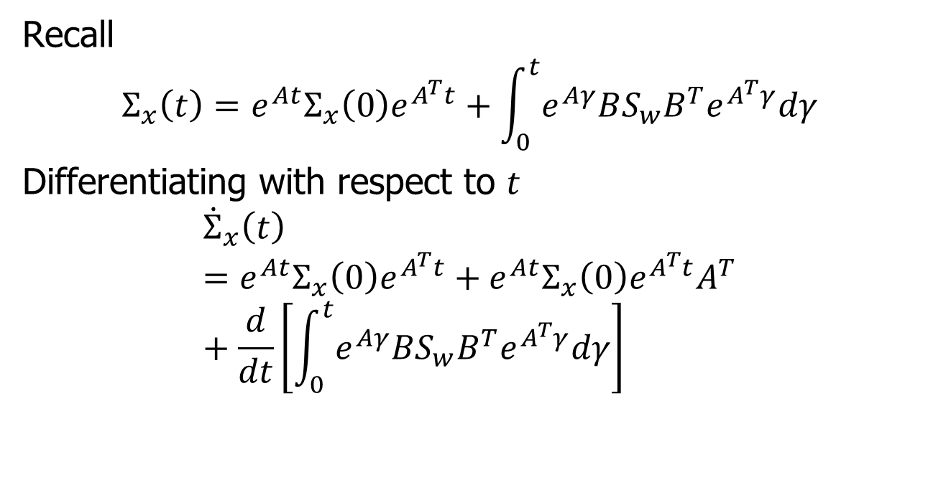
Propagation of State Covariance
Recall
$$Σ_{x}\left(t\right)=e^{At}Σ_{x}\left(0\right)e^{A^{T}t}+\int_{0}^{t}{e^{Aγ}BS_{w}B^{T}e^{A^{T}γ}dγ}$$
Differentiating with respect to $t$
$${\dot{Σ}}_{x}\left(t\right)=e^{At}Σ_{x}\left(0\right)e^{A^{T}t}+e^{At}Σ_{x}\left(0\right)e^{A^{T}t}A^{T}+\frac{d}{dt}\left[\int_{0}^{t}{e^{Aγ}BS_{w}B^{T}e^{A^{T}γ}dγ}\right]$$

Slide 7
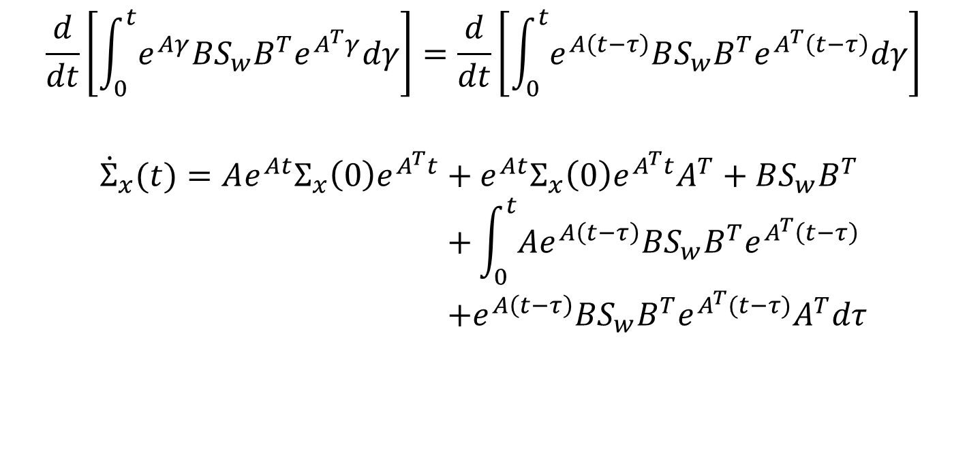
State Convariance
$$\frac{d}{dt}\left[\int_{0}^{t}{e^{Aγ}BS_{w}B^{T}e^{A^{T}γ}dγ}\right]=\frac{d}{dt}\left[\int_{0}^{t}{e^{A\left(t−τ\right)}BS_{w}B^{T}e^{A^{T}\left(t−τ\right)}dγ}\right]$$
$${\dot{Σ}}_{x}(t)=Ae^{At}Σ_{x}\left(0\right)e^{A^{T}t}+e^{At}Σ_{x}\left(0\right)e^{A^{T}t}A^{T}+BS_{w}B^{T} \\ +\int_{0}^{t}{Ae^{A\left(t−τ\right)}BS_{w}B^{T}e^{A^{T}\left(t−τ\right)}} \\ +e^{A\left(t−τ\right)}BS_{w}B^{T}e^{A^{T}(t−τ)}A^{T}dτ$$

Slide 8
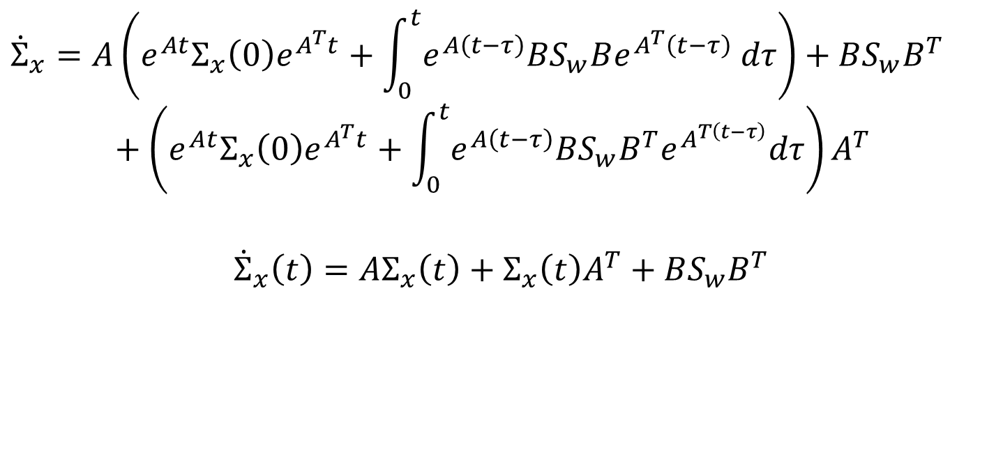
State Covariance Equation
$${\dot{Σ}}_{x}=A\left(e^{At}Σ_{x}\left(0\right)e^{A^{T}t}+\int_{0}^{t}{e^{A\left(t−τ\right)}BS_{w}Be^{A^{T}\left(t−τ\right)} dτ}\right)+BS_{w}B^{T}+\left(e^{At}Σ_{x}\left(0\right)e^{A^{T}t}+\int_{0}^{t}{e^{A\left(t−τ\right)}BS_{w}B^{T}e^{A^{T\left(t−τ\right)}}dτ}\right)A^{T}$$
$${\dot{Σ}}_{x}\left(t\right)=AΣ_{x}\left(t\right)+Σ_{x}\left(t\right)A^{T}+BS_{w}B^{T}$$

Slide 9
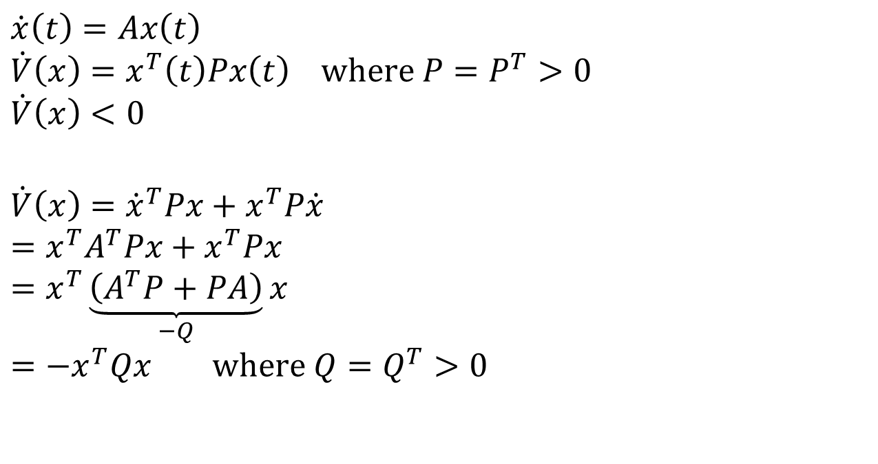
Lyapunov Analysis
$$\dot{x}\left(t\right)=Ax\left(t\right)$$
$$\dot{V}\left(x\right)=x^{T}\left(t\right)Px\left(t\right) where P=P^{T}>0$$
$$\dot{V}\left(x\right)<0$$
$$\dot{V}\left(x\right)={\dot{x}}^{T}Px+x^{T}P\dot{x} \\ =x^{T}A^{T}Px+x^{T}Px \\ =x^{T}\underset{−Q}{\underbrace{\left(A^{T}P+PA\right)}}x \\ =−x^{T}Qx where Q=Q^{T}>0$$

Slide 10
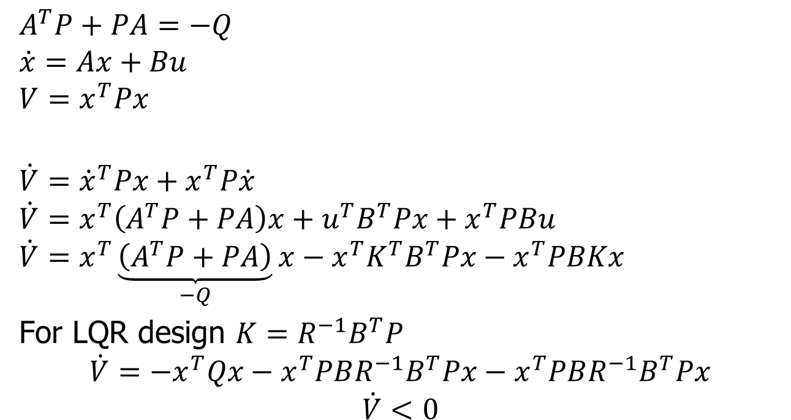
Lyapunov Analysis
$$A^{T}P+PA=−Q$$
$$\dot{x}=Ax+Bu$$
$$V=x^{T}Px$$
$$\dot{V}={\dot{x}}^{T}Px+x^{T}P\dot{x}$$
$$\dot{V}=x^{T}\left(A^{T}P+PA\right)x+u^{T}B^{T}Px+x^{T}PBu$$
$$\dot{V}=x^{T}\underset{−Q}{\underbrace{\left(A^{T}P+PA\right)}}x−x^{T}K^{T}B^{T}Px−x^{T}PBKx$$
For LQR design $K=R^{−1}B^{T}P$
$$\dot{V}=−x^{T}Qx−x^{T}PBR^{−1}B^{T}Px−x^{T}PBR^{−1}B^{T}Px$$
$$\dot{V}<0$$

Slide 11
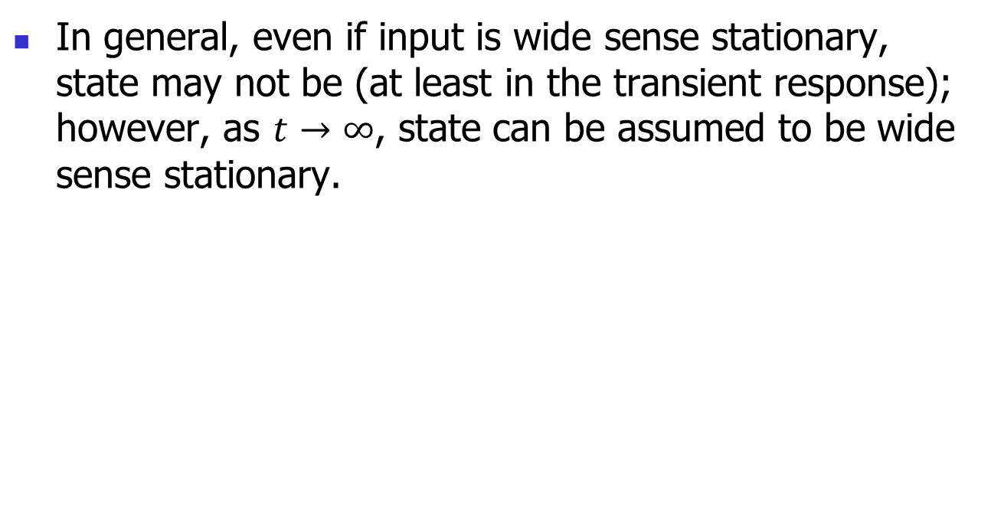
Steady-State Covariance
In general, even if input is wide sense stationary, state may not be (at least in the transient response); however, as $t→∞$, state can be assumed to be wide sense stationary.

Slide 12
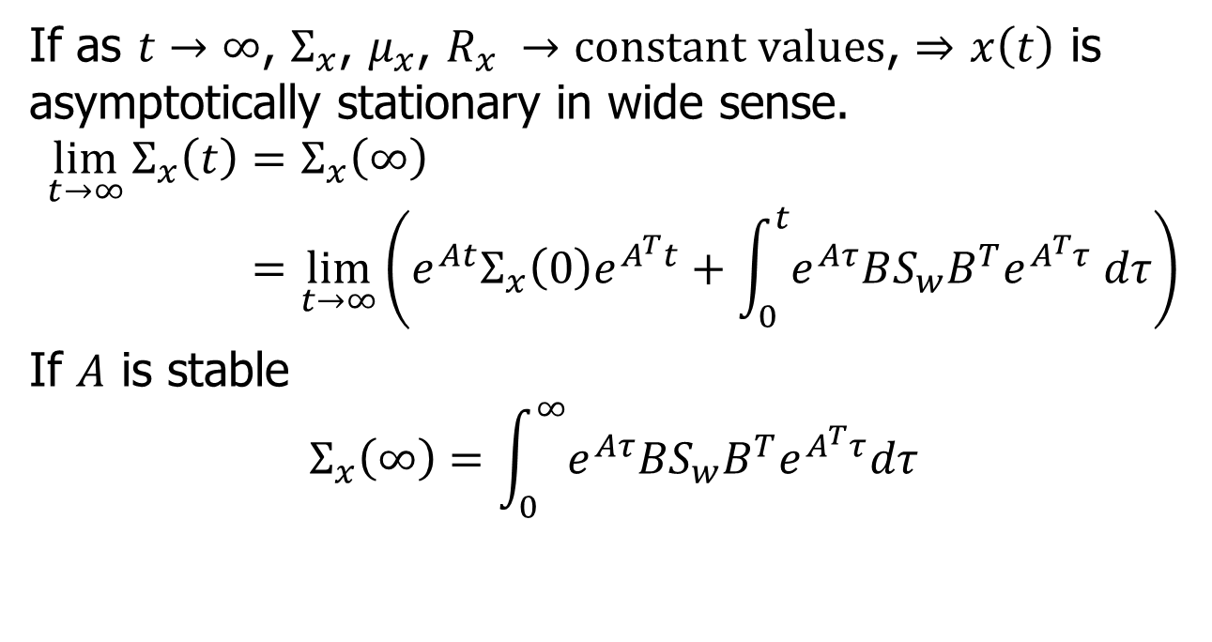
Steady-State Covariance
If as $t→∞$, $Σ_{x}$, $μ_{x}$, $R_{x} →constant values$, $⇒$ $x\left(t\right)$ is asymptotically stationary in wide sense.
$$\lim_{t→∞}{Σ_{x}\left(t\right)=Σ_{x}\left(∞\right)} \\ =\lim_{t→∞}\left(e^{At}Σ_{x}\left(0\right)e^{A^{T}t}+\int_{0}^{t}{e^{Aτ}BS_{w}B^{T}e^{A^{T}τ} dτ}\right)$$
If $A$ is stable
$$Σ_{x}\left(∞\right)=\int_{0}^{∞}{e^{Aτ}BS_{w}B^{T}e^{A^{T}τ}dτ}$$

Slide 13
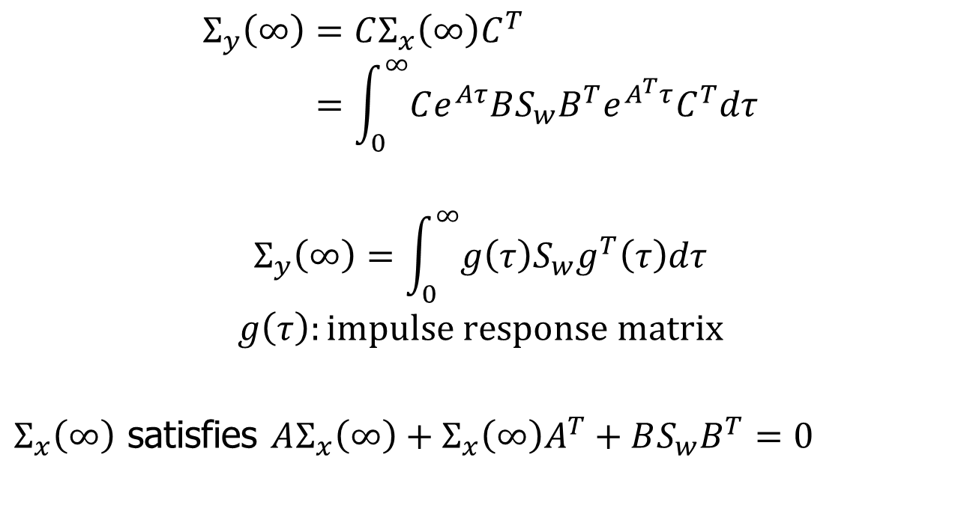
Steady-state Output Covariance
$$Σ_{y}\left(∞\right)=CΣ_{x}\left(∞\right)C^{T} \\ =\int_{0}^{∞}{Ce^{Aτ}BS_{w}B^{T}e^{A^{T}τ}C^{T}dτ}$$
$$Σ_{y}\left(∞\right)=\int_{0}^{∞}{g\left(τ\right)S_{w}g^{T}\left(τ\right)dτ}$$
$$g\left(τ\right):impulse response matrix$$
$Σ_{x}\left(∞\right)$ satisfies $AΣ_{x}\left(∞\right)+Σ_{x}\left(∞\right)A^{T}+BS_{w}B^{T}=0$

Slide 14
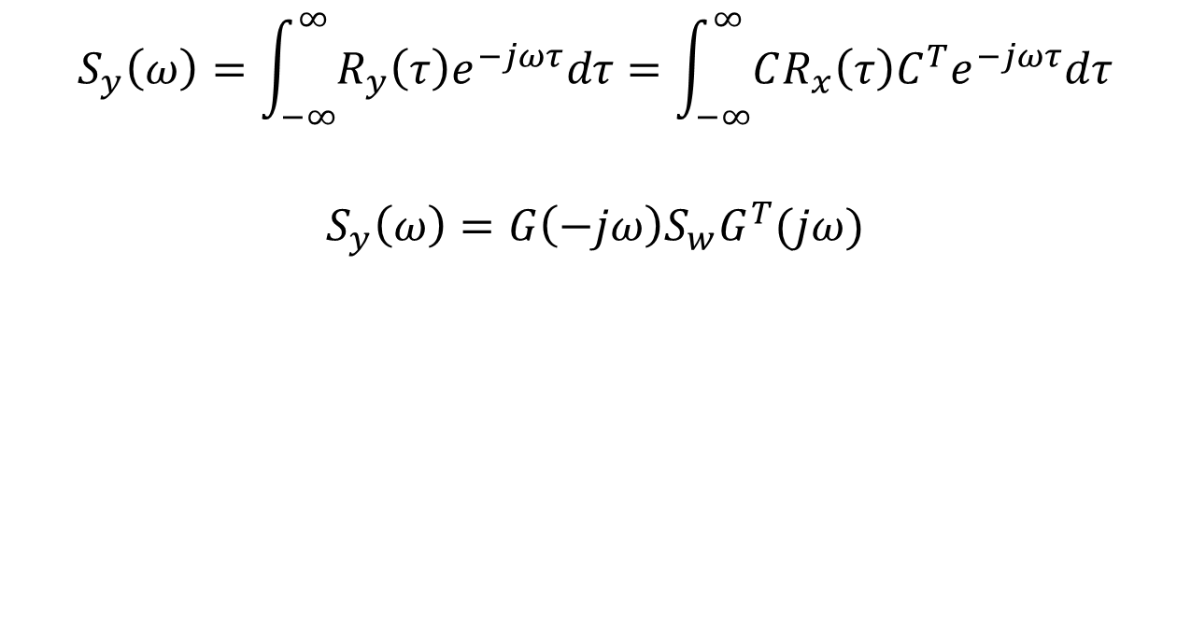
Output Spectral Density
$$S_{y}\left(ω\right)=\int_{−∞}^{∞}{R_{y}\left(τ\right)e^{−jωτ}dτ}=\int_{−∞}^{∞}{CR_{x}\left(τ\right)C^{T}e^{−jωτ}dτ}$$
$$S_{y}\left(ω\right)=G\left(−jω\right)S_{w}G^{T}(jω)$$

Slide 15
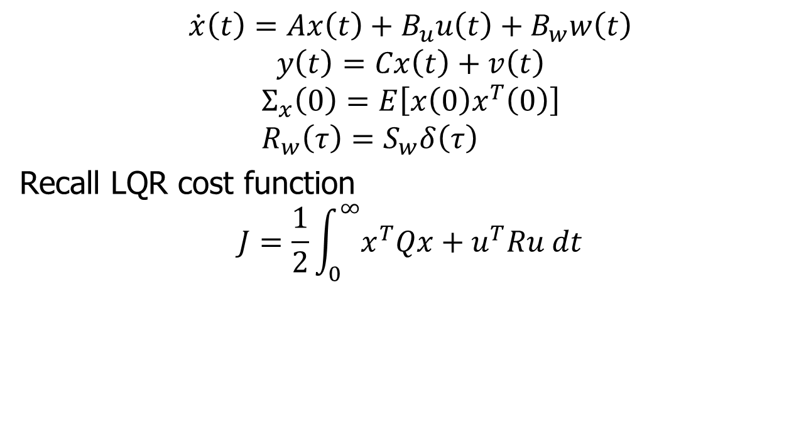
Stochastic Regulator
$$\dot{x}\left(t\right)=Ax\left(t\right)+B_{u}u\left(t\right)+B_{w}w\left(t\right)$$
$$y\left(t\right)=Cx\left(t\right)+v\left(t\right)$$
$$Σ_{x}\left(0\right)=E\left[x\left(0\right)x^{T}\left(0\right)\right] \\ R_{w}\left(τ\right)=S_{w}δ\left(τ\right)$$
Recall LQR cost function
$$J=\frac{1}{2}\int_{0}^{∞}{x^{T}Qx+u^{T}Ru dt}$$

Slide 16
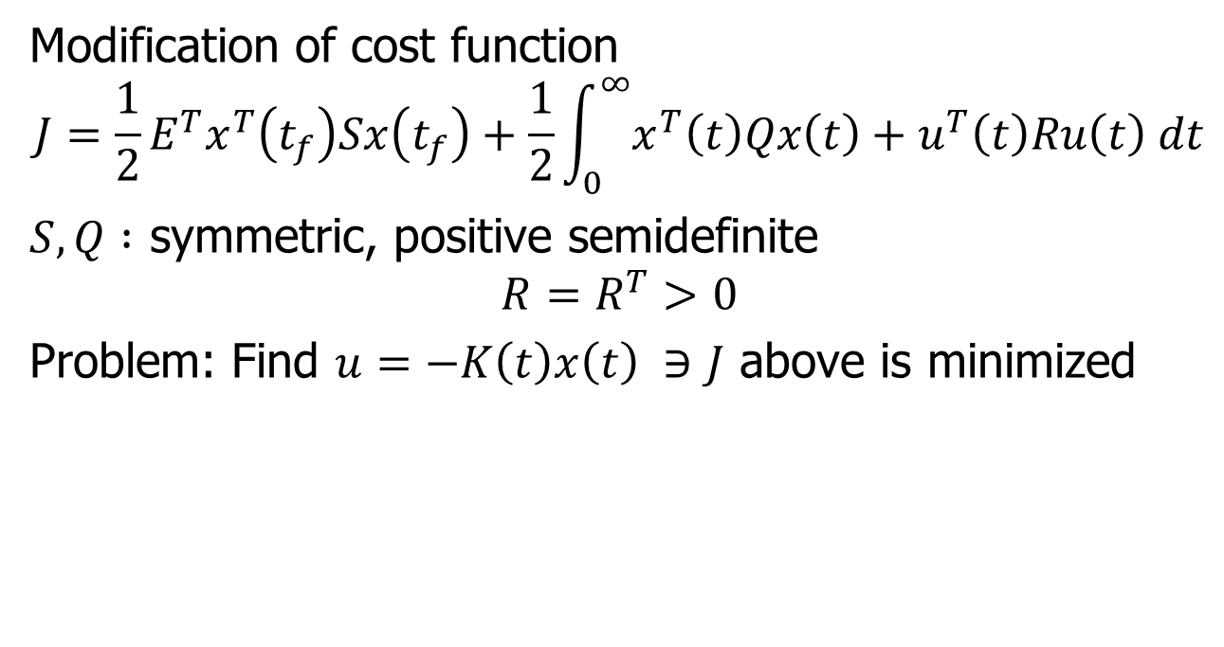
Stochastic Regulator
Modification of cost function
$$J=\frac{1}{2}E^{T}x^{T}\left(t_{f}\right)Sx\left(t_{f}\right)+\frac{1}{2}\int_{0}^{∞}{x^{T}\left(t\right)Qx\left(t\right)+u^{T}\left(t\right)Ru\left(t\right) dt}$$
$S,Q :$ symmetric, positive semidefinite
$$R=R^{T}>0$$
Problem: Find $u=−K\left(t\right)x\left(t\right) ∋J$ above is minimized

Slide 17
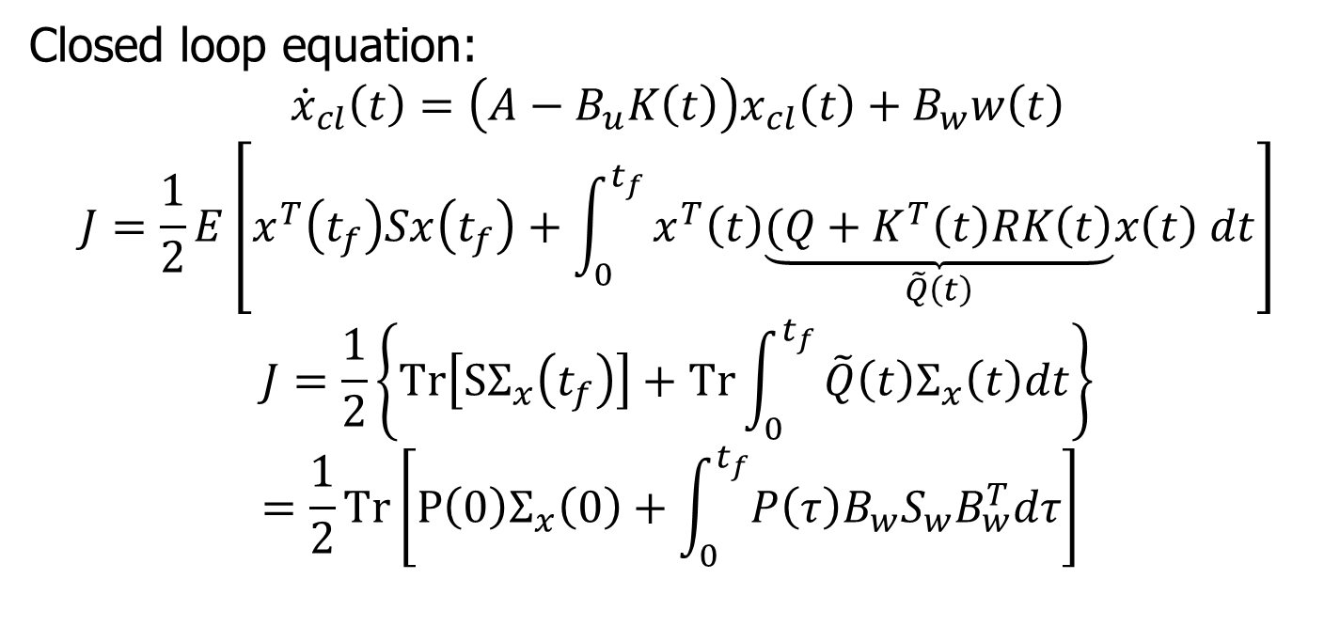
Stochastic Regulator
Closed loop equation:
$${\dot{x}}_{cl}\left(t\right)=\left(A−B_{u}K\left(t\right)\right)x_{cl}\left(t\right)+B_{w}w\left(t\right)$$
$$J=\frac{1}{2}E\left[x^{T}\left(t_{f}\right)Sx\left(t_{f}\right)+\int_{0}^{t_{f}}{x^{T}\left(t\right)\underset{\tilde{Q}\left(t\right)}{\underbrace{(Q+K^{T}\left(t\right)RK\left(t\right)}}x\left(t\right) dt}\right]$$
$$J=\frac{1}{2}\left\{Tr\left[SΣ_{x}\left(t_{f}\right)\right]+Tr\int_{0}^{t_{f}}{\tilde{Q}\left(t\right)Σ_{x}\left(t\right)dt}\right\} \\ =\frac{1}{2}Tr\left[P\left(0\right)Σ_{x}\left(0\right)+\int_{0}^{t_{f}}{P\left(τ\right)B_{w}S_{w}B_{w}^{T}dτ}\right]$$

Slide 18
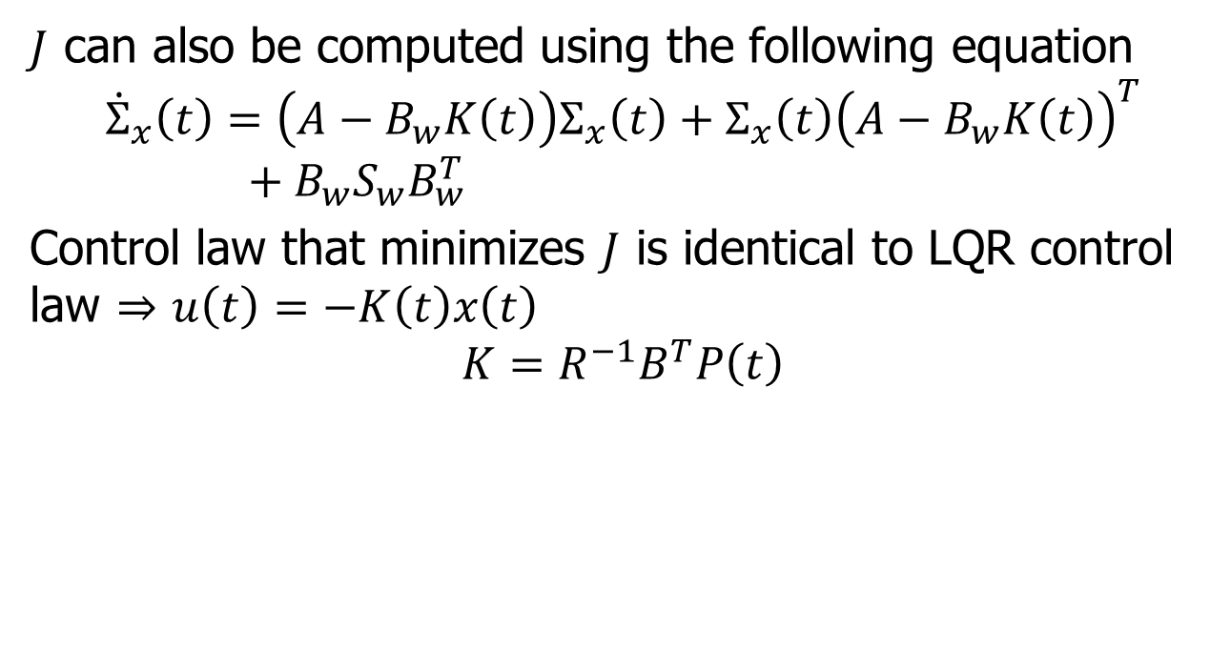
Stochastic Regulator
$J$ can also be computed using the following equation
$${\dot{Σ}}_{x}\left(t\right)=\left(A−B_{w}K\left(t\right)\right)Σ_{x}\left(t\right)+Σ_{x}\left(t\right){\left(A−B_{w}K\left(t\right)\right)}^{T}+B_{w}S_{w}B_{w}^{T}$$
Control law that minimizes $J$ is identical to LQR control law $⇒$ $u\left(t\right)=−K\left(t\right)x\left(t\right)$
$$K=R^{−1}B^{T}P\left(t\right)$$

Slide 19
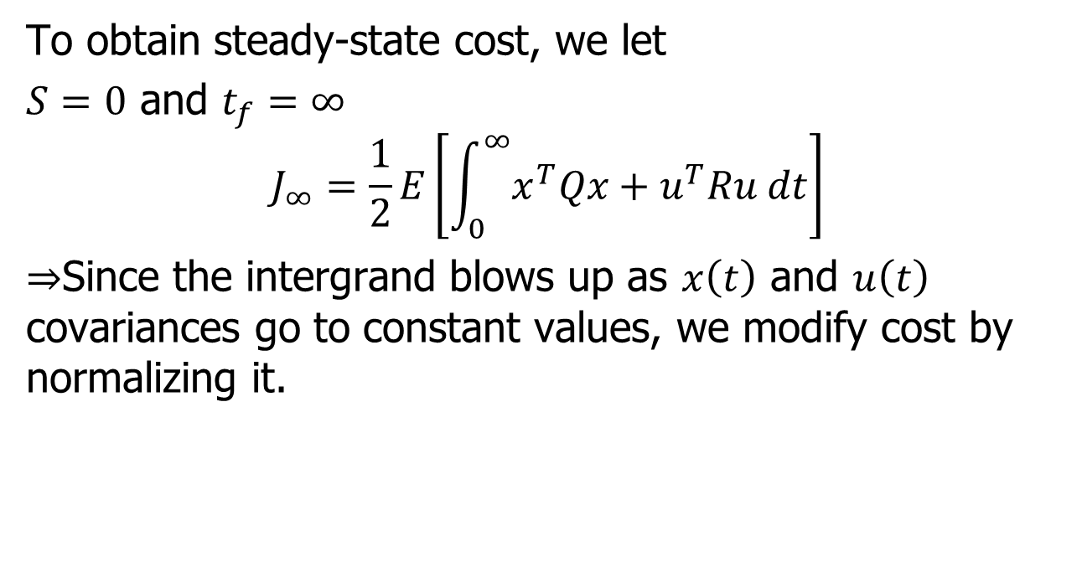
Steady-state Cost
To obtain steady-state cost, we let
$S=0$ and $t_{f}=∞$
$$J_{∞}=\frac{1}{2}E\left[\int_{0}^{∞}{x^{T}Qx+u^{T}Ru dt}\right]$$
$⇒$Since the intergrand blows up as $x\left(t\right)$ and $u\left(t\right)$ covariances go to constant values, we modify cost by normalizing it.

Slide 20
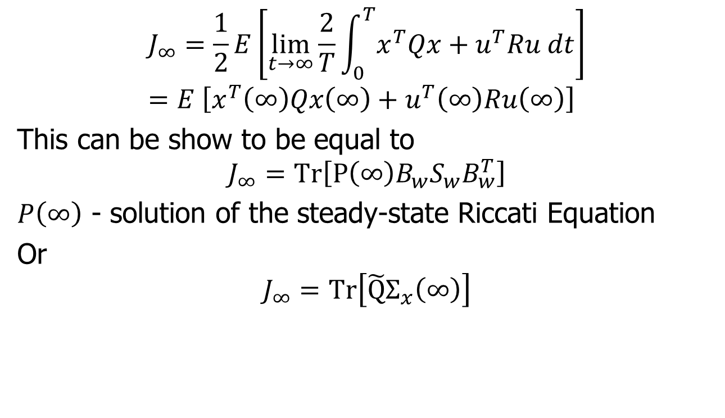
Steady-state Cost
$$J_{∞}=\frac{1}{2}E\left[\lim_{t→∞}{\frac{2}{T}\int_{0}^{T}{x^{T}Qx+u^{T}Ru dt}}\right] \\ =E \left[x^{T}\left(∞\right)Qx\left(∞\right)+u^{T}\left(∞\right)Ru\left(∞\right)\right]$$
This can be show to be equal to
$$J_{∞}=Tr\left[P\left(∞\right)B_{w}S_{w}B_{w}^{T}\right]$$
$P\left(∞\right)$ - solution of the steady-state Riccati Equation
Or
$$J_{∞}=Tr\left[\tilde{Q}Σ_{x}\left(∞\right)\right]$$

Slide 21
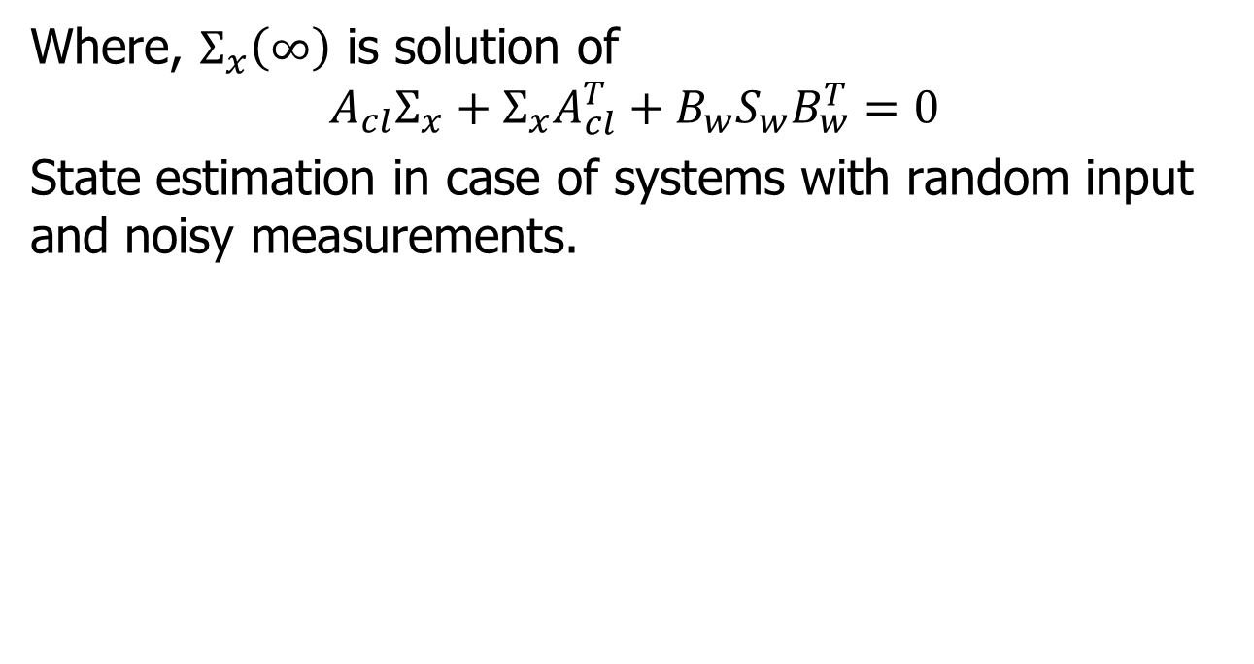
Solution of Steady-state State Covariance
Where, $Σ_{x}\left(∞\right)$ is solution of
$$A_{cl}Σ_{x}+Σ_{x}A_{cl}^{T}+B_{w}S_{w}B_{w}^{T}=0$$
State estimation in case of systems with random input and noisy measurements.

Slide 22
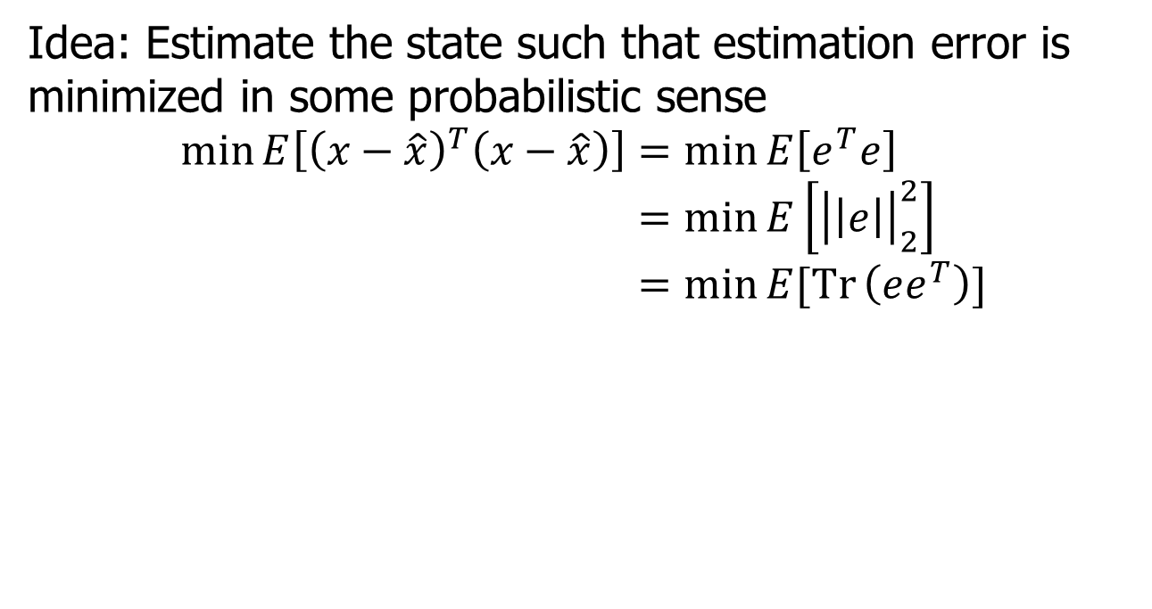
Estimation Error
Idea: Estimate the state such that estimation error is minimized in some probabilistic sense
$$\min{E\left[{\left(x−\hat{x}\right)}^{T}\left(x−\hat{x}\right)\right]}=\min{E\left[e^{T}e\right]} \\ =\min{E\left[{\left|\left|e\right|\right|}_{2}^{2}\right]} \\ =\min{E[Tr}\left(ee^{T}\right)]$$

Slide 23
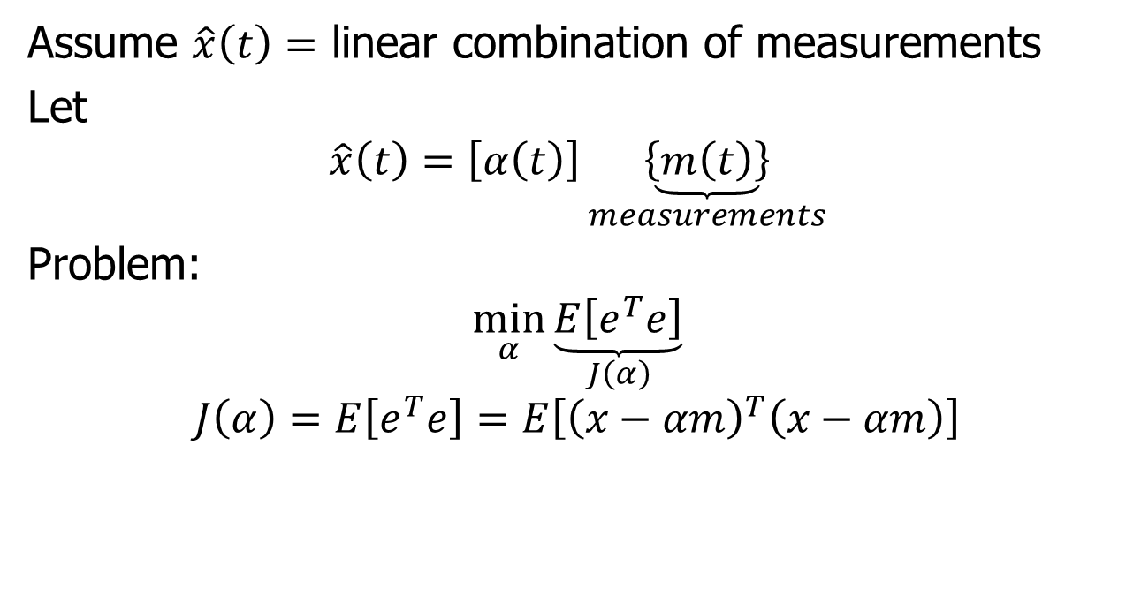
Optimal Linear Estimator
Assume $\hat{x}\left(t\right)=$ linear combination of measurements
Let
$$\hat{x}\left(t\right)=\left[α\left(t\right)\right]\underset{measurements}{\underbrace{\left\{m\left(t\right)\right\}}}$$
Problem:
$$\min_{α}{\underset{J\left(α\right)}{\underbrace{E\left[e^{T}e\right]}}}$$
$$J\left(α\right)=E\left[e^{T}e\right]=E\left[{\left(x−αm\right)}^{T}\left(x−αm\right)\right]$$

Slide 24
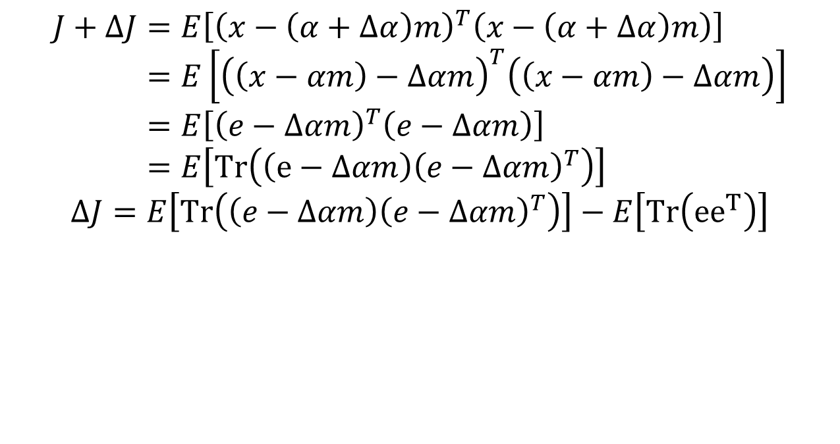
Optimal Linear Estimator
$$J+ΔJ=E\left[{\left(x−\left(α+Δα\right)m\right)}^{T}\left(x−\left(α+Δα\right)m\right)\right] \\ =E\left[{\left(\left(x−αm\right)−Δαm\right)}^{T}\left(\left(x−αm\right)−Δαm\right)\right] \\ =E\left[{\left(e−Δαm\right)}^{T}\left(e−Δαm\right)\right] \\ =E\left[Tr\left(\left(e−Δαm\right){\left(e−Δαm\right)}^{T}\right)\right]$$
$$ΔJ=E\left[Tr\left(\left(e−Δαm\right){\left(e−Δαm\right)}^{T}\right)\right]−E\left[Tr\left({ee}^{T}\right)\right]$$

Slide 25
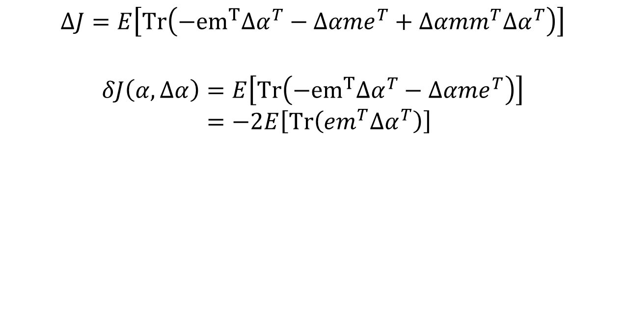
Optimal Linear Estimator
$$ΔJ=E\left[Tr\left(−{em}^{T}Δα^{T}−Δαme^{T}+Δαmm^{T}Δα^{T}\right)\right]$$
$$δJ\left(α,Δα\right)=E\left[Tr\left(−{em}^{T}Δα^{T}−Δαme^{T}\right)\right] \\ =−2E\left[Tr\left(em^{T}Δα^{T}\right)\right]$$

Slide 26
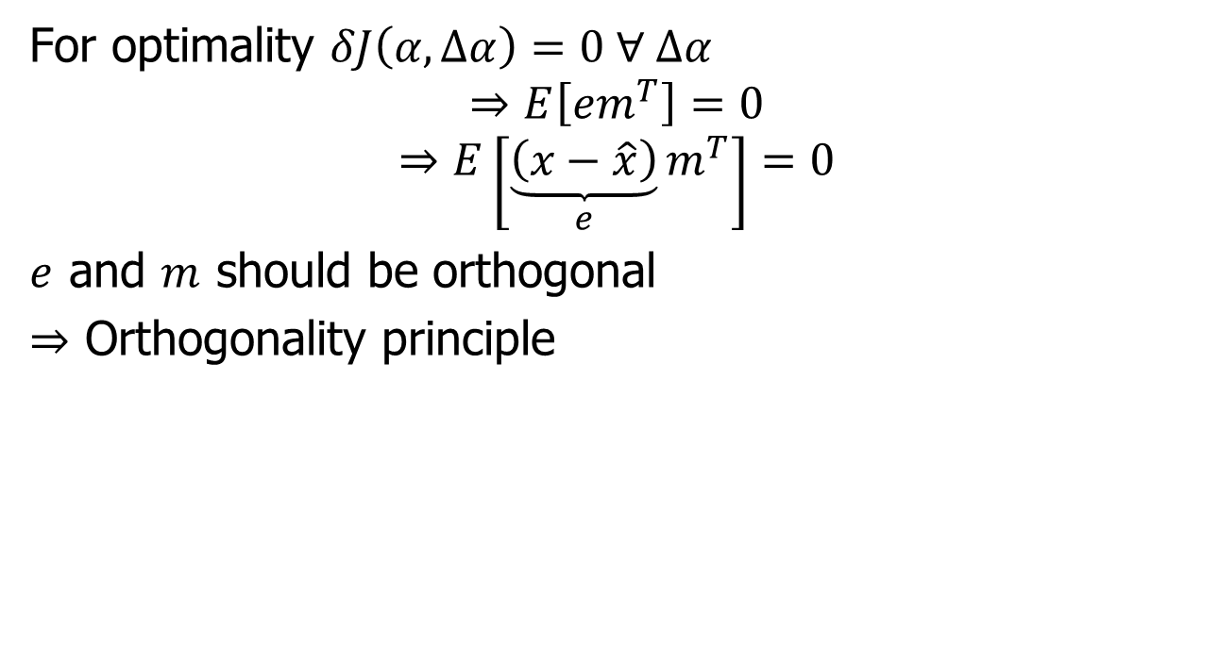
Optimal Linear Estimator
For optimality $δJ\left(α,Δα\right)=0 ∀ Δα$
$$⇒E\left[em^{T}\right]=0$$
$$⇒E\left[\underset{e}{\underbrace{\left(x−\hat{x}\right)}}m^{T}\right]=0$$
$e$ and $m$ should be orthogonal
$⇒$ Orthogonality principle

Slide 27
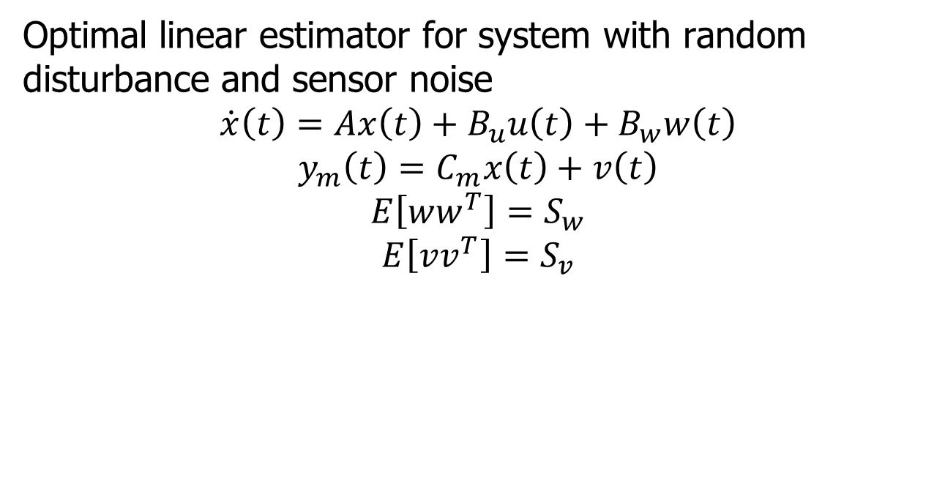
Kalman Filter
Optimal linear estimator for system with random disturbance and sensor noise
$$\dot{x}\left(t\right)=Ax\left(t\right)+B_{u}u\left(t\right)+B_{w}w\left(t\right)$$
$$y_{m}\left(t\right)=C_{m}x\left(t\right)+v\left(t\right)$$
$$E\left[ww^{T}\right]=S_{w}$$
$$E\left[vv^{T}\right]=S_{v}$$

Slide 28
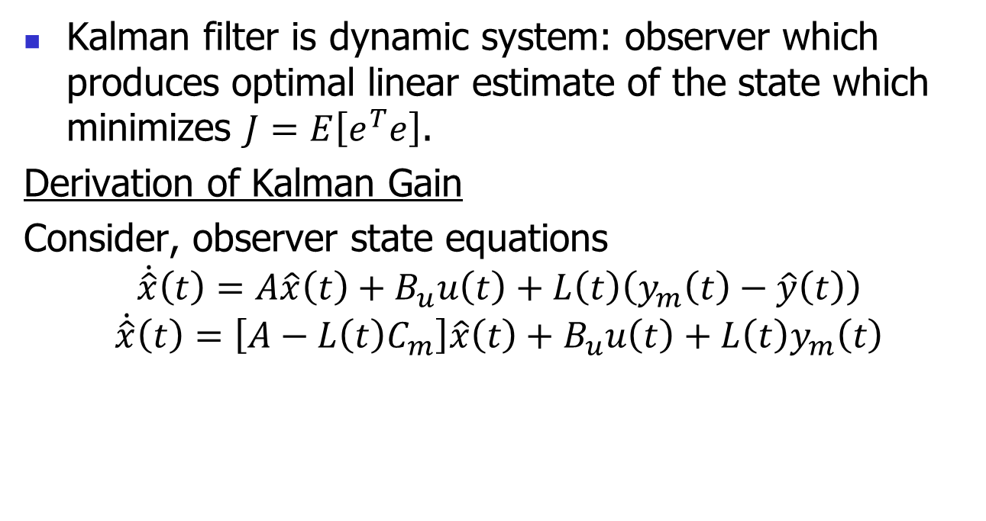
Kalman Filter
Kalman filter is dynamic system: observer which produces optimal linear estimate of the state which minimizes $J=E\left[e^{T}e\right]$.
Derivation of Kalman Gain
Consider, observer state equations
$$\dot{\hat{x}}\left(t\right)=A\hat{x}\left(t\right)+B_{u}u\left(t\right)+L\left(t\right)\left(y_{m}\left(t\right)−\hat{y}\left(t\right)\right)$$
$$\dot{\hat{x}}\left(t\right)=\left[A−L\left(t\right)C_{m}\right]\hat{x}\left(t\right)+B_{u}u\left(t\right)+L\left(t\right)y_{m}\left(t\right)$$

Slide 29









Kalman Filter
$$y$$
$$L\left(t\right)$$
$$u$$
+
$$\dot{\hat{x}}$$
$$\hat{x}$$
+
$$∫$$
$$\hat{x}$$
$$B_{u}$$
+
$$A−L\left(t\right)C_{m}$$

Slide 30

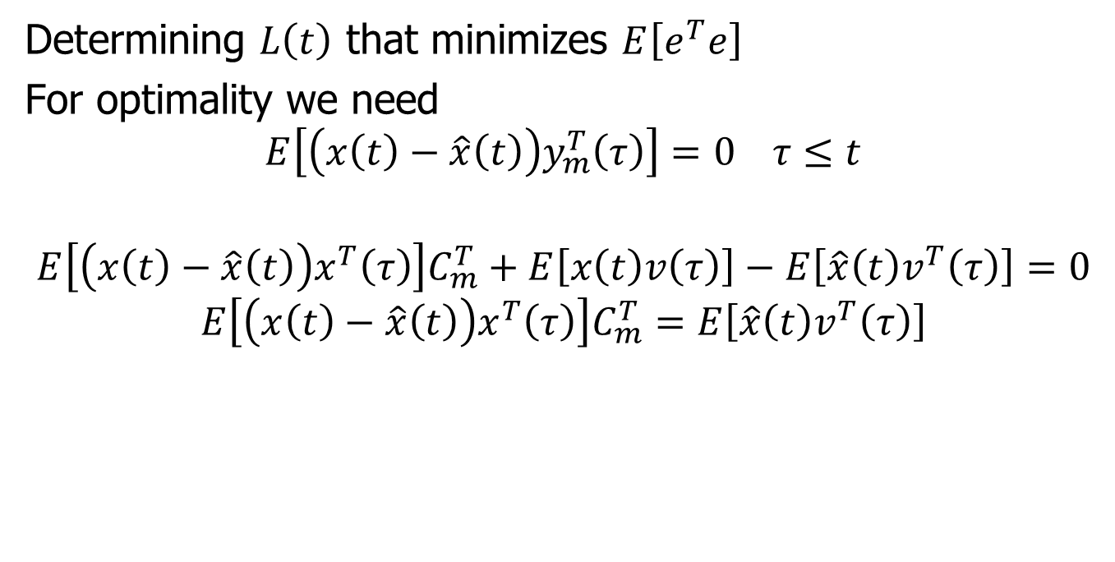
Determination of Kalman Gain
Determining $L\left(t\right)$ that minimizes $E\left[e^{T}e\right]$
For optimality we need
$$E\left[\left(x\left(t\right)−\hat{x}\left(t\right)\right)y_{m}^{T}\left(τ\right)\right]=0 τ≤t$$
$$E\left[\left(x\left(t\right)−\hat{x}\left(t\right)\right)x^{T}\left(τ\right)\right]C_{m}^{T}+E\left[x\left(t\right)v\left(τ\right)\right]−E\left[\hat{x}\left(t\right)v^{T}\left(τ\right)\right]=0$$
$$E\left[\left(x\left(t\right)−\hat{x}\left(t\right)\right)x^{T}\left(τ\right)\right]C_{m}^{T}=E\left[\hat{x}\left(t\right)v^{T}\left(τ\right)\right]$$
$$0$$

Slide 31
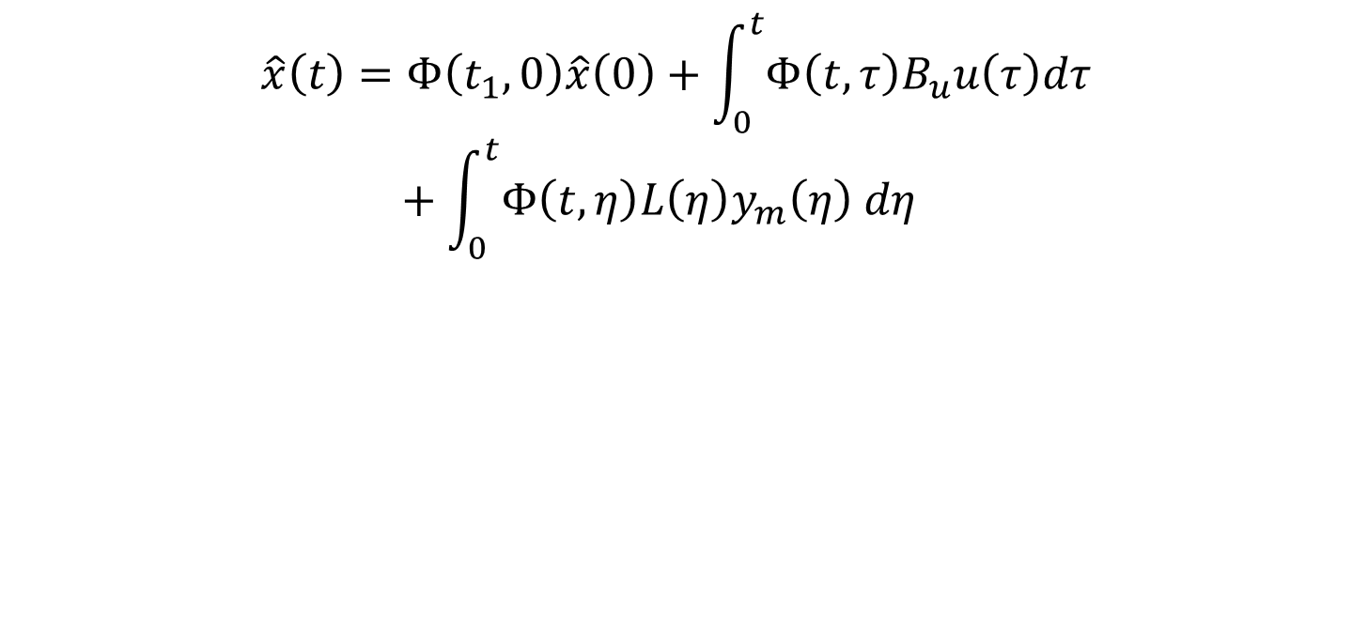
Determining Kalman Gain
$$\hat{x}\left(t\right)=Φ\left(t_{1},0\right)\hat{x}\left(0\right)+\int_{0}^{t}{Φ\left(t,τ\right)B_{u}u\left(τ\right)dτ}+\int_{0}^{t}{Φ\left(t,η\right)L\left(η\right)y_{m}\left(η\right) dη}$$

Slide 32

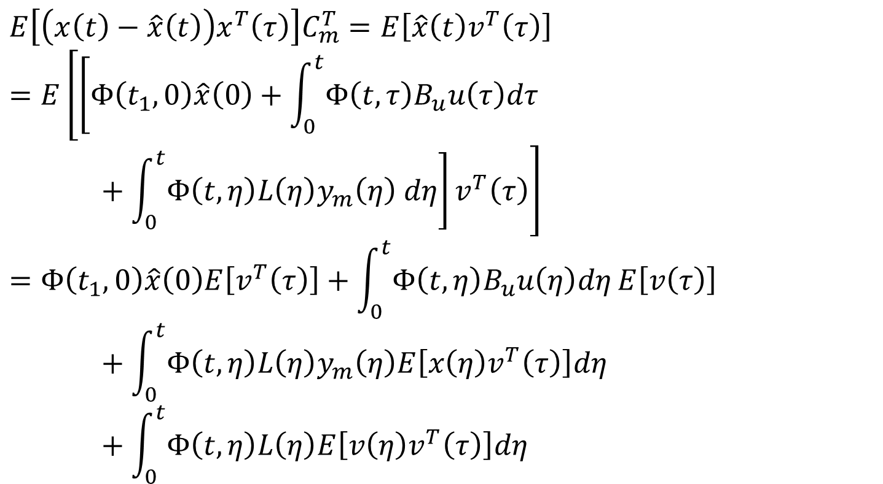


Determining Kalman Gain
$$E\left[\left(x\left(t\right)−\hat{x}\left(t\right)\right)x^{T}\left(τ\right)\right]C_{m}^{T}=E\left[\hat{x}\left(t\right)v^{T}\left(τ\right)\right] \\ =E\left[\left[Φ\left(t_{1},0\right)\hat{x}\left(0\right)+\int_{0}^{t}{Φ\left(t,τ\right)B_{u}u\left(τ\right)dτ}+\int_{0}^{t}{Φ\left(t,η\right)L\left(η\right)y_{m}\left(η\right) dη}\right]v^{T}\left(τ\right)\right] \\ =Φ\left(t_{1},0\right)\hat{x}\left(0\right)E\left[v^{T}\left(τ\right)\right]+\int_{0}^{t}{Φ\left(t,η\right)B_{u}u\left(η\right)dη}E\left[v\left(τ\right)\right]+\int_{0}^{t}{Φ\left(t,η\right)L\left(η\right)y_{m}\left(η\right)E\left[x\left(η\right)v^{T}\left(τ\right)\right]dη}+\int_{0}^{t}{Φ\left(t,η\right)L\left(η\right)E\left[v\left(η\right)v^{T}\left(τ\right)\right]dη}$$
$$0$$
$$0$$
$$0$$

Slide 33
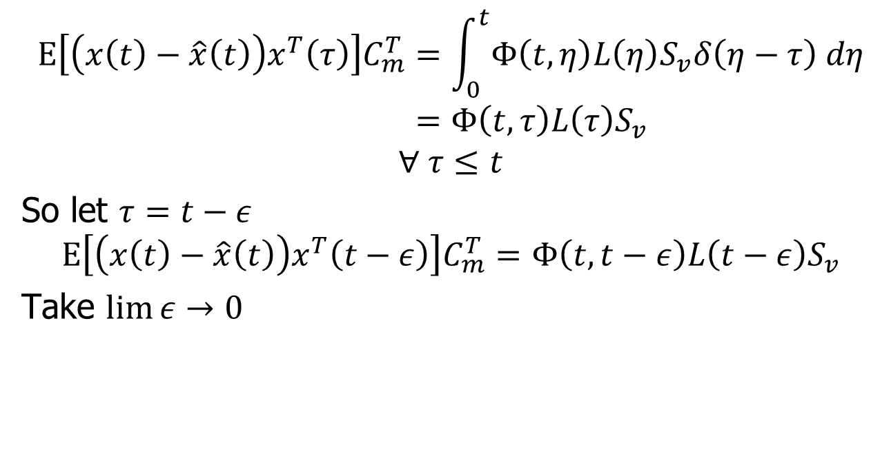
Determining Kalman Gain
$$E\left[\left(x\left(t\right)−\hat{x}\left(t\right)\right)x^{T}\left(τ\right)\right]C_{m}^{T}=\int_{0}^{t}{Φ\left(t,η\right)L\left(η\right)S_{v}δ\left(η−τ\right) dη} \\ =Φ\left(t,τ\right)L\left(τ\right)S_{v}$$
$$∀ τ≤t$$
So let $τ=t−ε$
$$E\left[\left(x\left(t\right)−\hat{x}\left(t\right)\right)x^{T}\left(t−ε\right)\right]C_{m}^{T}=Φ\left(t,t−ε\right)L\left(t−ε\right)S_{v}$$
Take $\lim{ε}→0$

Slide 34
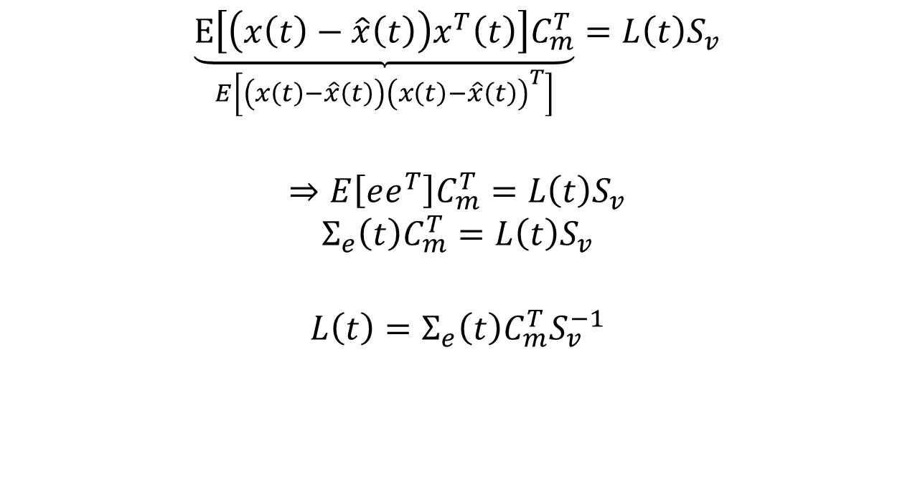
Determining Kalman Gain
$$\underset{E\left[\left(x\left(t\right)−\hat{x}\left(t\right)\right){\left(x\left(t\right)−\hat{x}\left(t\right)\right)}^{T}\right]}{\underbrace{E\left[\left(x\left(t\right)−\hat{x}\left(t\right)\right)x^{T}\left(t\right)\right]C_{m}^{T}}}=L\left(t\right)S_{v}$$
$$⇒E\left[ee^{T}\right]C_{m}^{T}=L\left(t\right)S_{v}$$
$$Σ_{e}\left(t\right)C_{m}^{T}=L\left(t\right)S_{v}$$
$$L\left(t\right)=Σ_{e}\left(t\right)C_{m}^{T}S_{v}^{−1}$$

Slide 35
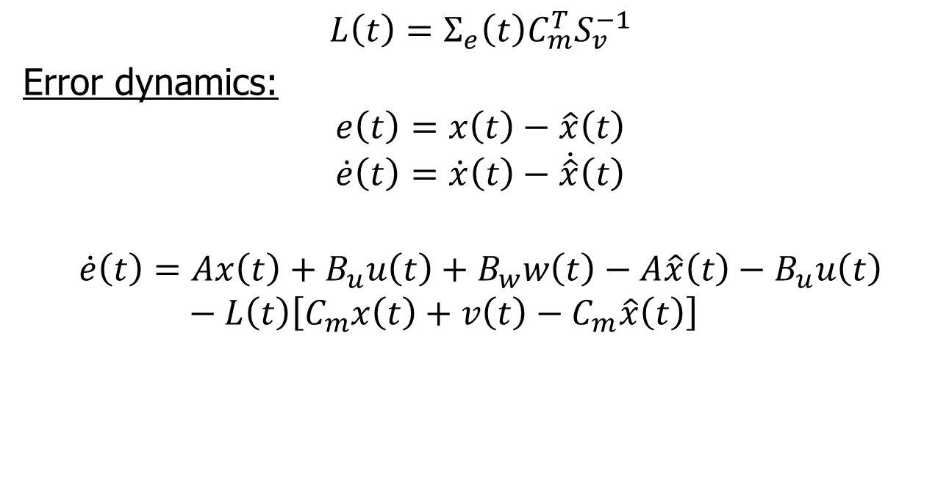
Kalman Gain
$$L\left(t\right)=Σ_{e}\left(t\right)C_{m}^{T}S_{v}^{−1}$$
Error dynamics:
$$e\left(t\right)=x\left(t\right)−\hat{x}\left(t\right)$$
$$\dot{e}\left(t\right)=\dot{x}\left(t\right)−\dot{\hat{x}}\left(t\right)$$
$$\dot{e}\left(t\right)=Ax\left(t\right)+B_{u}u\left(t\right)+B_{w}w\left(t\right)−A\hat{x}\left(t\right)−B_{u}u\left(t\right)−L\left(t\right)\left[C_{m}x\left(t\right)+v\left(t\right)−C_{m}\hat{x}\left(t\right)\right]$$

Slide 36

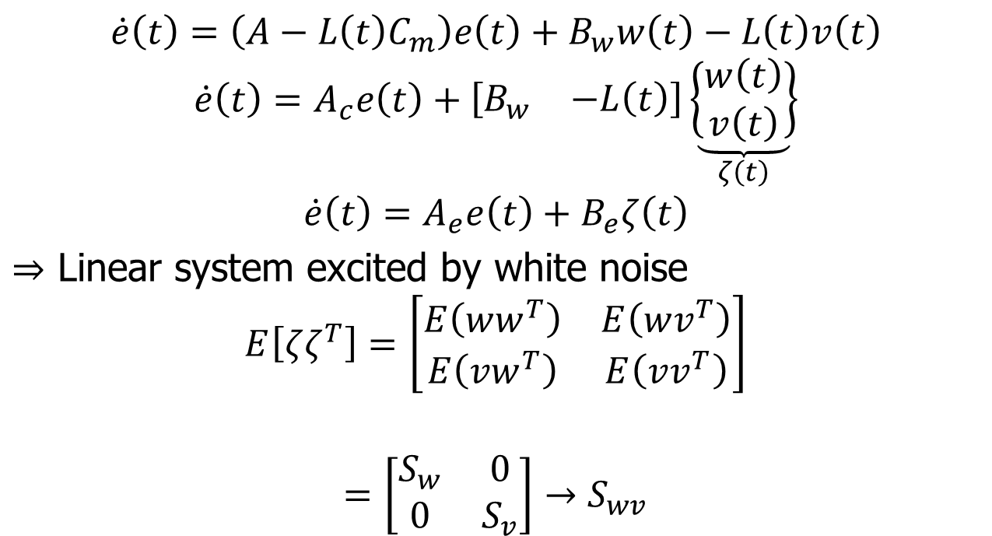

Kalman Gain
$$\dot{e}\left(t\right)=\left(A−L\left(t\right)C_{m}\right)e\left(t\right)+B_{w}w\left(t\right)−L\left(t\right)v\left(t\right)$$
$$\dot{e}\left(t\right)=A_{c}e\left(t\right)+\left[\begin{matrix}B_{w} & −L\left(t\right)\end{matrix}\right]\underset{ζ\left(t\right)}{\underbrace{\left\{\begin{matrix}w\left(t\right) \\ v\left(t\right)\end{matrix}\right\}}}$$
$$\dot{e}\left(t\right)=A_{e}e\left(t\right)+B_{e}ζ\left(t\right)$$
$⇒$ Linear system excited by white noise
$$E\left[ζζ^{T}\right]=\left[\begin{matrix}E\left(ww^{T}\right) & E\left(wv^{T}\right) \\ E\left(vw^{T}\right) & E\left(vv^{T}\right)\end{matrix}\right]$$
$$=\left[\begin{matrix}S_{w} & 0 \\ 0 & S_{v}\end{matrix}\right]→S_{wv}$$
$$0$$
$$0$$

Slide 37
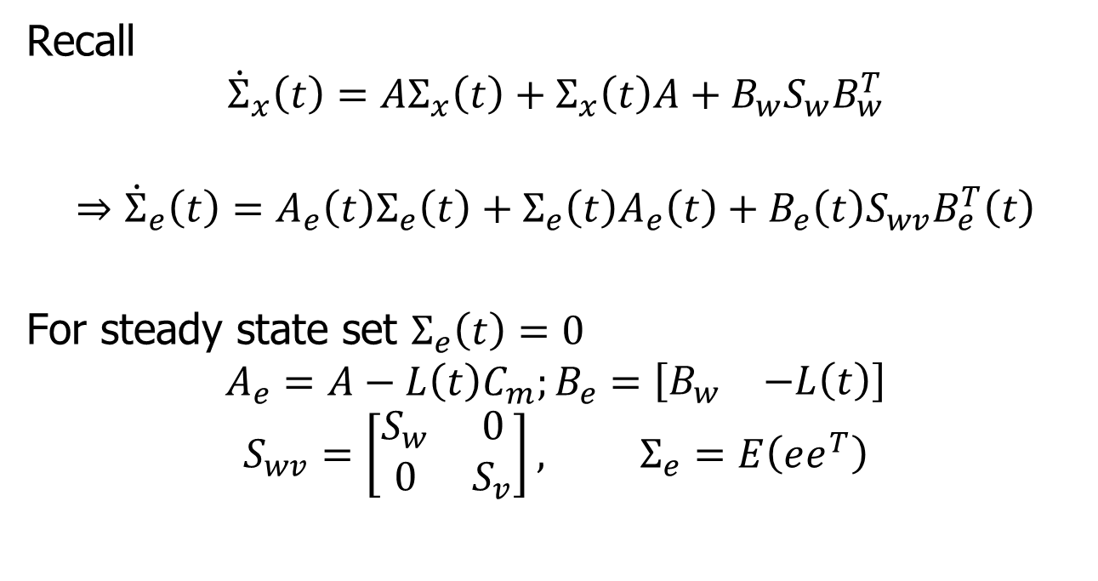
Kalman Gain
Recall
$${\dot{Σ}}_{x}\left(t\right)=AΣ_{x}\left(t\right)+Σ_{x}\left(t\right)A+B_{w}S_{w}B_{w}^{T}$$
$$⇒{\dot{Σ}}_{e}\left(t\right)=A_{e}\left(t\right)Σ_{e}\left(t\right)+Σ_{e}\left(t\right)A_{e}\left(t\right)+B_{e}\left(t\right)S_{wv}B_{e}^{T}\left(t\right)$$
For steady state set $Σ_{e}\left(t\right)=0$
$$A_{e}=A−L\left(t\right)C_{m};B_{e}=\left[\begin{matrix}B_{w} & −L\left(t\right)\end{matrix}\right]$$
$$S_{wv}=\left[\begin{matrix}S_{w} & 0 \\ 0 & S_{v}\end{matrix}\right], Σ_{e}=E\left(ee^{T}\right)$$

Slide 38
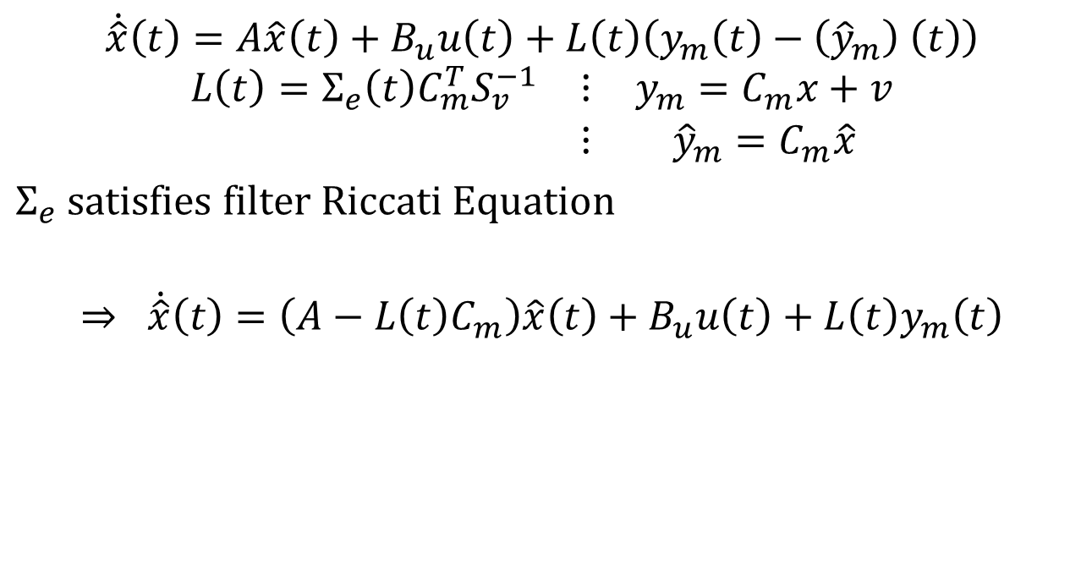
Kalman Filter Equations
$$\dot{\hat{x}}\left(t\right)=A\hat{x}\left(t\right)+B_{u}u\left(t\right)+L\left(t\right)\left(y_{m}\left(t\right)−\left({\hat{y}}_{m}\right) \left(t\right)\right)$$
$$\begin{matrix}L\left(t\right)=Σ_{e}\left(t\right)C_{m}^{T}S_{v}^{−1} & ⋮ & y_{m}=C_{m}x+v \\ & ⋮ & {\hat{y}}_{m}=C_{m}\hat{x}\end{matrix}$$
$Σ_{e}$ satisfies filter Riccati Equation
$$⇒ \dot{\hat{x}}\left(t\right)=\left(A−L\left(t\right)C_{m}\right)\hat{x}\left(t\right)+B_{u}u\left(t\right)+L\left(t\right)y_{m}\left(t\right)$$

Slide 39







Closed Loop System
$$u$$
$$y_{m}$$
$$Plant$$
$$Kalman \\ Filter$$
$$\hat{x}$$
$$−K$$
$$LQG$$

Slide 40
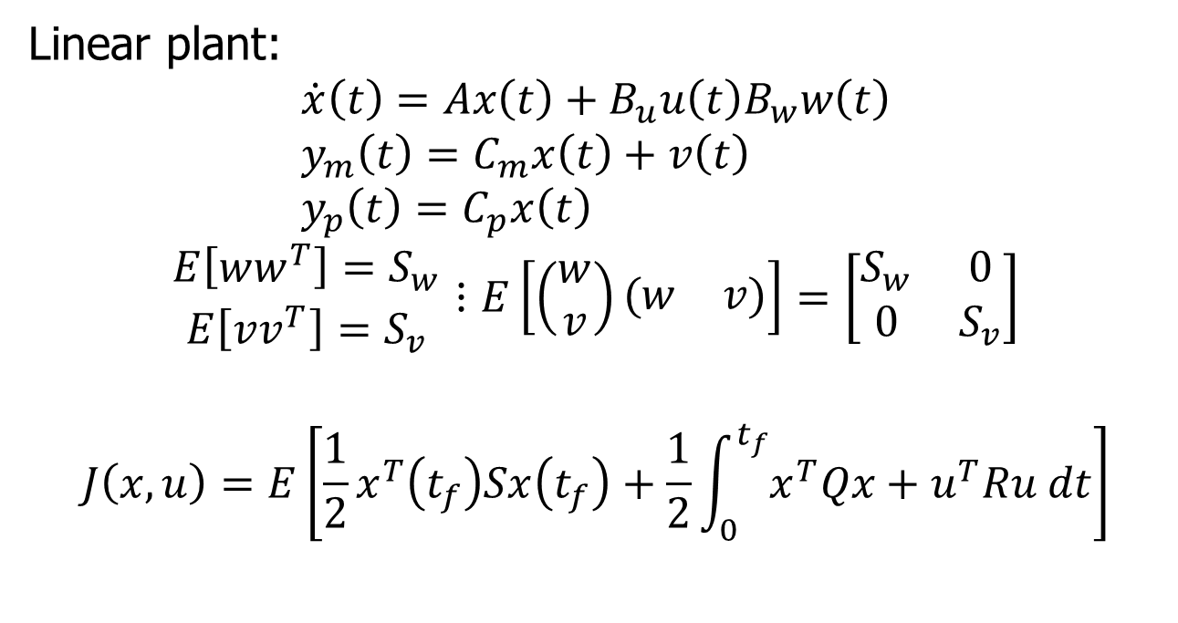
Linear Quadratic Gaussian (LQG)
Linear plant:
$$\dot{x}\left(t\right)=Ax\left(t\right)+B_{u}u\left(t\right)B_{w}w\left(t\right) \\ y_{m}\left(t\right)=C_{m}x\left(t\right)+v\left(t\right) \\ y_{p}\left(t\right)=C_{p}x\left(t\right)$$
$$\begin{matrix}E\left[ww^{T}\right]=S_{w} \\ E\left[vv^{T}\right]=S_{v}\end{matrix}⋮E\left[\left(\begin{matrix}w \\ v\end{matrix}\right)\left(\begin{matrix}w & v\end{matrix}\right)\right]=\left[\begin{matrix}S_{w} & 0 \\ 0 & S_{v}\end{matrix}\right]$$
$$J\left(x,u\right)=E\left[\frac{1}{2}x^{T}\left(t_{f}\right)Sx\left(t_{f}\right)+\frac{1}{2}\int_{0}^{t_{f}}{x^{T}Qx+u^{T}Ru dt}\right]$$

Slide 41
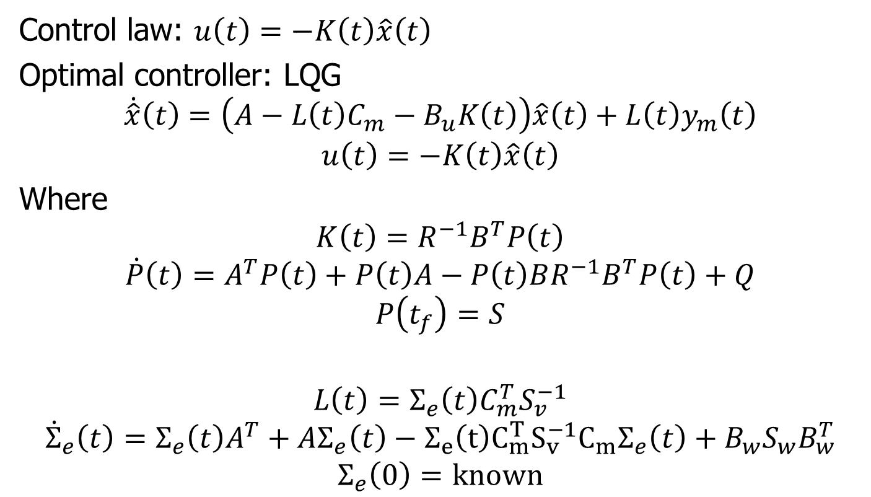
LQG
Control law: $u\left(t\right)=−K\left(t\right)\hat{x}\left(t\right)$
Optimal controller: LQG
$$\dot{\hat{x}}\left(t\right)=\left(A−L\left(t\right)C_{m}−B_{u}K\left(t\right)\right)\hat{x}\left(t\right)+L\left(t\right)y_{m}\left(t\right)$$
$$u\left(t\right)=−K\left(t\right)\hat{x}\left(t\right)$$
Where
$$K\left(t\right)=R^{−1}B^{T}P\left(t\right)$$
$$\dot{P}\left(t\right)=A^{T}P\left(t\right)+P\left(t\right)A−P\left(t\right)BR^{−1}B^{T}P\left(t\right)+Q$$
$$P\left(t_{f}\right)=S$$
$$L\left(t\right)=Σ_{e}\left(t\right)C_{m}^{T}S_{v}^{−1}$$
$${\dot{Σ}}_{e}\left(t\right)=Σ_{e}\left(t\right)A^{T}+AΣ_{e}\left(t\right)−Σ_{e}\left(t\right)C_{m}^{T}S_{v}^{−1}C_{m}Σ_{e}\left(t\right)+B_{w}S_{w}B_{w}^{T}$$
$$Σ_{e}\left(0\right)=known$$

Slide 42






LQG
$$Δ$$
$$w$$
$$P\left(s\right)$$
$$y$$
$$u$$
$$C\left(s\right)$$

Slide 43
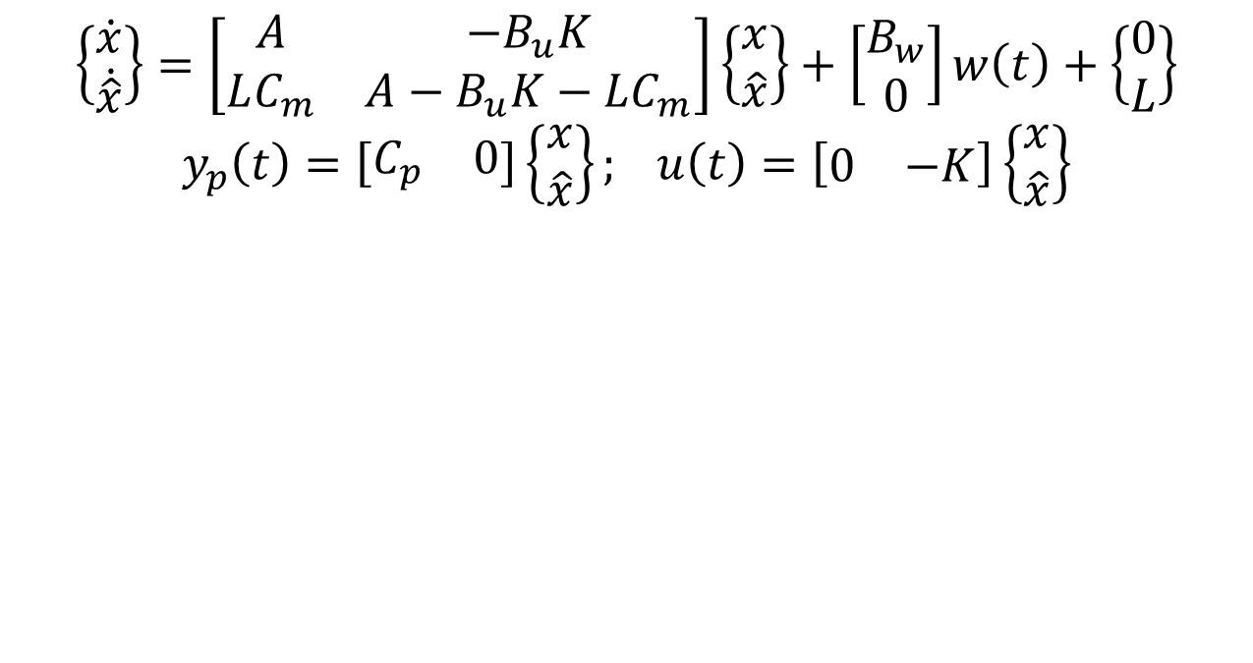
Closed-loop LQG System
$$\left\{\begin{matrix}\dot{x} \\ \dot{\hat{x}}\end{matrix}\right\}=\left[\begin{matrix}A & −B_{u}K \\ LC_{m} & A−B_{u}K−LC_{m}\end{matrix}\right]\left\{\begin{matrix}x \\ \hat{x}\end{matrix}\right\}+\left[\begin{matrix}B_{w} \\ 0\end{matrix}\right]w\left(t\right)+\left\{\begin{matrix}0 \\ L\end{matrix}\right\}$$
$$y_{p}\left(t\right)=\left[\begin{matrix}C_{p} & 0\end{matrix}\right]\left\{\begin{matrix}x \\ \hat{x}\end{matrix}\right\}; u\left(t\right)=\left[\begin{matrix}0 & −K\end{matrix}\right]\left\{\begin{matrix}x \\ \hat{x}\end{matrix}\right\}$$

Slide 44
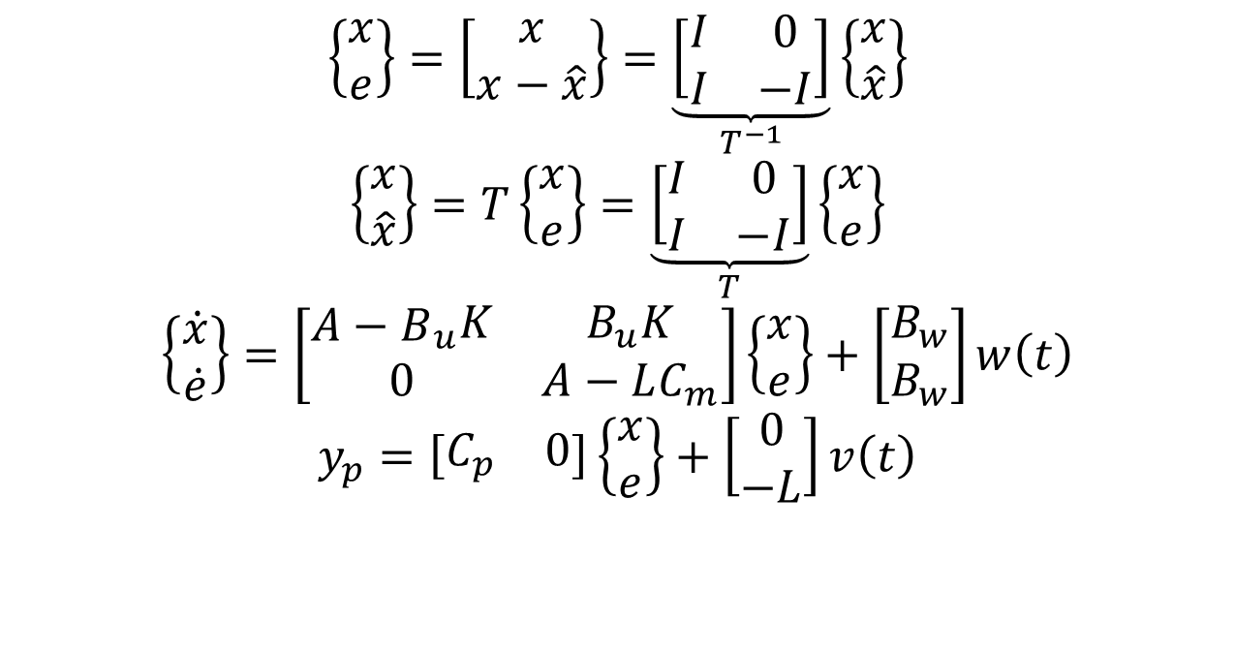
Closed-loop LQG System
$$\left\{\begin{matrix}x \\ e\end{matrix}\right\}=\left[\begin{matrix}x \\ x−\hat{x}\end{matrix}\right\}=\underset{T^{−1}}{\underbrace{\left[\begin{matrix}I & 0 \\ I & −I\end{matrix}\right]}}\left\{\begin{matrix}x \\ \hat{x}\end{matrix}\right\}$$
$$\left\{\begin{matrix}x \\ \hat{x}\end{matrix}\right\}=T\left\{\begin{matrix}x \\ e\end{matrix}\right\}=\underset{T}{\underbrace{\left[\begin{matrix}I & 0 \\ I & −I\end{matrix}\right]}}\left\{\begin{matrix}x \\ e\end{matrix}\right\}$$
$$\left\{\begin{matrix}\dot{x} \\ \dot{e}\end{matrix}\right\}=\left[\begin{matrix}{\begin{matrix}A−B\end{matrix}}_{u}K & B_{u}K \\ 0 & A−LC_{m}\end{matrix}\right]\left\{\begin{matrix}x \\ e\end{matrix}\right\}+\left[\begin{matrix}B_{w} \\ B_{w}\end{matrix}\right]w\left(t\right)$$
$$y_{p}=\left[\begin{matrix}C_{p} & 0\end{matrix}\right]\left\{\begin{matrix}x \\ e\end{matrix}\right\}+\left[\begin{matrix}0 \\ −L\end{matrix}\right]v\left(t\right)$$

