Slide 1
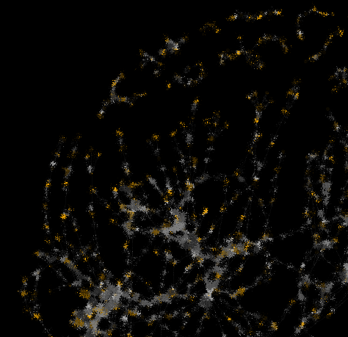
Adverse Outcome Pathway Network Analyses: Techniques and benchmarking the AOPwiki
N. Polleschª, J. O’ Brien^{b}, and D. Villeneuveª
ª United States Environmental Protection Agency, Mid- Continent Ecology Division, Duluth, MN, USA
^{b} Environment and Climate Change Canada, Ottawa, Ontario, Canada

Slide 2
AOPwiki Background
The AOPwiki (www.aopwiki.org) is a place to store and share AOP information among AOP developers, users, and stakeholders.
As the AOPwiki grows and collaborative effort builds the AOP knowledgebase, more and diverse AOPs are being added.
The AOPwiki itself can be considered one large network. Allowing us to use and develop network analysis techniques for studying it. It is from this view that we began our analyses and work.
Understanding how expansion of the AOPwiki and knowledge base is influencing the structure of the AOPwiki as a network can help guide development and create benchmarks for growth.

Slide 3
Outline
Summary of AOPwiki from a network perspective
Number of AOPs
Level of biological organization represented
Component Analyses
Weakly connected components
Strongly connected components and cycles
Degree Centrality Measures
Total degree
In-degree
Out-degree
Distance- and path-based Metrics
Betweenness
Closeness
Eccentricity
Summary and paths forward
Notes:
No pun intended on the “paths forward” comment

Slide 4
Outline
Summary of AOPwiki from a network perspective
Number of AOPs
Level of biological organization represented
Component Analyses
Weakly connected components
Strongly connected components and cycles
Degree Centrality Measures
Total degree
In-degree
Out-degree
Distance- and path-based Metrics
Betweenness
Closeness
Eccentricity
Summary and paths forward
As we move through the presentation terminology will be defined and calculations explained in brief.
Notes:
No pun intended on the “paths forward” comment

Slide 5
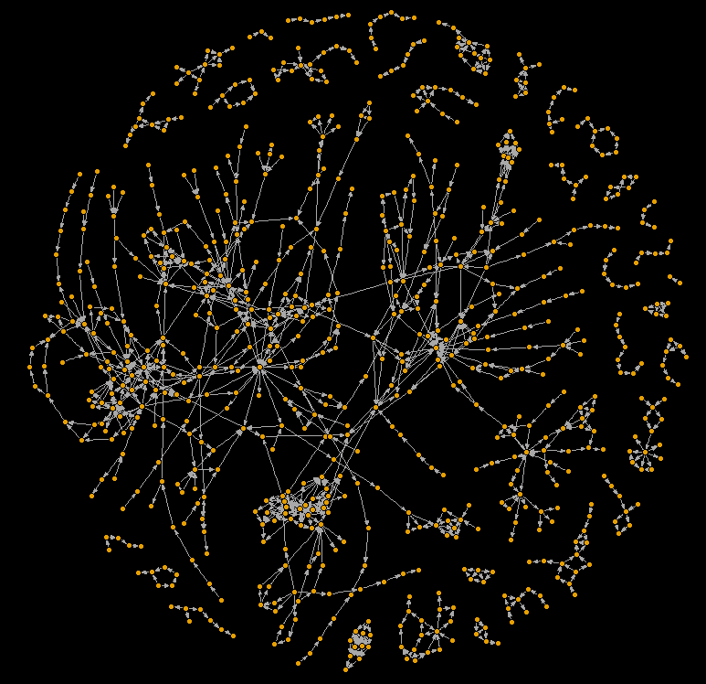
The Complete AOPwiki Network
A network diagram of the Adverse Outcome Pathway Wiki database as of: April 10th, 2017
All analyses were carried out using R software (www.r-project.org)
The iGraph package provided many of the tools (www.igraph.org)
All custom visualization and analyses can be made available

Slide 6
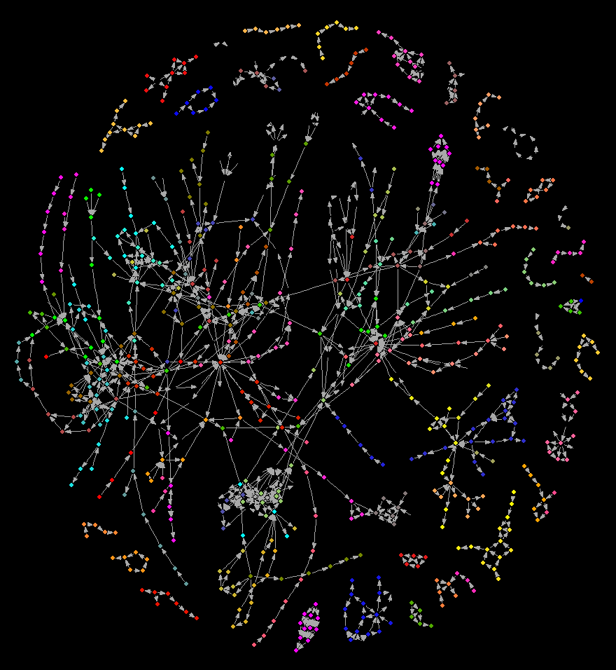
AOPwiki Snapshot
131 different AOPs
1058 key event relationships
750 unique key events
### contributing authors
From XXX countries around the world

Slide 7
AOPwiki Snapshot
131 different AOPs
1058 key event relationships
750 unique key events
### contributing authors
From XXX countries around the world
For example, this AOP is: Phospholipase A inhibitors lead to hepatotoxicity

Slide 8
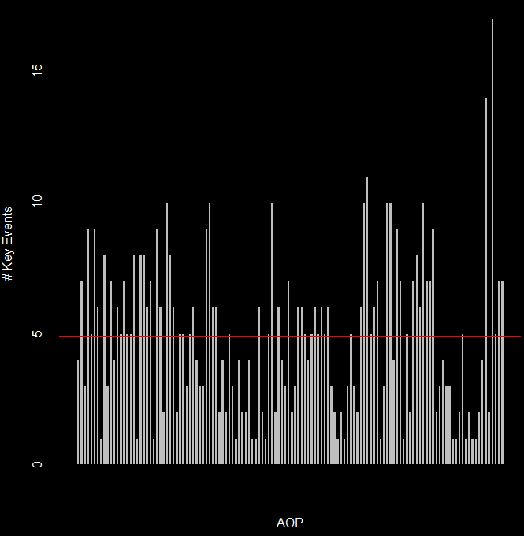
AOPwiki Snapshot
AOPs have between 1 and 17 unique key events
Mean number of unique key events (KE) per AOP is 4.8

Slide 9
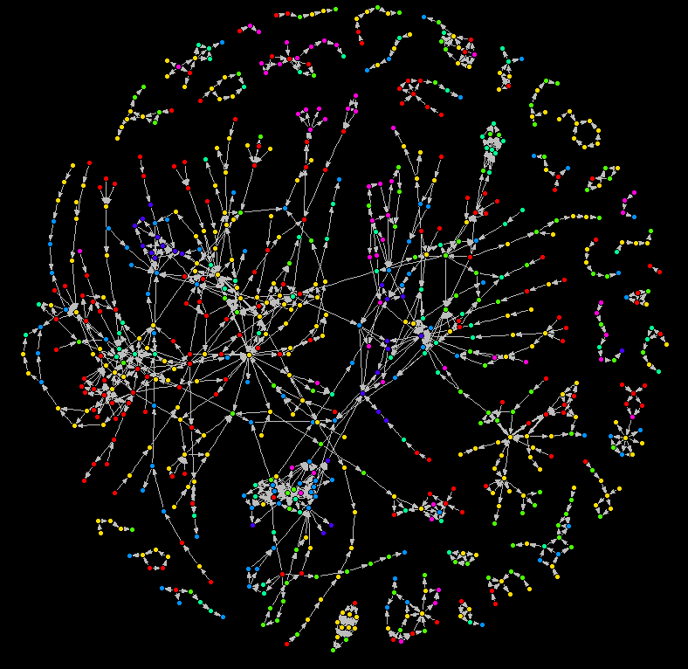
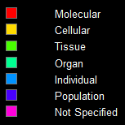
Levels of Biological Organization in the AOPwiki network
Colors represent levels of biological organization associated to Key Events in the AOPwiki. A total of 750 unique key events are in the wiki, 53 Key events in the AOPwiki had unspecified levels of biological organization.

Slide 10
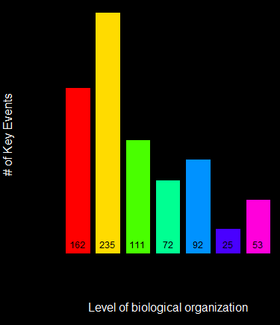
Levels of Biological Organization in the AOPwiki network
Colors represent levels of biological organization associated to Key Events in the AOPwiki. A total of 750 unique key events are in the wiki, 53 Key events in the AOPwiki had unspecified levels of biological organization
Notes:
To do: Create layout for AOP networks based on level of biological organization. Can we do a similar analysis for MIE and AO? What about KEs/KERs/AOPs by author?

Slide 11
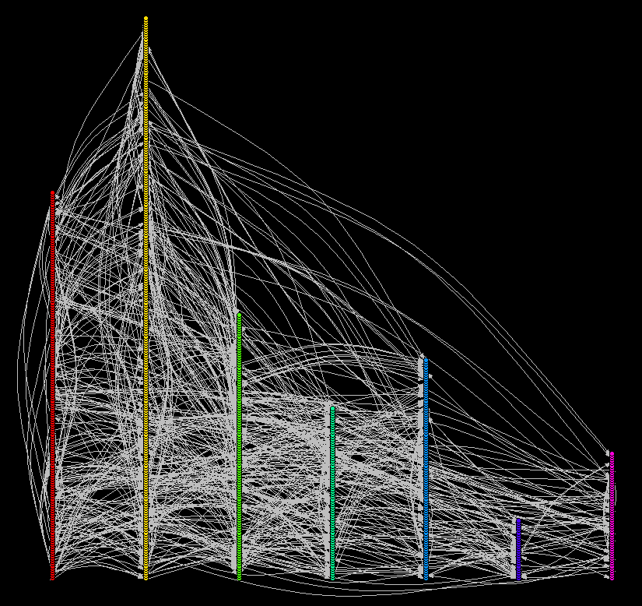
Levels of Biological Organization in the AOPwiki network
When the AOPwiki is viewed in the traditional AOP layout, by increasing level of biological organization, the result is essentially a plot of numbers of KEs in each category
Notes:
To do: Create layout for AOP networks based on level of biological organization. Can we do a similar analysis for MIE and AO? What about KEs/KERs/AOPs by author?

Slide 12
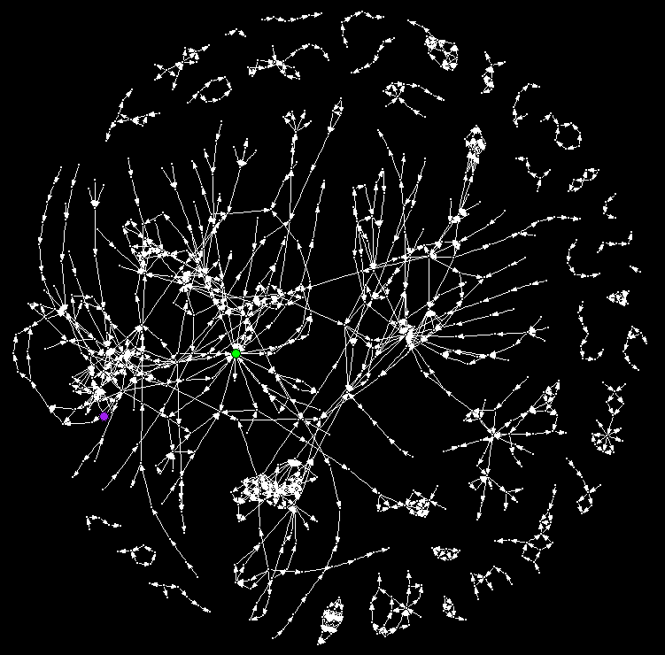
Centrality Measures in the AOPwiki network
The degree of a node is the number of adjacent edges. In this case, the key event with the highest degree is Increased oxidative stress, with 22 incident edges.
Increased oxidative stress is also the key event with the highest betweenness value, meaning that in the AOPwiki, from a non-directed standpoint, it has the most shortest paths between other nodes that travel through it.
When it comes to closeness however, which is a measure of distance between nodes on those shortest paths, Suppression, Constitutive androstane receptor, NR1l3, is the closest.

Slide 13
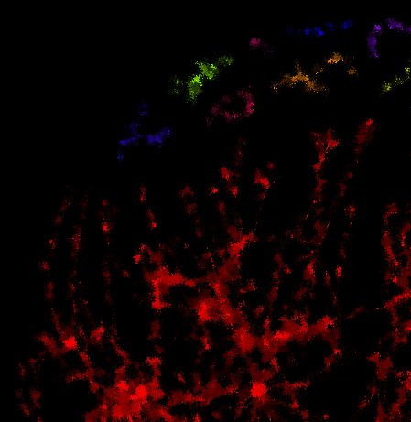
Component Analyses
Weakly connected components
Strongly connected components and cycles

Slide 14
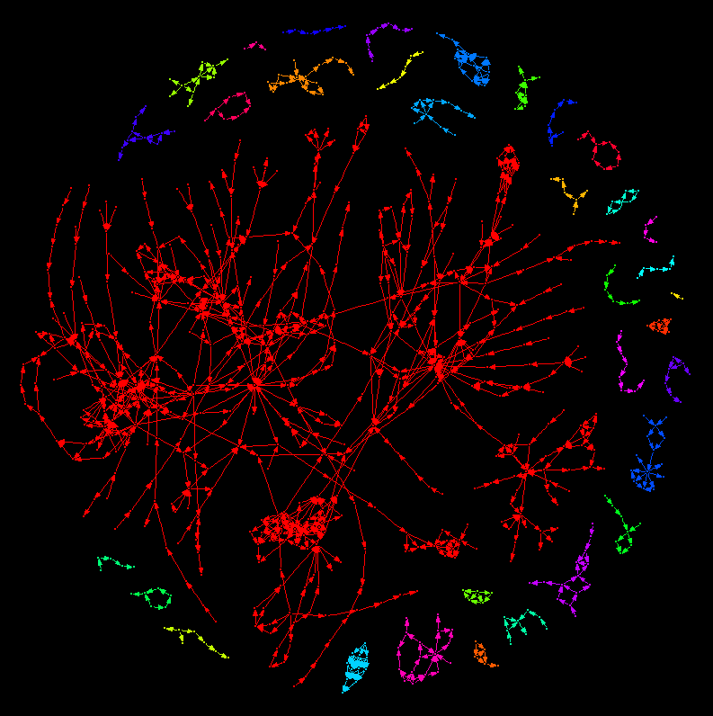
Weakly Connected Components of the AOPwiki
Weakly connected components have an undirected path between any nodes within the component
Within the AOP context, weakly connected components highlight AOP networks where at least one key event relationships is shared

Slide 15
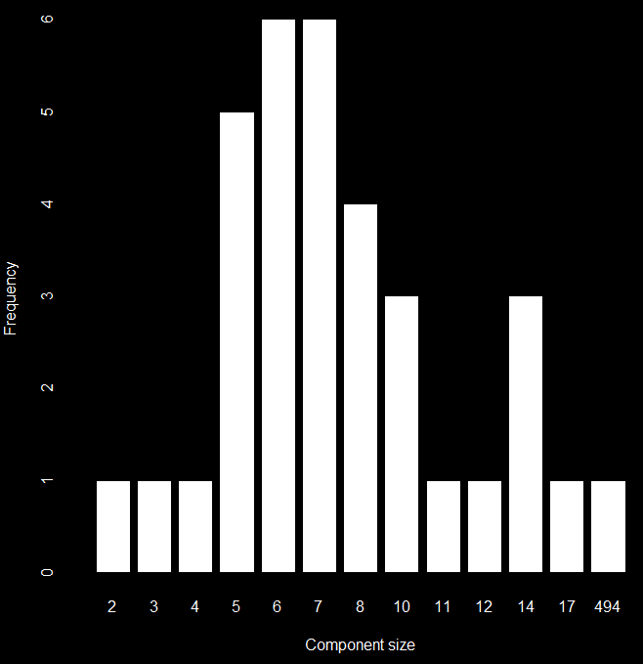
Weakly Connected Components of the AOPwiki
In the AOPwiki network. The largest weakly connected component has 494 key events in it, the smallest has 2.

Slide 16
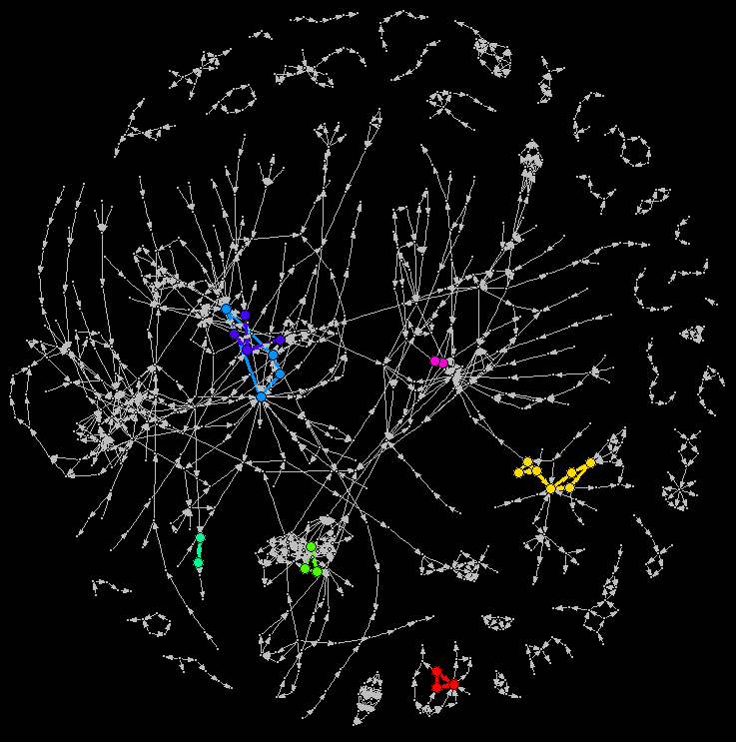
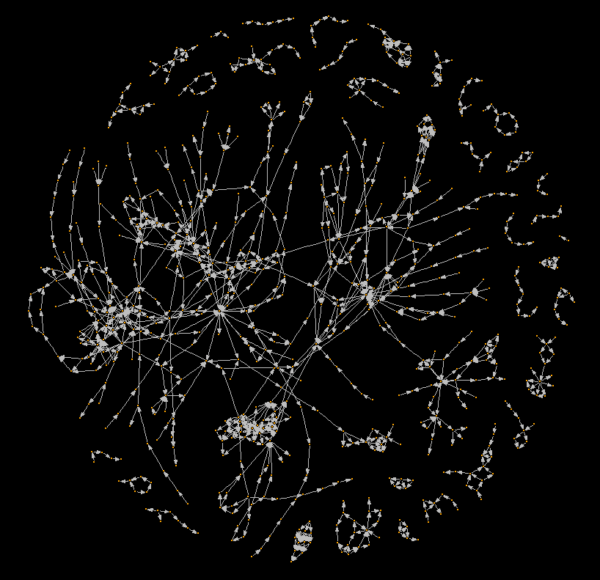
Components of the AOPwiki network
A network diagram of the Adverse Outcome Pathway Wiki database of AOPs.
In this figure, colors highlight distinct strongly connected components. Nodes within strongly connected components have a directed path to each other node in the network.
Within the AOP context, a strongly connected component highlights cycles or feedback loops between Key Events.
In the AOPwiki network there are 7 distinct cycles that emerge.

Slide 17
Components of the AOPwiki network
A network diagram of the Adverse Outcome Pathway Wiki database of AOPs.
Of the 7 distinct cycles, 3 are fully contained within a single AOP, while 3 are the result of key event relationships spanning multiple AOPs¹.
Tracking how cycles emerge and appear within the AOP wiki database will be useful for construction AOP networks. When an AOP network is without cycles, it is considered a directed acyclic graph, a classification that carries with it a special set analyses that can be utilized for study.
-----------------------------------
¹The last cycle appears to span multiple AOPs but AOP ID is a missing attribute for one of the three KE.

Slide 18
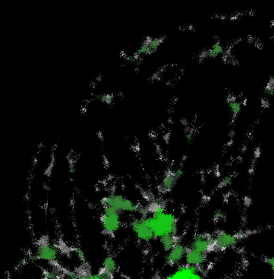
Degree Centrality Measures
Total degree
In-degree
Out-degree

Slide 19
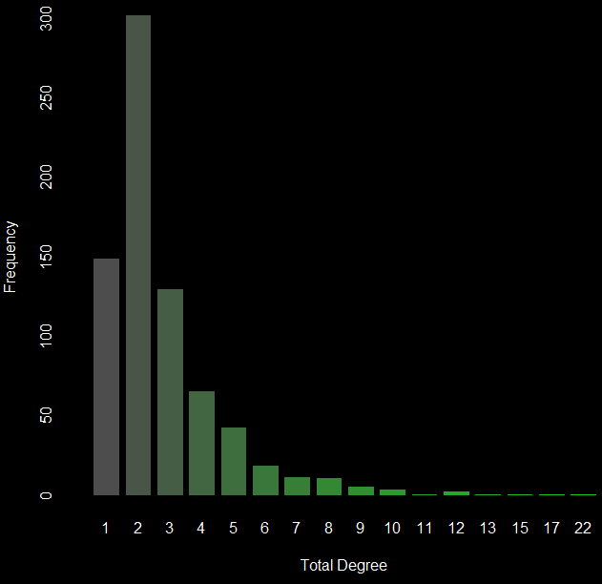
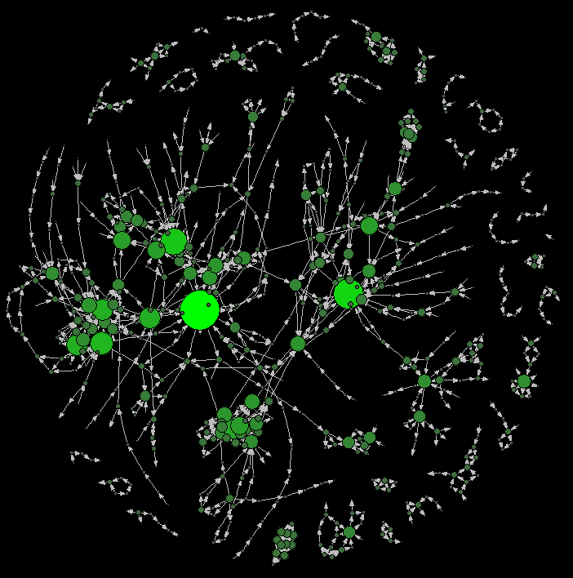

Degree (total) Heatmap
The degree (total), $D_{tot}$ of a node is the number of adjacent edges, regardless of directionality. In this case, the key event with the highest $D_{tot}$ is Increased oxidative stress, with 22 incident edges.
Notes:
To do: More specific information based on centrality measures. Expand to include better information about KEs, maybe show top ten?

Slide 20
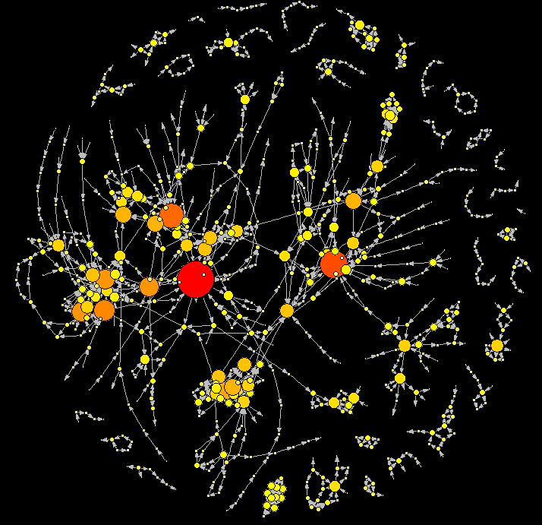




Degree (all) Heatmap
The degree (all), $D_{all}$ of a node is the number of adjacent edges, regardless of directionality. In this case, the key event with the highest $D_{all}$ is Increased oxidative stress, with 22 incident edges.
Ten key events with highest $D_{all}$ value
Key Event Name
"Increase, Oxidative Stress"
"Increased, Mortality"
"N/A, Mitochondrial dysfunction 1"
"Activation, PPAR$α$"
"Activation, LXR"
"Accumulation, Fatty acid"
"Activation, AHR"
"Increase, cilia movement"
"Increased, valve movement"
"Abnormal, Foraging activity and behavior"
$$D_{all}$$
22 17 15 13 12 12 12 11 10 10
Notes:
To do: More specific information based on centrality measures. Expand to include better information about KEs, maybe show top ten?

Slide 21
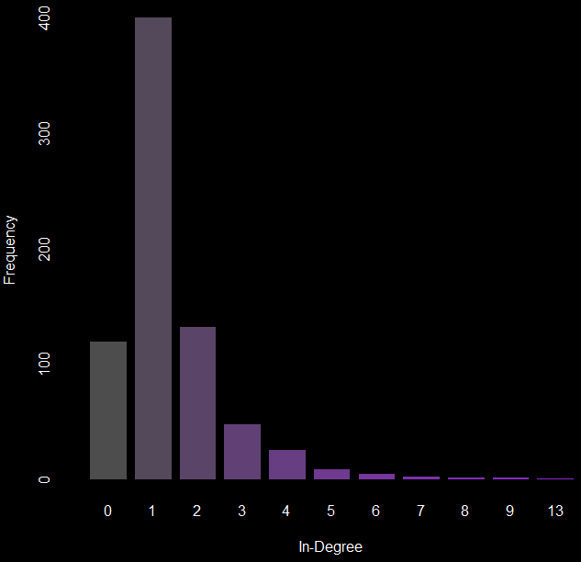
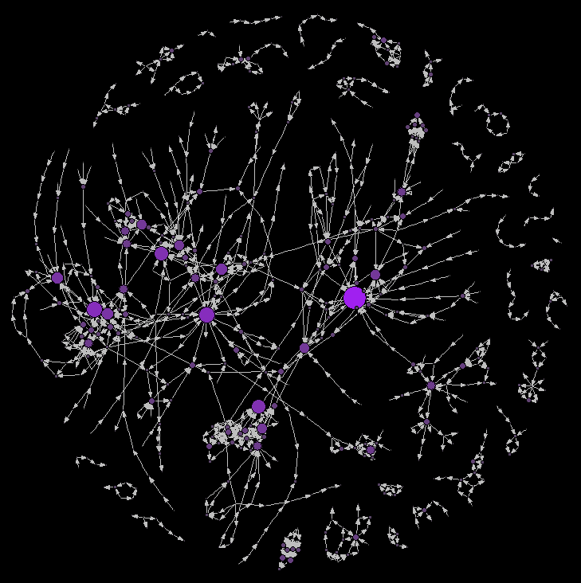
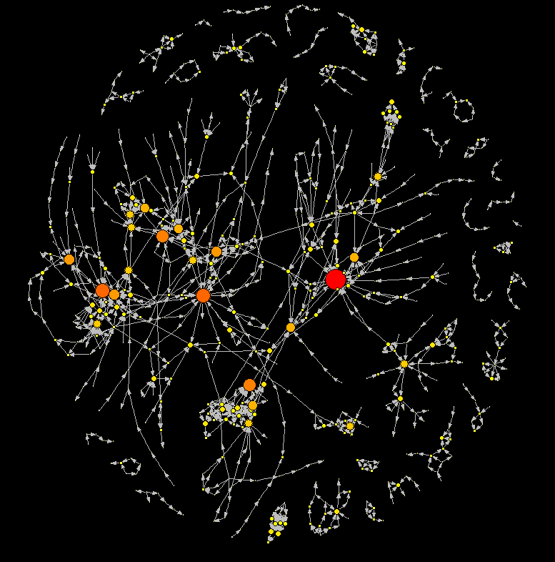

Degree (in) Heatmap
The degree (in), $D_{in}$ of a node is the number of adjacent edges coming into that node. The key event with the highest $D_{in}$ is Increased mortality, with 13 incident edges.
Notes:
To do: Incomplete AOP vs Complete AOP and ability to identify AOs and MIEs. With proper annotation we can use these analyses to identify complete vs incomplete AOPs.

Slide 22


Degree (in) Heatmap
The degree (in), $D_{in}$ of a node is the number of adjacent edges coming into that node. The key event with the highest $D_{in}$ is Increased mortality, with 13 incident edges.
Ten key events with highest $D_{in}$ value
Key Event Name
"Increased, Mortality"
"Increased, Liver Steatosis"
"Increase, Oxidative Stress"
"Decreased, Reproductive Success"
"Impairment, Learning and memory"
"Decreased, Synaptogenesis"
"Accumulation, Fatty acid"
"Reduction, 17beta-estradiol synthesis by ovarian granulosa cells"
"Depletion, energy reserves"
"Weakened, Colony"
$$D_{in}$$
13 9 9 8 8 7 7 7 6 6
Notes:
To do: Incomplete AOP vs Complete AOP and ability to identify AOs and MIEs. With proper annotation we can use these analyses to identify complete vs incomplete AOPs.

Slide 23
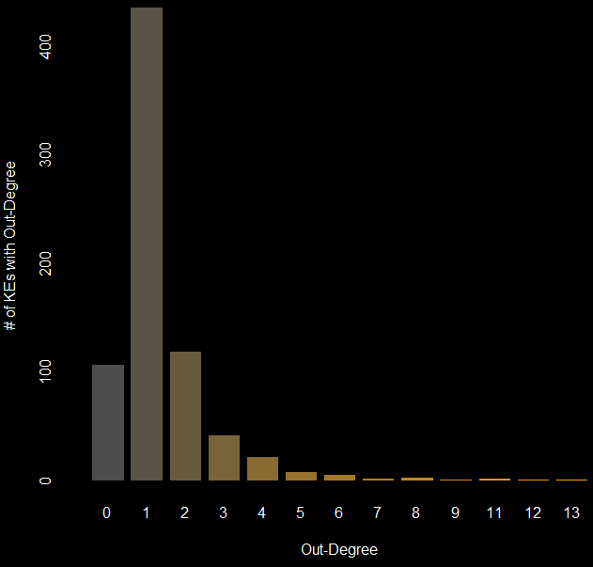
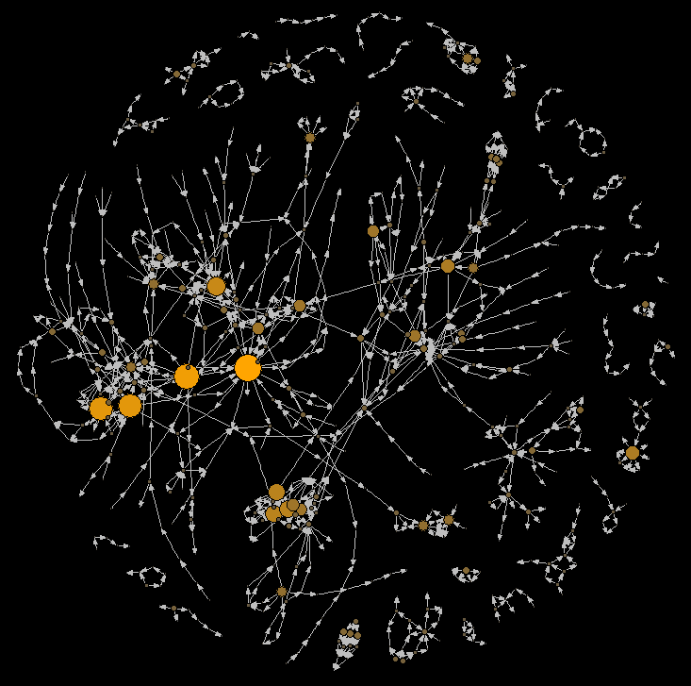

Degree (out) Heatmap
The degree (out), $D_{out}$ of a node is the number of adjacent edges, regardless of directionality. In this case, the key event with the highest $D_{out}$ is increased oxidative stress, with 13 incident edges.

Slide 24



Degree (out) Heatmap
The degree (out), $D_{out}$ of a node is the number of adjacent edges, regardless of directionality. In this case, the key event with the highest $D_{out}$ is increased oxidative stress, with 13 incident edges.
Ten key events with highest $D_{out}$ value
Key Event Name
"Increase, Oxidative Stress"
"Activation, AHR"
"Activation, PPAR$α$"
"Activation, LXR"
"N/A, Mitochondrial dysfunction 1"
"Increased, serotonin (5-HT)"
"Increase, cilia movement"
"Inhibition, 5-hydroxytryptamine transporter (5-HTT; SERT)"
"Suppression, Suppression of cytokine production in the presence of T-cell activation"
"Thyroxine (T4) in serum, Decreased"
$$D_{out}$$
13 12 11 11 9 8 8 8 7
7

Slide 25
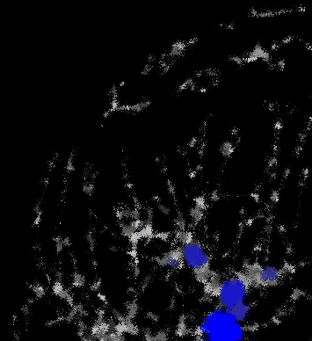
Distance- and path-based metrics
Betweenness
Directed
Undirected
Closeness
Total
In-Closeness
Out-Closeness
Eccentricity
Total Eccentricity
In-Eccentricity
Out-Eccentricity

Slide 26
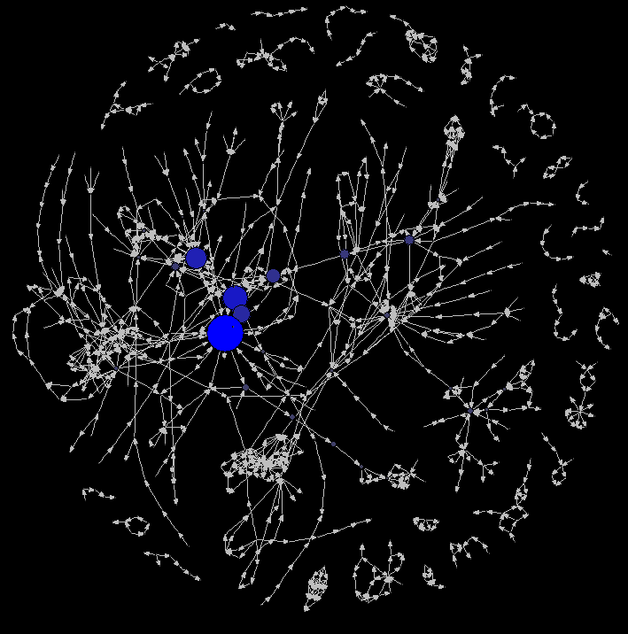

Betweenness Map
Betweenness values indicate which nodes are traversed most within shortest paths found in the network. A path is simply a set of edges (directed in this case) that connects nodes. Since multiple paths can exist between nodes, the betweenness calculation only uses those of which are the shortest (i.e. minimum number of steps between nodes).
The formula for betweenness is:
$$g\left(v\right)=\sum_{s≠v≠t}{\frac{σ_{st}\left(v\right)}{σ_{st}}}$$
Where $σ_{st}\left(v\right)$ is # of shortest paths from $s$ to $t$ through vertex $v$and$σ_{st}$ is # of shortest paths from $s$ to $t$ . Depending on the network, betweenness can be with respect to direction or not.
For the AOPwiki betweenness values range between 0 and 2360.167 and increased oxidative stress is the key event with the highest betweenness value when direction is considered.
Directed Betweenness

Slide 27
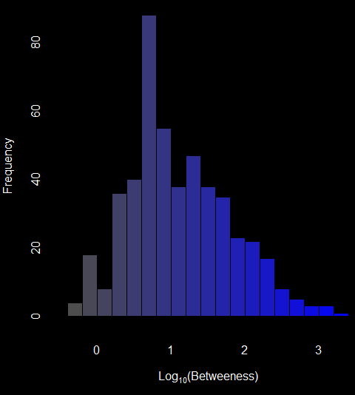
Betweenness Map
Betweenness values in the in the AOPwiki span 3 orders of magnitude from the largest to the smallest. The histogram below presents the frequency of log₁₀-transformed betweenness values.
Directed Betweenness

Slide 28
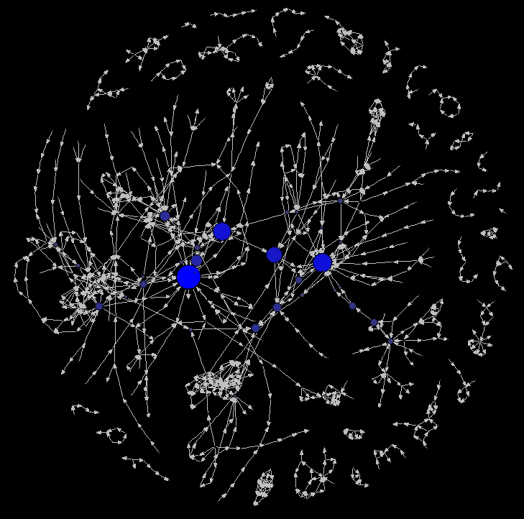
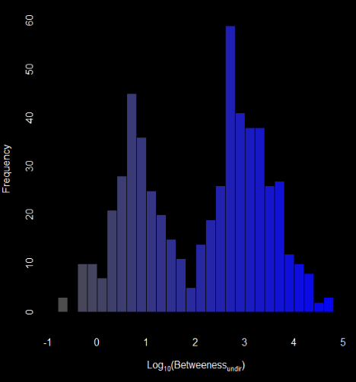
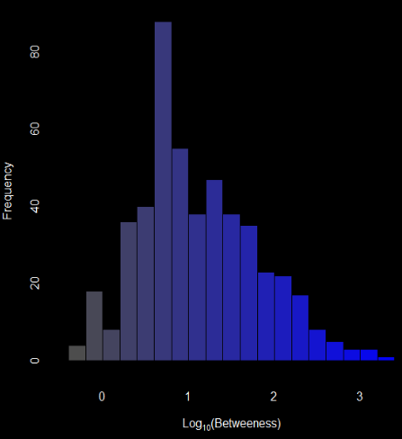
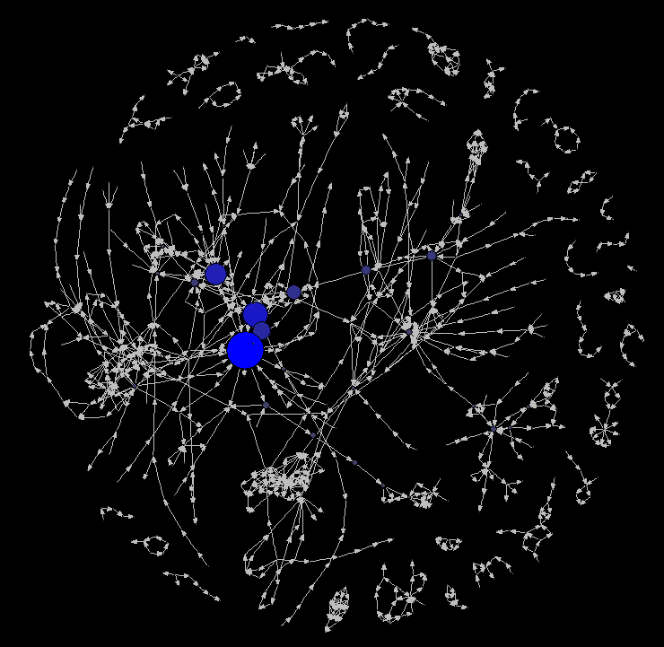
[1] "Increase, Oxidative Stress"
[2] "N/A, Cell injury/death"
[3] "N/A, Mitochondrial dysfunction 1"
[4] "Increased, Activation and Recruitment of Hepatic macrophages (Kupffer Cells)"
[5] "Reduced, Release of BDNF"
[6] "Thyroxine (T4) in serum, Decreased"
[7] "Thyroxine (T4) in neuronal tissue, Decreased"
[8] "Impairment, Learning and memory"
[9] "Increase, Cytotoxicity"
[10] "Increase, Tissue Degeneration, Necrosis & Atrophy"
Undirected Betweenness
Directed Betweenness
Undirected Betweenness
[1] "Increase, Oxidative Stress"
[2] "Increased, Mortality"
[3] "Altered, Cardiovascular development/function"
[4] "Increase, Mortality"
[5] "Increase, Pericardial edema"
[6] "N/A, Mitochondrial dysfunction 1"
[7] "Decrease, Population trajectory"
[8] "Decline, Population"
[9] "Activation, PPAR?"
[10] "Increased, blood potassium concentration"
Directed Betweenness

Slide 29
Betweenness in the AOP Context
Betweenness can be informative in identifying highly involved KEs in a global sense
When comparing directed to undirected betweenness we see a change in betweenness distribution among KEs. The KE with the highest betweenness value stays the same, but the top-ten values change quite a bit
Bi-modality in betweenness values also emerges when directionality is ignored
For AOPs and AOP networks we are perhaps more interested in looking at KEs that appear most frequently in paths between MIEs and AOs
In Villeneuve et al. 2017 (in prep.), we proposed MIE to AO path betweenness metric for more AOP specific network analysis

Slide 30
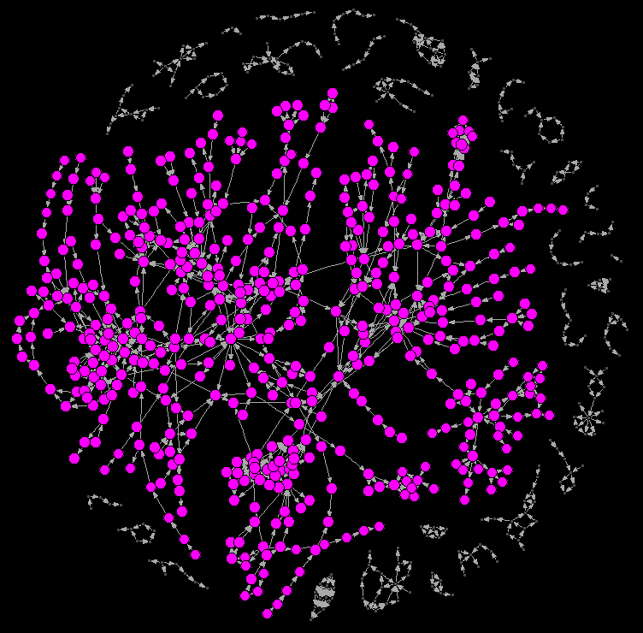
Closeness Map
Closeness is defined as the as the inverse of the average shortest path between a given node and all other nodes. This means that those nodes with the smallest average shortest path lengths, will have the largest closeness values.
When paths are found, we can consider all paths for the analysis, creating a total closeness value, or we can consider paths out of, or in to, nodes to calculate betweenness.
Total closeness

Slide 31
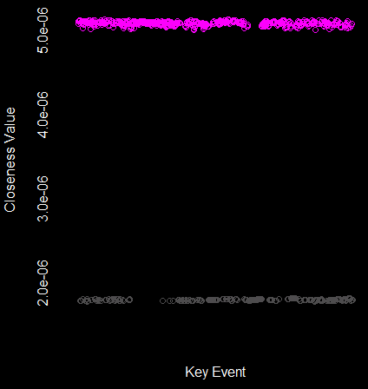
Closeness Map
Increased oxidative stress had the largest closeness value of all key events in the AOP wiki, however, all the key events in the large weakly connected component had very similar values.
Total closeness

Slide 32

Closeness Map
Increased oxidative stress had the largest closeness value of all key events in the AOP wiki, however, all the key events in the large weakly connected component had very similar values.
Total closeness

Slide 33
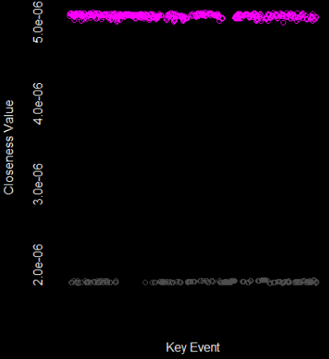
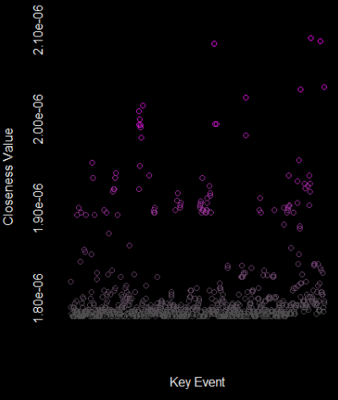
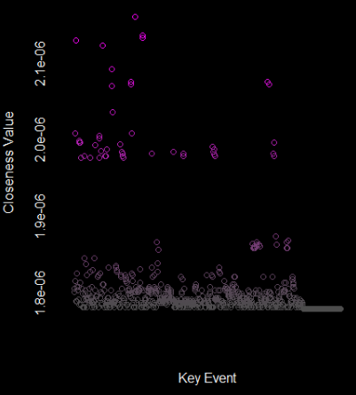
Total-closeness
In-closeness
Out-closeness
[1] "Increase, Oxidative Stress"
[2] "Increase, Pericardial edema"
[3] "Altered, Cardiovascular development/function"
[4] "Up Regulation, CYP1A1"
[5] "Altered regulation, AHR nuclear translocator (ARNT)-dependent pathways"
[6] "Increase, Mortality"
[7] "N/A, Mitochondrial dysfunction 1"
[8] "Activation, NADPH Oxidase"
[9] "Activation, AHR"
[10] "Decline, Population"
[1] "Suppression, Constitutive androstane receptor, NR1l3"
[2] "Activation, NRF2"
[3] "Activation, NR1H4"
[4] "Activation, AHR"
[5] "Activation, PPAR?"
[6] "Thyroperoxidase, Inhibition"
[7] "Inhibition, Na+/I- symporter (NIS)"
[8] "Inhibition, Iodotyrosine deiodinase (IYD)"
[9] "Decreased, Thyroidal iodide uptake"
[10] "Inhibition, Dual oxidase"
[1] "Alterations, Food-web structures"
[2] "Increased, Alterations of food-web structures"
[3] "Alteration, Food-web structures"
[4] "Decline, Population"
[5] "Reproductive failure"
[6] "Death/Failure, Colony"
[7] "Weakened, Colony"
[8] "impaired, Hive thermoregulation"
[9] "Decrease, Number of worker bees"
[10] "impaired, Larval development"

Slide 34
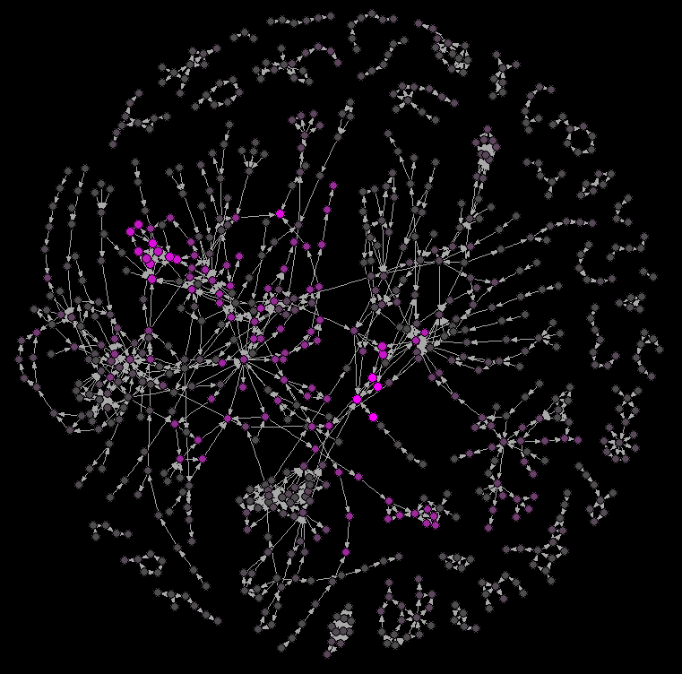
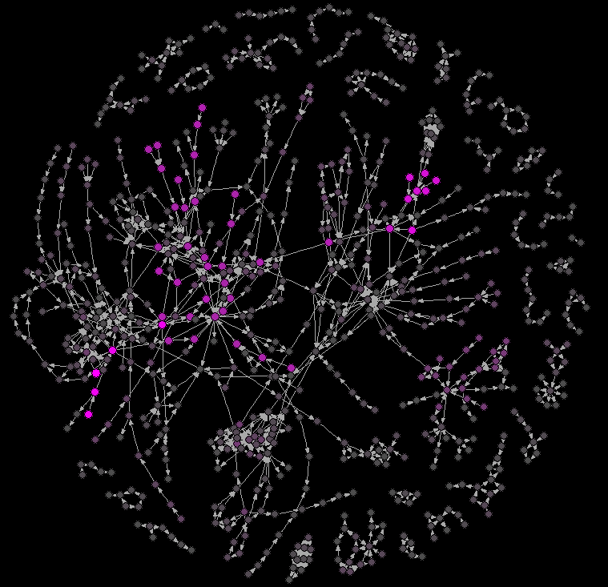
Total-closeness
In-closeness
Out-closeness
[1] "Increase, Oxidative Stress"
[2] "Increase, Pericardial edema"
[3] "Altered, Cardiovascular development/function"
[4] "Up Regulation, CYP1A1"
[5] "Altered regulation, AHR nuclear translocator (ARNT)-dependent pathways"
[6] "Increase, Mortality"
[7] "N/A, Mitochondrial dysfunction 1"
[8] "Activation, NADPH Oxidase"
[9] "Activation, AHR"
[10] "Decline, Population"
[1] "Suppression, Constitutive androstane receptor, NR1l3"
[2] "Activation, NRF2"
[3] "Activation, NR1H4"
[4] "Activation, AHR"
[5] "Activation, PPAR?"
[6] "Thyroperoxidase, Inhibition"
[7] "Inhibition, Na+/I- symporter (NIS)"
[8] "Inhibition, Iodotyrosine deiodinase (IYD)"
[9] "Decreased, Thyroidal iodide uptake"
[10] "Inhibition, Dual oxidase"
[1] "Alterations, Food-web structures"
[2] "Increased, Alterations of food-web structures"
[3] "Alteration, Food-web structures"
[4] "Decline, Population"
[5] "Reproductive failure"
[6] "Death/Failure, Colony"
[7] "Weakened, Colony"
[8] "impaired, Hive thermoregulation"
[9] "Decrease, Number of worker bees"
[10] "impaired, Larval development"

Slide 35
Closeness in the AOP context
Total closeness
When paths are considered without direction, closeness does not seem to distinguish well between KEs, other than to point out the relevance of knowing the Component structure of the network
When in- and out-closeness are considered, we see that the effect of the component structure is still present, but not as dramatically
In-closeness determines those KEs with the average shortest paths upstream
Out-closeness determines those KEs with the average shortest paths downstream
These analyses may gain relevance by considering MIE to AO paths
In-closeness
Out-closeness

Slide 36
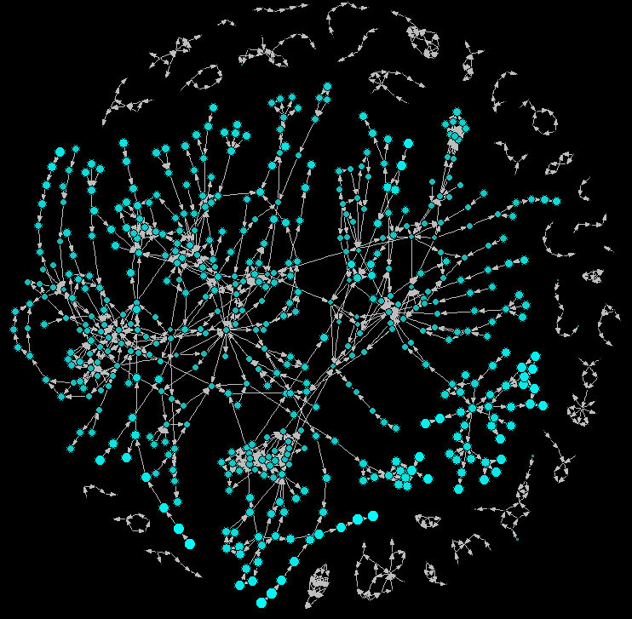
Eccentricity Map
Eccentricity is defined to be maximum of the shortest path lengths between a given node and all other nodes in the network.
Eccentricity values indicate which nodes may the most difficult to reach within a network.
In a disconnected network, if no paths between nodes exist, this would lead to infinite eccentricity values, however, if eccentricity is calculated within components, infinite values can be avoided.

Slide 37
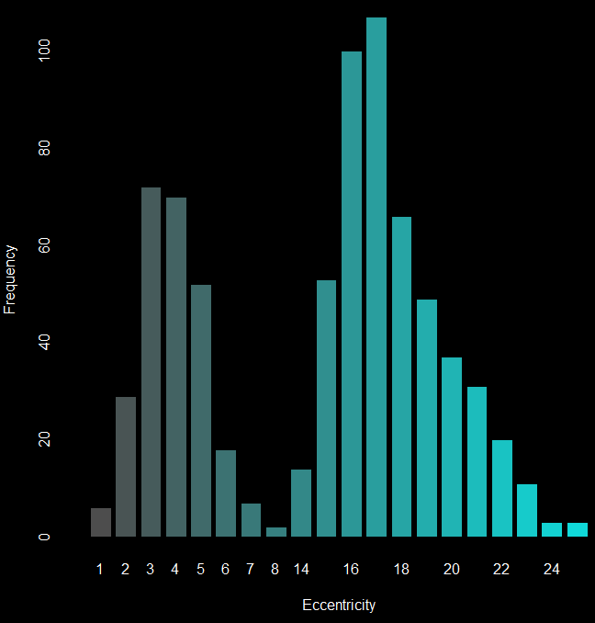

Eccentricity Map
Eccentricity values are again bi-modal, based on inclusion in the largest connected component. In an undirected sense, the most eccentric KEs in the AOPwiki are Activation Glucocorticoid Receptor, Reproductive Failure, and Inhibition 4-hydroxyphenyl-pyruvate dioxygenase (HPPD) enzyme

Slide 38
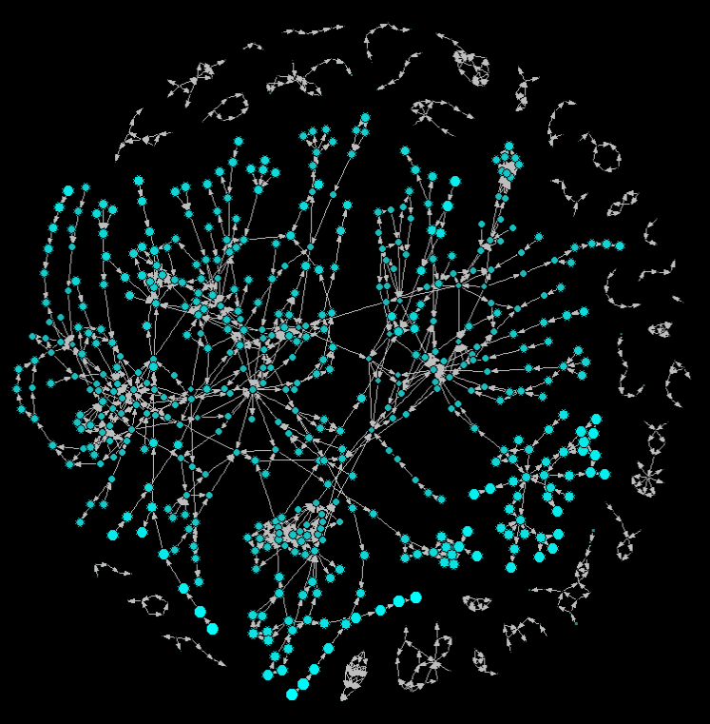
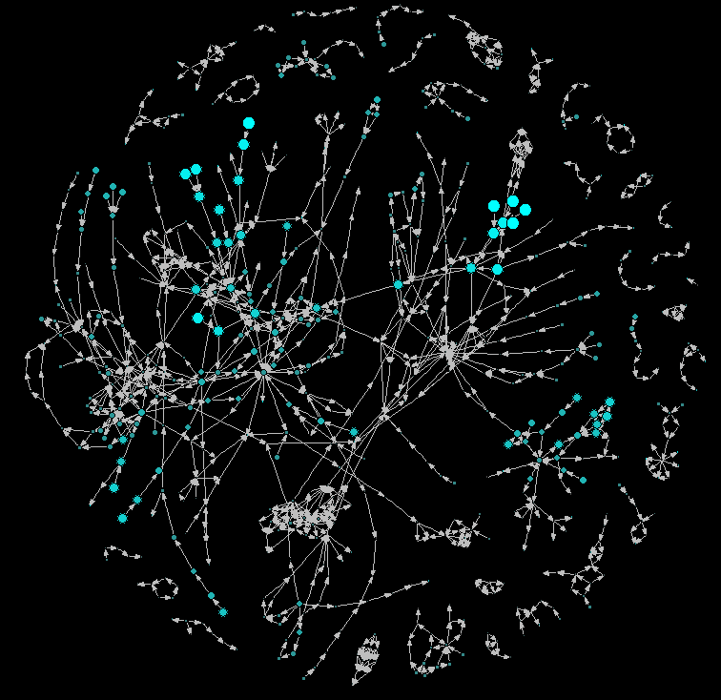
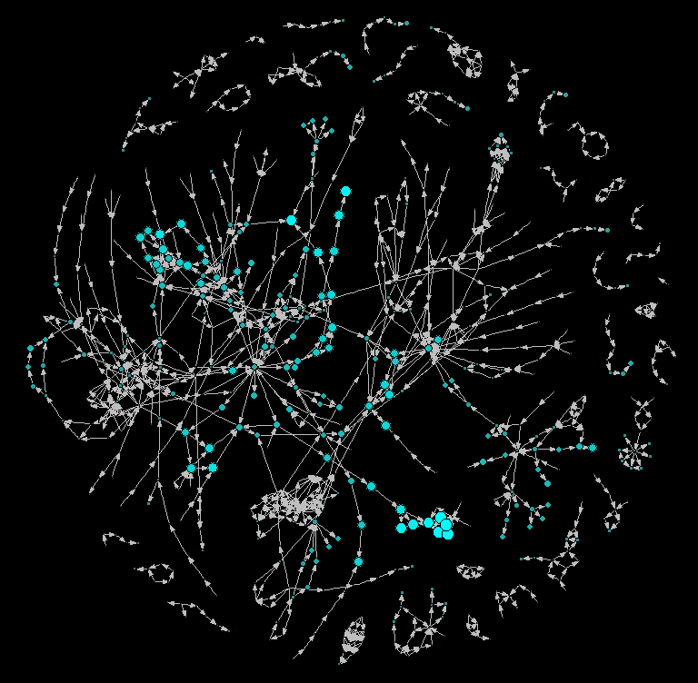
In-Eccentricity
[1] "Tumorigenesis, Hepatocellular carcinoma"
[2] "Clonal Expansion/Cell Proliferation, to form Altered Hepatic Foci (AHF)"
[3] "Increased, Clonal Expansion / Cell Proliferatin to form Pre-Neoplastic Altered Hepatic Foci"
[4] "Increased, Proliferation/Clonal Expansion of Mutant Cells (Pre-Neoplastic Lesions/Altered H"
[5] "Reproductive failure"
[6] "N/A, Hypertension"
[7] "Increase, Site of Contact Nasal Tumors"
[8] "Increase, Mutations in Critical Genes"
[9] "Increased, Induced Mutations in Critical Genes"
[10] "Defect of Embryogenesis"
Total Eccentricity
Out-Eccentricity
[1] "N/A, Reproductive failure"
[2] "Inhibition, 4-hydroxyphenyl-pyruvate dioxygenase (HPPD) enzyme"
[3] "Activation, Glucocorticoid Receptor"
[4] "Increased, Plasma tyrosine"
[5] "Induction, IKB inhibitory protein"
[6] "Reduction, Eggshell thickness"
[7] "N/A, Breast Cancer"
[8] "Increased, Second Messenger Production"
[9] "Increased, Migration (Endothelial Cells)"
[10] "Increase, Cell Proliferation (Epithelial Cells)"
[1] "Inhibition, Dual oxidase"
[2] "Inhibition, Pendrin"
[3] "Inhibition, Iodotyrosine deiodinase (IYD)"
[4] "Inhibition, Na+/I- symporter (NIS)"
[5] "Inhibition, Ca++ ATPase"
[6] "Binding of agonist, Ionotropic glutamate receptors"
[7] "Decreased, Thyroidal iodide uptake"
[8] "Binding of agonist, NMDARs"
[9] "Thyroperoxidase, Inhibition"
[10] "Thyroid hormone synthesis, Decreased"

Slide 39
Total Eccentricity
Eccentricity in the AOP context
In contrast to closeness, eccentricity will provide an idea of which KEs are the most remotely connected.
When In-Eccentricity is calculated, the KEs that stand-out will be those usually at the beginning of a long linear AOP progression. These are likely to be MIEs where multiple KEs must be traversed to get into the larger network.
When Out-Eccentricity is calculated, the KEs that stand-out will be those at the end of long linear AOP progressions. These are likely AOs with specific sequences of KEs required to activate them.
In-Eccentricity
Out-Eccentricity

Slide 40
Ideas to include in summary
Since distance is not well defined currently, metrics like betweenness, closeness, and eccentricity can be more meaningful in a qAOP context where ‘distance’ may indicate time course data or probabilistic activation of KEs.

Slide 41
