Slide 1
AOPWiki Network Analysis
Nate Pollesch, Jason O’Brien, and Dan Villenueve

Slide 2
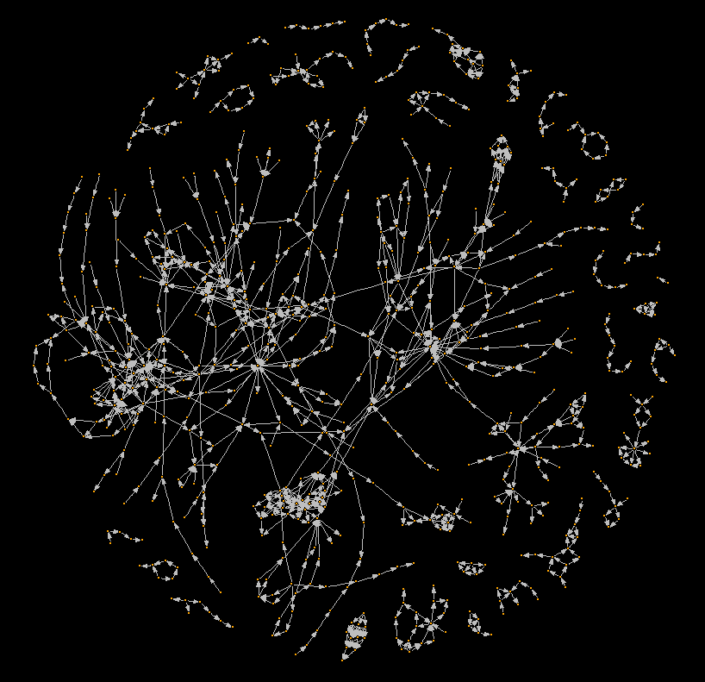
The Complete AOPwiki Network
A network diagram of the Adverse Outcome Pathway Wiki database of AOPs.
As of: April 10th, 2017

Slide 3
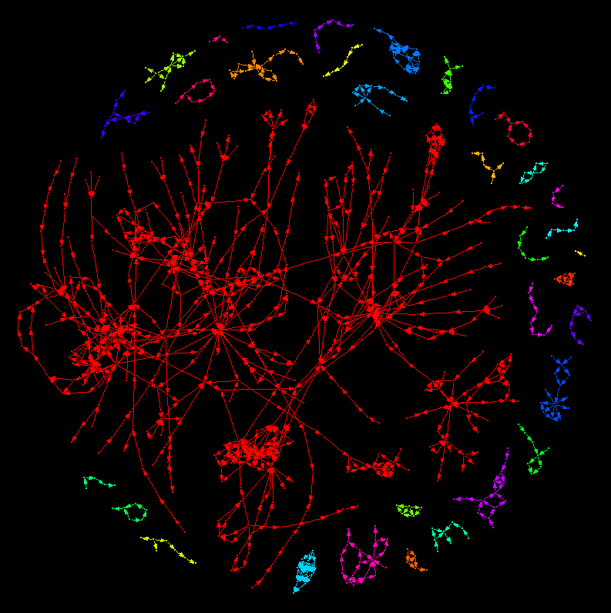
Components of the AOPwiki network
A network diagram of the Adverse Outcome Pathway Wiki database of AOPs.
In this figure, colors highlight distinct weakly connected components where an undirected path can be found between any nodes within the component (check def’n).
Within the AOP context, weakly connected components highlight AOP networks where at least one key event relationships.
There are 34 weakly connected components in the AOPwiki network. The largest has 494 key events in it, the smallest has 2.

Slide 4
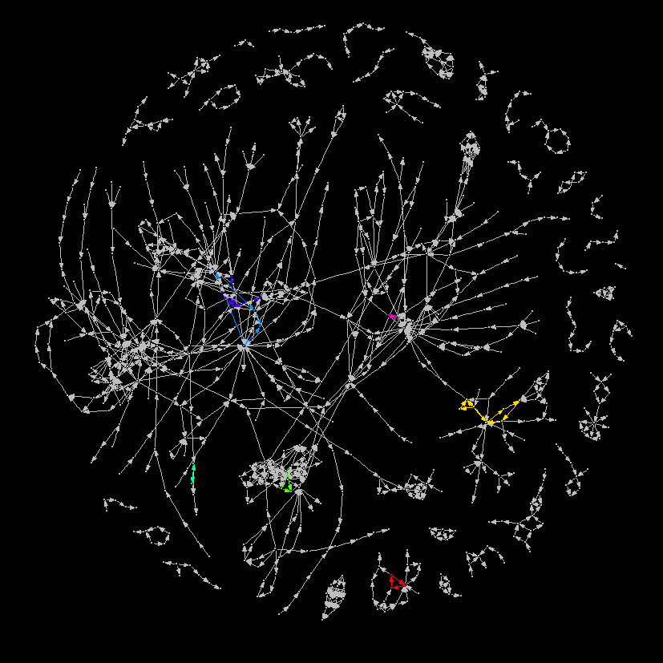
Components of the AOPwiki network
A network diagram of the Adverse Outcome Pathway Wiki database of AOPs.
In this figure, colors highlight distinct strongly connected components. Nodes within strongly connected components have a directed path to each other node in the network.
Within the AOP context, a strongly connected component highlights cycles or feedback loops between Key Events.
In the AOPwiki network there are 7 distinct cycles that emerge.

Slide 5
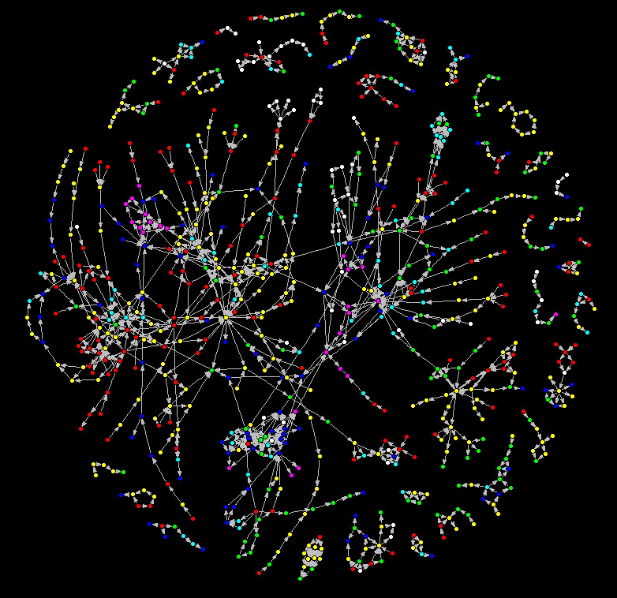
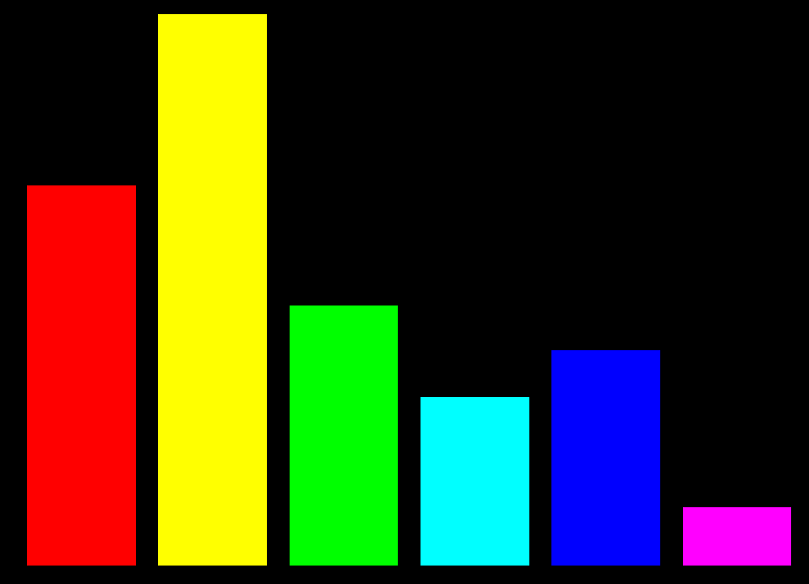
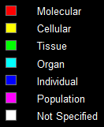

Levels of Biological Organization in the AOPwiki network
Colors represent levels of biological organization associated to Key Events in the AOPwiki. A total of 750 unique key events are in the wiki, 53 Key events in the AOPwiki had unspecified levels of biological organization
KE Occurrence
235
162
111
72
92
25
Increasing level of organization $→$

