Slide 1
AOPWiki Network Analysis
Nate Pollesch and Jason O’Brien

Slide 2
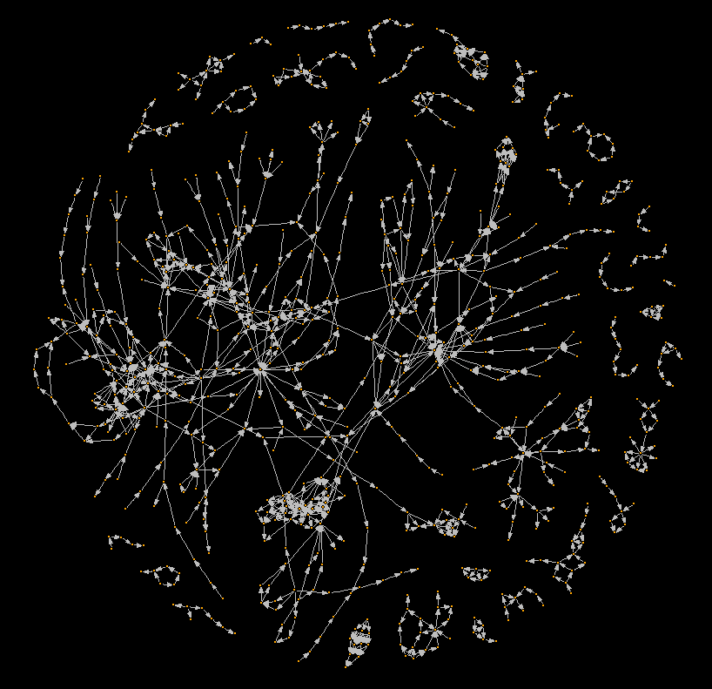
The AOPWiki

Slide 3
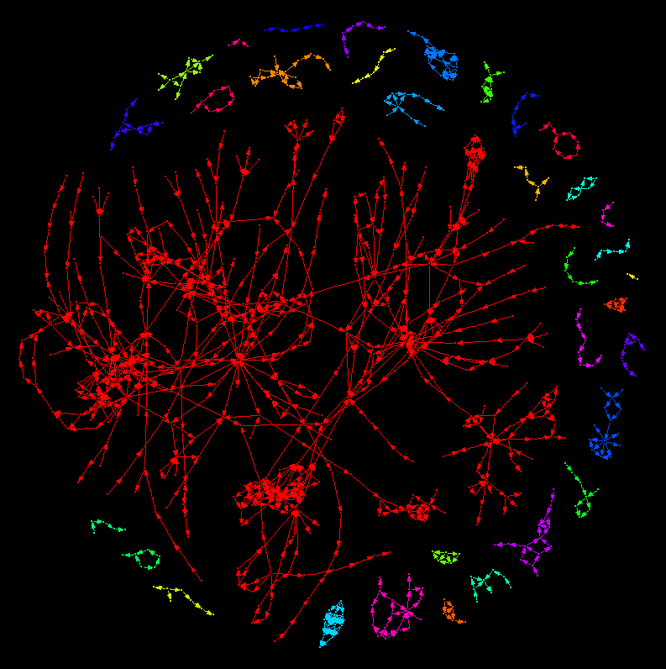
The AOPWiki - Colored by weakly connected components
Weakly connected components represent distinct AOP networks within the wiki

Slide 4
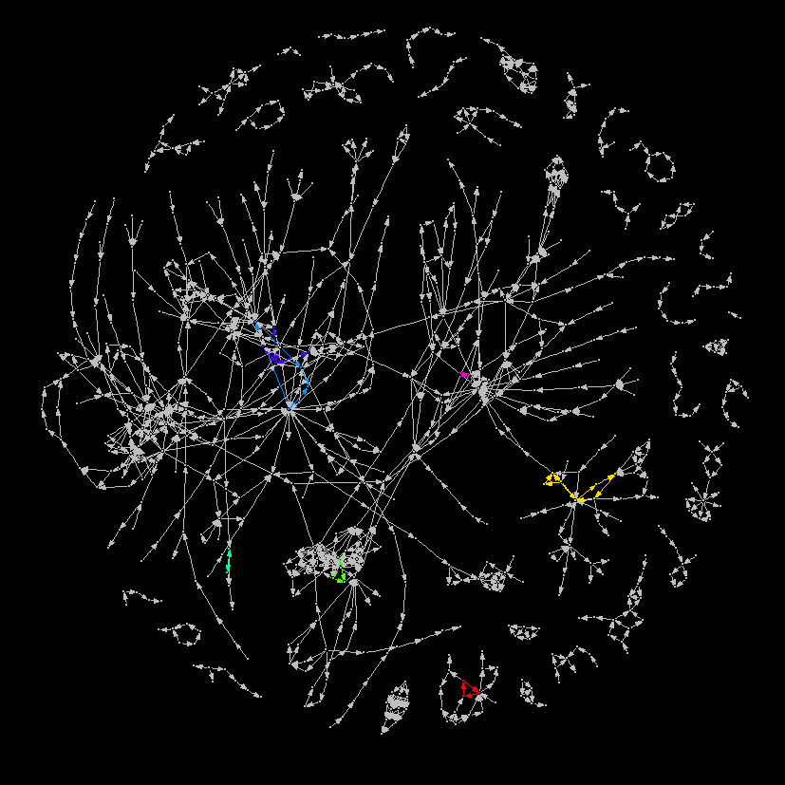
The AOPWiki - Colored by strongly connected components
Strongly connected components represent cycles or feedback loops within AOP networks within the wiki

