Slide 1
AOPWiki Network Analysis
Nate Pollesch, Jason O’Brien, …

Slide 2
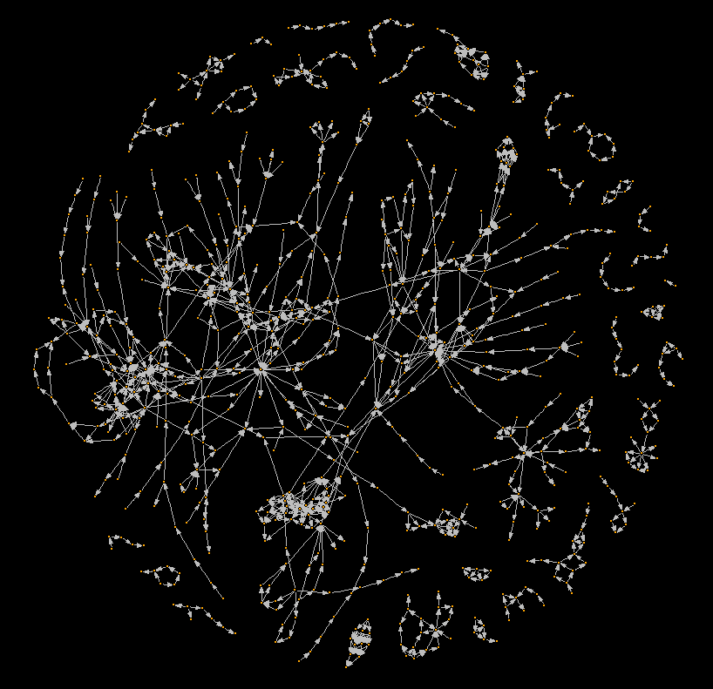
The AOPWiki Network
A network diagram of the Adverse Outcome Pathway Wiki database of AOPs.
As of: April 10th, 2017

Slide 3
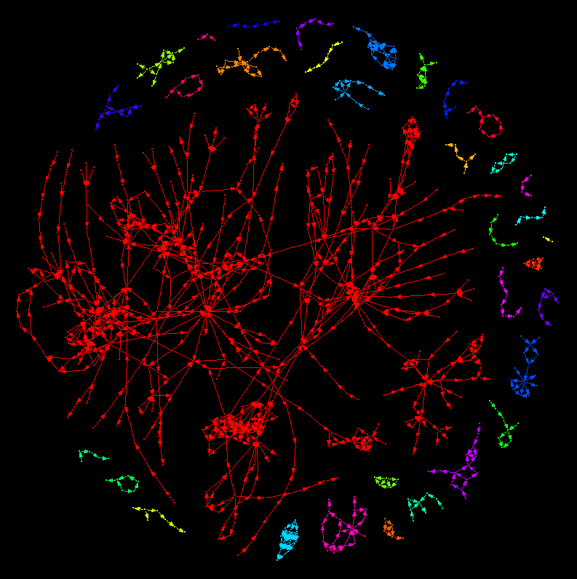
The AOPWiki
A network diagram of the Adverse Outcome Pathway Wiki database of AOPs.
In this figure, colors highlight distinct weakly connected components where an undirected path can be found between any nodes within the component (check def’n).
Within the AOP context, weakly connected components highlight AOP networks where at least one key event relationships.

Slide 4
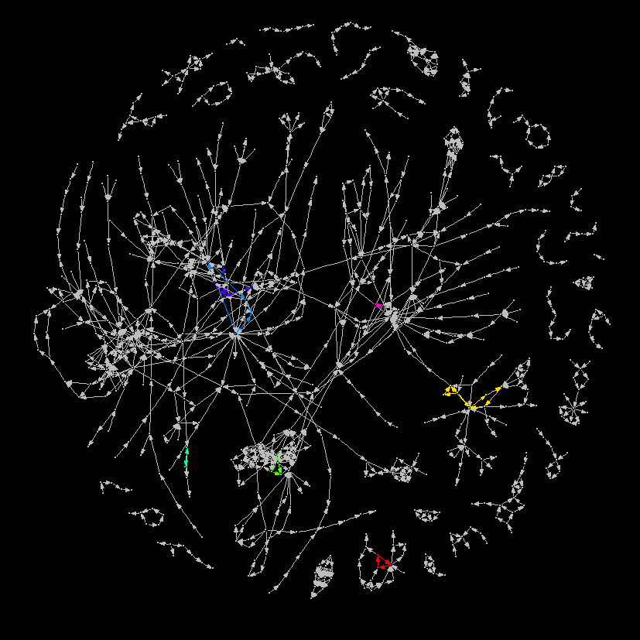
The AOPWiki
A network diagram of the Adverse Outcome Pathway Wiki database of AOPs.
In this figure, colors highlight distinct strongly connected components. Nodes within strongly connected components have a directed path to each other node in the network.
Within the AOP context, a strongly connected component highlights cycles or feedback loops between Key Events.

