Slide 1
Adverse Outcome Pathway Network Analyses: Techniques and benchmarking the AOPwiki
Nate Pollesch, Jason O’ Brien, and Dan Villeneuve

Slide 2
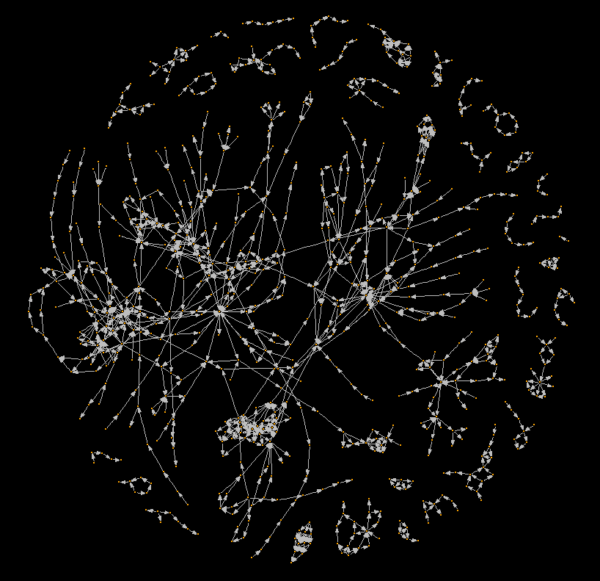
The Complete AOPwiki Network
A network diagram of the Adverse Outcome Pathway Wiki database of AOPs.
As of: April 10th, 2017

Slide 3
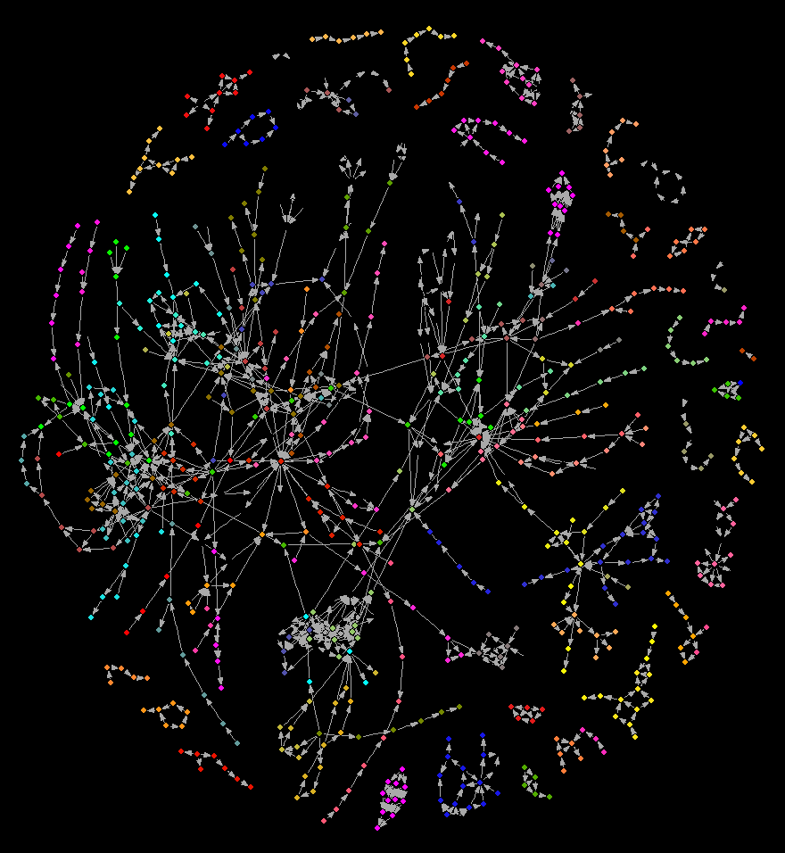
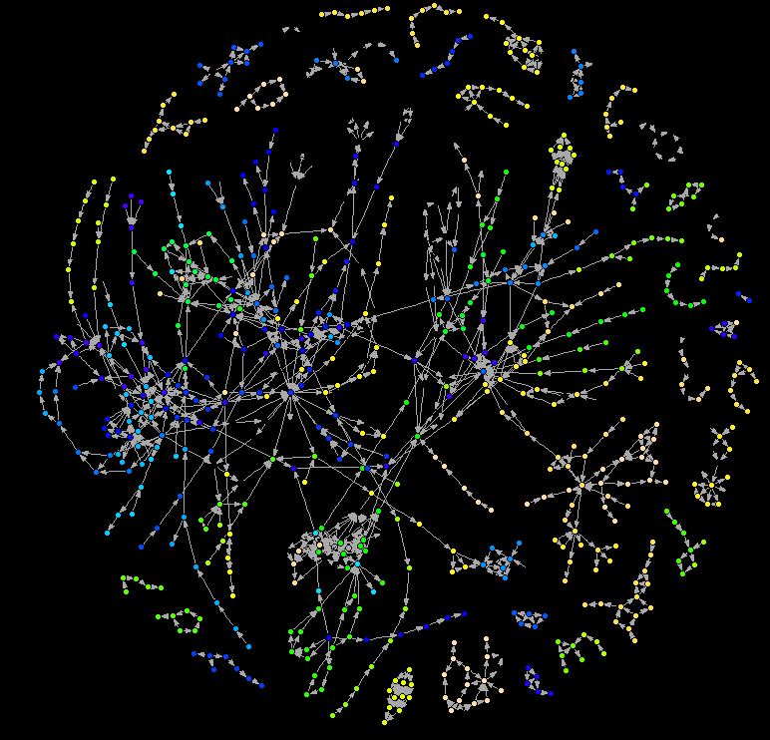
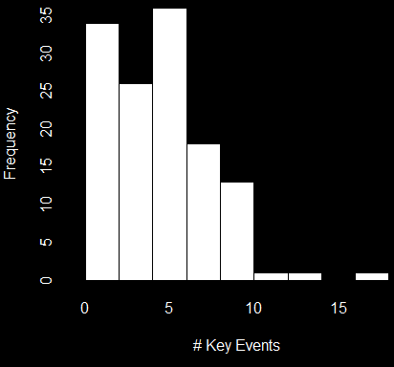
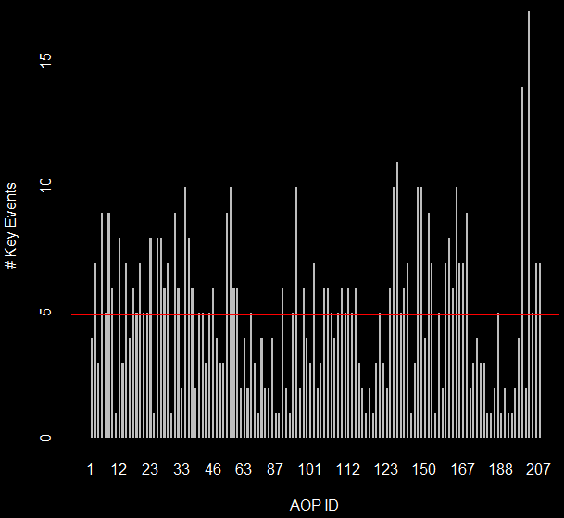
The Complete AOPwiki Network
131 different AOPs
1058 key event relationships
750 unique key events
Mean number of KEs per AOP is 4.8
Notes:
To do: Expand color palette, consider histogram for graph.
Compare publicly available database vs test database with newly incorporated ontologies.

Slide 4
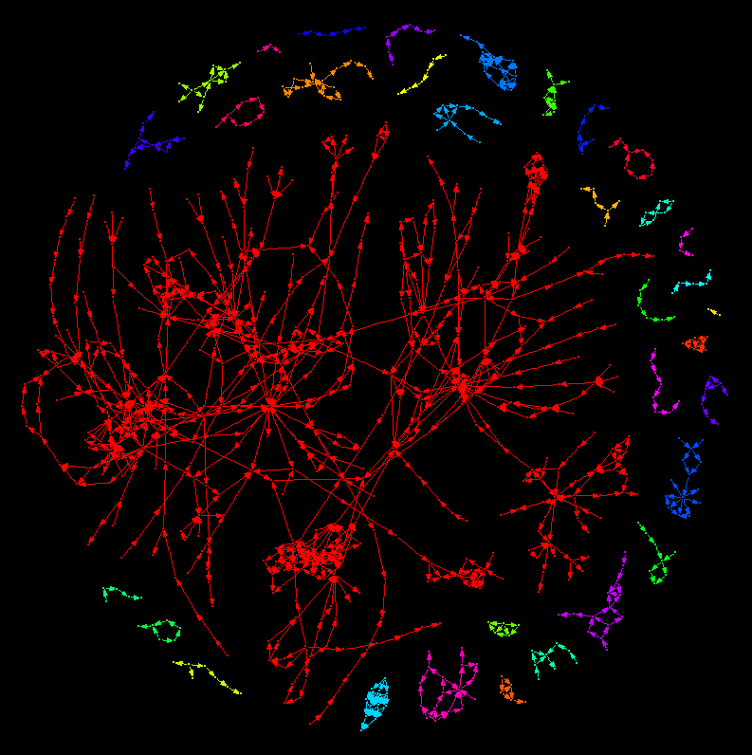
Components of the AOPwiki network
A network diagram of the Adverse Outcome Pathway Wiki database of AOPs.
In this figure, colors highlight distinct weakly connected components where an undirected path can be found between any nodes within the component (check def’n).
Within the AOP context, weakly connected components highlight AOP networks where at least one key event relationships is shared.

Slide 5
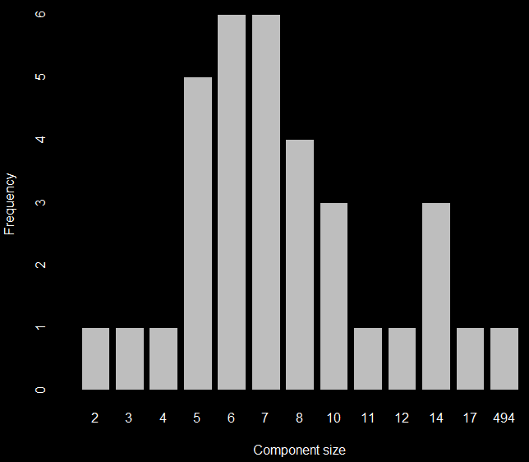
Components of the AOPwiki network
In the AOPwiki network. The largest weakly connected component has 494 key events in it, the smallest has 2.

Slide 6
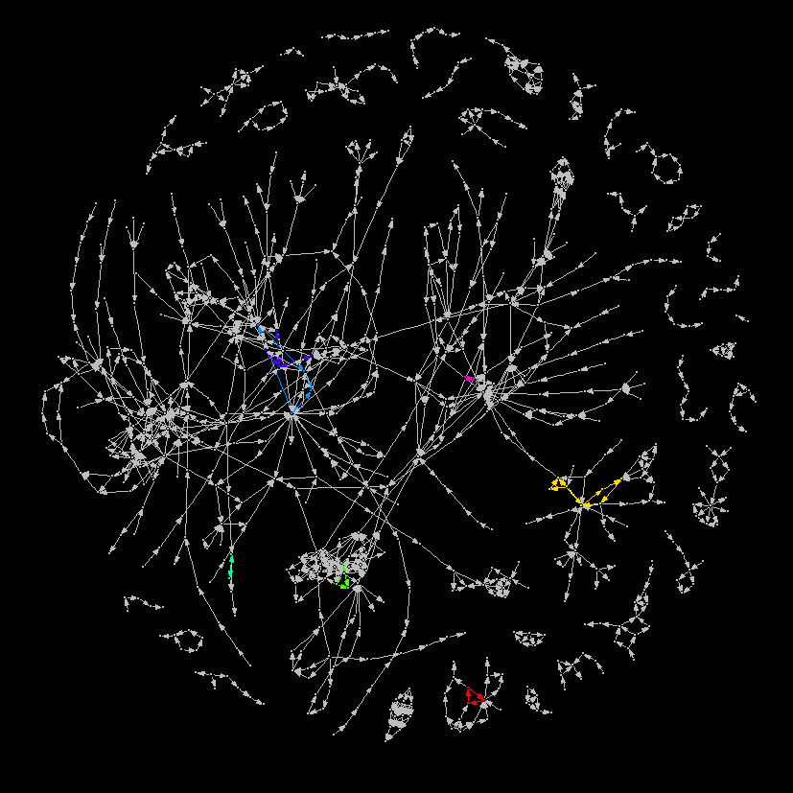
Components of the AOPwiki network
A network diagram of the Adverse Outcome Pathway Wiki database of AOPs.
In this figure, colors highlight distinct strongly connected components. Nodes within strongly connected components have a directed path to each other node in the network.
Within the AOP context, a strongly connected component highlights cycles or feedback loops between Key Events.
In the AOPwiki network there are 7 distinct cycles that emerge.

Slide 7
Components of the AOPwiki network
A network diagram of the Adverse Outcome Pathway Wiki database of AOPs.
Of the 7 distinct cycles, 3 are fully contained within a single AOP, while 3 are the result of key event relationships spanning multiple AOPs¹.
Tracking how cycles emerge and appear within the AOP wiki database will be useful for construction AOP networks. When an AOP network is without cycles, it is considered a directed acyclic graph, a classification that carries with it a special set analyses that can be utilized for study.
-----------------------------------
¹The last cycle appears to span multiple AOPs but AOP ID is a missing attribute for one of the three KE.
Notes:
To do: Network analysis to identify SODAs?

Slide 8
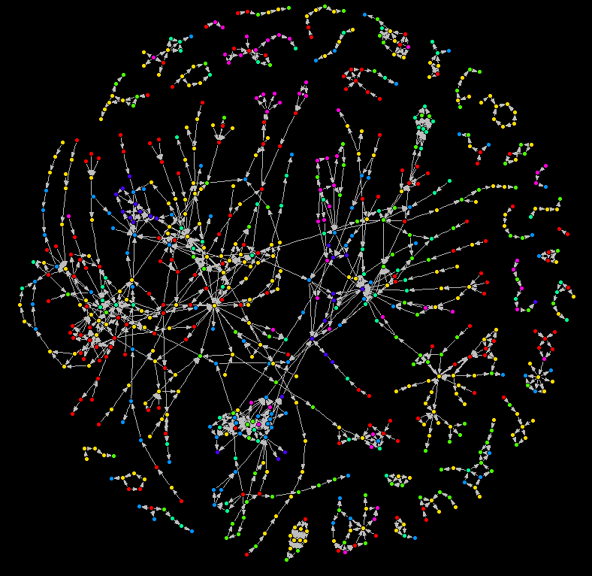
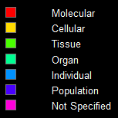
Levels of Biological Organization in the AOPwiki network
Colors represent levels of biological organization associated to Key Events in the AOPwiki. A total of 750 unique key events are in the wiki, 53 Key events in the AOPwiki had unspecified levels of biological organization.

Slide 9
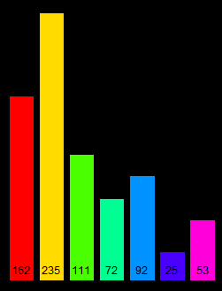
Levels of Biological Organization in the AOPwiki network
Colors represent levels of biological organization associated to Key Events in the AOPwiki. A total of 750 unique key events are in the wiki, 53 Key events in the AOPwiki had unspecified levels of biological organization
Notes:
To do: Create layout for AOP networks based on level of biological organization. Can we do a similar analysis for MIE and AO? What about KEs/KERs/AOPs by author?

Slide 10
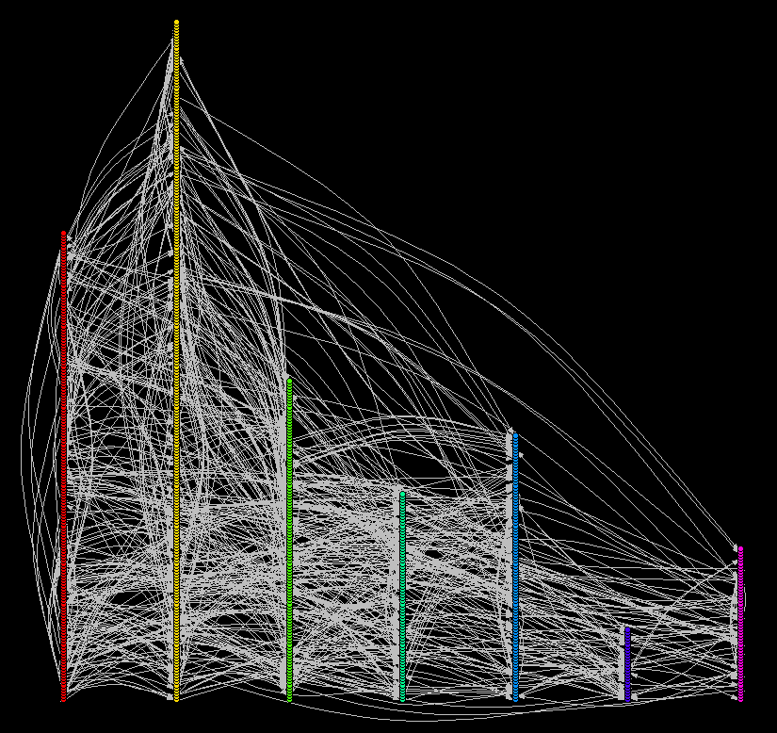
Levels of Biological Organization in the AOPwiki network
Colors represent levels of biological organization associated to Key Events in the AOPwiki. A total of 750 unique key events are in the wiki, 53 Key events in the AOPwiki had unspecified levels of biological organization
Notes:
To do: Create layout for AOP networks based on level of biological organization. Can we do a similar analysis for MIE and AO? What about KEs/KERs/AOPs by author?

Slide 11
Levels of Biological Organization in the AOPwiki network
Colors represent levels of biological organization associated to Key Events in the AOPwiki. A total of 750 unique key events are in the wiki, 53 Key events in the AOPwiki had unspecified levels of biological organization
Notes:
To do: Create layout for AOP networks based on level of biological organization. Can we do a similar analysis for MIE and AO? What about KEs/KERs/AOPs by author?

Slide 12
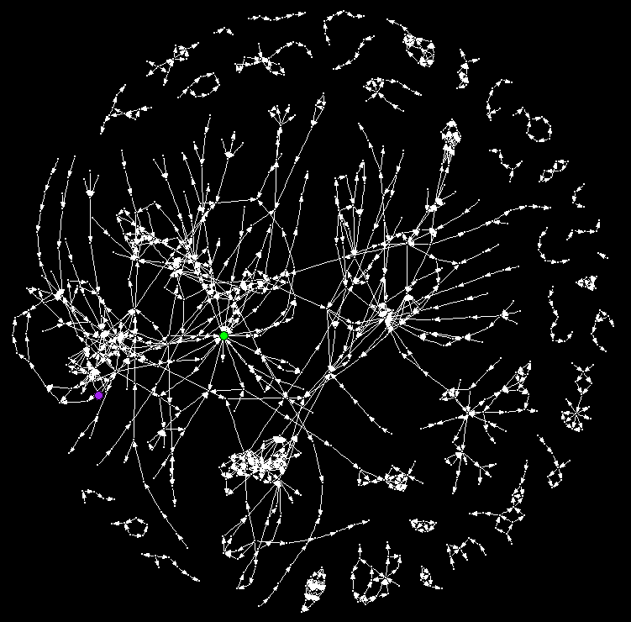
Centrality Measures in the AOPwiki network
The degree of a node is the number of adjacent edges. In this case, the key event with the highest degree is Increased oxidative stress, with 22 incident edges.
Increased oxidative stress is also the key event with the highest betweenness value, meaning that in the AOPwiki, from a non-directed standpoint, it has the most shortest paths between other nodes that travel through it.
When it comes to closeness however, which is a measure of distance between nodes on those shortest paths, Suppression, Constitutive androstane receptor, NR1l3, is the closest.

Slide 13
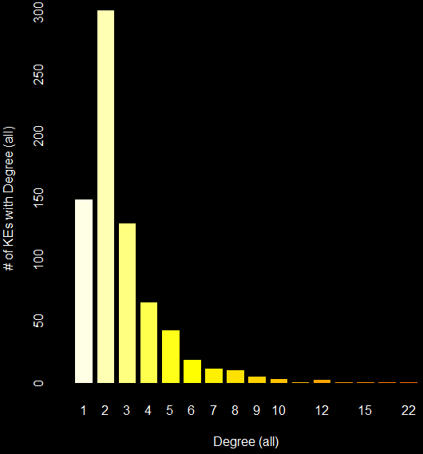
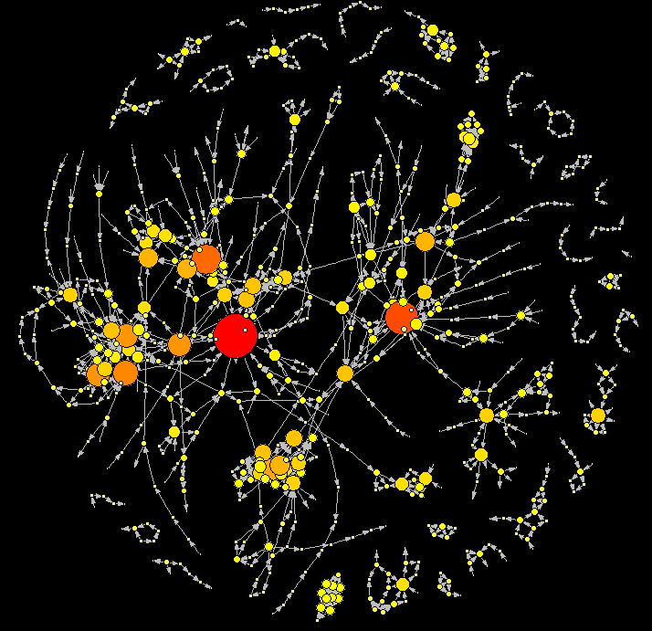

Degree (total) Heatmap
The degree (total), $D_{tot}$ of a node is the number of adjacent edges, regardless of directionality. In this case, the key event with the highest $D_{tot}$ is Increased oxidative stress, with 22 incident edges.
Notes:
To do: More specific information based on centrality measures. Expand to include better information about KEs, maybe show top ten?

Slide 14




Degree (all) Heatmap
The degree (all), $D_{all}$ of a node is the number of adjacent edges, regardless of directionality. In this case, the key event with the highest $D_{all}$ is Increased oxidative stress, with 22 incident edges.
Ten key events with highest $D_{all}$ value
Key Event Name
"Increase, Oxidative Stress"
"Increased, Mortality"
"N/A, Mitochondrial dysfunction 1"
"Activation, PPAR$α$"
"Activation, LXR"
"Accumulation, Fatty acid"
"Activation, AHR"
"Increase, cilia movement"
"Increased, valve movement"
"Abnormal, Foraging activity and behavior"
$$D_{all}$$
22 17 15 13 12 12 12 11 10 10
Notes:
To do: More specific information based on centrality measures. Expand to include better information about KEs, maybe show top ten?

Slide 15
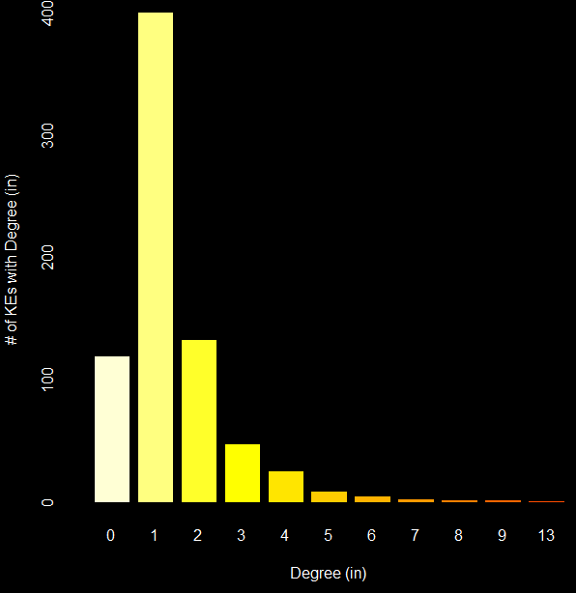
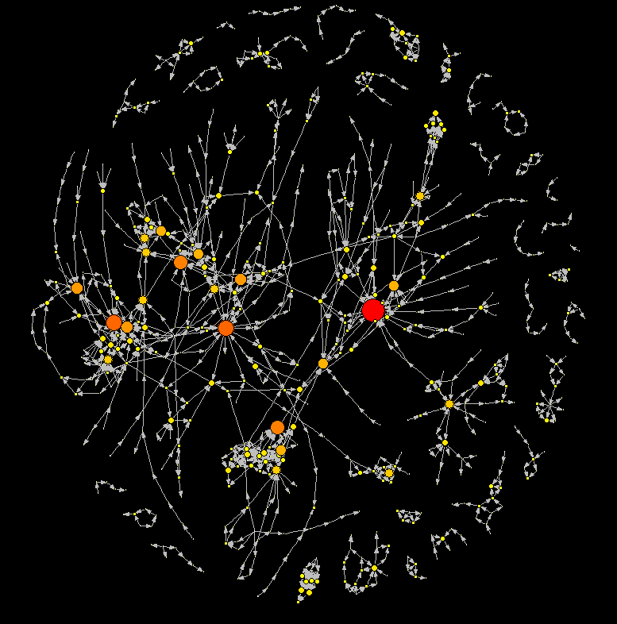

Degree (in) Heatmap
The degree (in), $D_{in}$ of a node is the number of adjacent edges coming into that node. The key event with the highest $D_{in}$ is Increased mortality, with 13 incident edges.
Notes:
To do: Incomplete AOP vs Complete AOP and ability to identify AOs and MIEs. With proper annotation we can use these analyses to identify complete vs incomplete AOPs.

Slide 16


Degree (in) Heatmap
The degree (in), $D_{in}$ of a node is the number of adjacent edges coming into that node. The key event with the highest $D_{in}$ is Increased mortality, with 13 incident edges.
Ten key events with highest $D_{in}$ value
Key Event Name
"Increased, Mortality"
"Increased, Liver Steatosis"
"Increase, Oxidative Stress"
"Decreased, Reproductive Success"
"Impairment, Learning and memory"
"Decreased, Synaptogenesis"
"Accumulation, Fatty acid"
"Reduction, 17beta-estradiol synthesis by ovarian granulosa cells"
"Depletion, energy reserves"
"Weakened, Colony"
$$D_{in}$$
13 9 9 8 8 7 7 7 6 6
Notes:
To do: Incomplete AOP vs Complete AOP and ability to identify AOs and MIEs. With proper annotation we can use these analyses to identify complete vs incomplete AOPs.

Slide 17
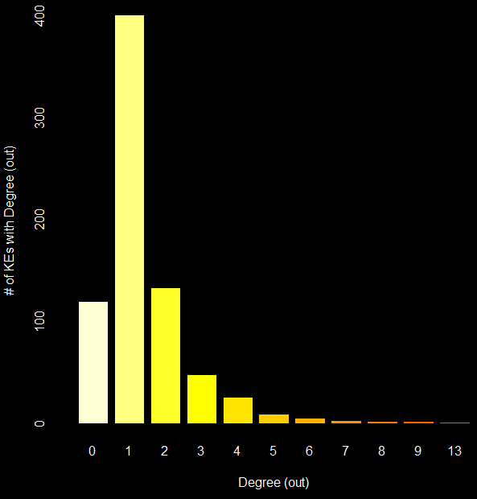
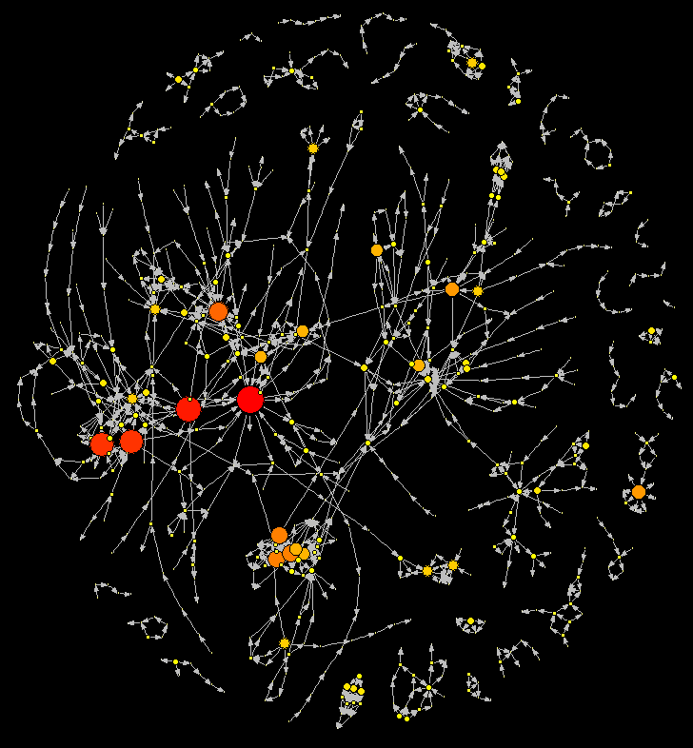

Degree (out) Heatmap
The degree (out), $D_{out}$ of a node is the number of adjacent edges, regardless of directionality. In this case, the key event with the highest $D_{out}$ is increased oxidative stress, with 13 incident edges.

Slide 18



Degree (out) Heatmap
The degree (out), $D_{out}$ of a node is the number of adjacent edges, regardless of directionality. In this case, the key event with the highest $D_{out}$ is increased oxidative stress, with 13 incident edges.
Ten key events with highest $D_{out}$ value
Key Event Name
"Increase, Oxidative Stress"
"Activation, AHR"
"Activation, PPAR$α$"
"Activation, LXR"
"N/A, Mitochondrial dysfunction 1"
"Increased, serotonin (5-HT)"
"Increase, cilia movement"
"Inhibition, 5-hydroxytryptamine transporter (5-HTT; SERT)"
"Suppression, Suppression of cytokine production in the presence of T-cell activation"
"Thyroxine (T4) in serum, Decreased"
$$D_{out}$$
13 12 11 11 9 8 8 8 7
7

Slide 19
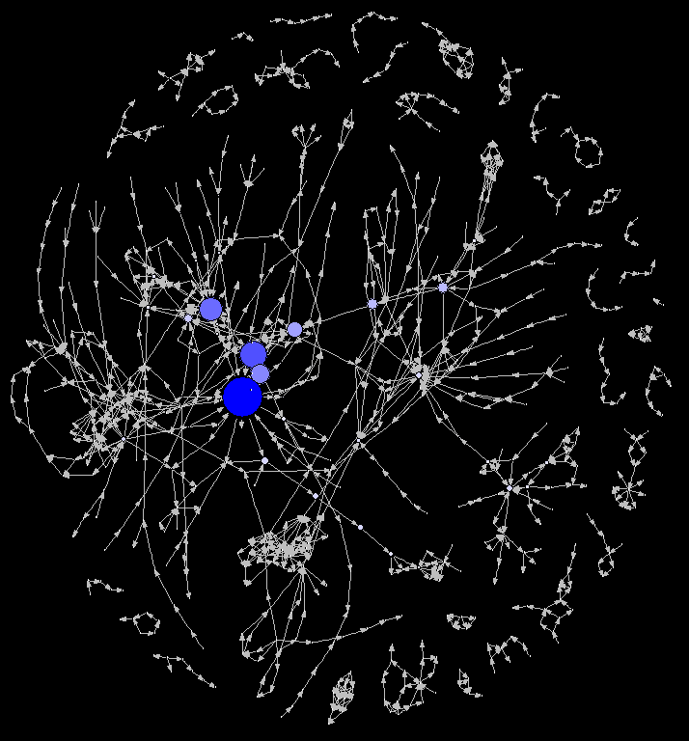

Betweenness Map
Betweenness values indicate which nodes are traversed most within shortest paths found in the network. A path is simply a set of edges (directed in this case) that connects nodes. Since multiple paths can exist between nodes, the betweenness calculation only uses those of which are the shortest (i.e. minimum number of steps between nodes).
The formula for betweenness is:
$$g\left(v\right)=\sum_{s≠v≠t}{\frac{σ_{st}\left(v\right)}{σ_{st}}}$$
Where $σ_{st}\left(v\right)$ is # of shortest paths from $s$ to $t$ through vertex $v$and$σ_{st}$ is # of shortest paths from $s$ to $t$ .
For the AOPwiki betweenness values range between 0 and 2360.167 and increased oxidative stress is the key event with the highest betweenness value.

Slide 20
