Slide 1
Adverse Outcome Pathway Network Analyses: Techniques and benchmarking the AOPwiki
N.L. Pollesch*, J. O’Brien, & D.L. Villeneuve
*Contact Information:
Nate Pollesch, PhD
Pollesch.Nathan@epa.gov US EPA Mid-Continent Ecology Division, Duluth, MN, USA
Office of Research and Development
National Health and Environment Effects Research Laboratory, Mid-Continent Ecology Division, Duluth, MN 55804
May 25, 2017

Slide 2
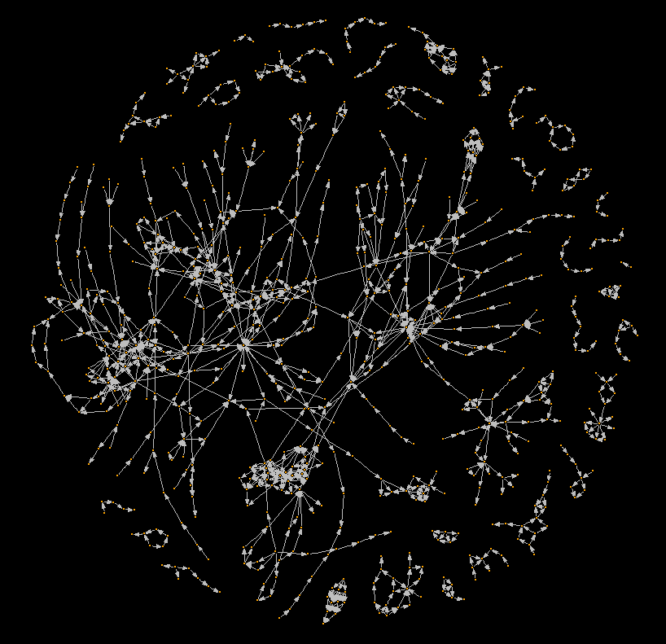
The Complete AOPwiki Network

Slide 3
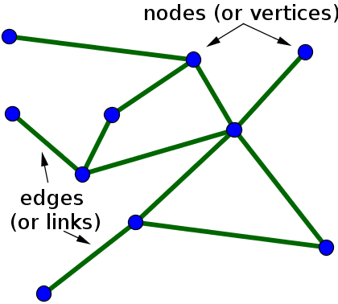
The Complete AOPwiki Network
Node
Edge
Edge
Node
Edge
Node

Slide 4
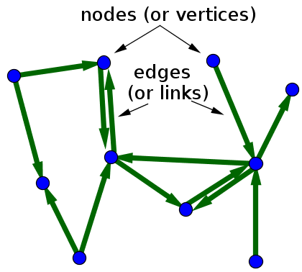
The Complete AOPwiki Network

Slide 5
The Complete AOPwiki Network
A network diagram of the Adverse Outcome Pathway Wiki database of AOPs (As of: April 10th, 2017)

Slide 6
The Complete AOPwiki Network
A network diagram of the Adverse Outcome Pathway Wiki database of AOPs (As of: April 10th, 2017)

Slide 7
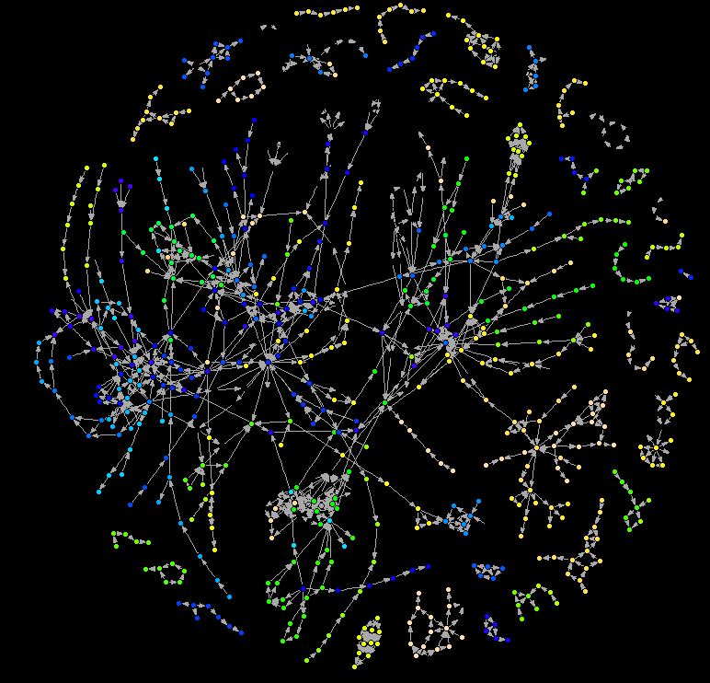
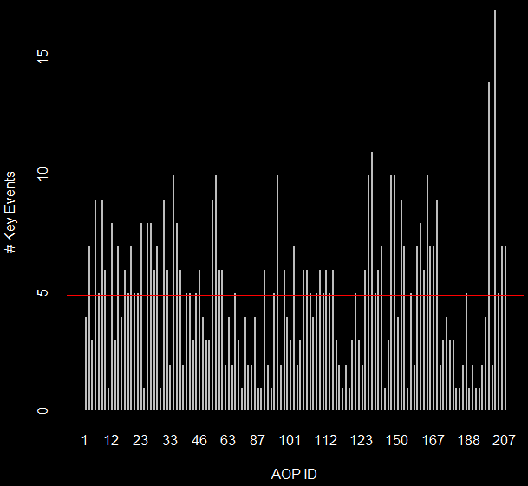
The Complete AOPwiki Network
The AOP wiki has:
131 different AOPs
1058 key event relationships
750 unique key events
Mean number of KEs per AOP is 4.8

Slide 8
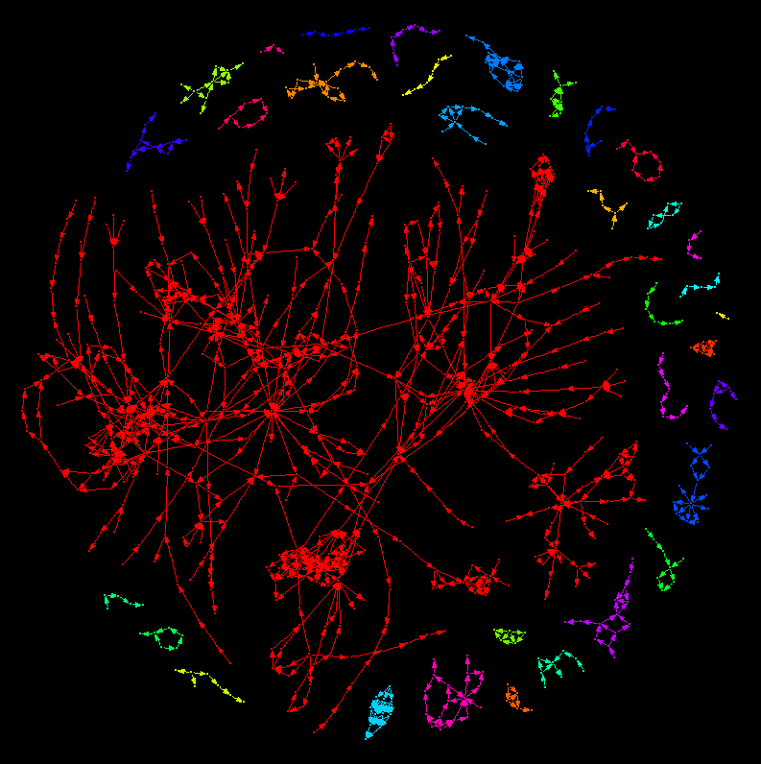
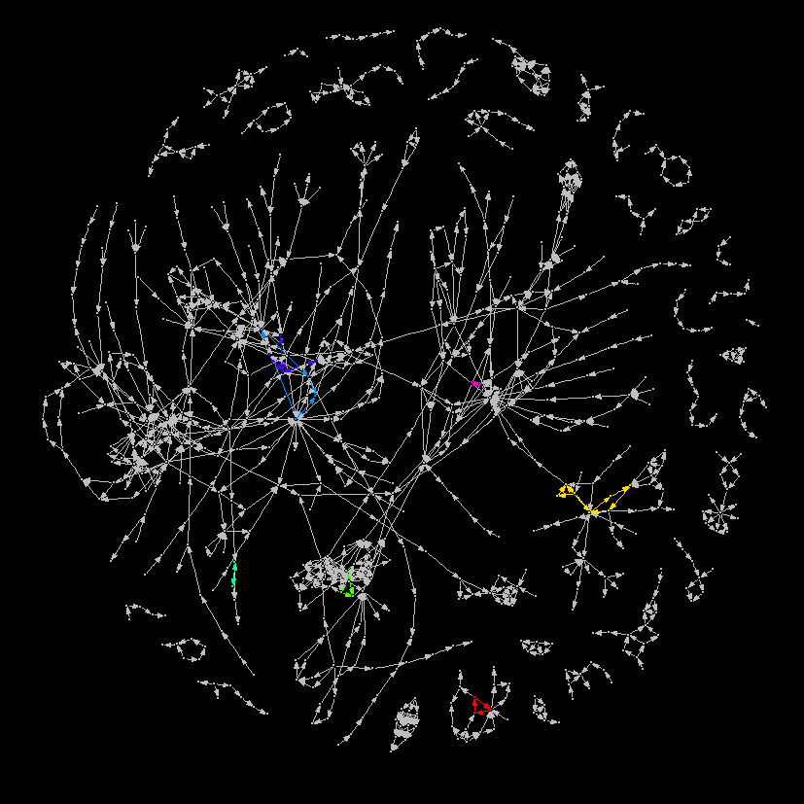
Component Analyses
Component analyses determine connectivity in the network.
In directed networks, like AOPs, components can be weakly or strongly connected.

