Slide 1
GeoGame Presentation
By Jason Ola for the capstone project

Slide 2

Idea
Geography quiz game
Shiny web app
Modules
Golem framework

Slide 3
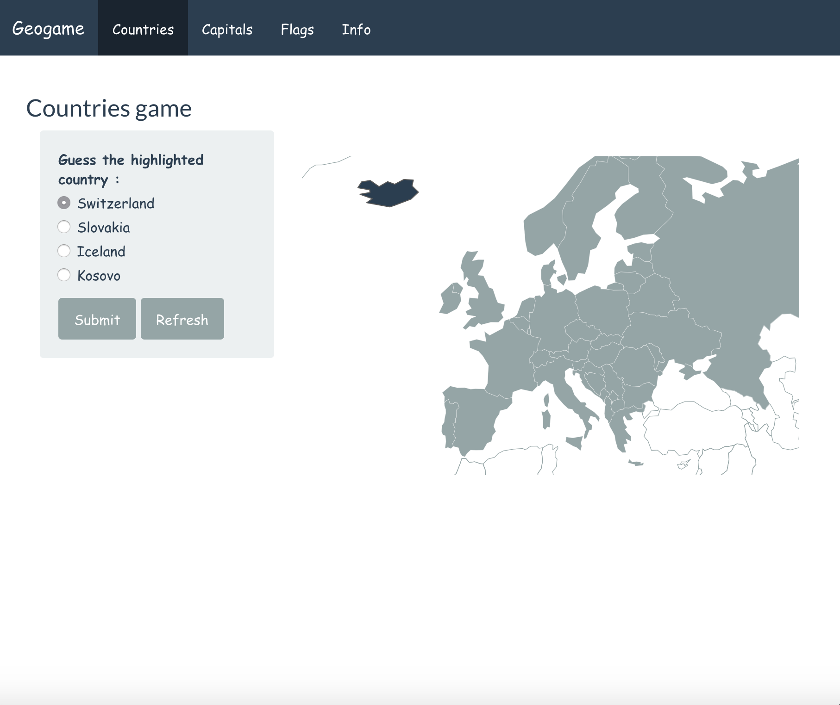
Structure
4 tabs
Countries
Capitals
Flags
Information
Map
Population
GDP
Quizzes
Display of country/flag
4 choices, 1 correct answer

Slide 4

Data
Natural Earth :
Dataset of countries with various data and a geometry variable to plot the countries as a map
Capitals :
Dataset with capitals of countries, info of admin capital or secondary
Flags :
Dataset of flags of countries contained in an URL

Slide 5

Code overview

Slide 6

Questions ?

