Slide 1
Wonderful title here

Slide 2
Outline
Use case overview
Problem
Patterns
Competency question
Feedback?? (TBD)

Slide 3
Use Case Overview
Ontology is designed for a specific customer
Several researchers from Dayton Children's hospital and Wright State University Boonshoft School of Medicine
Collect and analyze data for research purposes from large scale nationwide health databases

Slide 4
Use Case Overview
Databases contain info from a variety of sources:
Patient-specific medical info
Billing records
Prescription drugs ordered
And more!

Slide 5
Problem Overview
Each set is exported as a csv abstract
Most have some columns in common
NOT organized on the same keys
Research group would like to analyze data that relies on information from multiple abstracts
Often unclear how to merge these data sources
Would be nice to have a common representation framework

Slide 6
Problem Overview
Each set is exported as a csv abstract
Most have some columns in common
NOT organized on the same keys
Research group would like to analyze data that relies on information from multiple abstracts
Often unclear how to merge these data sources
Would be nice to have a common representation framework
An extensible ontology

Slide 7
Outline
Use case overview
Problem
Patterns
Competency question
Feedback?? (TBD)

Slide 8
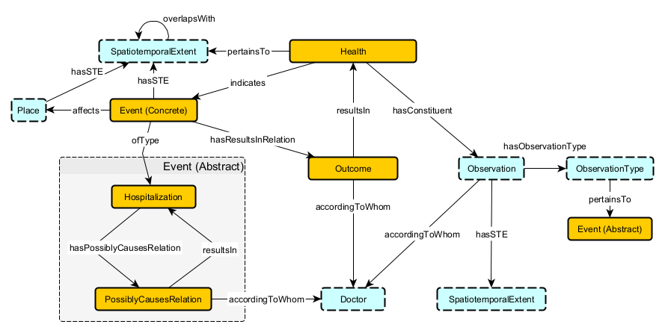
Patterns

Slide 9
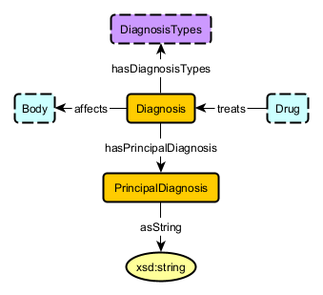
Diagnosis

Slide 10
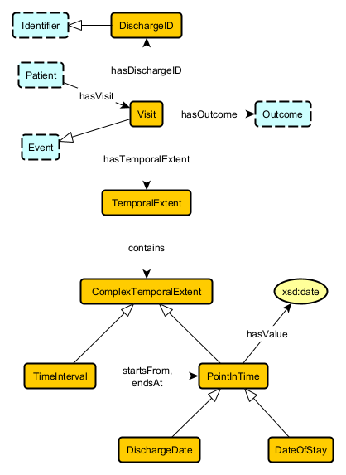
Temporal Event

Slide 11
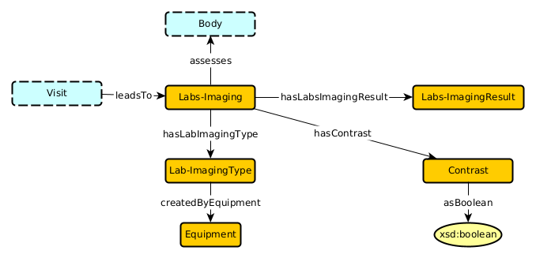
Labs and Imaging

Slide 12
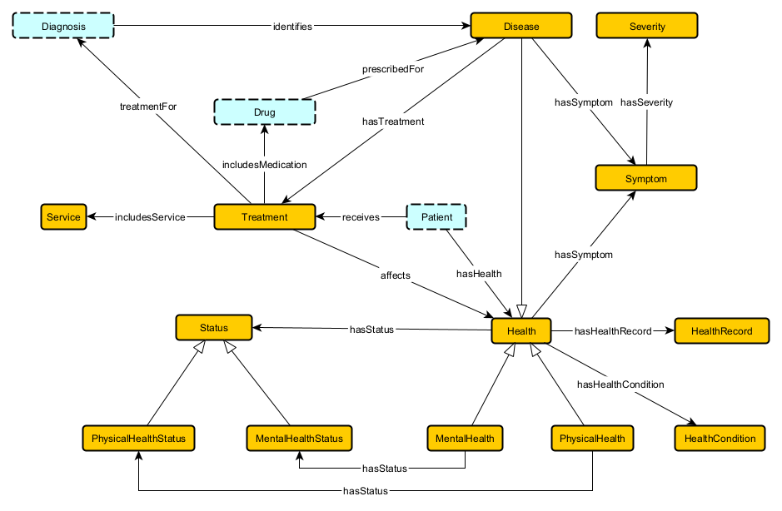
Health

Slide 13
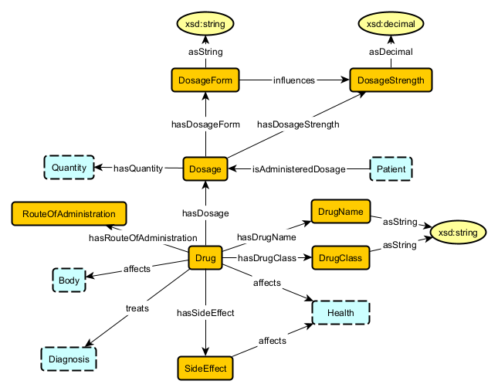
Drug

Slide 14
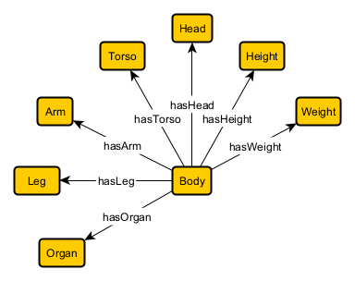
Body

Slide 15
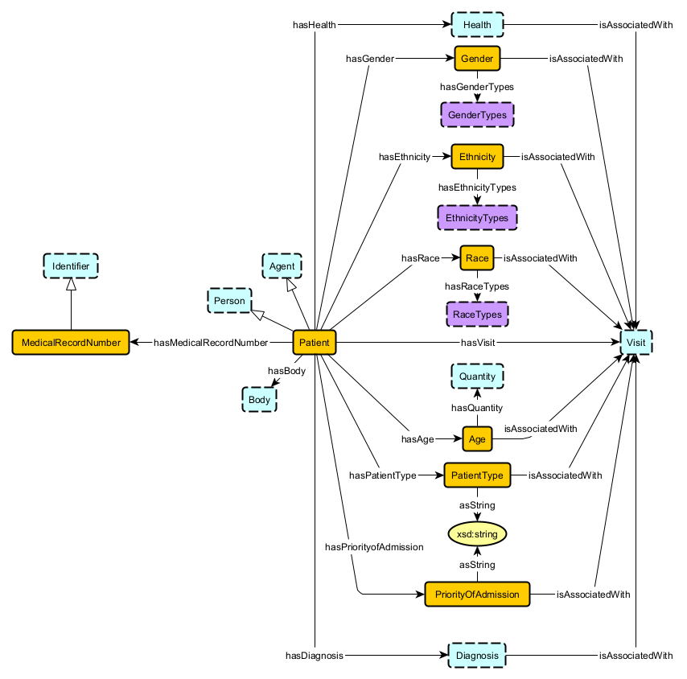
Patient

Slide 16
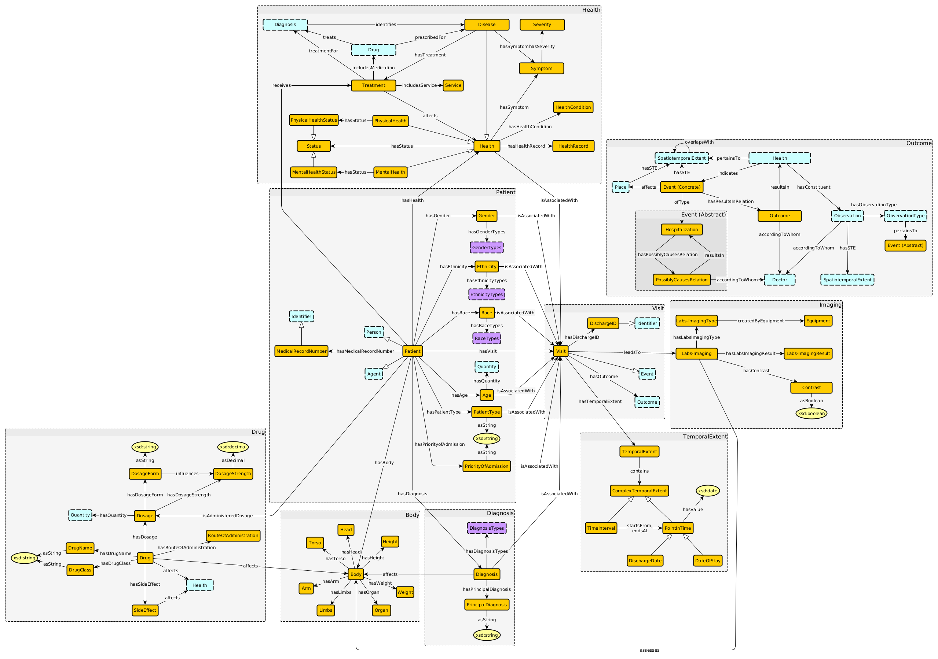
Overall Graph

