Slide 1

Anmol Saini * Jason Nolte * Spencer Seals

Slide 2
Outline
Use case overview
Problem
Key Notions
Schema Diagrams
SPARQL Queries
Future Work
Retrospective

Slide 3
Use Case Overview
Ontology is designed for a specific customer
Several researchers from Dayton Children's hospital and Wright State University Boonshoft School of Medicine
Collect and analyze data for research purposes from large scale nationwide health databases

Slide 4
Use Case Overview
Databases contain info from a variety of sources:
Patient-specific medical info
Billing records
Prescription drugs ordered
And more!

Slide 5
Problem Overview
Each set is exported as a csv abstract
Most have some columns in common
NOT organized on the same keys
Research group would like to analyze data that relies on information from multiple abstracts
Often unclear how to merge these data sources
Would be nice to have a common representation framework

Slide 6
Problem Overview
Each set is exported as a csv abstract
Most have some columns in common
NOT organized on the same keys
Research group would like to analyze data that relies on information from multiple abstracts
Often unclear how to merge these data sources
Would be nice to have a common representation framework
An extensible ontology

Slide 7
Key Notions
Patient
Drug
Body
Diagnosis
Visit
Temporal Extent
Imaging
Outcome
Health
Most Concrete – direct data and physical objects
Less Concrete – direct data available
Most abstract – interpreted from other data
Notes:
Patient: The patient is the critical class all healthcare data and studies. The patient has the symptoms, diagnosis, testing, treatment, and outcomes. It is the patient outcome that ultimately determines the success or failure of the hospitization. Potentially for this dataset, patient.hospitalized.
Visit: As part of the event chain symptom -> diagnosis -> hospilization, hospitilization is the key event that adds a patient to the particular dataset this project ananlyzes. The outcome of the hosipitlization is a critcial hospital success and evaluation metric.
Temporal Extent: modeling aspects related to time
Body: modeling human body parts for the purpose of symptoms and diagnoses
Diagnosis: record of patient's condition
Health: modeling health-related aspects (disease, illness, medical condition, medication, symptom, treatment, etc.)
Drug: modeling medications and dosages patients can take
Labs-Imaging: requested
Outcome: Health outcomes are important to the patient and the hospital

Slide 8
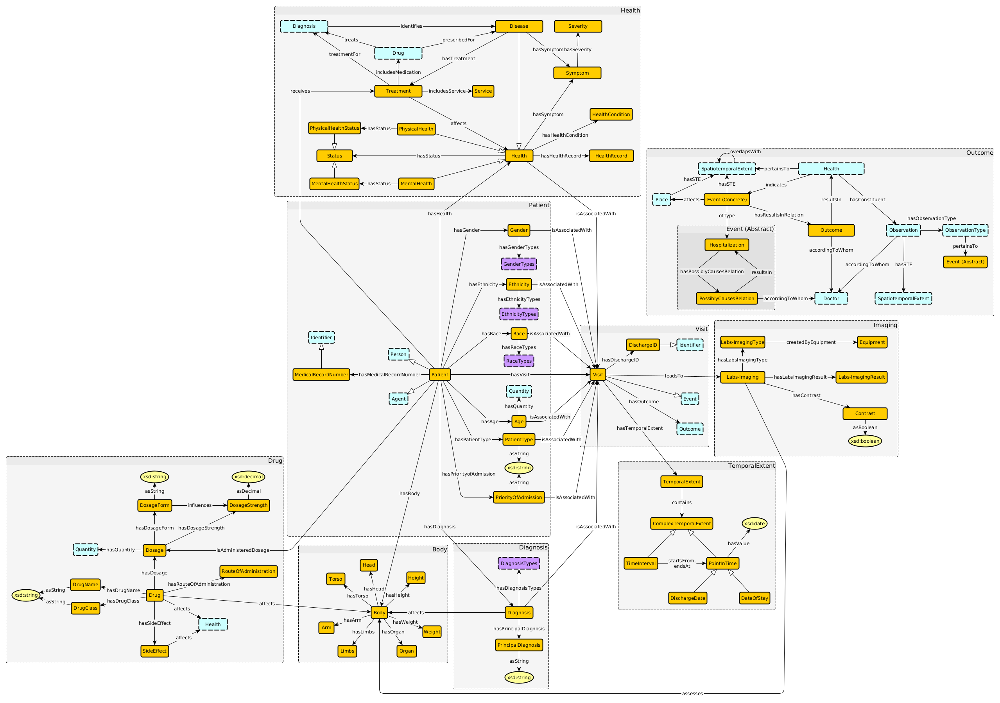
Overall Graph

Slide 9
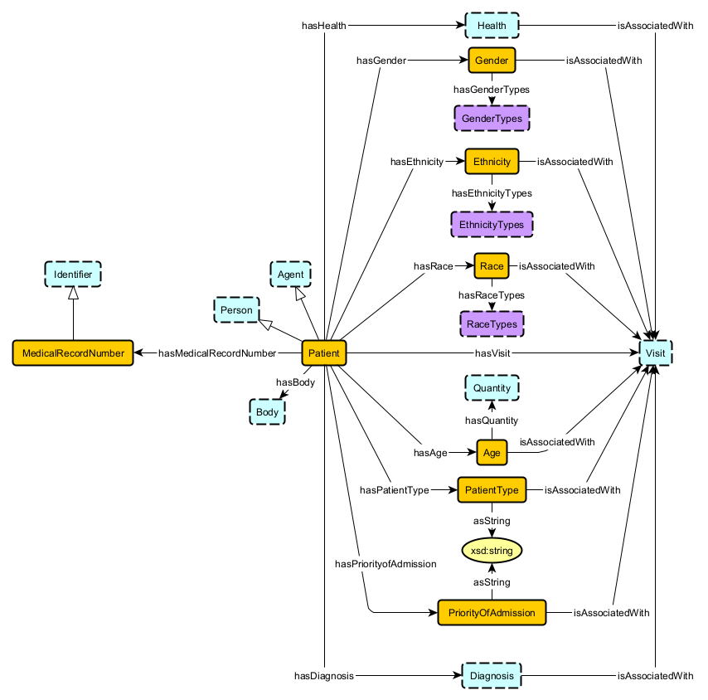
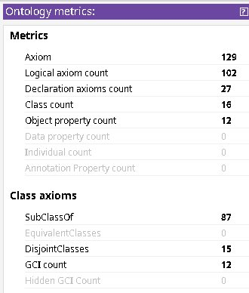
Patient
gd = [
"Patient hasVisit Visit",
"Patient hasPatientType PatientType",
"Patient hasPriorityofAdmission PriorityofAdmission",
"Patient hasMedicalRecordNumber MedicalRecordNumber",
"Patient hasDiagnosis Diagnosis",
"Patient isAdministeredDosage Dosage",
"Race hasRaceTypes RaceTypes",
"Ethnicity hasEthnicityTypes EthnicityTypes",
"Gender hasGenderTypes GenderTypes"
]
sr = [
"Patient hasGender Gender",
"Patient hasEthnicity Ethnicity",
"Patient hasRace Race",
"Patient hasAge Age",
"Patient hasVisit Visit",
"Patient hasPatientType PatientType",
"Patient hasPriorityofAdmission PriorityofAdmission",
"Patient hasMedicalRecordNumber MedicalRecordNumber",
"Patient hasDiagnosis Diagnosis",
"Patient isAdministeredDosage Dosage",
"Age hasQuantity Quantity",
"Race hasRaceTypes RaceTypes",
"Ethnicity hasEthnicityTypes EthnicityTypes",
"Gender hasGenderTypes GenderTypes"
]
Notes:
MedicalRecordNumber – identifier for patient
Controlled vocabs – dictionary detailed pdf providing instances of cvs
PatientType and PriorityOfAdmission are cvs

Slide 10
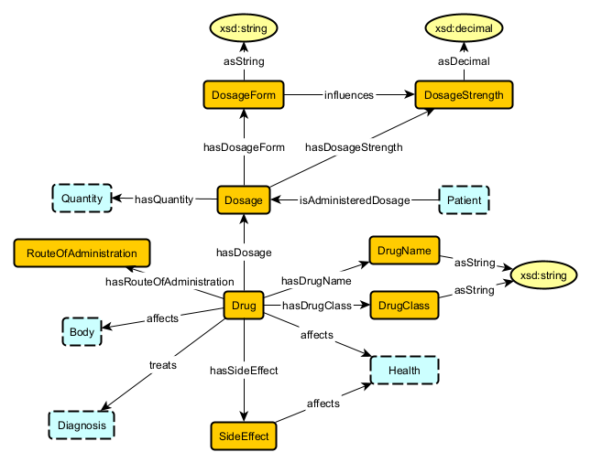
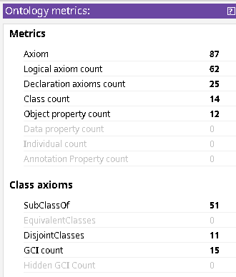
Drug
gd = [
"Drug hasDosage Dosage",
"Drug hasRouteOfAdministration RouteOfAdministration",
"patient isAdministered Dosage",
"Dosage hasDosageStrength DosageStrength",
"Drug hasSideEffect SideEffect",
"Dosage hasDosageForm DosageForm",
"Drug hasName DrugName",
"Drug hasDrugClass DrugClass"
]
sr = [
"Dosage hasDosageStrength DosageStrength",
"Dosage hasDosageForm DosageForm",
"Drug hasDosage Dosage",
"Drug hasRouteOfAdministration RouteOfAdministration",
"Drug affects Body_or_Health",
"Drug hasSideEffect SideEffect",
"Drug hasDrugName DrugName",
"Drug hasDrugClass DrugClass",
"SideEffect affects Health",
"Dosage hasQuantity Quantity"
]

Slide 11
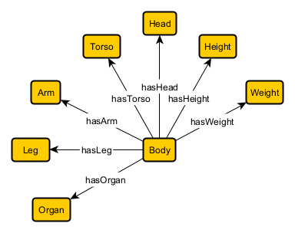
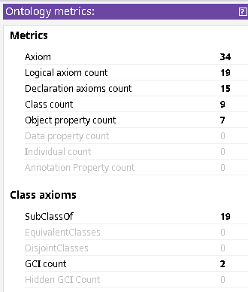
Body

Slide 12
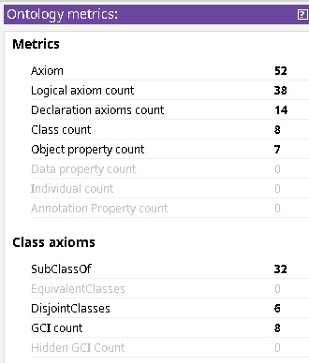
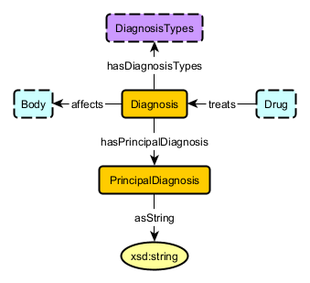
Diagnosis
gd = [
"Diagnosis hasPrincipalDiagnosis PrincipalDiagnosis",
"Diagnosis hasDiagnosisTypes DiagnosisTypes",
"Diagnosis identifies Disease",
"Patient hasDiagnosis Diagnosis",
"Treatment treatmentFor Diagnosis"
]
sr = [
"Diagnosis hasPrincipalDiagnosis PrincipalDiagnosis",
"Diagnosis hasDiagnosisTypes DiagnosisTypes",
"Diagnosis identifies Disease",
"Diagnosis affects Body",
"Diagnosis isAssociatedWith Visit",
"Patient hasDiagnosis Diagnosis",
]

Slide 13
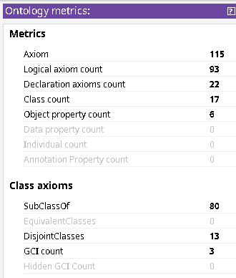
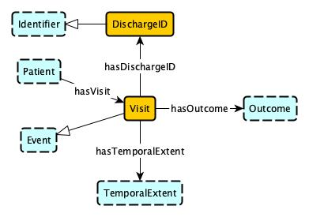
Visit

Slide 14
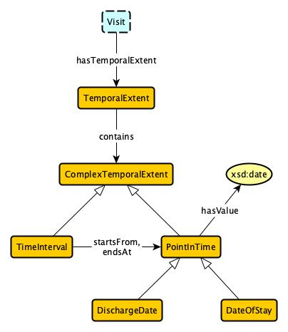
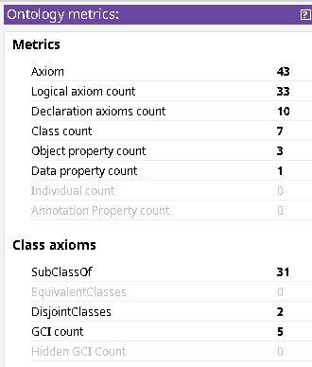
Temporal Event

Slide 15

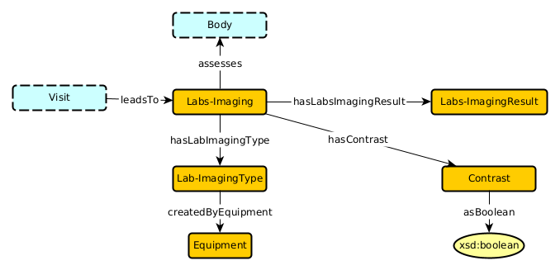
Labs and Imaging

Slide 16
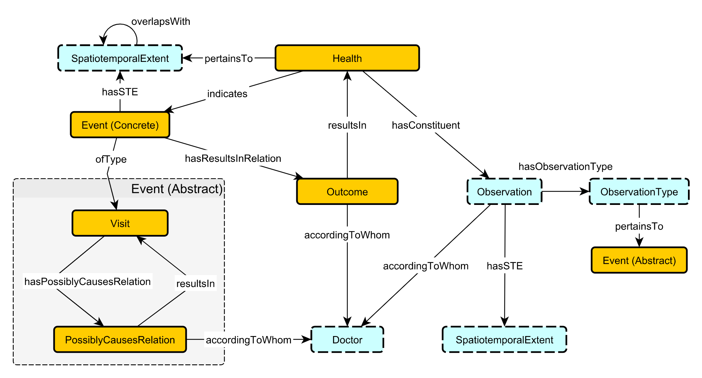
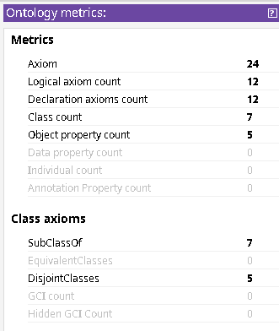
Outcome
Notes:
Not much applied at instance level (abstraction)
More complex mapping not easily found in data

Slide 17
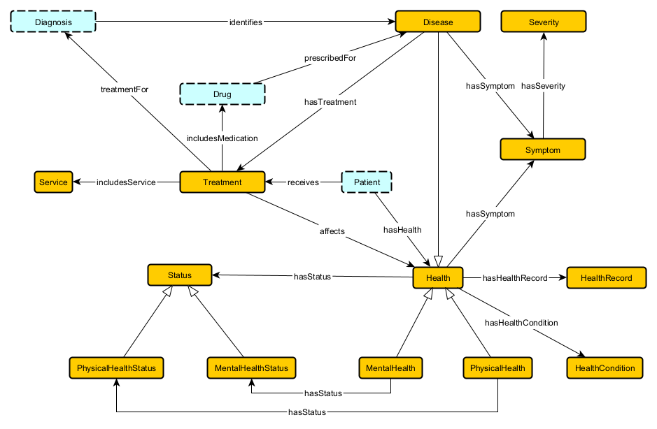
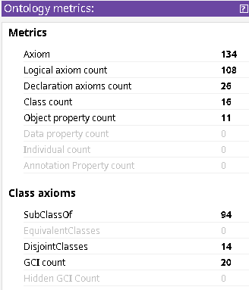
Health

Slide 18
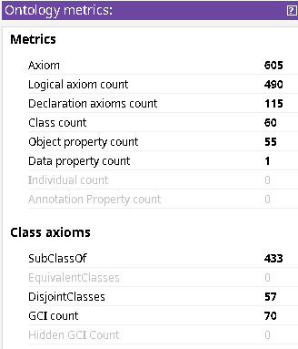
Overall Graph

Slide 19
Competency Questions
Has the incidence of Kawasaki disease decreased during the pandemic?
How have trends in pediatric drowning changed over the past 5-10 years? Are certain populations affected disproportionately?
Does a patient's sociodemographic factors affect outcomes of pediatric meningitis cases?
How have trends in pediatric open globe injuries changed over the past 5-10 years? Are certain populations affected disproportionately?

Slide 20
Competency Questions
How many Asian people have been diagnosed with Kawasaki disease?
In what race has Kawasaki disease been most prevalent? How many cases have there been?
How many patients that have been diagnosed with Kawasaki disease have also been diagnosed with a metabolic condition?

Slide 21
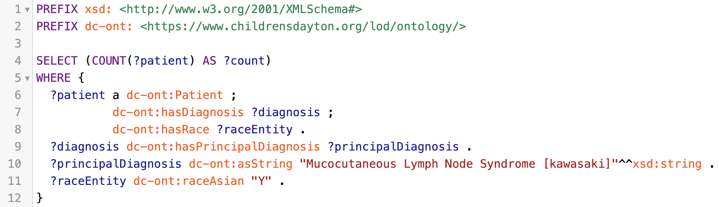
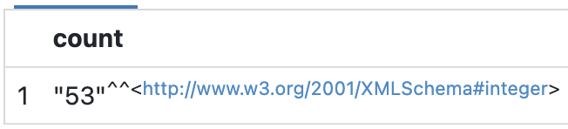
SPARQL Query
Count of cases of Kawasaki for a specific race

Slide 22
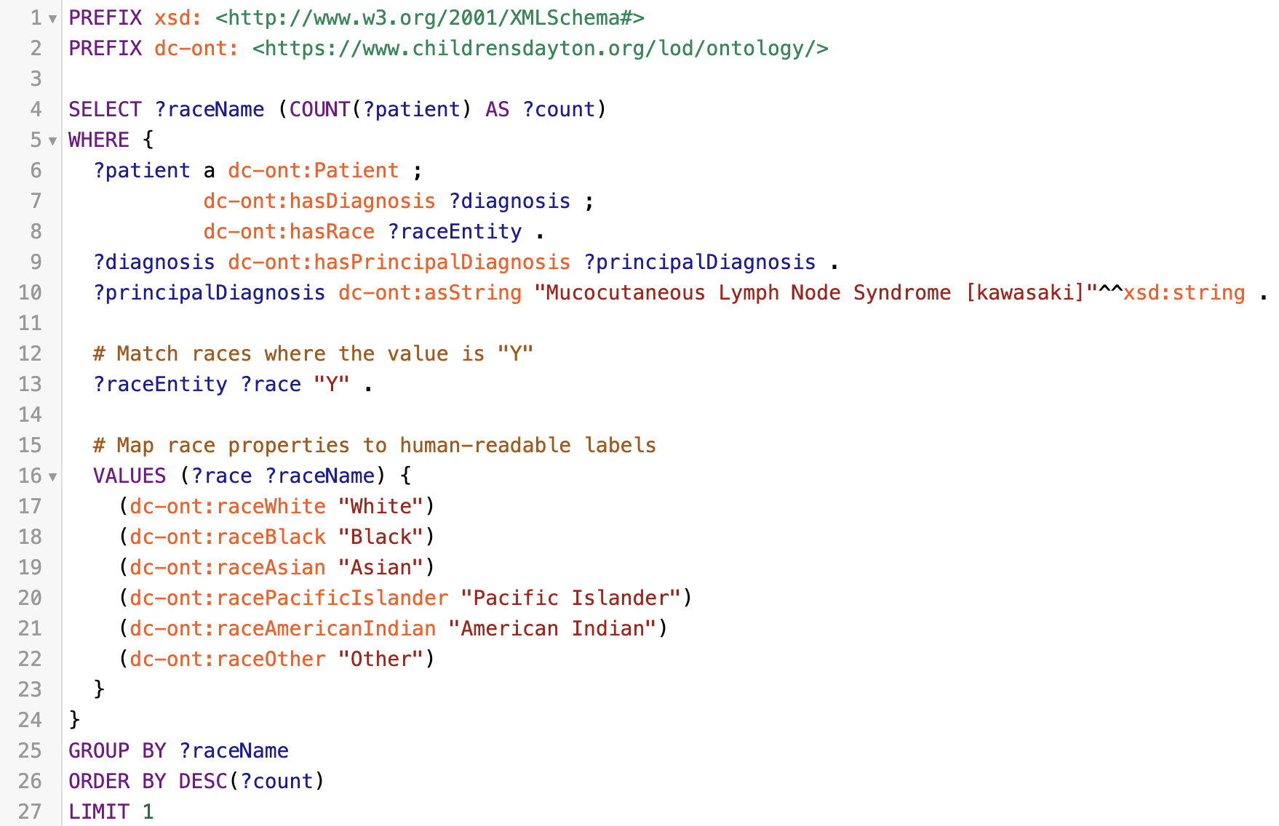
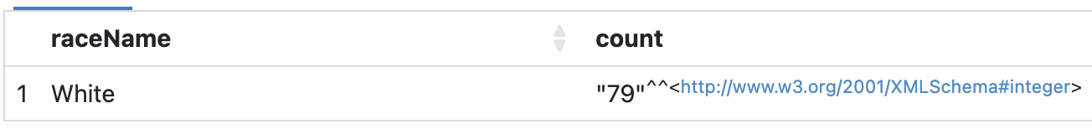
SPARQL Query
Identification of race with most cases of Kawasaki and count of cases

Slide 23
Future Work
Refine ontology to address errors and concerns noted in axiomatization and materialization phases
Expansion of ontology to represent more concepts or better represent existing concepts
Separate Labs and Imaging
PatientType and PriorityOfAdmission as controlled vocabularies
Expand or finetune use cases by incorporating more data
E.g., specific patient demographics, mental health information, etc
Bridge gap between abstract concepts and instance-level data
Health pattern
Outcome pattern

Slide 24
Retrospective
Anmol Saini
Pros
Greater insight and practice into process of creating a KG. Beginning to understand axioms
Flexibility in meeting schedule and tasking
Assigned topic with significant application
Application-oriented course
Cons
Suboptimal workload distribution over course of semester. Little time for materialization and axioms in Protégé
Limited feedback and guidance, especially later in semester
Somewhat disorganized with no grades assigned throughout the class

Slide 25
Retrospective
Jason Nolte
Part of a great team. Anmol and Spencer were awesome
Helped create an ontology
Group discussions about the project, key notions, and axioms taught me a lot
Learned a bit about Protégé and axioms while entering the axioms in Protégé
Not sure I could explain what I did outside this class
Having an assigned topic helped
More interaction with the professor in the second half of the course would have been nice
Could teach some concepts/software closer to when used in the project
I understand the irony of saying this while virtual

Slide 26
Retrospective
Spencer Seals
Our team was great
Flexibility in meeting schedule and tasking was great
More prepared to create and defend an ontology (semi) independently
Group discussions taught me a lot
Learned a lot more about the practical aspects of creating KGs
Distribution of workload over the semester wasn’t very uniform
Teaching some of the concepts closer to when they were used would be nice
Would like more exposure to reasoning algorithms and how they interact with the axioms

Slide 27

Thank you!

Slide 28
Competency Questions
How have hospitalizations for motor vehicle vs bicycle injuries changed over the past 5-10 years? Does a patient's sociodemographic factors affect outcomes of hospitalization?
Are there differences in surgical trauma outcomes between those who are trans vs cis?
How have patterns of blood transfusions changed over the past 5-10 years? Has the use of whole blood increase over the past 5-10 years and if so in which kinds of cases are these?
How often do pediatric trauma hospitalizations return to the emergency department within 28 days and are there factors that might help us predict these occurrences?

