Slide 1
Implementing Compressive Sampling Algorithms Across The Cloud
Jason Halpern
Final Presentation

Slide 2
Project Objectives
Research and evaluate Compressive Sensing algorithms.
Choose a specific algorithm and Java library.
Migrate the code from Matlab to Java.
Distribute the algorithm on a standalone Hadoop machine and then across an entire cluster.
Collect signals from the Android simulator or sensor networks and then use our distributed algorithm to recover these signals.

Slide 3
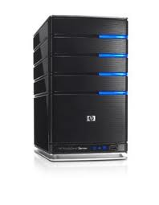

Big Picture
Send to Hadoop cluster
Take picture with smartphone
Decompress image across the cloud
using our recovery algorithm

Slide 4
Compressive Sampling
Involves acquiring and recovering a sparse signal in an efficient manner
Need to determine the number of measurements that are necessary to reconstruct the signal
Our goals
  Explore implementations of these algorithms
  Find ways to distribute a specific algorithm
Large reduction in bandwidth used and cost savings
Major applications across different industries (MRIs)

Slide 5
CoSaMP Algorithm
Greedy pursuit
Good balance in terms of its running time and sampling efficiency
Running time is O(mN), storage is O(N)
  m is the number of measurements, N is the signal length
It is the only signal reconstruction algorithm that accomplishes all of the following:
  Accepts samples from a variety of sampling schemes
  Succeeds using a minimal number of samples
  It is robust when samples are contaminated with noise
  It provides optimal error guarantees for every target signal
  It offers provably efficient resource usage

Slide 6
Migrating From Matlab to Java
Evaluated each line of Matlab code
Determined what functions needed to be written in Java (i.e. not covered by Mahout)
Wrote test cases then wrote the functions in Java
Matlab functions:
  abs(), sort(), zeros(), randperm() and randn(), and more….
Other Matlab matrix manipulations functions that involved slicing and rearranging matrices had to be written in Java
Final step was to rewrite the algorithm line by line in Java
Debugging one matrix manipulation step at a time

Slide 7
Improving the Algorithm
Created a full matrix (1024x10) and experimented with ways to reconstruct it
One column is reconstructed during each loop, then columns are combined into full matrix
A new measurement matrix is needed for each column vector
Several advantages to our algorithm over Matlab
  Works for full matrices
  Signal sparsity is dynamically set based on matrix
  Signal length is dynamically configured
Foundation has been set for distributing the algorithm

Slide 8
Discrete Wavelength Transform
Used for signal coding to represent a discrete signal in a more redundant form
Attempted to reconstruct image using DWT and CoSaMP
Several hurdles in migrating DWT to Java
  rgb2gray(), roots(), poly(), conv()

Slide 9
Testing
Used JUnit to write all of the tests
Wrote 16 unit tests for the functions that I wrote to simulate Matlab matrix manipulation
Created a testing framework to easily add test cases
  Input matrices are reconstructed with the CoSaMP algorithm
  Resulting matrix is compared to the expected matrix from Matlab
  New test cases can be added without modifying the code

Slide 10
Test Cases
There are currently 6 tests cases
  Two distinct column vectors
  Two distinct full matrices
  A column vector with all zeros
  An matrix with a single cell that has a zero
Allows for a difference of 0.065 between the reconstructed matrix and the original
Average time to run the entire testing suite: 53.71 seconds

Slide 11
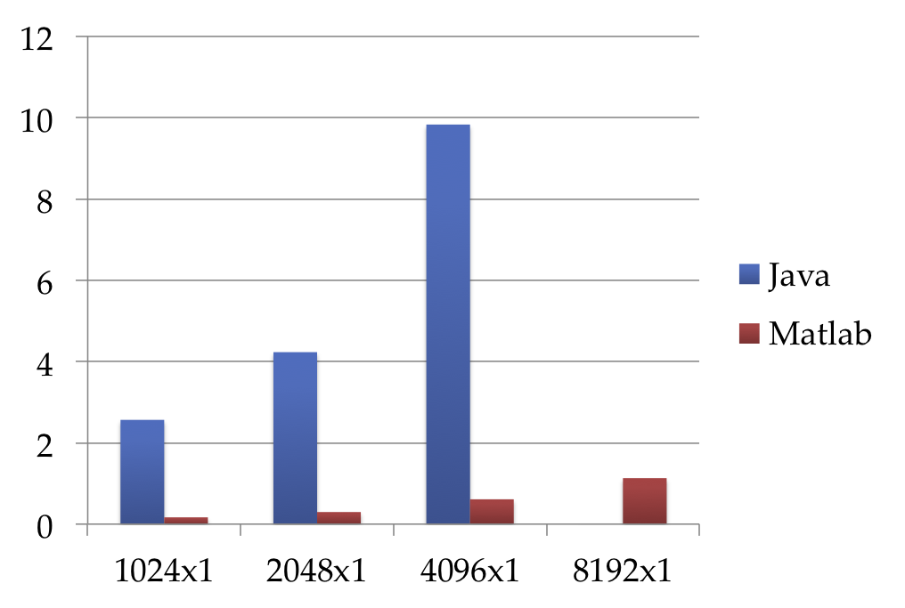
Running Times – Matlab vs. Java
Ran the algorithm 10 times on each column vector
Time
(seconds)
Matrix Size

Slide 12
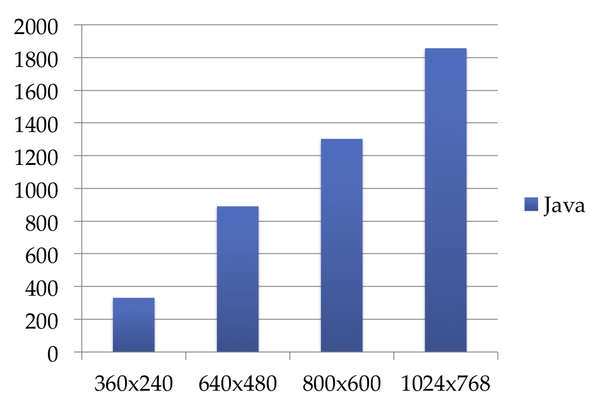
Running Times – Java
Ran the algorithm 10 times each matrix
Time
(seconds)
Matrix Size

Slide 13
Conclusion
Successful implementation of the CoSaMP algorithm
Improvements over the original algorithm
Laid out a framework for distribution
Strong documentation, clean and concise design
Robust testing framework and test cases are in place

