Slide 1
REST APIs and JSON Graphing
Jason Roman
@_jasonroman

Slide 2
Resources
Code: https://github.com/jasonroman/sloan-2018
Website: http://sloan.jayroman.com
You will need either of the following:
cURL: https://curl.haxx.se/download.html
Web browser REST client (Chrome extension: Yet Another REST Client)
Recommended:
Web browser JSON viewer (Chrome extension: JSONView)
Git: https://git-scm.com/downloads
Programming Language / Framework of your choice
(as long as it is Python, PHP/Symfony, JavaScript + Node.js + Express, or R)

Slide 3
What are we doing here?
Someone else has data
Get it!
Make it pretty

Slide 4
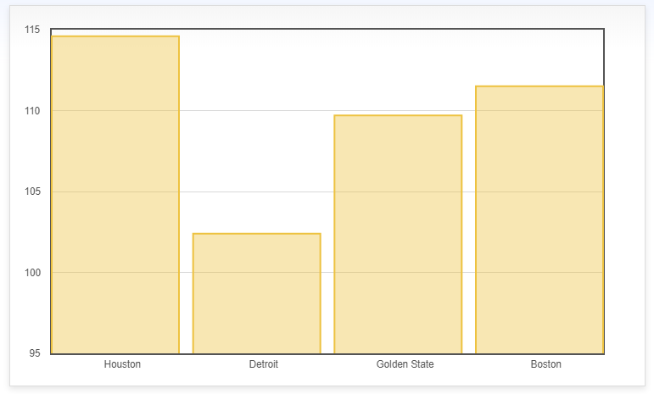
Process:
Client
Server / REST API
GET http://sloan.jayroman.com/api/users
[{id: 1, username: 'jason’}, …]
Transform Data
(some assembly/programming required)

Slide 5
REST Basics
REpresentational State Transfer (REST)
Uniform communication architecture
Stateless – each request treated as new/independent
Client/Server – no dependency between each other
Cacheable
Layered

Slide 6
REST APIs
API – Application Program Interface
Used for retrieving and modifying data
HTTP request methods used to interact
Pros:
Standard method of communication
Programming language-agnostic ; use the best tool for the job
Neither the server nor the client is dependent on each other
Can use without writing code (cURL, browser extensions)
Securable
Cons:
Not always available

Slide 7
REST Alternatives
SOAP (Simple Object Access Protocol)
XML-based, no JSON support
Generally slower, uses more bandwidth, rapidly going out of style
Not fun to use
RPC (Remote Procedure Calls)
Verb-based – URI is the action
Less Common
Requires underlying knowledge of the system being accessed
Web Scraping
Often your only choice

Slide 8
HTTP Request Methods
Methods:
GET – request resource – idempotent
POST – submit resource – not idempotent
PUT – replace a resource
PATCH – partially modify a resource
DELETE – delete a resource
HEAD, CONNECT, OPTIONS, TRACE – additional methods
Mirrors CRUD:
Create (POST), Read (GET), Update (PUT/PATCH), Delete (DELETE)

Slide 9
HTTP Request Examples:
Same endpoint - /api/users/{id} - used for multiple operations:
GET http://sloan.jayroman.com/api/users/{id}
PUT http://sloan.jayroman.com/api/users/{id}
PATCH http://sloan.jayroman.com/api/users/{id}
DELETE http://sloan.jayroman.com/api/users/{id}
POST http://sloan.jayroman.com/api/users
(Theoretical) RPC comparison:
/api/users/{id}/info
/api/users/{id}/replace
/api/users/{id}/edit
/api/users/{id}/delete
/api/users/create

Slide 10
JSON
[{"id":1,"username":"jason","email":"j@jayroman.com"},{"id":2,"username":"sloan","email":null]
JavaScript Object Notation (JSON)
Open standard file format
Human-readable, less verbose
Attribute/value pairs
Language-independent, schema-less
Widely supported by most programming languages
Smaller footprint than XML
Faster
Natural fit with REST

Slide 11
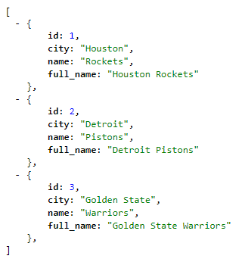
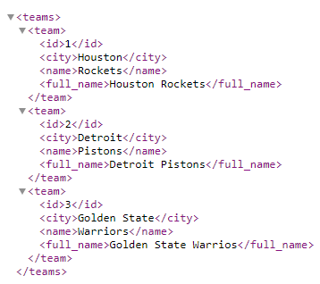
JSON vs XML comparison
JSON
XML

Slide 12
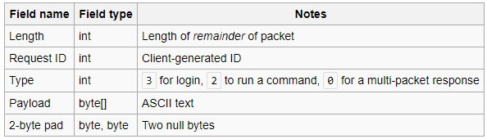
JSON Alternatives
XML (eXtensible Markup Language)
Schema-based
Requires XML parser
Less compact
Programming language-specific serialization
serialize($object); in PHP, for example
Need to use same language to parse
Custom string/binary data
Must know data specification, write custom parser (Half-Life rcon protocol)
Other
YAML
BSON (MongoDB), MessagePack
Protocol Buffers (Google)
O:15:"App\Entity\User":6:{s:19:"App\Entity\Userid";
i:2;s:25:"App\Entity\Userusername";s:5:"sloan";
s:23:"App\Entity\UserapiKey";s:9:"sloan2018";
s:22:"App\Entity\Useremail";N;
s:29:"App\Entity\UserisSuperAdmin";
b:0;s:24:"App\Entity\UserisAdmin";b:1;}

Slide 13
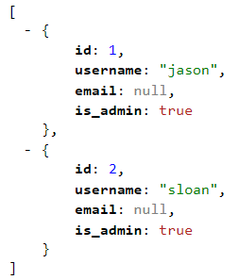
Example REST Call using cURL
curl -is -X "GET" http://sloan.jayroman.com/public/api/users
Congrats! You just accessed a REST API!

Slide 14
Graphs/Charts
Text is fun, but what about visuals?

Slide 15
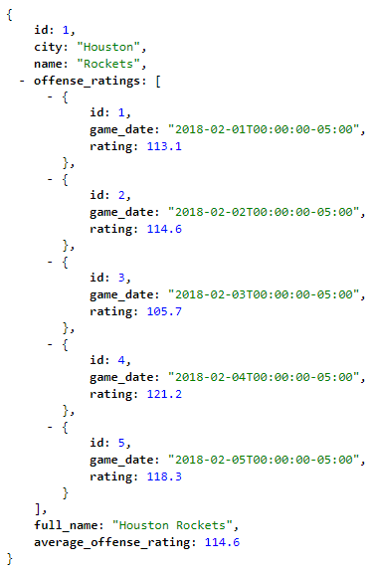
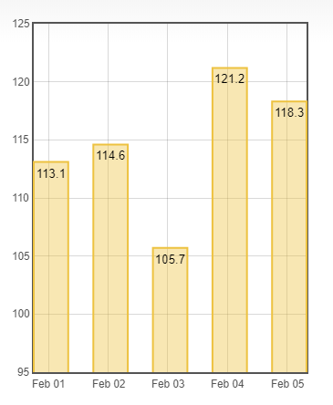
JSON to Graphs/Charts

Slide 16
Let’s do this thing!
Goals:
Add ourselves as a user to access the REST API
Retrieve data
Make some graphs!

Slide 17
Questions?
Code: https://github.com/jasonroman/sloan-2018
Website: http://sloan.jayroman.com
Find me at:
Twitter @_jasonroman
Email: j@jayroman.com
https://github.com/jasonroman/
http://jayroman.com/

