Slide 1
REST APIs and JSON Graphing
Jason Roman
@_jasonroman

Slide 2
Resources
Code: https://github.com/jasonroman/sloan-2018
Website: http://sloan.jayroman.com / http://sloan-client.jayroman.com
You will need either of the following:
cURL: https://curl.haxx.se/download.html
Web browser REST client (Chrome extension: Yet Another REST Client)
Recommended:
Web browser JSON viewer (Chrome extension: JSONView)
Git: https://git-scm.com/downloads
Programming Language / Framework of your choice
(as long as it is Python, PHP/Symfony, JavaScript + Node.js + Express, or R)

Slide 3
REST Basics
REpresentational State Transfer (REST)
Uniform communication architecture
Stateless – each request treated as new/independent
Client/Server – no dependency between each other
Cacheable
Layered

Slide 4
REST APIs
API – Application Program Interface
HTTP request methods used to interact
Used for retrieving and modifying data
Pros:
Standard method of communication
Programming language-agnostic ; use the best tool for the job
Neither the server nor the client is dependent on each other
Simple to secure
Can use without writing code (cURL)
Securable
Cons:
??

Slide 5
REST Alternatives
SOAP (Simple Object Access Protocol)
XML-based, no JSON support
Generally slower, uses more bandwidth, rapidly going out of style
Not fun to use
RPC (Remote Procedure Calls)
Verb-based – URI is the action
Less Common
Requires underlying knowledge of the system being accessed
Web Scraping
Often your only choice

Slide 6
HTTP Request Methods
Methods:
GET – request resource – idempotent
POST – submit resource – not idempotent
PUT – replace a resource
PATCH – partially modify a resource
DELETE – delete a resource
HEAD, CONNECT, OPTIONS, TRACE – additional methods
Mirrors:
Create (POST), Read (GET), Update (PUT/PATCH), Delete (DELETE)

Slide 7
HTTP Request Examples:
Same endpoint - /api/users/{id} - used for multiple operations:
GET /api/users/{id}
PUT /api/users/{id}
PATCH /api/users/{id}
DELETE /api/users/{id}
POST /api/users

Slide 8
JSON
JavaScript Object Notation (JSON)
Open standard file format
Human-readable, less verbose
Attribute/value pairs
Language-independent, schema-less
Widely supported by most programming languages
Smaller footprint than XML
Faster
Natural fit with REST

Slide 9
JSON Alternatives
XML (eXtensible Markup Language)
Schema-based
Requires XML parser
Less compact
Programming language-specific serialization
serialize($object); in PHP, for example
Need to use same language to parse
Custom string/binary data
Must know data specification, write custom parser (Half-Life rcon protocol)
Other
YAML
BSON (MongoDB), MessagePack
Protocol Buffers (Google)

Slide 10
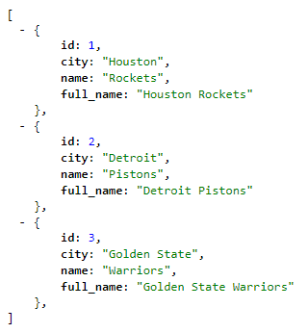
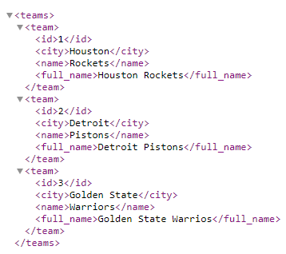
JSON vs XML comparison
JSON
XML

Slide 11
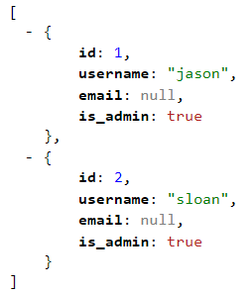
Example REST Call using cURL
curl -is -X "GET" http://sloan.jayroman.com/public/api/users
Congrats! You just accessed a REST API!

Slide 12
Graphs/Charts
Text is fun, but what about visuals?

Slide 13
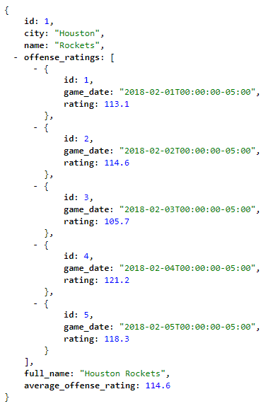
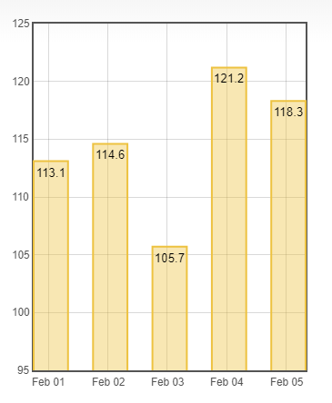
Graphs/Charts

Slide 14
Let’s do this thing!
Goals:
Add ourselves as a user to access the REST API
Retrieve data
Make some graphs!

Slide 15
Questions?
Code: https://github.com/jasonroman/sloan-2018
Website: http://sloan.jayroman.com
Find me at:
https://twitter.com/_jasonroman
https://github.com/jasonroman/
http://jayroman.com/

