Slide 1
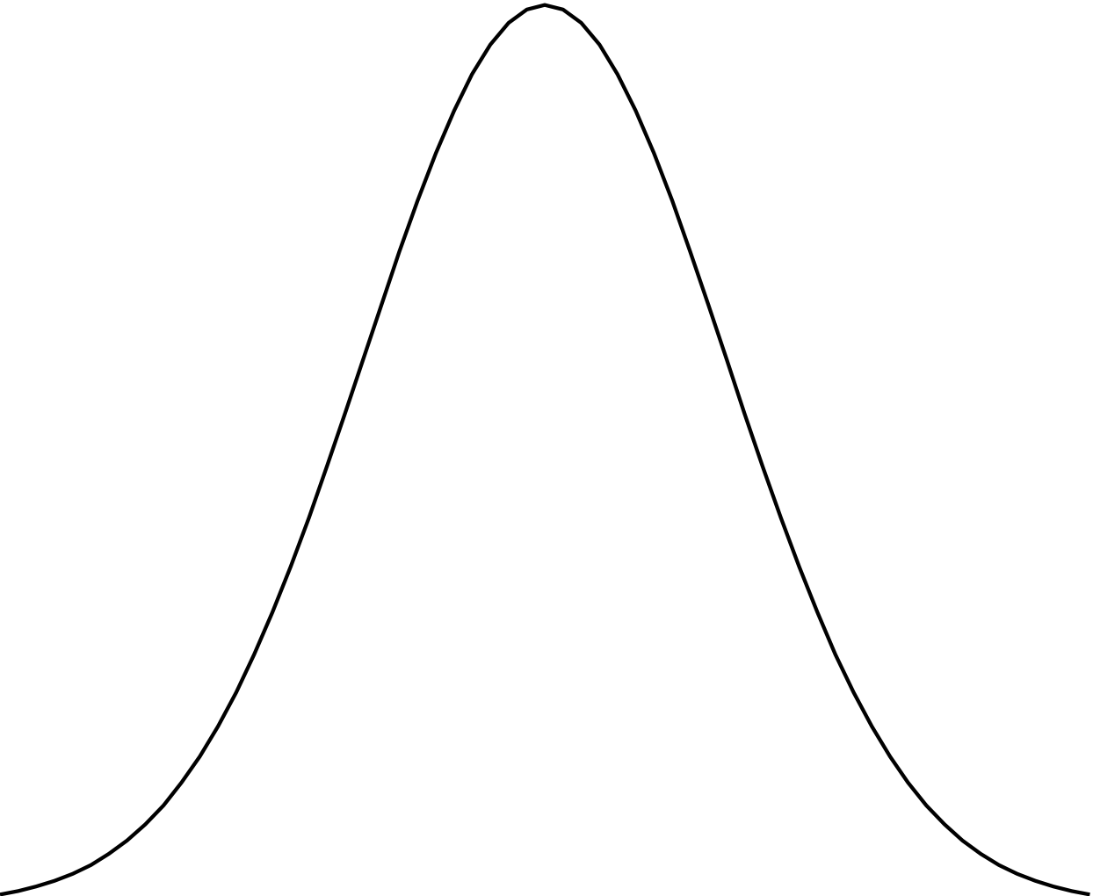
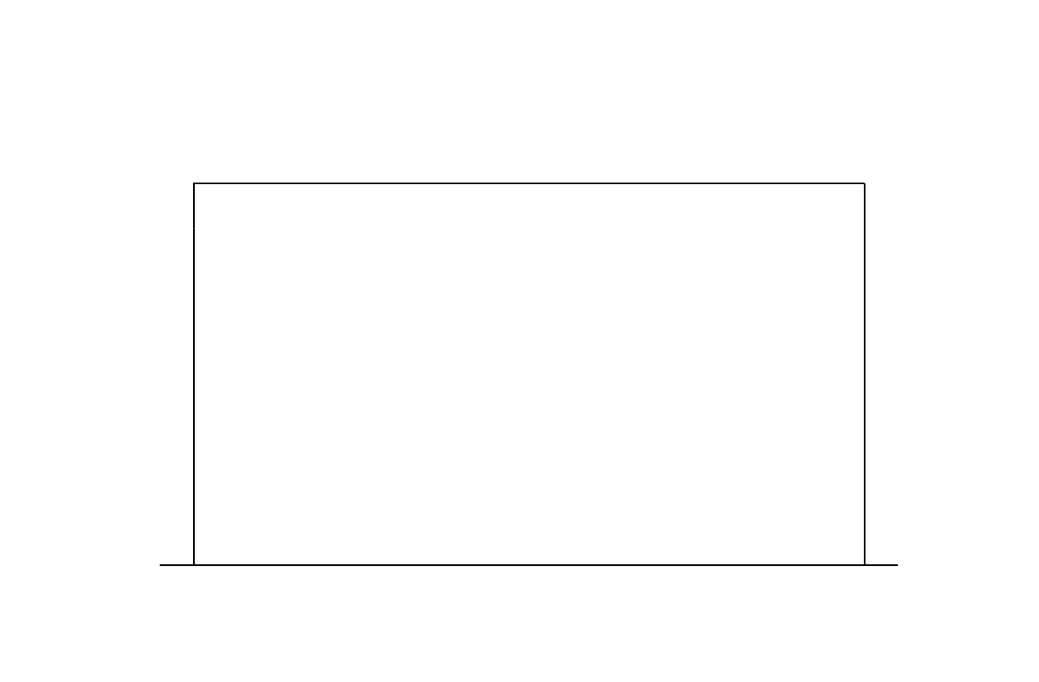













$$x_{A}$$
σ=0.01
σ=0.01
μ=0
μ=0
σ=0.01
σ=0.01
σ=0.01
σ=0.01
μ=0
μ=0
μ=0
μ=0
$$β_{1}+β_{2}∙x_{A}$$
$$β_{3}+β_{4}∙x_{A}$$
$$β_{5}+β_{6}∙x_{A}$$
0
1
0
1
0
1
$$μ_{1}$$
$$μ_{2}$$
$$μ_{3}$$
$$σ_{1}$$
$$σ_{2}$$
$$σ_{3}$$
$$y_{1}$$
$$y_{2}$$
$$y_{3}$$

