Slide 1

Location is everything.

Slide 2
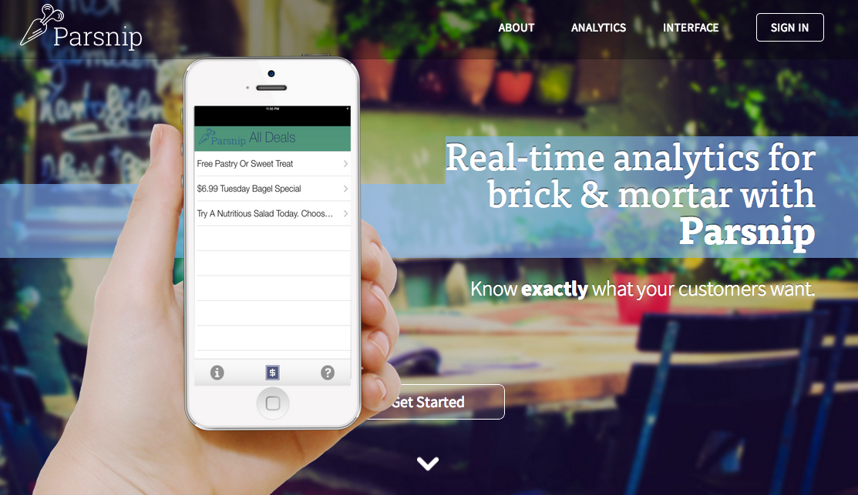
Purpose
Make customer tracking a breeze for store owners.
Create delightful shopping experiences for customers.
Parsnip

Slide 3
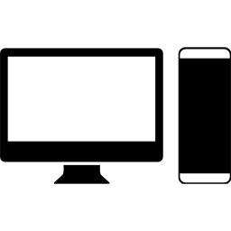
Basic Use
Web App
Mobile App
Store owner sets up Parsnip account
Store Owner creates floorplans of store and sets up iBeacons.
Store Owners take advantage of Parsnip’s cutting edge analytics
Customers receive special deals and offers.
Store owners receive foot traffic data.

Slide 4

Mobile Rundown

Slide 5
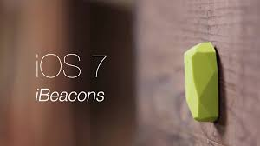
iBeacons
Low frequency bluetooth device.
Can be used to determine distance from mobile device.
Accurate up to 200 ft.

Slide 6




Data Transfer
1. Beacon transmits signal.
4. Begin sending distances to server.
2. Phone detects Beacon signal & ID
3. Request store information from server.

Slide 7
Win-Win
Customers receive special deals and offers.
Store owners receive foot traffic data.

Slide 8
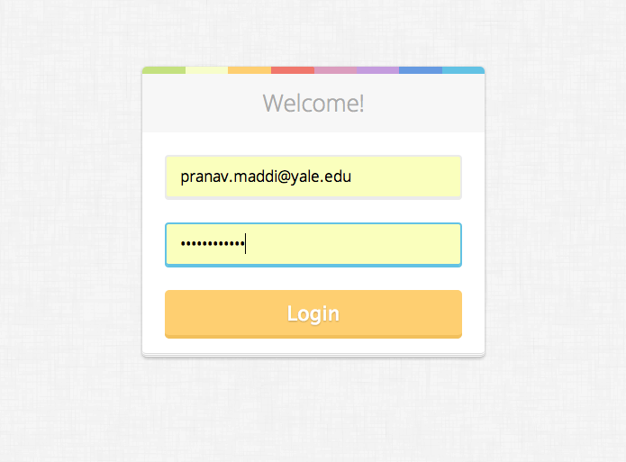
Web App Features

Slide 9
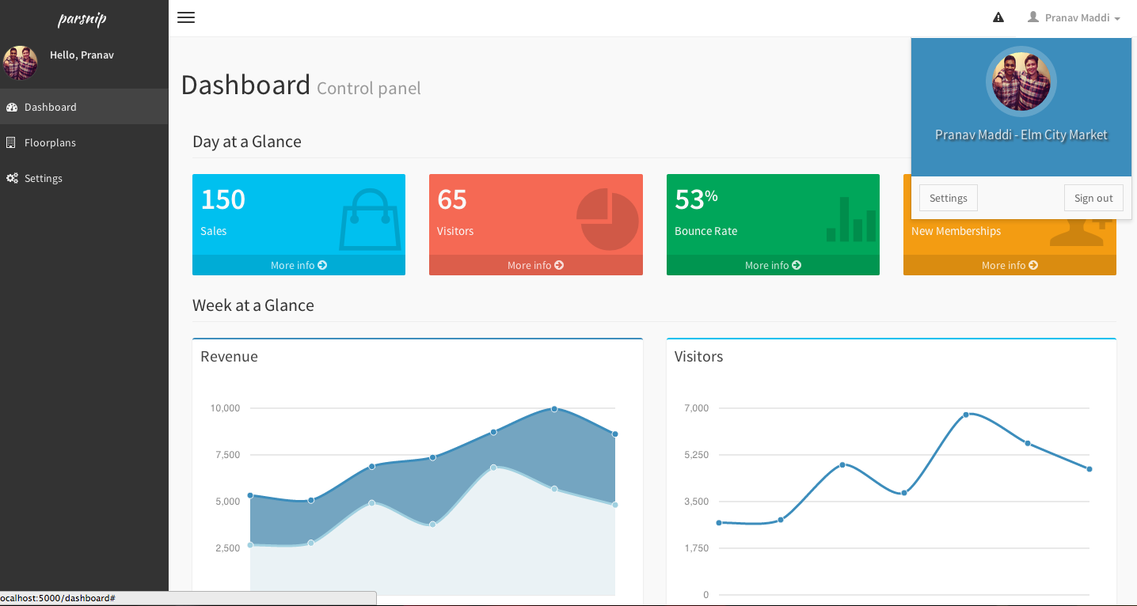
Dashboard
Notifications
Floorplans
Vital Metrics
Settings

Slide 10
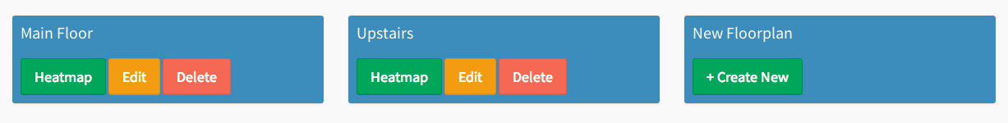
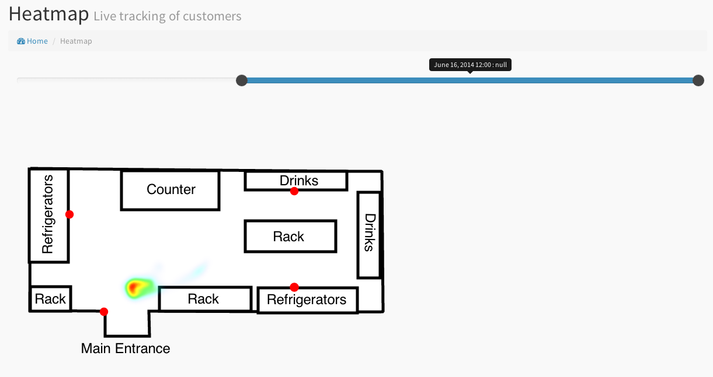
Floorplans & Heatmaps

Slide 11
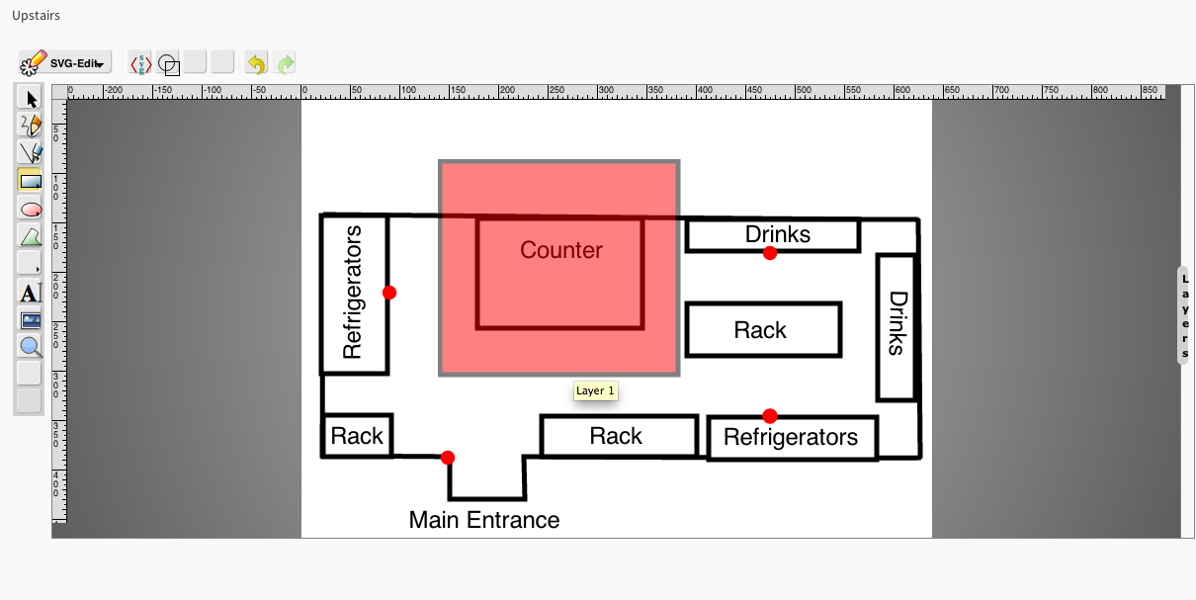
Editing Floorplans

Slide 12
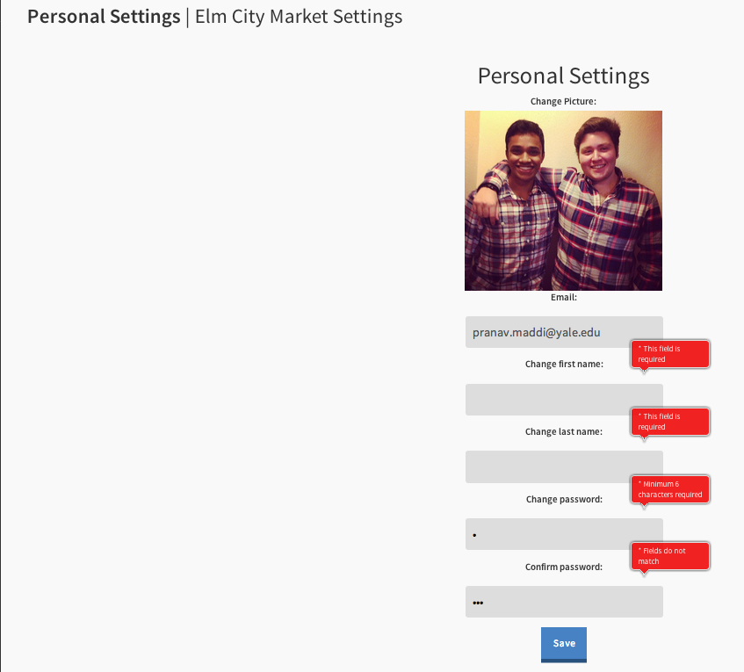
Settings

Slide 13
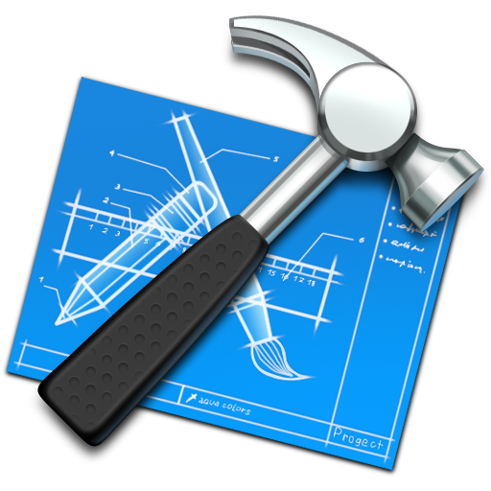
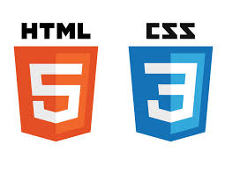



Technologies

Slide 14
Let’s get down and dirty

