Slide 1
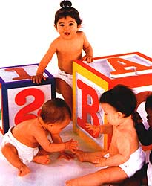
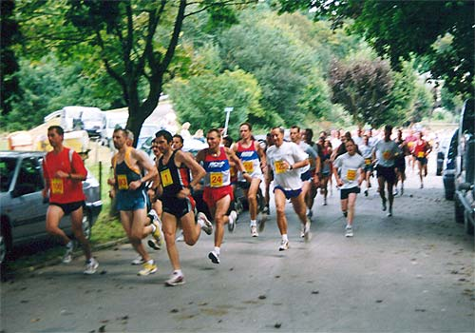
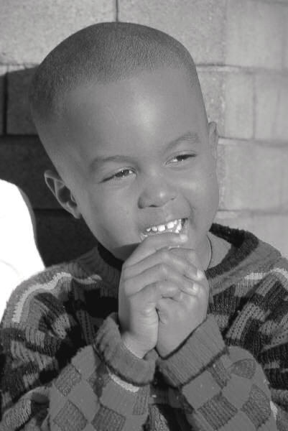


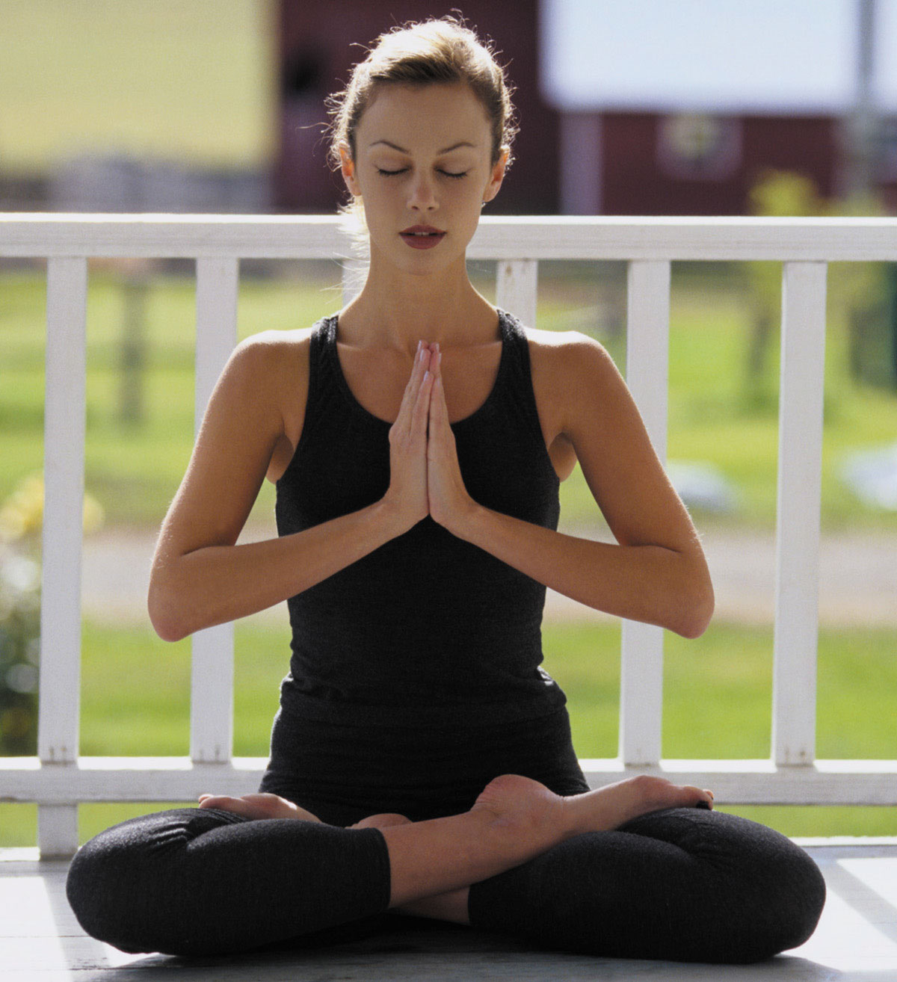

Psychology 1504
Positive Psychology

Slide 2
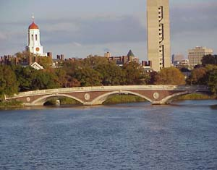
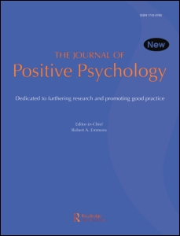
Bridging Ivory Tower and Main Street
The objective of positive psychology is to unite the rigor of academic research with the accessibility of the self-help movement.

Slide 3
House keeping
Feedback or questions
In case of an emergency…
… we’ll take a PP-break
Powerpoints and videotape on website
Active note-taking
Regular Time-Ins

Slide 4

“Words are not the sole medium of exchange in teaching and learning—we educate with silence as well. Silence gives us a chance to reflect on what we have said and heard… In authentic education, silence is treated as a trustworthy matrix for the inner work students must do, a medium for learning of the deepest sort.”

Slide 5
The Road to Positive Psychology
Humanistic Psychology (50’s)
The Third Force
  Reaction to behaviorism (First Force)
  Reaction to psychoanalysis (Second Force)
Lacked rigorous methodology

Slide 6
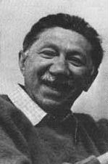
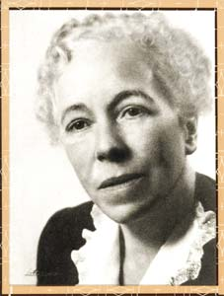
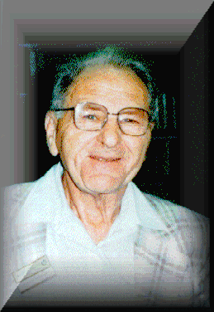
Meet the Grandparents
Abraham Maslow
(1908-1970)
Karen Horney
(1885-1952)
Aaron Antonovsky
(1923-1994)

Slide 7
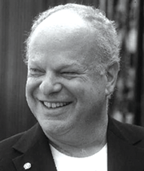

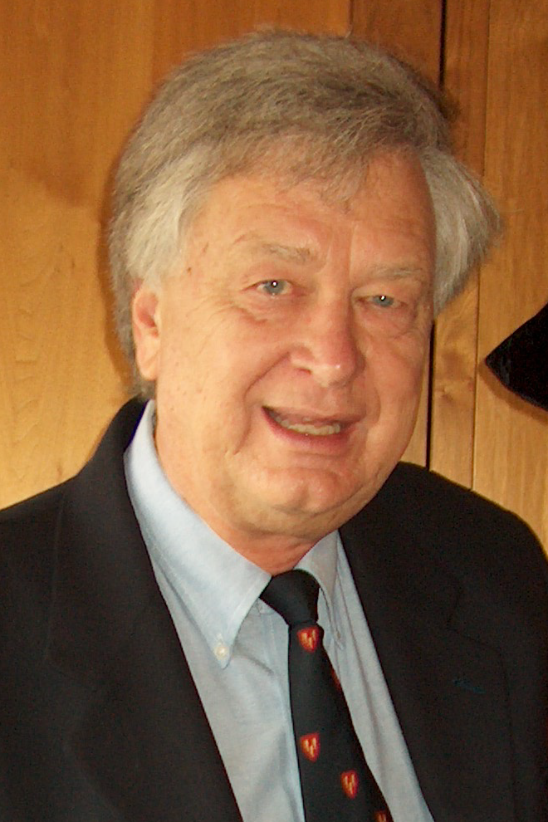
Meet the Parents
Martin Seligman
Ellen Langer
Philip Stone

Slide 8

Meet 1504

Slide 9
It is not merely about information
It is also about transformation
Covering less; uncovering more

Slide 10
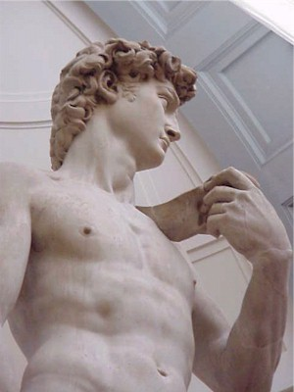
“The soul grows by subtraction, not addition.”
Thoreau
“In pursuit of knowledge, every day something is acquired; in pursuit of wisdom, every day something is dropped.”
Lao Tzu

Slide 11

In Search of “WOW”
There is no “WOW”!
Making common sense more common

Slide 12
Information is not enough
“What is wrong is not the great discoveries of science—information is always better than ignorance, no matter what information or what ignorance. What is wrong is the belief behind the information, the belief that information will change the world. It won’t.”
Archibald MaCleish

Slide 13
Information is not enough
“Humanistic philosophy [offers] a new conception of learning, of teaching, and of education. Stated simply, such a concept holds that the function of education, the goal of education—the human goal, the humanistic goal, the goal so far as human beings are concerned—is ultimately the ‘self-actualization’ of a person, the becoming fully human, the development of the fullest height that the human species can stand up to or that the particular individual can come to. In a less technical way, it is helping the person to become the best that he is able to become.”
Abraham Maslow

Slide 14
It is not about providing definitive answers concerning the good life
It is about identifying the right questions
Education is the quest for information and transformation, and therefore must begin with a question.
“The most common source of mistakes in management decisions is the emphasis on finding the right answer rather than the right question.”
Peter Drucker

Slide 15


Slide 16
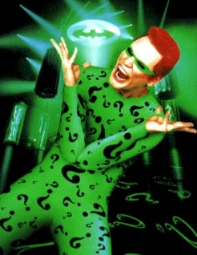
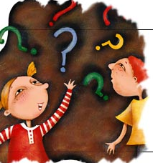
“The one real object of education is to leave a man in the condition of continually asking questions.” Bishop Creighton

Slide 17
The Question of Questions
How can we help ourselves and others—individuals, communities, and society—become happier?

Slide 18
It is not a survey of positive psychology
It is a selective exploration of the ‘question of questions.’
Eclectic
Cross cultural psychology
“[We were] a little surprised by the Dalai Lama’s seeming resistance to the notion of cultural differences.”
Daniel Goleman

Slide 19
Studying Ourselves (as well)
“What is most personal is most general.” Carl Rogers
“We must remember that knowledge of one’s own deep nature is also simultaneously knowledge of human nature in general.” Abraham Maslow

Slide 20
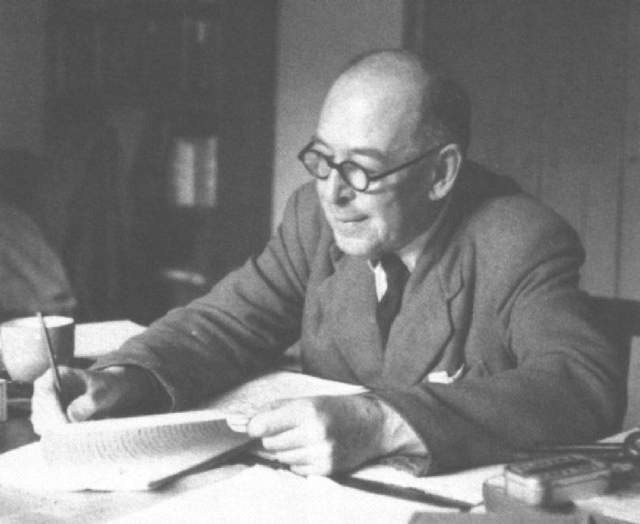
“There is one thing, and only one in the whole universe which we know more about than we could learn from external observation. That one thing is [ourselves]. We have, so to speak, inside information; we are in the know.”
CS Lewis

Slide 21
It is not English 10a or Math 55
It is about rigorous fun
“I would not give a fig for the simplicity on this side of complexity, but I would give my life for the simplicity on the other side of complexity.”
Oliver Wendell Holmes
A different kind of effort
“On Monday, don’t tell me how great it was; tell me what you’re doing differently.”
Peter Drucker

Slide 22
Final Project
20-30 minute Presentation
  Any topic within positive psychology
  Written text (10-15 pages double spaced)
  Slides (word or powerpoints)
Include:
  Reference to research
  Optional: stories, film clips, exercises, etc
Why a presentation?
  Teaching as learning
  Spread goodness…

Slide 24

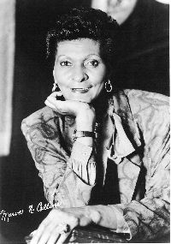

Why Positive Psychology?

Slide 25
Psychological Abstracts (1967-2000)
Anger: 5,584
Anxiety: 41,416
Depression: 54,040
Joy: 415
Happiness: 1,710
Life satisfaction: 2,582
Ratio: 21/1

Slide 26
Focusing on What Doesn’t Work
“The science of psychology has been far more successful on the negative than on the positive side; it has revealed to us much about man’s shortcomings, his illnesses, his sins, but little about his potentialities, his virtues, his achievable aspirations, or his psychological height. It is as if psychology had voluntarily restricted itself to only half its rightful jurisdiction, and that the darker, meaner half.”
Abraham Maslow

Slide 27
Psychology Needs Help
21/1 ratio is unhealthy…
… but it reflects reality
  depression 10 times higher today than 1960
  mean age for depression today is 14.5 (compared to 29.5 in 1960)

Slide 28
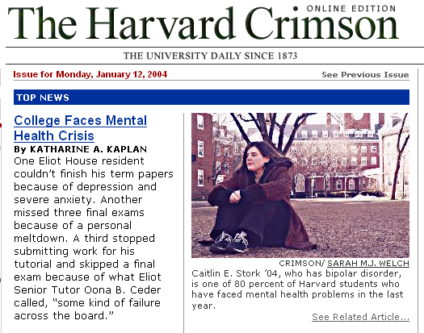

Slide 29
Does Psychology Need Help?
21/1 ratio of studies is unhealthy…
… but it reflects reality
  depression 10 times higher today than 1960
  mean age for depression today is 14.5 (compared to 29.5 in 1960)
  mental health crisis on campuses nationwide (Kadison, 2005)
  worldwide mental health epidemic

Slide 30
Why Positive Psychology?
The importance of focusing on what works
Happiness is not the negation of unhappiness
Prevention through cultivating capacity

Slide 31
1. The Importance of Focusing on What Works
“The aim of Positive Psychology is to catalyze a change in psychology from a preoccupation only with repairing the worst things in life to also building the best qualities in life.”
Martin Seligman

Slide 32
Reframing Questions:
The Case of At-Risk Population
Traditional psychology (Post-WWII)
  “Why do these individuals fail?”
Positive psychological approach (1980s-)
  “What makes some individuals succeed despite unfavorable circumstances?”

Slide 33
Resilience
“A class of phenomena characterized by patterns of positive adaptation in the context of significant adversity or risk.”
Masten & Reed
Superkids?
Ordinary characteristics, extraordinary results
  Optimism
  Faith and a sense of meaning
  Prosocial behavior
  Focusing on strengths
  Set goals
  A role model
  Social support

Slide 34
From Pathogenic Questions to Salutogenic Questions
“All those familiar with the history of science are aware that important advances come with the formulation of new questions. The question is the breakthrough; the answer comes with difficulty, but it is the new question that is important. The salutogenic question, I submit to you, is a radically new question, which provides the impetus for formulating a new paradigm to help us understand health and illness. It has serious implications for researcher and clinician, biological and social scientist alike.”
Aaron Antonovsky

Slide 35
“We see what we look for and we miss much of what we are not looking for even though it is there... Our experience of the world is heavily influenced by where we place our attention.”
Stavros and Torres

Slide 36

Role models
High Expectations
From blame to responsibility
Tough and respectful
Optimism and faith in future
From focusing on deficiencies to focusing on strengths

Slide 37
Passive Victim Vs. Active Agent
___________________________________________
self pity
blame
frustration
anger
take action
responsibility
confidence
hope and optimism

Slide 38
Reframing Questions:
The Case of a Chicago School
Traditional Way
  “How can we keep students in school?”
Marva Collins’ Way
  “How can we cultivate the seed of greatness in our students?”
  “How can we cultivate the seed of greatness in our selves and families, in our communities and organization, in our nation and our world?”

Slide 39
2. Happiness isn’t the Negation of Unhappiness
neurosis, anger, anxiety, wellbeing, satisfaction, joy
depression, psychosis excitement, happiness
_______________________ 0 ____________________ +
Disease Model Health Model
Focus on weaknesses Focus on strengths
Overcoming deficiencies Building competencies
Avoiding pain Seeking pleasure
Running from unhappiness Pursuing happiness
Neutral state (0) as ceiling No ceiling
Tensionless as ideal Creative tension as ideal

Slide 40
3. Prevention through Cultivating Positive
Illness as the absence of health (vs. health as the absence of illness)
“It [neurosis] is a falling short of what one could have been, and even, one could say, of what one should have been, biologically speaking, that is, if one had grown and developed in an unimpeded way. Human and personal possibilities have been lost. The world has been narrowed, and so has consciousness. Capacities have been inhibited.” Abraham Maslow

Slide 41
“We have discovered that there are human strengths that act as buffers against mental illness: courage, future-mindedness, optimism, interpersonal skill, faith, work ethic, hope, honesty, perseverance, the capacity for flow and insight, to name several... We have shown that learning optimism prevents depression and anxiety in children and adults, roughly halving their incidence over the next two years... Similarly, I believe, that if we wish to prevent drug abuse in teenagers who grow up in a neighborhood that puts them at risk, that the effective prevention is not remedial. Rather it consists of identifying and amplifying the strengths that these teens already have.”
Martin Seligman

Slide 42
Cultivating Capacity
Stronger “psychological immune system”
Larger and stronger “psychological engine”
Mental health at Harvard

Slide 43
“The message of the Positive Psychology movement is to remind our field that it has been deformed. Psychology is not just the study of disease, weakness, and damage; it also is the study of strength and virtue. Treatment is not just fixing what is wrong; it also is building what is right. Psychology is not just about illness or health; it is about work, education, insight, love, growth, and play. And in this quest for what is best, Positive Psychology does not rely on wishful thinking, self-deception or hand-waving; instead it tries to adapt what is best in the scientific method to the unique problems that human behavior presents in all its complexity.” Martin Seligman

Slide 44
Bibliography and Recommendations
www.psychologymatters.org
http://www.ppc.sas.upenn.edu/
Antonovsky (1979). Health, Stress, and Coping. San Fransisco: Jossey-Bass.
Masten, A. S. & Reed, M. J. (2002). Resilience in development. In C. R. Snyder and S. J. Lopez (Eds.), Handbook of Positive Psychology, 528-540. Oxford University Press.
Seligman, M. E. P., & Csikszentmihalyi, M. (2000). Positive Psychology. American Psychologist, 55, 5-14.
Sheldon, K. M. & King, L (2001). Why Positive Psychology Is Necessary. American Psychologist, 56, 216-217.
Snyder, C. R. & Lopez, S. J. (Eds.) (2002). Handbook of Positive Psychology, 528-540. Oxford University Press.
Collins, M. & Tamarkin, C. (1990). Marva Collins’ Way. Putnam: New York.
Werner, E. & Smith, R. (2001). Journeys from Childhood to Midlife: Risk, Resilience and Recovery. Cornell University Press.

