Slide 1
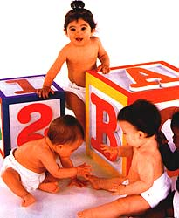
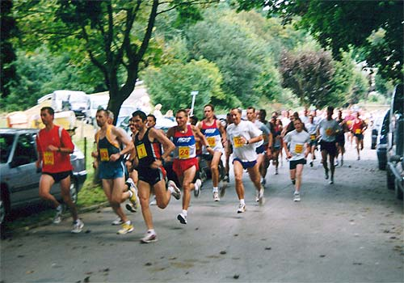
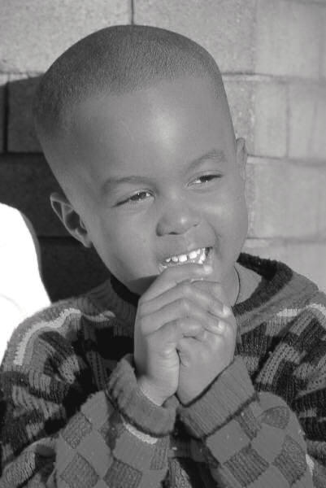

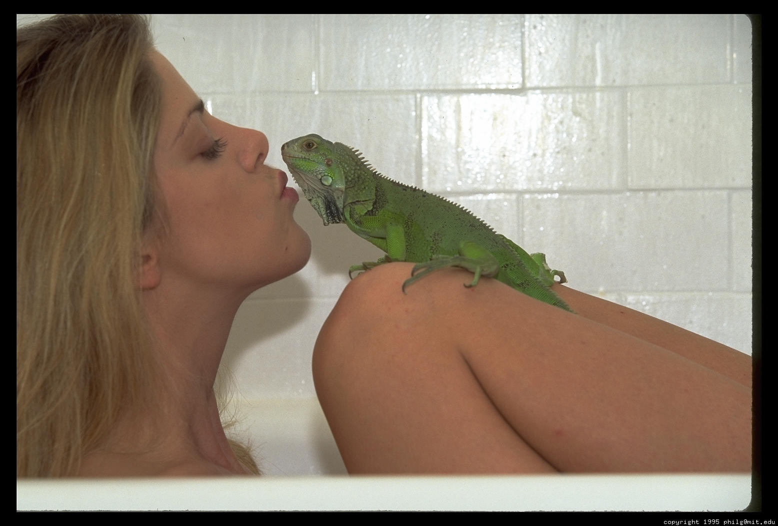
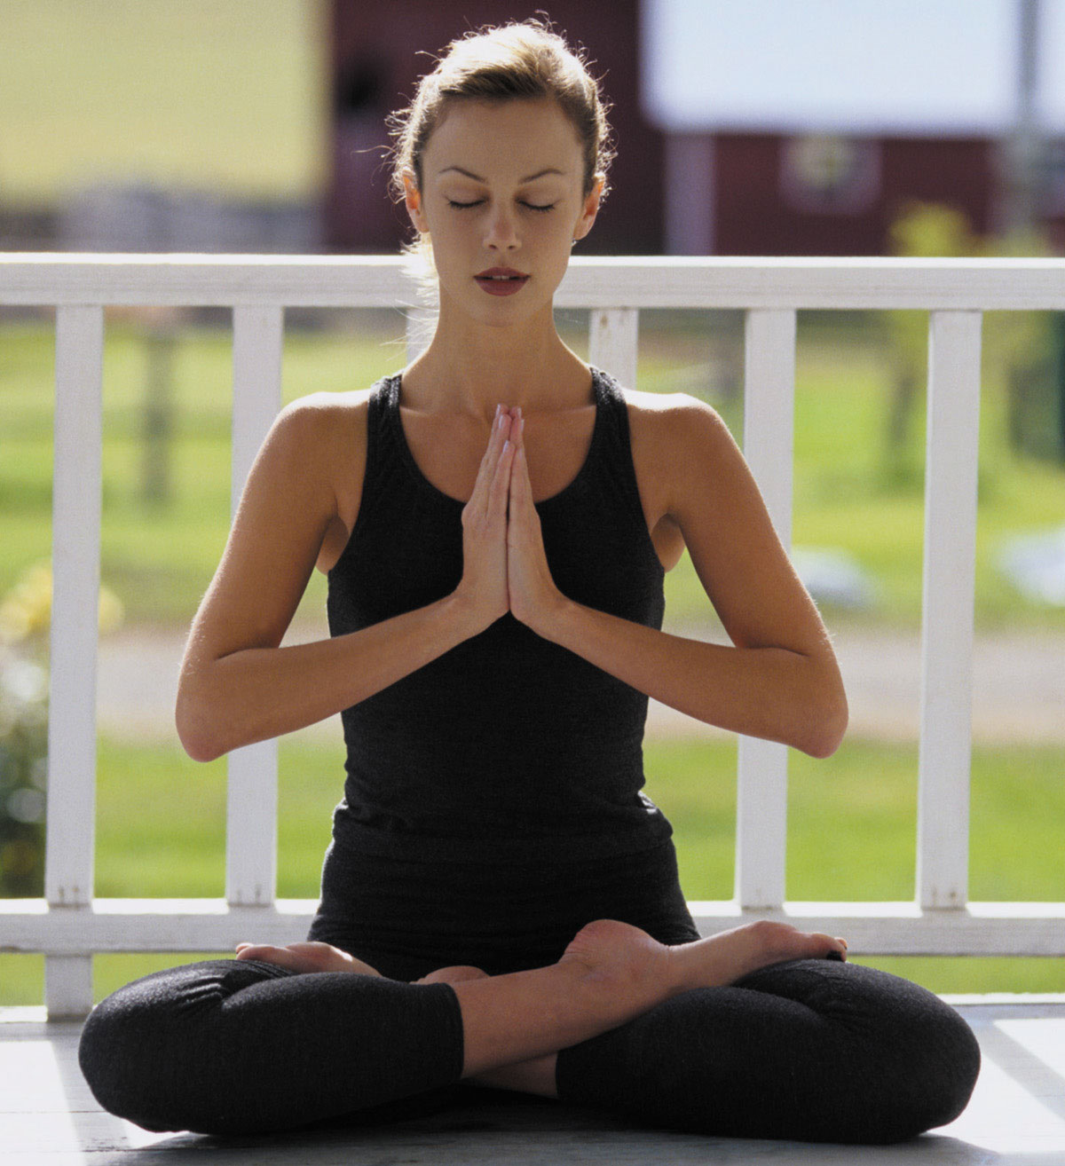
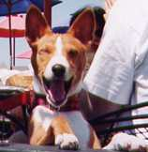
Psychology 1504
Positive Psychology

Slide 2


Slide 3
Psychology 1504
Positive Psychology

Slide 4
Top Ten 1504 Tips
Eleven
Oh, the questions you’ll ask
Believe—in yourself and others
Learn to fail or fail to learn
Give yourself the permission to be human
Open up (journal and/or person)
Cultivate the benefit finder (express gratitude)
Simplify
Cultivate relationships
Remember the mind-body connection
Strive to be known rather than validated
Introduce behavioral change NOW

Slide 5
Practical Idealism: Making A Difference
“I am not only the disinterested and impersonal seeker for pure cold truth for its own sake. I am also very definitely interested and concerned with man’s fate, with his ends and goals and with his future. I would like to help improve him and better his prospects. I hope to help teach him how to be brotherly, cooperative, peaceful, courageous, and just. I think science is the best hope for achieving this, and of all the sciences, I consider psychology most important to this end. Indeed, I sometimes think that the world will either be saved by psychologists—in the very broadest sense—or else it will not be saved at all.”
Abraham Maslow

Slide 6
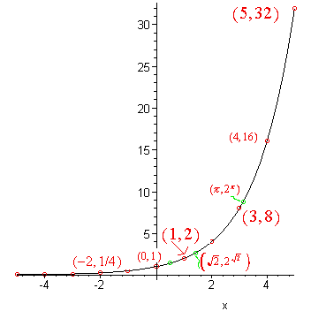
We underestimate our capacity to effect change because we underestimate the growth of an exponential function.

Slide 7
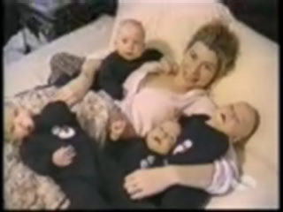

Slide 8
Spreading Happiness
“Thousands of candles can be lighted from a single candle, and the life of the candle will not be shortened. Happiness never decreases by being shared.”
The Buddha
“Be the change you want to see in the world.”
Gandhi

Slide 9
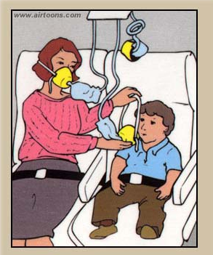
Take Care of Yourself

Slide 10

Top Ten Eleven 1504 Tips
Oh, the questions you’ll ask
Believe—in yourself and others
Learn to fail or fail to learn
Give yourself the permission to be human
Open up (journal and/or person)
Cultivate the benefit finder (express gratitude)
Simplify
Cultivate relationships
Remember the mind-body connection
Strive to be known rather than validated
Introduce behavioral change NOW

