Slide 1
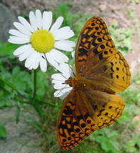

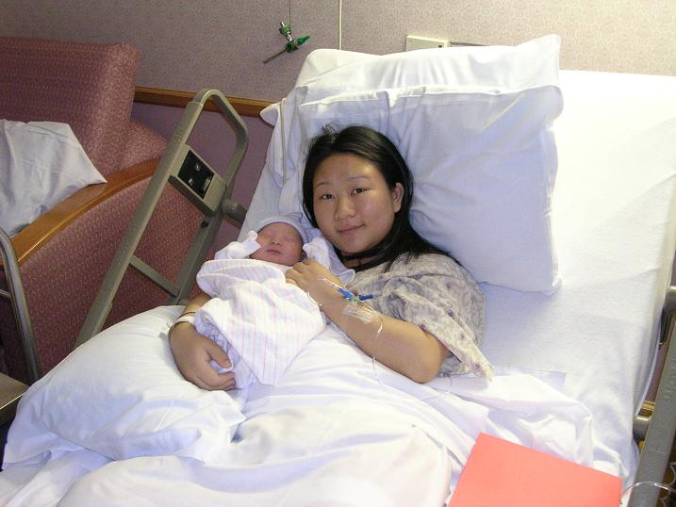
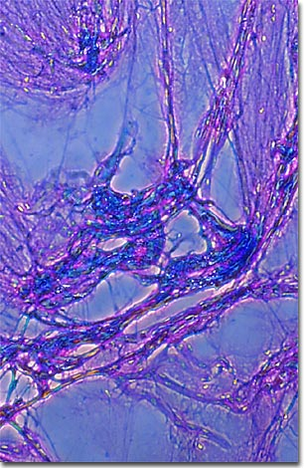
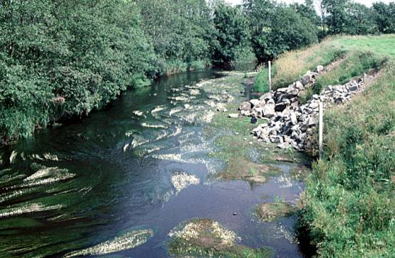
Change

Slide 2
The Nature of Change
Change is hard
  Twin research (Lykken & Tellegan, 1996)
  Affective forecasting (Gilbert, 1998)
  Cambridge-Somerville study
Change is possible
  Error of the average
  The exception proves the rule

Slide 3
The Anatomy of Change
Neuroplasticity (Davidson, 2000)
Neural pathways (channels)
Self-reinforcing
Habits as fortified pathways

Slide 4
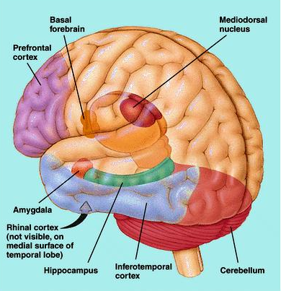
Healthy and Unhealthy Pathways
Negative channels
Positive channels
Same trigger, different response
Trans-forming the brain

Slide 5
Two Types of Change
Gradual approach
Acute approach
Neither is quick-fix
“The belief that we can rely on shortcuts to gratification and bypass the exercise of personal strengths and virtues is folly. It leads... to legions of humanity who are depressed in the middle of great wealth and are starving to death spiritually.”
Martin Seligman

Slide 6
But do I really want to change?
(Langer & Thompson 1989)
Rigidity
Gullibility
Grimness
Perfectionism
Worry/anxiety
Guilt
Simplify
Fault-finding
Happiness
Consistency
Trustworthiness
Seriousness
Drive/ambition
Responsibility
Empathy/sensitivity
Lose edge
Realism
No pain no gain
A more nuanced understanding of what change

Slide 7
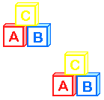




Learning (and applying) Your ABC’s
Affect
Behavior
Cognition
Need all three

Slide 8
Happiness =
Genetic set range
+
External circumstances
+
Intentional activities
(ABC)

Slide 9

Affect: Our Emotions

Slide 10
Gradual Change: Mindfulness Meditation
“Cultivating mindfulness can lead to the discovery of deep realms of relaxation, calmness, and insight within yourself... The path to it in any moment lies no farther than your own body and mind and your own breathing.”
Jon Kabatt-Zin
“All of us have the capacity to be mindful. All it involves is cultivating our ability to pay attention in the present moment.”
Jon Kabatt-Zin
“Mindfulness means seeing things as they are, without trying to change them. The point is to dissolve our reactions to disturbing emotions, being careful not to reject the emotion itself.”
Tara Bennett-Goleman

Slide 11
Acute Change
Post Traumatic Stress Disorder (PTSD)
Widespread (Society for Neuroscience)
Creating new pathways (shock treatment)
Post traumatic growth (Tedeschi & Calhoun)
Is there a positive equivalent to trauma?
Can a single positive experience create a positive channel that will lead to a permanent increase in well-being, calm, and positive memories?

Slide 12
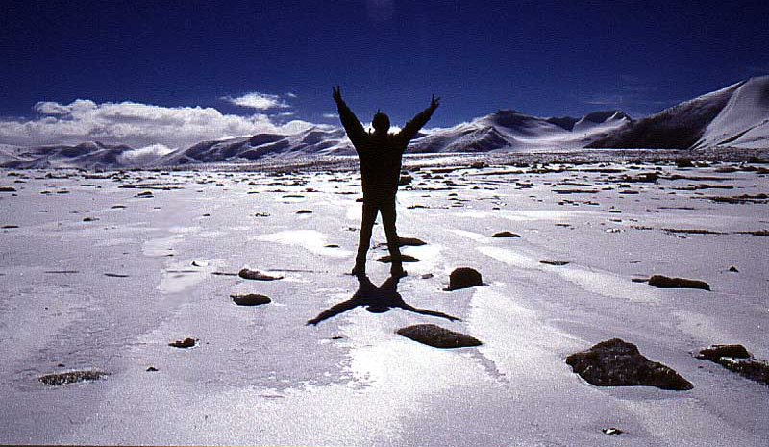

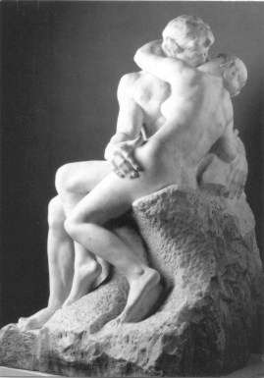
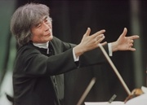
Acute Change Through Peak Experience

Slide 13
Acute Change Through Peak Experience
“The term peak experiences is a generalization for the best moments of the human being, for the happiest moments of life, for experiences of ecstasy, rapture, bliss, of the greatest joy. I found that such experiences came from profound aesthetic experiences such as creative ecstasies, moments of mature love, perfect sexual experiences, parental love, experiences of natural childbirth, and many others.” Abraham Maslow
Peak experience as ‘positive trauma’

Slide 14
Post Peak Experience Order (PPEO)
“Peak experiences often have consequences... They can do the same there as psychotherapy, if one keeps his goals right, and if one knows just what he is about, and if one is conscious of what he is going toward. We can certainly talk, on the one hand, of the breaking up of symptoms, like the breaking up of cliches, of anxieties, or the like; or on the other hand, we can talk about the development of spontaneity, and of courage, and of Olympian or Godlike humor and suchness, sensory awareness, body awareness, and the like.” Abraham Maslow
Peak experiences can lead to a new brain order

Slide 15
Making the Most of Peak Experiences
Enhancing the likelihood of PE
  acceptance
  mindfulness
  music and dance
  meaningful goal
  taking time
Enhancing the likelihood of PPEO
  replaying and imagining
  journaling (describing)
  taking time
  taking action

Slide 16
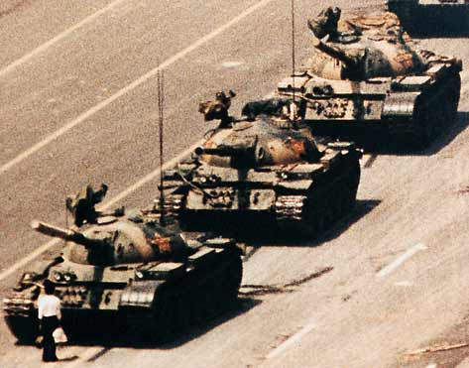
Behavior: Taking Action

Slide 17
Permanent Change
Attitude
Behavior

Slide 18
Behavior Changing Attitudes
POWs in Korea (Schein, 1956)
Cognitive Dissonance (Festinger, 1959)
Self-perception theory (Bem, 1967)
Facial feedback hypothesis (Ekman, 1983)
“Whistling to keep up courage is no mere figure of speech. On the other hand, sit all day in a moping posture, sigh, and reply to everything with a dismal voice, and your melancholy lingers... Smooth the brow, brighten the eye, contract the dorsal rather than the ventral aspect of the frame, and speak in a major key, pass the genial compliment, and your heart must be frigid indeed if it does not gradually thaw.”
William James

Slide 19
Behavior Changing Attitudes
POWs in Korea (Schein, 1956)
Cognitive Dissonance (Festinger, 1959)
Self-perception theory (Bem, 1967)
Facial feedback hypothesis (Ekman, 1983)
Body feedback hypothesis
Overcoming shyness (Haemmerlie, 1987)
Fake it till you make it (Myers, 1992)

Slide 20


Slide 21
“Those whose deeds exceed their wisdom, their wisdom shall endure; but those whose wisdom exceeds their deeds, their wisdom shall not endure.”
Chapters of the Fathers

Slide 22
Dan Millman’s Advice on Change
"To change the course of your life, choose one of two basic methods:
1. You can direct your energy and attention toward trying to fix your mind, find your focus, affirm your power, free your emotions and visualize positive outcomes so that you can finally develop the confidence to display the courage to discover the determination to make the commitment to feel sufficiently motivated to do what it is you need to do.
2. Or you can just do it."

Slide 23
Coping (Bednar and Peterson, 1995)
Exiting comfort zone

Slide 24


Slide 25
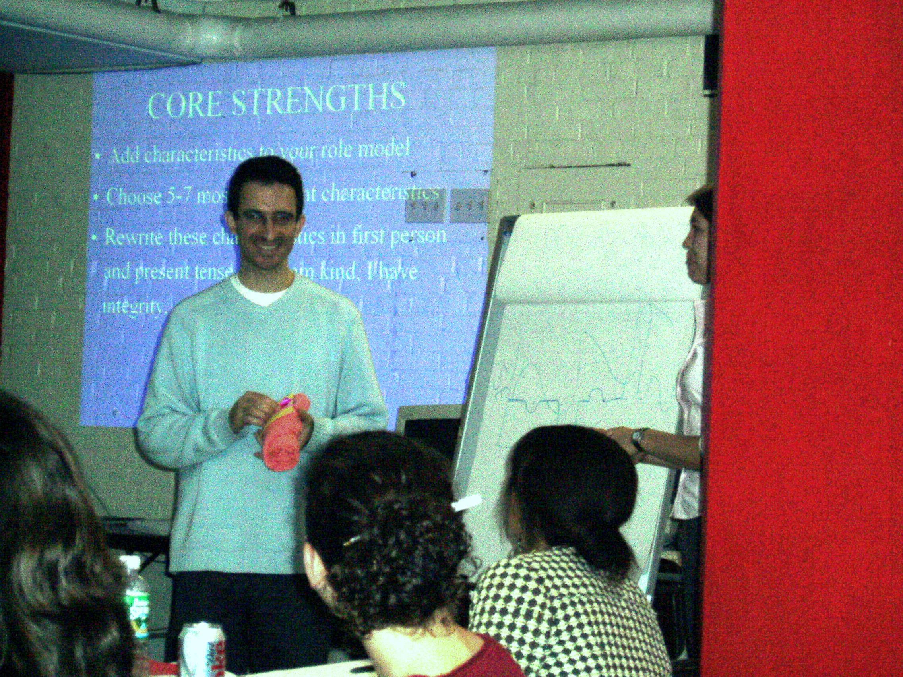

Slide 26


Slide 27


Slide 28
Coping (Bednar and Peterson, 1995)
Exiting comfort zone
Attaining ‘optimum levels of discomfort’
Panic Zone (anxiety)
Tension
Stretch Zone (optimal discomfort)
Comfort Zone

Slide 29
Bias For Action
Increase confidence by taking risks
Reduce stress by simplifying
Become more positive by practicing gratefulness
Imagination (exposure through visualization)

Slide 30

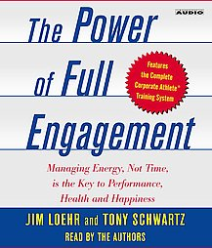


From Self Discipline to Rituals

Slide 31
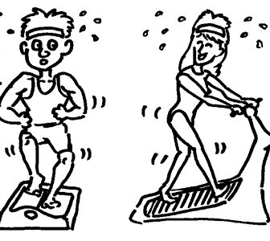

“Building rituals requires defining very precise behaviors and performing them at very specific times—motivated by deeply held values.”
Loher & Schwartz

Slide 32
From Self Discipline to Rituals
Increases productivity and creativity
30 days to a new ritual
Introduce one or two rituals at a time
“Incremental change is better than ambitious failure.... Success feeds on itself.” Loehr and Schwartz
“There isn’t anything that isn’t made easier through constant familiarity and training. Through training we can change; we can transform ourselves.”
Dalai Lama

Slide 33
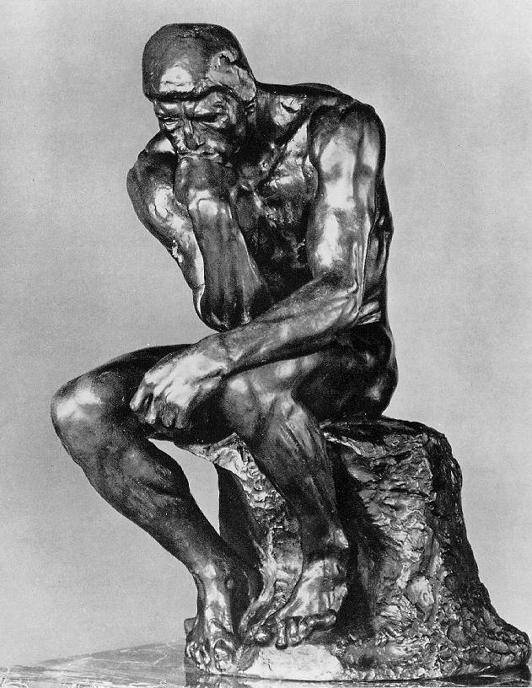
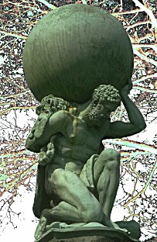
Cognition: Thoughts Create Worlds

Slide 34
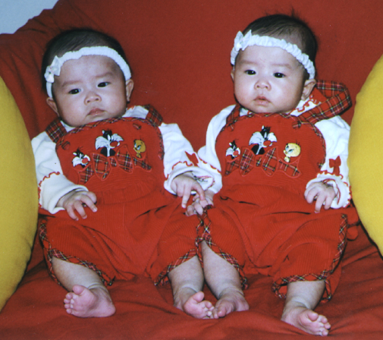
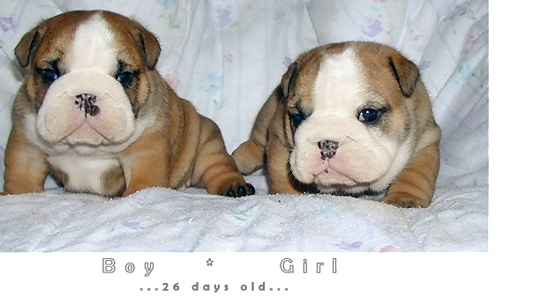
Cognitive Reconstruction Revisited
Interpretation as neural pathway
The world according to the fault-finder
The (same) world according to the merit-finder
The identical twins (revisited)
Changing our interpretation style takes time

Slide 35
Examples of Cognitive Reconstruction
Challenge or threat (Tomaka et al., 1997)
Arousal as euphoria or anger (Schachter & Singer, 1962)
Cooperation or competition (Ross & Samuels, 1993)
Volunteering as privilege or duty (Lareau, 2004)
Relationships about being known or being validated (Schnarch, 1997)
Failure as opportunity or disaster
Work as exercise or chore (Crum & Langer, 2007)

Slide 36

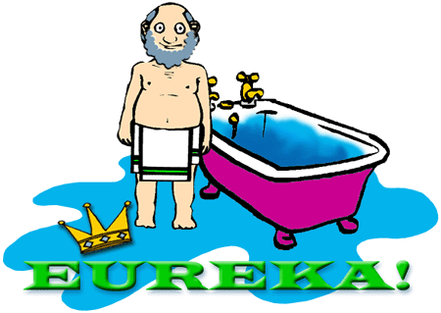
Acute Change: The Eureka Experience
The Creative Process
  preparation—immersion
  incubation—idle time

Slide 37
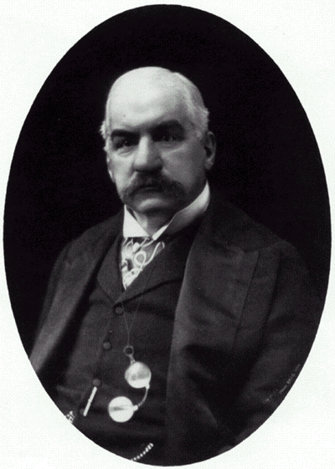
I can do a year’s work in nine months, but not in twelve. JP Morgan

Slide 38
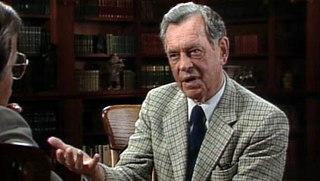
“You must have a room, or a certain hour or so a day, when you don’t know what was in the newspapers that morning, you don’t know who your friends are, you don’t know what you owe anybody, you don’t know what anybody owes to you. This is a place where you can simply experience and bring forth what you are and what you might be. This is the place of creative incubation. At first, you may find that nothing happens there. But if you have [such] a sacred place and use it, something eventually will happen.”
Joseph Campbell

Slide 39
Acute Change: The Eureka Experience
The Creative Process
  preparation—immersion
  incubation—idle time
  eureka—insight
  evaluation—reality test
  elaboration—coherence

Slide 40
Combining ABC’s: Journaling
Coping through writing (Pennebaker, 1997)

Slide 41
“Write continuously about the most upsetting or traumatic experience of your entire life. Don’t worry about grammar, spelling, or sentence structure. In your writing, I want you to discuss your deepest thoughts and feelings about the experience. You can write about anything you want. But whatever you choose, it should be something that has affected you very deeply. Ideally, it should be about something you have not talked about with others in detail. It is critical, however, that you let yourself go and touch those deepest emotions and thoughts that you have. In other words, write about what happened and how you felt about it, and how you feel about it now. Finally, you can write on different traumas during each session or the same one over the entire study. Your choice of trauma for each session is entirely up to you.”

Slide 42
Combining ABC’s: Journaling
Coping through writing (Pennebaker, 1997)
  reduced anxiety
  50% drop in visits to doctor
  immune system and overall health improved
  general emotional well-being increased
  became more social
  found gender differences
  replicated across cultures

Slide 43
Combining ABC’s: Journaling
Writing about intense positive experiences (Burton & King, 2004)

Slide 44
“Think of the most wonderful experience or experiences in your life, happiest moments, ecstatic moments, moments of rapture, perhaps from being in love, or from listening to music, or suddenly ‘being hit’ by a book or painting or from some great creative moment. Choose one such experience or moment. Try to imagine yourself at that moment, including all the feelings and emotions associated with the experience. Now write about the experience in as much detail as possible trying to include the feelings, thoughts, and emotions that were present at the time. Please try your best to re-experience the emotions involved.”

Slide 45
Combining ABC’s: Journaling
Writing about intense positive experiences (Burton & King, 2004)
  fewer health center visits
  enhanced positive mood

Slide 46
Combining ABC’s: Journaling
Mechanism:
  tension release
  coherence
“An artifact of our ambiguous and unpredictable world is the anxiety of not attaining completion and not understanding a simple cause-and-effect explanation for traumatic disturbances. Alas, we naturally search for meaning and the completion of events; it gives us a sense of control and predictability over our lives.”
Jamie Pennebaker

Slide 47
Sense of Coherence (Antonovsky)
Sense of comprehensibility
Sense of manageability
Sense of meaningfulness
“A global orientation that expresses the extent to which one has a pervasive, enduring though dynamic feeling of confidence that (1) the stimuli deriving from one’s internal and external environments in the course of living are structured, predictable and explicable; (2) the resources are available to one to meet the demands posed by these stimuli; and (3) these demands are challenges, worthy of investment and engagement.”

Slide 48
Combining the ABC’s
Affect
Cognition
Behavior

Slide 49

“I know of no more encouraging fact than the unquestionable ability of man to elevate his life by a conscious endeavor. It is something to be able to paint a particular picture, or to carve a statue, and so to make a few objects beautiful; but it is far more glorious to carve and paint the very atmosphere and medium through which we look, which morally we can do. To affect the quality of the day, that is the highest of arts.” Henry David Thoreau

