Slide 1
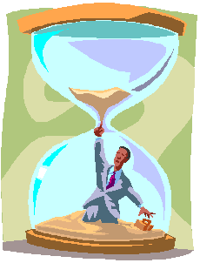

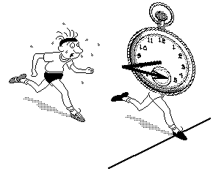
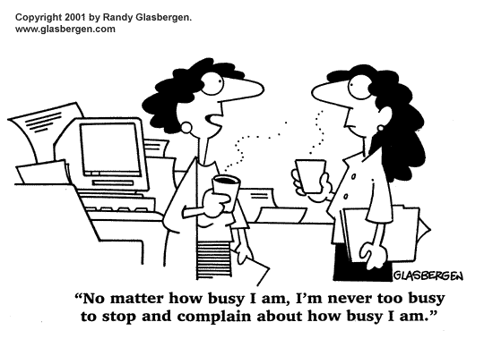

Goal Setting

Slide 2
Overview
Goal setting theory and practice
Dealing with stress
From material to happiness perception

Slide 3
Goals and Performance
Focus
“Being focused on a task produces organization for efficiency both within the organism and in the environment” Abraham Maslow
Resilience
Beliefs as self-fulfilling prophecies (knapsack)
Words create worlds
Concepts conceive

Slide 4
Concerning all acts of creation there is one elementary truth, the ignorance of which kills countless ideas and splendid plans: That the moment one definitely commits oneself, then providence moves too.
All sorts of things occur to help one that would not have otherwise occurred. A whole stream of events issues from the decision, raising in one’s favor all manner of unforeseen incidents and meetings and material assistance which no man would have dreamed would come his way.
I have learned a deep respect for one of Goethe’s couplets:
“Whatever you can do, or dream you can, begin it! Boldness has genius, magic, and power in it.
W.H. Murray

Slide 5
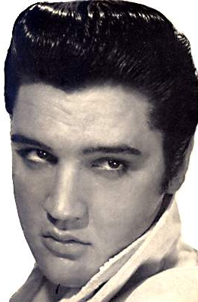
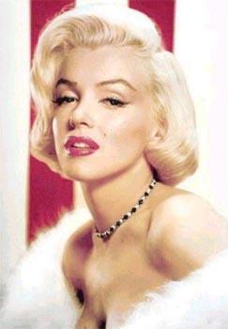
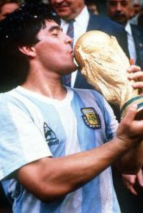
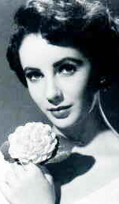
Goals and Wellbeing
Liberating
Resolving internal conflicts
Future goals as means; present experiences as ends
The case of unhappy achievers

Slide 6

Happiness is not about making it to the peak of the mountain, nor is it about climbing aimlessly around the mountain; happiness is the experience of climbing toward the peak.
“Contemporary researchers emphasize that it is the process of striving after goals—rather than goal attainment per se—that is crucial for happiness and positive affectivity.”
David Watson
“Happiness grows less from the passive experience of desirable circumstances than from involvement in valued activities and progress toward one’s goals.”
Myers & Diener

Slide 7
Live not for battles won.
Live not for the-end-of-the-song.
Live for the along.
Gwendolyn Brooks

Slide 8
Self-Concordant Goals
Aligned with personal interests and values
Freely chosen goals
‘Want to’ vs. ‘Have to’
“What do you really, really want to do?”
“[Becoming self concordant] is a difficult skill, requiring both accurate self-perceptual abilities and the ability to resist social pressures that may sometimes push one in inappropriate directions.” Sheldon & Houser-Marco (2001)
Life is too short to do what I have to do; it’s barely long enough to do what I want to do.

Slide 9
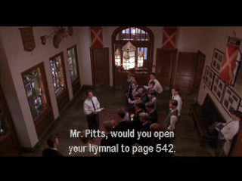

Slide 10
The Benefits of Self-Concordance
Increase in wellbeing
Increased likelihood of success
Entering a positive upward spiral
Trickle effect (Sheldon & Eliot, 1999)
Health (Langer, 1989)
Freedom vs. oppression

Slide 11
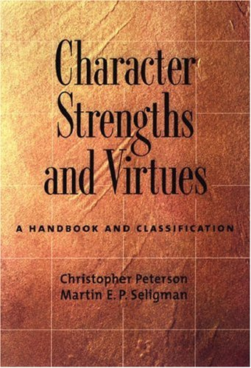

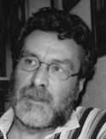

Values in Action (VIA)
PP’s Alternative to DSM (Peterson & Seligman)
Identifying character strengths
Universally admired (human nature)
Morally valued (beyond talents/abilities)
A self concordant journey
Success and happiness

Slide 12
Strengths Criteria
The real me
Energy and motivation
Associated with growth and improvement
I have often thought that the best way to define a man’s character would be to seek out the particular mental or moral attitude in which, when it came upon him, he felt himself most deeply and intensively active and alive. At such moments, there is a voice inside which speaks and says, ‘This is the real me.’
William James

Slide 13
VIA Classification of Character Strengths
Wisdom
-Creativity
-Curiosity
-Judgment
-Love of Learning
-Perspective
Courage
-Bravery
-Industry
-Authenticity
-Zest
Justice
-Citizenship
-Fairness
-Leadership
Love
-Intimacy
-Kindness
-Social Intelligence
Temperance
-Forgiveness
-Humility
-Prudence
-Self-Control
Transcendence
-Awe
-Gratitude
-Hope
-Humor
-Spirituality

Slide 14
Applying the VIA: Building Capacity
Identify your character strengths
  Take the online test (www.viastrengths.org)
  From the top 10, choose the 5 that best fulfill the “Strengths Criteria”
Choose one character strengths and for the following week use the strength in a new way every day
Each night, briefly describe how you used your strength in a new way today and how you intend to use the strength in a new way tomorrow

Slide 15
Applying the VIA: For Problem Solving
Identify your character strengths
Identify a problem with which you are dealing
How can you apply your character strengths to solving the problem?

Slide 16
Work Orientation (Wrzesniewski, 1997)
 | Motivation | Work as… | Expectation | Looking forward to
JOB
CAREER
CALLING

Slide 17
Work Orientation (Wrzesniewski, 1997)
 | Motivation | Work as… | Expectation | Looking forward to
JOB | Paycheck | Chore / necessity | None | Friday / vacation
CAREER
CALLING

Slide 18
Work Orientation (Wrzesniewski, 1997)
 | Motivation | Work as… | Expectation | Looking forward to
JOB | Paycheck | Chore / necessity | None | Friday / vacation
CAREER | Money and advancement | Race | Prestige and power | Next promotion
CALLING

Slide 19
Work Orientation (Wrzesniewski, 1997)
 | Motivation | Work as… | Expectation | Looking forward to
JOB | Paycheck | Chore / necessity | None | Friday / vacation
CAREER | Money and advancement | Race | Prestige and power | Next promotion
CALLING | Thing in itself / self-concordant goals | Mission / vocation / passion / privilege | Better world / fulfillment | More work

Slide 20
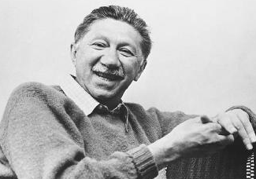
“It is certainly true that many of us evade our constitutionally suggested vocations (call, destiny, task in life, mission). So often we run away from the responsibilities dictated (or rather suggested) by nature, by fate, even sometimes by accident, just as Jonah tried—in vain—to run away from his fate.” Abraham Maslow

Slide 21
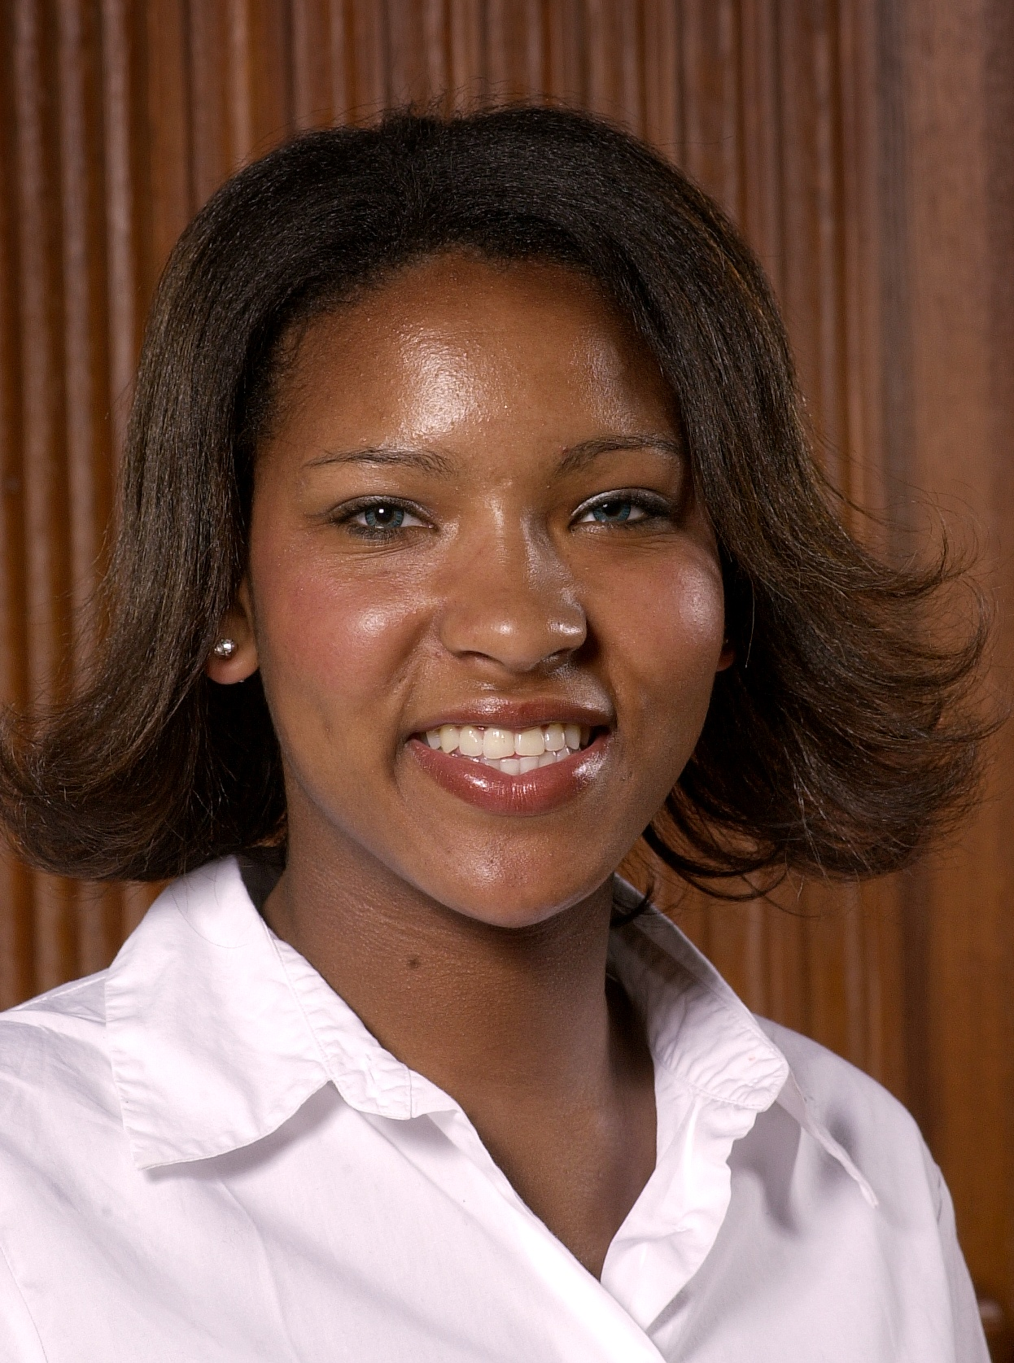
“Instead of focusing on what we can ‘live with,’ we should be thinking about what we can’t live without.”
Ebony Carter ‘07

Slide 22
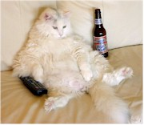
Dealing With Stress

Slide 23
Time Out!
“In a recent national survey of 13,500 college students, nearly 45 percent reported being so depressed that they had difficulty functioning, and 94 percent reported feeling overwhelmed by everything they had to do.”
Richard Kadison
Too much
to do
Stress (feeling
Overwhelmed)
Depression

Slide 24
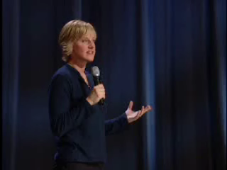

Slide 25
The Cost of Stress
Psychological health
Physical health
Reduced productivity and creativity

Slide 26
Reframing Questions:
The Case of Stress
Traditional psychology
  “Why are so many people stressed?”
Positive psychology
  “What do those who are successful and able to lead a healthy and happy life do?”

Slide 27
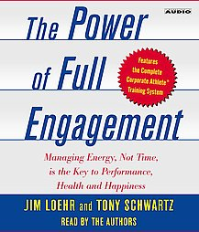
Ritualizing Work and Recovery
Stress is not the problem
Lack of recovery is the problem
From marathon to sprint intervals
Creating a ritual:
  60-120 minutes of work
  15+ minutes of recovery
Maintaining flexibility

Slide 28
“In the living laboratory of sports, we learned that the real enemy of high performance is not stress, which, paradoxical as it may seem, is actually the stimulus for growth. Rather, the problem is the absence of disciplined, intermittent recovery. Chronic stress without recovery depletes energy reserves, leads to burnout and breakdown, and ultimately undermines performance.”
Loher & Schwartz

Slide 29


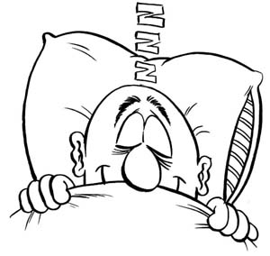
Multi-Level Recovery
Micro (minutes, hours)
Mezzo (nights, days)
Macro (weeks, months)

Slide 30
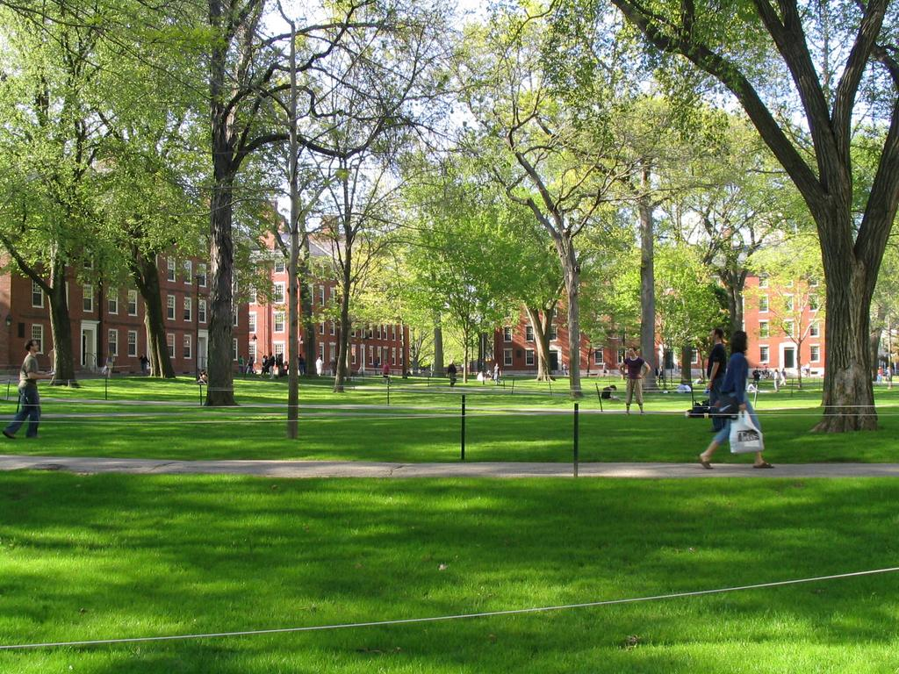
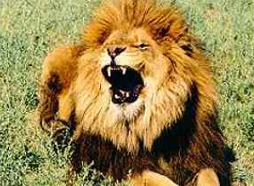
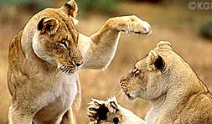

Slide 31
Focus!
Recovery: Quantity affects quality
Work: Reducing multi-tasking
“Love and sex are affected negatively by stress… If we can help people to simplify their lives, thus reducing their stress levels, it is very likely that people’s relationships would be enriched greatly. Moreover, the positive aspects of their lives would be enriched accordingly.”
Susan & Clyde Hendrick (2002)
“The IQ of those who tried to juggle messages and work fell by 10 points -- the equivalent to missing a whole night's sleep and more than double the 4-point fall seen after smoking marijuana.”
Findings by Dr. Glen Wilson

Slide 32
Simplify!
Do less, not more
Time Affluence (versus Material Affluence)
Functionality versus Fun
Say “yes” by saying “no”
Optimum levels of simplicity
“Work expands to fill the time available for its completion.”
Cyril Northcote Parkinson
“I can do a year’s work in nine months, but not in twelve.”
JP Morgan

Slide 33

Sustainable Growth
“Simplicity, simplicity, simplicity! I say let your affairs be as two or three, and not a hundred or a thousand; instead of a million count half a dozen... In the midst of this chopping sea of civilized life, such are the clouds and storms and quicksands and the thousand-and-one items to be allowed for… and he must be a great calculator indeed who succeeds. Simplify. Simplify .” Henry David Thoreau

Slide 34
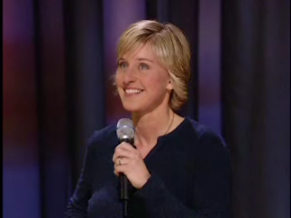

Slide 35
Overcoming Procrastination

Slide 36
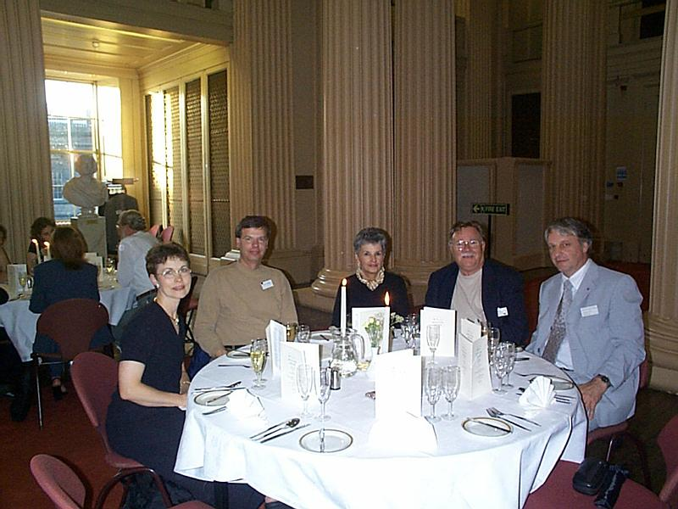

Slide 37
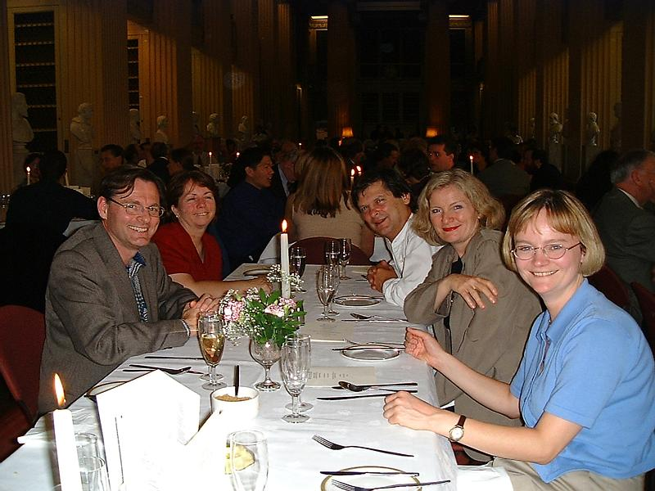

Slide 38
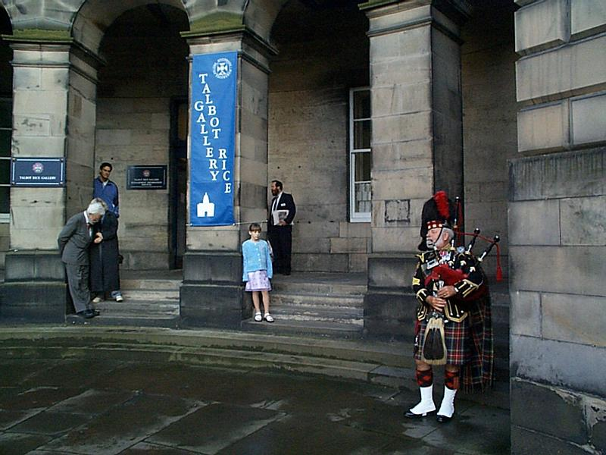

Slide 39
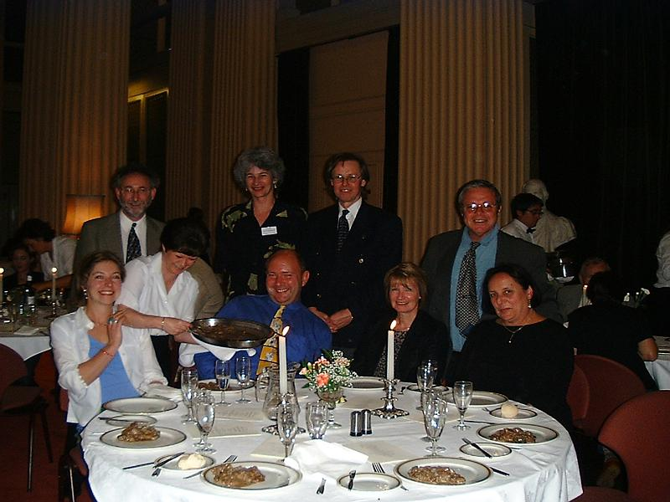

Slide 40
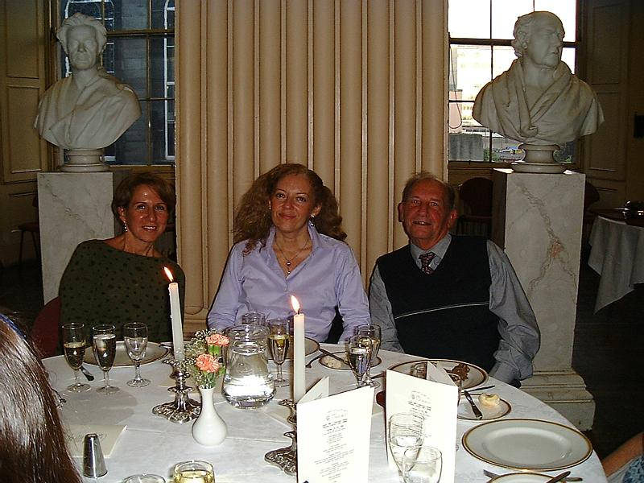

Slide 41
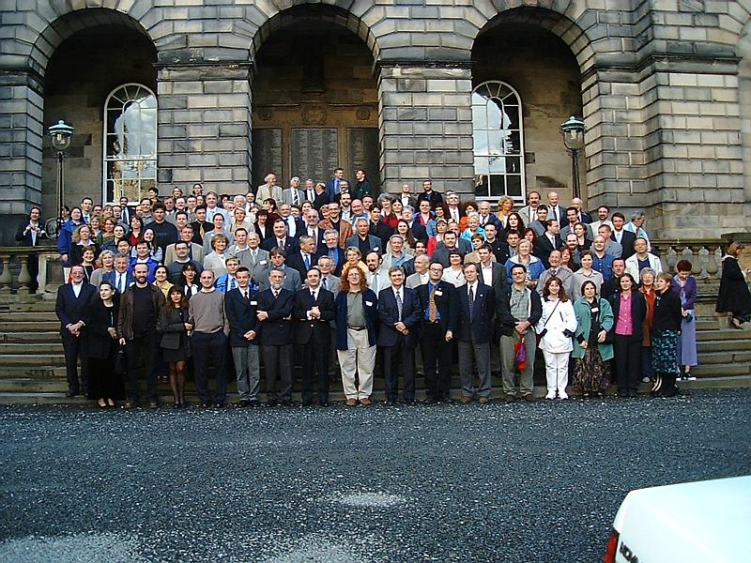

Slide 42
Overcoming Procrastination
The 5-minute take off
Reward yourself
Go public
The team approach
Goals, plans, lists
Permission to re-create

Slide 43
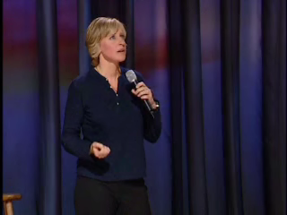

Slide 44
Material Perception
Material as the highest end
“Society tells us the only thing that matters is matter—the only things that count are the things that can be counted.” Laurence G. Boldt
Counting activities
Counting publications
Counting money

Slide 45
Obsession With Material Wealth
“The inherent vice of capitalism is the unequal sharing of blessings; the inherent virtue of socialism is the equal sharing of miseries.”
Winston Churchill
Making the most of our blessings?
1968: 41% to make a lot of money
83% to develop a meaningful philosophy of life
1997: 75% to make a lot of money
41% to develop a meaningful philosophy of life

Slide 46
The Consequences
Money can’t buy you happiness (Diener, 1999)
“The Dark Side of the American Dream” (Kasser & Ryan, 1993)
  lower likelihood of self-actualization
  higher levels of distress, depression, anxiety
  lower levels of happiness
  poorer physical health
Replicated in Singaporean business-school (Kasser & Ahuvia, 2002)
A caveat

Slide 47
Happiness Perception
Happiness as the highest end
“Happiness is the meaning and purpose of life, the whole aim and end of human existence.”
Aristotle
“Whether one believes in religion or not, whether one believes in this religion or that religion, the very purpose of our life is happiness, the very motion of our life is towards happiness.”
Dalai Lama
The ultimate currency

Slide 48
Happiness Perception in Our Lives
“People seeking greater well-being would be well advised to focus on the pursuit of (a) goals involving growth, connection, and contribution rather than goals involving money, beauty, and popularity and (b) goals that are interesting and personally important to them rather than goals they feel forced or pressured to pursue.” Sheldon et al. (2004)
Asking the right questions
Framing makes all the difference

Slide 49
The Happiness Revolution
Inside out (Vs. outside in)
Positive-sum game
“Thousands of candles can be lighted from a single candle, and the life of the candle will not be shortened. Happiness never decreases by being shared.”
The Buddha
Peaceful revolution

Slide 50
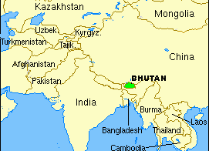
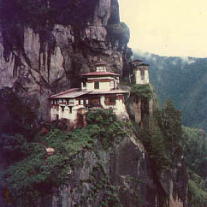
Implications for Politics
Wars mostly over material possessions
Government’s role
  Creating conditions for pursuing happiness
  Ensuring freedom
  Educating

Slide 51


Slide 52
Material Perception
Happiness Perception
Ultimate Currency:
Money and prestige
Happiness
Primary Focus:
External circumstances
Internal interpretation
Relationships As:
Zero-sum game
Positive-sum game

Slide 53
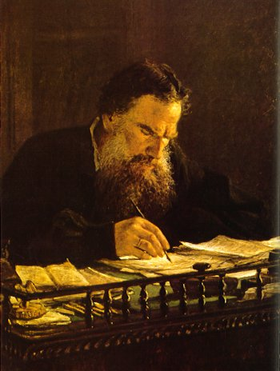
“Everybody thinks of changing humanity and nobody thinks of changing himself.”
Leo Tolstoy

Slide 54
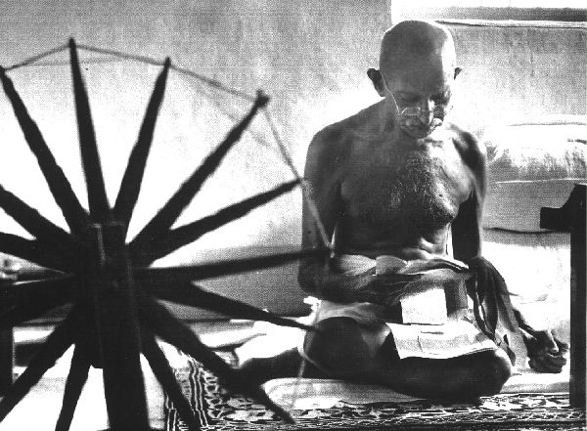
“Be the change you want to see in the world.”
Gandhi

Slide 55
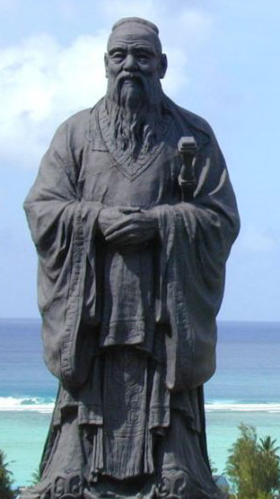
“From the Son of Heaven down to the common people, all must regard cultivation of the personal life as the root. A disordered root cannot grow into ordered branches. If what is near is neglected, how can one take care of what is far away?” Confucius

Slide 56
Bibliography and Recommendations
Csikszentmihaly, M. (1991). Flow: The Psychology of Optimal Experience, 71-93. Harper Collins Publishers.
Kasser, T., & Ryan, R. M. (1993). A dark side of the American dream: Correlates of financial success as a central life aspiration. Journal of Personality and Social Psychology, 65, 410-422.
Locke, E. A. (1998). “Study Methods and Motivation.” New Milford, CT: Second Renaissance Books.
Mumford, M. D., Schultz, R. A. & Van Doorn, J. R. (2001). Performance in Planning: Processes, Requirements, and Errors. Review of General Psychology, 5, 213-240.
Sheldon, K. M. & Elliot, A. J. (1999). Goal striving, need-satisfaction, and longitudinal well-being: The Self-Concordance Model. Journal of Personality and Social Psychology, 76, 482-497.
www.VIAstrengths.org

