Slide 1
Progresses from the 16th/Martch
- It was made the code imitated DeepLoco in Python
- total reward never increases, althoug the code runs
Request points
- To Identify the causes that reward does not increase
- To fix/run the causes
Present results
- Character can not keep standing at all even after learning 200000 episodes
- The number of threads can not changed over 2. Only one thread is always run.

Slide 2
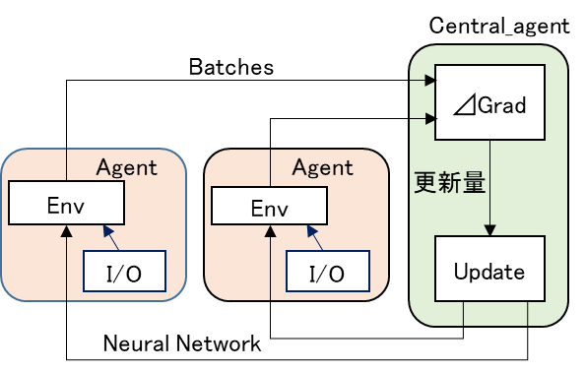
Progress since 17th/March
Summaries
- A Python simulator was made to reproduce the LLC of DeepLoco
- Pybullet and Tensorflow were used to make simulator simply
- Same specification of simulation character and motion reference character as Deeploco were used. Reward functions and neural network I/O are almost same.
-Learning is done by PPO and neural network parameters were updated even when the TD error was negative.
-Neural networks has three layers. At the first layer, binary functions caring for the walking phase is not defined. The network does not have tile information.
-Multithreading function was made but not multiprocessing like DeepLoco.

Slide 3
Python simulator
class Agent:
def run(self):
while self.episode < num_episodes:
trajectories = self.run_policy(self.env, self.central_agent.policy, self.scaler, 0, batch_size, self.episode)
self.episode += len(trajectories)
self.add_value(trajectories, self.central_agent.value) # add estimated values to episodes
self.add_disc_sum_rew(trajectories, gamma) # calculated discounted sum of Rs
self.add_gae(trajectories, gamma, lam) # calculate advantage
self.central_agent.update_parameter_server(self.episode, trajectories, self.name)
class Central_agent:
def update_parameter_server(self, episode, trajectories, name):
self.num_tuple += len(trajectories)
if len(trajectories) < batch_size:
return
observes, actions, advantages, disc_sum_rew = self.build_train_set(trajectories)
self.policy._update(observes, actions, advantages, self.logger) # update policy
self.value._update(observes, disc_sum_rew, self.logger) # update value function
self.log_batch_stats(observes, actions, advantages, disc_sum_rew, self.logger, episode)
self.logger.write(display=False) # write logger results to file and stdout
print(['thread_name: ' + name + ', episode: ' + str(episode) + ', tuples: ' + str(self.num_tuple)])
if(episode % batch_size == 0):
#print(['stop'])
self.policy._save(episode)
self.value._save(episode)

Slide 4
Class diagram
Character
urdfRootPath timeStep rah qh motion_copy:initial character joint angle data_[abdomen_x-data_left_ankle_z]
__init__ _reset _current_relative_position _collect_observations _getActionDimension _getObservationDimension _getObservation
Agent
name scaler episode central_agent env
__init__ _run _run_episode _run_policy _discount _add_disc_sum_rew _add_value _add_gae _primary_delay
Central_agent
logger value policy num_tuple
__init__ _update_parameter_server _build_train_set _log_batch_stats
Logger
path write_header log_entry f writer
__init__ _write _log _close
Value
replay_buffer_x replay_buffer_y obs_dim hid1_mult epochs lr
__init__ _build_graph _build_model _update _predict _save _restore _close_sess
Policy
beta eta kl_targ hid1_mult policy_logvar epochs lr lr_multiplier obs_dim act_dim
__init__ _build_graph _build_model _act _update _save _restore _close_sess
Environment
Path timeStep urdfRoot actionRepeat isEnableSelfCollision observation envStepCounter renders pybullet
__init__ _pos_to_vel _reset _seed _getExtendedObservation _step _termination _pos_diff _vel_diff _reward_pos _reward_vel _reward_root _reward_com _reward_end _reward_heading _reward _qpos_transform
MotionReferenceCharacter
dt tm, rah, qh curvature rvh, vh MRchar pos_MRD foot_step, foot_width pos_FP, old_pos_FP objs_b, objs_r dthe total_step dt_inv i_lis id_[abdomen_x-id_left_ankle_z] data_[abdomen_x-data_left_ankle_z] flag_MRD MRD_tm MRD_rah, MRD_qh elapsed_time pos_step foot_pos_left, foot_pos_right pos_MRD, old_pos_MRD
__init__ _find_nearest _step

Slide 5
Functions
Class | Function | Explanation
Policy | build_graph | Loss function and Optimization method is defined here.
 | build_model | Component o neural network is defined here.
 | update | Gain of neural netork is defined here.
 | act | New action is selected.
 | save | All gain of neural network are saved into files.
 | restore | All gain of neural network are restored into program.
 | close_sess | Tensorflow session is ended.
Value | build_graph | Loss function and Optimization method is defined here.
 | build_model | Component o neural network is defined here.
 | update | Gain of neural netork is defined here.
 | predict | New state is predicted.
 | save | All gain of neural network are saved into files.
 | restore | All gain of neural network are restored into program.
 | close_sess | Tensorflow session is ended.
Logger | write | File to store data is made.
 | log | Data is written into above file.
Motion Reference Character | find_nearest | After comparing curvature between each motion reference's root XY and random footprints, the best fitting motion reference is selected. This function output the id from 50 motion reference files.
 | step | One simulation step is incremented.
Character | reset | Character information is reset.
 | applyAction | Torque control is done.
Environment | pos_to_vel | Speed is calculated from position.
 | reset | Environment information is reset.
 | seed | Seed number is returned.
 | getObservation | State variables are made. It is 127 dimension.
 | step | One simulation step is incremented.
 | termination | How to terminate of the episode is defined.
 | pos_diff | Square of position error between motion reference character and main character are return.
 | vel_diff | Square of velocity error between motion reference character and main character are return.
 | reward_pos | Square of joint angle error between motion reference character and main character are return.
 | reward_vel | Square of joint speed error between motion reference character and main character are return.
 | reward_root | Square of root position error between motion reference character and main character are return.
 | reward_com | Square of root speed error between motion reference character and main character are return.
 | reward_end | Square of foot position error between motion reference character and main character are return.
 | reward_heading | Square of root orientation error between motion reference character and main character are return.
 | reward | Square of root orientation error between motion reference character and main character are return.
 | qpos_transform | Quaternion is converted to euler angle.
Central_agent | update_parameter_server | Policy and Value neural network parameters are updated.
 | build_train_set | Data is pup from batch files. The batch size is 32.
 | log_batch_stats | Batches are saved into log file.
Agent | run | Simulation steps are defined.
 | run_episode | Episode is defined.
 | run_policy | After executing an action according to a policy, batches are made here.
 | discount | Discounted reward is calculated by appling filter.
 | add_disc_sum_rew | Discounted reward is added into batch.
 | add_value | Value information is added into batch.
 | add_gae | GAE is added into batch.

Slide 6
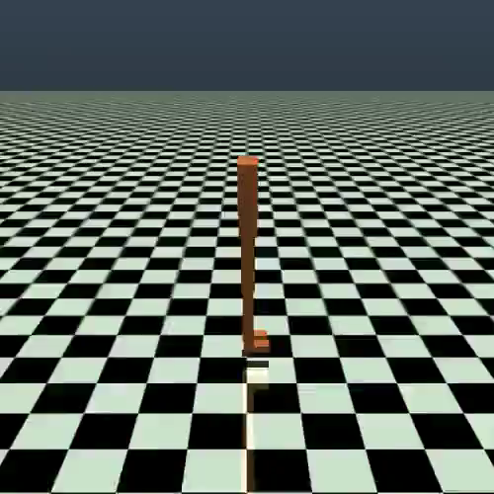
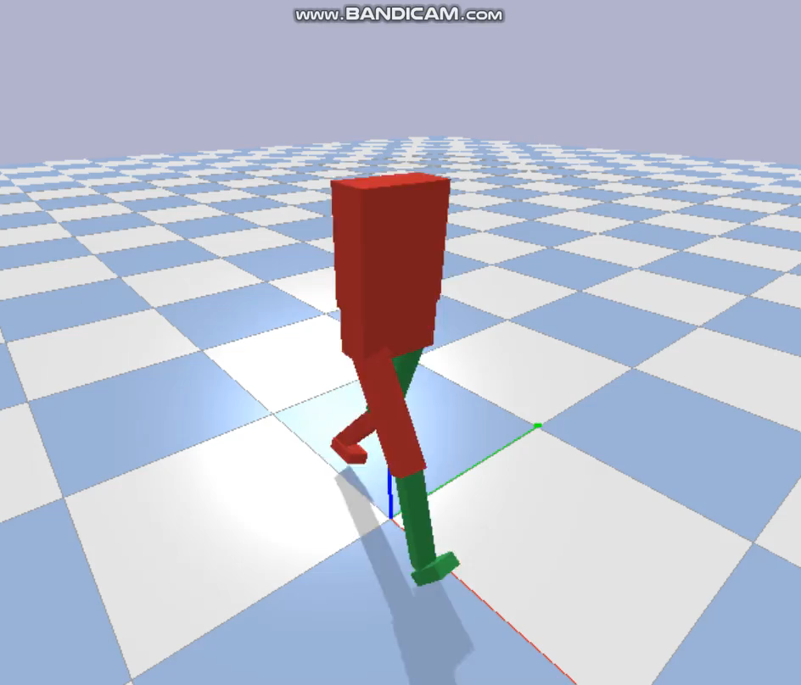
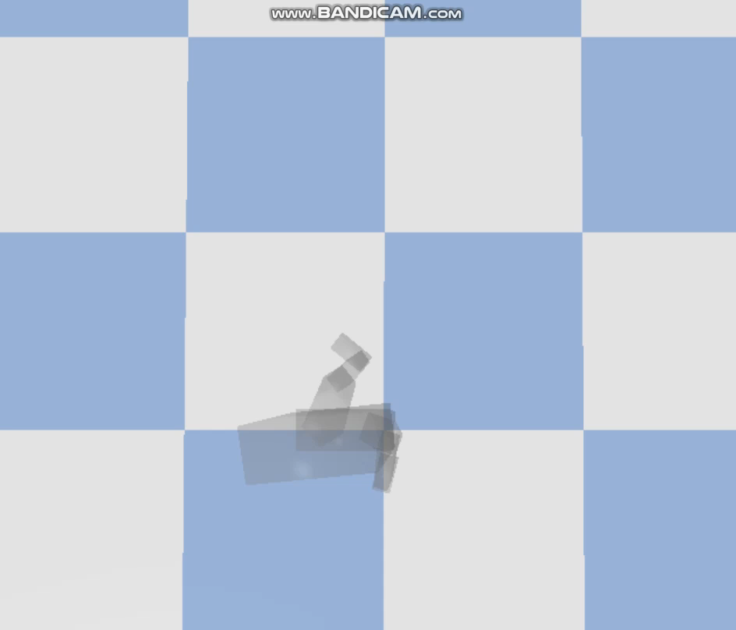
Present result 1/2: background of troubled points
Deep learning program without motion reference data was made
Basic functions were opened below
Learning Artificial Intelligence
https://learningai.io/projects/2017/07/28/ai-gym-workout.html
I only changed the model and termination of episode. Result was well over expectation. But the motion reference character to lead simulation character(MRchar) can not have mass and collidion field. Gym might not be friendly to define such a character and so I had to change the physical simulator from Gym to Pybullet.
In the Pybullet, the motion files could be imported and each character moved without any problem. Test_MRchar.py show following video.
Motion usage for simulation character
MRchar moving according on the curvature of foots path

Slide 7
Present result 2/2 : Troubled points
-Troubled point 1: Total reward never increass
Discounted total reward (disc_sum_rew in the code) doesn’t go up. At the second PPT page, where are same or not between original Deeploco and my python simulator is introduced roughly. No phase function or tile coding are cause that the learning doesn’t go well? Or anything else?
-Troubled point 2：Multi thread doesn’t work.
To use the multithread function, N_WORKERS must be over 2. But if it is changed, the following statements are shown. If N_WORKERS is 1, nothing is any trouble. Have you ever encountered same trouble?
pybullet build time: Feb 10 2018 13:01:57
2018-05-12 20:49:30.178877: I C:\tf_jenkins\workspace\rel-win\M\windows\PY\35\tensorflow\core\platform\cpu_feature_guard.cc:140] Your CPU supports instructions that this TensorFlow binary was not compiled to use: AVX2
Exception in thread Thread-1:
Traceback (most recent call last):
File "C:\Python35\lib\threading.py", line 923, in _bootstrap_inner
self.run()
File "C:\Python35\lib\threading.py", line 871, in run
self._target(*self._args, **self._kwargs)
File "C:\Users\115765\eclipse-workspace-6\test\main_no_scaler.py", line 1545, in <lambda>
job = lambda: worker.run()
File "C:\Users\115765\eclipse-workspace-6\test\main_no_scaler.py", line 1461, in run
batches = self.run_policy(self.env, self.central_agent.policy, 0, batch_size, self.episode)
File "C:\Users\115765\eclipse-workspace-6\test\main_no_scaler.py", line 1494, in run_policy
observes, actions, rewards = self.run_episode(env, policy, False, episode + e)
File "C:\Users\115765\eclipse-workspace-6\test\main_no_scaler.py", line 1480, in run_episode
obs, reward, done, _ = self.env._step(np.squeeze(action, axis=0))
File "C:\Users\115765\eclipse-workspace-6\test\main_no_scaler.py", line 1200, in _step
reward = self._reward()
File "C:\Users\115765\eclipse-workspace-6\test\main_no_scaler.py", line 1330, in _reward
reward_root = w[2] * self._reward_root()
File "C:\Users\115765\eclipse-workspace-6\test\main_no_scaler.py", line 1288, in _reward_root
body_xyz, _ = p.getBasePositionAndOrientation(self._MRD.MRchar)
pybullet.error: GetBasePositionAndOrientation failed.j0115765j01157651

Slide 8
Reference
Deeploco
DeepLoco git page
https://github.com/xbpeng/DeepLoco
Tensorflow+PPO+Mujoco
Learning Artificial Intelligence
https://learningai.io/projects/2017/07/28/ai-gym-workout.html
Proximal Policy Optimization with Generalized Advantage Estimation
https://github.com/pat-coady/trpo
Pybullet
Quick start guide
https://docs.google.com/document/d/10sXEhzFRSnvFcl3XxNGhnD4N2SedqwdAvK3dsihxVUA/edit
Multithread
Let’s make an A3C: Implementation
https://jaromiru.com/2017/03/26/lets-make-an-a3c-implementation/
Reinforcement-learning-with-tensorflow https://github.com/MorvanZhou/Reinforcement-learning-with-tensorflow/blob/master/experiments/Robot_arm/A3C.py

