Slide 1
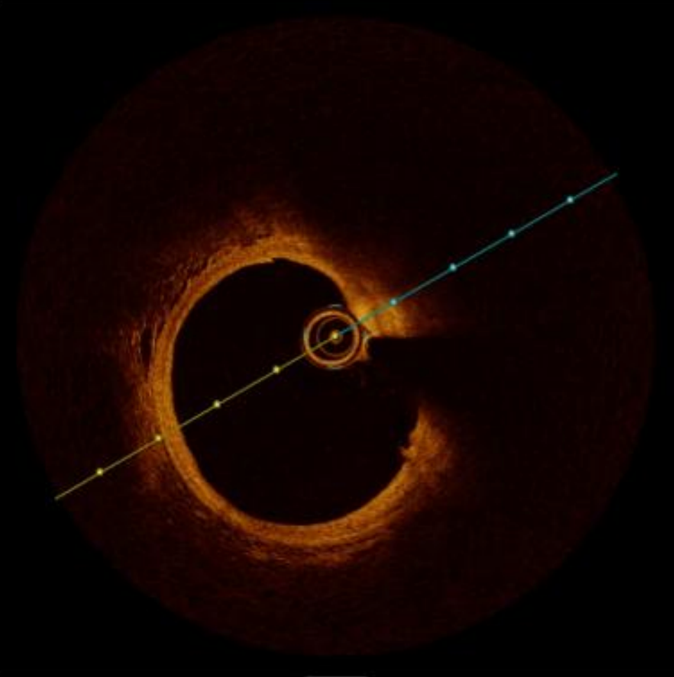
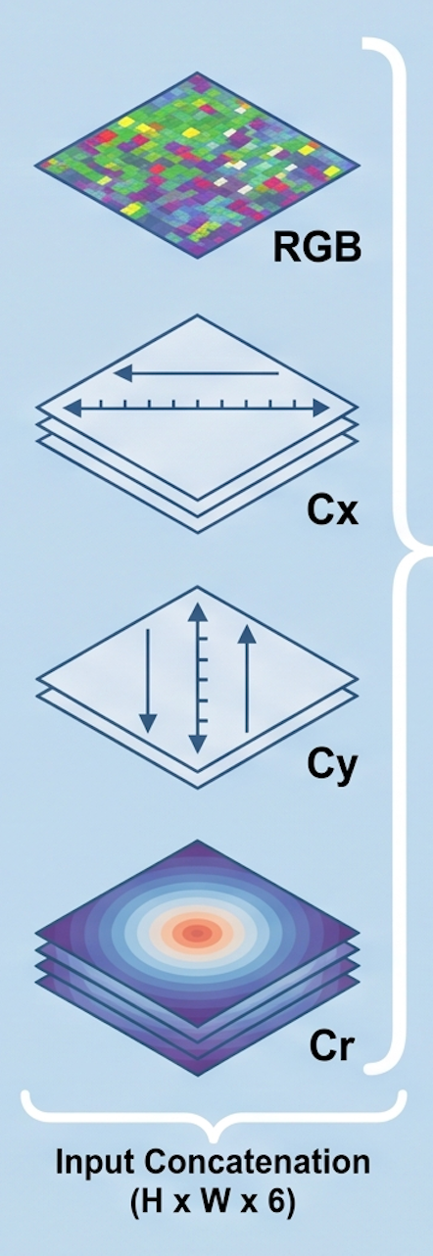
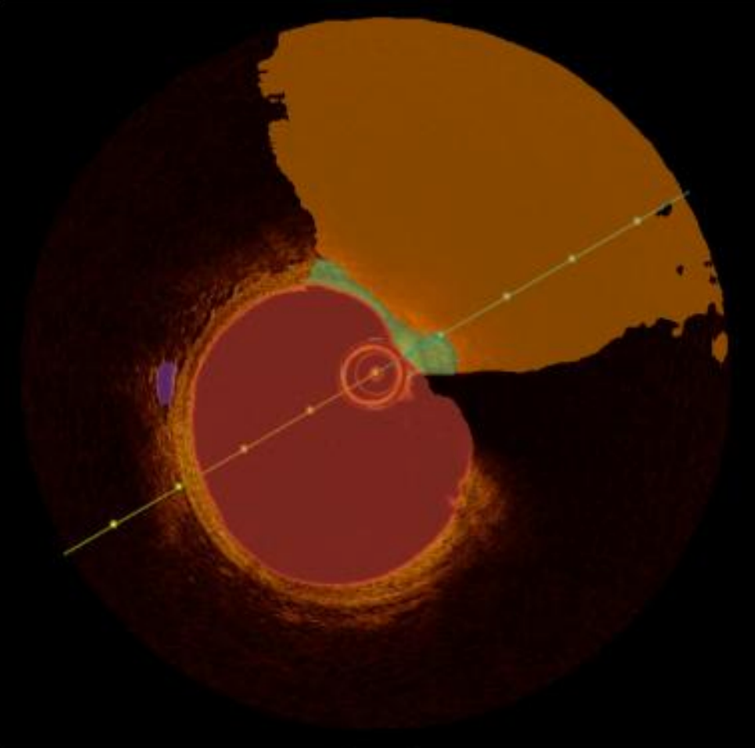
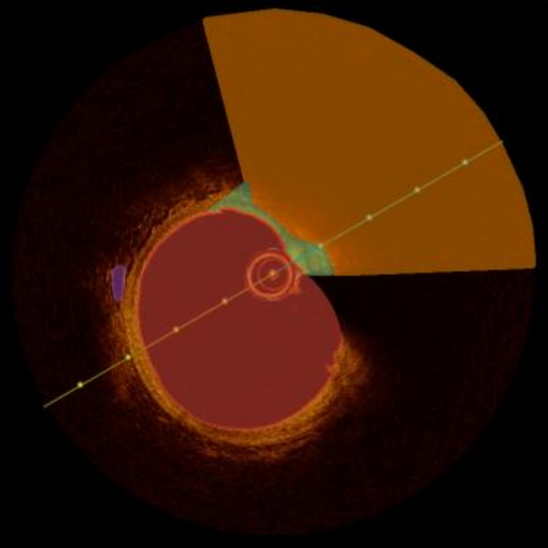
RadialMamba: Coordinate-Augmented Swin-UMamba for IV-OCT Segmentation
INPUT AND COORDINATE CHANNELS
SWIN-UMAMBA BACKBONE
OUTPUT
Internal SS2D scan operators unchanged
Four-class segmentation
Patch-local coordinates
Encoder
Decoder
Prediction
Encoder
stage
Decoder
stage
Segmentation
head
IV-OCT input
Skip connections
Deep supervision
Main loss weight: 4/7
Preprocess
and crop
Cy
Encoder
stage
Decoder
stage
Aux
head
Dice + Focal
2/7
Ground truth
512 × 512
RGB patch
Cx
Encoder
stage
Decoder
stage
Aux
head
Dice + Focal
1/7
Illustrative development case
Lumen
Encoder
stage
Decoder
stage
Weight = 0
Fibrous cap
Primary A/B training
Aux
head
Lipid core
Dice–Focal + foreground sampling (0.5)
Vasa vasorum
Feature flow
Skip connection
Auxiliary supervision
Schematic encoder–decoder organization
Notes:
RadialMamba augments RGB patches with local x, y, r channels and uses the existing Swin-UMamba backbone for multiclass segmentation. The figure summarizes the encoder–decoder organization, skip connections and auxiliary Dice–Focal supervision. The internal SS2D scan operators remain unchanged. The coordinate channels refer to the current input patch rather than a catheter-centered anatomical reference. The primary matched comparison shares loss and sampling settings between the coordinate and RGB-only arms. Class weighting and VV-specific sampling belong to the separate joint refinement, not the primary recipe illustrated here. The clinical overlays are retained illustrative examples from the earlier development experiments, not new hold-out results. Source: author-provided Schema.pptx and the revision experiment handoff. The RGB/Cx/Cy/Cr artwork and concatenation bracket follow the author-provided original illustration. Cx, Cy and Cr each contribute one coordinate channel, giving six channels together with RGB. The illustrated radial map refers to the center of the current patch. The layered planes are a conceptual channel illustration. Homepage export: x denotes height and y denotes width. Deep-supervision weights are 4/7, 2/7, 1/7, 0. The medical images are an illustrative development case from the author-provided source figure, not results from the revised holdout evaluation.

