Slide 1



Community Health Estimator
A self-service population health estimator
Developed by
Jason Summer
Partners

Slide 2




With a mission of improving population healthcare at the local level, the app provides a self-service tool enabling community and healthcare officials to better understand population risk and key drivers of community healthcare.
Motivation
Population health is estimated based on 4 community-level categories
Health Outcomes
Health Risk Behaviors
Preventative Measurements
Demographics

Slide 3
Demo

Slide 4
Data Overview
Population health is estimated based on 4 community-level categories
Data Landscape
Relational Database
PLACES is a CDC-led effort that provides model-based, population level community estimates of health measures to US counties.
The app uses a subset of these estimates to predict the proportion of county residents that rate their health as fair/poor.
RDS captures data at 4 points in the overarching pipeline:
Measurement definitions are captured following database initialization
Min and max values of scaled parameters, such as population during featurization
Model coefficients during training
User input entered in the live app
Health Outcomes:
- Arthritis | - Coronary heart disease | - High blood pressure
- Cancer (except skin) | - Asthma | - High cholesterol
- Chronic kidney disease | - Depression | - Obesity
- COPD | - Diabetes | - Stroke
Risk Behaviors:
- Binge drinking | - Smoking
Preventative Measures:
- Cholesterol Screening | - Health Insurance | - Colorectal cancer screening
- Taking BP Medication | - Annual Checkup
Demographics:
- Population | - US Region

Slide 5
Model Overview
Algorithm
The proportion of county residents
with fair/poor was treated as a response.
To enable linear regression on a proportion,
the target response was transformed into a log-odds
Algorithm
Model success was based on prediction root mean squared error (RMSE). The model resulted with a RMSE of 0.014, which is superior to the original threshold of 0.025 set.
Model Predictions
The model serves online predictions based on user input in the online application.

Slide 6
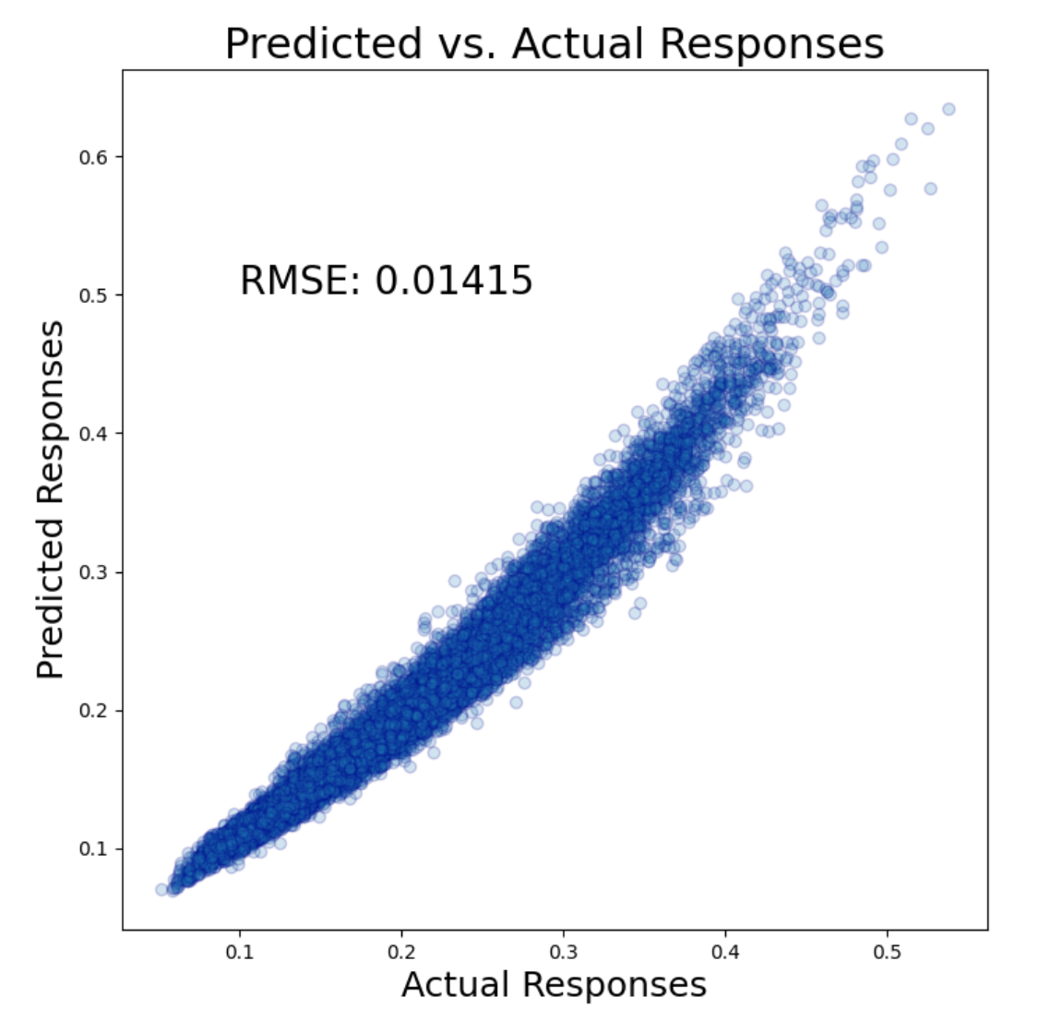
Model Performance
There were some measures with significant multi-collinearity that were removed.
Other correlation remained, e.g., diabetes and obesity. However,
despite this innate multi-collinearity, the simple linear model performed very well.

Slide 7

Thank You
Jason Summer
JasonSummer2022@u.northwestern.edu

