Slide 1

Machine Learning Pipeline for Loan Default Prediction
Sun Jie-Sheng, Jason
CS611 Machine Learning Engineering Assignment 2

Slide 2
Business Problem, Objective & Scope
Problem: Default is the biggest source of credit loss, it must be caught at the point of application. After approval, the loss is locked in.
Objective: Predict default probability at application.
Scope: Production end to end ML pipeline
12,500
28.9%
4
Total Loans
Observed Default Rate
Sources: LMS, attributes, financials, clickstream

Slide 3
End-to-end ML Pipeline Architecture
Model bank
Orchestrated by Apache Airflow
SOURCES
BRONZE
SILVER
GOLD
ML PIPELINE
Label Store
ML Train
ML Inference
LMS
Raw LMS
Clean LMS
Feature Store
Predictions
User features
Raw features
Clean features
Feature engineering
Visualize
Monitoring

Slide 4
Dataset Split Design
• Target leakage - label comes from the LMS only, no outcome fields. (overdue / paid / balance)
• Temporal leakage - clickstream is aggregated strictly pre-loan-start, and the split is chronological by snapshot.
Target leakage
Chronological 70 / 10 / 10 / 10 split (by snapshot date) - OOT = most recent 10% (~2024-05 to 2024-06)
wq
TEST
898
TRAIN
6,282
VAL
897
OOT
897

Slide 5
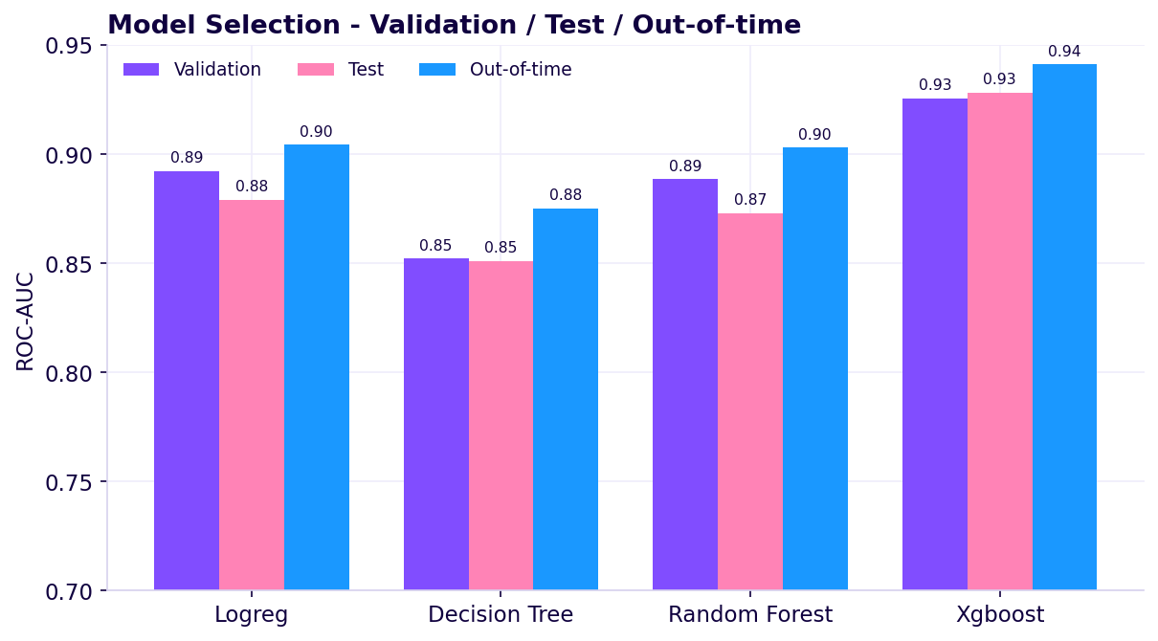
Model Training & Selection
Training Set:
8,974 matured loans
52 features
28.9% default
Candidates:
Logistic Regression
Decision Tree
Random Forest
XGBoost
Preprocessing: Median-impute missing values, scaling numericals + one-hot encoding for categories
Selection: Best by validation AUC -> XGBoost (val 0.93, test 0.93, OOT 0.94).
Model bank. 4 artefacts per run + manifest.json (metrics, feature schema, best model).

Slide 6
Inference & Model Bank
Model Bank
Champion Model
Inference
Store predictions in Gold Layer
Model Selection by Performance
Versioned & Reproducible
Manifest names the best model + feature columns. Load by reference.
Timestamped model-bank runs.
Schema-safe Scoring
Backfillable
Rows reindexed per model schema.
Per-snapshot inference, backfill back-scores historical records

Slide 7
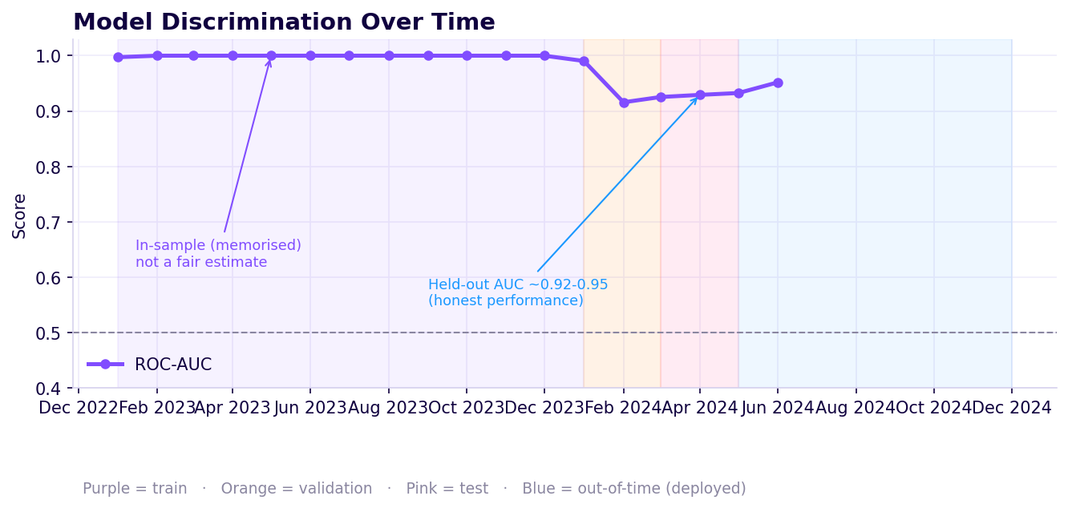
Monitoring - Model Performance Over Time
What we track:
ROC-AUC - model evaluation (ranking power).
PSI - stability of the output scores.
CSI - stability of the input features.
Reading the chart:
Focus on OOT time-frame.
AUC holds >0.90, good at generalizing.

Slide 8
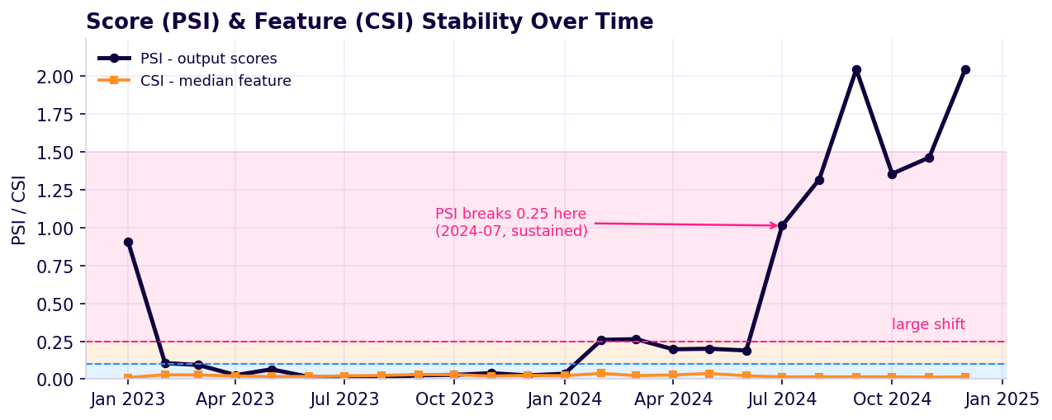
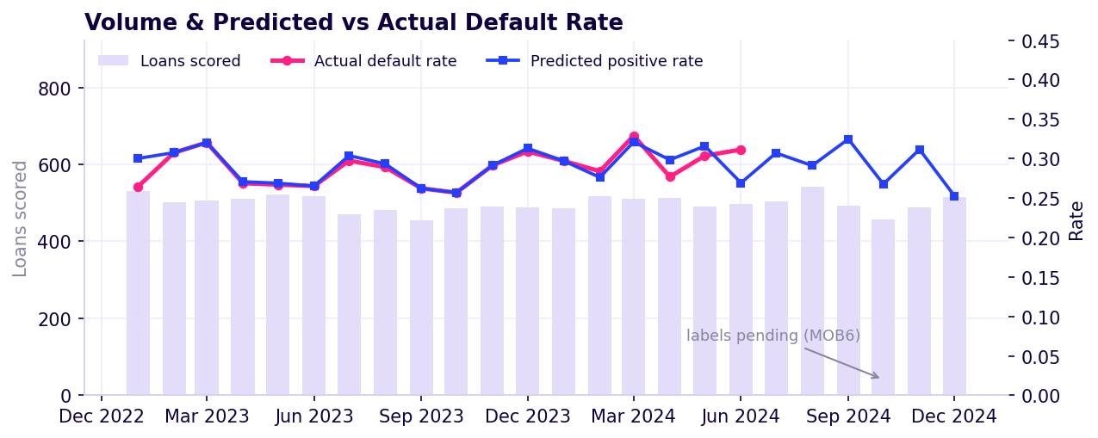
Monitoring - Stability & Drift
PSI (Prediction) & CSI (Features)
Threshold | Risk Level | PSI | CSI
< 0.1 | Low Risk | PSI breaks above 0.25 on July 2024 | CSI remains stable below 0.05
0.1 to 0.25 | Moderate
> 0.25 | High Risk
Monitoring verdict
Since PSI shows that the prediction is drifting starting from July 2024, we should investigate and refresh on latest data to re-validate the model.

Slide 9
Model Governance, Refresh SOP
When and how to refresh the model in production
Refresh triggers
Refresh SOP
PSI > 0.25 sustained over 2 or more snapshots
Monitor
Stability
Out-of-time AUC drops > 0.05 vs baseline
Alert
Performance
Validate & retrain
Scheduled
Quarterly retrain on latest matured data
Champion / challenger
Data change
Upstream schema / feature change
Promote & redeploy

Slide 10





Technical Implementation & Summary
Docker
PySpark
Portable, Reproducible Environment
Orchestration, Scheduling & Backfill
Scaling for Processing
Scikit-learn
Parquet
GitHub
Model Training & Selection
Columnar Storage
Version Control & Governance
Pipeline DAG (one run per monthly snapshot)
bronze
silver
gold:label
gold:feature
training_set
train
infer
monitor
Key takeaways
Medallion Architecture · Reproducible (versioned model bank) · Monitored (performance + stability) · Governed (triggers + SOP)
Airflow Orchestration

