Slide 1
Interpretable and generative models for mouse spaceflight
Jason Trinh
EECS | UC Berkeley
Mentor: James Casaletto | August 2026
Notes:
Target time: 0:10
This project uses machine learning to study mouse bulk RNA-seq from NASA spaceflight experiments. One model asks which pathways change. The other asks whether realistic synthetic samples can improve a tissue-specific comparison of flight and ground control.

Slide 2
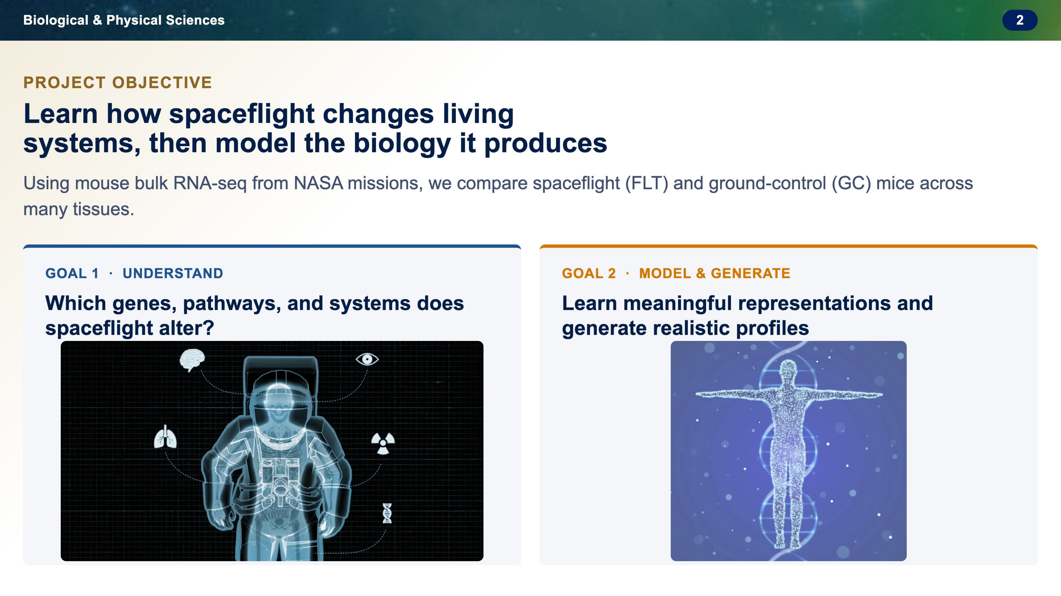
Notes:
Target time: 0:30
The project has two connected goals. First, identify which genes, pathways, and biological systems differ between flight and ground-control mice. Second, learn meaningful expression patterns and generate realistic profiles that can support that comparison.

Slide 3
NEURAL NETWORKS
Autoencoders compress thousands of genes into a few features
The encoder summarizes a gene profile; the decoder learns enough structure to reconstruct it.
AUTOENCODER
COMPRESSED SPACE
gene profile
compressed features
output profile (reconstruction)
encoder
decoder
profiles with similar expression occupy nearby regions
Concept adapted from the midpoint presentation. expiMap: Lotfollahi et al., Nature Cell Biology (2023).
Notes:
Target time: 0:35
An autoencoder compresses thousands of gene measurements into a smaller set of features and then reconstructs the original profile. The output bars are close to, but not exactly the same as, the input bars. Samples with similar compressed profiles sit near one another. MOBER uses this compressed space to reduce study identity, while expiMap connects its features to known Reactome gene programs.

Slide 4
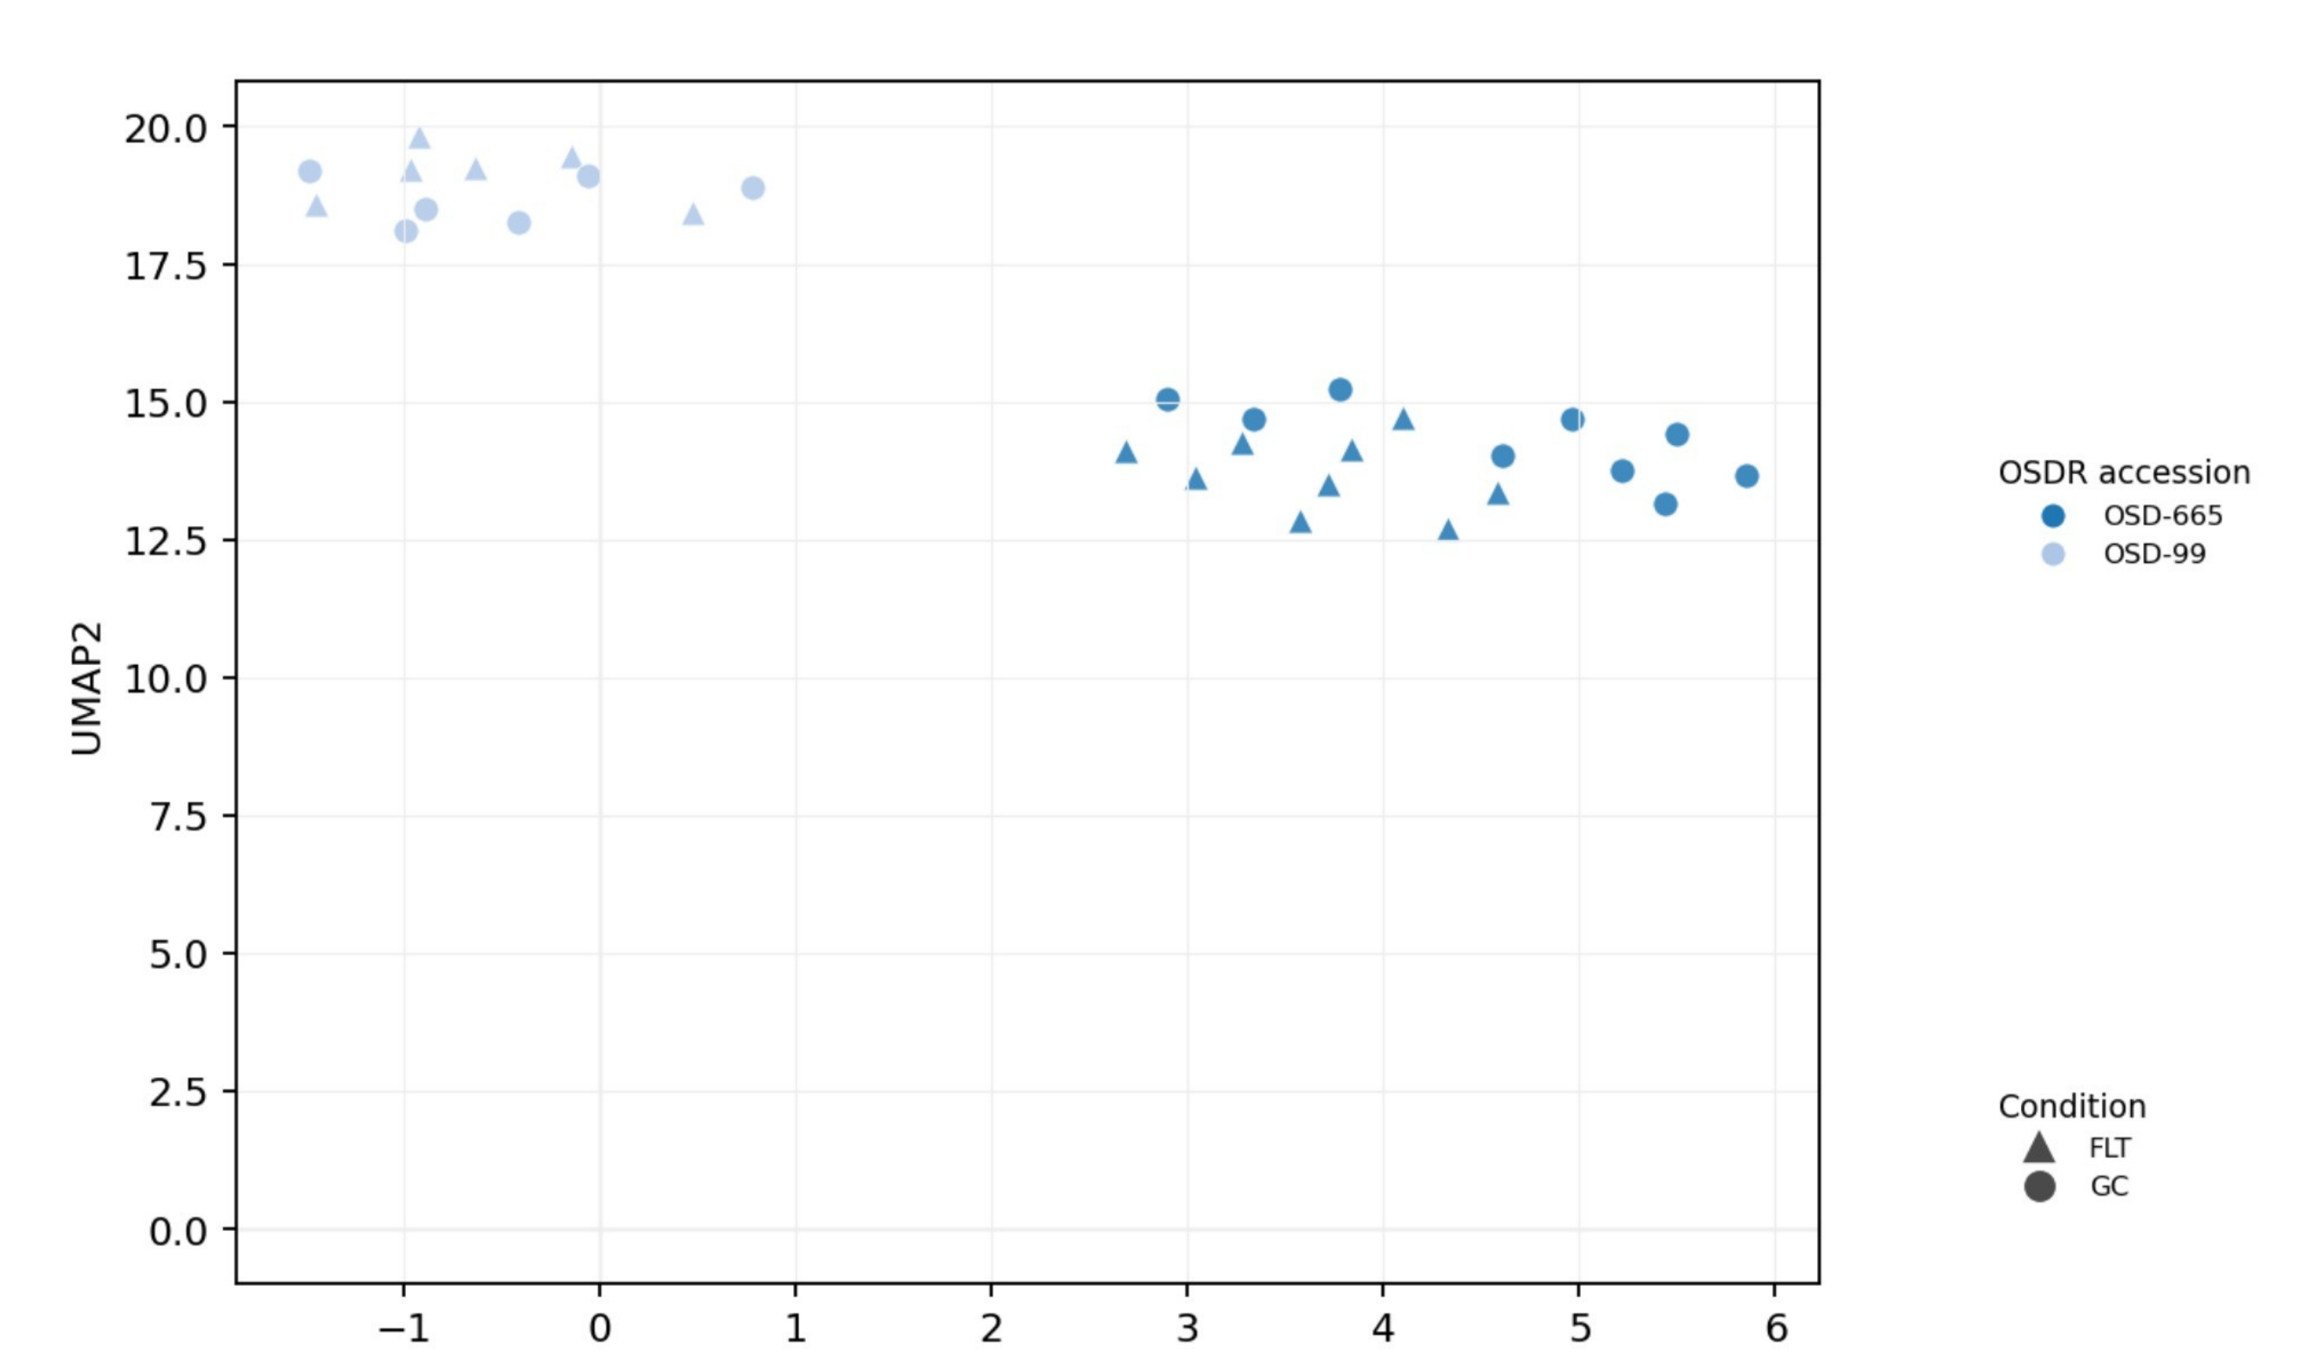
THE COMPLICATION
Study identity dominates the expression structure
In EDL muscle, the two studies separate while FLT and GC overlap within each study.
Midpoint slide 7; EDL profiles from OSD-665 and OSD-99.
Notes:
Target time: 0:20
This is EDL skeletal muscle from two OSDR studies. Color marks the study and shape marks flight or ground control. The two colors form separate UMAP clusters, while triangles and circles overlap within each cluster. Study identity is the strongest visible structure.

Slide 5
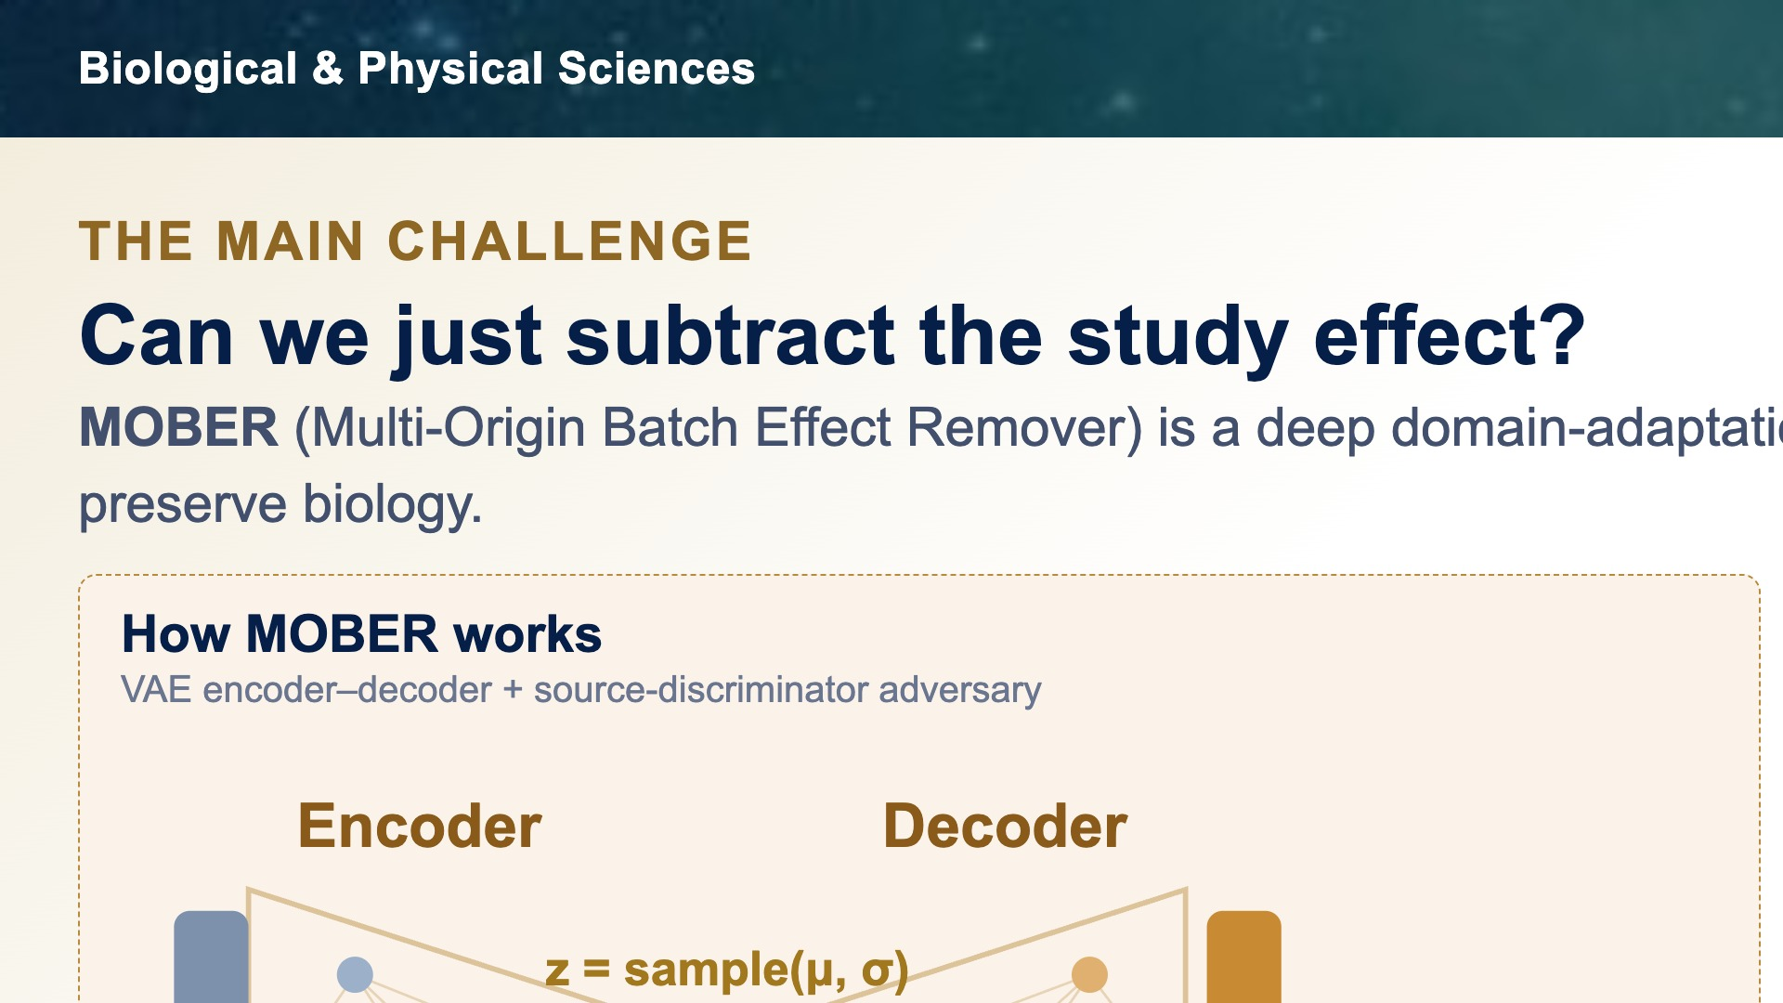

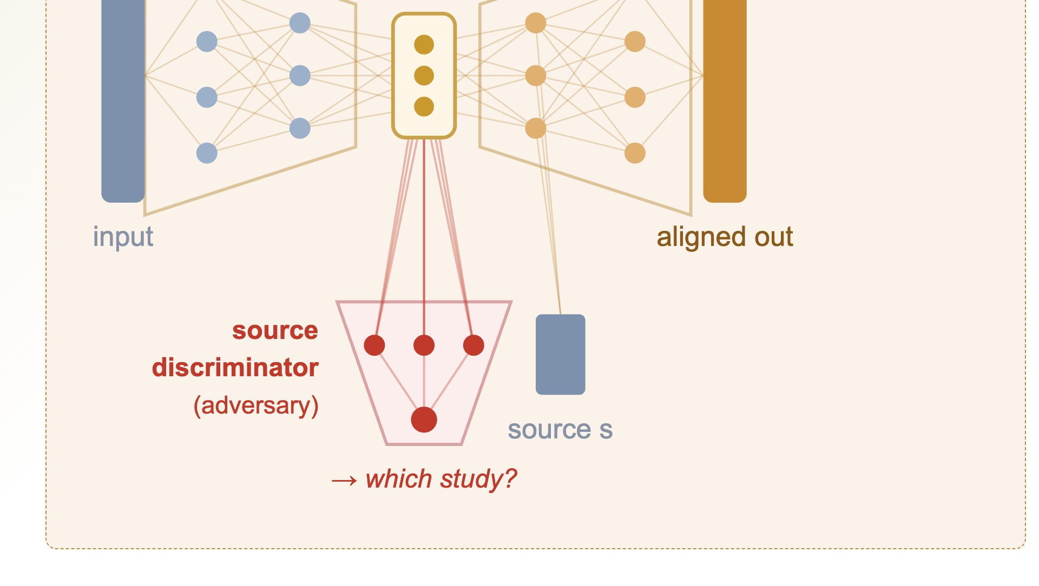

5
Notes:
Target time: 0:30
Study differences can be larger than the biological effect. MOBER combines an autoencoder with a source discriminator that tries to identify the originating study. The encoder makes study labels harder to predict while still reconstructing the expression profiles. The animation starts with separated studies and moves them into a shared distribution.

Slide 6
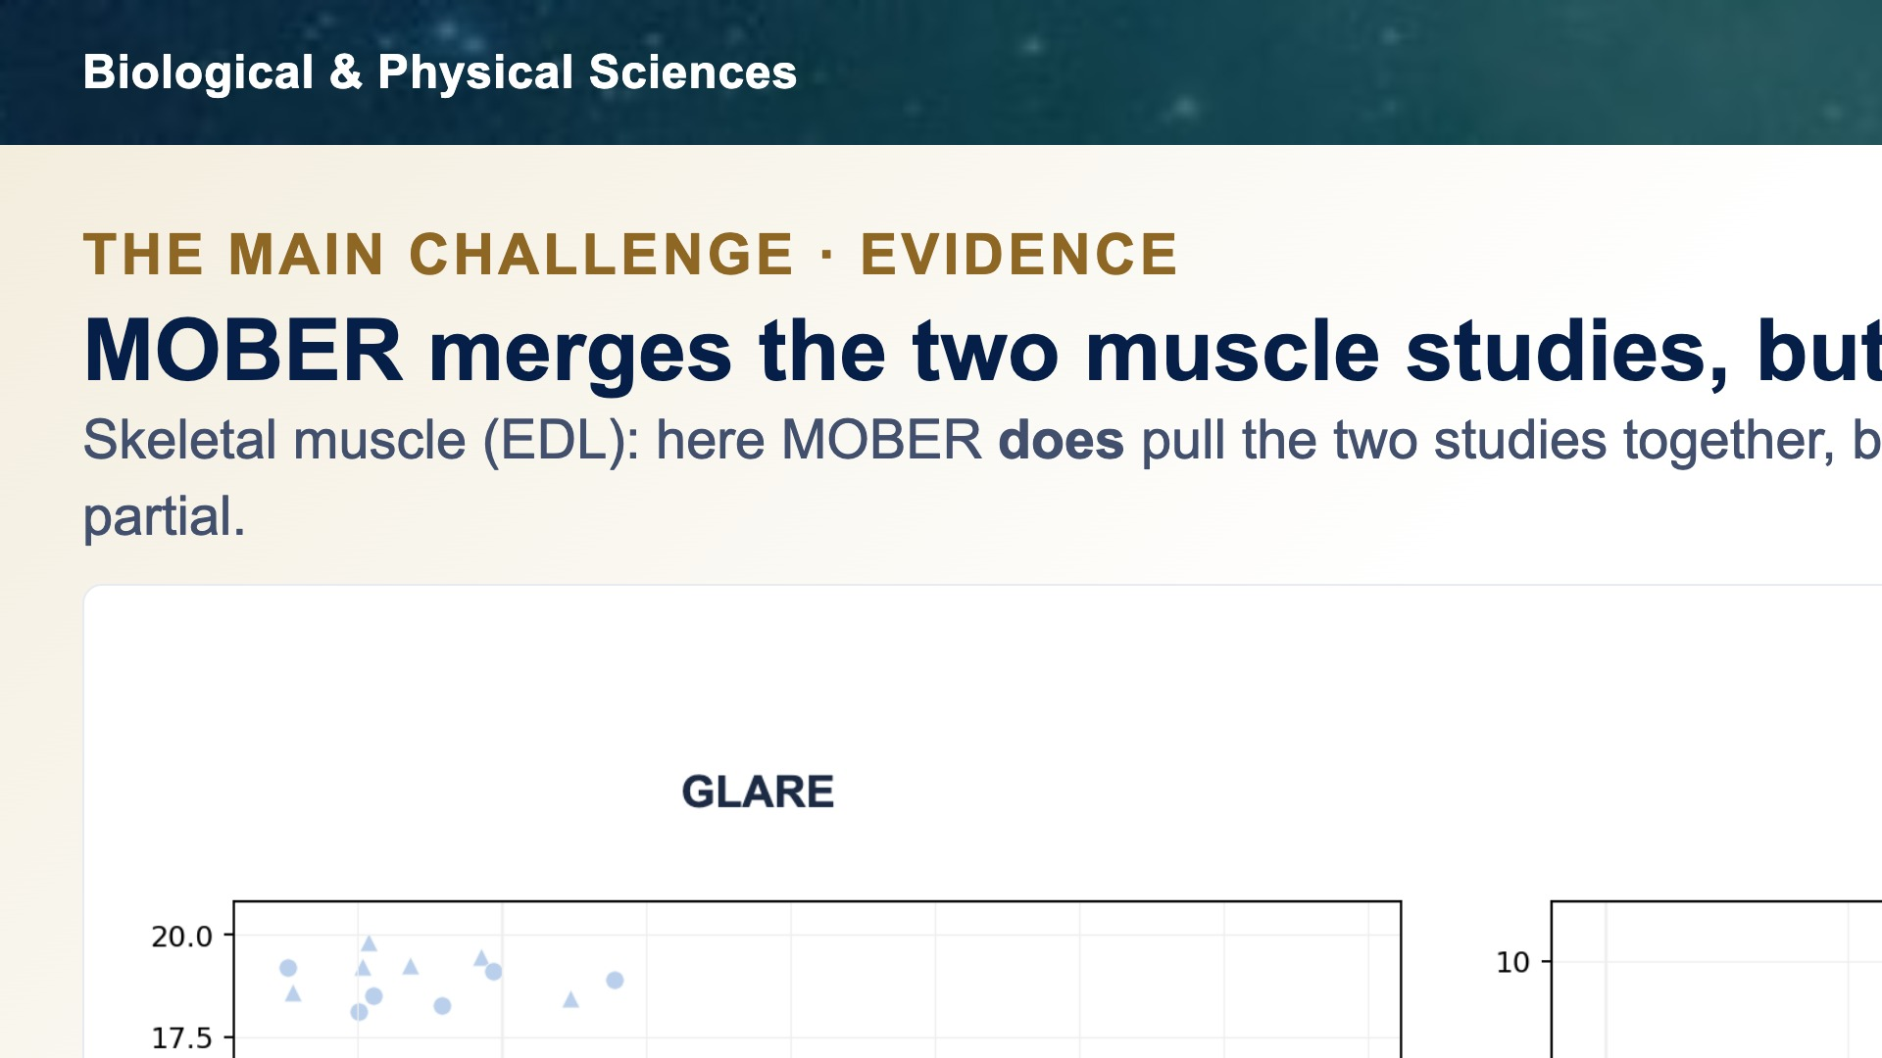
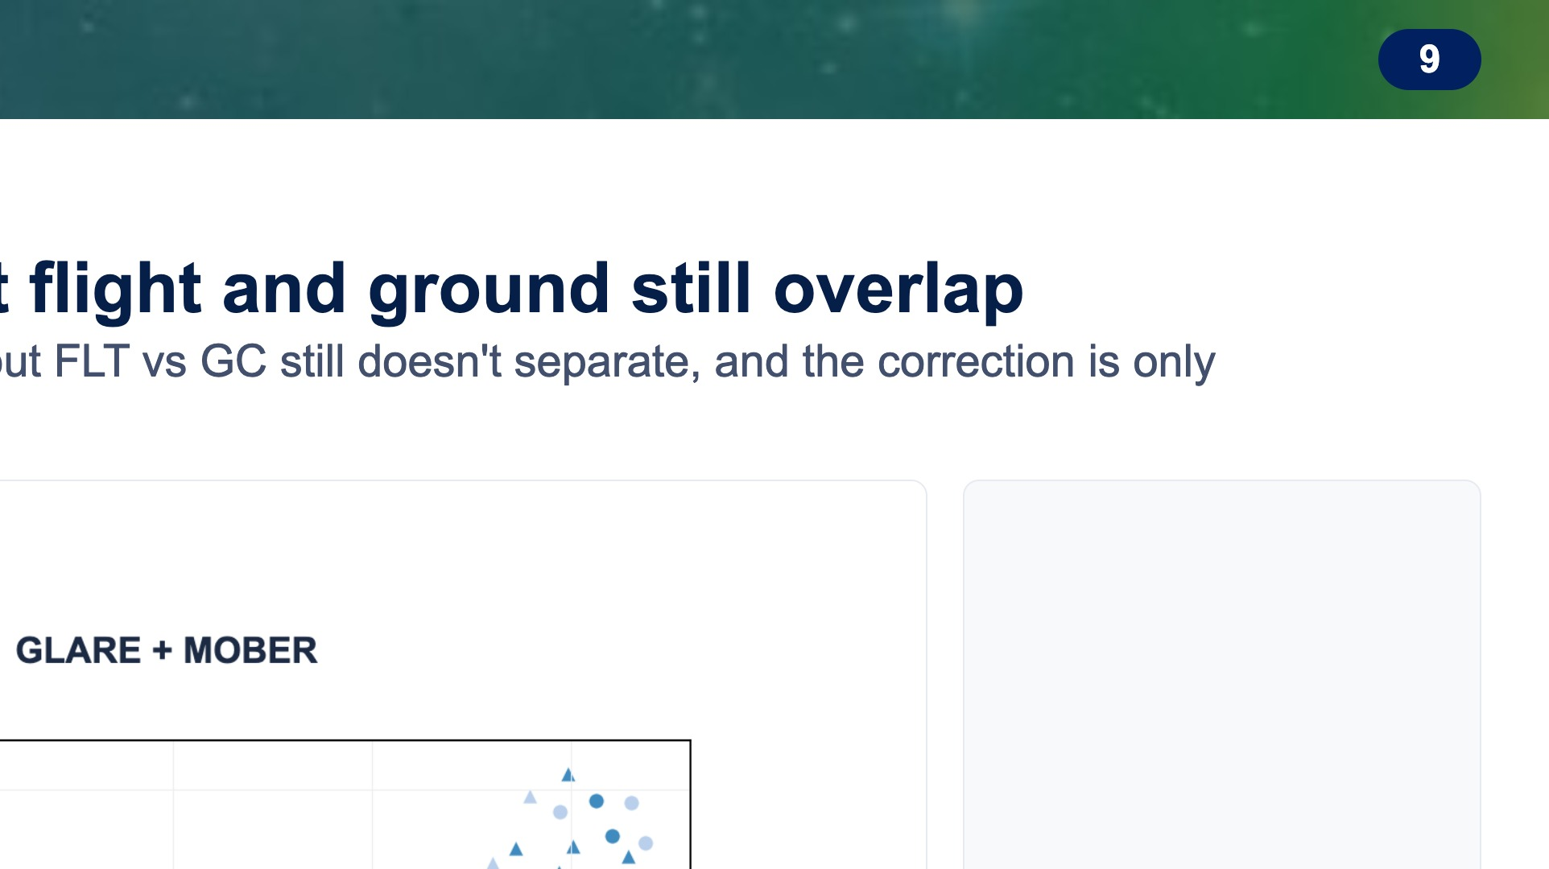
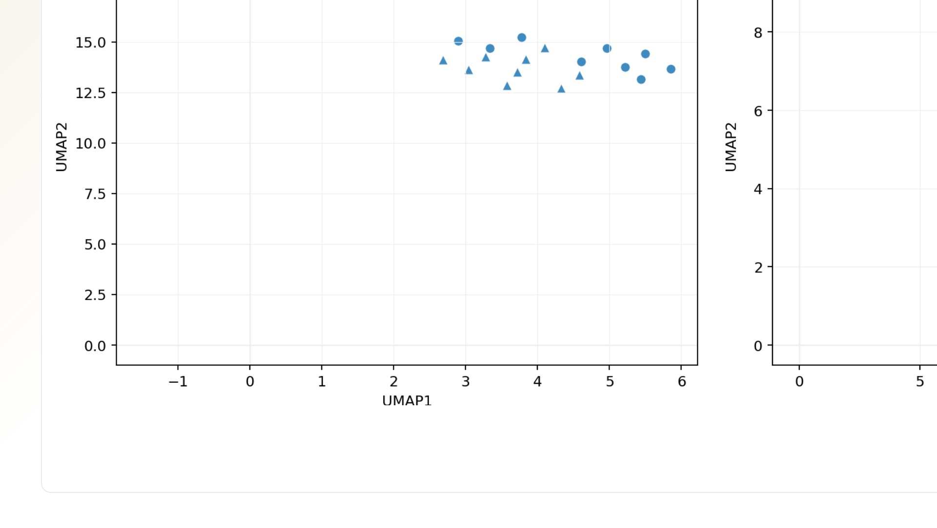
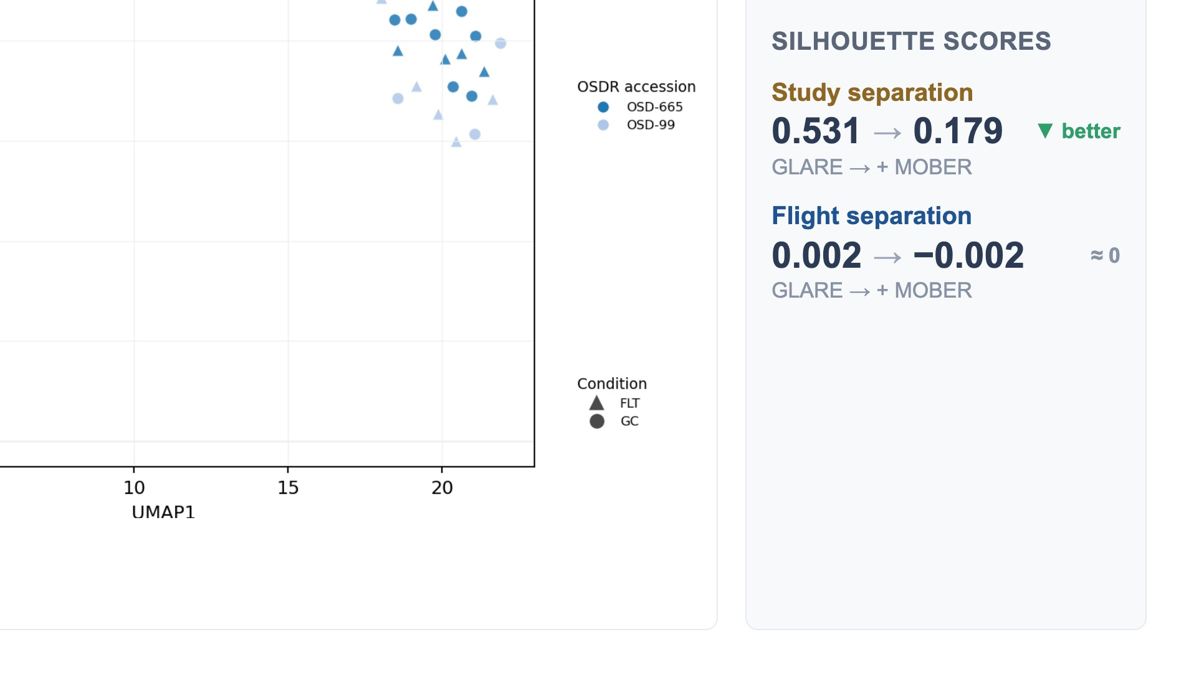
6
Notes:
Target time: 0:25
This UMAP compares the same two muscle studies before and after MOBER. Before correction, study identity dominates the layout. After MOBER, samples from the studies mix more closely, but flight and ground control still overlap. Removing visible study structure does not automatically reveal a strong spaceflight axis.

Slide 7
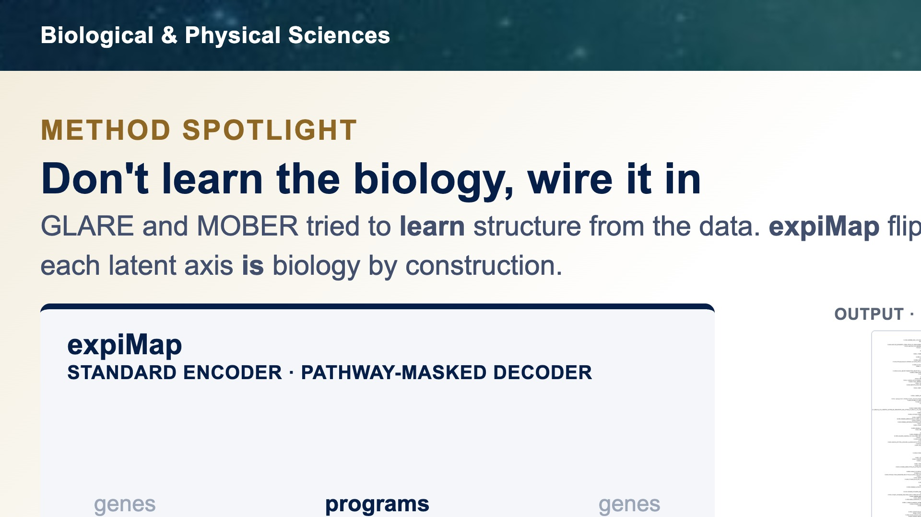
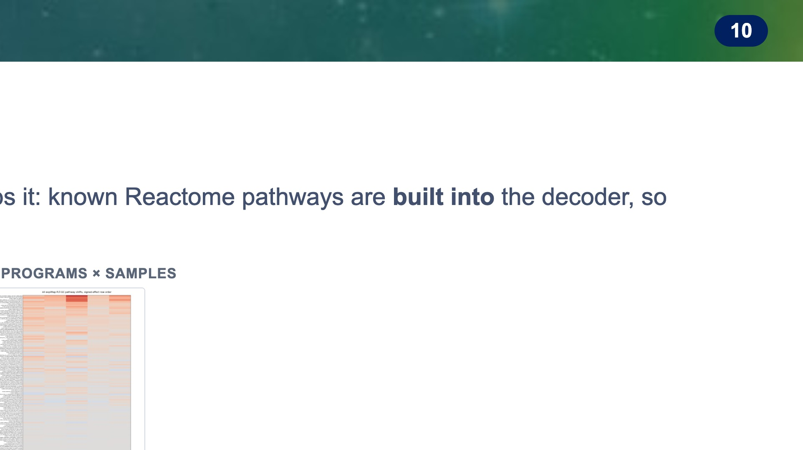
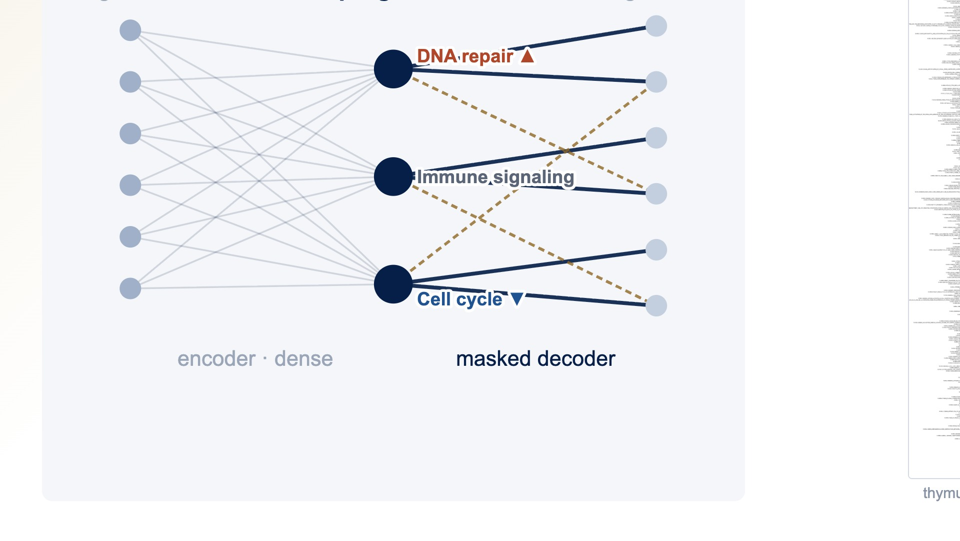
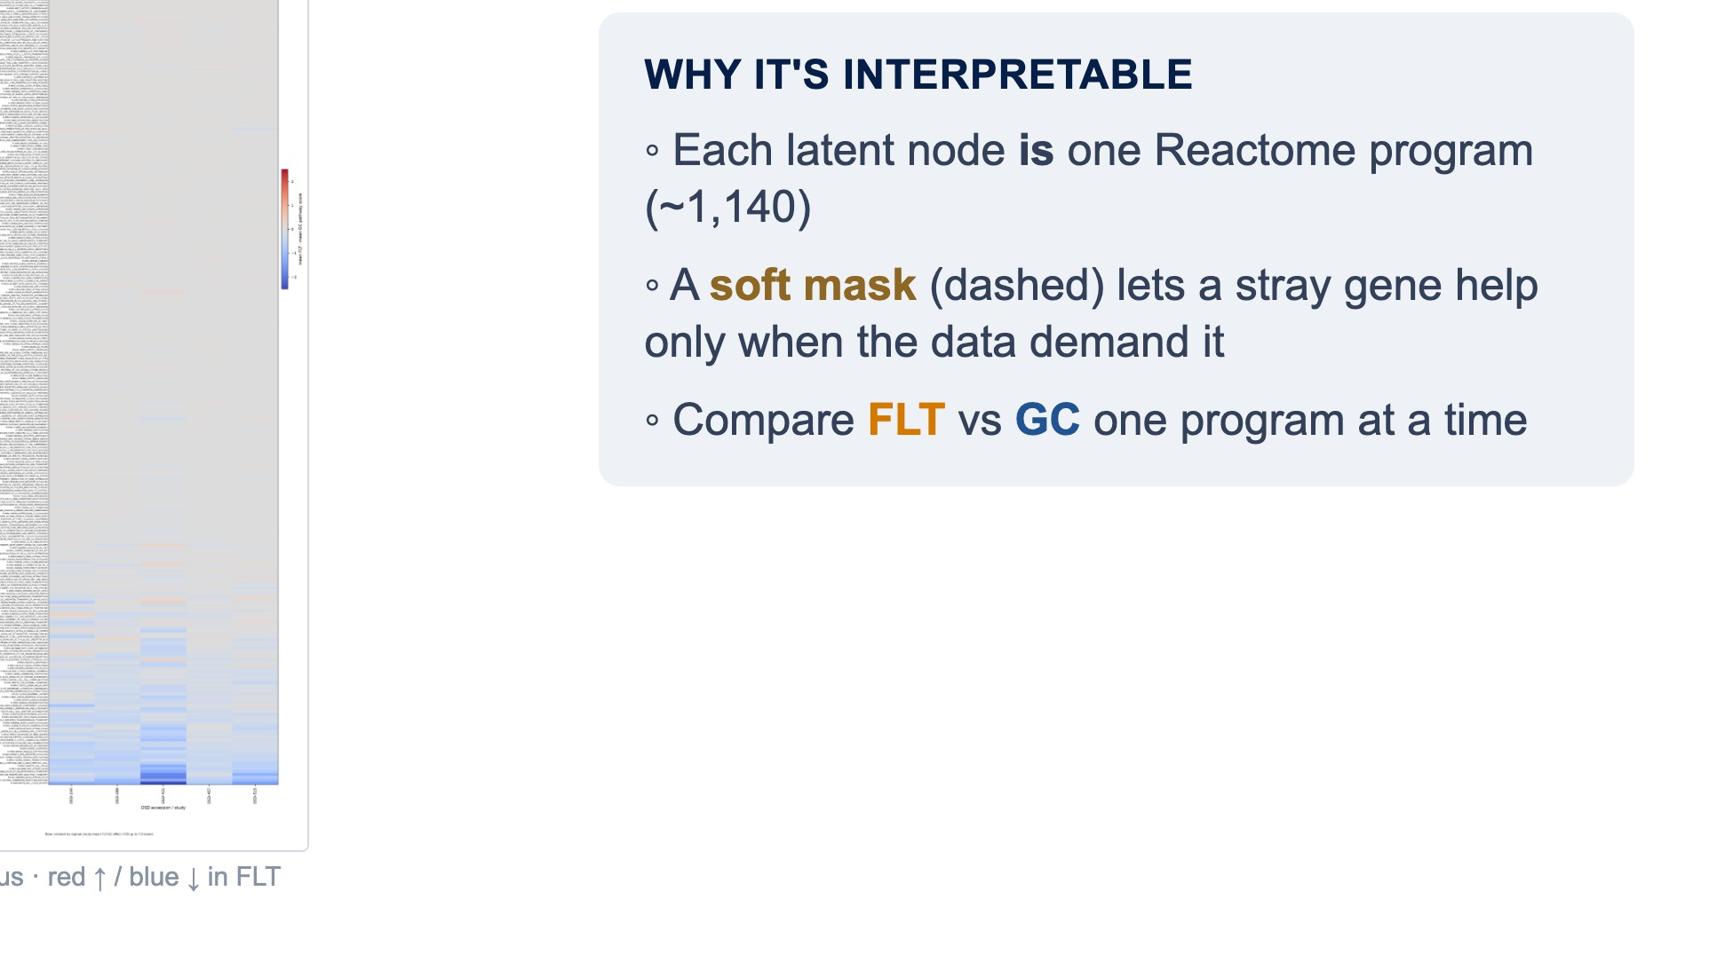
7
WHY IT'S INTERPRETABLE
Each latent node is one Reactome program (~1,140).
A soft mask lets a stray gene help only when the data support it.
Compare FLT and GC one program at a time.
Notes:
Target time: 0:30
GLARE and MOBER learn their latent structure from expression. expiMap instead connects each latent node to a known mouse Reactome pathway through a masked decoder. That lets us compare flight and ground control one named biological program at a time. The next slide shows how those program scores are summarized.

Slide 8
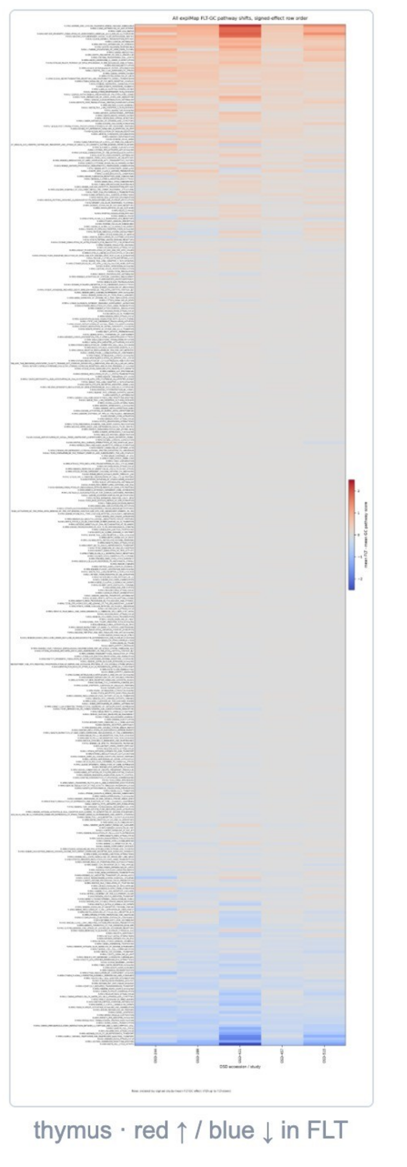
EXPIMAP SCORES
Program scores summarize pathway changes within one tissue
OUTPUT · PROGRAMS × SAMPLES
FLT score
-
GC score
=
FLT - GC
Extracellular matrix
+0.47
-
+0.08
=
+0.39
Cell-cycle control
+0.42
-
+0.10
=
+0.32
Immune signaling
+0.15
-
+0.13
=
+0.02
Oxidative metabolism
-0.06
-
-0.03
=
-0.03
DNA repair
-0.10
-
+0.34
=
-0.44
lower
little change
higher
Example values, ordered from higher to lower FLT - GC. Literature review appears next.
Notes:
Target time: 0:35
The table is an illustrative example for one tissue, not a project result. Each sample receives one score per Reactome program. We compare the average flight and ground-control scores and subtract GC from FLT. The rows are ordered from higher red shifts to lower blue shifts. The heatmap at right shows the complete program-by-sample output that these comparisons summarize.

Slide 9
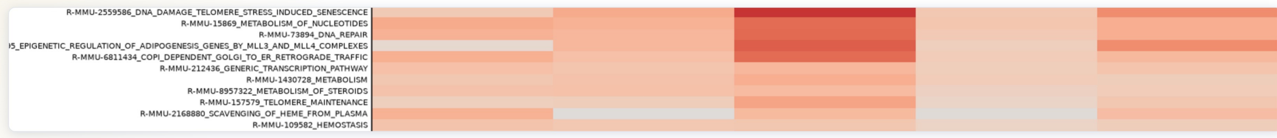
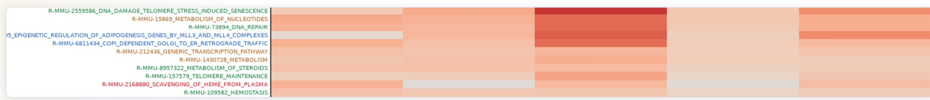
EXPIMAP INTERPRETATION
Each program, reviewed against prior literature
The pathway scores stay fixed; the pathway-name colors summarize the literature comparison.
1 PATHWAY SCORES
2 LITERATURE LABELS
Aligned
Complementary
Uncertain
Conflicting
Low effect
Name color records the literature assessment; heatmap color records the program score.
Heatmaps reproduced from midpoint slides 11 and 12.
Notes:
Target time: 0:25
The top heatmap shows the pathway scores alone. The lower heatmap shows the same scores after each pathway name was reviewed against spaceflight literature. Green agrees with prior work, blue adds a related or complementary interpretation, orange is uncertain, red conflicts, and gray has little effect. The score values do not change; the colors describe the evidence attached to each pathway.

Slide 10
EXPIMAP RESULTS
Five tissues showed recurring pathway patterns
FLT and GC were compared within each study before the study-level changes were combined.
Thymus
LOWER IN FLIGHT
Known involution may also involve lower repair, motility, and niche coordination.
117 samples | 5 projects
DNA repair; RHOA cytoskeletal cycle; lymphoid-stromal interactions
Skin
LOWER IN FLIGHT
Barrier injury may include a broader loss of tissue maintenance and coordination.
151 samples | 4 projects
Chromatin regulation; DNA repair; Hedgehog; sphingolipids; cell junctions
Liver
LOWER IN FLIGHT
Metabolic heterogeneity coexisted with lower adaptive immune communication.
197 samples | 9 projects
MHC class II antigen presentation; T-cell receptor signaling
Spleen
LOWER IN FLIGHT
The most consistent multi-pathway result joined adaptive and innate immune changes.
100 samples | 5 projects
T-cell receptor signaling; neutrophil degranulation; C-type lectin signaling
Kidney
HIGHER IN FLIGHT
Matrix and growth-factor programs rose together, suggesting a renal remodeling response.
135 samples | 6 projects
ECM proteoglycans; WNT signaling; IGF transport and uptake
Source: expiMap manuscript Figures 3, 4, and 6. Program-score direction does not by itself prove biochemical activation or inhibition.
Notes:
Target time: 0:45
Thymus showed lower repair, cytoskeletal, and stromal-interaction programs. Skin showed lower chromatin regulation, repair, Hedgehog, sphingolipid, and cell-junction programs. Liver showed lower MHC class II and T-cell receptor scores. Spleen combined lower T-cell receptor, neutrophil-degranulation, and C-type lectin programs. Kidney showed higher ECM proteoglycan, WNT, and IGF-transport programs, suggesting structural and growth-factor remodeling.

Slide 11
BACKGROUND
What is synthetic transcriptomics?
A generator learns patterns in measured RNA-seq data, then samples new expression vectors under chosen conditions.
01
Observed profiles
02
Learn expression patterns
03
Synthetic profiles
profiles
profiles
genes
genes
Measured gene expression from real mouse tissue
Capture gene relationships and variation by tissue and FLT/GC condition
Sample new numeric expression vectors for a selected context
Notes:
Target time: 0:20
A generator learns patterns from measured RNA-seq and creates new numeric expression profiles for a chosen tissue and FLT or GC condition. These profiles are useful model outputs, but they are not new animals or independent biological measurements.

Slide 12
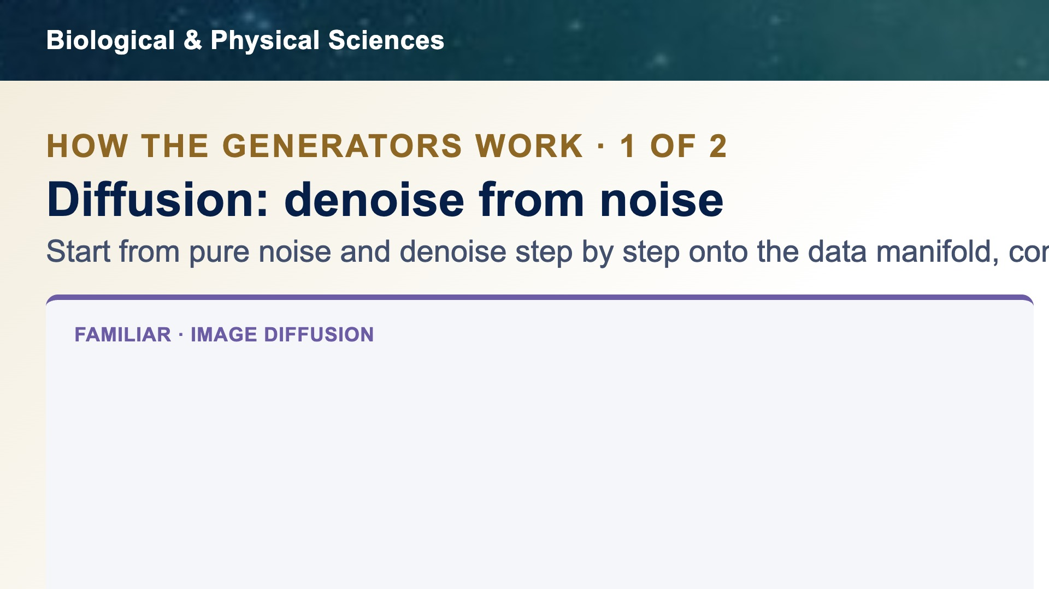
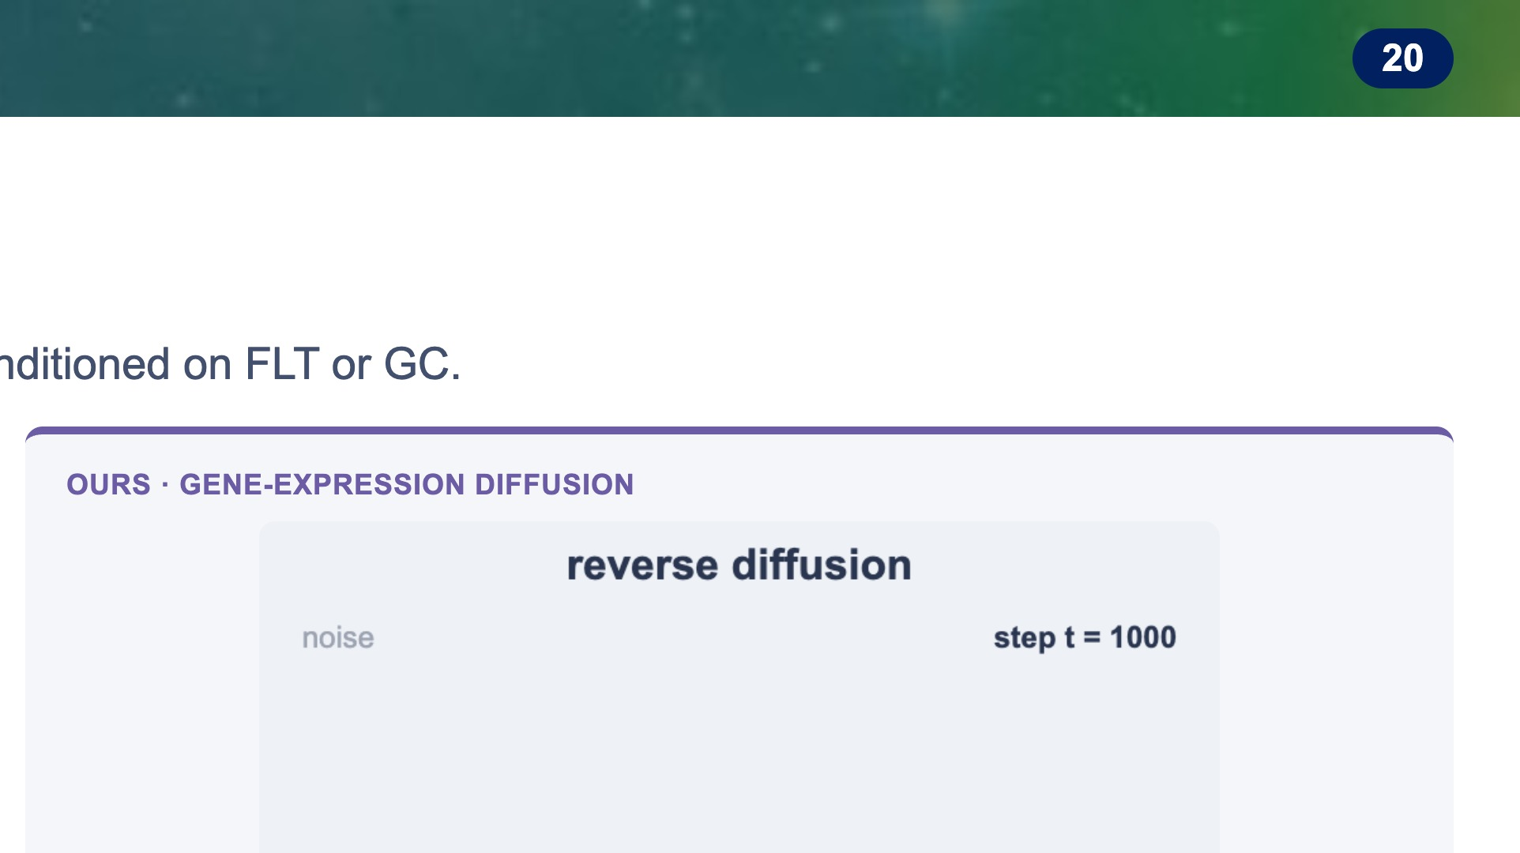
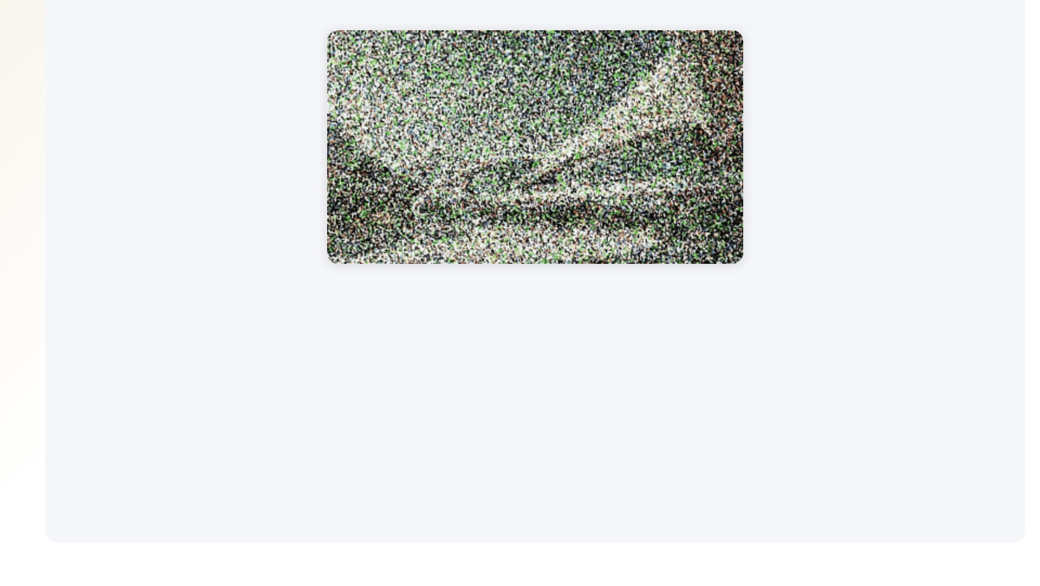
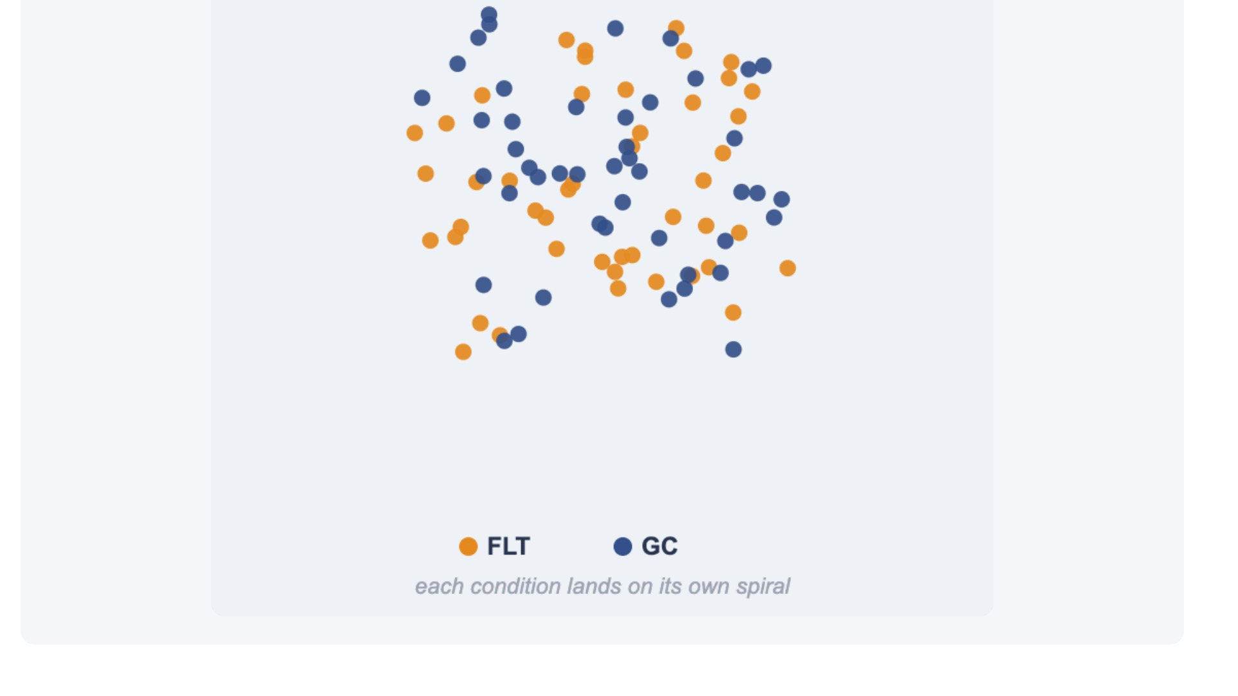
12
Notes:
Target time: 0:25
The left animation shows diffusion for images: start with random noise and remove it step by step until an image appears. The right side applies the same idea to gene expression. The phrase data manifold on the slide means the region occupied by real expression profiles.

Slide 13
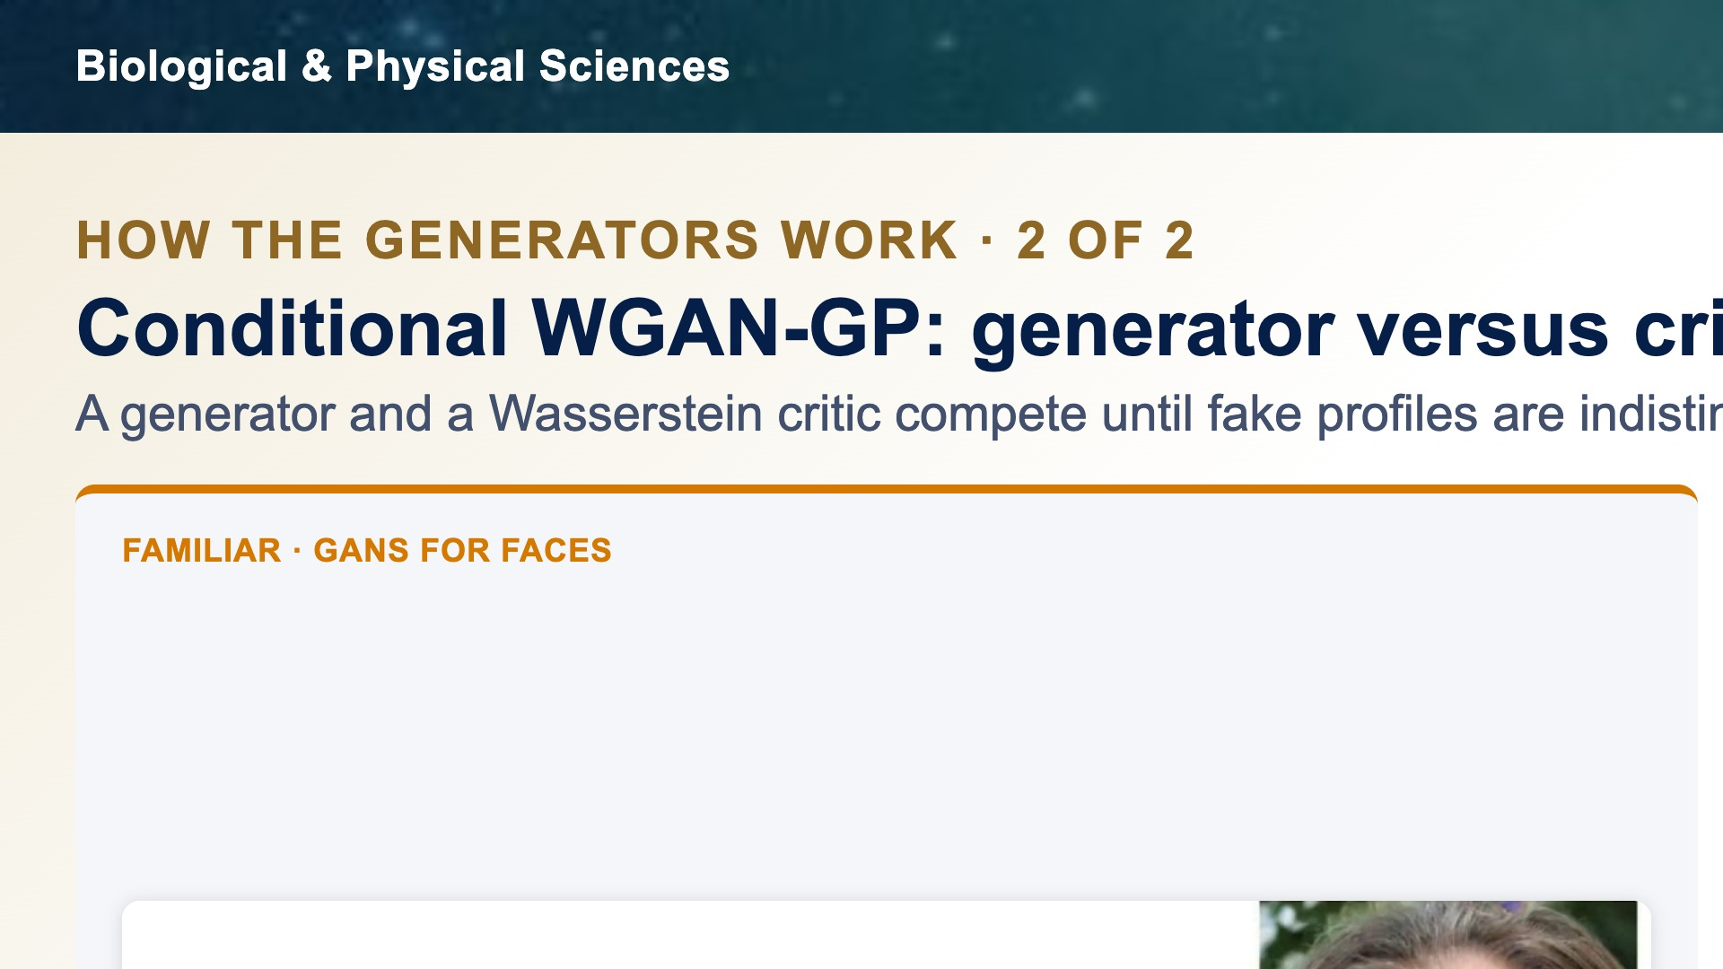
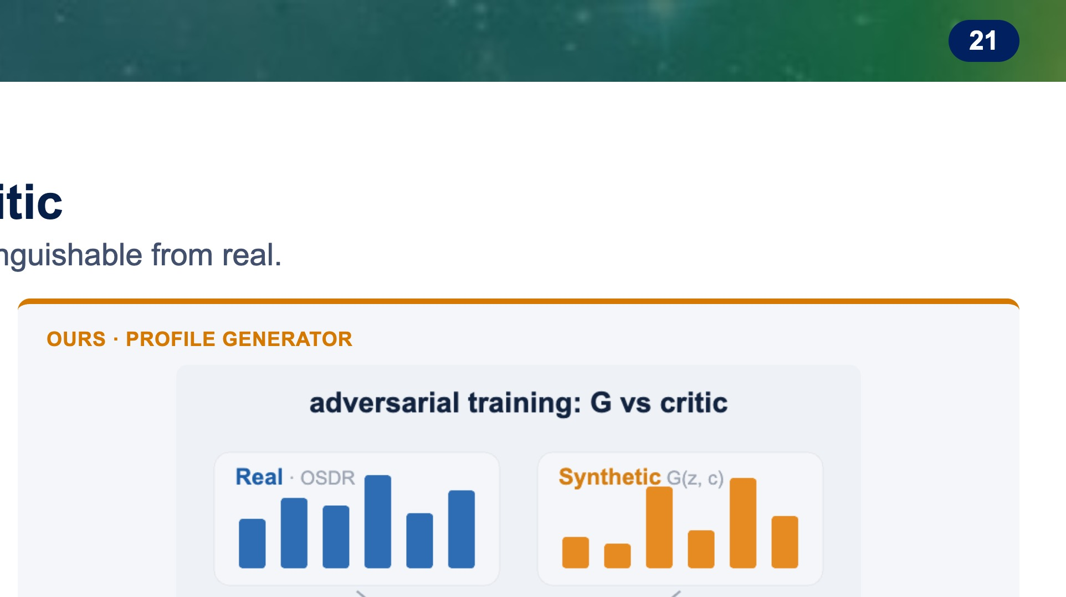
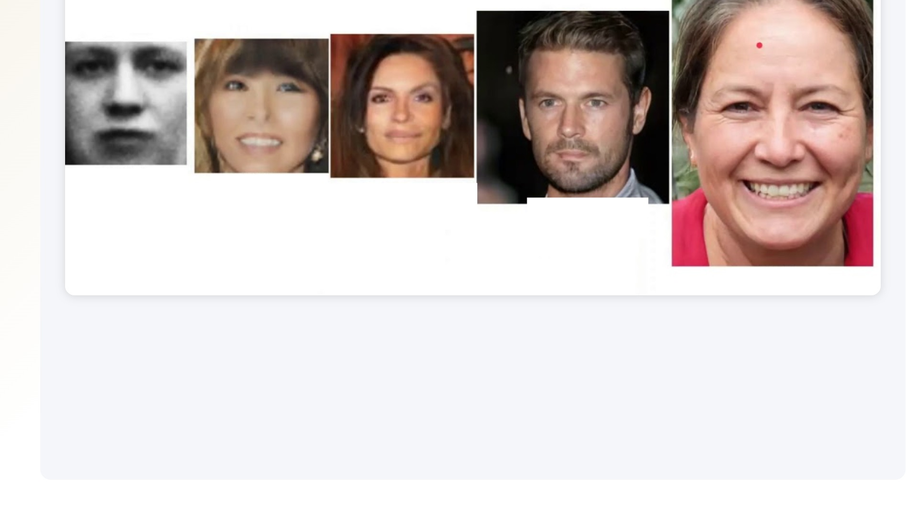
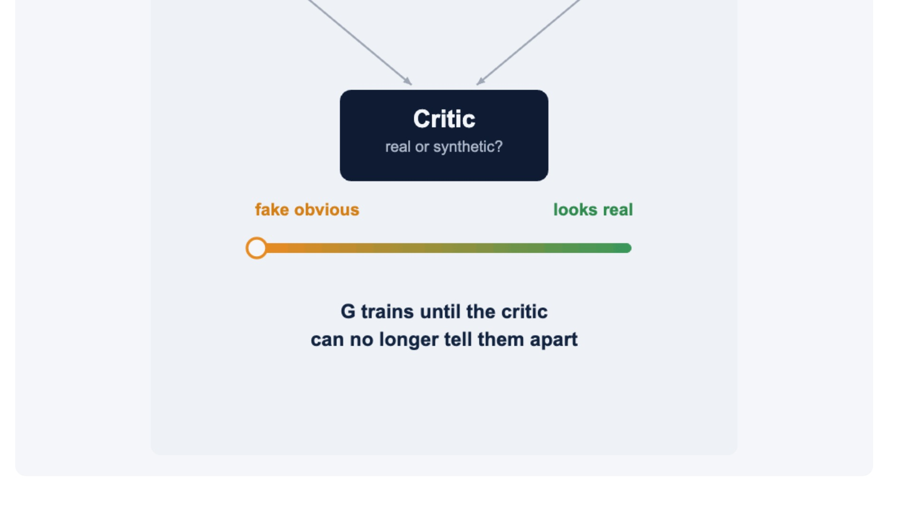
13
Notes:
Target time: 0:25
A GAN trains two networks against each other. The generator makes expression profiles. The critic, which is similar to a discriminator, scores how much each profile resembles measured data. Tissue, FLT or GC, study, and sample material tell the generator what type of profile to make.

Slide 14
MODEL DEVELOPMENT
Building the RNA-seq generator
We compared how to process the data, handle study differences, train the model, and tell it what to generate.
01
Data scope
02
Processing
03
Study effects
04
Model training
05
Conditioning
Sources
Expression
Alternative methods
Generator
Model inputs
OSDR API
ARCHS4
Raw
CPM
TPM
None
WGAN-GP
DDIM
Tissue
Studies
Scaling
Within-study z-score
Training source
FLT / GC
Single
Multiple
None
Z-score
MaxAbs
OSDR only
Study
ComBat / MBatch
Tissues
Features
ARCHS4 only
Material type
Per tissue
All tissues
All genes
HVGs
MOBER
ARCHS4 then OSDR
Sex / age
Reactome
L1000 map
Downstream
PROCESS
PRETRAIN
ADAPT
GENERATE
TPM / MaxAbs / 974 landmarks
ARCHS4
OSDR
Conditional DDIM
configuration
CONDITION
Tissue
FLT / GC
Study
Material type
HARMONIZE
None
SCOPE
All tissues
Pipeline evaluated with OSDR and ARCHS4. Generator designs follow Vinas et al. (2022) and Lacan et al. (2026).
Notes:
Target time: 0:35
We compared different ways to prepare the data, handle study differences, train the generator, and specify what it should make. Feature-space options included all shared genes, highly variable genes, Reactome genes, and a mouse mapping of the human L1000 landmark panel. The selected diffusion model uses the 974-gene L1000 mapping with TPM and ARCHS4-training MaxAbs scaling. It first learns broad mouse tissue patterns from ARCHS4, then adapts to OSDR.

Slide 15
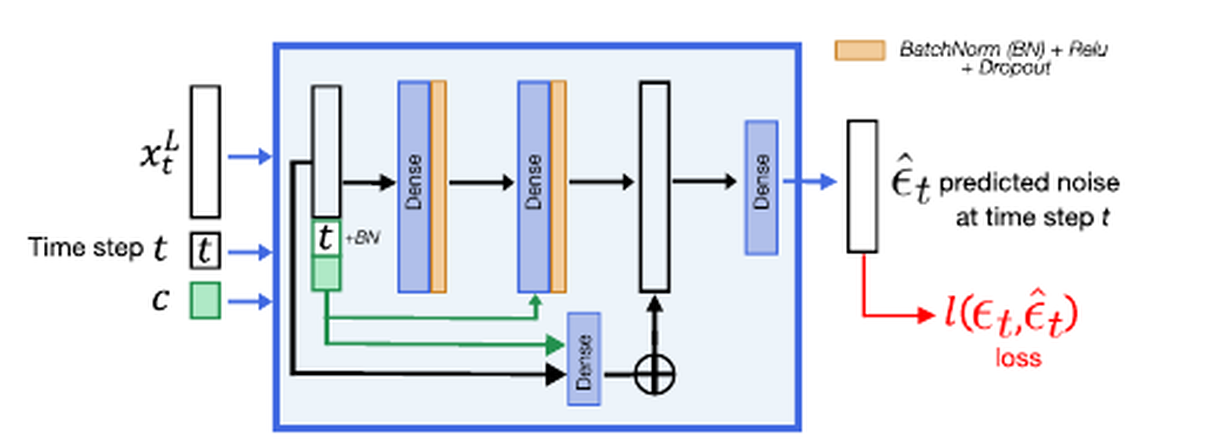
VALIDATION
Diffusion best reproduced the measured expression distribution
Both models reproduced gene expression. Diffusion samples were harder to distinguish from measured samples.
Architecture from Lacan et al.
Metric
WGAN-GP
DDIM
Read
Expression corr.
0.976
0.974
higher
Coverage (F1)
0.985
0.997
higher
Real-vs-synth. acc.
0.636
0.475
0.5 is ideal
Distribution distance
0.144
0.074
lower
The network repeatedly predicts and removes noise using tissue and time information.
For OSDR, the model also receives FLT/GC, study, and sample-material information.
Use diffusion
Better coverage and closer to the real distribution.
Tissue identity retained
Real 0.781 | Synthetic 0.781
A score near 0.5 means a prediction model cannot reliably tell measured and generated samples apart.
Balanced accuracy is preserved in generated tissue labels.
Architecture: Lacan et al. (2026), Fig. 1C, doi:10.1186/s12859-026-06470-8. Each model was evaluated on its own fixed test split.
Notes:
Target time: 0:35
We compared WGAN-GP with diffusion. Correlation measures gene-expression agreement. Coverage F1 asks whether generated samples cover the same regions as measured samples. Real-versus-synthetic accuracy asks whether a prediction model can tell the two apart, where 0.5 is ideal. Distribution distance measures overall separation, so lower is better. Diffusion had better coverage, near-chance discrimination, and the smaller distance, so we used it for the biological analysis.

Slide 16
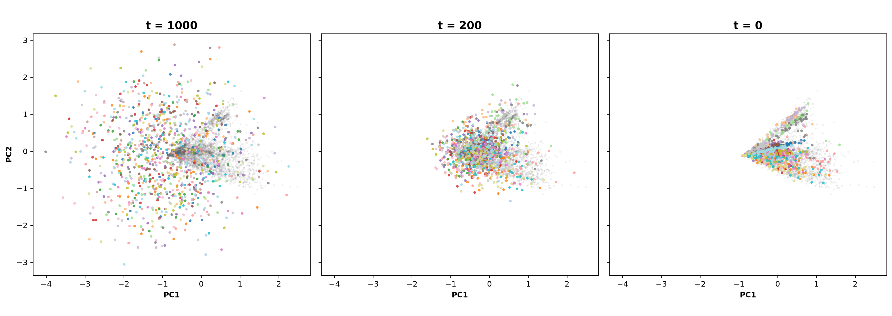
DIFFUSION
Diffusion learns tissue structure from noise
The same PCA axes follow 1,024 generated profiles through reverse diffusion.
t = 1000: noise
t = 200: partial structure
t = 0: tissue-conditioned profiles
Gray points are real ARCHS4 profiles; colors identify generated tissue conditions. PC1 and PC2 limits are shared across panels.
Notes:
Target time: 0:20
The same 1,024 generated samples begin as noise, develop tissue structure by step 200, and reach their final expression profiles at step zero. PCA compresses the 974 gene values to two axes so the movement can be plotted.

Slide 17
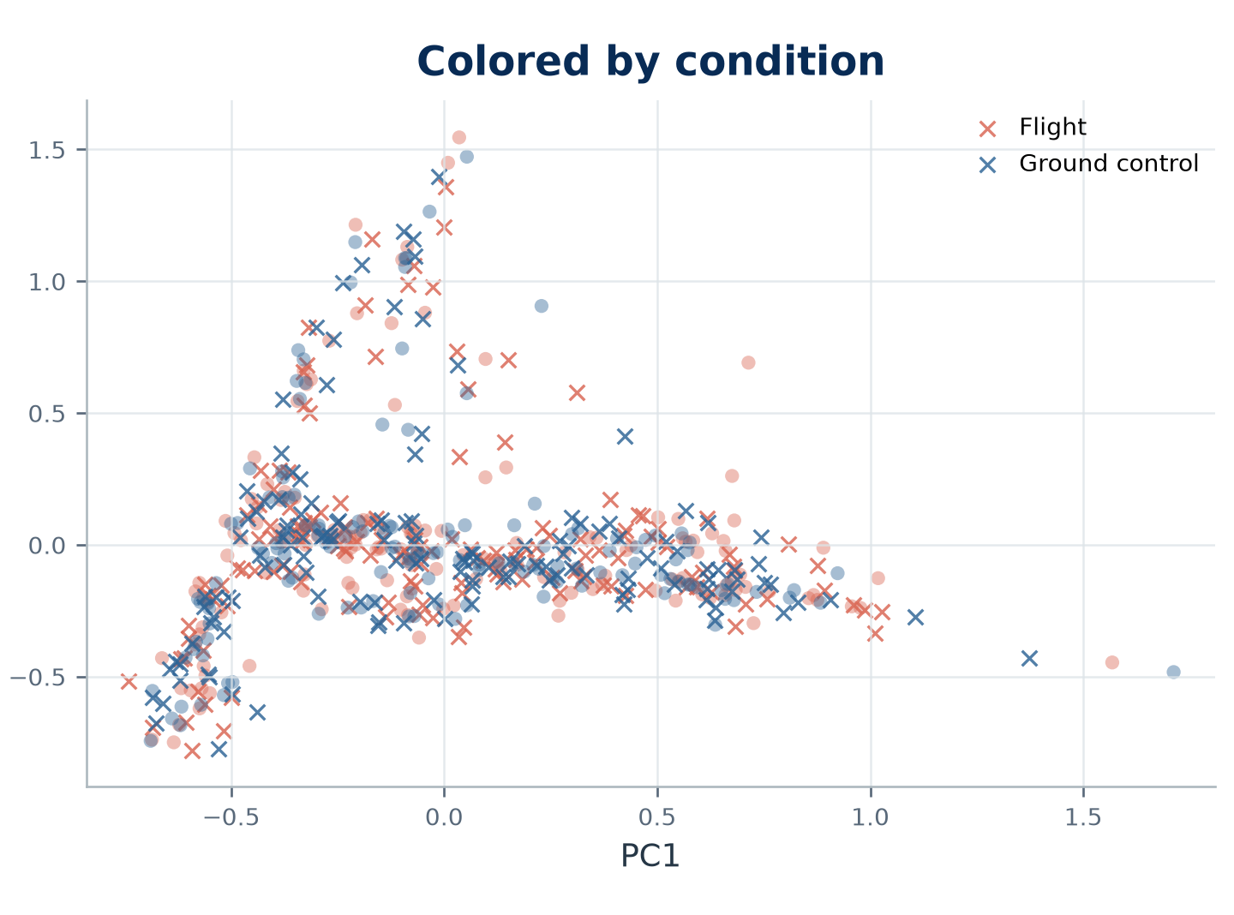
DIFFUSION OUTPUT
FLT and GC overlap in the global PCA view
The condition signal is not clear when all tissues and studies are combined.
Color: FLT or GC. Circles are real samples; crosses are generated samples.
Notes:
Target time: 0:20
We first ask whether flight and ground-control profiles separate when all tissues and studies are viewed together. They overlap across the first two principal components, so there is no clear global condition axis. This motivates a closer look at the tissue and study structure.

Slide 18
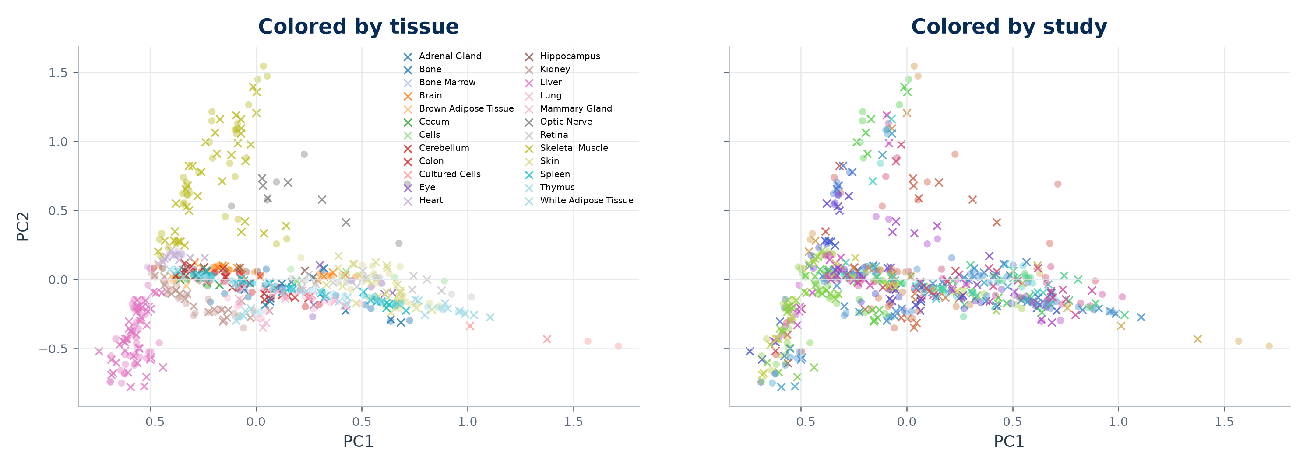
DIFFUSION OUTPUT
Tissue and study structure dominate the PCA space
We therefore compare FLT and GC within tissues and account for study.
Left: tissue. Right: study. Circles are real samples; crosses are generated samples.
Notes:
Target time: 0:25
Recoloring the same profiles by tissue and study reveals much stronger structure. The left panel shows tissue and the right shows study. Circles are real samples and crosses are generated samples. We therefore compare flight and ground control within each tissue and account for study in the downstream analysis.

Slide 19
PRIMARY ANALYSIS
Does adding synthetic data improve FLT vs GC prediction?
Train the same tissue-specific classifier two ways, then compare both versions on real samples.
01
TRAIN ON REAL DATA
TEST BOTH
R
Real profiles
FLT / GC classifier
Same real samples
FLT
GC
02
TRAIN ON REAL + SYNTHETIC DATA
R
+
S
Real + synthetic profiles
FLT / GC classifier
Compare prediction accuracy
Both classifiers are evaluated on real OSDR profiles.
Notes:
Target time: 0:25
We train the same tissue-specific classifier twice: once with real profiles and once with real plus synthetic profiles. Both versions are tested on the same real samples. This directly asks whether adding synthetic profiles improves flight-versus-ground-control prediction.

Slide 20
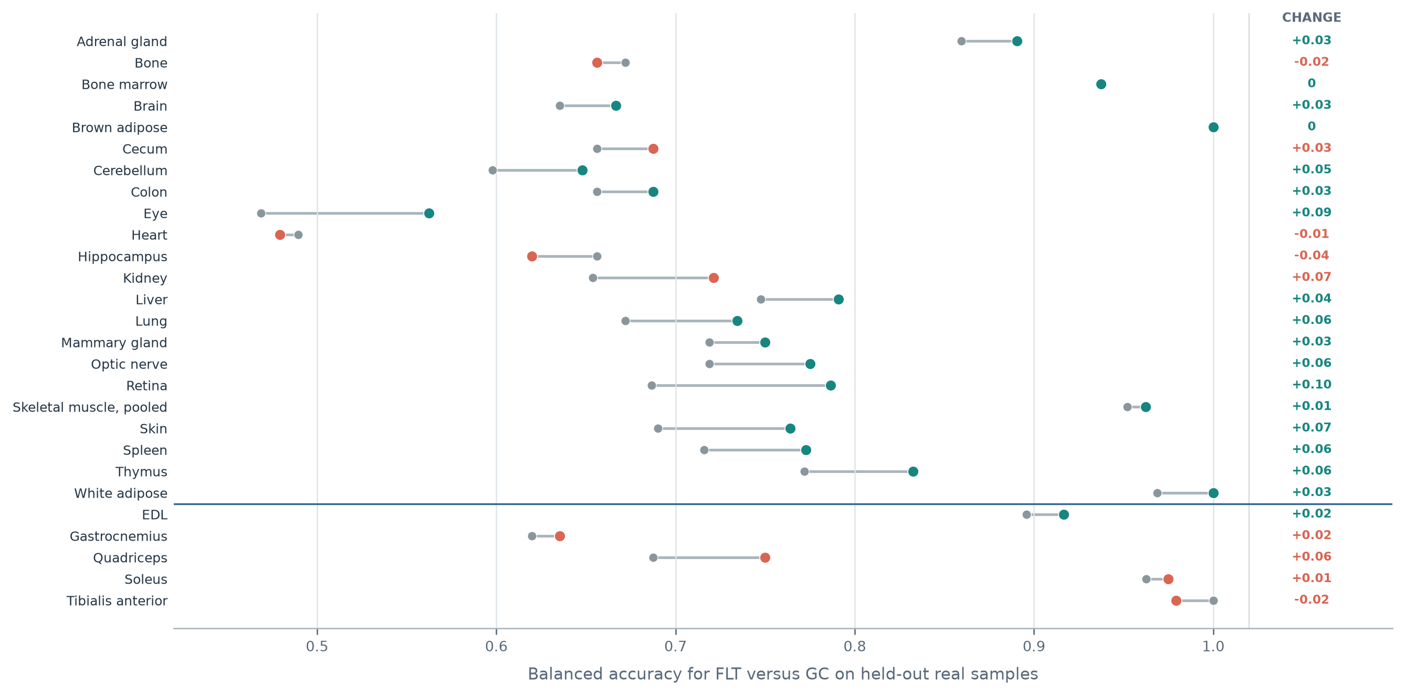
PREDICTION
Real + synthetic vs real-only balanced accuracy across 27 tissues
Real only
All six metrics passed
At least one declined
Outcome: FLT versus ground control within each tissue. All versions used the same 974 genes and prediction settings.
Notes:
Target time: 0:35
Each line compares real-only training with real-plus-synthetic training for flight-versus-ground-control classification in one tissue analysis. All scores come from held-out real OSDR samples. Balanced accuracy averages flight sensitivity and ground-control specificity. Teal points identify the 18 analyses where balanced accuracy, AUROC, and average precision all held or improved both overall and after giving each study equal weight. Coral marks the nine mixed results where at least one measure declined.

Slide 21
SYNTHETIC ANALYSIS
Compare what each classifier finds important
Real-only classifier
Real + synthetic classifier
REAL ONLY
REINFORCED
PROMOTED
Important without
Important
Important after adding
synthetic samples
in both
synthetic samples
Notes:
Target time: 0:25
Both classifiers see the same 974 genes and are evaluated on the same real samples. Features important in both classifiers are reinforced. Features that become important only after adding synthetic samples are promoted.

Slide 22
SYNTHETIC ANALYSIS
We compared feature importance at three levels
Each analysis compares the real-only and real + synthetic classifiers.
1
INDIVIDUAL GENES
2
REACTOME GROUPS
3
CONSENSUS RANKING
Permutation + SHAP
Grouped permutation + grouped SHAP
Compact gene panels
real
generated
shuffle
Gene 1
one pathway
top-k
Gene 2
Gene 3
Permutation: does prediction weaken?
Move related genes together
Combine measured and generated ranks
SHAP: does the gene push toward FLT or GC?
Test correlated genes as one group
Test small panels of the highest-ranked genes
OUTPUT · RANKED GENES
OUTPUT · RANKED PATHWAYS
OUTPUT · COMPACT GENE PANELS
Notes:
Target time: 0:30
Each analysis asks which features support flight-versus-ground-control prediction. Individual-gene permutation and SHAP score one gene at a time. Grouped permutation and grouped SHAP score a Reactome pathway together. Consensus ranking compares real and generated gene rankings and tests compact panels.

Slide 23
RESULTS
The three analyses retained different types of results
Every retained candidate was also supported by the real OSDR data.
Individual genes
Reactome groups
Consensus ranking
Permutation + SHAP
Grouped permutation + SHAP
Compact gene panels
21
associations in 4 tissues
10
pathways in 3 tissues
49
associations in 10 analyses
7 promoted
14 reinforced
4 promoted
6 reinforced
26 promoted
23 reinforced
RETAINED BY TISSUE
RETAINED BY TISSUE
RETAINED BY TISSUE
Thymus
15
Thymus
7
Thymus
16
Liver
4
Skin
2
Pooled muscle
12
Skin
1
Spleen
1
Soleus
5
Spleen
1
Seven others
16
Promoted: retained only after adding synthetic information. Reinforced: retained in both analyses.
Notes:
Target time: 0:30
The individual-gene analysis retained 21 associations. The grouped analysis retained 10 Reactome pathways, and consensus ranking retained 49 gene associations in compact panels. Promoted means the feature became important after synthetic samples were added. Reinforced means it was important with and without synthetic samples.

Slide 24
RESULTS
All three analyses found candidates in thymus, skin and spleen
TISSUE
Individual genes
Reactome groups
Consensus ranking
Permutation + SHAP
Grouped permutation + SHAP
Compact gene panels
Thymus
15 | 7 promoted, 8 reinforced
7 | 2 promoted, 5 reinforced
16 | 13 promoted, 3 reinforced
Skin
1 | 0 promoted, 1 reinforced
2 | 2 promoted, 0 reinforced
1 | 1 promoted, 0 reinforced
Spleen
1 | 0 promoted, 1 reinforced
1 | 0 promoted, 1 reinforced
4 | 3 promoted, 1 reinforced
Liver
4 | 0 promoted, 4 reinforced
-
-
Pooled muscle
-
-
12 | 4 promoted, 8 reinforced
Soleus
-
-
5 | 0 promoted, 5 reinforced
Kidney
-
-
2 | 1 promoted, 1 reinforced
Tibialis anterior
-
-
4 | 1 promoted, 3 reinforced
Gastrocnemius
-
-
2 | 2 promoted, 0 reinforced
Adrenal gland
-
-
2 | 1 promoted, 1 reinforced
Eye
-
-
1 | 0 promoted, 1 reinforced
FOUND BY ALL THREE
Results below the divider came from one analysis.
Counts refer to tissue-feature associations. Genes and pathways are different evidence units.
Notes:
Target time: 0:35
Thymus, skin, and spleen have retained candidates in every column. This agreement is why the biological interpretation focuses on these three tissues. The full analysis retains the single-method candidates for follow-up.

Slide 25
LITERATURE REVIEW
Feature selection and literature review answer separate questions
Selection compares classifiers. Literature review compares each candidate with prior evidence.
MODEL COMPARISON
Real-only importance
Real + synthetic importance
Promoted or reinforced
EVIDENCE REVIEW
Candidate + tissue + direction
Search prior studies
Evidence category
Literature classifications among retained candidates
Individual genes
n = 21
9
9
1
2
Reactome groups
n = 10
6
2
2
Consensus ranking
n = 49
22
19
4
4
Aligning
Complementary
Ambiguous
Unmatched
Annotations used the fixed tissue, FLT-GC direction and candidate identity; detailed rationale and sources are in Tables S16, S22 and S23.
Notes:
Target time: 0:30
The model comparison labels a candidate as promoted or reinforced. The literature review then fixes the candidate, tissue, and flight direction and asks whether prior work agrees, supports a related mechanism, is ambiguous, or offers no close match.

Slide 26
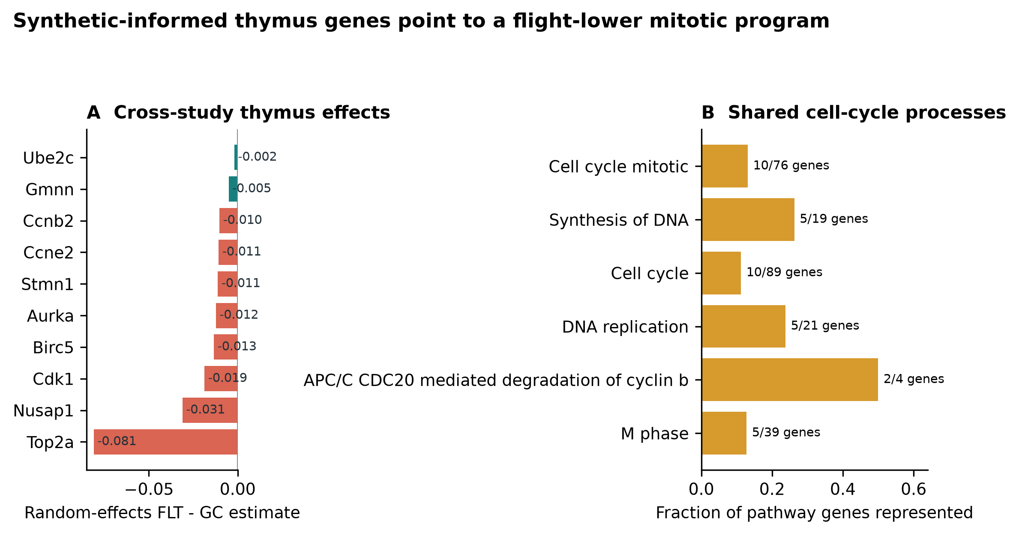
THYMUS
Thymus: all three analyses point to lower cell-cycle activity in flight
Genes, Reactome pathways and the compact panel all show the same direction.
Real OSDR effects and shared Reactome processes
INDIVIDUAL GENES
15
7 promoted | 8 reinforced
Most retained genes are FLT lower.
REACTOME GROUPS
7
2 promoted | 5 reinforced
Six pathways describe mitosis, DNA replication or APC/C control.
CONSENSUS RANKING
16
13 promoted | 3 reinforced
Thirteen genes are FLT lower, including CDK1, TOP2A and AURKA.
BIOLOGICAL READING
Lower thymic proliferative activity
Individual genes: Table S19. Reactome groups: Table S23. Consensus ranking: Table S10.
Notes:
Target time: 0:40
Thymus has the clearest agreement. Fifteen individual genes, seven Reactome groups, and a 16-gene compact panel point toward lower mitotic activity in flight. This could reflect reduced proliferative renewal or a smaller fraction of cycling thymocytes. The expression data cannot distinguish those explanations.

Slide 27
BIOLOGICAL INTERPRETATION
Skin and spleen show different flight-associated patterns
Skin: regulated cell death | Spleen: structural remodeling
SKIN
SPLEEN
Interferon-linked regulated cell death
Matrix, adhesion and cytoskeletal remodeling
GENE EVIDENCE
PLSCR1 was higher in flight and retained by two analyses
GENE EVIDENCE
LOXL1 was retained by two analyses; RAI14, PTPRK and MYL9 were also flight higher
PATHWAY EVIDENCE
Two necroptosis pathways were higher in flight
PATHWAY EVIDENCE
No shared structural Reactome pathway
CONTEXT
PLSCR1 is interferon inducible
CONTEXT
The genes span matrix, adhesion and cytoskeletal functions
COMPLEMENTARY HYPOTHESIS
COMPLEMENTARY HYPOTHESIS
Direct spaceflight evidence for skin necroptosis is limited
Matrix, adhesion and cytoskeletal remodeling
All displayed gene results were higher in flight. Direct spaceflight evidence for both complementary hypotheses was limited.
Notes:
Target time: 0:40
In skin, flight-higher PLSCR1 and two flight-higher necroptosis pathways suggest an interferon-linked regulated cell-death response. This is a complementary hypothesis because direct spaceflight evidence for skin necroptosis is limited. In spleen, flight-higher LOXL1, RAI14, PTPRK, and MYL9 suggest extracellular-matrix, adhesion, and cytoskeletal remodeling. This is also complementary because prior work supports the component mechanisms but not the same spleen-flight gene directions. The four genes did not form a significant shared Reactome pathway.

Slide 28
TAKEAWAYS
What the models can and cannot tell us
01
Computational evidence
02
Candidates to follow up
03
Experimental testing
expiMap and the generative models summarize patterns in the measured RNA-seq data. They do not reveal mechanism directly.
Agreement among genes, pathways, models, and prior studies narrows the list of tissues and targets.
Wet-lab experiments must confirm the biological changes and distinguish regulation from shifts in cell composition.
Notes:
Target time: 0:25
The models summarize patterns in the RNA-seq data and narrow the list of tissues, pathways, and genes to examine. They do not establish mechanism. Wet-lab experiments must confirm the biological changes and distinguish gene regulation from shifts in cell composition.

Slide 29
Thank you
Mentor
James Casaletto
Questions?
Program
NASA Space Life Sciences Training Program
Data
NASA OSDR | ARCHS4 | Reactome
Jason Trinh
jasontrinh@berkeley.edu
AI tools
ChatGPT | Claude
Code and manuscript
github.com/jasont314/nasa-mouse
All biological associations were tested in observed OSDR profiles.
Notes:
Target time: 0:10
Acknowledge James Casaletto, SLSTP, NASA OSDR, ARCHS4, Reactome, ChatGPT, and Claude, then invite questions.

