Slide 1

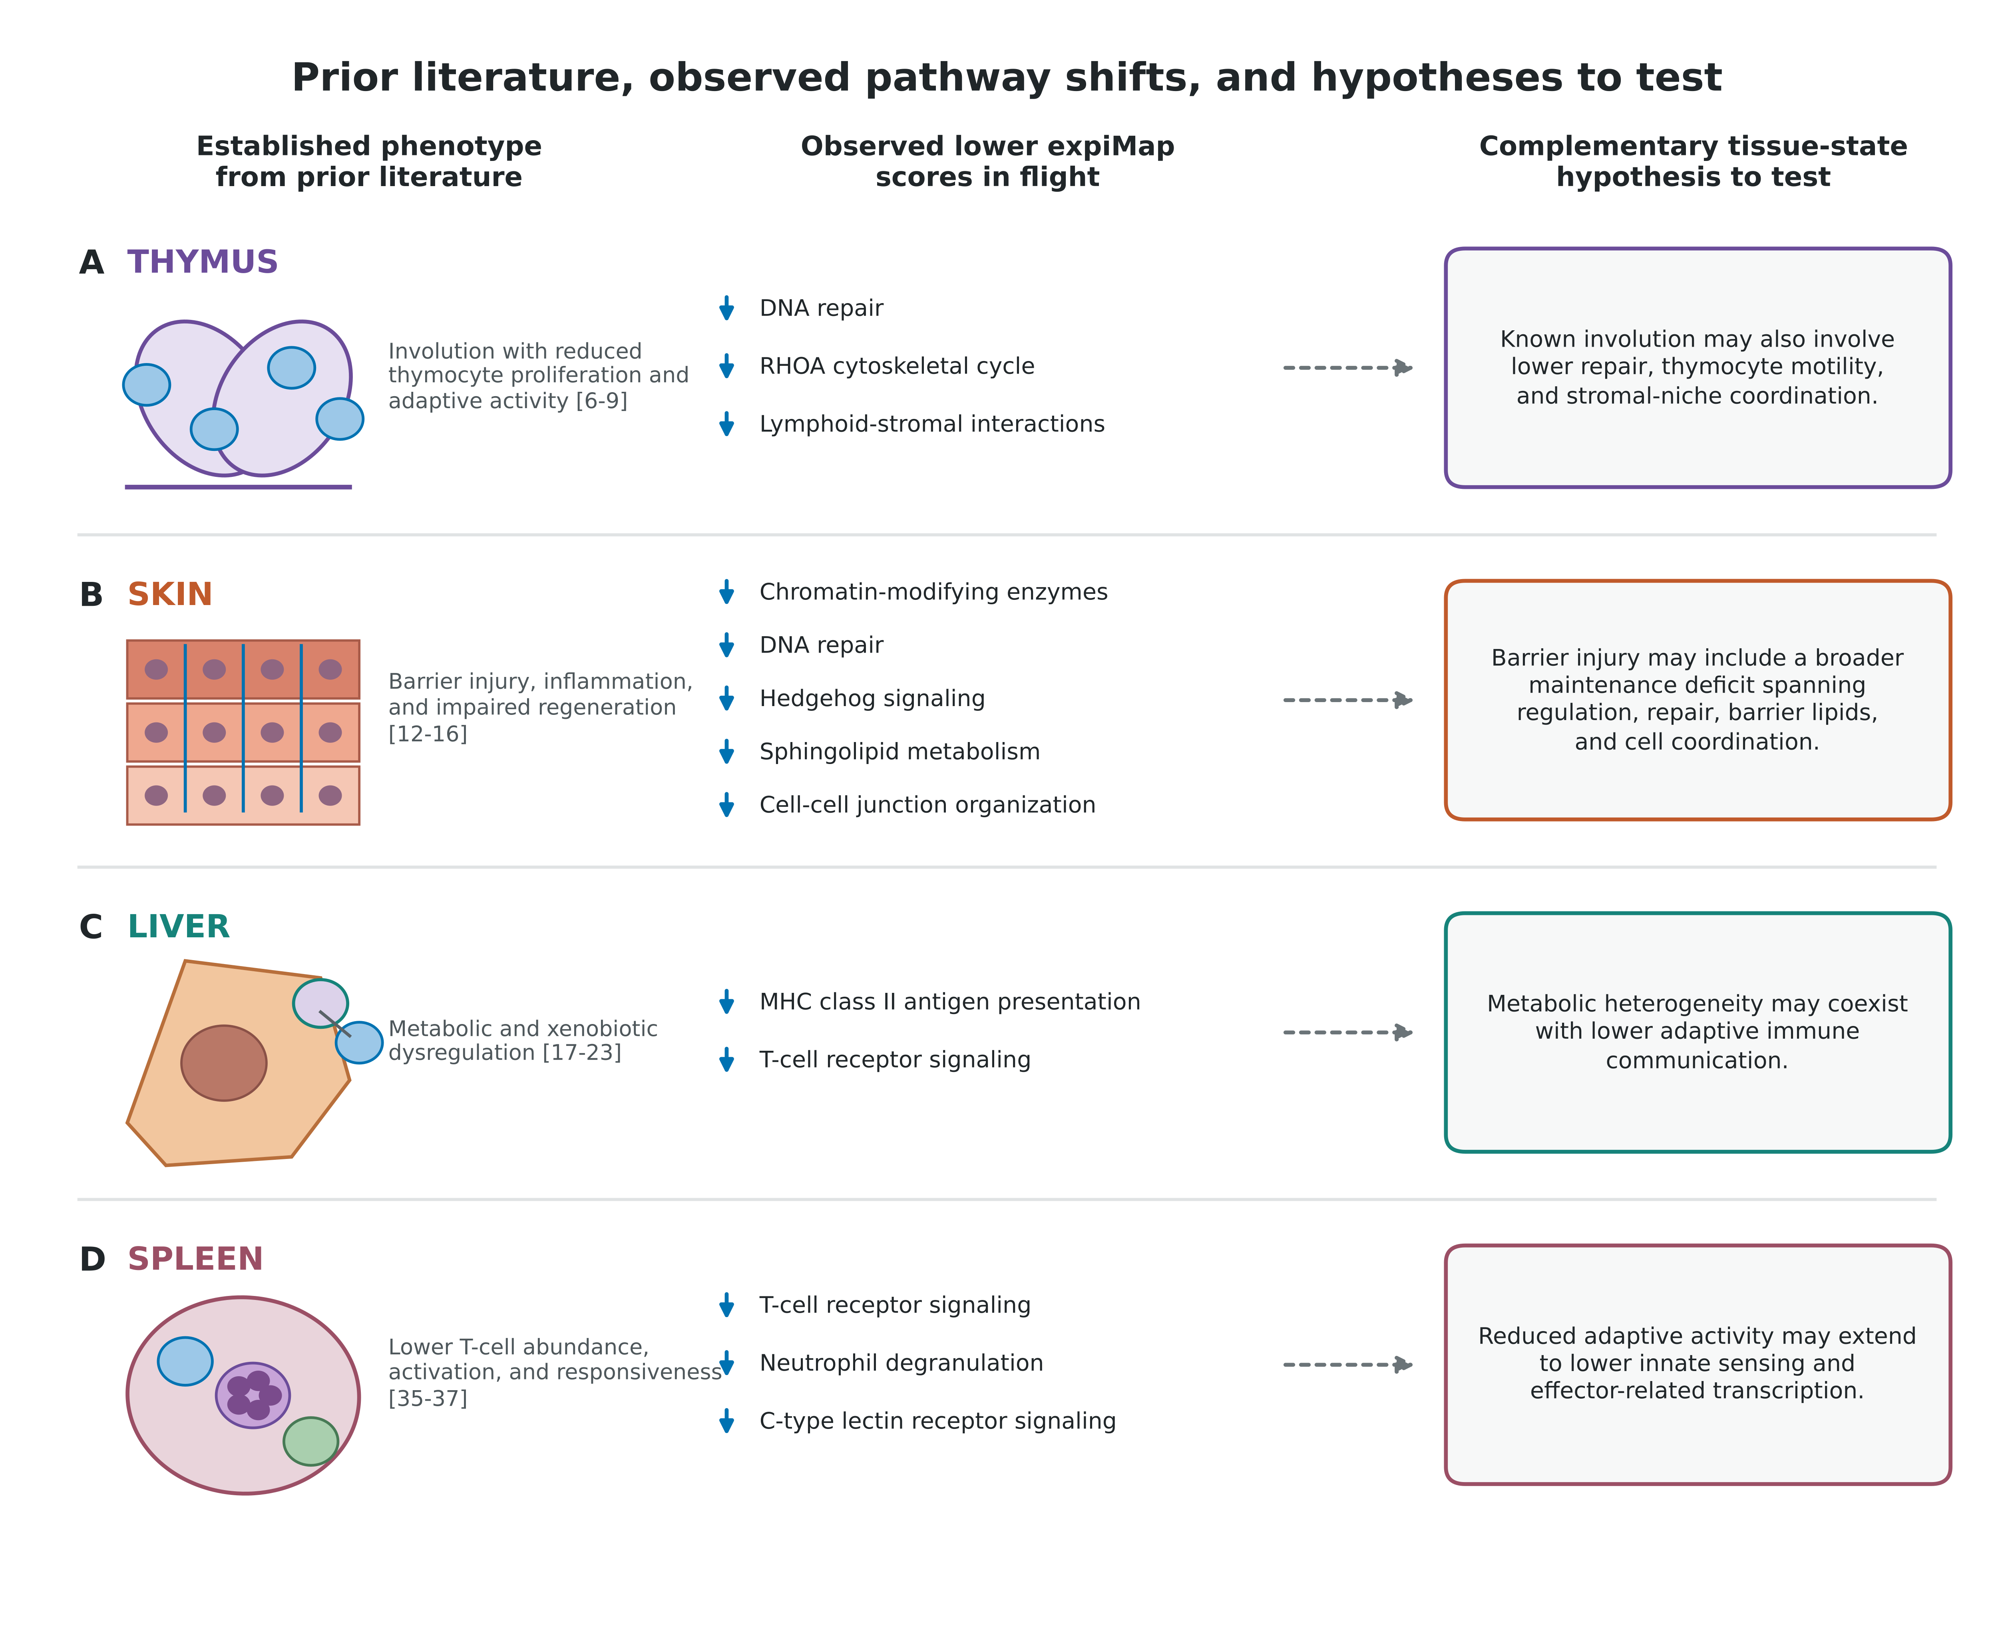
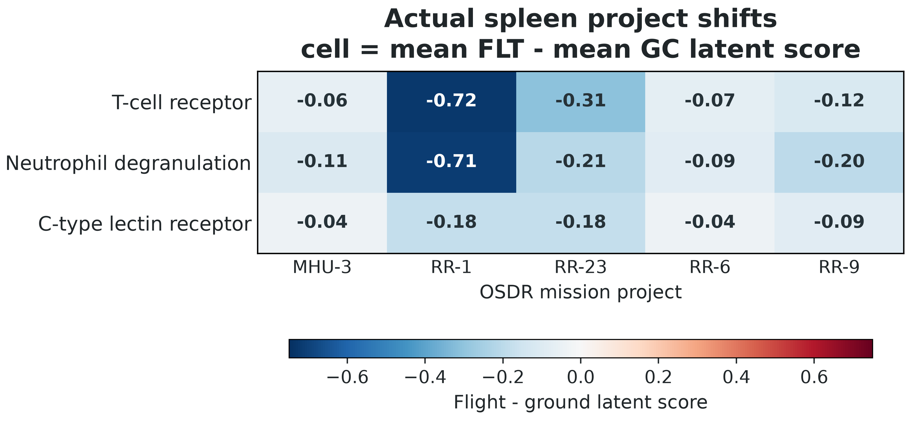
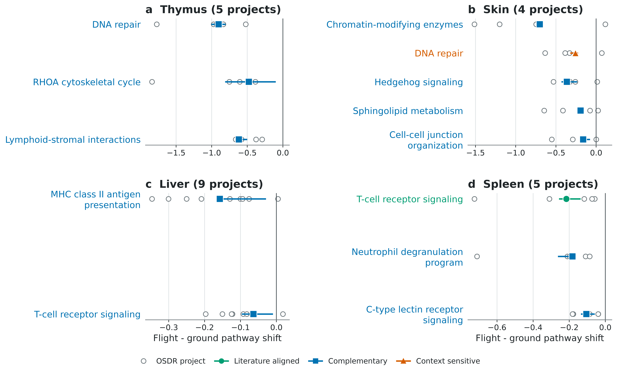
National Aeronautics and Space Administration
Cross-Mission expiMap Analysis Recovers Established Tissue Responses
and Identifies Complementary Pathway Shifts in Mouse Spaceflight Transcriptomes
Jason Trinh / University of California, Berkeley | NASA Space Life Sciences Training Program, NASA Ames Research Center
ABSTRACT
PROGRAM SCORES AND LITERATURE ANNOTATION
RESULTS: BIOLOGICAL INTERPRETATION
Spaceflight affects multiple organs, but mission differences can obscure recurring biological responses. We mapped
PROGRAM-SCORE SUMMARY
LLM-ASSISTED LITERATURE ANNOTATION
Prior evidence, observed shifts, and hypotheses to test
NASA OSDR mouse bulk RNA-sequencing samples into tissue-matched expiMap models trained on non-spaceflight
Posterior program score
one value per sample and pathway
Within-project shift
mean FLT - mean GC
Program + effect
TCR: -0.216
Mission context
5 of 5 lower
Primary sources
references 35-37
ARCHS4 data, using about 2,000 highly variable genes linked to mouse Reactome pathways. Project-balanced shifts
were evaluated with enrichment, held-out projects, three complete trainings, composition proxies, and member genes.
Four tissues produced reproducible patterns: lower thymic repair and cytoskeletal programs; lower skin regulatory,
repair, barrier-lipid, and cell-junction programs; lower hepatic antigen-presentation and T-cell signaling; and lower
splenic T-cell, neutrophil-degranulation, and C-type lectin-receptor programs; all three splenic programs had GSEA
OpenAI Codex (GPT-5)
FDR < 0.05. These results recover established responses and identify complementary tissue hypotheses to test.
LLM-assisted synthesis
INTRODUCTION
Source verification
direction, citations, and tissue context checked
PROJECT OBJECTIVE
Identify reproducible tissue-specific gene programs across spaceflight missions.
Heatmap cells are actual seed-2020 project effects; OSD-288 was excluded before spleen means.
Literature aligned
Complementary
Context sensitive
THE CENTRAL CHALLENGE
Tissue summaries weight projects equally. Retained programs were checked with held-out projects,
T-cell receptor
Neutrophil degranulation
Skin DNA repair
Observed expression
Spaceflight biology
+
Tissue biology
+
Animal variation
+
Study / protocol
three full trainings, enrichment, member genes, and composition sensitivity.
The LLM organized evidence; retained labels were not accepted without source-level review.
Study identity and protocol can dominate an unconstrained expression representation. Tissue-matched reference
mapping, accession conditioning, and equal project weighting reduce this bias without removing all confounding.
RESULTS: RETAINED PROGRAM SHIFTS
DATA AND REFERENCE MAPPING
ANALYSIS SCOPE
Tissue | ARCHS4 | OSDR | Projects | Programs
Thymus | 1,362 | 117 | 5 | 387
Skin | 2,593 | 151 | 4 | 319
Liver | 5,000 | 197 | 9 | 364
Spleen | 6,289 | 100 | 5 | 360
Spleen excludes nine condition-strain-confounded OSD-288 samples from the primary analysis.
CONCLUSIONS
METHODS: REFERENCE TRAINING AND QUERY MAPPING
• Spleen showed the strongest evidence: three immune programs were lower across five projects and
1 REFERENCE TRAINING
three trainings, with GSEA FDR < 0.05 for each.
ARCHS4 reference
non-spaceflight tissue counts
expiMap reference with Reactome-masked decoder
• Thymus retained lower repair, cytoskeletal, and niche-interaction programs; skin retained lower
regulatory, repair, regenerative, barrier-lipid, and cell-junction programs.
• Liver retained lower antigen-presentation and T-cell signaling; kidney showed a reproducible
structural and growth-factor pattern but remains exploratory.
• These bulk latent shifts generate tissue-level hypotheses; they do not prove pathway inhibition
2 QUERY MAPPING
or distinguish altered cell abundance from altered cell state.
NASA OSDR query
FLT, GC, and accession
scArches adaptation
map into the trained reference
Mapped OSDR samples
posterior pathway scores
~2,000 tissue HVGs | 319-387 Reactome programs | accession retained as a query covariate
REFERENCES
Selected sources; numbering follows the manuscript: [1] Gebre et al., NAR 2025; [2] Lotfollahi et al., Nat Cell Biol 2023.
[4] Lachmann et al., Nat Commun 2018; [5] Milacic et al., NAR 2024; [6] Horie et al., Sci Rep 2019.
[12] Cope et al., Commun Med 2024; [13] Park et al., Nat Commun 2024; [17] Beheshti et al., Sci Rep 2019.
[35] Gridley et al., J Appl Physiol 2009. Complete citations and source tables accompany the manuscript.
Acknowledgements
jasontrinh@berkeley.edu github.com/jasont314/nasa-mouse
Mentor: James Casaletto | NASA Space Life Sciences Training Program
www.nasa.gov
NASA OSDR, ARCHS4, and Reactome investigators and curation teams

