Slide 1




Notes:
Good morning. I'm Jason Trinh, and this is my SLSTP midpoint project, Biomedical Foundation Models, done with my mentor James Casaletto. Over the next ten minutes I'll cover how we use machine learning to find how spaceflight changes mouse biology, and where we're heading with generative models. (~13s)

Slide 2
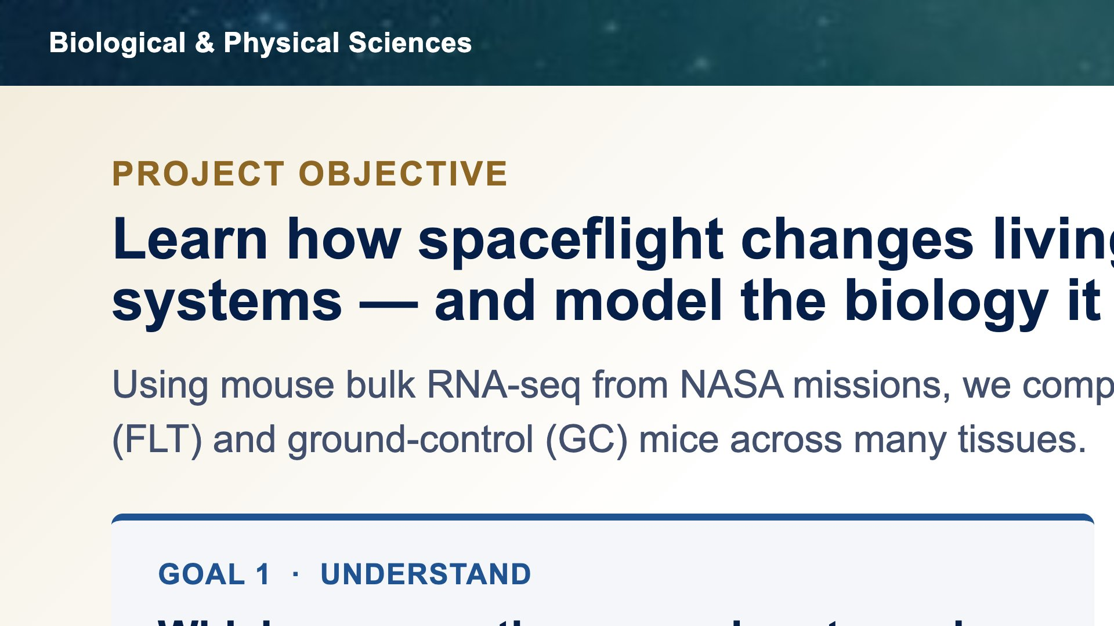

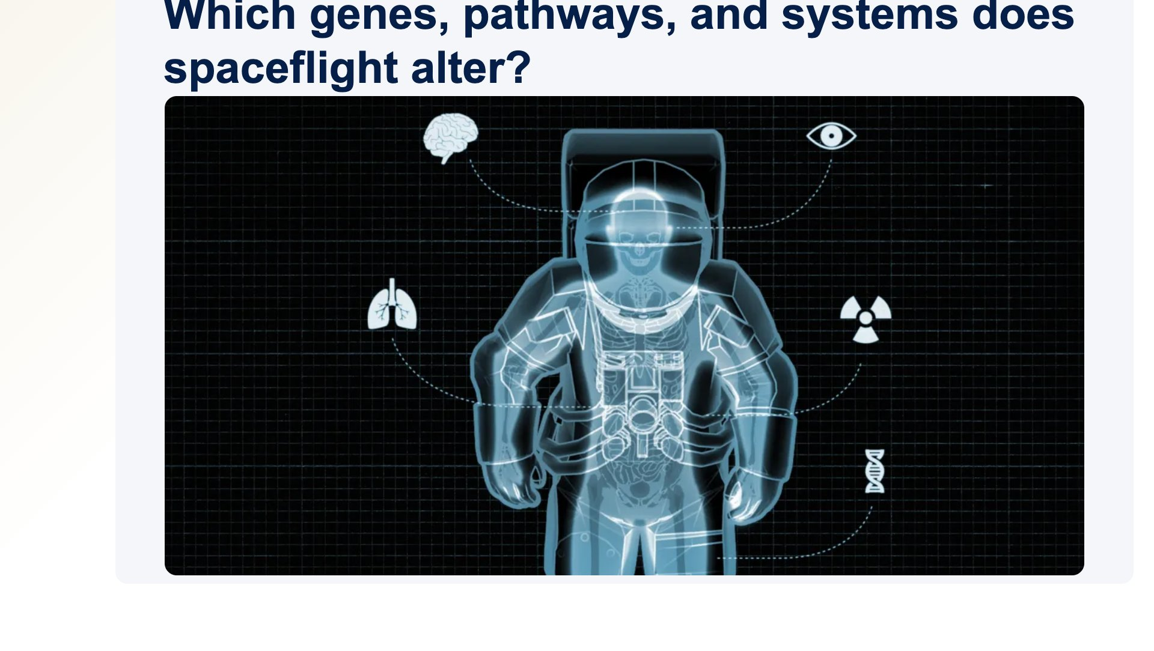
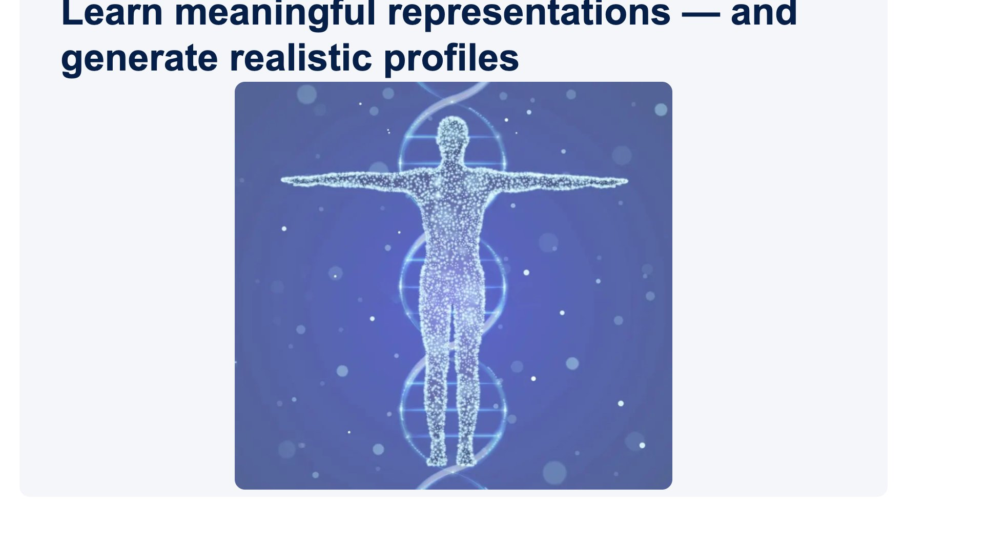
Notes:
The objective has two linked halves. First, understand the biology: which genes, pathways, and systems change when mice fly in space, comparing spaceflight to ground-control mice. Second, build models that learn meaningful representations of that biology and, eventually, generate realistic synthetic RNA-seq profiles. The first is discovery; the second is about making the most of a small, precious dataset. (~28s)

Slide 3
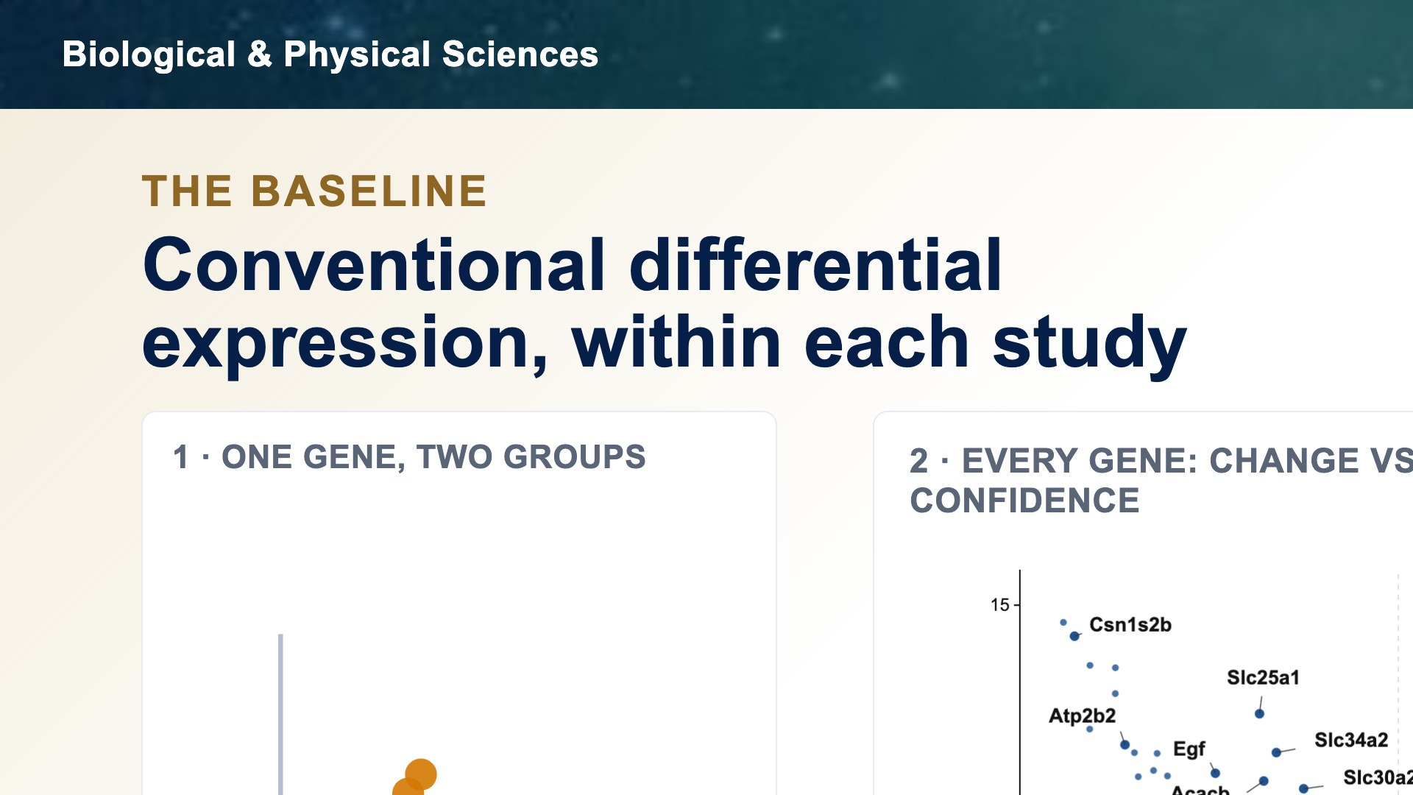

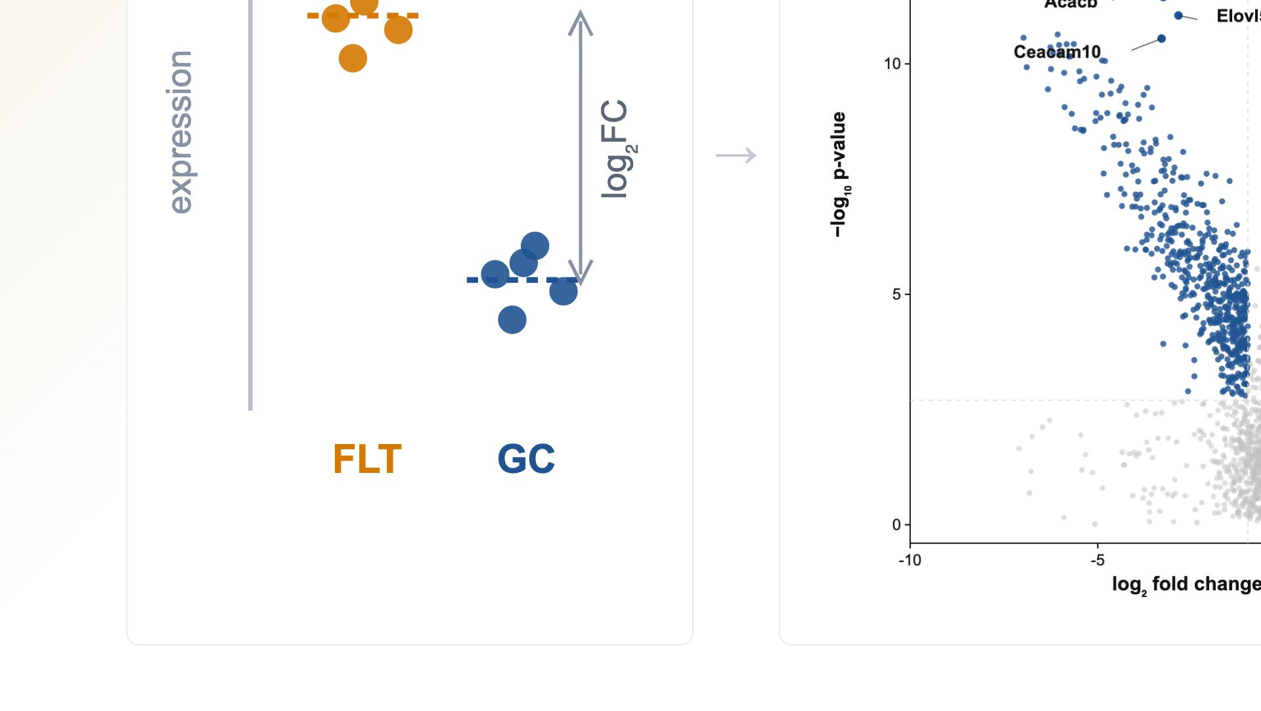
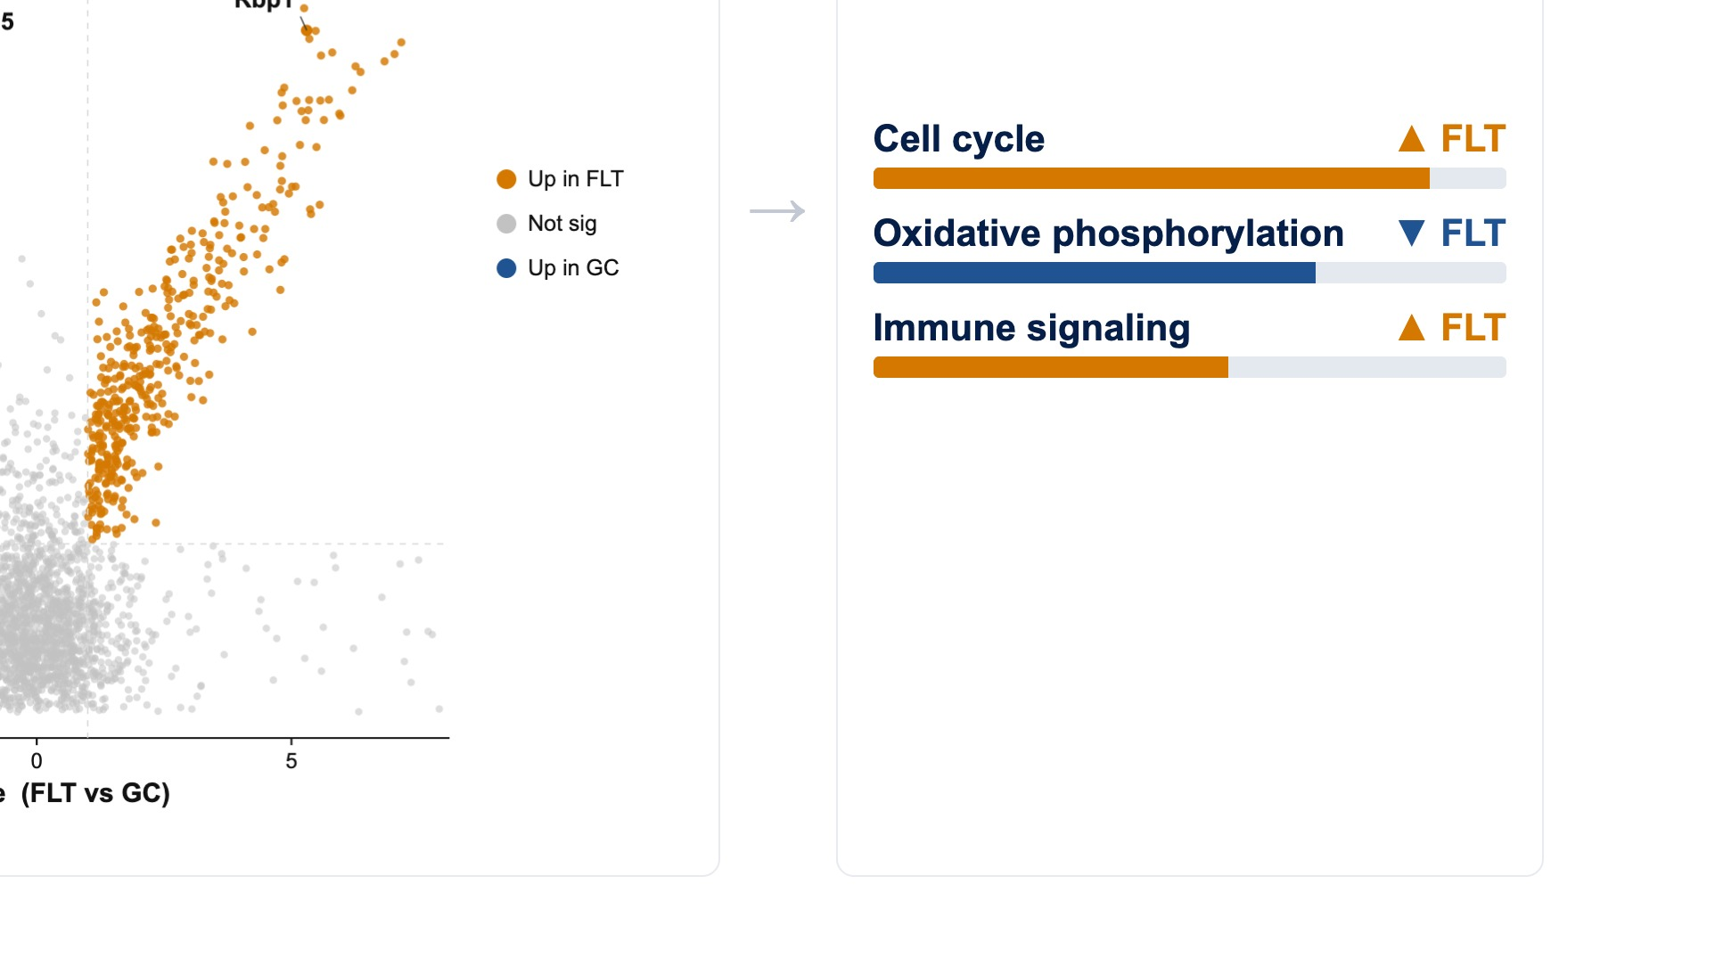
Notes:
Before any deep learning, the essential baseline is conventional differential expression. Within each study, we compare flight to ground control, rank the genes that change, and test which biological pathways those genes enrich — using Reactome and Metascape. The most trustworthy result is a pathway that recurs across independent studies. This approach is interpretable and it's the standard we hold every model to. Its limit is that gene-by-gene linear tests can miss coordinated, nonlinear programs — which is exactly where machine learning comes in. (~32s)

Slide 4
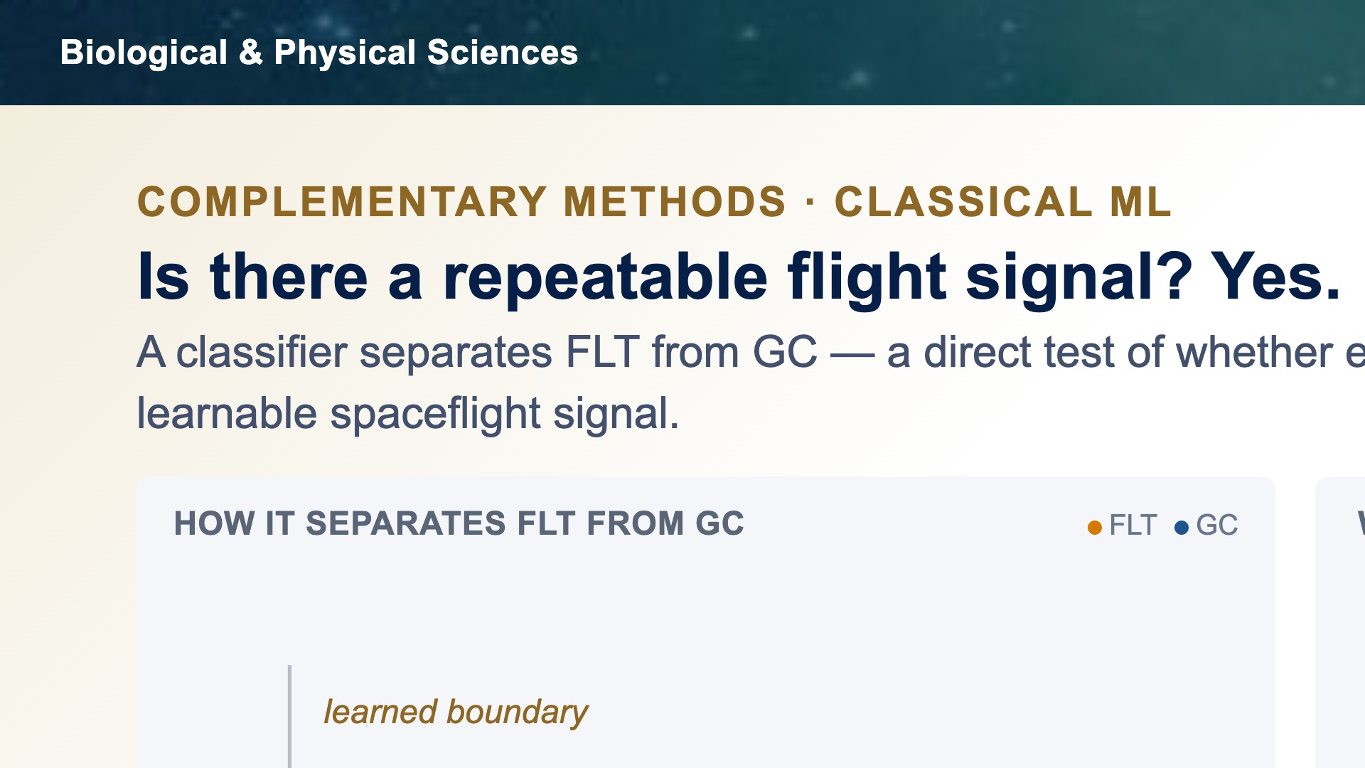

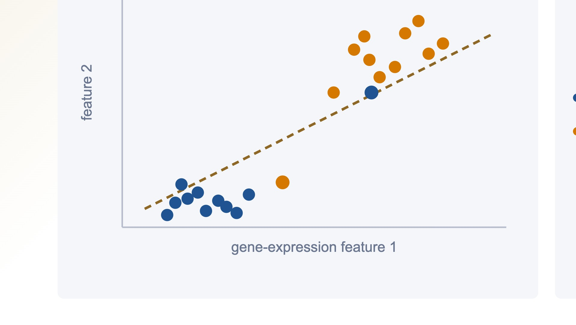
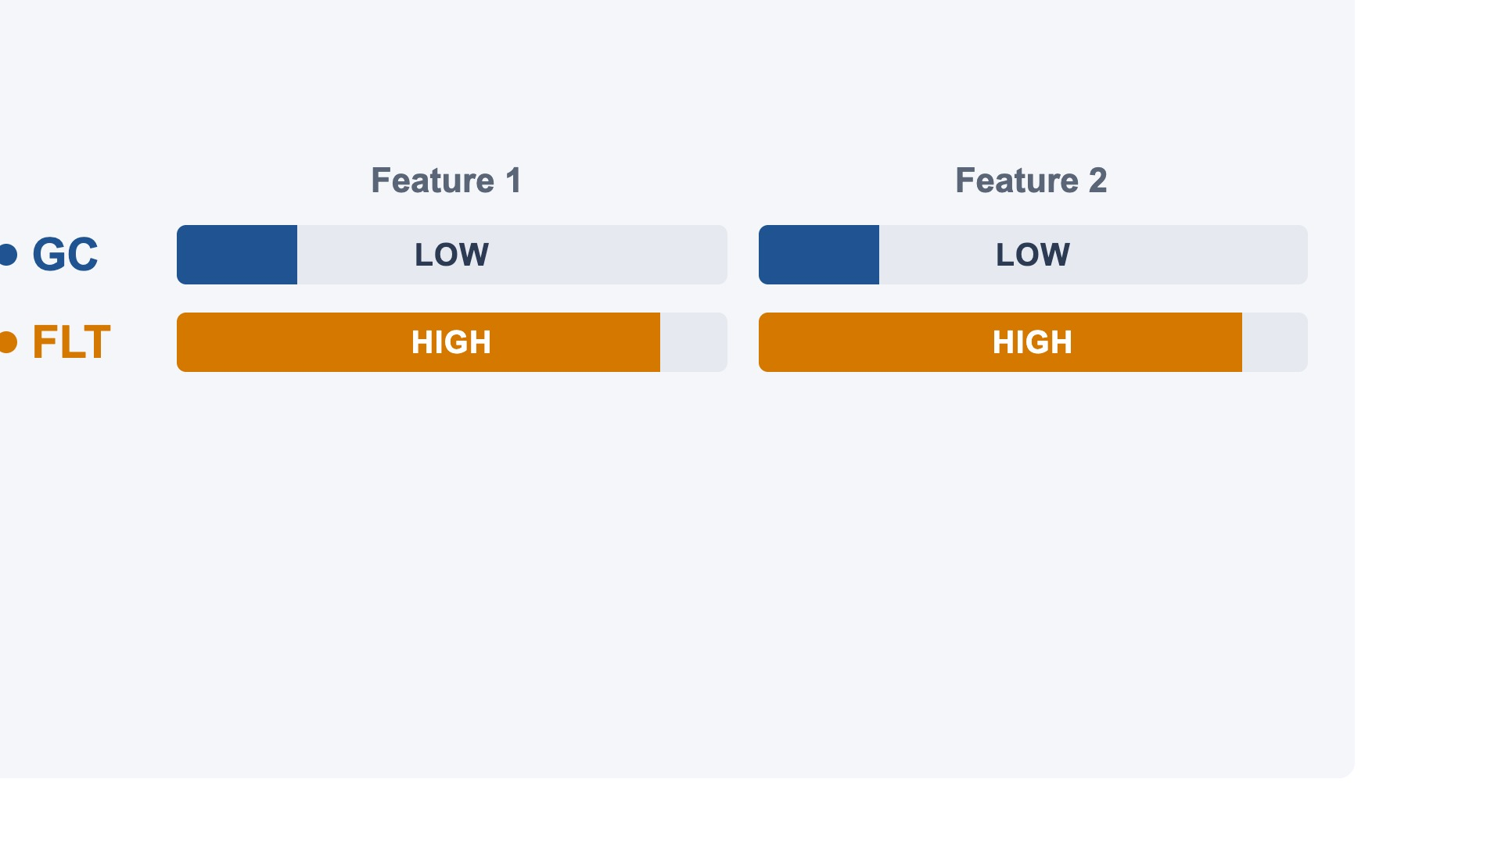
Notes:
The first complementary question is simple: is there a repeatable flight signal at all? To test it, we train a classifier to tell flight from ground control, and score it on held-out data so it can't just memorize. The answer is a clear yes. Across the well-covered tissues the classifier separates flight from ground almost perfectly — thymus and spleen essentially so — and it stays clearly above chance even across the small single-study scopes. We can also read out which genes drive the prediction. One honest caveat: high accuracy proves the states are separable, not yet which biology separates them — and some of that separability can come from the study itself, which I'll return to. (~46s)

Slide 5
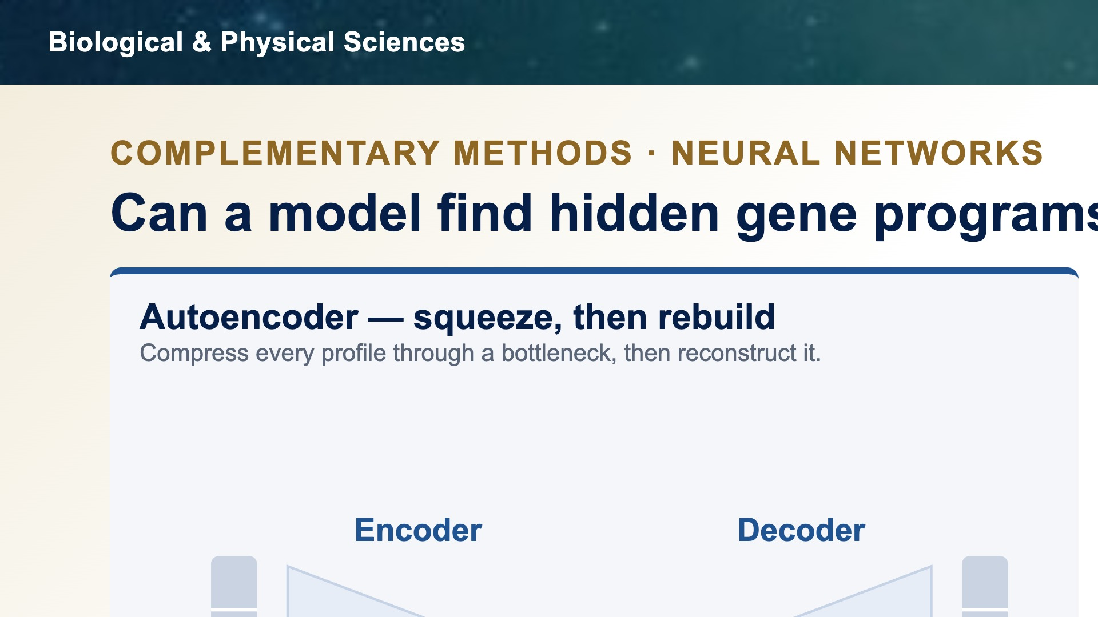
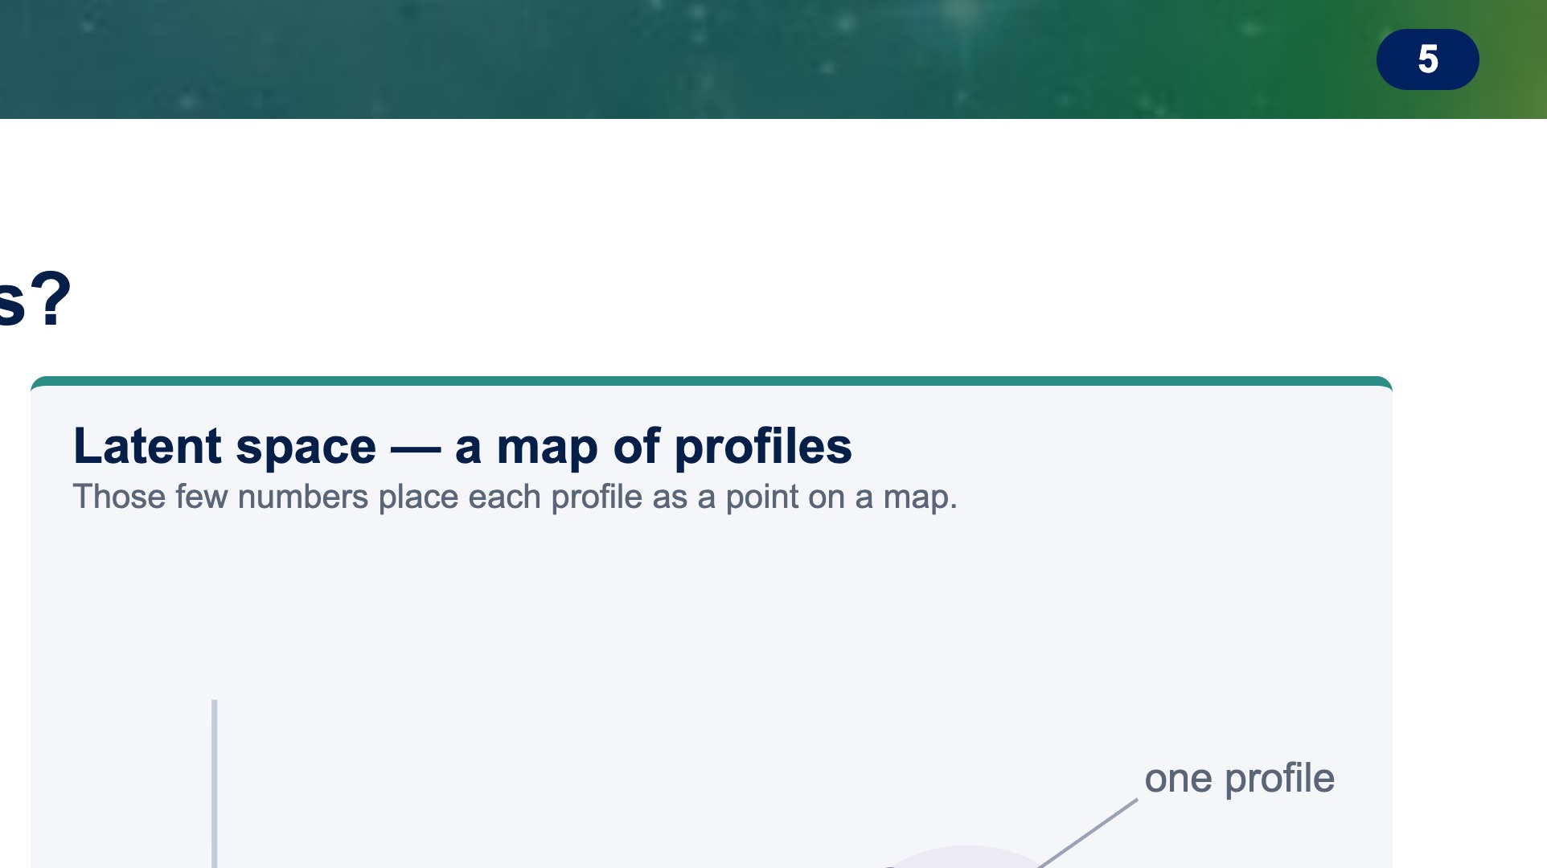
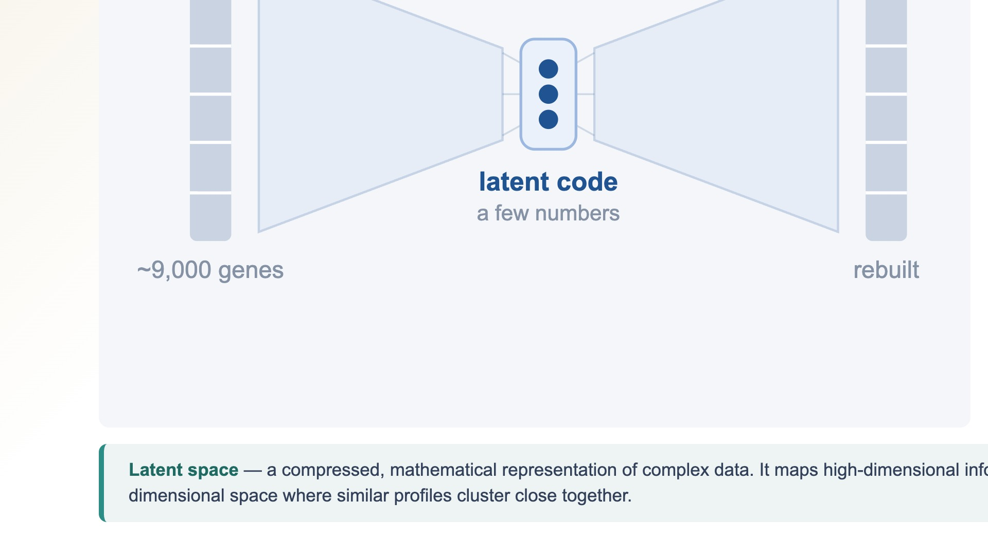
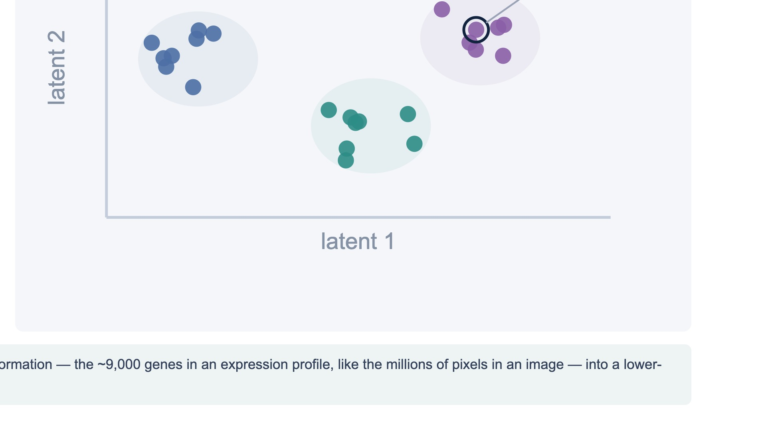
Notes:
Before the results, a quick primer for the biology folks. A neural network called an autoencoder does two things: an encoder squeezes each expression profile — thousands of genes — down through a narrow bottleneck into just a handful of numbers, and a decoder rebuilds the original profile from those few numbers. To reconstruct well, the bottleneck has to keep only the essential structure and drop the noise. Those few numbers are the latent code, and the space they live in is the latent space — think of it as a map where every RNA-seq profile is a single point, and profiles with similar biology land near each other. The axes are not single genes; they are learned combinations of many genes. The bet is simple: if spaceflight is the strongest signal in the data, flight and ground profiles should separate in that map on their own, without ever being told which is which. (~38s)

Slide 6
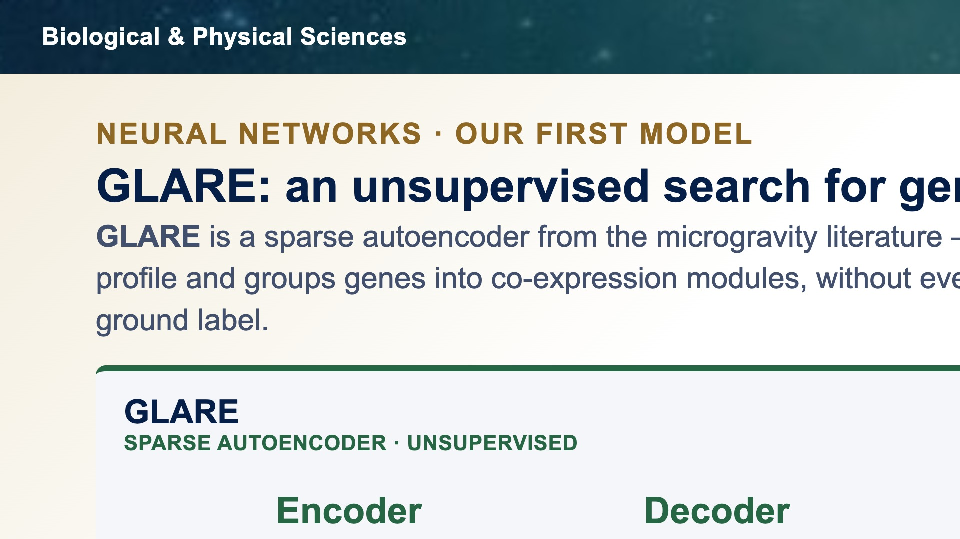
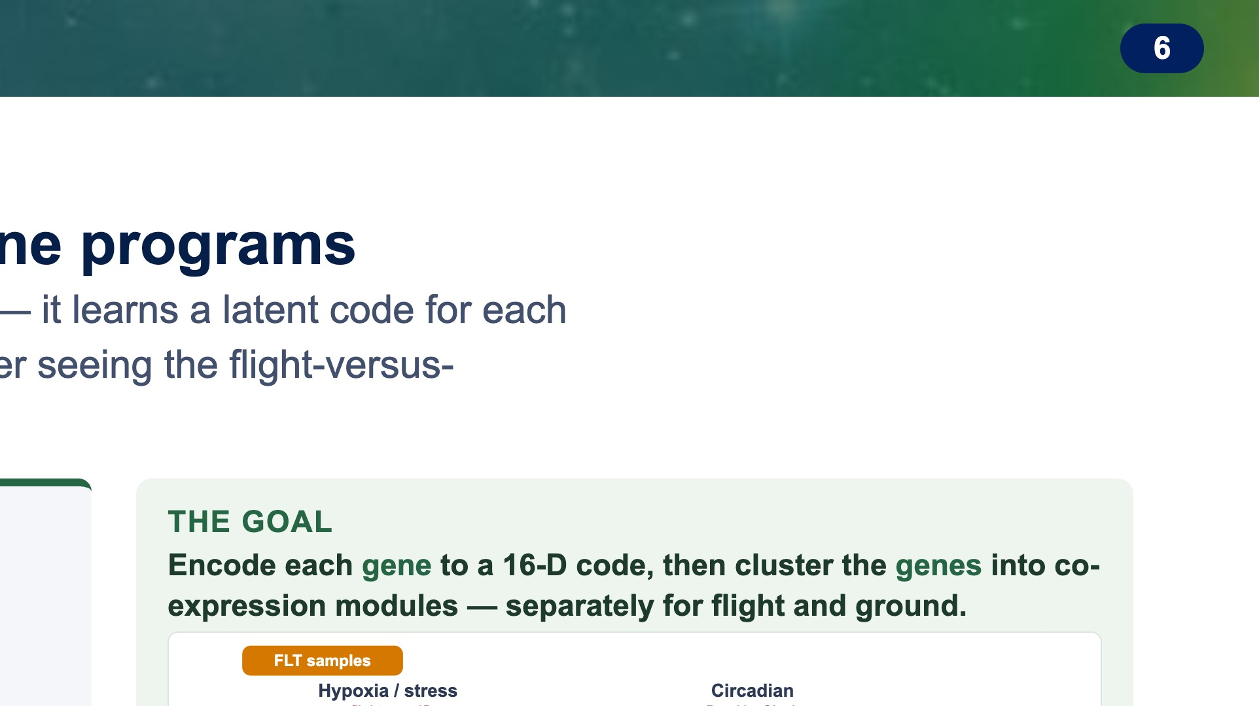
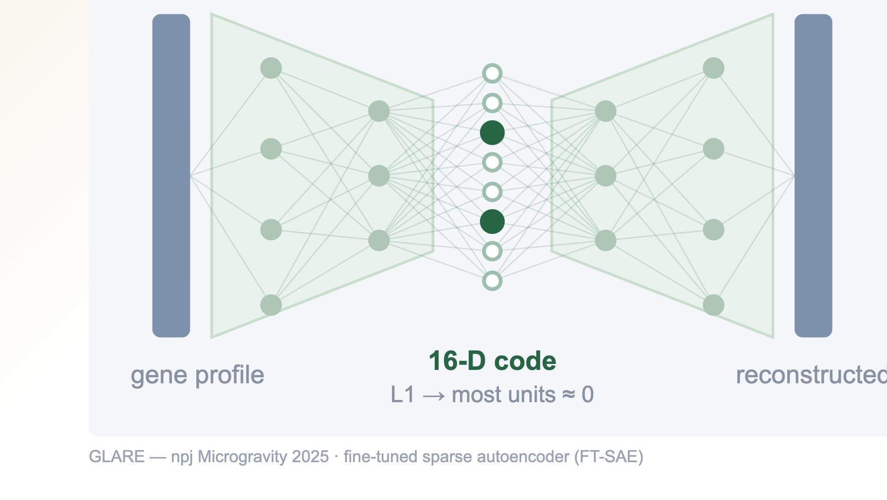
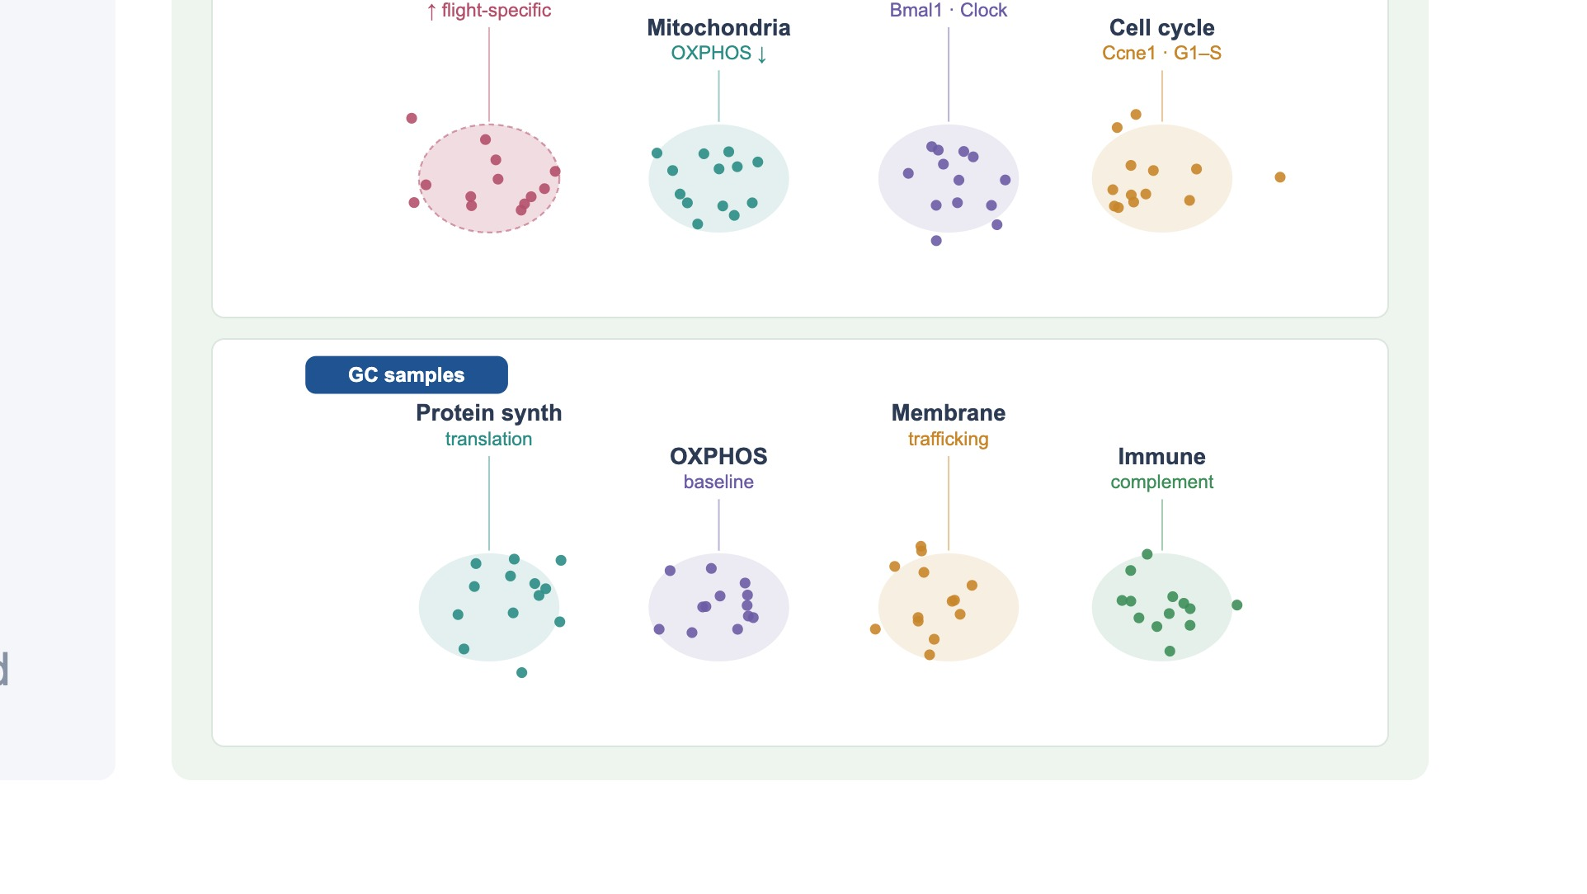
Notes:
Our first model is GLARE, a representation-learning model from the microgravity literature. It is a deep sparse autoencoder: it compresses about nine thousand genes down through a narrow bottleneck and reconstructs them, and the compressed code is a learned representation of each profile. Crucially it is unsupervised — it never sees the flight-versus-ground label. The hope was that if we cluster that learned code, hidden co-expression modules would emerge on their own, and flight and ground would pull apart without being told to. Because it is label-blind, it is an honest test: if spaceflight is the strongest structure in the data, GLARE should surface it. (~42s)

Slide 7
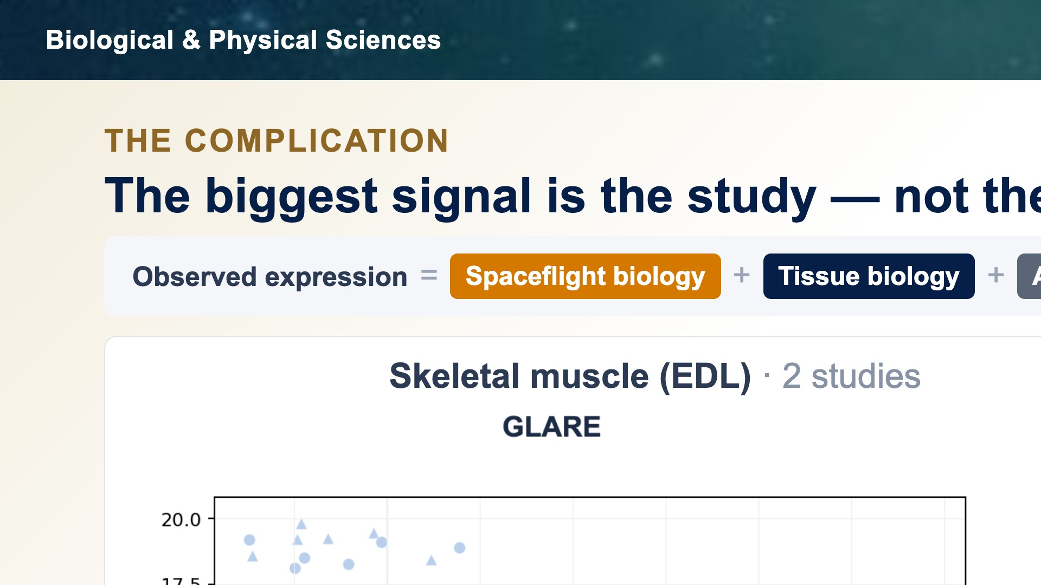
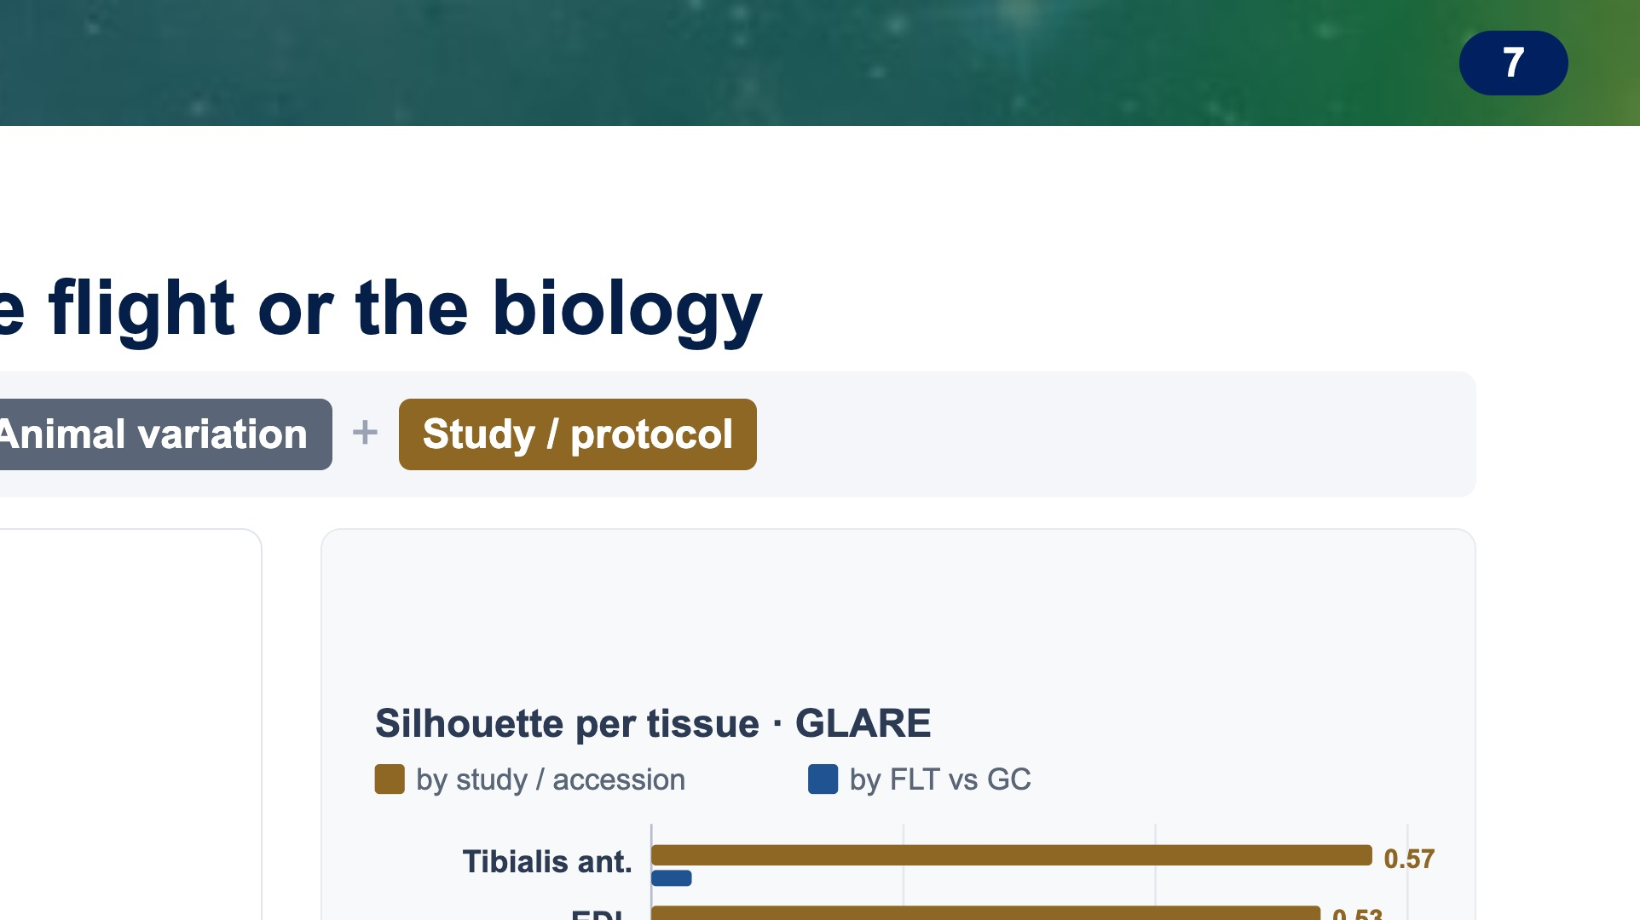
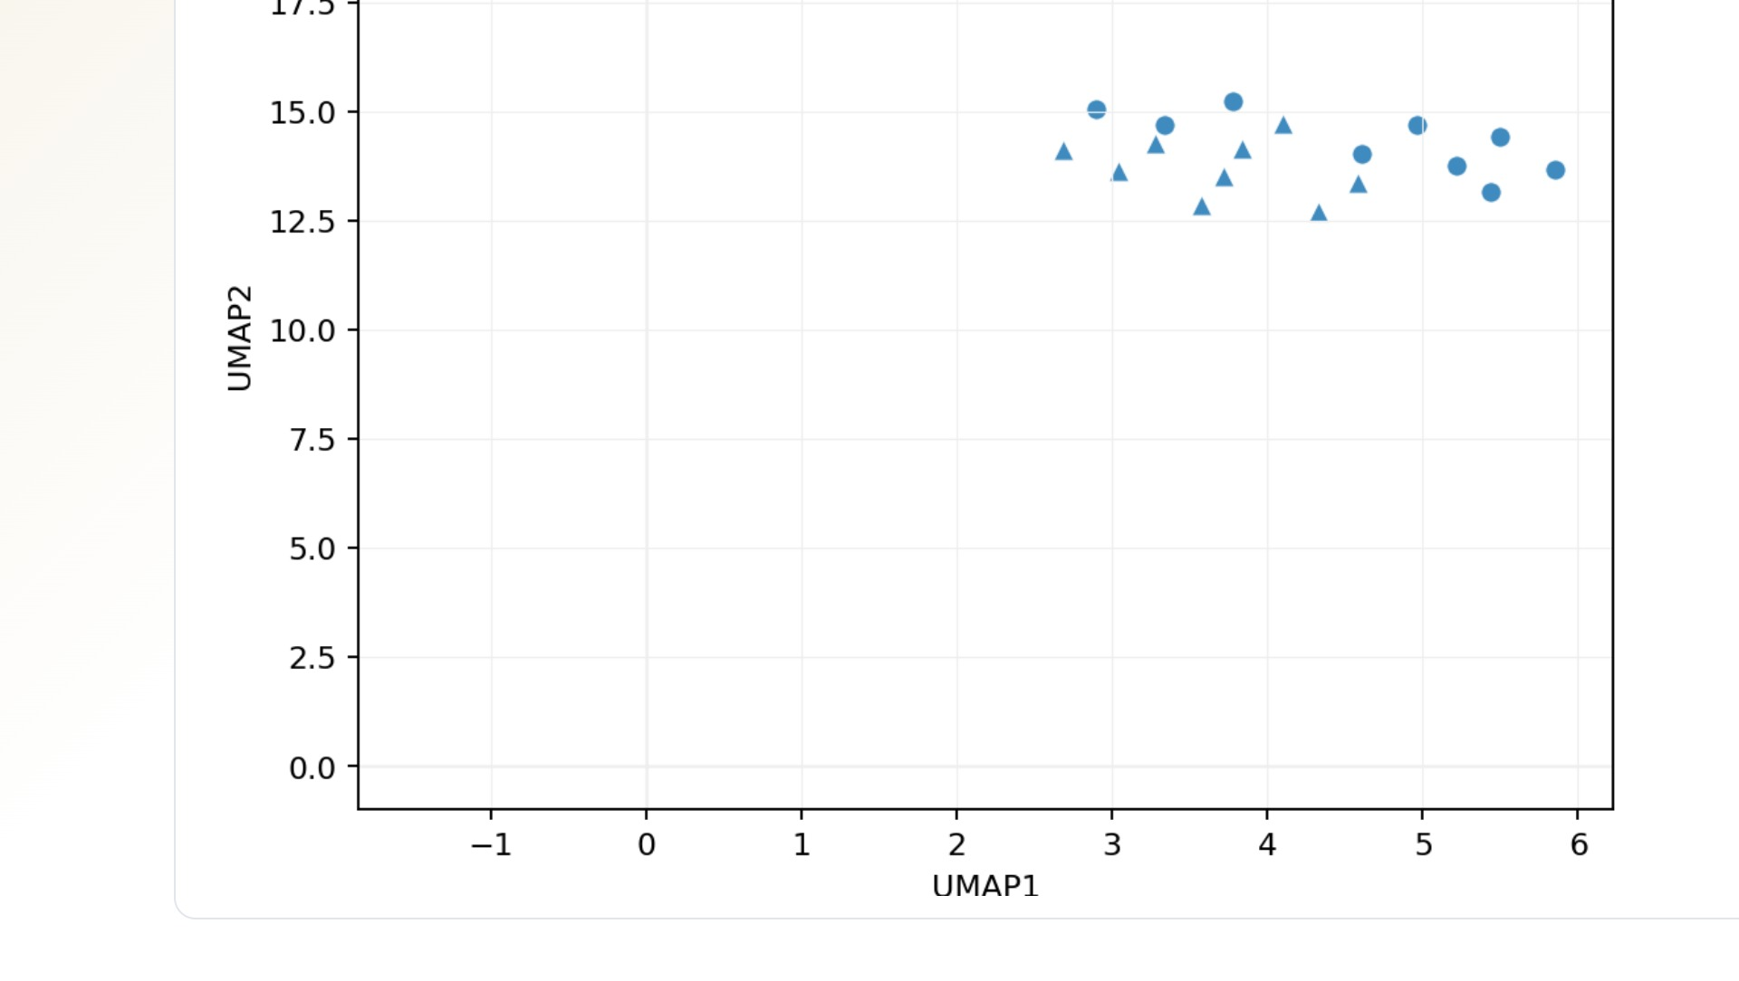
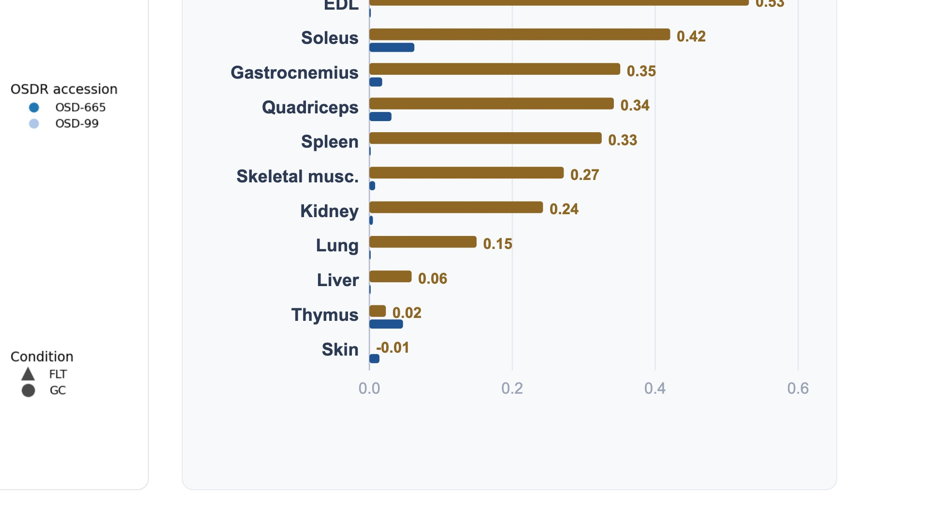
Notes:
Here is what actually happened, and it is the pivot of the whole talk. When we run unsupervised GLARE on the pooled data, samples cluster by study of origin, not by flight. In skeletal muscle it is stark: only two studies, and they split into two clear clusters, while flight and ground stay intermixed inside each. Color is the study. (~20s)

Slide 8
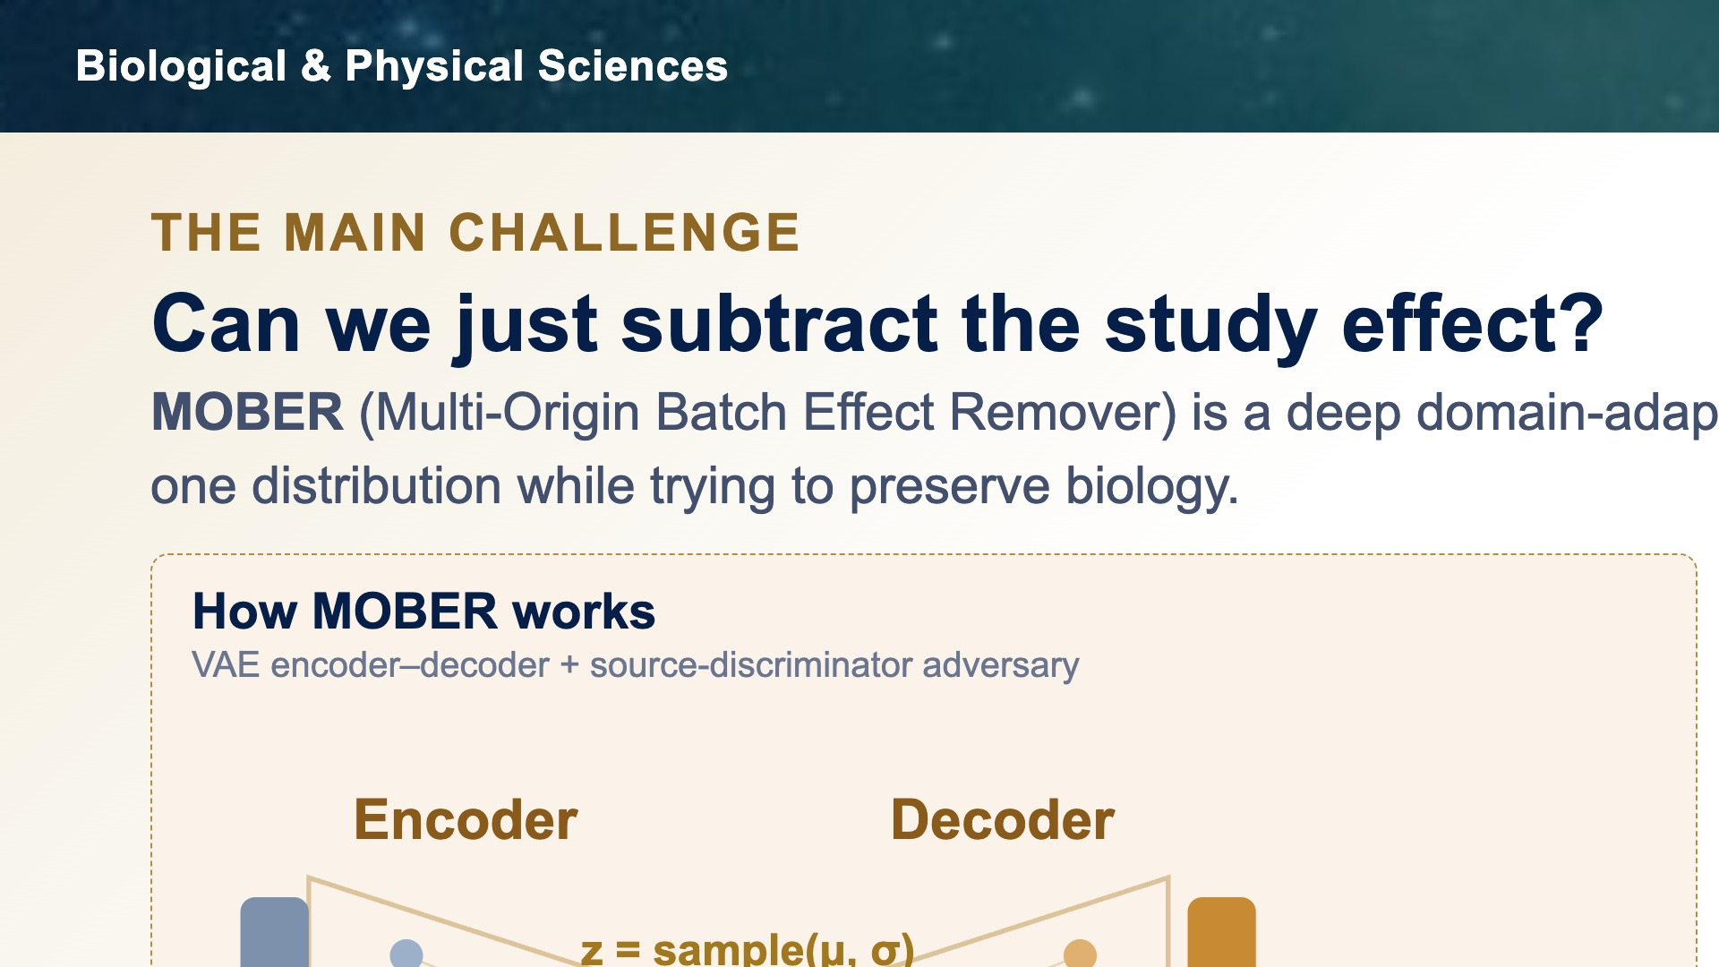

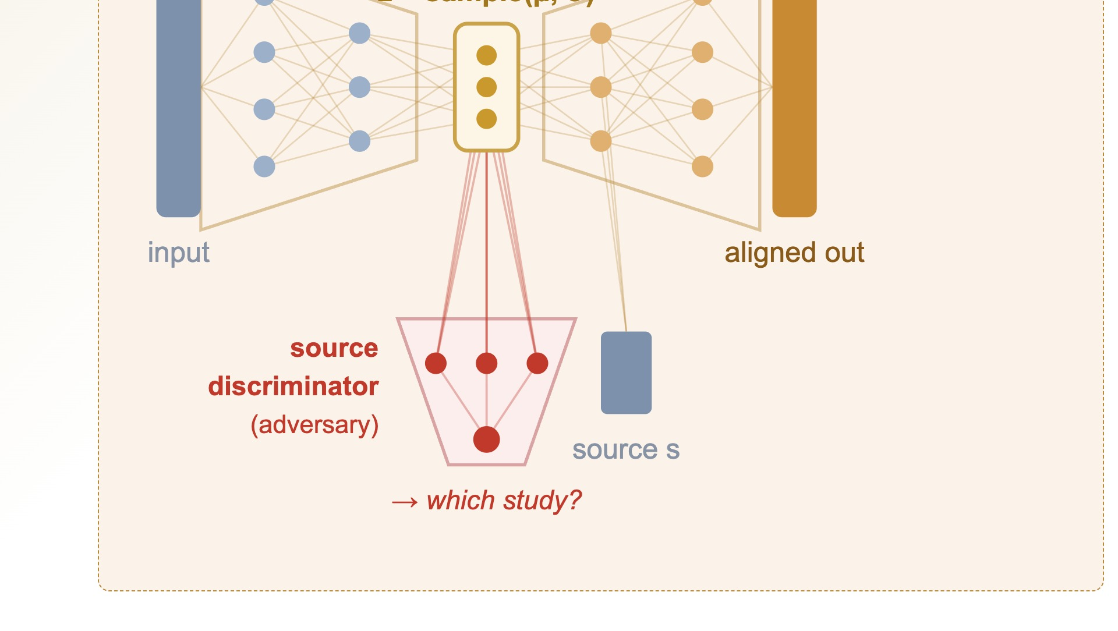

Notes:
The obvious response to the study problem is to remove it — so we're testing MOBER, the Multi-Origin Batch Effect Remover. Architecturally it's an autoencoder with an adversarial twist: an encoder compresses each profile to a latent z, a decoder reconstructs it, and a source discriminator tries to guess which study the sample came from. Training the encoder to fool that discriminator should scrub out study identity while the decoder preserves biology. The animation shows the intent — three separate study clusters pulled into one shared distribution. The real question is whether it works without erasing signal. (~42s)

Slide 9
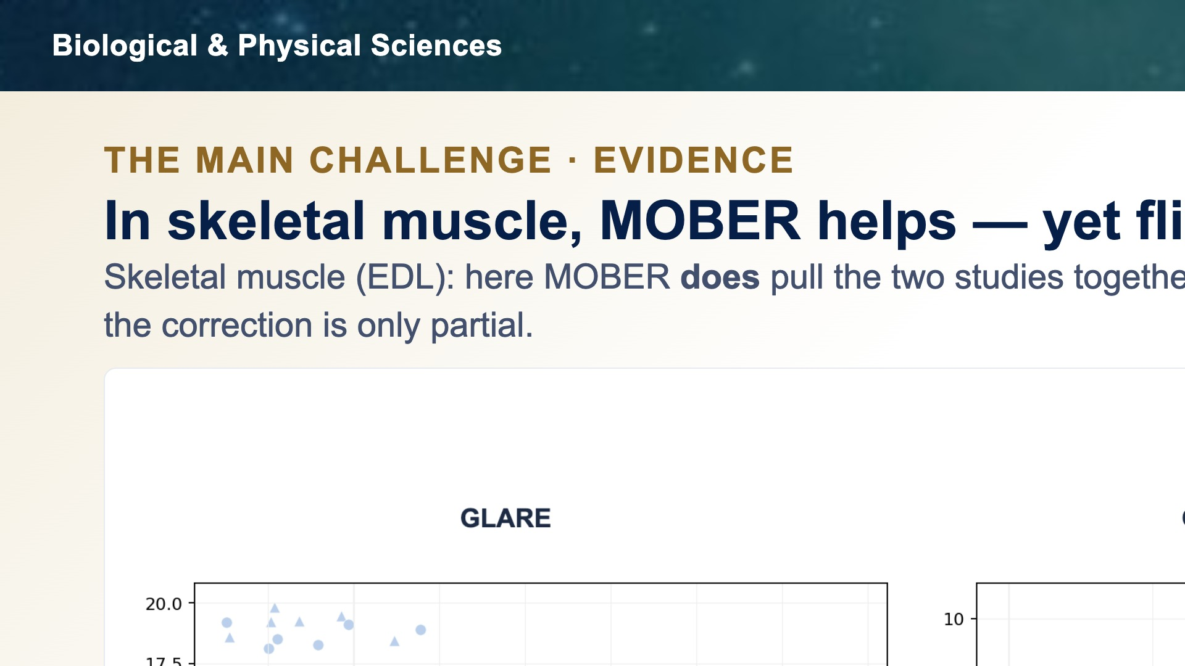

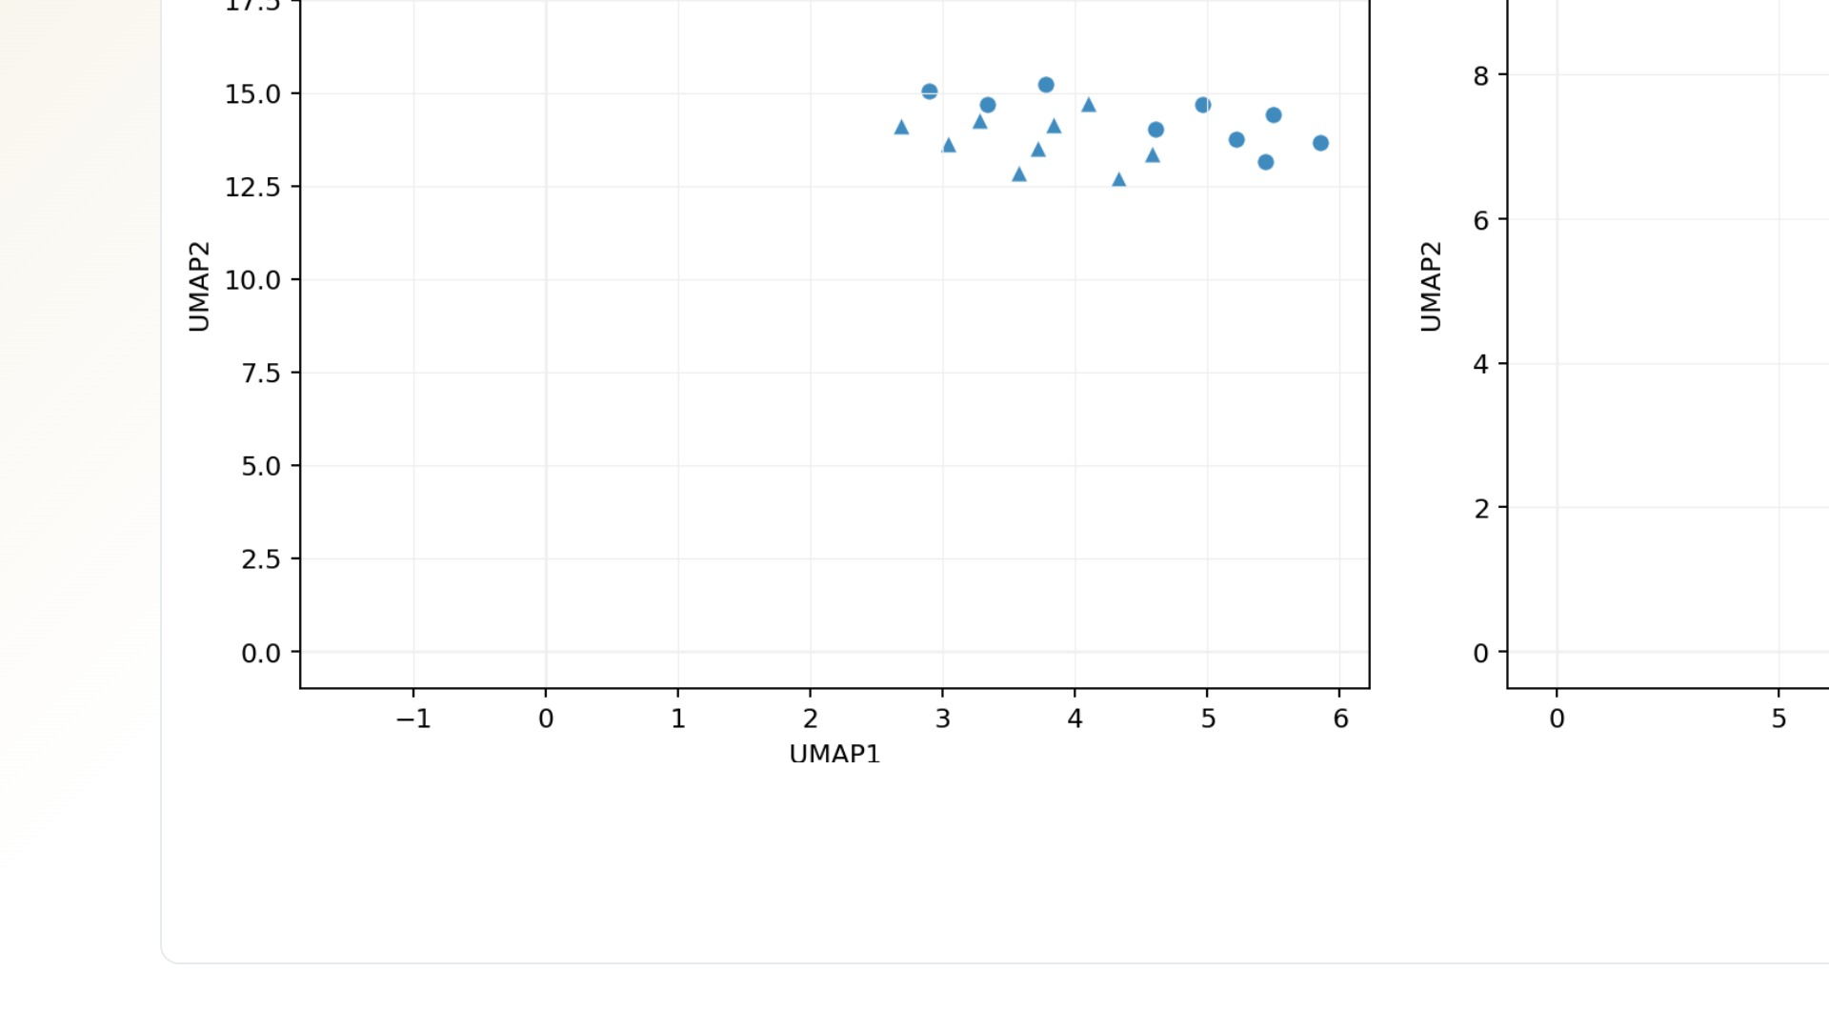
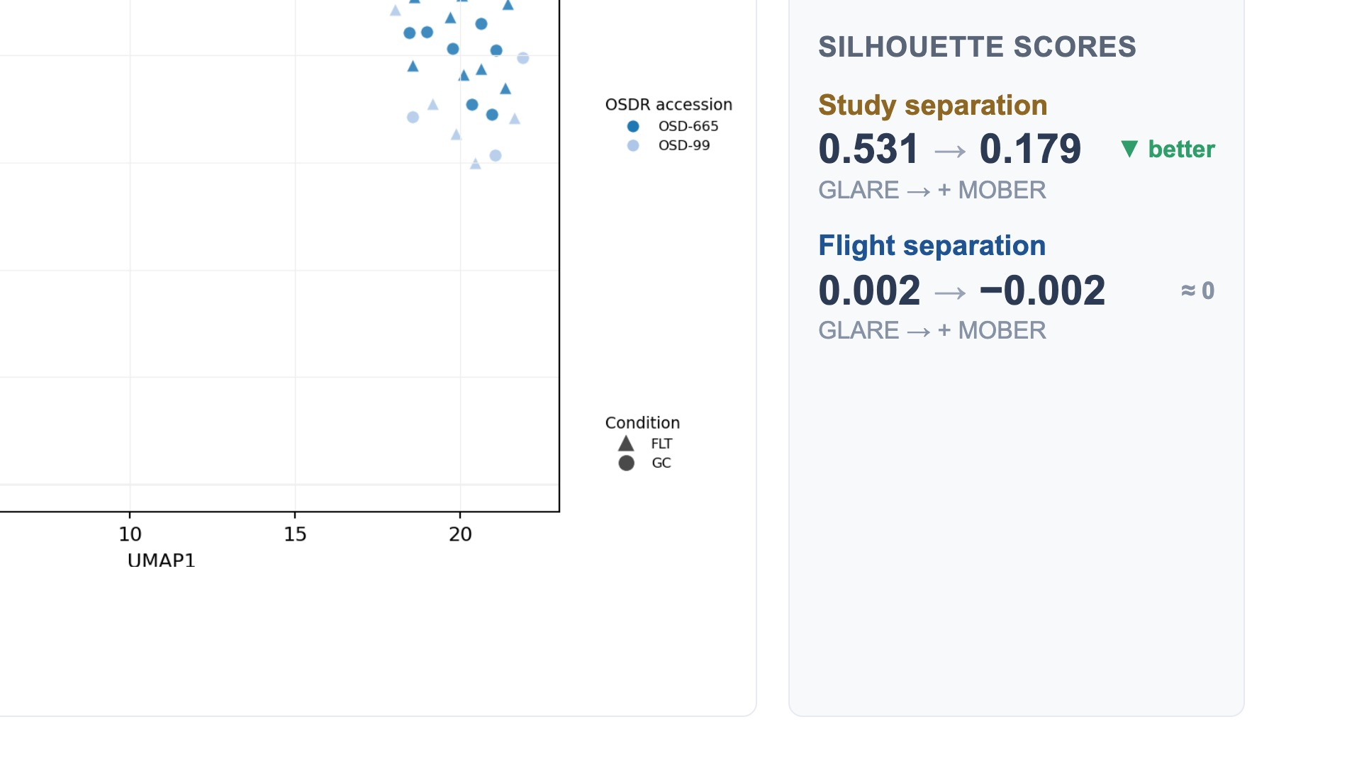
Notes:
This is the before-and-after analysis for skeletal muscle — the EDL — and it's why we call MOBER ambiguous rather than broken. Here MOBER actually moves in the direction we want: before correction the two studies sit in completely separate clusters, with a very high study silhouette of 0.53; after MOBER that falls to 0.18, so the studies really do mix better. But look at the flight signal — the condition silhouette starts at essentially zero and stays at zero, even slightly negative. So even in the tissue where MOBER most clearly reduces the batch effect, no spaceflight signal emerges in this space. So even when MOBER clearly reduces the batch effect, it never surfaces a flight signal — which is exactly why we treat batch correction as an open problem, not a solved preprocessing step. (~40s)

Slide 10
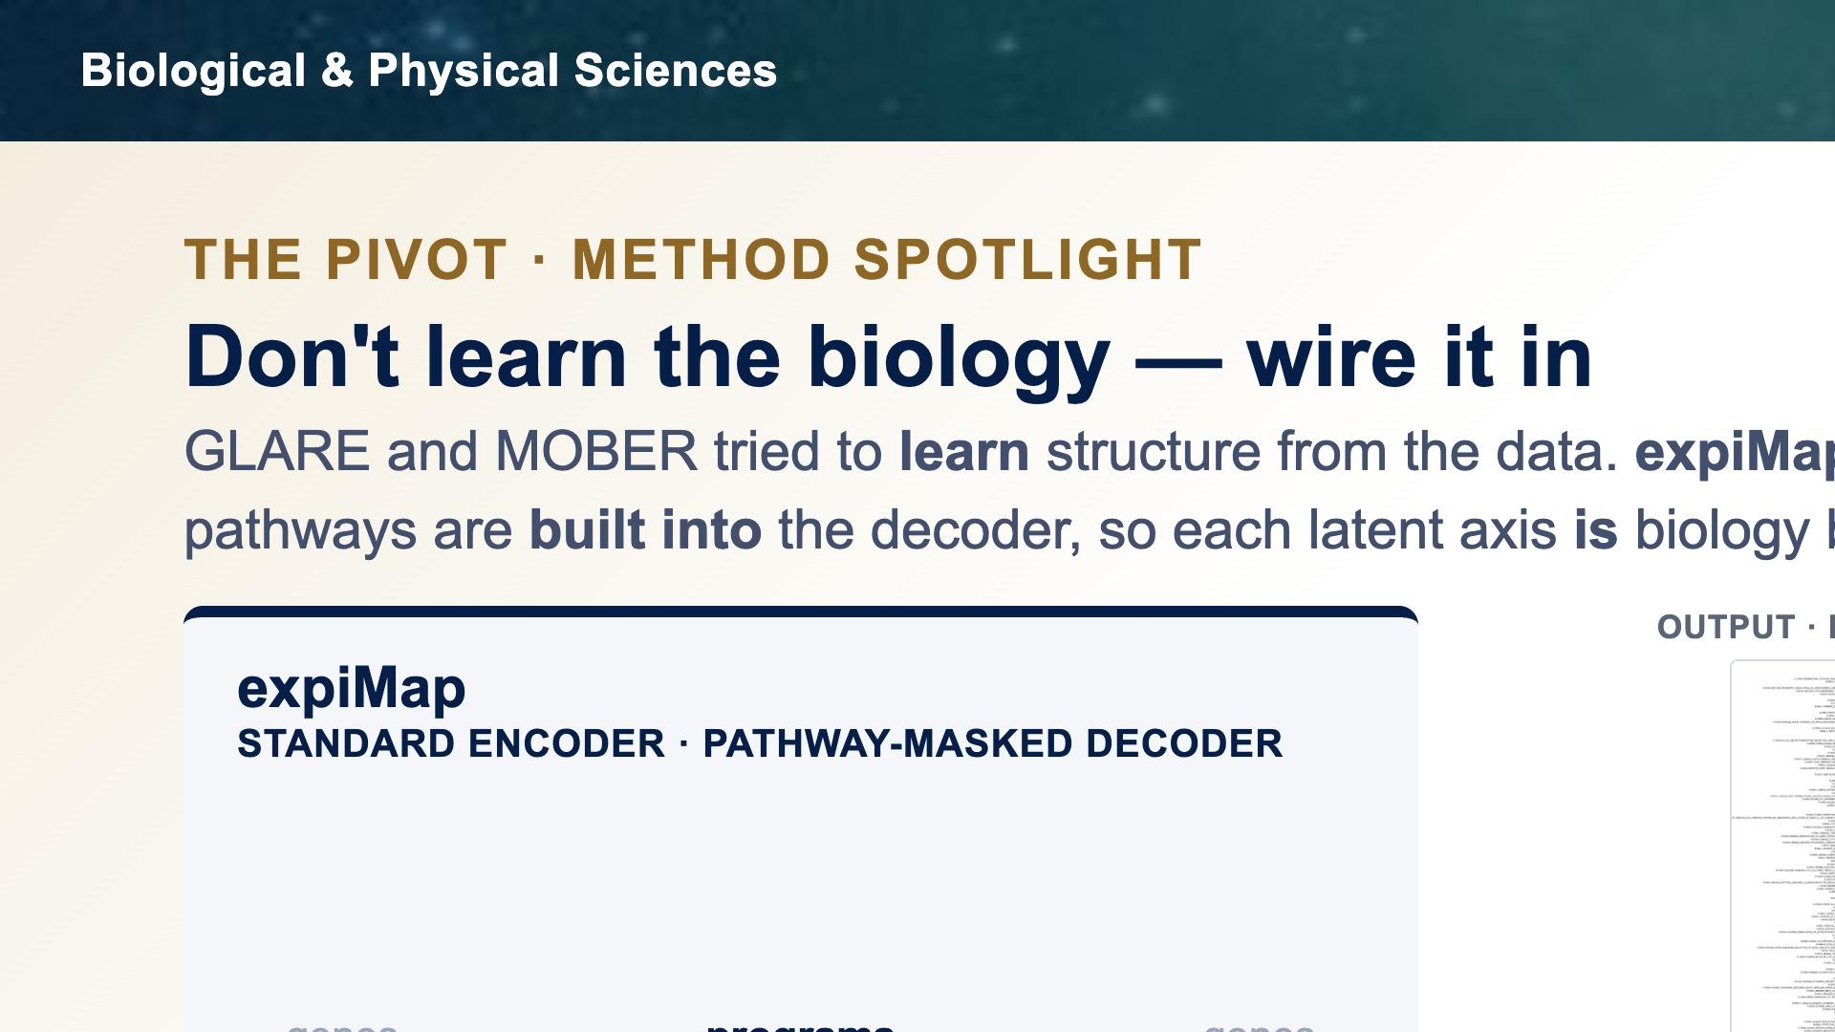

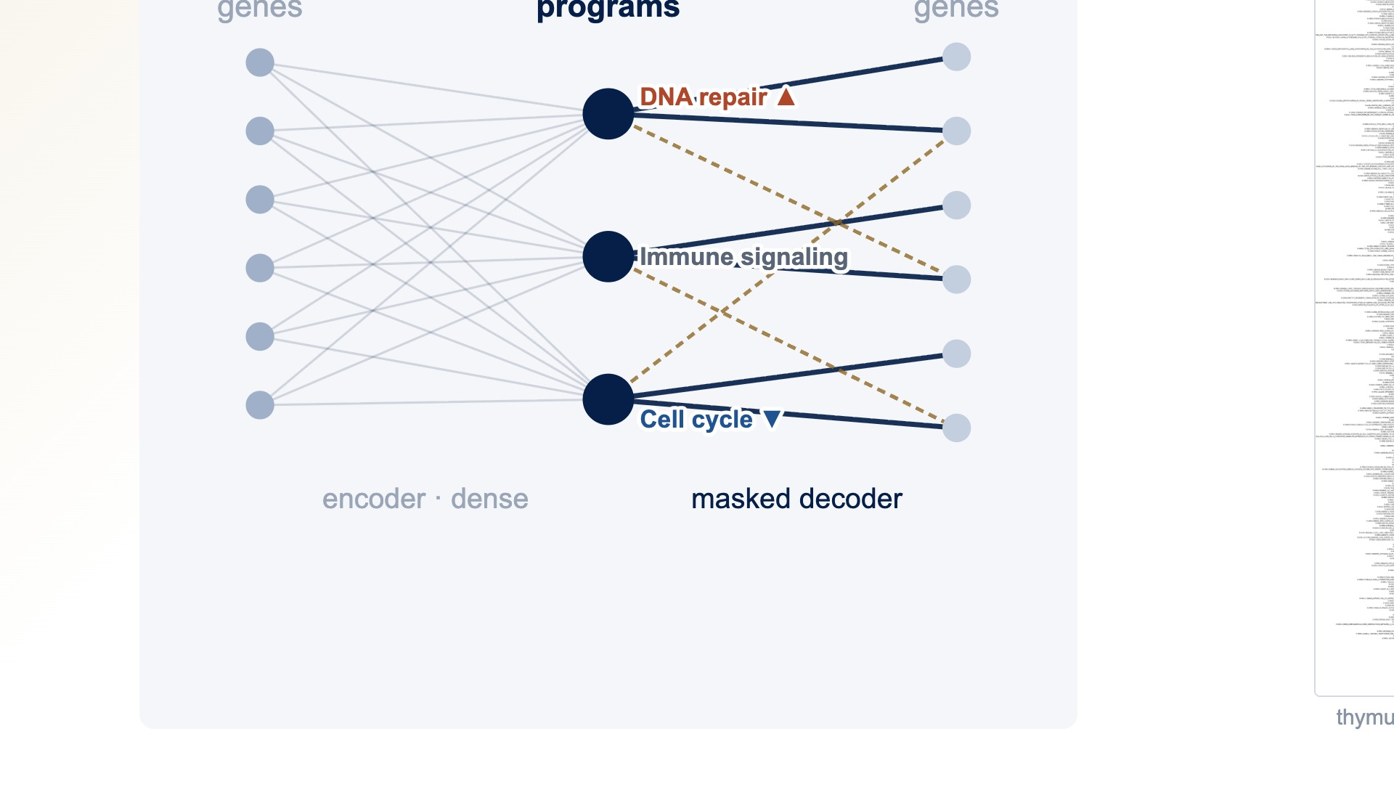
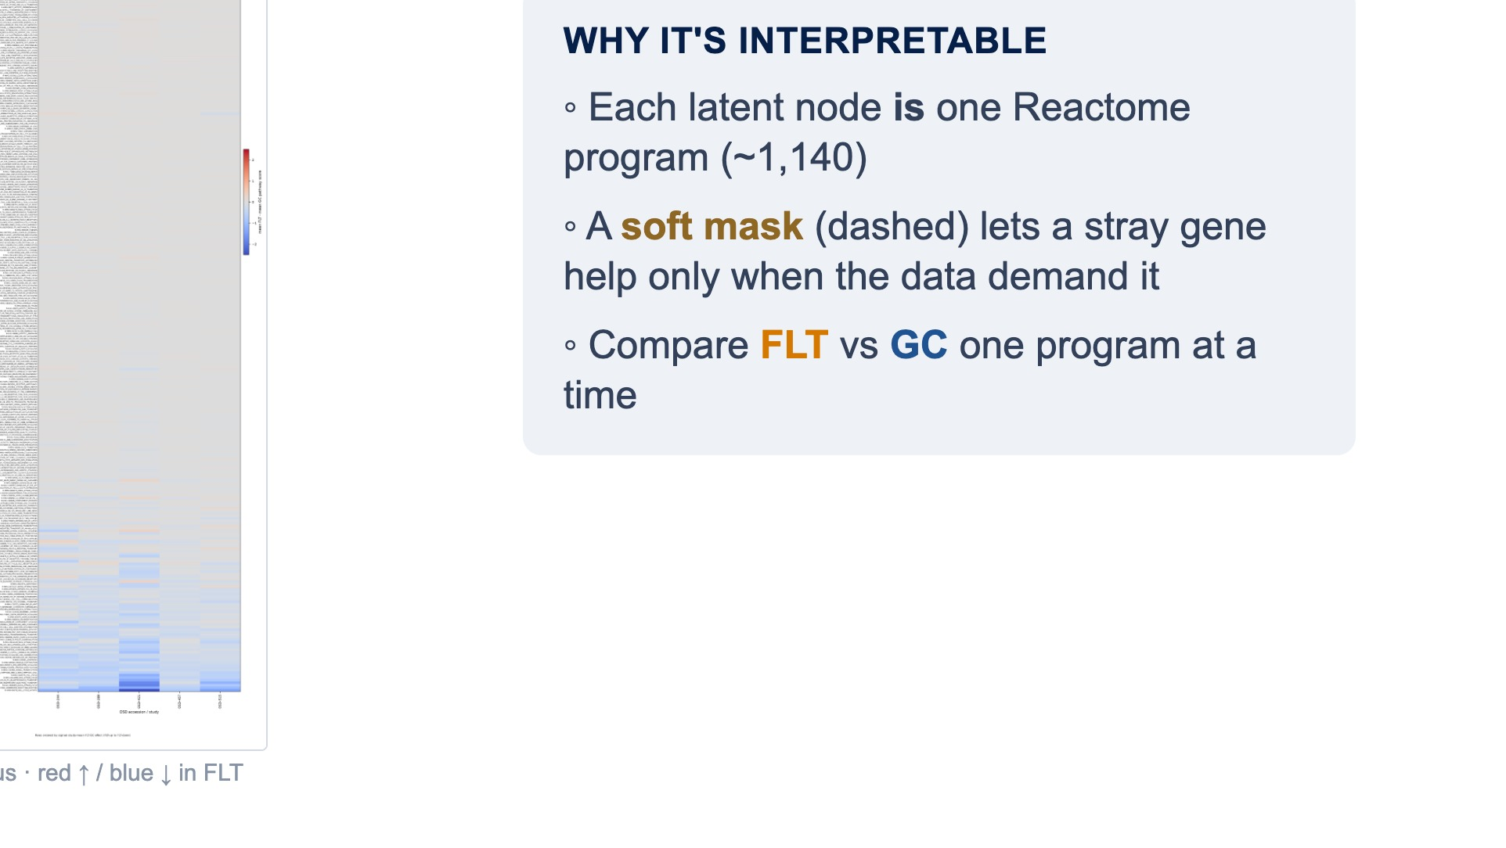
Notes:
So instead of learning a free latent space and hoping the study effect stays out, we change strategy: we wire the biology into the model from the start. That is exactly what expiMap does. A normal autoencoder compresses genes into anonymous latent numbers. expiMap masks the network so that each latent node connects only to the genes in one known Reactome pathway — so every latent variable is a named pathway program, roughly eleven hundred of them. A soft mask lets a gene outside a program pick up a small weight only when the data really demand it, shown by the dashed lines. The network estimates how active each program is in every sample, and we compare flight versus ground one program at a time. The axes are biology by construction, so study structure can't masquerade as an anonymous latent factor. (~46s)

Slide 11
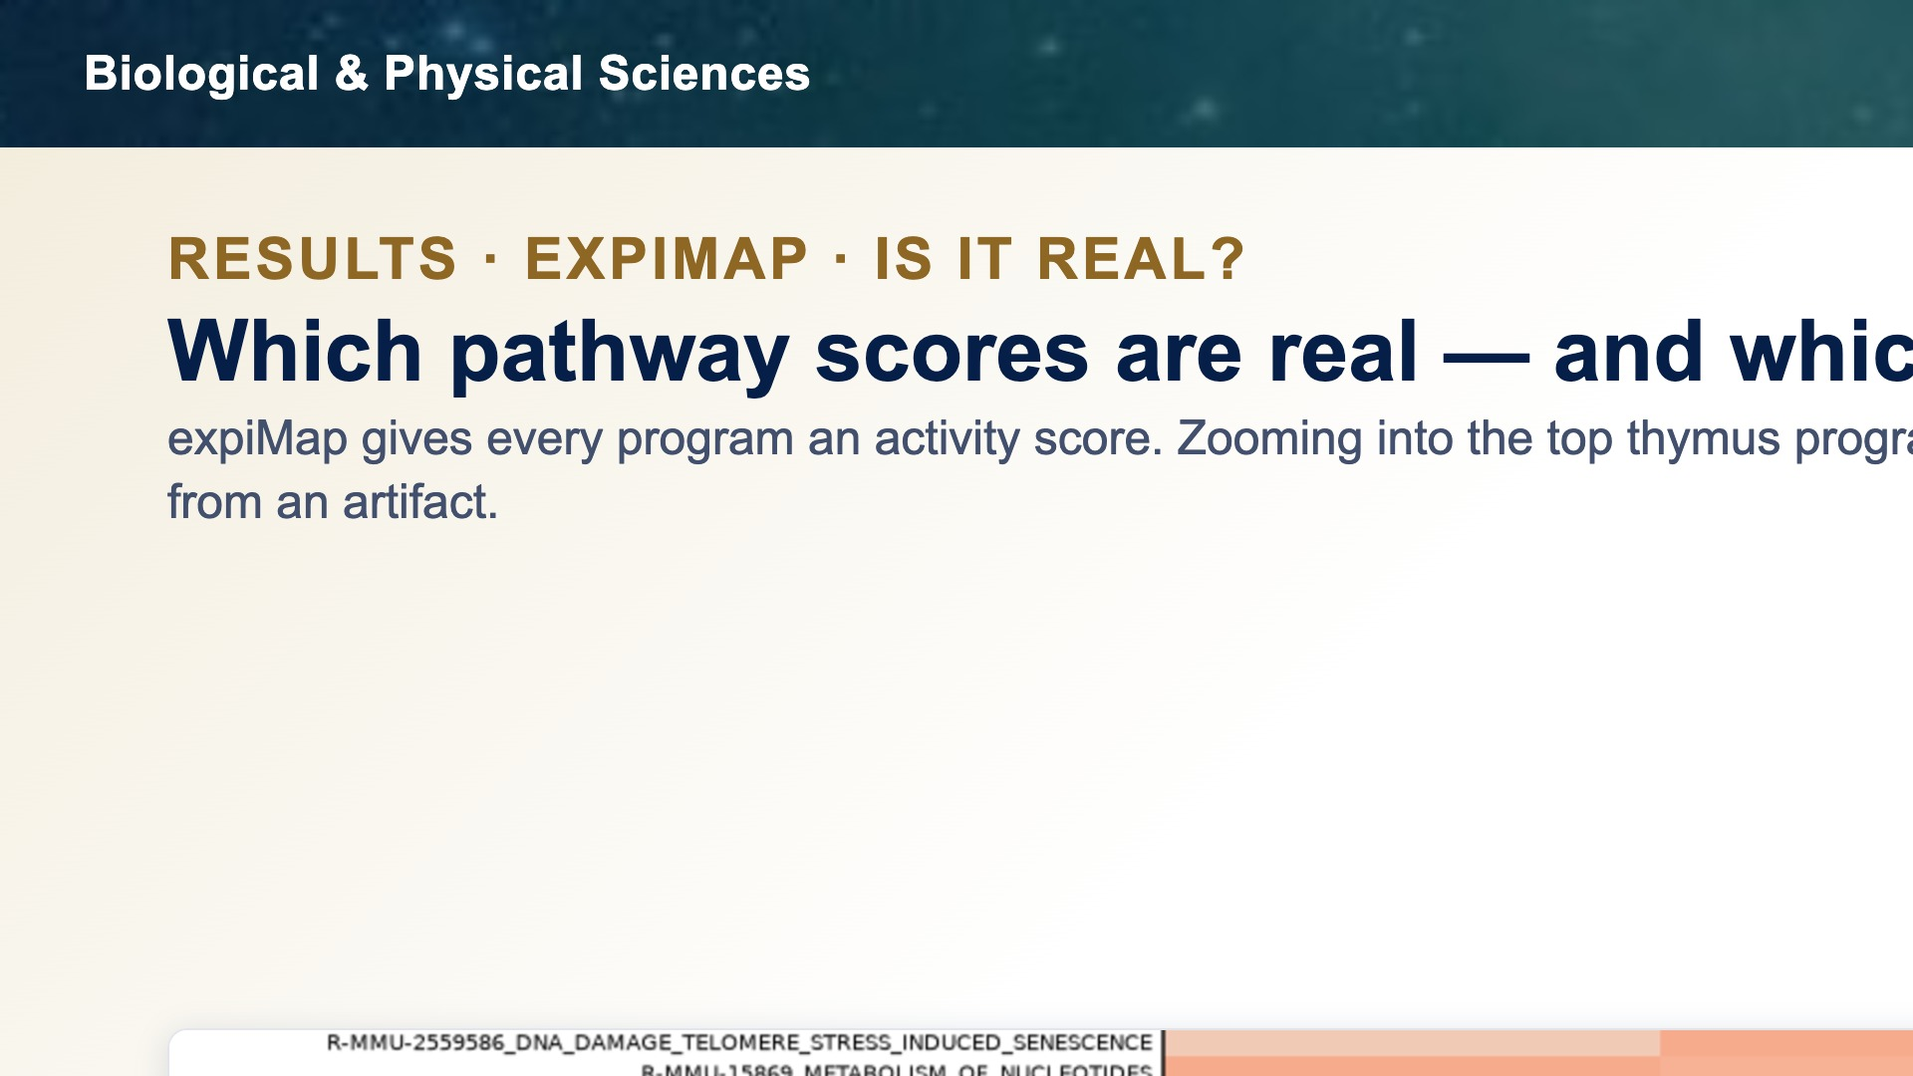
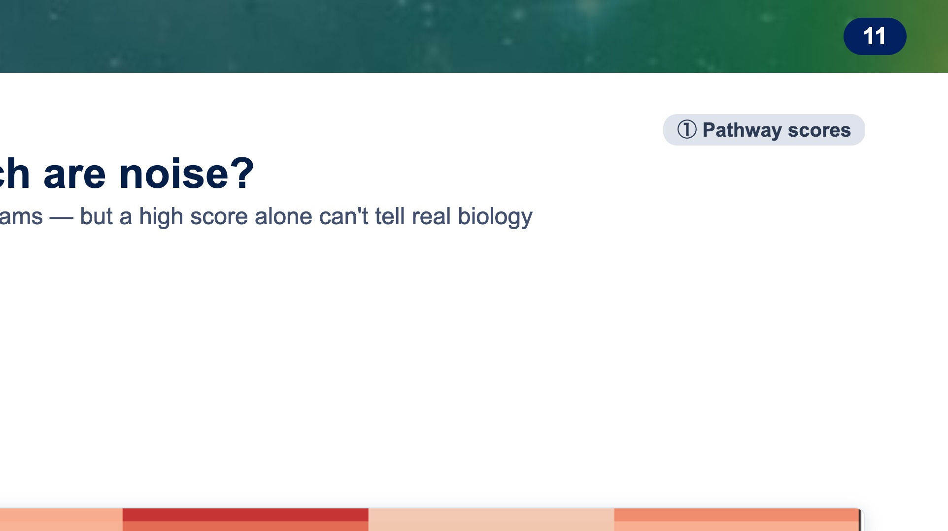
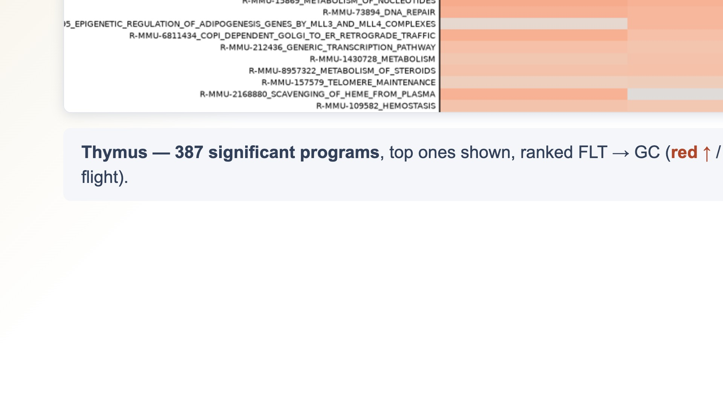
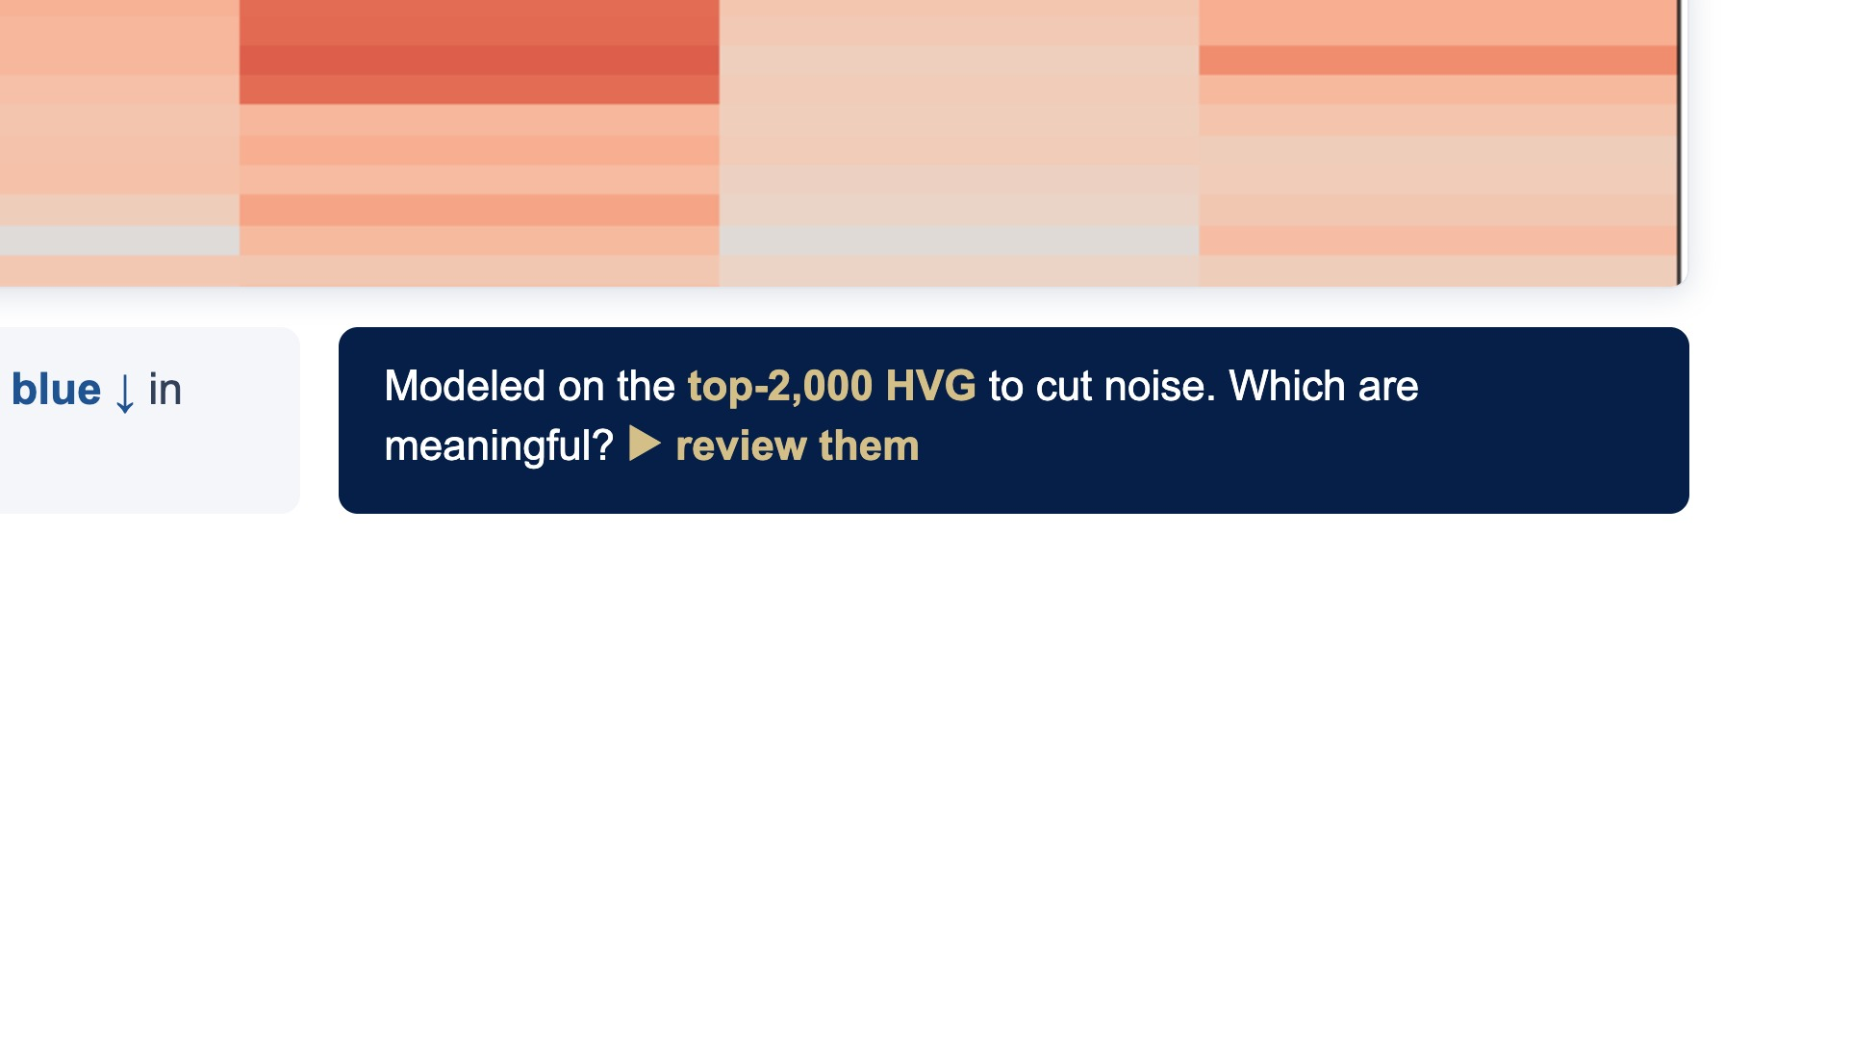
Notes:
expiMap scores every pathway program. For thymus, about three hundred ninety come out significant, and here are the top ones, ranked flight-versus-ground — red is up in flight, blue down. Two things matter before we read into them: we model only the top two-thousand highly variable genes, not all protein-coding genes, to cut flat signal; and a high score by itself doesn't tell us whether a program is real biology or an artifact. So the question is — which of these are meaningful? (~24s)

Slide 12
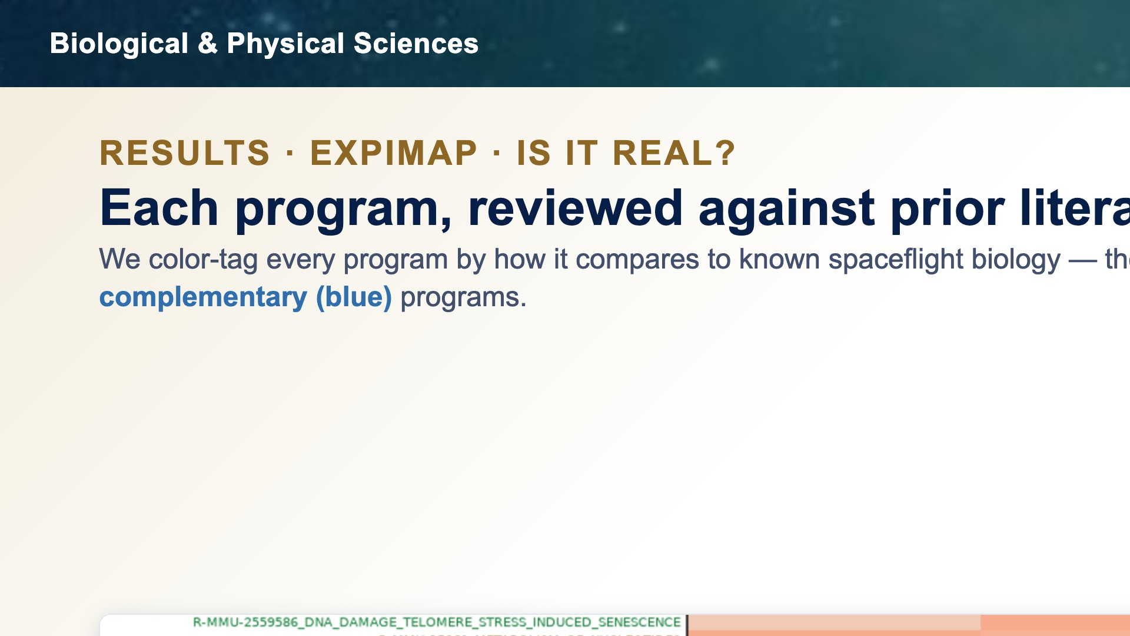

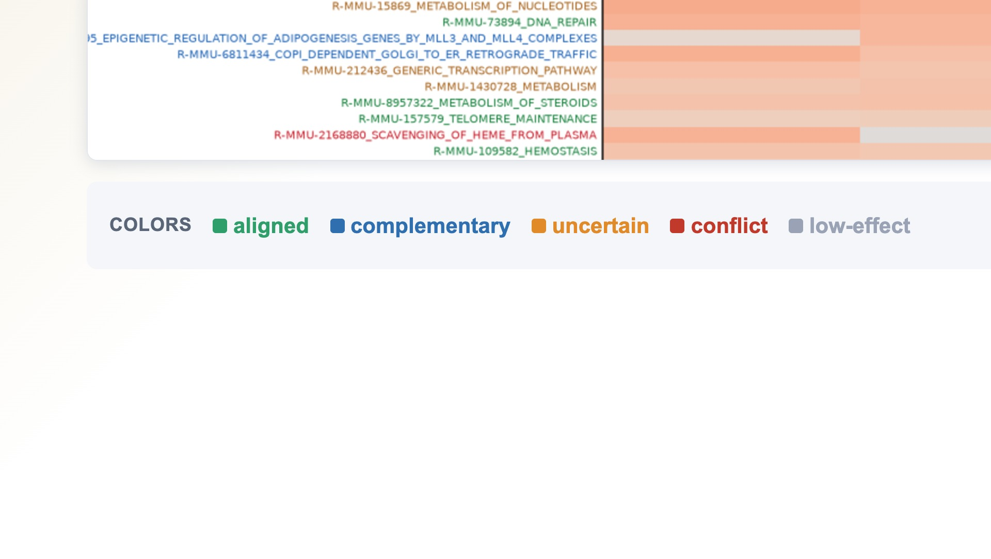
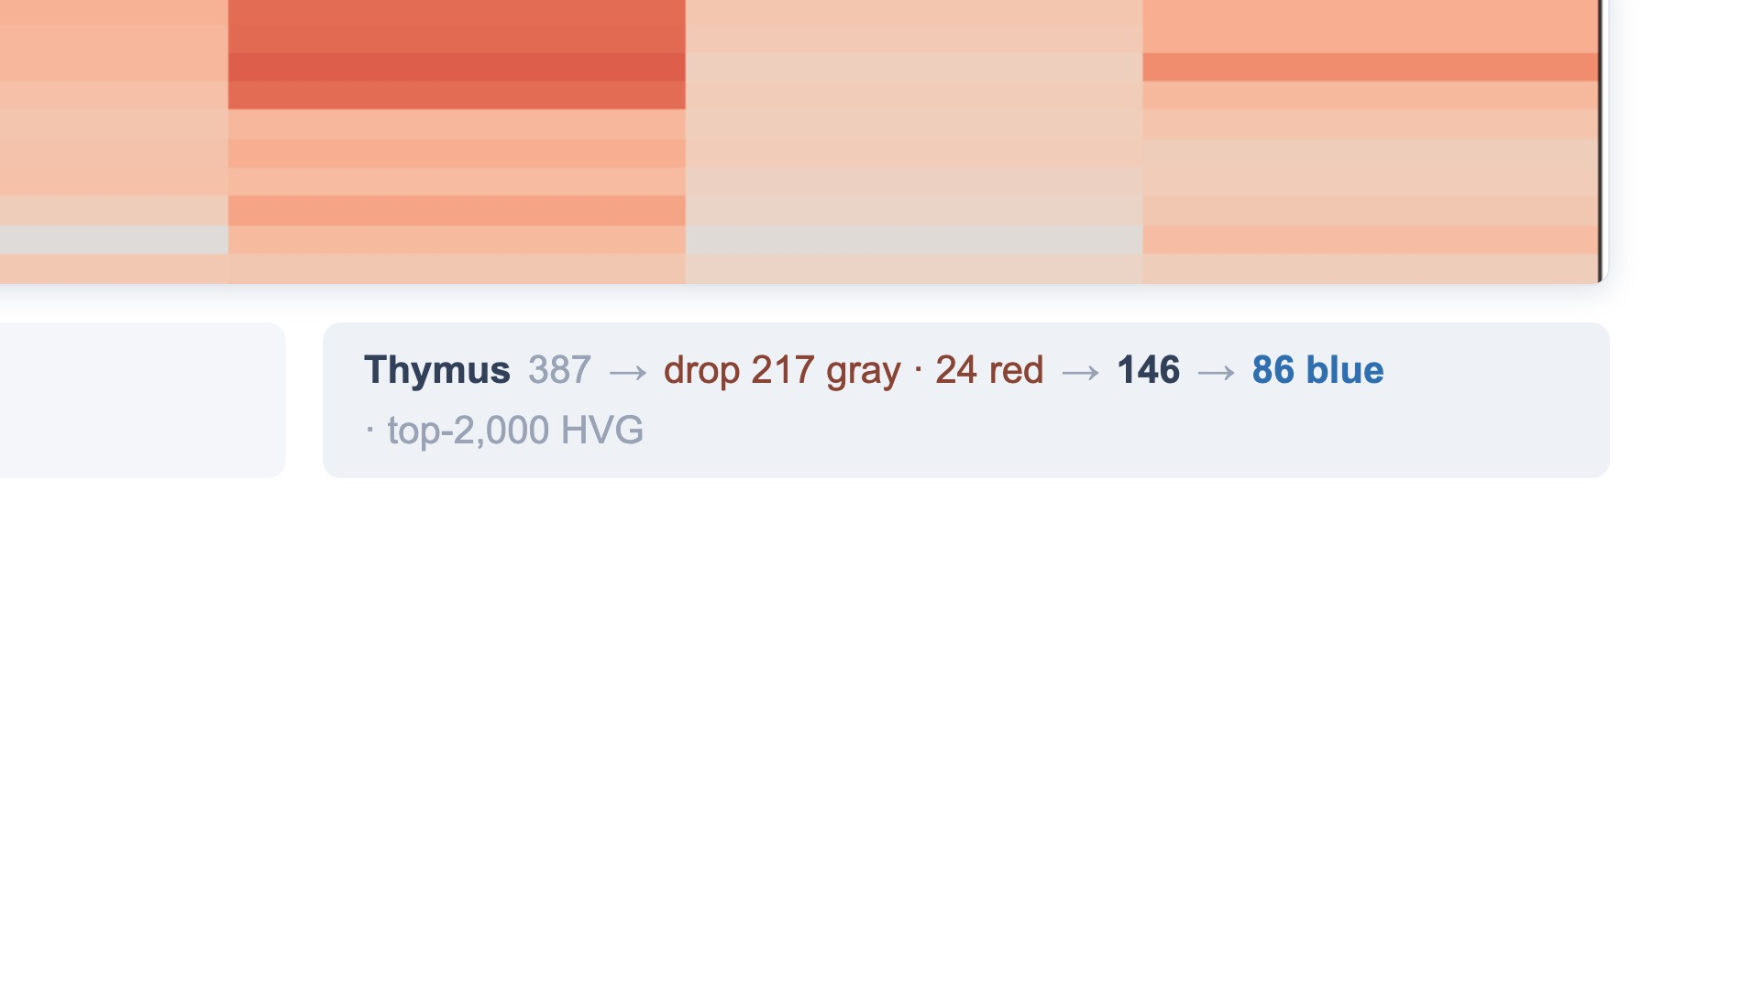
Notes:
To answer that, we hand-review every significant program against the prior spaceflight literature and color-tag it: green matches known biology, blue is a plausible complementary angle the literature hasn't emphasized, orange is uncertain, red conflicts, and gray is low-effect. For thymus, more than two hundred are gray and two dozen red — we drop those, leaving about a hundred fifty meaningful programs, eighty-six of them blue. Those blue, complementary programs are what we find most interesting — and we'll walk through them tissue by tissue. (~30s)

Slide 13
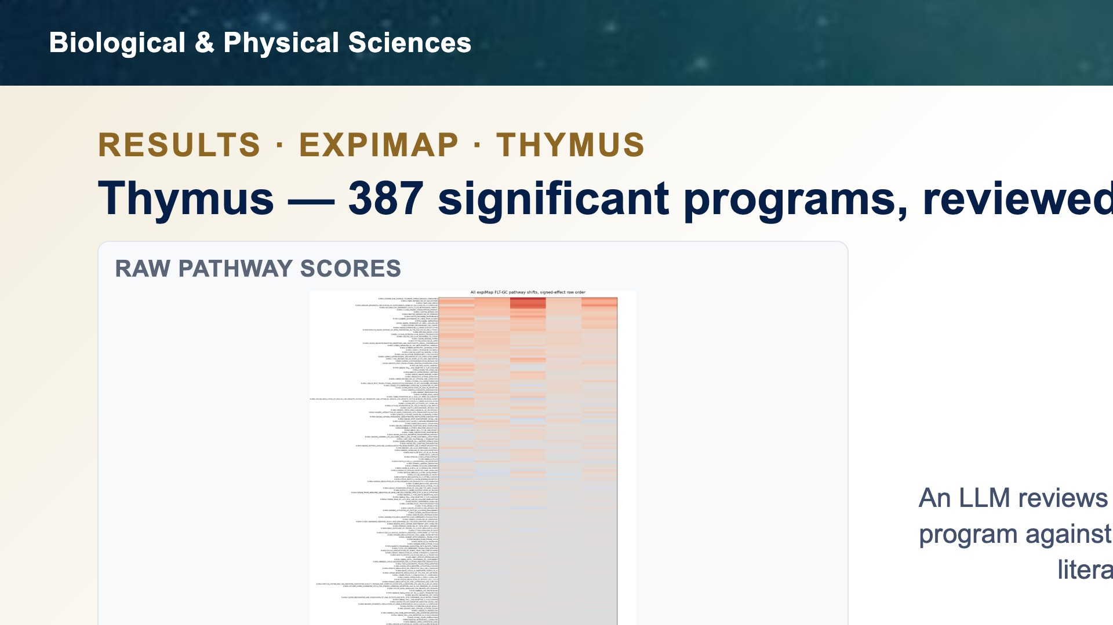
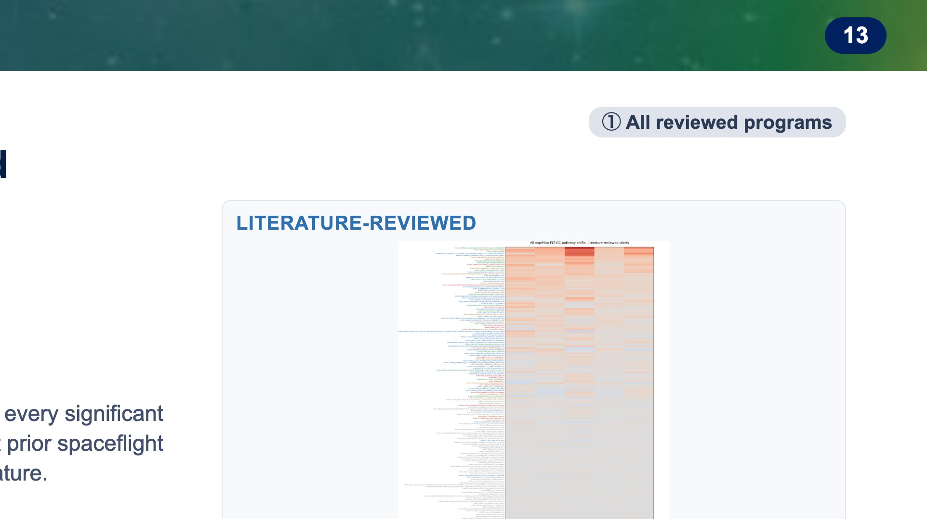
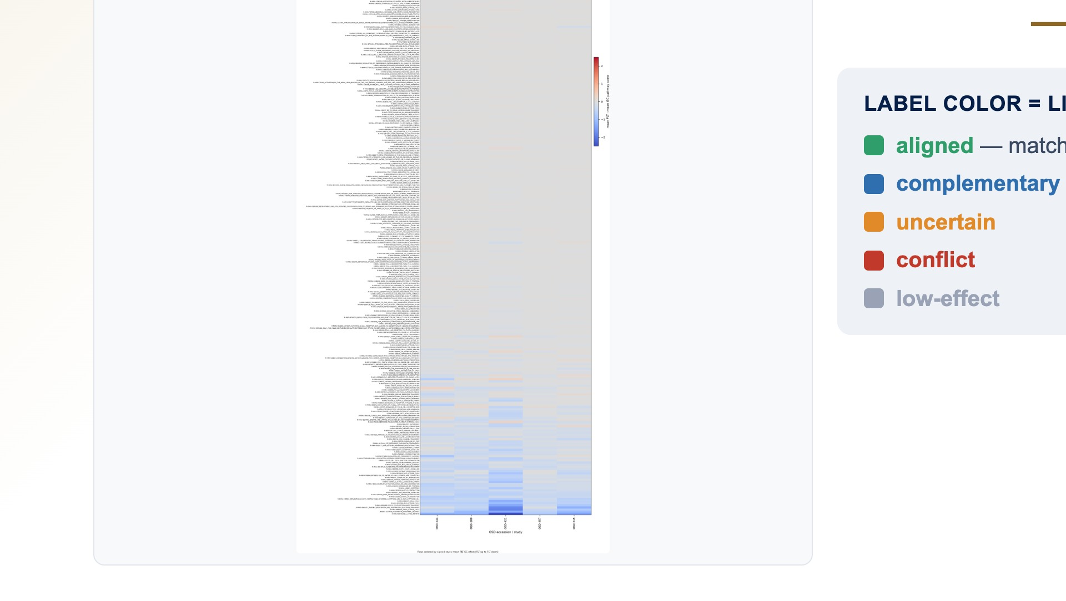
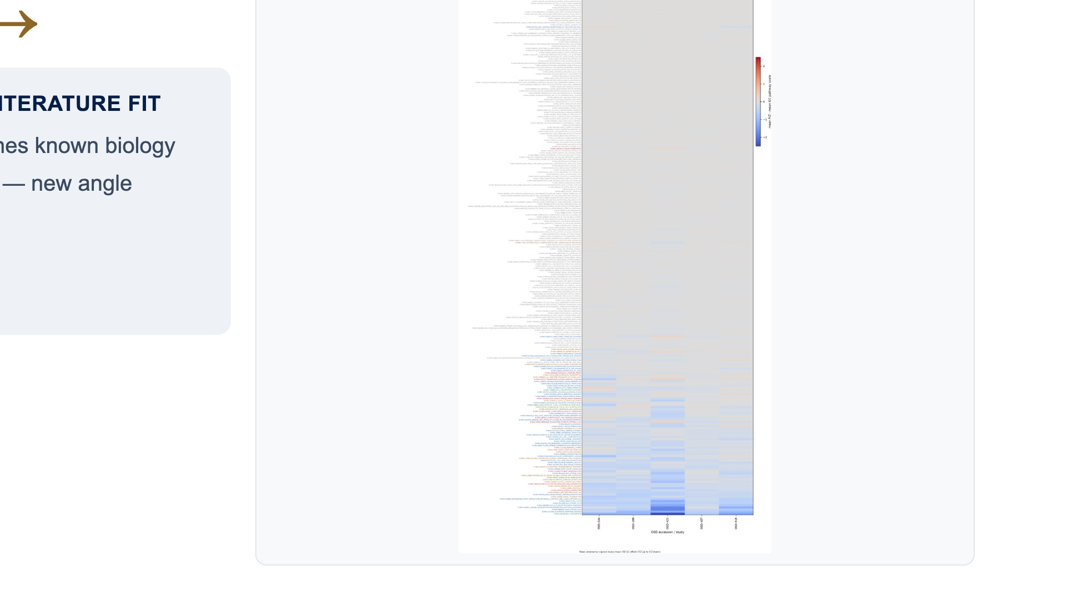
Notes:
Take thymus, our strongest signal. expiMap scored about three hundred ninety significant programs — here they all are, color-tagged against prior spaceflight literature: green matches known biology, blue is a complementary angle, orange uncertain, red conflicting, and most of the wall is low-effect gray. We drop the gray and red, leaving roughly a hundred fifty meaningful programs. (~24s)

Slide 14
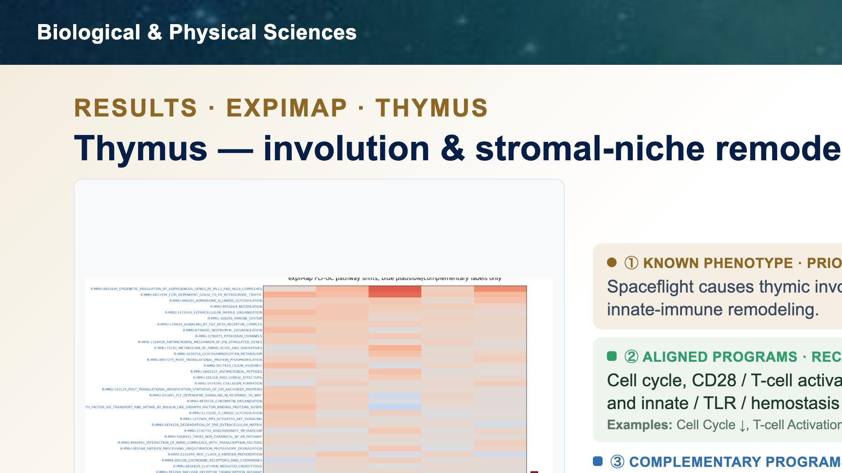
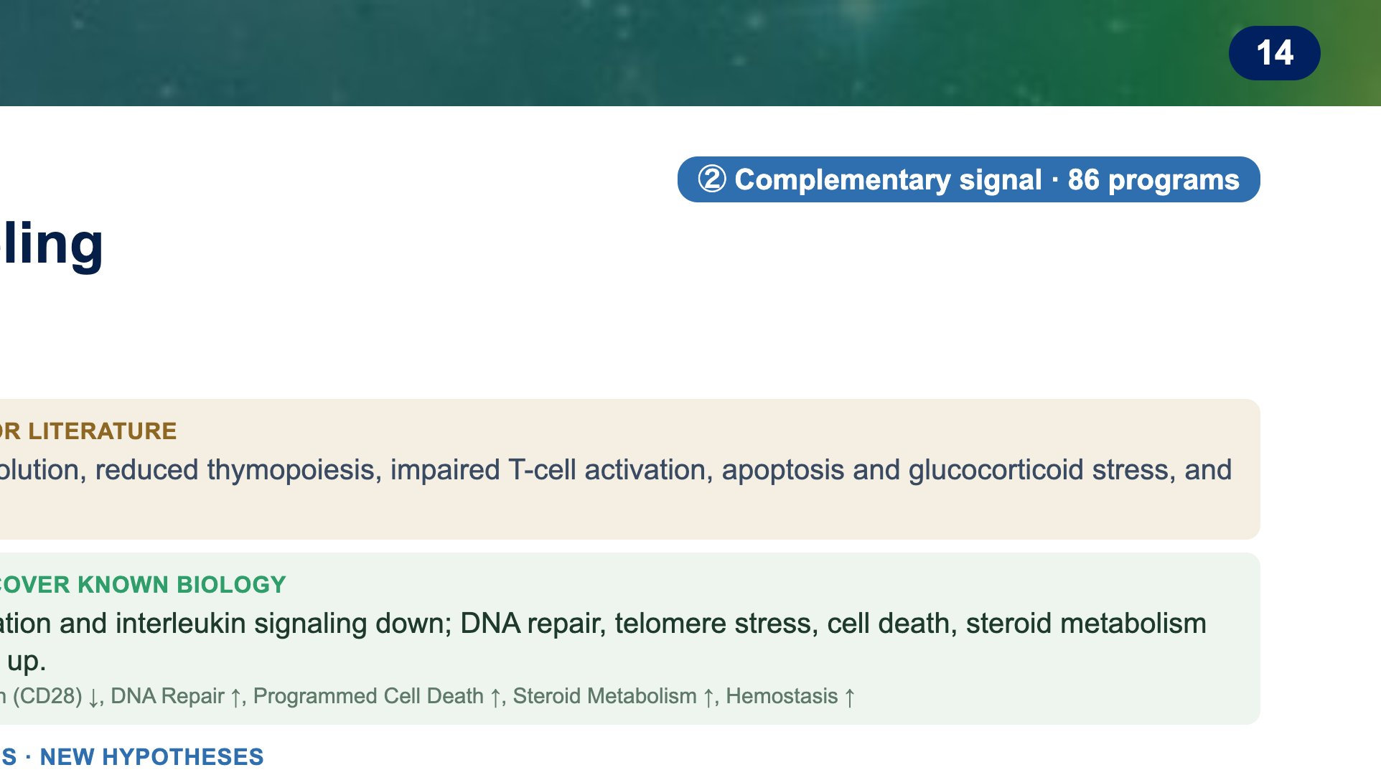
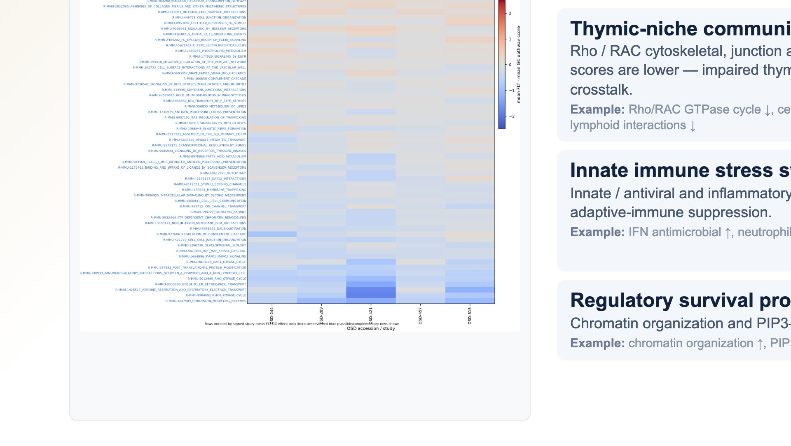
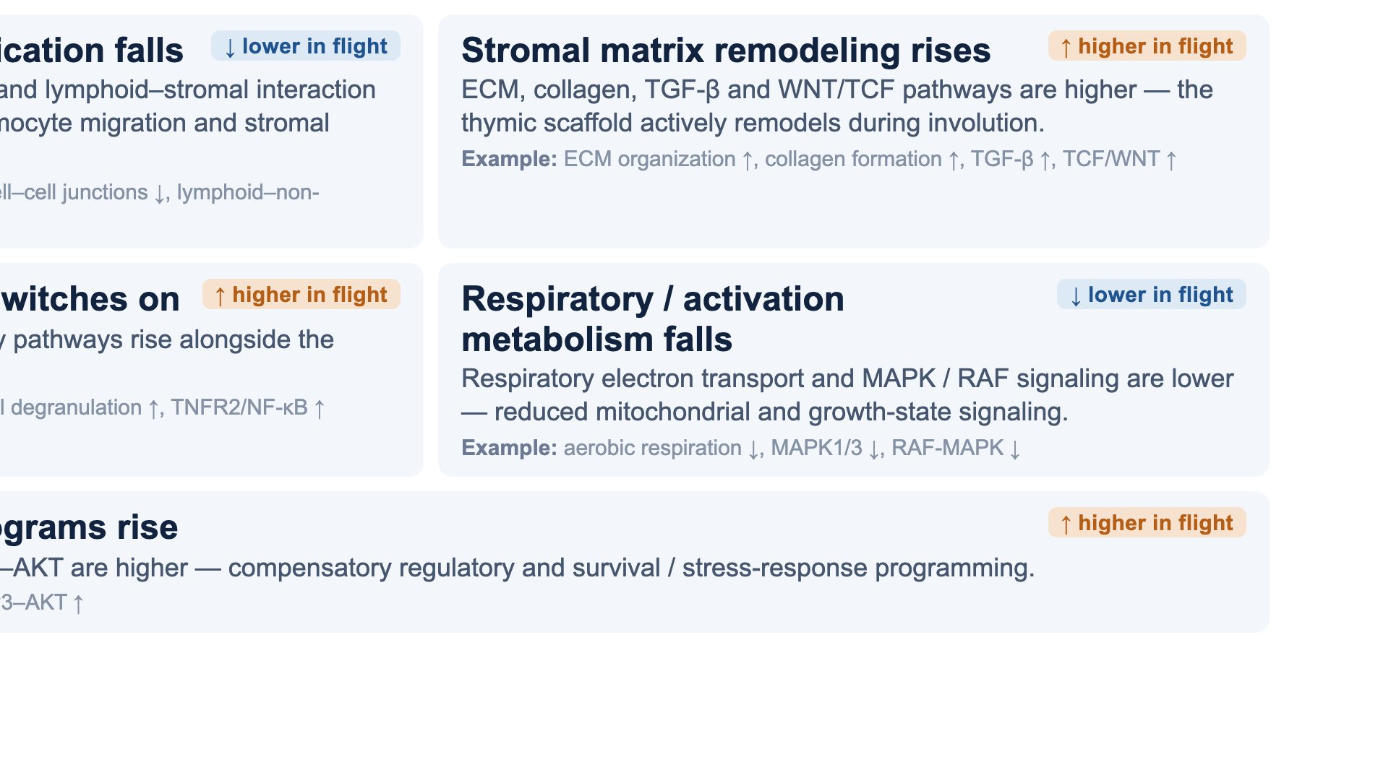
Notes:
The thymus result matches the known immune effect of spaceflight: the thymus shrinks, produces fewer new T cells, has lower proliferation, and shows stress and cell-death signals. The complementary finding is that pathways related to cell movement, adhesion, and cell-to-cell communication are lower in flight. In plain terms, thymus cells may be less able to move through the tissue and communicate with the support cells that help train new immune cells. At the same time, pathways related to the tissue scaffold and support-cell signals are higher. That suggests the thymus support structure is changing during flight, not just losing cells. Innate immune stress pathways are higher too. So even while the adaptive immune side is weakened, the thymus shows higher stress or antiviral-like immune signaling. Finally, energy-production and activation-signaling pathways are lower, while some survival and gene-control pathways are higher. That suggests the thymus is under stress and may be trying to compensate. Takeaway: flight thymus looks like reduced immune-cell production plus weaker cell communication, higher tissue-scaffold signaling, higher innate immune stress, and lower energy/activation signaling.

Slide 15
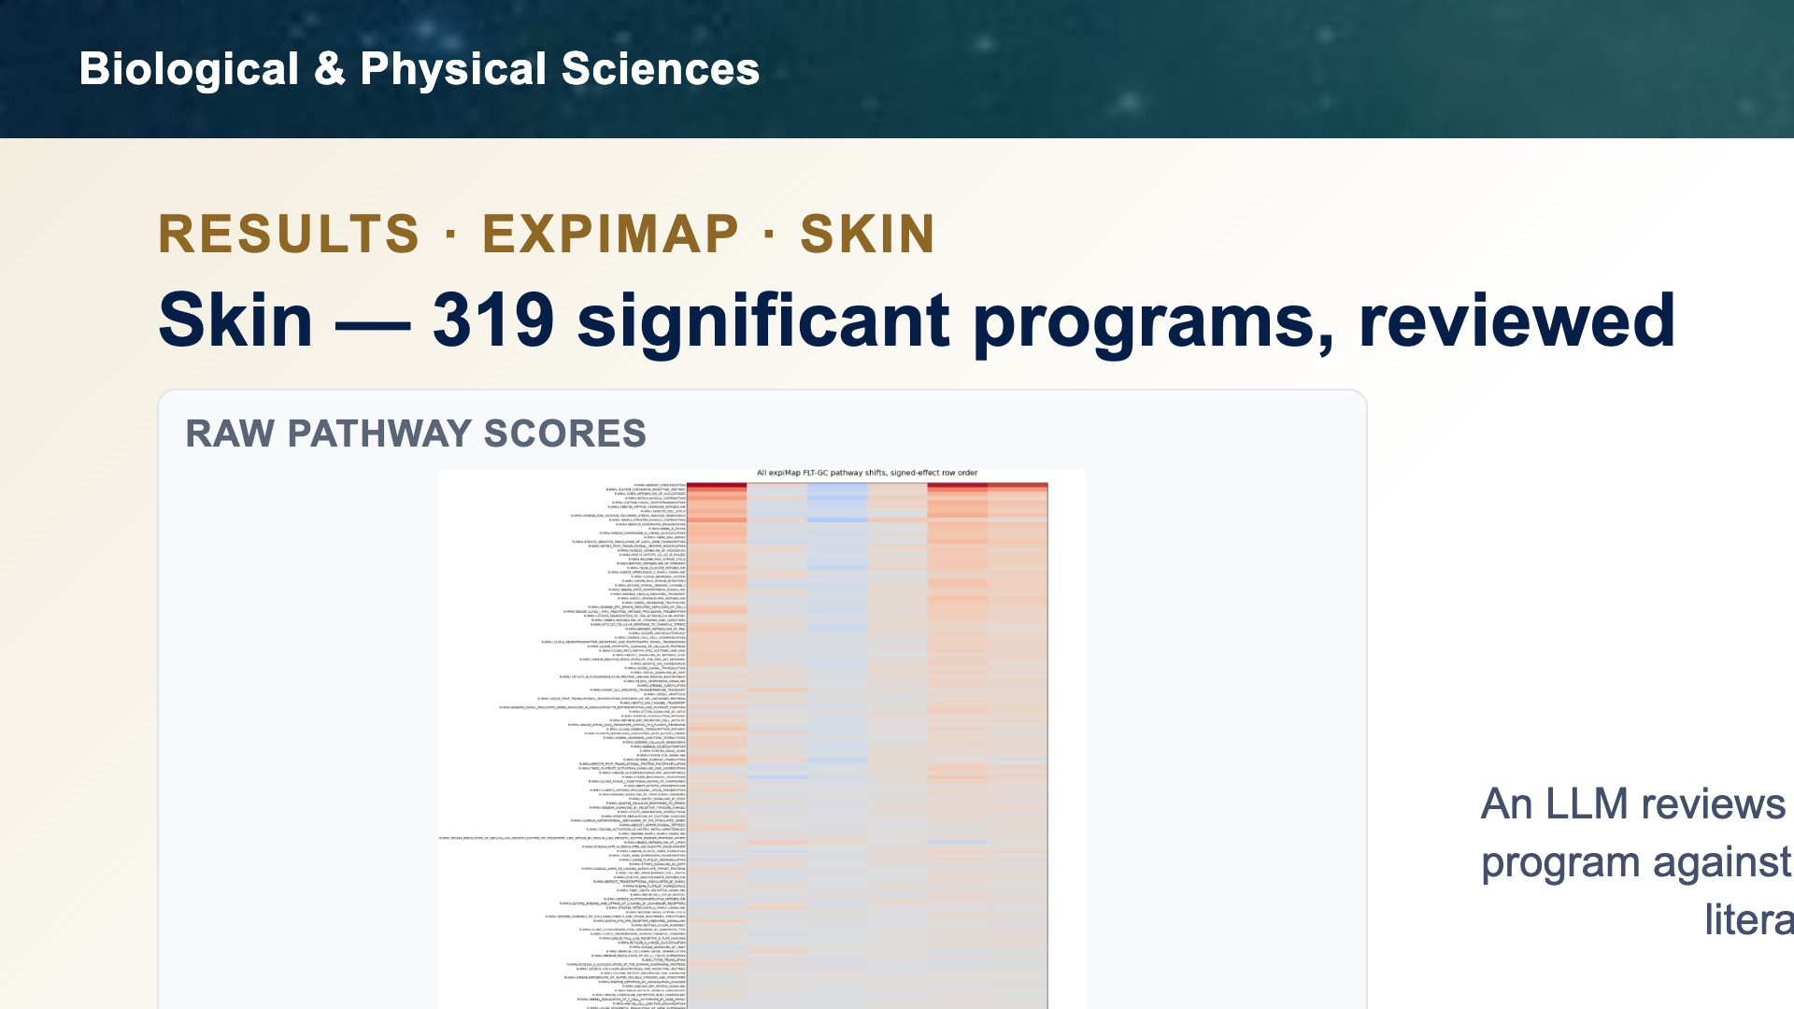
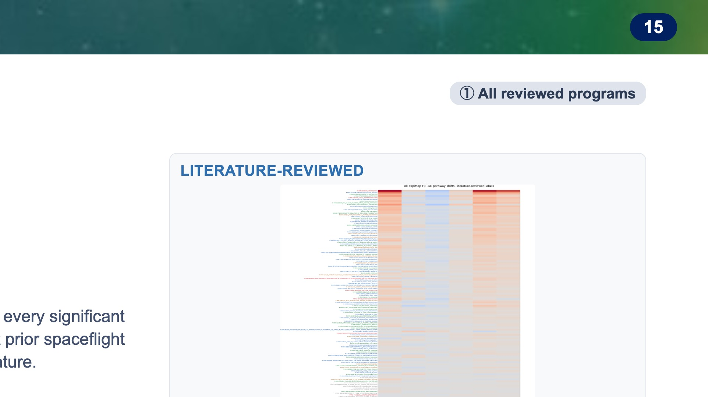
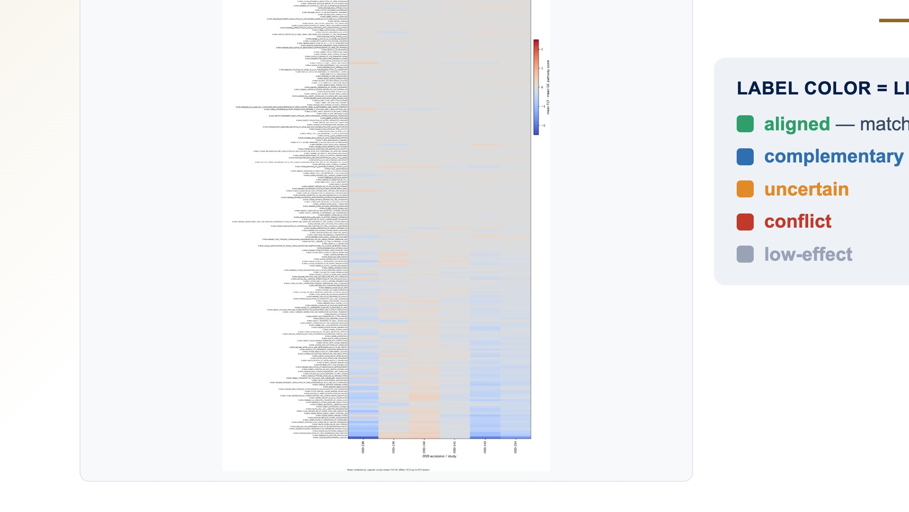
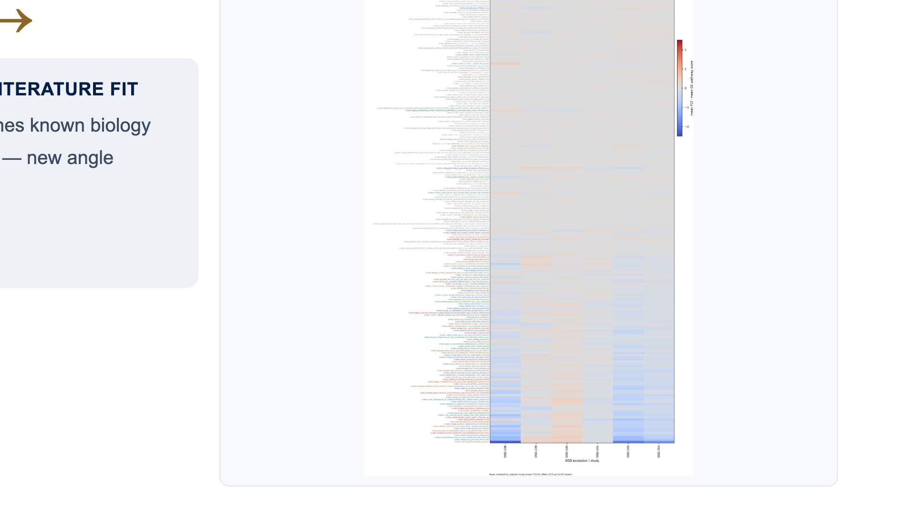
Notes:
Skin has three hundred nineteen significant programs. Same review — color-tag against the literature, drop gray and red, leaving a hundred ninety-two meaningful. (~13s)

Slide 16
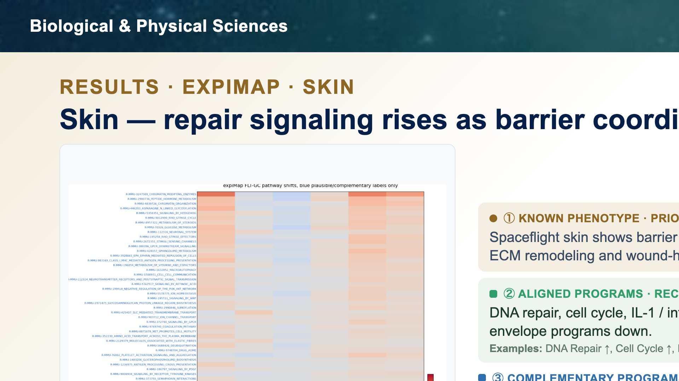
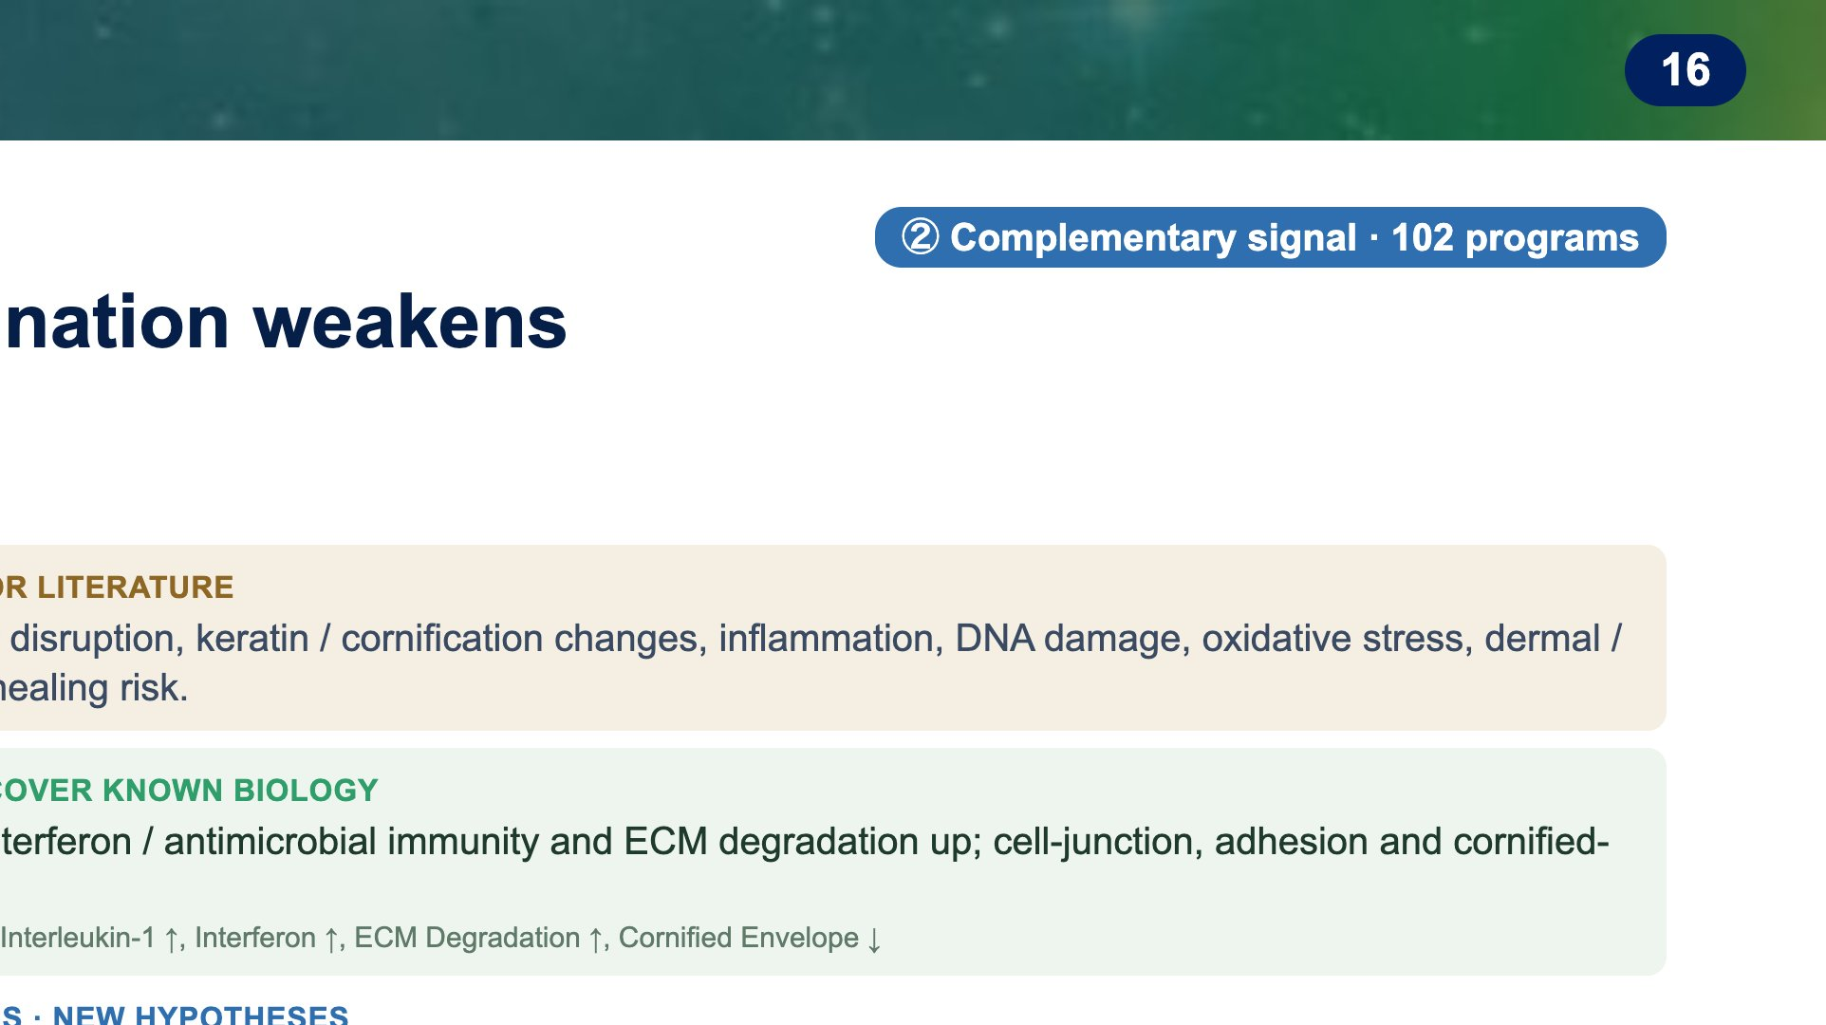


Notes:
The skin result matches known spaceflight skin biology: barrier stress, inflammation, DNA damage, oxidative stress, and wound-healing risk. The complementary finding is that repair-related signaling is higher in flight. Pathways related to growth signals, cell movement, and wound repair are higher, suggesting the skin is trying to activate repair programs. But direct cell-to-cell communication is lower. That matters because skin repair depends on cells coordinating across the tissue. So the skin may be turning on repair signals while losing some of the communication needed to organize repair properly. Individual stress-control programs are also higher. That suggests skin cells may be turning on internal protection programs to handle damage, stress, and protein or DNA repair. For barrier support, the pattern is specific: one barrier-lipid pathway is higher, suggesting active lipid adjustment, but cholesterol, fatty-acid, and detox/antioxidant pathways are lower. That suggests reduced metabolic support for rebuilding a healthy barrier. Takeaway: flight skin appears to activate repair and stress-protection programs, but with weaker cell-cell coordination and reduced detox/metabolic support.

Slide 17




Notes:
Liver, a moderate case — three hundred sixty-four programs reviewed and filtered to a hundred sixty-four meaningful. (~11s)

Slide 18




Notes:
The liver result matches prior spaceflight studies: flight affects how the liver handles fats, drug-processing, hormones, oxidative stress, and immune balance. What expiMap adds is that this does not look like metabolism alone. Pathways related to cell shape, force sensing, and attachment are higher in flight. In plain terms, liver cells may be changing how they sense and respond to the physical environment of spaceflight. We also see higher tissue-structure and repair-signal pathways. That suggests the liver may be activating programs related to tissue adjustment after stress, not just changing metabolism. The immune result is more subtle. Some broad immune pathways are higher, but antigen presentation and T-cell signaling are lower. So this is not simply 'more inflammation.' It may reflect immune imbalance, with weaker adaptive immune communication. Takeaway: flight liver looks like metabolic injury combined with altered force-sensing, tissue-structure signaling, and reduced adaptive immune communication.

Slide 19




Notes:
Soleus, a postural muscle — three hundred fifty-seven programs, filtered to a hundred four meaningful. (~11s)

Slide 20




Notes:
The soleus result matches the classic spaceflight muscle phenotype: lower contractile function, lower energy-producing metabolism, and reduced fat-use pathways. The complementary finding is that transport and small-molecule handling pathways are also lower. In plain terms, the muscle may be less able to move and process the molecules and ions it needs for normal function. Pathways related to breakdown of the support structure around muscle fibers are lower. That suggests the extracellular environment around the muscle fibers is changing, specifically with less matrix-breakdown activity. At the same time, pathways related to load sensing, cell attachment, stress signaling, and inflammatory signaling are higher. So the muscle is not just passively shrinking; cells are also changing how they sense load and respond to stress. Cell-cycle and developmental-like pathways are higher too. I would frame that carefully: not as muscle growth, but as possible repair attempts, tissue reprogramming, or activity from support cells in the muscle. Takeaway: flight soleus shows lower muscle energy and transport capacity, plus higher load-sensing, stress, and repair-like signaling.

Slide 21




Notes:
Everything so far has fought the same underlying limit — very few samples per study. That scarcity is what motivates the project's second half: generative models. If a model can learn the distribution of real expression profiles, it could generate synthetic flight and ground samples to support augmentation, simulation, and hypothesis generation. Three families are on the table. GeneJepa is a new foundation model that predicts latent representations rather than raw counts — a representation idea, not a bulk generator. Conditional WGAN-GP and diffusion models are true generators, and we've already prototyped both, with GeneJEPA next. Whichever we use, the plan is the same: pretrain on public mouse RNA-seq, adapt to the NASA tissues, generate conditional flight-versus-ground profiles, and validate hard. (~55s)

Slide 22




Notes:
The first generator is a diffusion model. You've seen diffusion in image tools — they start from pure noise and denoise it, step by step, until a photo emerges. We do the exact same thing, except the output is a full gene-expression profile, and every step is conditioned on flight or ground. Noise in, a realistic FLT or GC profile out. (~22s)

Slide 23




Notes:
The second is a conditional WGAN-GP — a GAN. GANs are the models that learned to generate photorealistic faces; in just a few years they went from blurry to indistinguishable from real. Same adversarial game here: a generator fakes expression profiles while a Wasserstein critic scores them, and they compete until the critic can no longer tell fake from real. (~22s)

Slide 24




Notes:
The third is GeneJEPA, a joint-embedding predictive model. Instead of reconstructing raw counts, it predicts the latent representation of masked gene sets from context, using a student–teacher setup with an EMA teacher and a predictor. The point isn't the samples — it's the pretrained backbone: a foundation-model representation we can adapt to many downstream tasks. (~22s)

Slide 25




Notes:
Before any synthetic sample is trusted, it has to pass five checks: statistical fidelity — do the gene means, variances, and correlations match; diversity — no mode collapse; biological fidelity — do the flight-versus-ground effects and pathway shifts agree with the real data; a train-on-synthetic, test-on-real classifier check; and a memorization check that we haven't just copied training samples. Only a generator that clears all of these is worth trusting for anything downstream. (~35s)

Slide 26




Notes:
Finally, thank you — to my mentor James Casaletto for his guidance, to the NASA Space Life Sciences Training Program, and to NASA's Open Science Data Repository and the many contributing studies whose data made this possible. This work also builds on open-source methods — GLARE, expiMap, and MOBER. I'm happy to take questions. (~16s)

