Slide 1



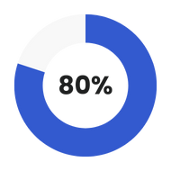
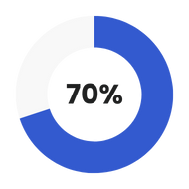
Studio Shodwe
Home
Photo
About Us
Contact
Domain 3: Empowering Economic Through AI
Prototype Presentation
Group Members:
Ong Zheng He
Ho Hoong Khuan
Soong Tze Yeng
Jason Tang Kwong Wee
Lee Tong Hua
Data 01
Data 02
Explore Now

Slide 2
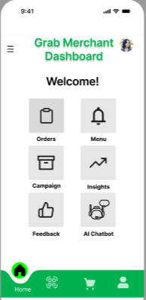
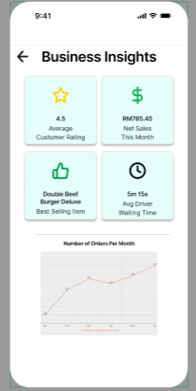
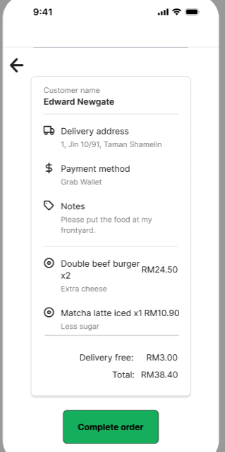
UI interface
02
Business insight page gives insights of sales trends and opportunities such as best selling item and average customer rating
Monitor and provide insightful graphs such as number of orders per month
Dashboard consist of important shortcuts such as orders, menu, campaign, insights, feedback and AI chatbot
The orders page give merchants an overview of the customers orders details such as addresses, payment method and notes from the customers

Slide 3

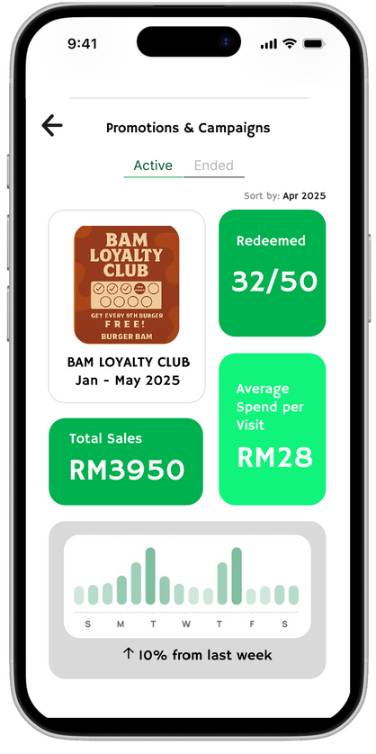
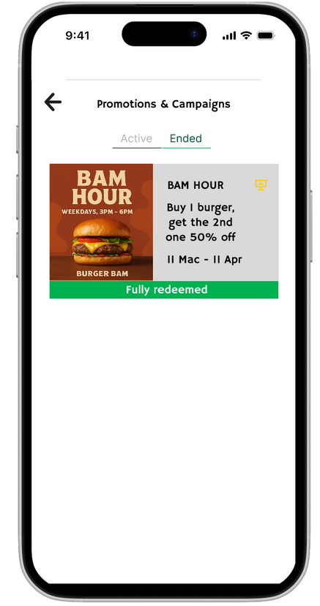
Promotions & Campaigns: Active vs Ended
Displays completed campaigns with status (e.g. Fully Redeemed)
Highlights campaign details: poster, offer and period
Easy access to detailed insights via insights icon
Helps merchants quickly assess campaign success
Real-time performance tracking
Live sales & redemption widgets
Weekly sales chart
Active
Ended

Slide 4
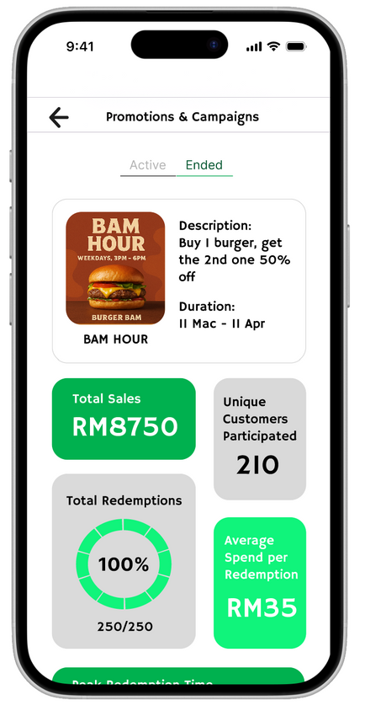
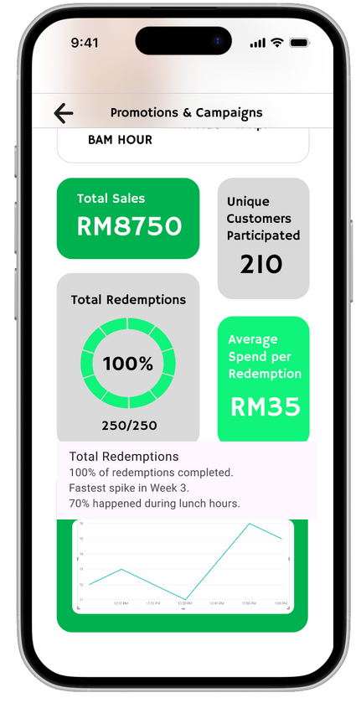
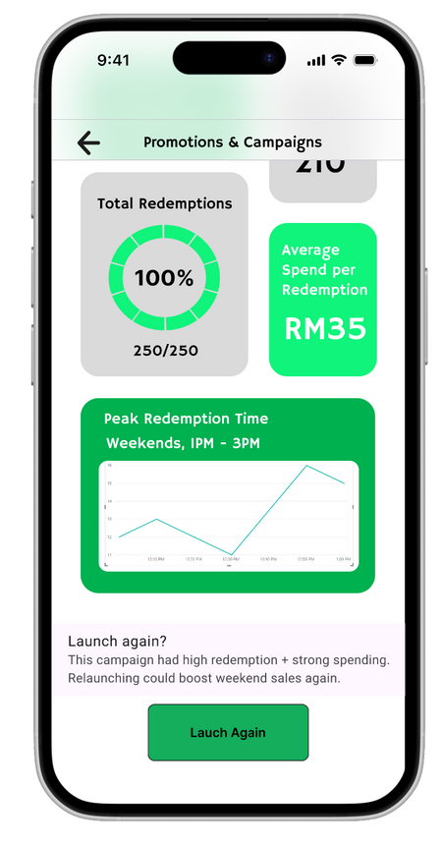
Studio Shodwe
Promotions & Campaigns
Campaign overview with key performance widgets
(e.g. Total Sales, Redemptions, Average Spend, Peak Time)
AI Insights appear on hover for each metric
“Lauch Again” button with smart suggestions based on performance

Slide 5
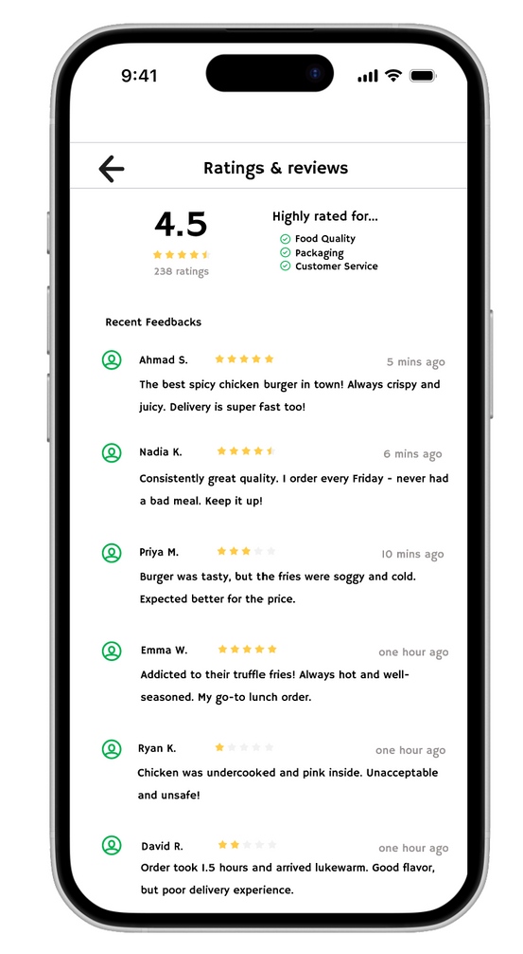
Feedback
To allow merchants to view and manage customer feedback and ratings.
AI analyzes reviews to determine the overall sentiment (positive, neutral, negative), providing a clear overview of customer satisfaction.
Merchants are ranked based on ratings and sentiment, with higher rankings for better feedback, offering more visibility and a competitve edge.

Slide 6
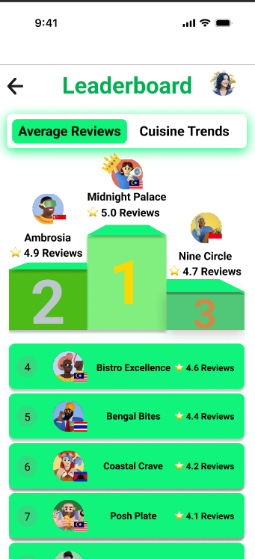
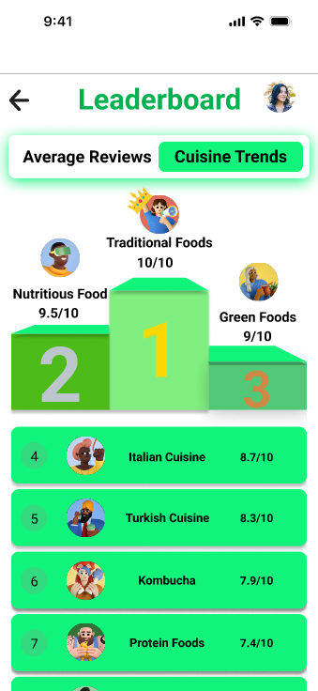
Actionable Recommendation
Leaderboard page can provide competitive insights on current market trends
Fostering competition and motivation, allowing merchants to track their progress and compare themselves with others
Average Reviews
02
Cuisine Trends
01
Analyzing reason behind each merchant’s success based on customer reviews
Provide actionable insights to the merchants based on popularity score of the region

Slide 7
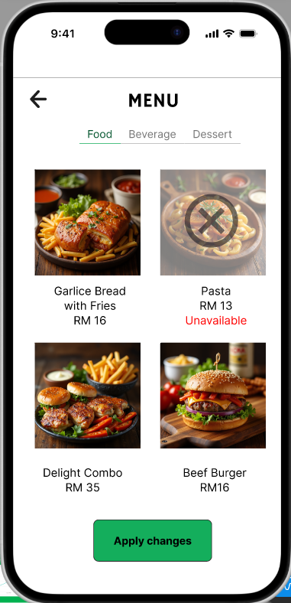
Food Menu
Allows the merchant to add or remove food items from the menu.
AI keeps track of the inventory status and disable food items that are out of stock, reflecting on both merchant and customer application.

Slide 8
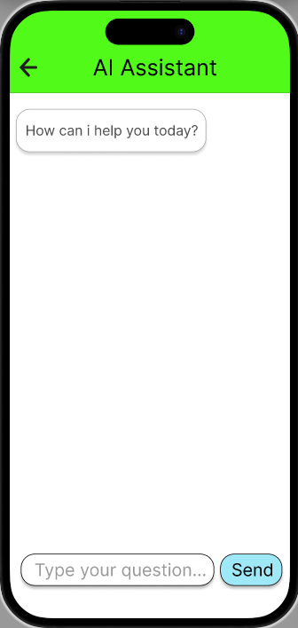



AI Chatbot (Gemini API)
Concepts
Personalized Recommendations
Cater to People from Diverse Backgrounds
Forecasting Sales
Provide guidance and recommendations based on the merchant’s sales data.
Respond to merchants based on the language they use.
Analyze past data and uses machine learning models to identify business trends and forecast future sales.

Slide 9
Prototype Demo Session

Slide 10
Thank You

