Slide 1
.sdt -> TIFF Stacks
JS, 02/06/19

Slide 2
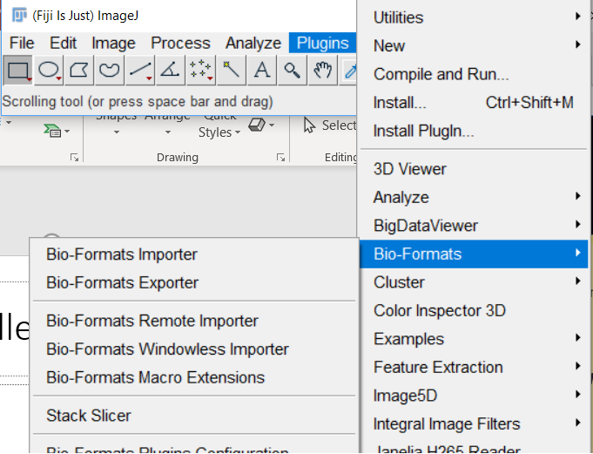
Is Bio-Formats installed?
Quick check in ‘Plugins’ tab. If it is Fiji, it should be there.

Slide 3
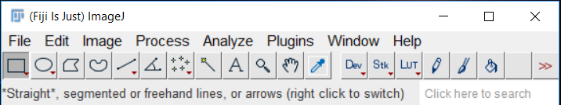
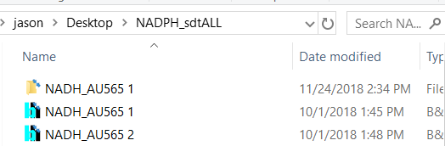
.sdt -> TIFF (#1)
Drag & drop .sdt file into Fiji GUI

Slide 4
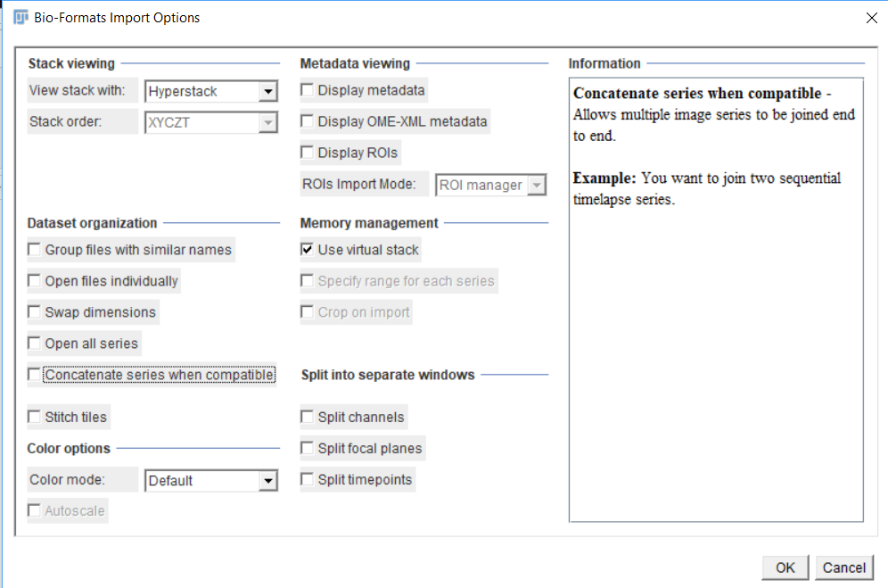

Slide 5
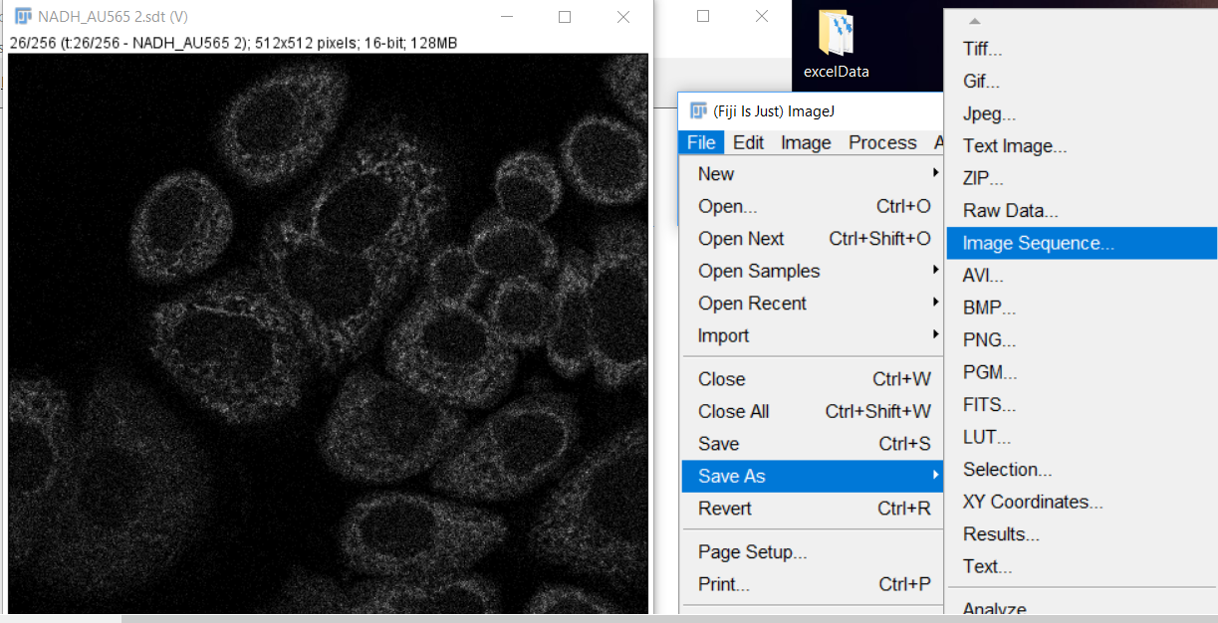
Export

Slide 6
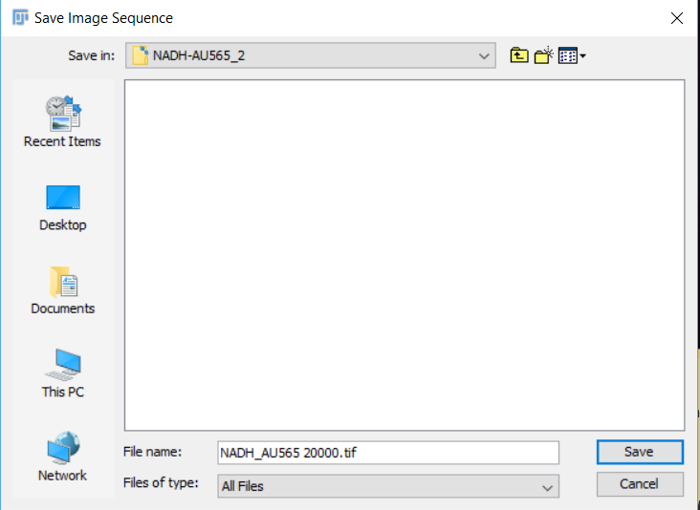
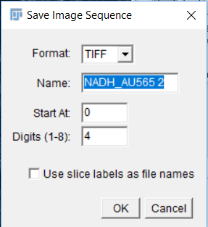
You can make a new, empty folder if not created beforehand.
All TIFF files exported here.

Slide 7
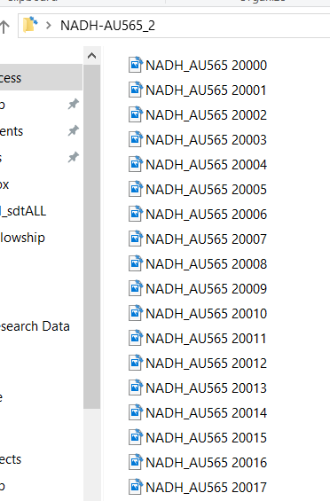
And voila!
…

Slide 8
Exporting SPCImage Data

Slide 9
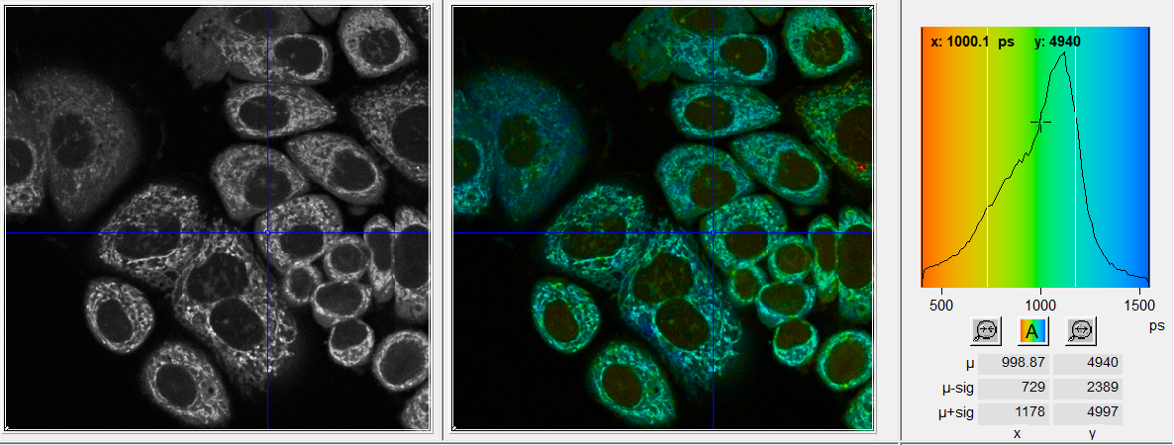
Let’s say we already have a calculated result ready.

Slide 10
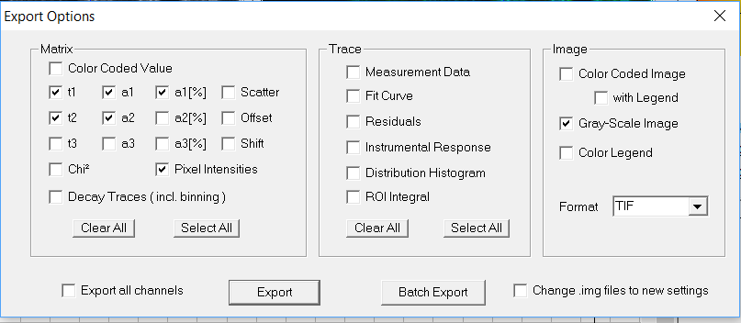
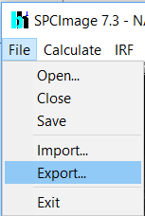
Exporting all of the metrics

Slide 11
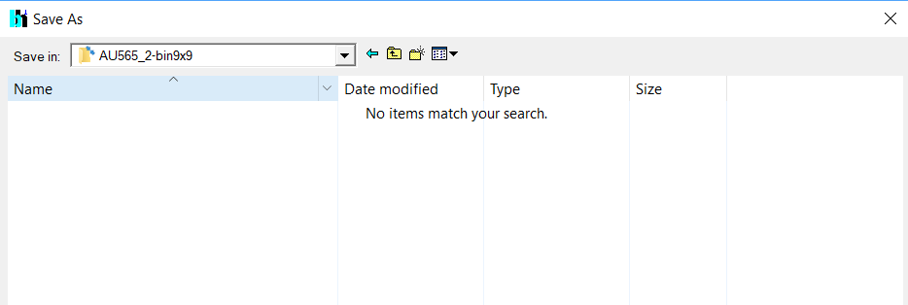
Again… Make Empty Folder

Slide 12
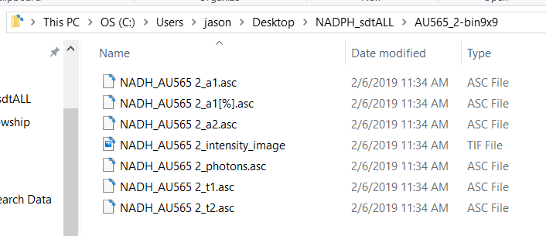
.asc files?...
…MATLAB (or Octave) makes it easy

Slide 13
I’ve attached the MATLAB code and comments… But here is an example workflow
1.0961 ± 0.1117 ns
T_{m} = A₁T₁ + (1-A₁)T₂

Slide 14
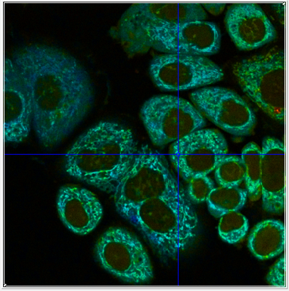
Example side-by-side

