Slide 1

AI Scroll
An academic email agent that turns course messages into a verified plan
Jason Wang Chen Yu
PE6201 Course Project
Evidence first · Human approval before calendar writes
Notes:
Hi, I’m Jason. My project is called AI Scroll. It is an academic email agent for students who receive deadlines, extensions and course updates across many messages. The system reads selected course emails, keeps the original evidence, merges related updates and prepares a practical study plan. It can then create calendar proposals, but only after the student reviews and approves them. In this presentation, I will explain the problem, the Agent design, the tools I built, and the current working result.

Slide 2
02
The problem: important actions are buried in email
01
Deadlines arrive in different formats
A typical student inbox
A date may appear in the subject, body, attachment or a later correction.
Deadline
Project due 1 Oct
02
One task can span several messages
Update
Deadline extended to 4 Oct
Students must decide whether a message creates, updates or cancels the same task.
Reminder
Please submit on time
03
Manual calendar entry creates risk
Noise
Campus newsletter
A wrong date or an automatic write can turn a useful assistant into a costly mistake.
The user needs one reliable final state
PE6201 Course Project · AI Scroll
2
Notes:
The main problem is not a lack of email. It is the effort required to turn several messages into one reliable decision. A deadline can appear in different formats, and a later message may extend or cancel it. Students also receive reminders, newsletters and platform notifications that look important but do not create a real deadline. If the user manually copies every date, errors are easy. If an Agent writes to a calendar automatically, the risk is even higher. So the product must understand the message chain and preserve evidence before it takes any external action.

Slide 3
03
Product flow from inbox to approved plan
1
2
3
4
5
6
Read
Filter
Extract
Merge
Plan
Approve
›
›
›
›
›
Mailbox connector
Course scope
Task and evidence
Latest final state
Backward schedule
Calendar gate
The Agent prepares the decision. The student owns the final action.
Every proposal links back to an exact sentence from the source email.
PE6201 Course Project · AI Scroll
3
Notes:
AI Scroll follows six steps. First, a mailbox connector reads new messages. Second, a course scope filter removes unrelated mail before any model call. Third, the extraction layer identifies the task, deadline and exact evidence sentence. Fourth, the merge engine combines related emails and keeps the latest valid state. Fifth, the planner works backwards from the verified deadline to create manageable sessions. Finally, the approval gate shows the proposal to the student. The Agent prepares the plan, but the student owns the final calendar action. This separation is important for both safety and trust.

Slide 4
04
The Agent loop and its tools
Five working tools
OBSERVE
›
REASON
›
ACT
mailbox.fetch_new
1
Read inbox
and current state
Choose tools
and resolve updates
Prepare plan
and stop for review
Read new messages
2
scan_policy.classify
Filter course mail
3
extract
Create structured JSON
4
thread_matcher + merge
Consolidate updates
5
calendar.approval_gate
Block unapproved writes
LLM: openai/gpt-5-mini through OpenRouter
Deterministic rules still control date validation, urgency, deduplication and approval.
PE6201 Course Project · AI Scroll
4
Notes:
The system uses a simple ReAct style loop: observe, reason and act. The Agent observes new messages and the existing timeline. It reasons about which tools are needed and whether a message is new, related or irrelevant. It then acts by preparing a timeline item or a calendar proposal, before stopping for review. The main tools read the mailbox, filter course messages, extract structured JSON, match and merge related threads, and enforce the calendar approval gate. I use GPT 5 Mini through OpenRouter for language understanding. Deterministic rules still validate dates, calculate urgency, remove duplicates and block unsafe writes.

Slide 5
05
Hybrid architecture: AI for language, rules for control
Language model
Deterministic application
Rented capability
Built for this project
Understands varied academic wording
Extracts tasks and exact evidence
Suggests whether a message updates an earlier task
Validates dates and Singapore time
Merges threads and preserves history
Calculates urgency and enforces approval
Build
workflow · merge logic · evaluation · safety
Rent
language model · mailbox API · calendar API
PE6201 Course Project · AI Scroll
5
Notes:
I chose a hybrid architecture because the two parts of the problem need different strengths. The language model handles varied academic language, extracts evidence and interprets whether a message is a new task or an update. The application code handles the parts that must remain predictable: date validation, Singapore time, urgency thresholds, thread history, deduplication and approval. I built the workflow, merge logic, evaluation and safety controls. I rent the language model and the external mailbox and calendar APIs. This reduces development time while keeping the important project logic visible and testable.

Slide 6
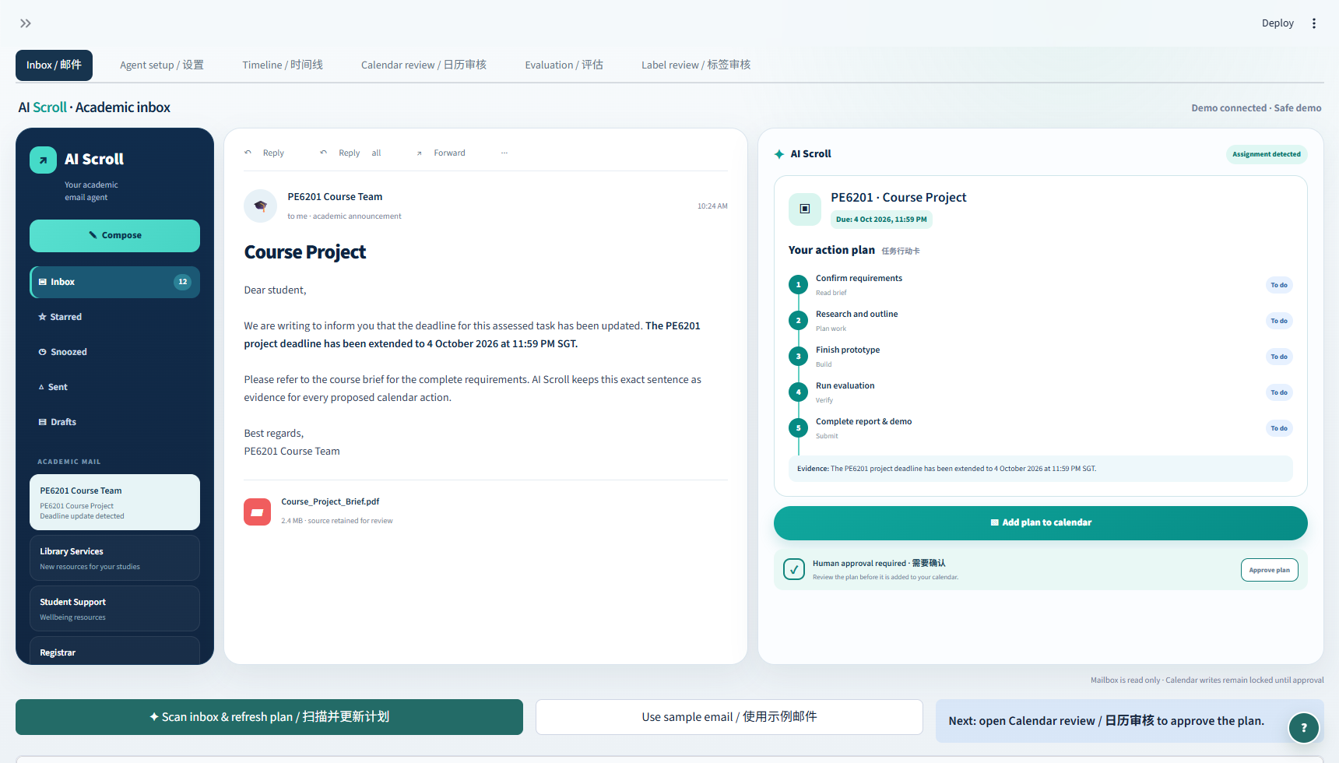
06
Final product experience
1 · Read the source email
2 · Review the action card
PE6201 Course Project · AI Scroll
6
Notes:
This is the current product experience. The left side behaves like an academic inbox. The middle panel keeps the selected email visible, including the exact sentence that created or changed the deadline. The right panel turns the message into a five step action plan. It shows the final deadline, the planned stages and the evidence used by the Agent. The scan button refreshes the interface using the actual mailbox pipeline. Settings stay in a collapsed sidebar, so the main screen remains simple. The user then opens Calendar Review, checks the proposal and confirms it. Without that confirmation, the system performs no calendar write.

Slide 7
07
Current evidence and next steps
6 / 6
Live web-derived cases passed
47
Automated tests passed
$0.01074
Cost of the six-case live run
Next: freeze the 50 human labels, run the final evaluation and record the live demo.
Draft-label comparison shown on the left. Final assessment numbers require label review.
PE6201 Course Project · AI Scroll
7
Notes:
The current evidence shows that the pipeline improves on a simple keyword and date baseline, especially for calendar actions and cross email merging. These comparison numbers still use draft labels, so I will not present them as the final assessment result until the 50 labels are reviewed and frozen. The completed live model check passed all six web derived edge cases, the code passes 47 automated tests, and the six case live run cost about 1.1 cents. The next steps are to freeze the labels, run the final evaluation and record the live demo. AI Scroll shows how an Agent can reduce email overload while keeping the student in control.

