Slide 1

A Practical Quicksort Algorithm for Graphics Processors
Daniel Cederman and Philippas Tsigas
Distributed Computing and Systems
Chalmers University of Technology

Slide 2
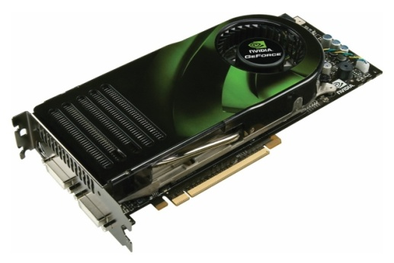
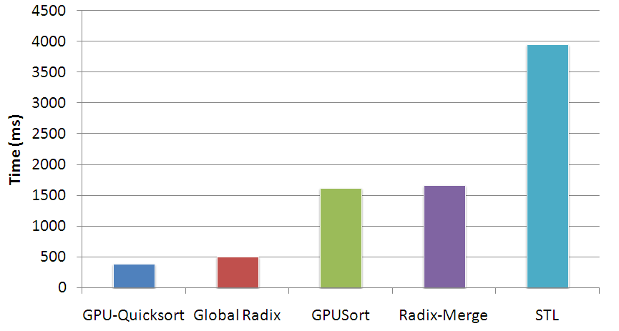
Overview
System Model
The Algorithm
Experiments
5 8 3 2
3 2
5 8
2
3
5
8

Slide 3
System Model
System Model
The Algorithm
Experiments
5 8 3 2
3 2
5 8
2
3
5
8

Slide 4
CPU vs. GPU
Multi-core
Large cache
Few threads
Speculative execution
Many-core
Small cache
Wide and fast memory bus
Thousands of threads hides memory latency
Normal processors
Graphics processors

Slide 5

CUDA
Designed for general purpose computation
Extensions to C/C++

Slide 6
System Model – Global Memory
Global Memory

Slide 7
System Model – Shared Memory
Global Memory
Multiprocessor 0
Multiprocessor 1
Shared
Memory
Shared
Memory

Slide 8
System Model – Thread Blocks
Global Memory
Multiprocessor 0
Multiprocessor 1
Thread Block 0
Thread Block 1
Thread Block x
Thread Block y
Shared
Memory
Shared
Memory

Slide 9
Challenges
Minimal, manual cache
32-word SIMD instruction
Coalesced memory access
No block synchronization
Expensive synchronization primitives

Slide 10
The Algorithm
System Model
The Algorithm
Experiments
5 8 3 2
3 2
5 8
2
3
5
8

Slide 11
Quicksort
5 8 3 2
3 2
5 8
2
3
5
8

Slide 12
Quicksort
5 8 3 2
3 2
5 8
2
3
5
8
Data Parallel!

Slide 13
Quicksort
5 8 3 2
3 2
5 8
2
3
5
8
NOT
Data Parallel!

Slide 14
Quicksort
Phase One
Sequences divided
Block synchronization on the CPU
5 8 3 2
3 2
5 8
2
3
5
8
Thread Block 1
Thread Block 2

Slide 15
Quicksort
5 8 3 2
3 2
5 8
2
3
5
8
Phase Two
Each block is assigned own sequence
Run entirely on GPU
Thread Block 1
Thread Block 2

Slide 16
Quicksort – Phase One
2 2 0 7 4 9 3 3 3 7 8 4 8 7 2 5 0 7 6 3 4 2 9 8

Slide 17
Quicksort – Phase One
2 2 0 7 4 9 3 3 3 7 8 4 8 7 2 5 0 7 6 3 4 2 9 8
Assign Thread Blocks

Slide 18
Quicksort – Phase One
2 2 0 7 4 9 3 3 3 7 8 4 8 7 2 5 0 7 6 3 4 2 9 8
Uses an auxiliary array
In-place too expensive

Slide 19
Quicksort – Synchronization
2 2 0 7 4 9 3 3 3 7 8 4 8 7 2 5 0 7 6 3 4 2 9 8
LeftPointer = 0
1
Thread Block ONE
Fetch-And-Add
on
LeftPointer
0
Thread Block
TWO

Slide 20
Quicksort – Synchronization
2 2 0 7 4 9 3 3 3 7 8 4 8 7 2 5 0 7 6 3 4 2 9 8
3
2
LeftPointer = 2
2
Thread Block ONE
Fetch-And-Add
on
LeftPointer
3
Thread Block
TWO

Slide 21
Quicksort – Synchronization
2 2 0 7 4 9 3 3 3 7 8 4 8 7 2 5 0 7 6 3 4 2 9 8
3
2
2
3
LeftPointer = 4
5
Thread Block ONE
Fetch-And-Add
on
LeftPointer
4
Thread Block
TWO

Slide 22
Quicksort – Synchronization
2 2 0 7 4 9 3 3 3 7 8 4 8 7 2 5 0 7 6 3 4 2 9 8
3
2
2
3
3
0
2
0
3
2
7
9
7
8
8
7
5
7
6
9
8
LeftPointer = 10

Slide 23
Quicksort – Synchronization
2 2 0 7 4 9 3 3 3 7 8 4 8 7 2 5 0 7 6 3 4 2 9 8
3
2
2
3
3
0
2
0
3
2
4
4
4
7
9
7
8
8
7
5
7
6
9
8
Three way partition

Slide 24
Two Pass Partitioning
2 2 0 7 4 9 3 3 3 7 8 4 8 7 2 5 0 7 6 3 4 2 9 8
<
<
<
<
<
<
<
<
<
<
=
=
=
>
>
>
>
>
>
>
>
>
>
>
=
=
=

Slide 25
Second Phase
Recurse on smallest sequence
Max depth log(n)
Explicit stack
Alternative sorting
Bitonic sort

Slide 26
The Algorithm
System Model
The Algorithm
Experiments
5 8 3 2
3 2
5 8
2
3
5
8

Slide 27
Set of Algorithms
GPU-Quicksort Cederman and Tsigas, ESA08
GPUSort Govindaraju et. al., SIGMOD05
Radix-Merge Harris et. al., GPU Gems 3 ’07
Global radix Sengupta et. al., GH07
Hybrid Sintorn and Assarsson, GPGPU07
Introsort David Musser, Software: Practice and Experience

Slide 28
Distributions
Uniform
Gaussian
Bucket
Sorted
Zero
Stanford Models

Slide 29
Distributions
Uniform
Gaussian
Bucket
Sorted
Zero
Stanford Models

Slide 30
Distributions
Uniform
Gaussian
Bucket
Sorted
Zero
Stanford Models

Slide 31
Distributions
Uniform
Gaussian
Bucket
Sorted
Zero
Stanford Models

Slide 32
Distributions
Uniform
Gaussian
Bucket
Sorted
Zero
Stanford Models

Slide 33
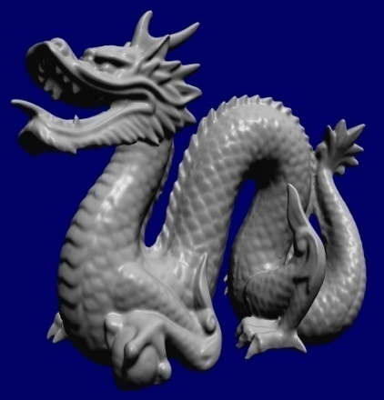


Distributions
Uniform
Gaussian
Bucket
Sorted
Zero
Stanford Models
x₁
x₂
P
x₃
x₄

Slide 34
Pivot selection
First Phase
Average of maximum and minimum element
Second Phase
Median of first, middle and last element

Slide 35

Hardware
8800GTX
16 multiprocessors (128 cores)
86.4 GB/s bandwidth
8600GTS
4 multiprocessors (32 cores)
32 GB/s bandwidth
CPU-Reference
AMD Dual-Core Opteron 265 / 1.8 GHz

Slide 36
8800GTX – Uniform Distribution

Slide 37
8800GTX – Uniform Distribution

Slide 38
8800GTX – Uniform – 16M

Slide 39
8800GTX – Uniform – 16M
CPU-Reference
~4s

Slide 40
8800GTX – Uniform – 16M
GPUSort and
Radix-Merge
~1.5s

Slide 41
8800GTX – Uniform – 16M
GPU-Quicksort
~380ms
Global Radix
~510ms

Slide 42
8800GTX – Sorted Distribution

Slide 43
8800GTX – Sorted Distribution

Slide 44
8800GTX – Sorted – 8M

Slide 45
8800GTX – Sorted – 8M
Reference is faster than GPUSort and Radix-Merge

Slide 46
8800GTX – Sorted – 8M
GPU-Quicksort
takes less than
200ms

Slide 47
8800GTX – Zero Distribution

Slide 48
8800GTX – Zero Distribution

Slide 49
8800GTX – Zero – 16M

Slide 50
8800GTX – Zero – 16M
Bitonic is unaffected by distribution

Slide 51
8800GTX – Zero – 16M
Three-way partition

Slide 52
8600GTS – Uniform Distribution

Slide 53
8600GTS – Uniform Distribution

Slide 54
8600GTS – Uniform – 8M

Slide 55
8600GTS – Uniform – 8M
Reference equal to Radix-Merge

Slide 56
8600GTS – Uniform – 8M
Quicksort and hybrid ~4 times faster

Slide 57
8600GTS – Sorted Distribution

Slide 58
8600GTS – Sorted Distribution

Slide 59
8600GTS – Sorted – 8M

Slide 60
8600GTS – Sorted – 8M
Hybrid needs randomization

Slide 61
8600GTS – Sorted – 8M
Reference better

Slide 62
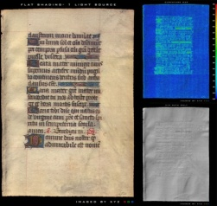

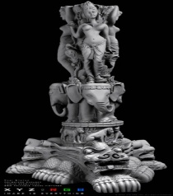
Visibility Ordering – 8800GTX

Slide 63
Visibility Ordering – 8800GTX
Similar to uniform distribution

Slide 64
Visibility Ordering – 8800GTX
Sequence needs to be a power of two in length

Slide 65
Conclusions
Minimal, manual cache
Used only for prefix sum and bitonic
32-word SIMD instruction
Main part executes same instructions
Coalesced memory access
All reads coalesced
No block synchronization
Only required in first phase
Expensive synchronization primitives
Two passes amortizes cost

Slide 66
Conclusions
Quicksort is a viable sorting method for graphics processors and can be implemented in a data parallel way
It is competitive

Slide 67
Thank you! www.cs.chalmers.se/~cederman

