Slide 1
Software Security
Lesson Introduction
Software vulnerabilities and how attackers exploit them.
Defenses against attacks that try to exploit buffer overflows.
Secure programming: Code “defensively”, expecting it to be exploited. Do not trust the “inputs” that come from users of the software system.

Slide 2
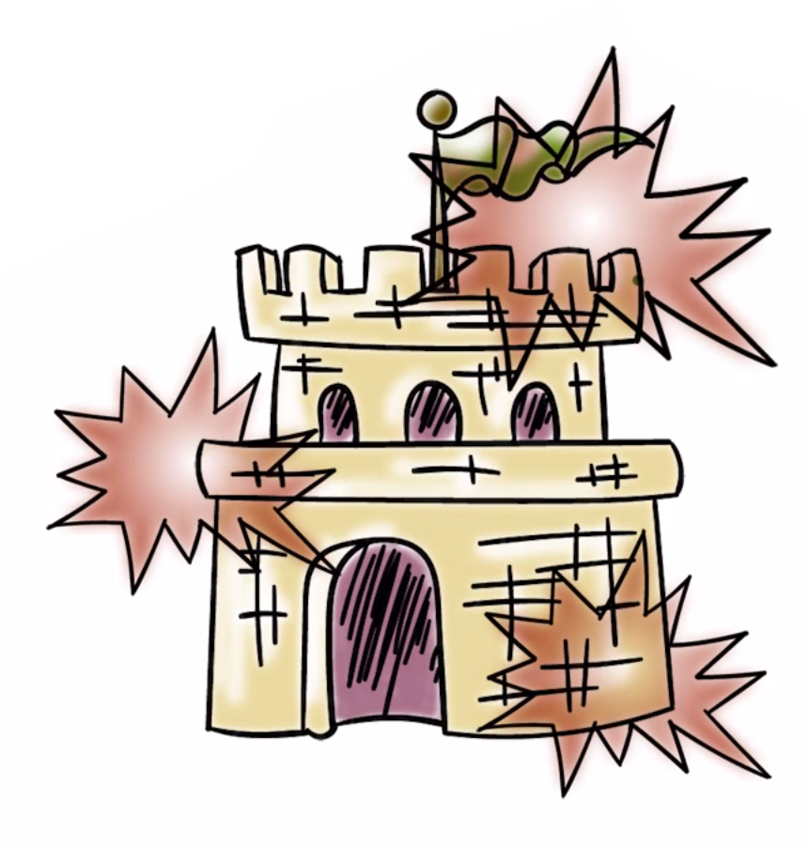
Software Vulnerabilities &
How They Get Exploited
Example: Buffer overflow - a common and persistent vulnerability
Stack buffer overflows
Stacks are used...
in function/procedure calls
for allocation of memory for...
local variables
parameters
control information (return address)

Slide 3

A Vulnerable Password Checking Program
#include <stdio.h>
#include <strings.h>
int main(int argc, char *argv[]) {
int allow_login = 0;
char pwdstr[12];
char targetpwd[12] = "MyPwd123";
gets(pwdstr);
if (strncmp(pwdstr,targetpwd, 12) == 0)
allow_login = 1;
if (allow_login == 0)
printf("Login request rejected");
else
printf("Login request allowed");
}

Slide 4

Stack Access Quiz
Check the lines of code, when executed, accesses addresses in the stack frame for main():
int main(int argc, char *argv[]) {
int allow_login = 0;
char pwdstr[12];
char targetpwd[12] = "MyPwd123";
gets(pwdstr);
if (strncmp(pwdstr,targetpwd, 12) == 0)
allow_login = 1;
if (allow_login == 0)
printf("Login request rejected");
else
printf("Login request allowed");
}

Slide 5
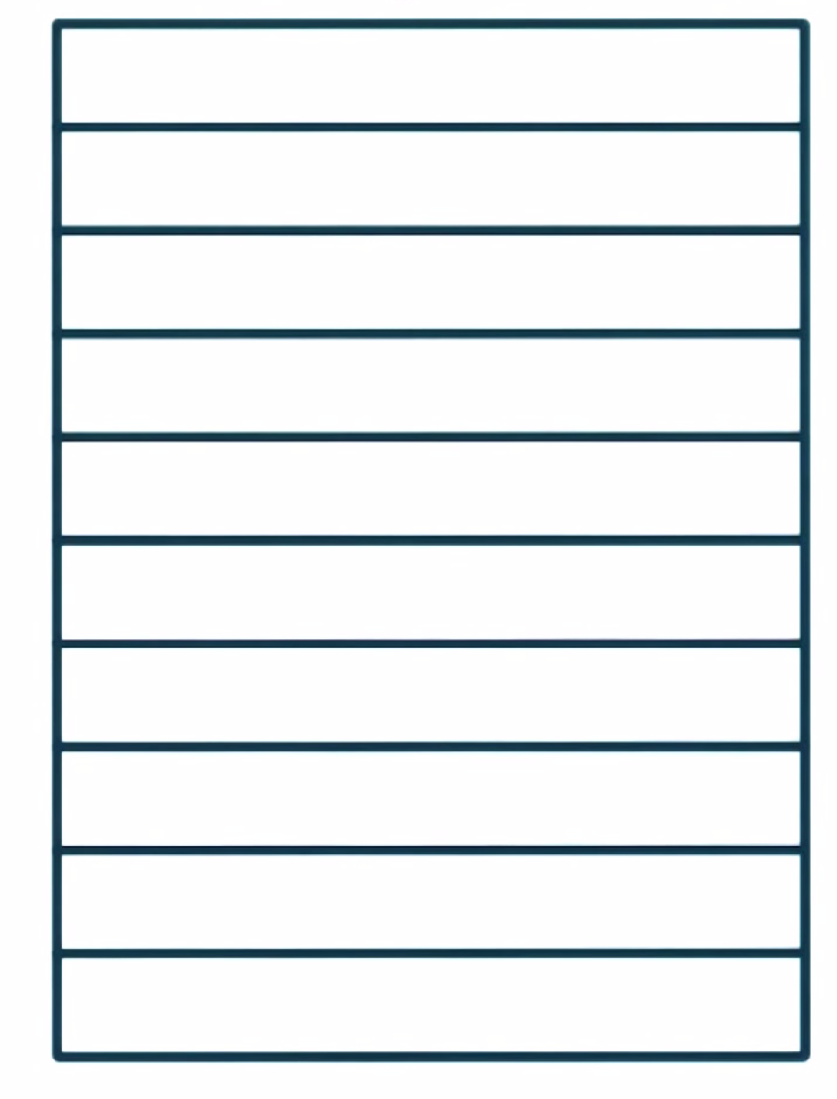
Understanding the Stack
High Address
Low Address

Slide 6
Attacker Bad Input Quiz
What type of password string could defeat the
password check code? (Check all that apply)
#include <stdio.h>
#include <strings.h>
int main(int argc, char *argv[]) {
int allow_login = 0;
char pwdstr[12];
char targetpwd[12] = "MyPwd123";
gets(pwdstr);
if (strncmp(pwdstr,targetpwd, 12) == 0)
allow_login = 1;
if (allow_login == 0)
printf("Login request rejected");
else
printf("Login request allowed");
}
Any password of length greater than 12 bytes that ends in ‘123’
Any password of length greater than 16 bytes that begins with ‘MyPwd123’
Any password of length greater than 8 bytes

Slide 7

Attacker Code Execution
We type a correct password (MyPwd123) of less than 12 characters:
The login request is allowed.
Now let us type “BadPassWd” when we are asked to provide the password:
The login request is rejected.

Slide 8
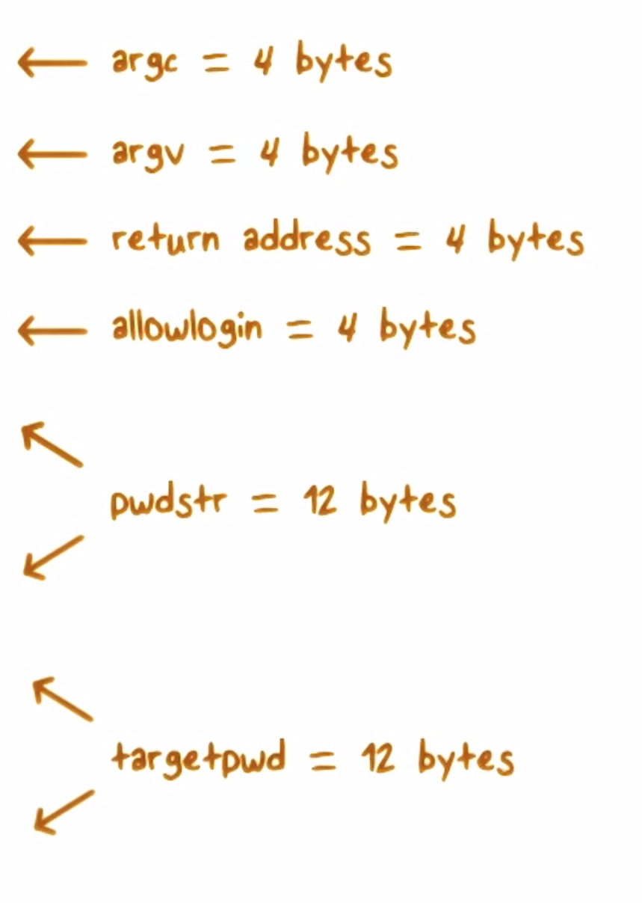
Attacker Code Execution

Slide 9
Attacker Code Execution
If we type a really long string, we will overflow into the return address space.

Slide 10
Attacker Code Execution
We can carefully overflow the return address so it contains the value of an address where we put some code we want executed.

Slide 11
Buffer Overflow Quiz
Which of these vulnerabilities applies to
the code:
The target password was too short, this made it easy to overflow the buffer.
The code did not check the input and reject password strings longer than 12 bytes.
The code did not add extra, unused variables. If this is done then when the user inputs a long password, it won’t overflow into the return address.

Slide 12

ShellCode
Shell Code: creates a shell which allows it to execute any code the attacker wants.
Whose privileges are used when
attacker code is executed?
The host program’s
System service or OS root privileges
LEAST Privilege is IMPORTANT

Slide 13
National Vulnerability Database (NVD) Quiz
How many CVE (Common Vulnerability and Exposure) vulnerabilities do you think NVD will have?
[1] Close to 500, [2] A few thousand, [3] Close to 70000
If you search the NVD, how many buffer overflow vulnerabilities will be reported from the last three months?
[1] less than 10, [2] Several hundred, [3] Close to one hundred
How many buffer overflow vulnerabilities in the last 3 years?
[1] Over a thousand, [2] fifty thousand, [3] five hundred
Notes:
7000; 100; 1000

Slide 14
Variations of Buffer Overflow
Return-to-libc: the return address is overwritten to point to a standard library function.
Heap Overflows: data stored in the heap is overwritten. Data can be tables of function pointers.
OpenSSL Heartbleed Vulnerability: read much more of the buffer than just the data, which may include sensitive data.

Slide 15
Heap Overflow
Buffer overflows that occur in the heap data area.
Typical heap manipulation functions: malloc()/free()
Higher Address
Stack
char* p = malloc (256);
memset (p, ‘A’, 1024);
Heap
Lower Address

Slide 16
Heap Overflow – Example
Overwrite the function pointer in the adjacent buffer
Higher Address
Function Pointer
Function Pointer
Chunk 2
Chunk 1
Before heap overflow
After heap overflow

Slide 17

Defense Against Buffer Overflow Attacks
Programming language choice is crucial.
The language...
Should be strongly typed
Should do automatic bounds checks
Should do automatic memory management
Examples of Safe languages: Java, C++, Python

Slide 18

Defense Against Buffer Overflow Attacks
Why are some languages safe?
Buffer overflow becomes impossible due to runtime system checks
The drawback of secure languages
Possible performance degradation

Slide 19
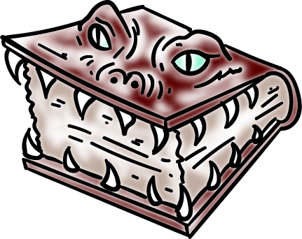
Defense Against Buffer Overflow Attacks
When Using Unsafe Languages:
Check input (ALL input is EVIL)
Use safer functions that do bounds checking
Use automatic tools to analyze code for potential unsafe functions.

Slide 20

Defense Against Buffer Overflow Attacks
Analysis Tools…
Can flag potentially unsafe functions/constructs
Can help mitigate security lapses, but it is really hard to eliminate all buffer overflows.
Examples of analysis tools can be found at:
https://www.owasp.org/index.php/Source_Code_Analysis_Tools

Slide 21

Thwarting Buffer Overflow Attacks
Stack Canaries:
When a return address is stored in a stack frame, a random canary value is written just before it. Any attempt to rewrite the address using buffer overflow will result in the canary being rewritten and an overflow will be detected.

Slide 22
Countermeasure – Stack Protection
Canary for tamper detection
No code execution on stack
…
Before using the return address,
check if the canary value on stack is the
same as value stored in a register
Injected
code
Return
address
Overwriting return
address will always
overwrite the canary value
Canary
Stack
growth
direction
passwordok
Unbounded
write
overwrites
contents
of stack
userid
password

Slide 23

Thwarting Buffer Overflow Attacks
Address Space Layout Randomization (ASLR) randomizes stack, heap, libc, etc. This makes it harder for the attacker to find important locations (e.g., libc function address).
Use a non-executable stack coupled with ASLR. This solution uses OS/hardware support.

Slide 24
Buffer Overflow Attacks Quiz
Do stack canaries prevent return-to-libc buffer overflow attacks?
Does ASLR protect against read-only buffer overflow attacks?
Can the OpenSSL heartbleed vulnerability be avoided with non-executable stack?
Yes No
Yes No
Yes No

Slide 25
Software Security
Lesson Summary
Understand how software bug/ vulnerabilities can be exploited
Several defenses possible against attacks
Buffer overflows remain a problem
Web security: Important for web
Secure coding -- check all input!

