Slide 1
Access Control
Lesson Introduction
Understand the importance of access control
Explore ways in which access control can be implemented
Understand how access control is implemented

Slide 2
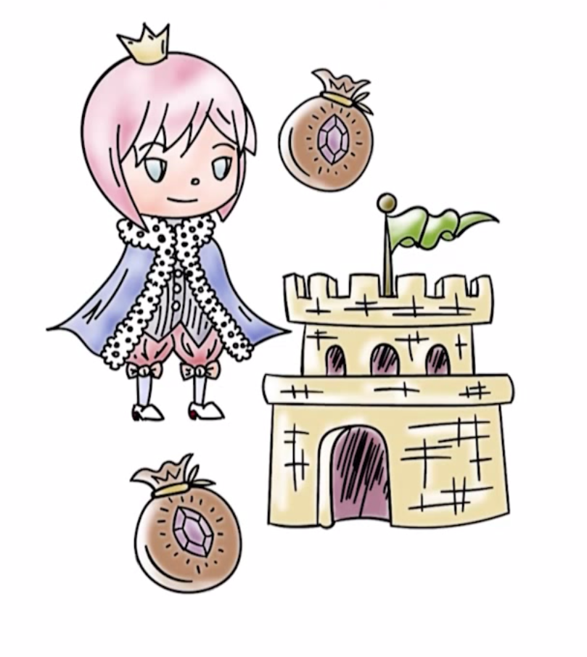
Controlling Accesses to Resources
TCB (reference monitor) sees a request for a resource, how does it decide whether it should be granted?
Example: Should John’s process making a request to read a certain file be allowed to do so?

Slide 3
Controlling Accesses to Resources
Authentication establishes the source of a request (e.g., John’s UID)
Authorization or access control answers the question if a certain source of a request (User ID) is allowed to read the file
Subject who owns a resource (creates it) should be able to control access to it (sometimes this is not true)

Slide 4
Controlling Accesses to Resources
Access Control
Basically, it is about who is allowed to access what.
Two parts
Part I: Decide who should have access to certain resources (access control policy)
Part II: Enforcement – only accesses defined by the access control policy are granted.
Complete mediation is essential for successful enforcement

Slide 5

Access Control Matrix (ACM)
An access control matrix (ACM) abstracts the state relevant to access control.
Rows of ACM correspond to users/subjects/groups
Columns correspond to resources that need to be protected.
ACM defines who can access what
ACM [U,O] define what access rights user U has for object O.

Slide 6
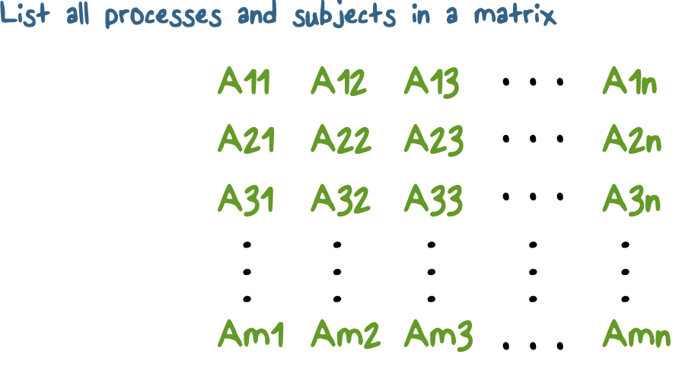
Implementing Access Control

Slide 7
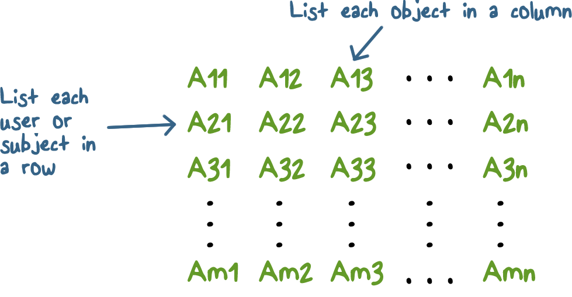
Access Control Matrix (ACM)

Slide 8

Data Confidentiality Quiz
Select the best answer to complete
this sentence:
A file is created by a certain user who becomes its owner. The owner can choose to provide access to this file to other users. If file data confidentiality is desired, the owner should control who has...
Read access to the file
Write access to the file
Both read and write access to the file

Slide 9
Determining Access Quiz
Select the best answer to the question:
The access control policy in a system can either define positive access for a certain subject or can specify that the subject be denied access. Consider a case where subject Alice belongs to a group All-Students. The system specifies that members of the group All-Students be able to read file foo but Alice is denied access for it. In such a case, what should the system do?
Alice has access because she is member of All-Students so she must be allowed to read foo
Negative access should take precedence and Alice’s request must be denied

Slide 10
Discretionary Access Control Quiz
In discretionary access control, access to a resource is at the discretion of its owner. Let us assume owner Alice of file foo can choose to grant read access to foo to another user Bob but can prevent Bob from propagating this access right to others. Does this ensure that a third user, Charlie, can never read the data from foo?
Yes, Charlie is not granted access so cannot read
No, there may be another way for Charlie to access the data from foo

Slide 11
Implementing Access Control
Access control matrix is large
How do we represent it in the system?
Column for object Oi is [(ui1, rights1), (ui2, rights2),…]
Called access control list or ACL
Associated with each resource
For user ui, a row in the matrix is [(oi1, rights1), (oi2,rights2,….].
Called a capability-list or C-list.
Such a C-list stored for each user

Slide 12
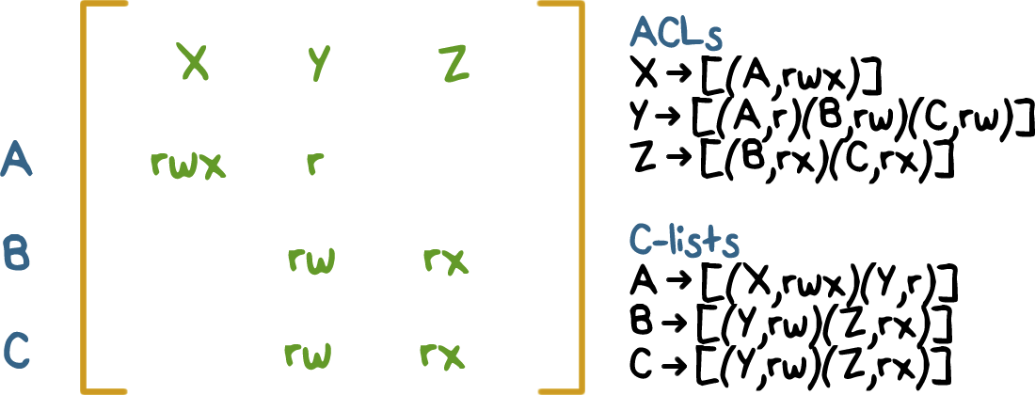
Implementing Access Control

Slide 13
ACL and C-Lists Implementation:
ACL
Where should an ACL be stored?
In trusted part of the system
Consists of access control entries, or, ACEs
Along with other object meta-data
For example, file meta-data has a bunch of information where this can go as well
Checking requires traversal of the ACL

Slide 14
ACL and C-Lists Implementation:
C-list
Where do C-lists go?
A capability is an unforgeable reference/handle for a resource
User catalogue of capabilities defines what a certain user can access
Can be stored in objects/resources themselves (Hydra)
Sharing requires propagation of capabilities

Slide 15
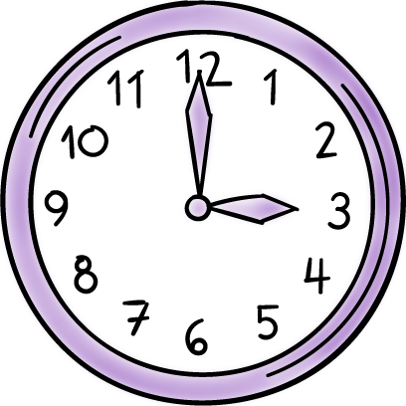


ACL and C Lists Implementation:
ACL
vs.
C-list
Revocation
Efficiency
Accountability

Slide 16
ACE Quiz
Select the best answer:
Alice goes to a movie theater and purchases a ticket for her favorite movie. She is allowed access to the movie because she has the ticket. The ticket is more like a...
Access control entry
Capability

Slide 17
ACE Access Quiz
Select the best answer:
Some operating systems (e.g., Windows) include deny or negative access rights. In this case, an access check procedure can terminate as soon as...
A positive or grant access ACE is found for the requestor
A negative or deny ACE is found
The whole ACL must be traversed always

Slide 18
Revocation of Rights Quiz
Select the best answer:
Revocation of access certain access rights can be carried out easily in systems that use...
ACLs
C-lists

Slide 19
Access Control Implementation
How is Access Control Implemented in Unix-like Systems?
In Unix, each resource looks like a file.
Each file has an owner (UID) and access is possible for owner, group and everyone (world).
Permissions are read, write and execute.
Original ACL implementation had a compact fixed size representation (9 bits)
Now full ACL support is available in many variants (Linux, BSD, MacOS,..)
Few other things (sticky bit, setuid,…)

Slide 20
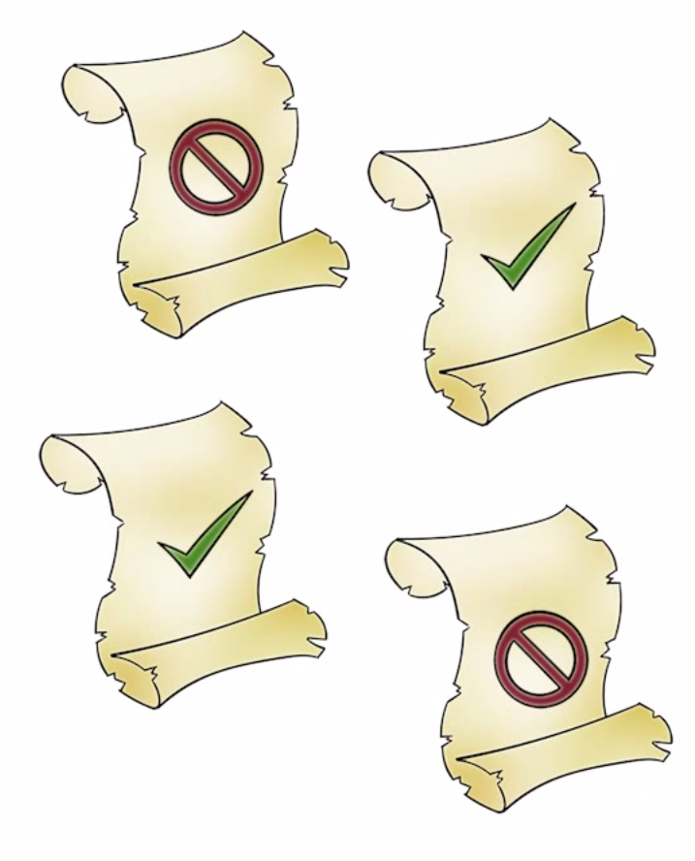
Access Control Implementation
How are files used (system calls for accessing files)?
Create (filename) /* several ways to do it */
fd = open (filename, mode)
read (fd, buf, sizeof(buf))
write (fd, buf, sizeof(buf))
close(fd)

Slide 21
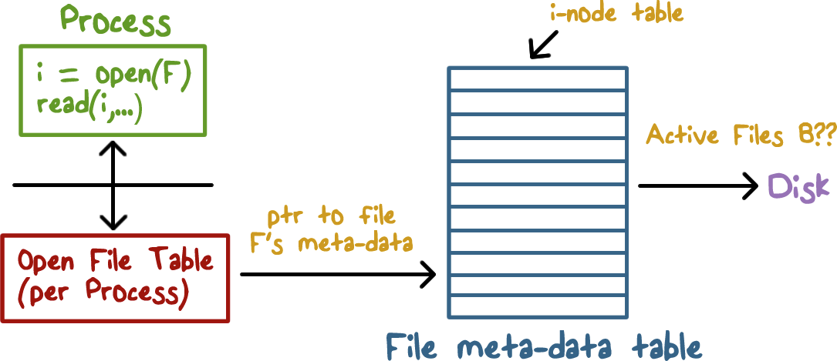
How does the OS Implement ACL?

Slide 22
Time to Check vs. Time to Use (TOCTOU) Quiz
A time-to-check-time-to-use vulnerability arises when access check is performed separately from when a file is read or written. TOCTOU vulnerability arises when...
File permissions change after an open() call completes for the file and before it is closed.
The file permission change only when the file is currently not opened by any program

Slide 23
Unix File Sharing Quiz
In Unix based systems, a file can be shared by sharing its descriptor.
True
False

Slide 24
SetUID Bit Quiz
An executable file F1 has the setuid bit set and is owned by user U1. When user U2 executes F1 (assuming U2 has execute permission for F1), the UID of the process executing F1 is...
U1
U2

Slide 25

Role-Based Access Control (RBAC)
In enterprise setting, access may be based on job function or role of a user
Payroll manager, project member etc.
Access rights are associated with roles
Users authenticate themselves to the system
Users then can activate one or more roles for themselves

Slide 26

RBAC Benefits
Policy need not be updated when a certain person with a role leaves the organization
New employee should be able to activate the desired role
Revisiting least privilege
User in one role has access to a subset of the files
Switch roles to gain access to other resources
SELinux supports RBAC

Slide 27
Access Control Quiz
Alice has some sensitive data that she only wants to share with Bob and not Charlie. Alice will need to...
Fully trust Bob to not share the data with Charlie for her to ensure that Charlie does not gain access to it.
Does not need to trust Bob because access control will stop Charlie from accessing it

Slide 28
RBAC Benefits Quiz
In systems that do not support RBAC but allow user groups to be defined, benefits of RBAC can be realized with groups.
True
False

Slide 29
Access Control Policy Quiz
Fail-safe defaults implies that when an access control policy is silent about access to a certain user U ...
Access must be denied when U makes a request
Access can be granted because it is not explicitly denied

Slide 30
Access Control
Lesson Summary
Fundamental requirement when resources need to be protected
An access control matrix captures who can access what and the manner in which it can be done
ACLs and C-lists are ways for implementing access control
Getting access control policy right is challenging

