Slide 1
Web Security
Lesson Summary
Overview of Web and security vulnerabilities
Cross Site Scripting
Cross Site Request Forgery
SQL Injection
Notes:
The Web is an extension of our computing environment because most of our daily tasks involve interaction with the Web.
In this lesson we will first review how the Web works, that is, how the browser interacts with websites, and the major threat vectors.
We will then discuss several attacks: cross site scripting, cross site request forgery, and SQL injection

Slide 2
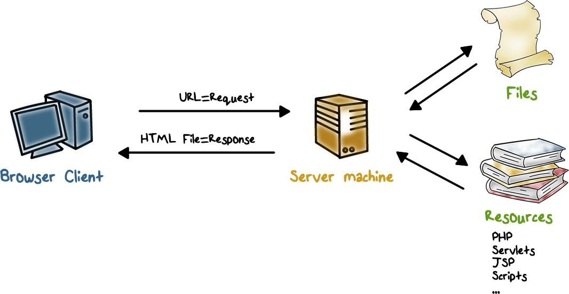
How the Web Works
Notes:
Let’s briefly review how the web works.
The web browser and the web server communicate using the hypertext transfer protocol (http)
Browser requests “documents” (or scripts) through URL.
The Server responds with “documents” in Hyper-text markup language (html), which can include not just text but also graphics, video/audio, postscript, JavaScript, etc.
Browsers display html documents and embedded graphics, it can run JavaScript and other helper applications.

Slide 3
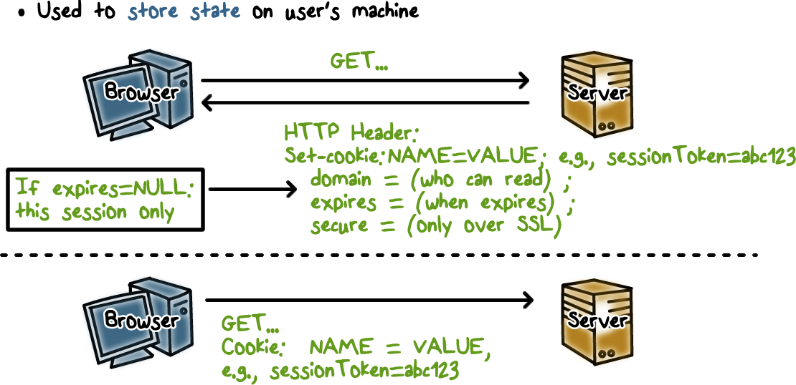
Cookies
Notes:
http is a stateless protocol, that is, each request is its own TCP connection. For example, if you log into a your bank’s web site, each click on a URL generates a separate TCP connection. In order to carry information across multiple http requests, such as user authentication, cookies are used.
A cookie is created by the web server when the user logs into the site. It contains not only user identity information but also security information such as access, expiration time, and if SSL is required.
The user’s browser stores the cookie, and includes it in subsequent requests so that the server knows that these requests are related, for example, they belong to the same user login session.

Slide 4

Cookie Quiz
Which of the following are true statements?
Cookies are created by ads that run on websites
Cookies are created by websites a user is visiting
Cookies are compiled pieces of code
Cookies can be used as a form of virus
Cookies can be used as a form of spyware
All of the above
Notes:
QUIZ:
As we discussed, cookies are added to the browser directories of website visitors. So we should make sure we really understand what exactly it is we are letting onto our computers.
---
SOLUTION:
True-Cookies are created by ads, widgets, and elements on the web page the user is visiting.
True-Cookies are created by websites a user is visiting
False- cookies are not compile code. They are plaintext.
False - since cookies are not compiled code they cannot be used as a virus. They cannot replicate themselves, they cannot be executed and are not self-executing. These are all characteristics necessary to be a virus.
True- cookies can be used as spyware. Cookies store user preferences and browsing history.

Slide 5
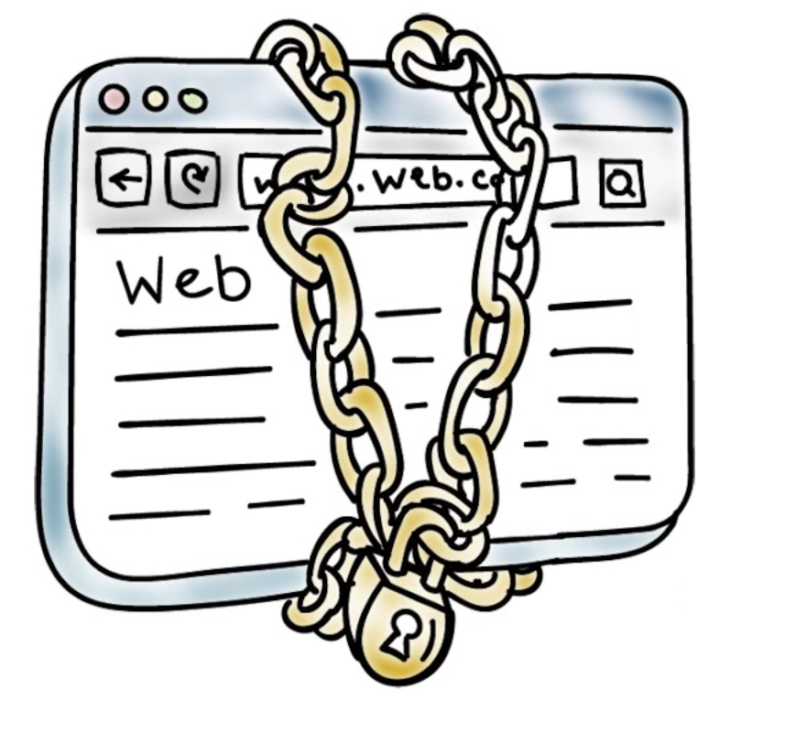
The Web and Security
Web page contains both static and dynamic contents, e.g., JavaScript
Sent from a web site(s)
Run on the user’s browser/machine
Notes:
Let’s look at the main Web security issues.
The Browser accepts contents, and often runs dynamic contents such as scripts, from web sites. The question is: can a browser trust these contents? In some cases, the browser can authenticate the web site, but in many cases, authentication is not required. But even if a web site is authenticated, the contents that it sends may not be trustworthy because the web site may have security vulnerabilities that allow attackers to inject malicious content that gets passed onto the users visiting the web site. Or the web site includes contents or links to other web sites, which may also have security vulnerabilities.

Slide 6
The Web and Security
Web sites run applications (e.g., PHP) to generate response/page
According to requests from a user/browser
Often communicate with back-end servers
Notes:
On the server side, a web site runs web applications that process requests from browsers, and often interacts with back-end servers to produce the contents for users. These web applications, like any software, may have security vulnerabilities. Furthermore, many web sites do not authenticate users. That is, attackers are not prevented from sending requests designed to exploit security vulnerabilities.

Slide 7
Web Browser Quiz
Mark each statement as true or false.
Web browser can be attacked by any web site that it visits
Even if a browser is compromised, the rest of the computer is still secure
Web servers can be compromised because of exploits on web applications
Notes:
QUIZ:
Discuss
---
SOLUTION:
1. T. 2. F (can lead malware installation, data theft, etc.) 3. T (e.g., deface sites, and back-end servers can be compromised as well, e.g., stolen credit cards)

Slide 8
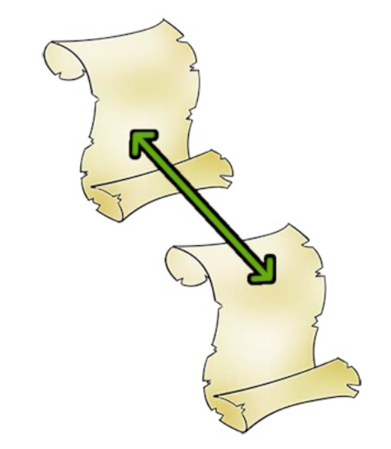
Cross-Site Scripting (XSS)
If a website allows users to input content without controls, then attackers can insert malicious code as well.
Social networking sites, blogs, forums, wikis
Suppose a website echoes user-supplied data, e.g., his name, back to user on the html page
Notes:
Many websites allow users to input data and then display or echo the data back, that is, include the user-input data in the html page to the user’s browser. Such web sites include social networking sites, blogs, etc.

Slide 9
Cross-Site Scripting (XSS)
Suppose the browser sends to the site <script type=”text/javascript”>alert(“Hello World”); </script> as his “name”
The script will be included in the html page sent to the user’s browser; and when the script runs, the alert “Hello World” will be displayed
What if the script is malicious, and the browser had sent it without the user knowing about it?
But can this happen?
Notes:
For example, when the user’s browser sends the user’s name to a web site, the web site echos the name back. If the browser sends a script as the name, then the script will be included in the html page and the user’s browser will execute the script.
What if the script is malicious, and the browser sent it to the web site without the user knowing about it? The browser will end up having to execute the malicious script when it is included in the html page sent back from the web site.
This can happen in a cross-site scripting attack.

Slide 10
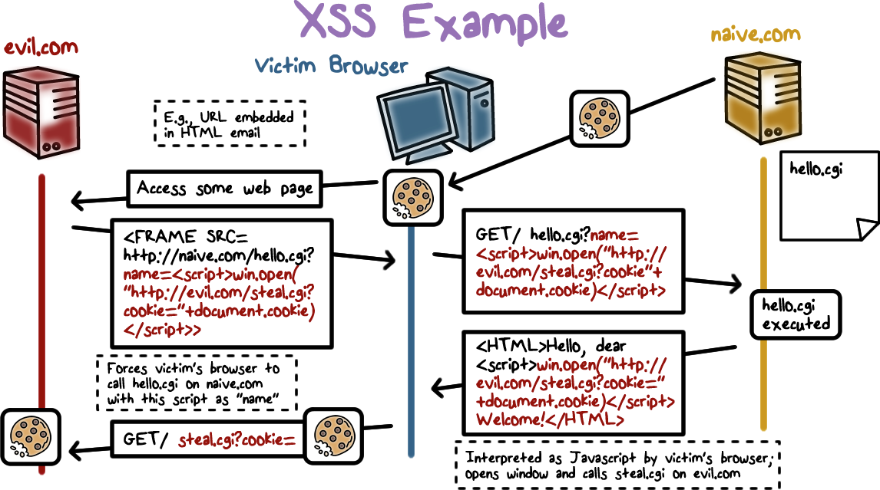
Notes:
Here is an example XSS:
The user has logged into a vulnerable site naïve.com and his browser now stores a cookie from naïve.com.
The user is phished and clicks a URL to visit evil.com.
evil.com returns a page that has a hidden frame that forces the browser to visit naïve.com and invoke hello.cgi, with a malicious script as the “name” of the user.
hello.cgi at naïve.com echos the name, which is actually the malicious script in the html page that is sent back to the user’s browser.
The user’s browser displays the html page and executes the malicious script, which steals the cookie to naïve.com, and sends it to an attacker.
So what if evil.com gets the cookie for naive.com? Cookies can include session authenticators for naive.com, that is, the attacker can now impersonate the user.

Slide 11
XSS Query Quiz
Mark each statement as true or false.
When a user’s browser visits a compromised or malicious site, a malicious script is returned
To prevent XSS, any user input must be checked and preprocessed before it is used inside html
Notes:
QUIZ:
Discuss
---
SOLUTION:
1. T. 2. T. (e.g., name should not be a script)

Slide 12

XSRF: Cross-Site Request Forgery
A browser runs a script from a “good” site and a malicious script from a “bad” site
Malicious script can make forged requests to “good” site with user’s cookie
Notes:
Cross-site request forgery (XSRF) is another web-based attack.
A user’s browser may be running a script from a good site and also a malicious script from a bad site. This can happen when the user has logged into the good site and keeps the session alive. For example the user has logged into Gmail, and has not logged off. Meanwhile, the user may be browsing other sites, include a bad site that sends malicious script to the browser.
The malicious script can then forge a request to the good site using the user’s cookie. The good site does not know the request is not sent by the user.

Slide 13
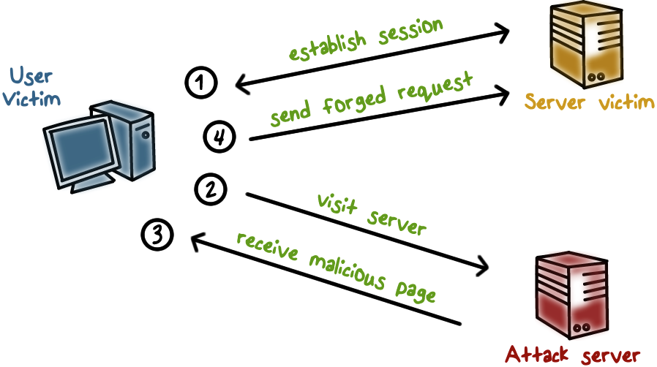
XSRF: Basic Idea
Notes:
Here is an illustration:
The user logs in and establishes a session with a good site, and keeps the session alive.
Meanwhile, the user browses a bad site, e.g., because he is phished, and the browser runs a malicious script from the bad site.
The malicious script then sends forged request to the good site.

Slide 14
XSRF: Example
<form name=BillPayForm
action=http://bank.com/BillPay.php>
<input name=recipient value=badguy>
…
<script>
document.BillPayForm.submit();
</script>
Notes:
Here is a realistic example:
A User logs into bank.com, forgets to sign off.
The Session cookie remains in browser state
The User then visits a malicious website, which sends a HTML page that contains a hidden iframe that includes this malicious element:
<form name=BillPayForm
action=http://bank.com/BillPay.php>
<input name=recipient value=badguy> …
<script> document.BillPayForm.submit(); </script>
That is, when the user’s browser displays the HTML page, actions will be performed on the Bill Payment form of the bank.com page as if the users are entering these values. Because the iframe is invisible, the user knows nothing about it. The browser will send a request on behalf of the user and without his consent and knowledge.

Slide 15
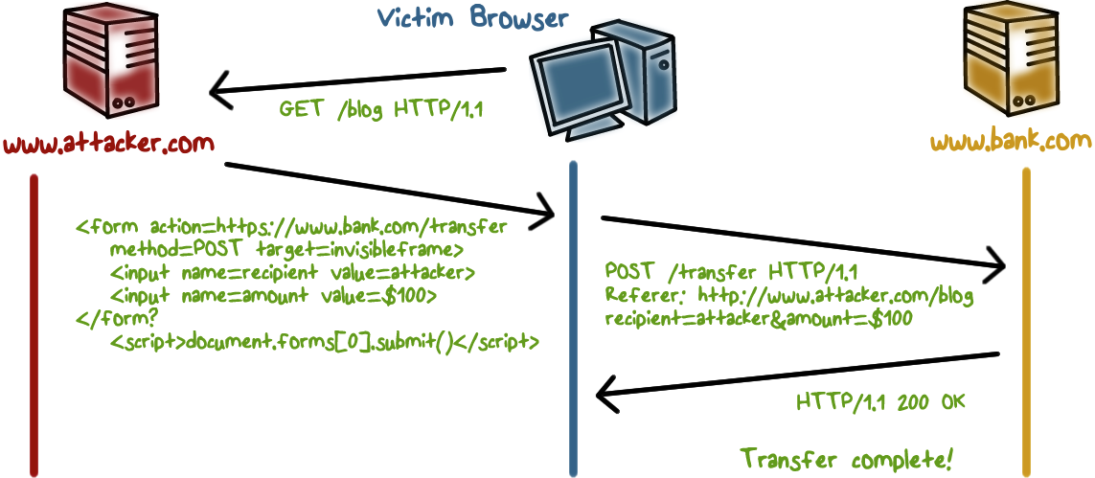
XSRF: Example
Notes:
Here is an illustration of the example …
And since the user is still logged into bank.com, the user’s cookie is also sent to the bank along with the request.
And so the bank web site believes the request is from the user, and so payment request is fulfilled!

Slide 16
XSRF vs XSS
Cross-site scripting
User trusts a badly implemented website
Attacker injects a script into the trusted website
User’s browser executes attacker’s script
Cross-site request forgery
A badly implemented website trusts the user
Attacker tricks user’s browser into issuing requests
Website executes attacker’s requests
Notes:
Comparing XSRF and XSS …
XSS: user trusts a site, attacker injects a script to the site and it is echoed back to the user’s site, which then executes the malicious script.
XSRF: a site trusts requests are from the user, attacker forges user requests to the site, which executes the attacker’s malicious actions.
They are both the result of security weakness of web sites, in particular, the lack of authenticating and validating user input.

Slide 17
XSRF Quiz
Which of the following methods can be used to prevent XSRF?
Checking the http Referer header to see if the request comes from an authorized page.
Use synchronizer token pattern where a token for each request is embedded by the web application in all html forms and verified on the server side.
Logoff immediately after using a web application.
Do not allow browser to save username/password and do not allow web sites to “remember” user login
Do not use the same browser to access sensitive web sites and to surf the web freely
All the above
Notes:
QUIZ:
Discuss
---
SOLUTION:
Correct answer: F

Slide 18
Structured Query Language (SQL)
Widely used database query language
Retrieve a set of records, e.g.,
SELECT * FROM Person WHERE Username=‘Lee’
Add data to the table, e.g.,
INSERT INTO Key (Username, Key) VALUES (‘Lee’, lfoutw2)
Modify data, e.g.,
UPDATE Keys SET Key=ifoutw2 WHERE PersonID=8
Notes:
Before we discuss SQL Injection attacks, let’s quickly review SQL.

Slide 19

Sample PHP Code
Sample PHP
$selecteduser = $_GET['user'];
$sql = "SELECT Username, Key FROM Key”.
"WHERE Username='$selecteduser'";
$rs = $db->executeQuery($sql);
What if ‘user’ is a malicious string that changes the meaning of the query?
Notes:
Nowadays, many databases have a web front-end to allow users to query the database using the Web. The website typically offers a web form for entering the query, and runs a program to form the input into an SQL query and send it to the back-end database.
The security threat here is that the input may be malicious. That is, the SQL to the database server is malicious and can lead to compromise of data confidentiality and integrity.

Slide 20
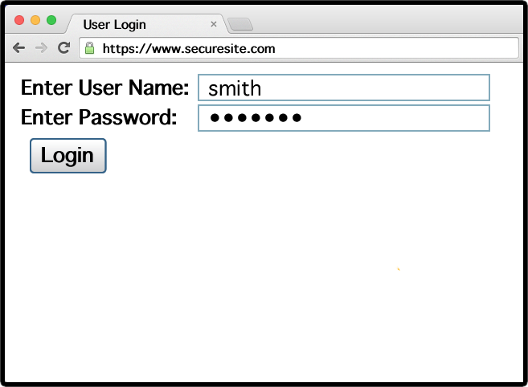
Example Login Prompt
Notes:
Here is an example of web form. A user would enter his name and password.

Slide 21
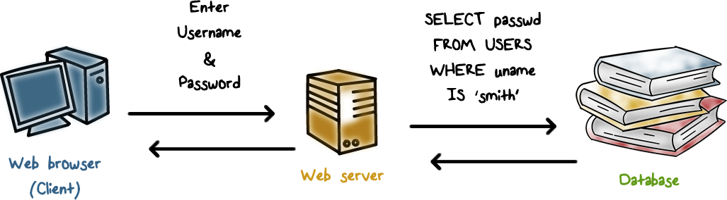
Normal Login
Notes:
The password is sent in encrypted hash form to the web server, and the web server needs to retrieve the user’s password hash from the database to compare and authenticate the user. That is, the web server issues a SQL query to the database.

Slide 22
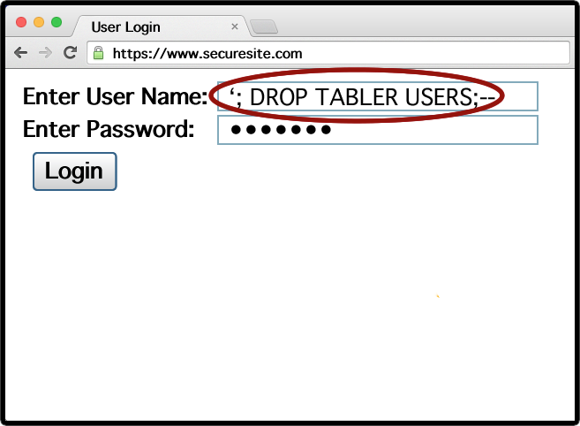
Malicious User Input
Notes:
Now suppose an attacker enters this malicious string as the user name.

Slide 23
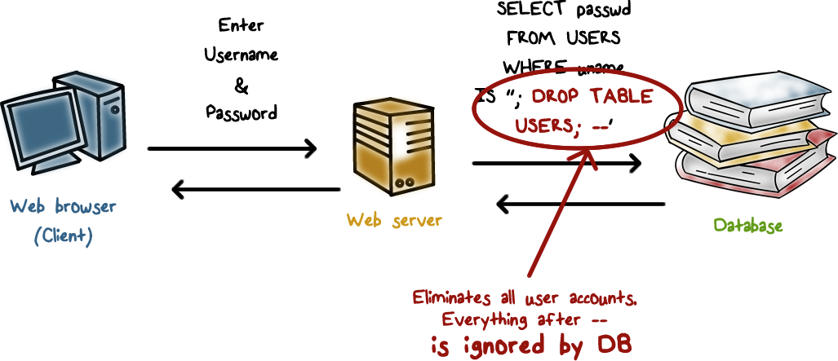
Example SQL Injection Attack
Notes:
The actual SQL query to the backend database server is to delete all user records!

Slide 24
SQL Injection Quiz
Which is the better way to prevent SQL injection?
Use blacklisting to filter out “bad” input
Use whitelisting to allow only well-defined set of safe values
Notes:
QUIZ:
Discuss
---
SOLUTION:
B. Blacklisting is hard because there can be many possible ways to inject malicious strings.

Slide 25
Web Security
Lesson Summary
Both browser and servers are vulnerable: dynamic contents based on user input
XSS: attacker injects a script into a website and the user’s browser executes it
XSRF: attacker tricks user’s browser into issuing request, and the website executes it
SQL injection: attacker inject malicious query actions, and a website’s back-end db server executes the query
Notes:
Discuss

