Slide 1
Cyber Security Management
Lesson Introduction
Understand organizational context for cyber security
Understand the people, process and technology dimensions of cyber security management
Assessing cyber risk and its relationship to security management
Notes:
Headshot

Slide 2
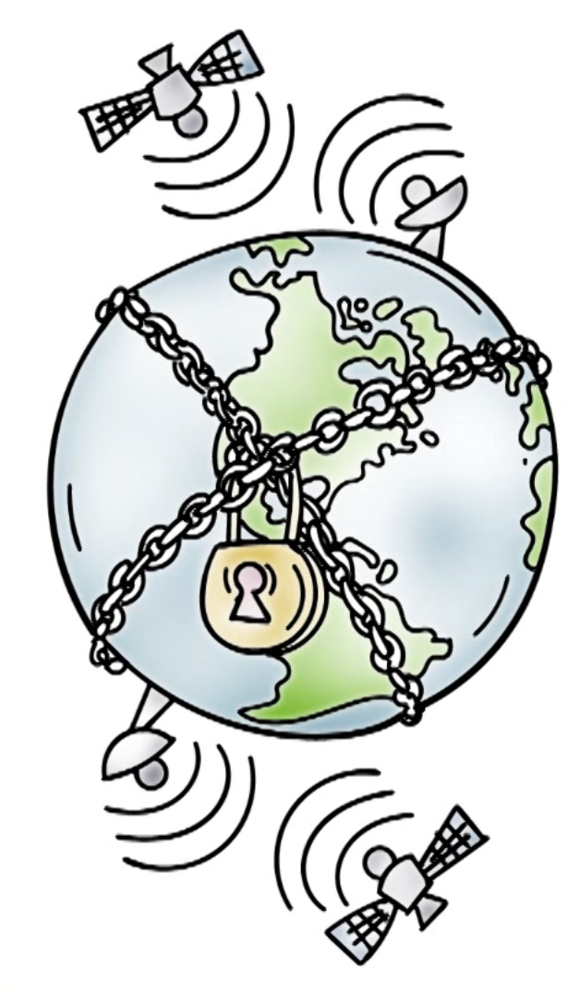
Managing Security
Technical controls (authentication, access control etc.) are used to reduce the risk of attacks on valuable assets.
What assets need to be secured and from whom?

Slide 3
Organizational Context
Legal and compliance drivers for cyber security
Financial and health data
What technical controls should be deployed?
Must understand risks posed by threats
Costs and benefits of security measures

Slide 4

Key Challenges
What assets are under risk?
What are the threats and how serious is the risk posed by them?
Likelihood of successful attack and its impact

Slide 5
Key Challenges
What technological solutions/controls exist to counter threats?
How can we address risk in a cost-effective manner?
Cost is less than reduction in risk
How do we understand people and process aspects of cyber security management?

Slide 6

Network Use Policy Quiz
Cyber security planning and management in an
enterprise must define allowed computer and network use by employees. Georgia Tech’s computer and network use policy strives to do this for students, faculty and staff. Check all that you think are required by this policy:
Georgia Tech account passwords should be changed periodically.
A compromise of a computer should be reported to someone responsible for cyber security at Georgia Tech.
Georgia Tech computers cannot be used to download illegal content (e.g., child pornography).
Notes:
QUIZ:
Discuss
---
SOLUTION:
Discuss

Slide 7
Botnet Quiz
A botnet operator compromises a number of
computers in a company. The malware executed by the bots only sends large amounts of spam email but does not exfiltrate sensitive data or interfere with legitimate activities. Choose the appropriate action by the company in this situation:
The company should detect and prevent abuse of its resources by unauthorized parties.
Since it poses no risk to company’s sensitive data or normal operations, it can be ignored.
Notes:
QUIZ:
Discuss
---
SOLUTION:
Discuss

Slide 8
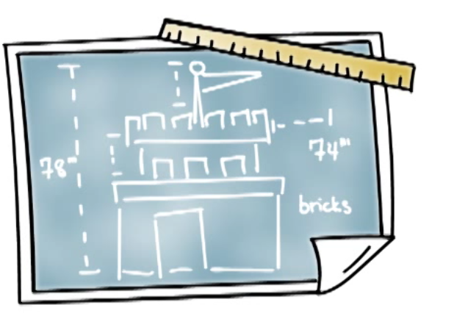
Security Planning
What needs to be secured?
Who is responsible for it?
What technical/non-technical controls should be deployed?
How are people supported to do what they need to do?
What if something goes wrong?
Response and recovery
Accountability and consequences

Slide 9
Assets and Threats
What Needs to be Secured?
Hardware, software and services
Servers, routers, switches, laptops and mobile devices
OS, databases, services and applications
Data stored in databases or files
From whom?
Remote hackers?
Insiders?

Slide 10
Security Audit Quiz
A news story in 2014 reported that an inspector
general’s report gave Veteran Affairs (VA) a failing grade for 16th straight year. The CIO of VA discussed a number of challenges that could explain this grade. Mark the ones that you think could be possible reasons: (See the instructor notes for a link to the article)
The need to manage cyber security for over a million devices each running many services
Lack of sense of urgency in fixing cyber
vulnerabilities.
Choosing to support key functions even when this
could introduce vulnerabilities.
Notes:
QUIZ:
Discuss
---
SOLUTION:
Discuss

Slide 11
CISO Quiz
Choose the best answer.
Chief Information Security Officer (CISO) is the executive who is responsible for information security in a company. Did Target, the major retailer, have a CISO when it suffered the serious breach?
Yes
No
Notes:
QUIZ:
Discuss
---
SOLUTION:
Discuss

Slide 12
Security Planning: Controls
Identity and access management (IAM)
Credentialing, account creation and deletion
Password policies
Network and host defenses
Firewalls, IDS, IPS
Anti-virus
VPN and BYOD
Vulnerability patching
User awareness and education
Phishing attack awareness (Phishme)

Slide 13
Security Planning: Security Policy
High level articulation of security objectives and goals
Legal, business or regulatory rationale
Do’s and don’ts for users
Password length
Web and email policies
Response to security events
Address prevention, detection, response and remediation as it concerns/impacts users

Slide 14

Georgia Tech Computer and
Network Use Policy
States guiding principles
Protect GT IT resources
Ensure no state or federal laws are violated
Some interesting highlights
Copyright and IP
Export control
Who is responsible?
Network – Office of Information Technology
Devices – Units or individual

Slide 15
Computer Use Policy Quiz
Choose the best answer.
Does Georgia Tech’s computer and network use policy prohibit personal use of university resources?
Yes
No
Notes:
QUIZ:
Discuss
---
SOLUTION:
Discuss

Slide 16
Student Privacy Quiz
Choose the best answer.
Georgia Tech systems store student data such as grades. The Institute must protect such data due to...
Regulatory reasons
Because the data is sensitive it can only be disclosed to student and his/her family
Notes:
QUIZ:
Discuss
---
SOLUTION:
Discuss

Slide 17
Anthem Breach Quiz
Choose the best answer.
Anthem suffered from a major breach in 2015. Based on an analysis of its response to the breach, did Anthem respond well to the breach? (see the instructor notes for a link to the analysis)
Yes
No
Notes:
QUIZ:
Discuss
---
SOLUTION:
Discuss

Slide 18

Cyber Risk Assessment
Investments in cyber security are driven by risk and how certain controls may reduce it
Some risk will always remain
How can risk be assessed?

Slide 19
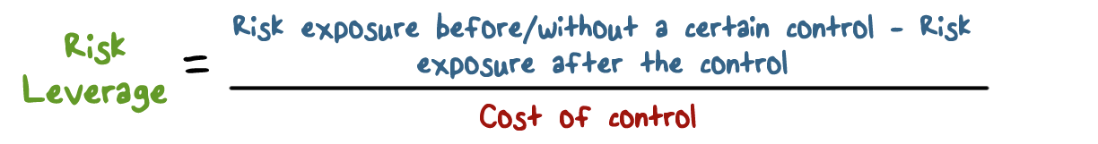
Quantifying Cyber Risk
Risk exposure = Prob. [Adverse security event] * Impact [ adverse event]
Risk leverage > 1 for the control to make sense

Slide 20
Managing Cyber Risk
How do we assess and reduce cyber risk?
Impact
Expected loss (reputational, recovery and response, legal, loss of business etc.)
Risk management
Accept, transfer (insurance) and reduce
Reduction via technology solutions, education and awareness training

Slide 21
Security Breach Quiz
Mark all applicable choices.
A company stores sensitive customer data. The impact of a breach of such data must include...
Cost of purchasing identify theft protection for customers
Loss of business due to reduced customer confidence
Compensation for new cyber security personnel the company hires to better manage cyber security in the future
Notes:
QUIZ:
Discuss
---
SOLUTION:
Discuss

Slide 22
Reducing Exposure Quiz
Choose the best answer.
A company is considering two possible IDS solutions to reduce its exposure to attacks on its network. The first one costs $100K and reduces risk exposure by $150K. The second one costs $250K but reduces risk exposure by $500K. Which solution would you recommend?
Cheaper solution that costs $100K
More expensive solution that costs $250K
Notes:
QUIZ:
Discuss
---
SOLUTION:
Discuss

Slide 23
Cyber Insurance Quiz
Choose the best answer.
Cyber insurance is still not very popular. Based on a 2014 survey, what percentage of customers of major insurance brokers were interested in buying cyber insurance? (see the instructor notes for a link to the survey)
Less than 25%
Over 50%
Notes:
QUIZ:
Discuss
---
SOLUTION:
Discuss

Slide 24

Enterprise Cyber Security Posture
Reactive:
Regulation/compliance
Customer demands
In response to a breach (Target or Home Depot)
In response to events

Slide 25

Enterprise Cyber Security Posture
Proactive:
Champion of an organization who has influence
Board level conversation about cyber security and risk

Slide 26

Enterprise Cyber Security Posture
Economic value argument:
Return on investment (RoI)
Estimating costs and benefits is tricky
Perception vs. data-driven risk

Slide 27
Security Planning and Management
Bringing It All Together!
Values at risk
Assets, reputation etc.
Threats and attack vectors
Plan, implement and manage
Deploy appropriate controls
Empower people and hold them responsible
Plan for response and remediation (do not be surprised)
User awareness
Understand and proactively address risk

Slide 28
Cyber Security Budgets Quiz
Choose the best answer.
Are cyber security budgets increasing as the number of reported incidents increases (see the instructor notes for a link to the PwC report)?
Yes
No
Notes:
QUIZ:
Discuss
---
SOLUTION:
Discuss

Slide 29
Proactive Security Quiz
Choose the best answer.
An example of proactive security measure is...
Making sure the company complies with all regulatory requirements
Chief risk officer (CRO) of the company addressing cyber risk regularly at highest level (e.g., board) when other risks are discussed
Notes:
QUIZ:
Discuss
---
SOLUTION:
Discuss

Slide 30
Cyber Security Management
Lesson Summary
Managing cyber security is a complex process that involves technology, people and processes
Organizational context and cost/benefit analysis is necessary for security controls
Risk based argument for cyber security
Notes:
Headshot

