Slide 1
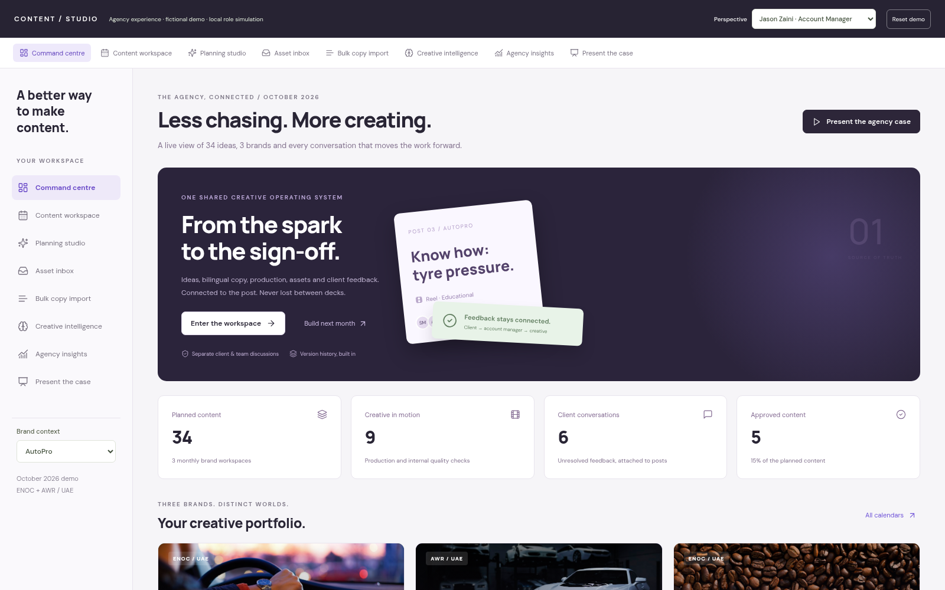
CONTENT / STUDIO · A CONNECTED AGENCY WORKFLOW
The calendar
is alive.
A management case for replacing deck
administration with a shared content
operations platform.
Ideas → production → review → approval
ZOOM / ENOC · AutoPro / ENOC · NXT / AWR
Working internal prototype · fictional demo content
AGENCY CONTENT OPERATIONS / MANAGEMENT CASE / 08 OCTOBER 2026
01
Notes:
Opening: This proposal is about improving how the agency operates its monthly content workflow. It is a working internal prototype, not a production rollout. Three fictional brand workspaces show the experience. The core presentation is slides 1–23; slides 24–33 are the detailed screenshot appendix. Allow 15–20 minutes for the core story, then use the appendix for questions.

Slide 2
CONTENT / STUDIO · THE MANAGEMENT CASE
The cost is in the handoffs.
A single revision can trigger another round of deck and file administration.
01
02
03
Build the deck
Transfer feedback
Rebuild and resend
Ideas, references and captions are
assembled manually.
Client comments are copied back
into an internal version.
Assets, videos and captions are
repackaged for another review.
Business opportunity: reduce repetitive admin while keeping creative work, feedback and
decisions connected.
AGENCY CONTENT OPERATIONS / MANAGEMENT CASE / 08 OCTOBER 2026
02
Notes:
Use the workflow the agency described, not an invented time study. Highlight downloads, repeated uploads, comment transfer, searching for the latest file and packaging videos. No measured cost or ROI is being claimed yet. Ask management to assess the amount of administrative effort in the current process.

Slide 3
CONTENT / STUDIO · THE MANAGEMENT CASE
One content item. One source of truth.
The database is organised around posts, rather than PowerPoint slides.
Calendar view
CONTENT ITEM / POST
Client presentation
Idea + reference + bilingual copy
Assets + owners + due dates
Feedback + approval + history
Production board
Review & approval
Copywriting desk
Agency dashboard
Update the post once. Every view reflects the same content.
AGENCY CONTENT OPERATIONS / MANAGEMENT CASE / 08 OCTOBER 2026
03
Notes:
Explain the architectural principle in ordinary language: we do not maintain separate decks for each team. A planned social post holds its idea, copy, media and feedback. Calendar, board and client presentation are different views of that record. Exports are secondary and rich media remains in the web portal.

Slide 4
CONTENT / STUDIO · THE MANAGEMENT CASE
A connected journey from brief to sign-off.
Clear handoffs across the agency and the client.
01
02
03
04
05
Plan
Create
Check
Review
Deliver
Account Manager
Creative + Copy
Creative Director +
AM
Client
Agency
Objectives, pillars
and monthly
calendar
Assigned work,
references and
bilingual captions
Deliverable approval
and health check
Presentation,
comments and
decisions
Resolve revisions
and track approved
content
Account Managers coordinate the work. The platform carries the context.
AGENCY CONTENT OPERATIONS / MANAGEMENT CASE / 08 OCTOBER 2026
04
Notes:
Take management through the complete lifecycle before the screens. The important point is continuity: a client change request remains on the same post and returns directly to the production team. Internal and client review have separate visibility and approval states.

Slide 5
CONTENT / STUDIO · PRODUCT WALKTHROUGH
The agency, connected.
Command centre / the starting point for the agency.
WORKING PROTOTYPE
A shared overview
Current content, production,
approvals and client conversations.
Act from the dashboard
Open the post behind a
conversation or enter a brand
workspace.
One place to start
Jump into planning, batch tools,
insights or presentation.
A clear starting point for every
day.
AGENCY CONTENT OPERATIONS / MANAGEMENT CASE / 08 OCTOBER 2026
05
Notes:
Show the Command centre tab. Counts are calculated from the current demo records, not fictitious performance results. The initial seed has 34 posts across three October calendars. The presentation captures a fresh demo state; browser edits can change live counts.
SCREENSHOT: 01-command-centre.png. Captured from the fictional interactive HTML demo. Text and shapes are editable; screenshots are raster images.

Slide 6
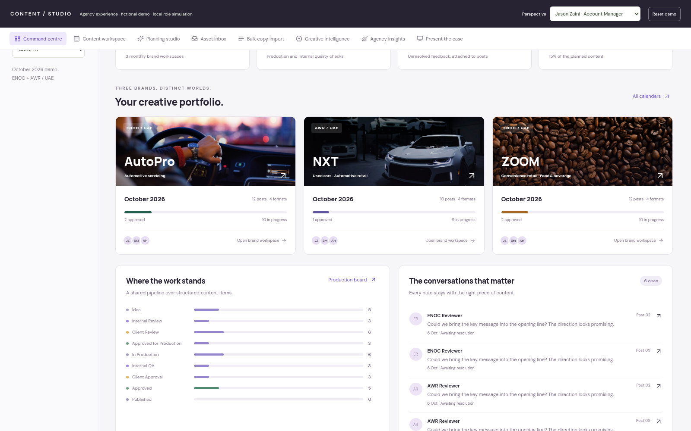
CONTENT / STUDIO · PRODUCT WALKTHROUGH
Three brands. Distinct workspaces.
Brand portfolio / built to grow beyond the first three brands.
WORKING PROTOTYPE
Separate brand contexts
ZOOM and AutoPro belong to ENOC;
NXT belongs to AWR.
Shared operating model
The same calendar, review and
production system serves every
brand.
Configurable knowledge
Profiles hold guidelines, terminology
and planning context.
Scale the structure, keep brand
context.
AGENCY CONTENT OPERATIONS / MANAGEMENT CASE / 08 OCTOBER 2026
06
Notes:
Portfolio photography is illustrative stock imagery, not approved client artwork. Real brand guidelines have not been invented. The seed includes placeholder settings that the agency can replace. Brand, client and agency hierarchy is designed to allow additional brands.
SCREENSHOT: 02-brand-portfolio.png. Captured from the fictional interactive HTML demo. Text and shapes are editable; screenshots are raster images.

Slide 7
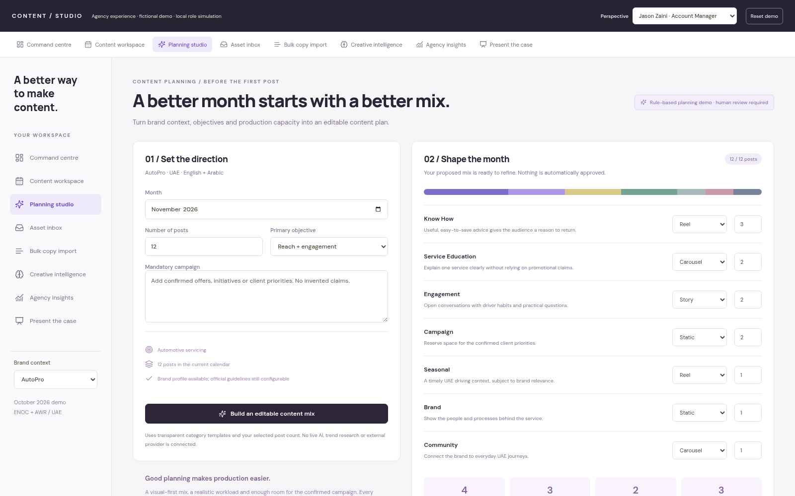
CONTENT / STUDIO · PRODUCT WALKTHROUGH
Plan the mix before creating the month.
Planning studio / turn the brief into editable draft content items.
WORKING CREATION + RULE-BASED
SUGGESTIONS
Set the direction
Choose the brand, month,
objectives and required post count.
Balance the workload
Adjust pillar counts and formats
before committing the plan.
Create draft records
Build the calendar with editable
posts; every approval remains
pending.
A faster start, with human
control.
AGENCY CONTENT OPERATIONS / MANAGEMENT CASE / 08 OCTOBER 2026
07
Notes:
This planning studio is a working local creation workflow supported by deterministic category templates. It is not connected to an AI provider or live trend research. The mix is editable and the total must match the requested post count. Account Managers and Admins create calendars. Demonstrate November 2026 if switching to the live HTML; October remains the seeded review calendar.
SCREENSHOT: 03-planning-studio.png. Captured from the fictional interactive HTML demo. Text and shapes are editable; screenshots are raster images.

Slide 8
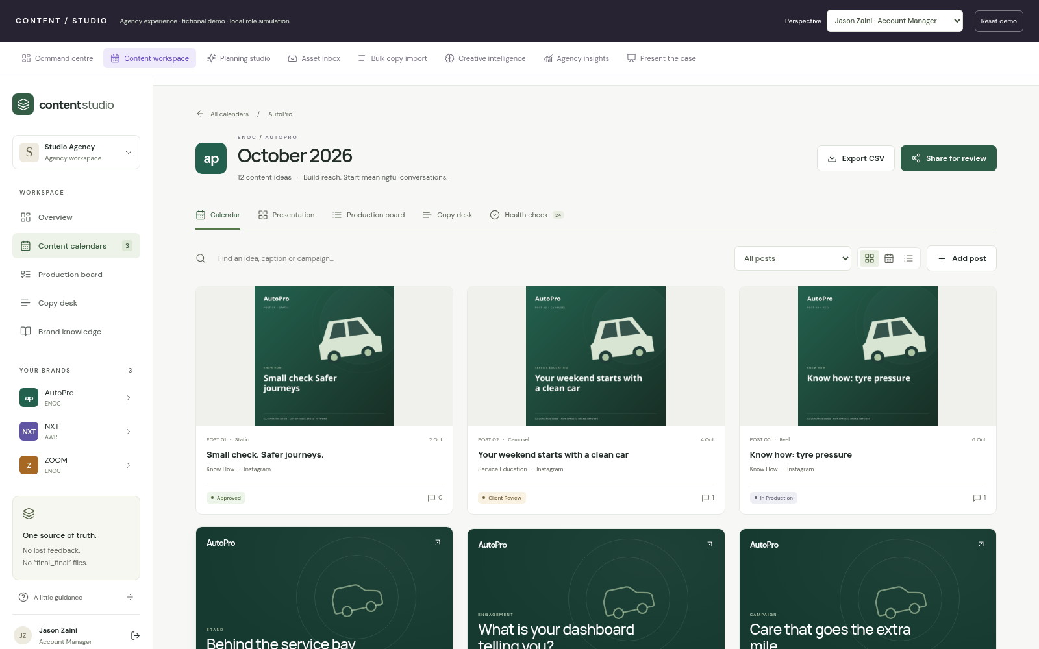
CONTENT / STUDIO · PRODUCT WALKTHROUGH
A calendar the whole team can use.
Content workspace / monthly planning over structured posts.
WORKING PROTOTYPE
See the monthly mix
Review post titles, formats, status
and attached creative.
Open the real record
Move from the calendar directly into
a post’s brief and deliverables.
Change the perspective
Calendar, board, copy and
presentation share the same posts.
Stop rebuilding the calendar in
slides.
AGENCY CONTENT OPERATIONS / MANAGEMENT CASE / 08 OCTOBER 2026
08
Notes:
Use AutoPro October as the concrete example. The calendar contains 12 demonstration posts. Emphasise that an edit to a caption or an uploaded version appears in the same post across the views. Appendix includes the monthly date grid and workspace dashboard.
SCREENSHOT: 12-calendar-grid.png. Captured from the fictional interactive HTML demo. Text and shapes are editable; screenshots are raster images.

Slide 9
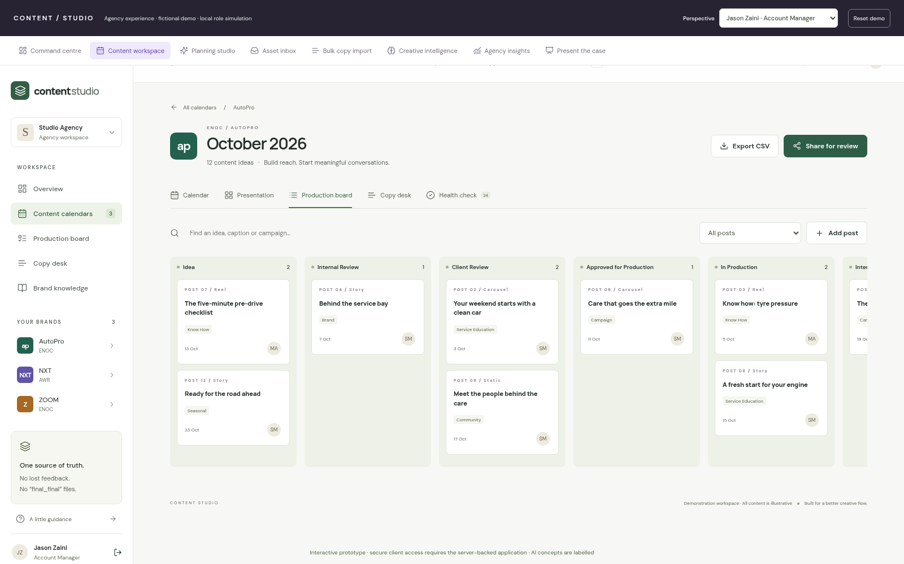
CONTENT / STUDIO · PRODUCT WALKTHROUGH
Make the next action visible.
Production board / a shared pipeline with ownership.
WORKING PROTOTYPE
Track the workflow
Idea through internal review,
production, client approval and
published.
Spot the queues
See where content is gathering
before the monthly delivery slips.
Assign the work
Post-level ownership and role
assignments give the team context.
Less chasing for status updates.
AGENCY CONTENT OPERATIONS / MANAGEMENT CASE / 08 OCTOBER 2026
09
Notes:
The prototype provides a nine-stage board. Board status alone is not proof that every deliverable is approved; separate idea, copy, artwork, video, internal and client approval dimensions remain on the post. Published is a workflow status, not a connected social publishing action.
SCREENSHOT: 14-production-board.png. Captured from the fictional interactive HTML demo. Text and shapes are editable; screenshots are raster images.

Slide 10
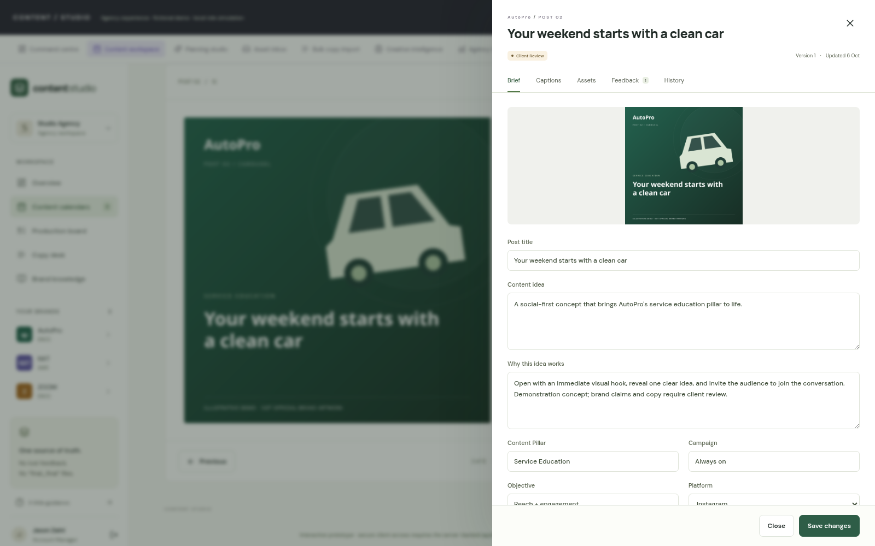
CONTENT / STUDIO · PRODUCT WALKTHROUGH
Keep the entire brief with the post.
Post detail / the working unit for everyone on the team.
WORKING PROTOTYPE
Structured context
Idea, rationale, format, campaign
and objective stay together.
Connected deliverables
Captions, assets, feedback and
audit history are tabs on one record.
Clear ownership
Assignments and due dates support
the production handoff.
No searching across decks and
folders.
AGENCY CONTENT OPERATIONS / MANAGEMENT CASE / 08 OCTOBER 2026
10
Notes:
Open a post from the calendar or a conversation. This drawer demonstrates the idea-to-execution record. Use the asset and history appendix for more detail. Content is fictional and brand settings are configurable; the interface does not imply official approved guidelines.
SCREENSHOT: 17-post-brief.png. Captured from the fictional interactive HTML demo. Text and shapes are editable; screenshots are raster images.

Slide 11
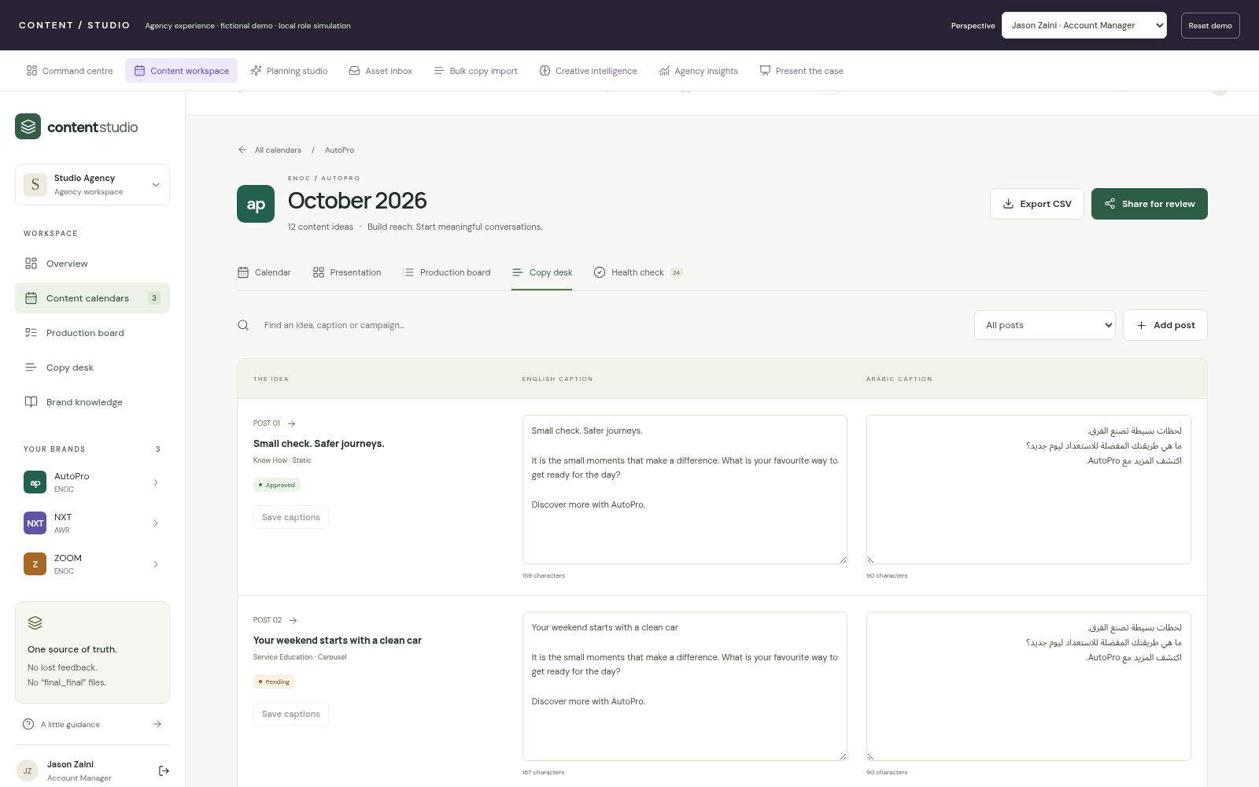
CONTENT / STUDIO · PRODUCT WALKTHROUGH
Give copywriters a useful workspace.
Copy desk / English and Arabic across the monthly calendar.
WORKING PROTOTYPE
Write across posts
Review several ideas and captions
without opening each slide.
Bilingual by design
Separate English and Arabic fields,
with RTL rendering.
Protect the review state
Revised copy resets downstream
approvals for renewed review.
Make caption editing part of the
workflow.
AGENCY CONTENT OPERATIONS / MANAGEMENT CASE / 08 OCTOBER 2026
11
Notes:
Switch to Ahmed to demonstrate the copywriter perspective during a live walkthrough if desired. Assigned-role permissions still apply. Arabic samples should be reviewed by a native-language copywriter; an RTL field is not a claim of translation quality.
SCREENSHOT: 15-copy-desk.png. Captured from the fictional interactive HTML demo. Text and shapes are editable; screenshots are raster images.

Slide 12
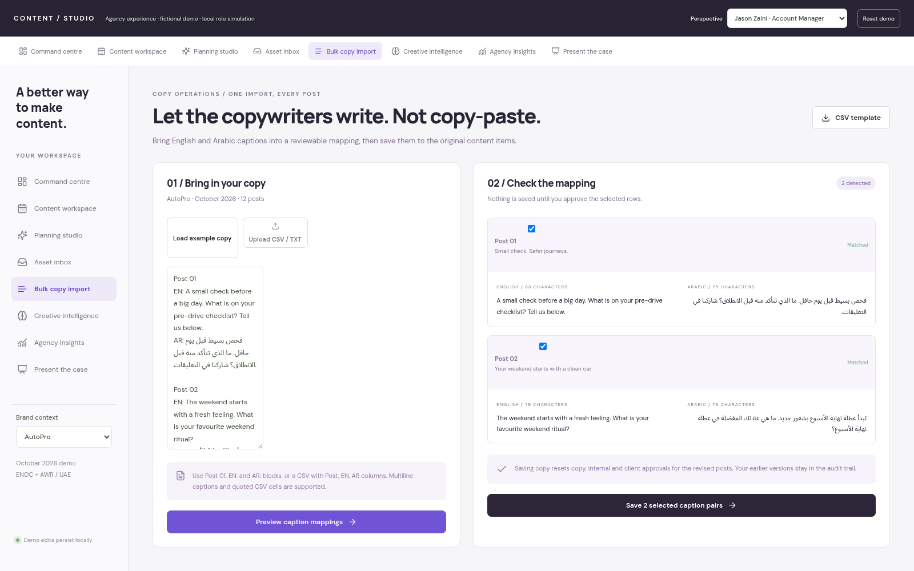
CONTENT / STUDIO · PRODUCT WALKTHROUGH
Import the copy. Review the mapping.
Bulk copy import / remove repetitive caption transfer.
WORKING PROTOTYPE
Bring a batch
Paste Post / EN / AR blocks or
upload structured CSV.
Check before saving
Preview post matches and flag
duplicates or missing language
pairs.
Save to the source
Selected captions are written to the
original content items.
One reviewable import, many
posts.
AGENCY CONTENT OPERATIONS / MANAGEMENT CASE / 08 OCTOBER 2026
12
Notes:
This is a working browser-demo workflow. Nothing is saved until the user selects and confirms the rows. CSV supports quoted commas and multiline cells. Native Excel parsing is not implemented; export Excel to CSV. Saving revisions resets approval states, preserving the audit trail.
SCREENSHOT: 05-caption-import.png. Captured from the fictional interactive HTML demo. Text and shapes are editable; screenshots are raster images.

Slide 13
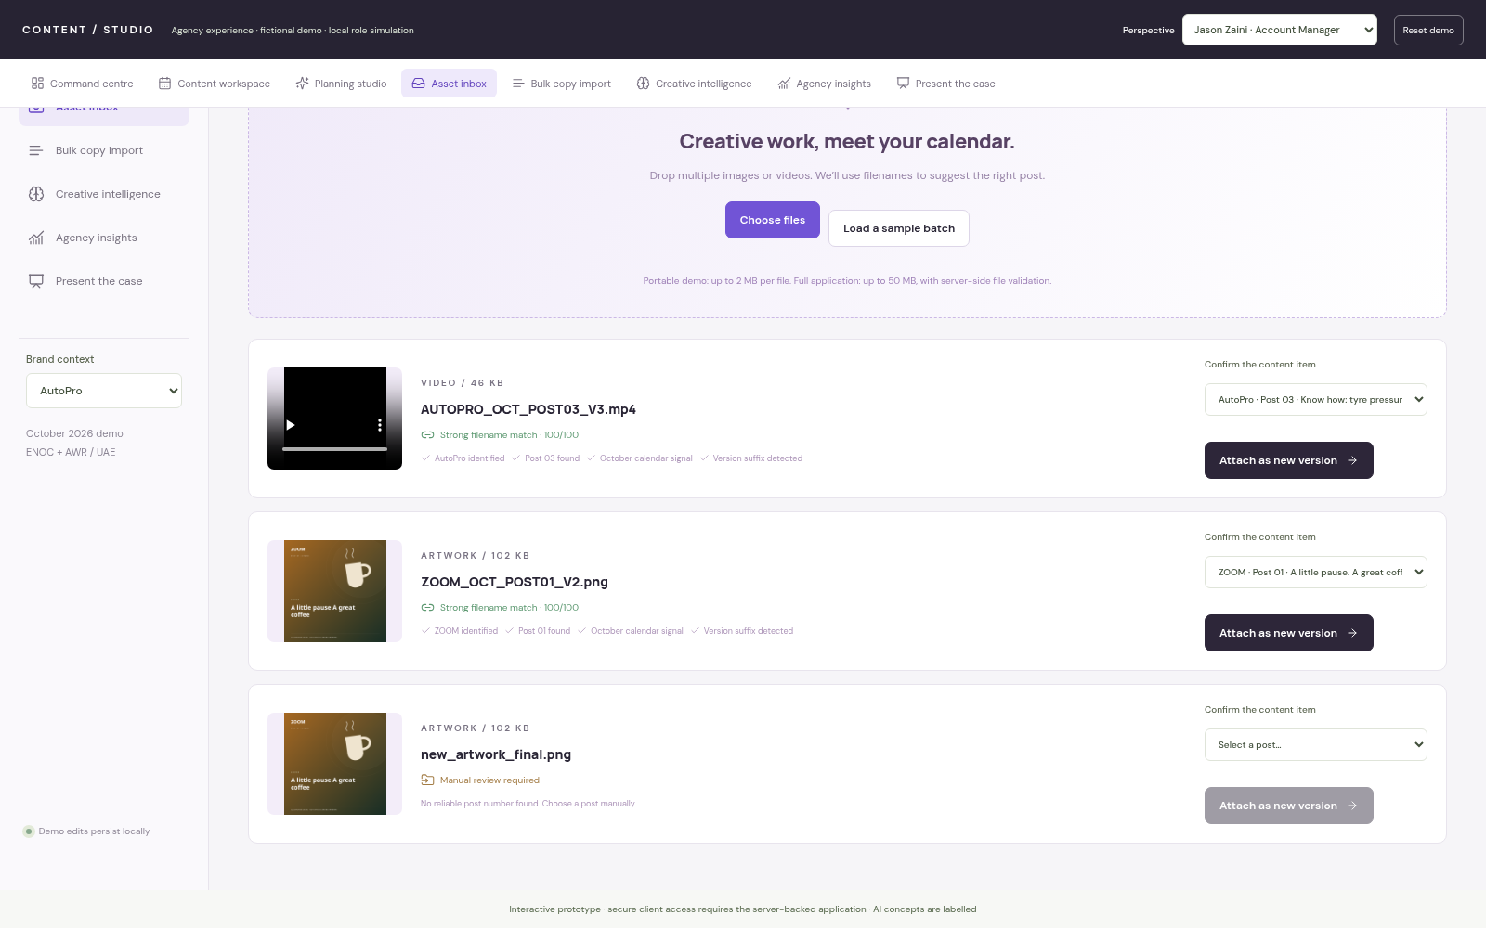
CONTENT / STUDIO · PRODUCT WALKTHROUGH
Route creative files to the right post.
Asset inbox / review suggestions before attaching versions.
WORKING PROTOTYPE
Upload a batch
Preview multiple images and
browser-playable video.
Use filename signals
Brand, post number, month and
version guide the recommendation.
Confirm the destination
Ambiguous files remain unassigned
until a person chooses.
Remove manual artwork
placement.
AGENCY CONTENT OPERATIONS / MANAGEMENT CASE / 08 OCTOBER 2026
13
Notes:
The inbox is rule-based, not a live AI matcher. Scores describe filename signals, not calibrated statistical confidence. Attach creates a new version on the post; it never automatically attaches a low-confidence file. The portable HTML limits files to 2 MB; the server prototype validates files with a higher configured limit. Previous versions remain available.
SCREENSHOT: 04-asset-inbox.png. Captured from the fictional interactive HTML demo. Text and shapes are editable; screenshots are raster images.

Slide 14
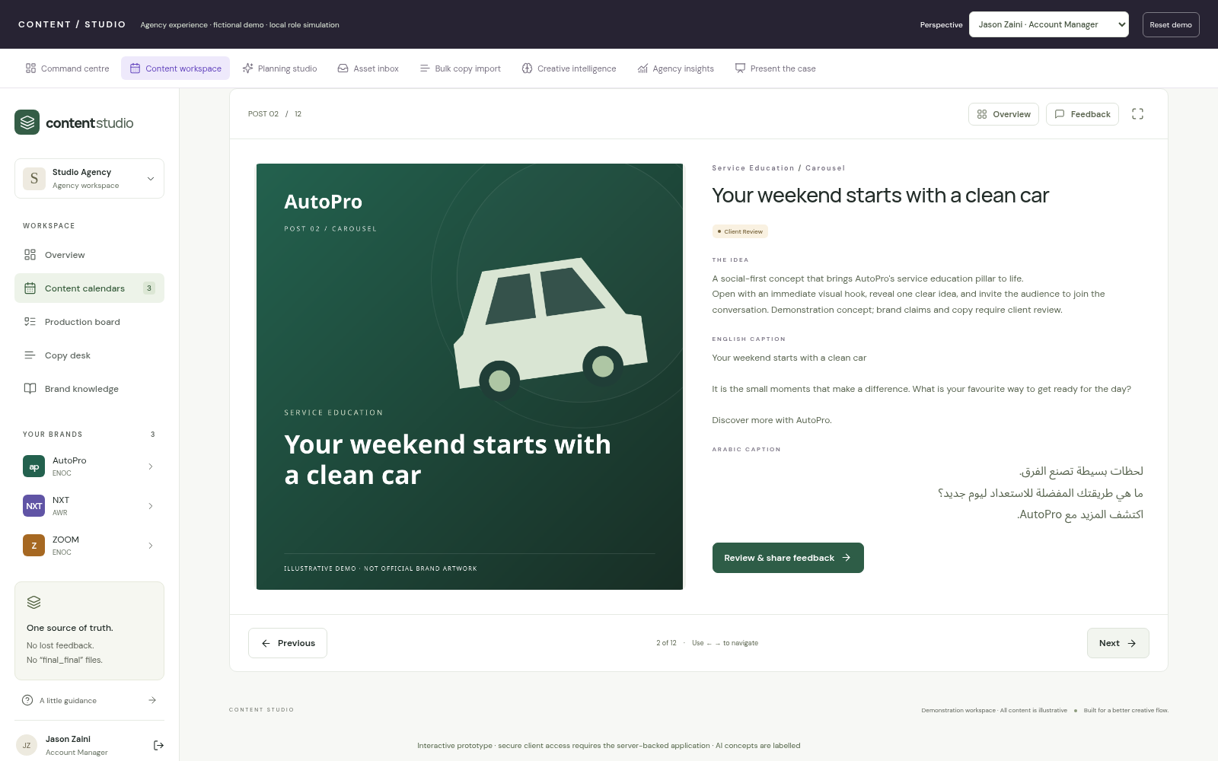
CONTENT / STUDIO · PRODUCT WALKTHROUGH
Present from the calendar itself.
Client presentation / web review becomes the primary experience.
WORKING PROTOTYPE
A familiar review flow
Move sequentially through
presentation-style content cards.
Native media review
View artwork and play video without
downloading a package.
Decide in context
Read the brief and copy, then
comment or approve the post.
Make the portal the preferred
review space.
AGENCY CONTENT OPERATIONS / MANAGEMENT CASE / 08 OCTOBER 2026
14
Notes:
Presentation is an actual view over the same content records. Full-screen presentation is available in the browser. The PPT deck being delivered is a management case, not an automatically generated approved client content export. Secure URLs belong to the server-backed application; local HTML perspective switching is simulated.
SCREENSHOT: 16-client-presentation.png. Captured from the fictional interactive HTML demo. Text and shapes are editable; screenshots are raster images.

Slide 15
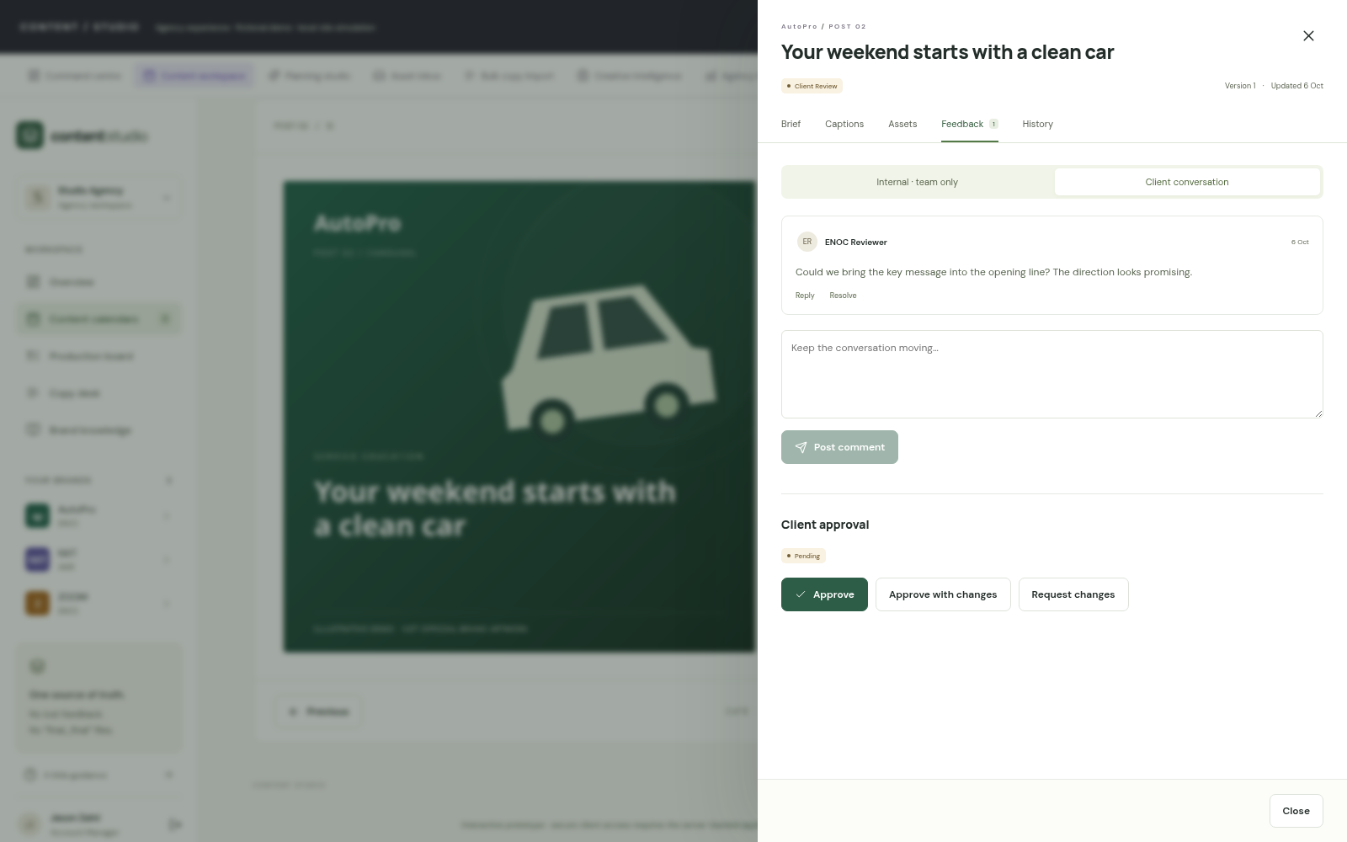
CONTENT / STUDIO · PRODUCT WALKTHROUGH
Feedback stays with the work.
Connected conversations / the revision loop without comment transfer.
WORKING PROTOTYPE
Post-level discussion
Authors, timestamps, replies and
resolved states retain context.
Separate audiences
Internal team discussion and
client-visible feedback are distinct.
One revision loop
The Account Manager and creative
team see the original client note.
Stop copying comments between
versions.
AGENCY CONTENT OPERATIONS / MANAGEMENT CASE / 08 OCTOBER 2026
15
Notes:
Demonstrate an ENOC client comment, then switch to Jason and reopen the same post. Client interfaces hide internal comments. The HTML contains fictional embedded seed data and is not a security boundary. Strict client access enforcement must use the authenticated server and its scoped APIs.
SCREENSHOT: 18-connected-feedback.png. Captured from the fictional interactive HTML demo. Text and shapes are editable; screenshots are raster images.

Slide 16
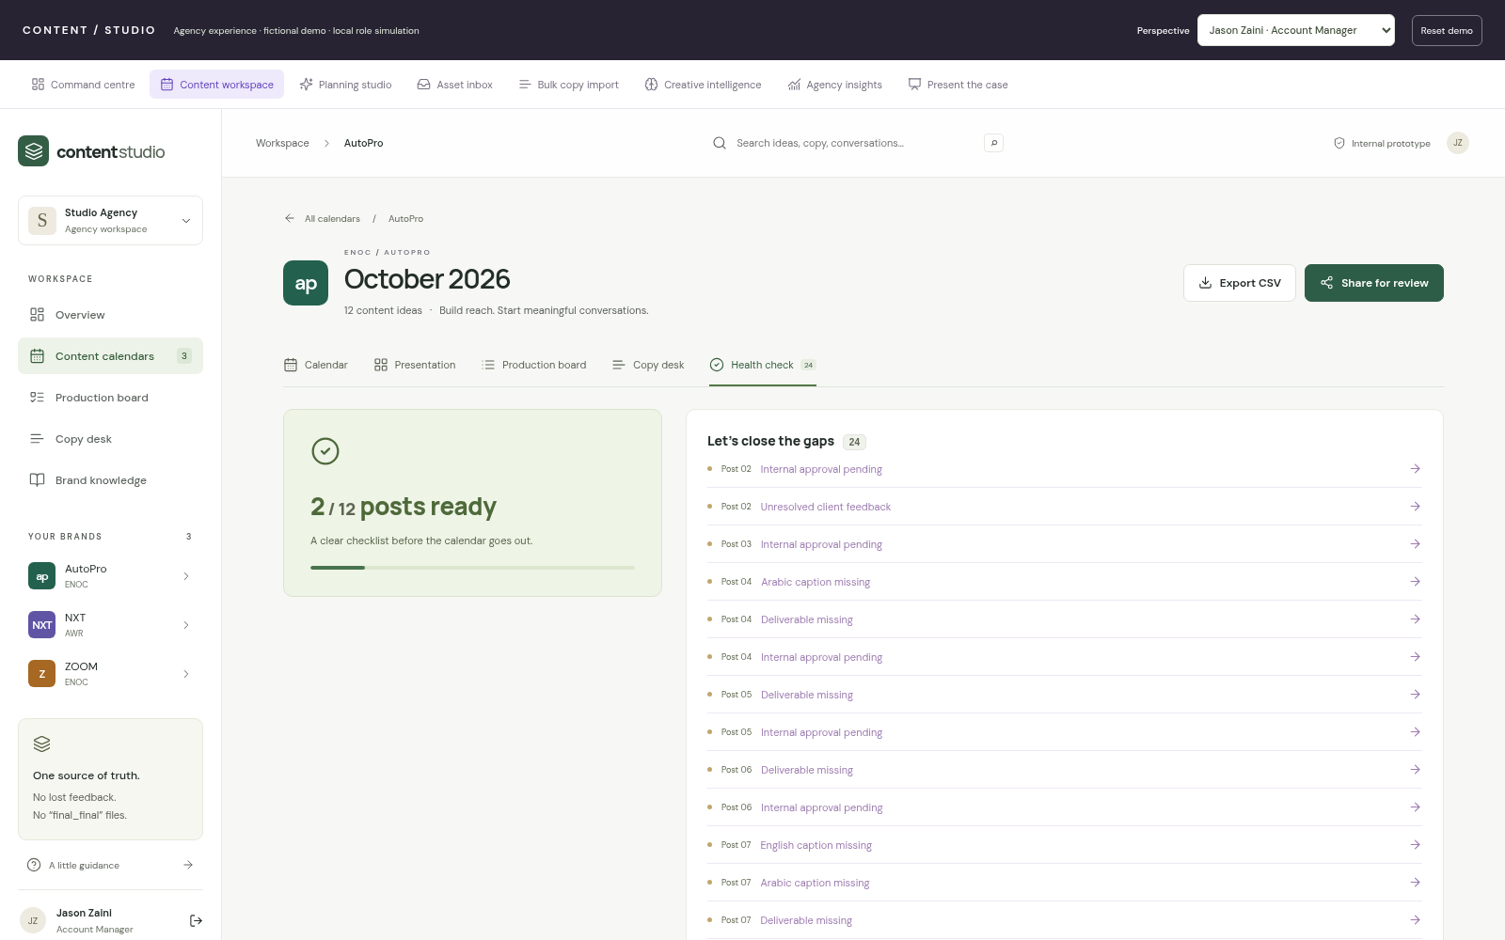
CONTENT / STUDIO · PRODUCT WALKTHROUGH
Catch the gaps before submission.
Calendar health / clickable readiness checks.
WORKING PROTOTYPE
Check the essentials
Missing copy, thumbnails, review
states and open feedback.
Go straight to the issue
Click the affected content item
instead of maintaining a checklist.
Retain human sign-off
Health readiness supports review; it
does not approve the work.
Replace a manual pre-flight
checklist.
AGENCY CONTENT OPERATIONS / MANAGEMENT CASE / 08 OCTOBER 2026
16
Notes:
Calendar health flags specific problems in the current demo records. It complements separate deliverable approval states. It should not be described as comprehensive legal, brand or cultural compliance. The agency still needs to agree its submission rules and mandatory brand checks.
SCREENSHOT: 21-health-check.png. Captured from the fictional interactive HTML demo. Text and shapes are editable; screenshots are raster images.

Slide 17
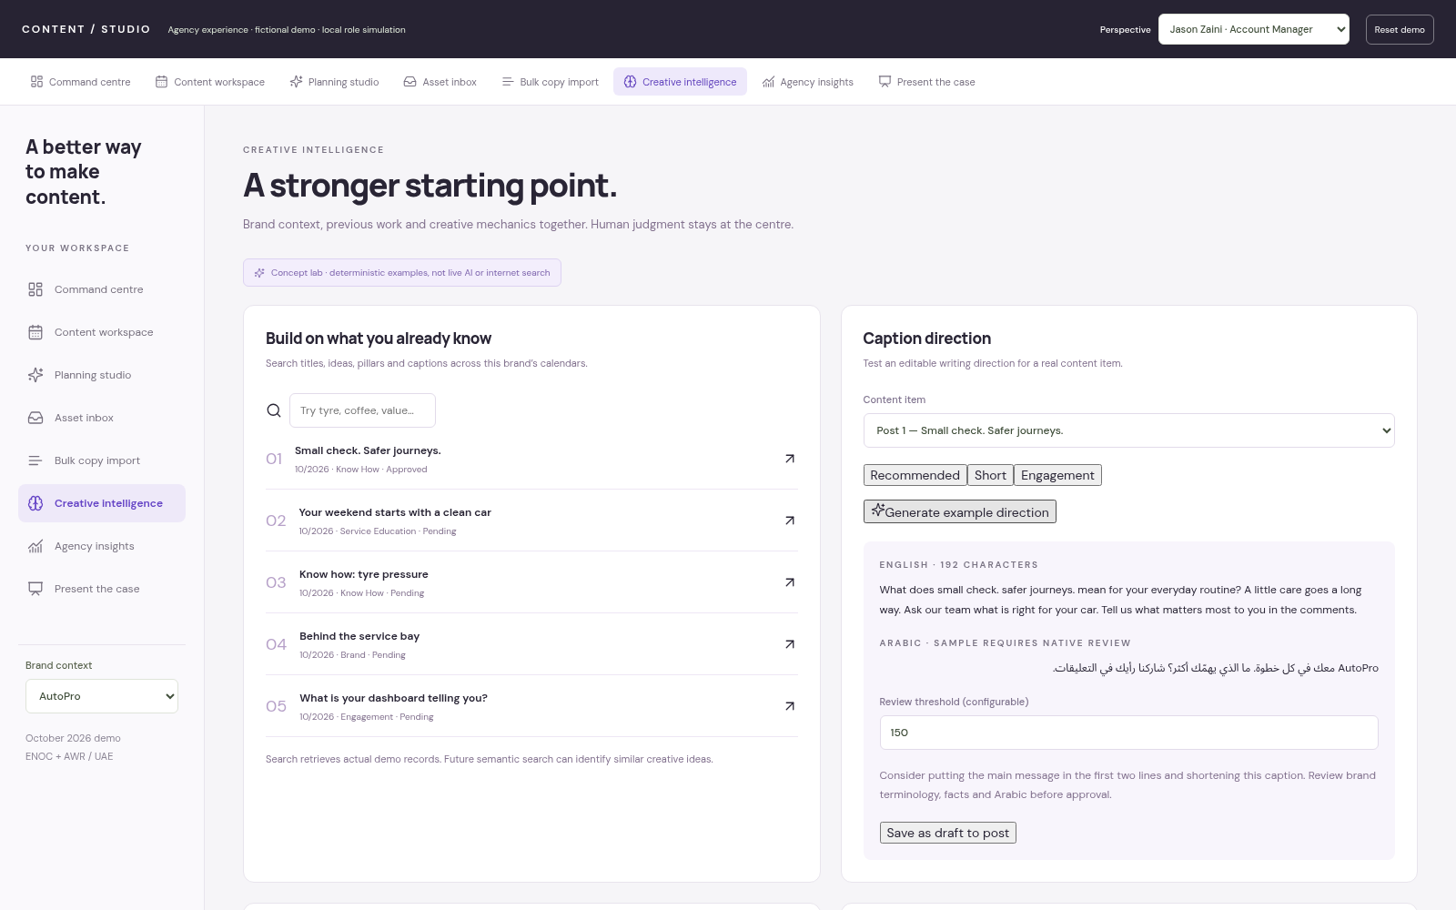
CONTENT / STUDIO · PRODUCT WALKTHROUGH
Give creativity a better starting point.
Creative intelligence / context and previous work, with human review.
WORKING SEARCH + LABELLED AI
CONCEPTS
Find earlier work
Search actual demo titles, ideas,
pillars and captions.
Explore a direction
Generate a deterministic caption
example and save it as a draft.
Keep judgment visible
Brand claims and Arabic samples
still require review.
Useful assistance without
automatic approval.
AGENCY CONTENT OPERATIONS / MANAGEMENT CASE / 08 OCTOBER 2026
17
Notes:
Clearly call this a concept lab: caption directions use deterministic templates, not an external AI provider. Previous-content search retrieves actual local records by text; semantic similarity is future work. General learning resources are attributed; no social post discovery or engagement-performance claim is made. UAE occasion examples appear in the appendix.
SCREENSHOT: 06-creative-intelligence.png. Captured from the fictional interactive HTML demo. Text and shapes are editable; screenshots are raster images.

Slide 18
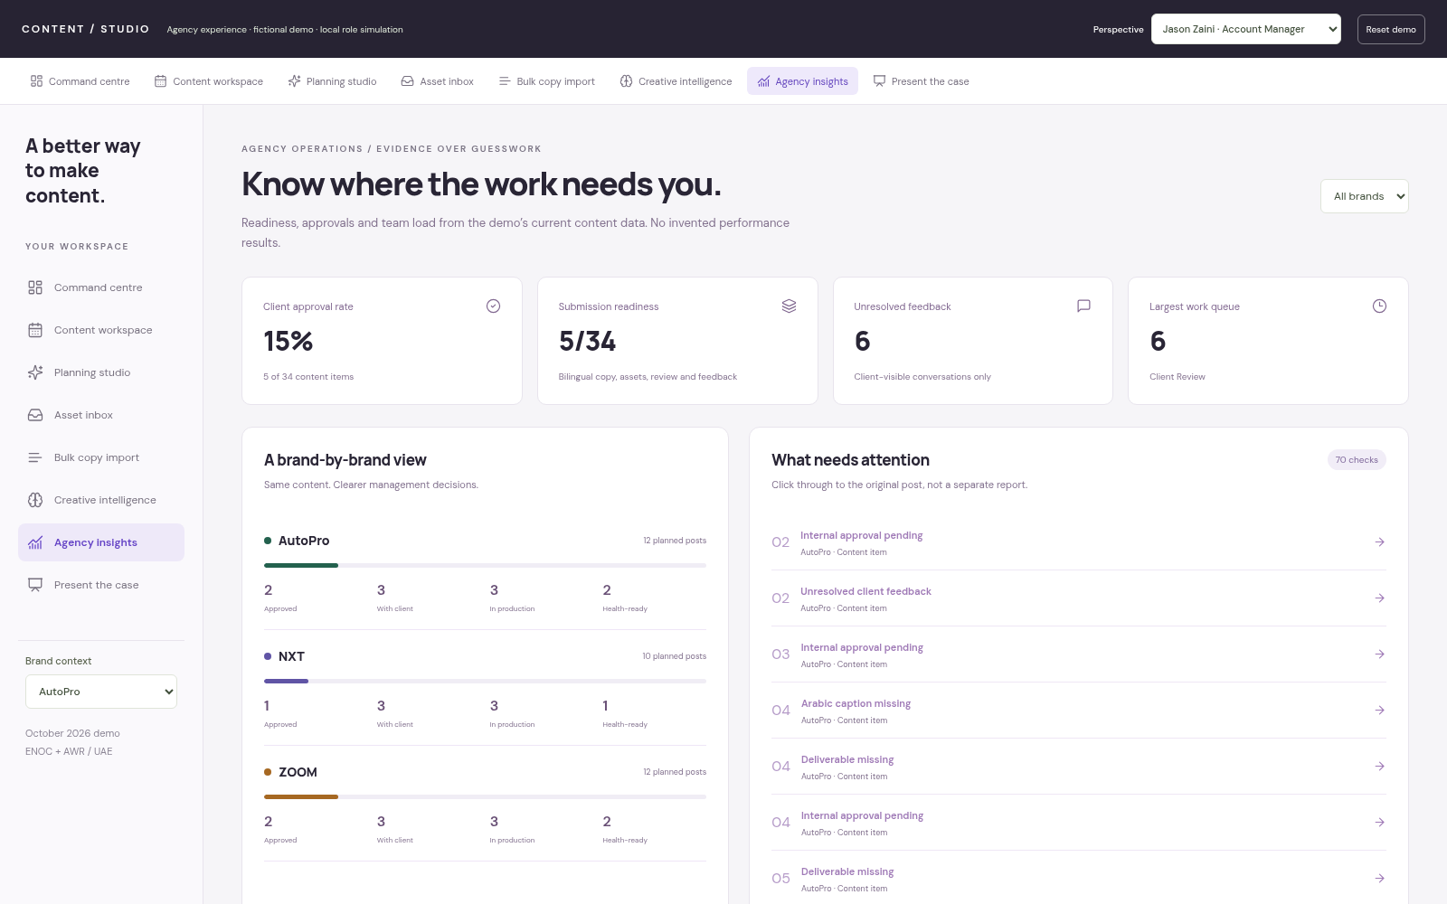
CONTENT / STUDIO · PRODUCT WALKTHROUGH
Manage from the current work.
Agency insights / approvals, readiness and bottlenecks.
WORKING PROTOTYPE
Real record counts
Approval rates, health-ready posts
and unresolved conversations.
Find the queue
See the largest workflow stage and
brand-level progress.
Make issues actionable
Open the post behind a readiness
issue.
A management view with an
action attached.
AGENCY CONTENT OPERATIONS / MANAGEMENT CASE / 08 OCTOBER 2026
18
Notes:
These are current-record metrics, not longitudinal performance analytics. The prototype does not yet provide measured average approval time, revision trends or actual time saved. Those require real workflow history and reliable instrumentation. Workload is assignment count, not a staff capacity estimate.
SCREENSHOT: 08-agency-insights.png. Captured from the fictional interactive HTML demo. Text and shapes are editable; screenshots are raster images.

Slide 19
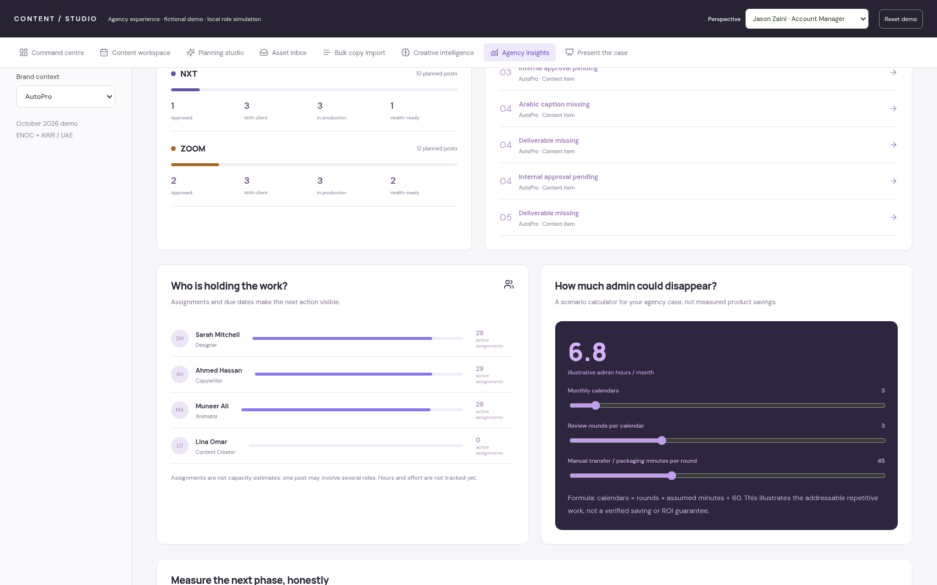
CONTENT / STUDIO · PRODUCT WALKTHROUGH
Make the value measurable.
Workload and savings / a transparent scenario, followed by a real baseline.
ILLUSTRATIVE SCENARIO · NOT MEASURED
ROI
Illustrate the opportunity
Calendars × rounds × manual
minutes ÷ 60.
Use agency assumptions
Three calendars, three rounds, 45
minutes = 6.75 hours per month.
Validate in a pilot
Measure actual admin time and
turnaround before claiming ROI.
A hypothesis to test, not a
savings claim.
AGENCY CONTENT OPERATIONS / MANAGEMENT CASE / 08 OCTOBER 2026
19
Notes:
The default calculator displays 6.8 hours after rounding 6.75 to one decimal place. This is addressable assumed repetitive work, not a verified saving. Include adoption effort, review effort and operational overhead when evaluating actual ROI. The pilot should capture a baseline and comparable results; the prototype contains no observed time-savings evidence.
SCREENSHOT: 09-workload-savings.png. Captured from the fictional interactive HTML demo. Text and shapes are editable; screenshots are raster images.

Slide 20
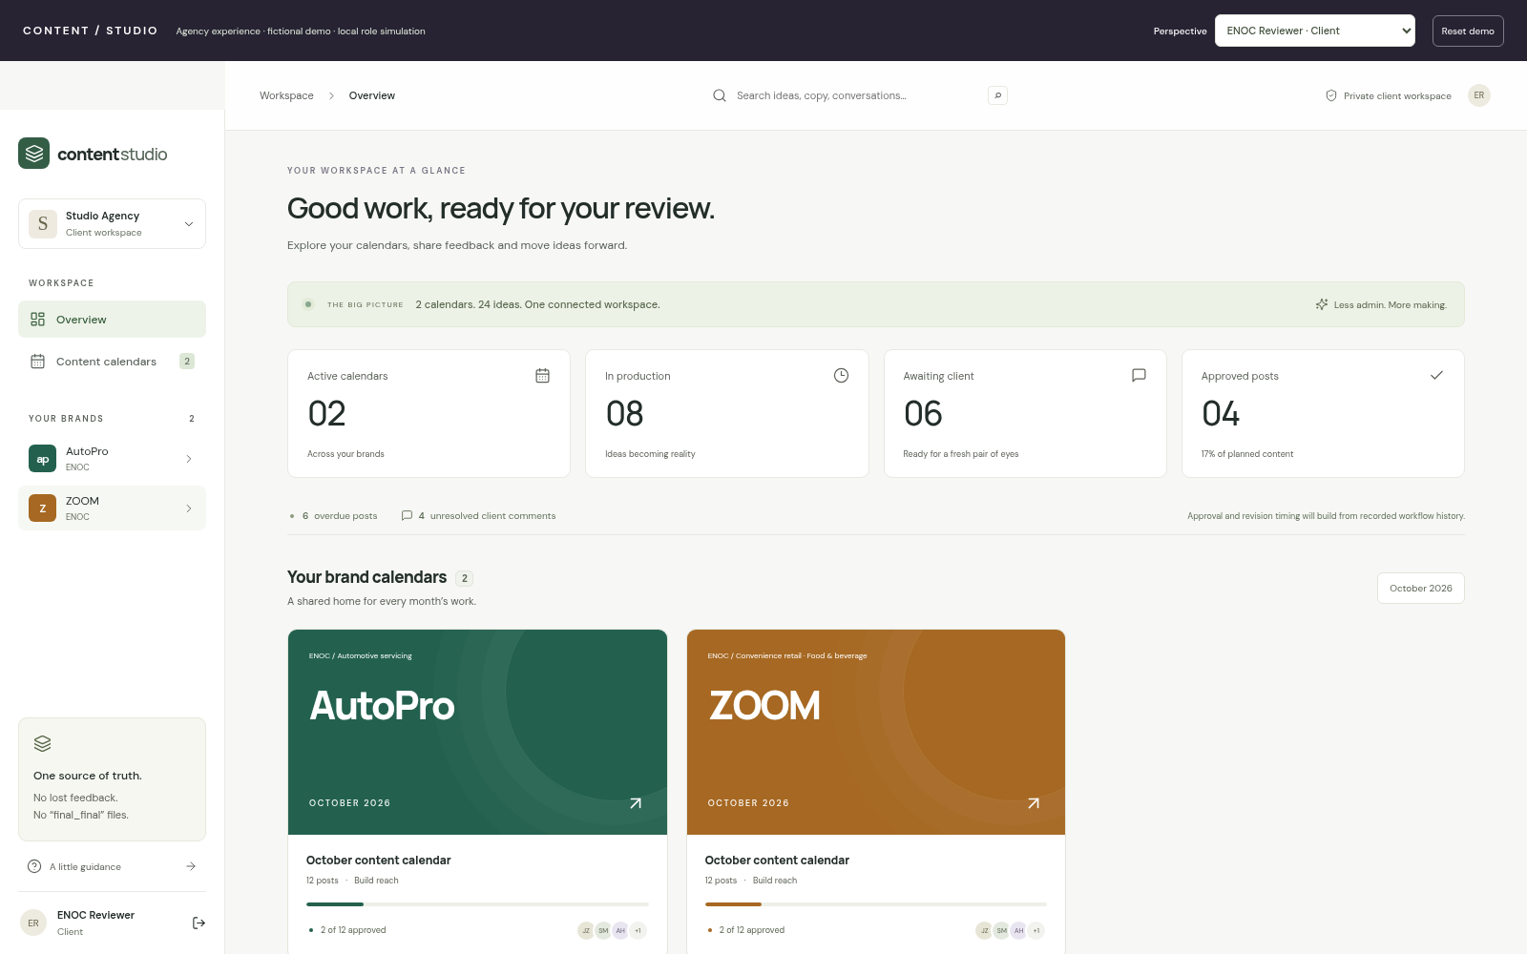
CONTENT / STUDIO · PRODUCT WALKTHROUGH
Match the experience to the person.
Roles and client boundaries / staff collaboration, focused client review.
ROLE SIMULATION IN HTML
Agency roles
Admin, AM, director, designer,
animator, creator and copywriter.
Client-specific scope
ENOC reviews ZOOM + AutoPro;
AWR reviews NXT.
Internal visibility
Client interfaces omit team-only
notes and conversations.
Focused access for every
participant.
AGENCY CONTENT OPERATIONS / MANAGEMENT CASE / 08 OCTOBER 2026
20
Notes:
HTML roles demonstrate interface behaviour and local simulated permission rules. All seed data is inspectable in the portable file. Do not claim that sharing this HTML is secure client isolation. The server-backed prototype implements authenticated client scopes and private media routes; production security review and identity lifecycle work are release gates.
SCREENSHOT: 24-client-scope.png. Captured from the fictional interactive HTML demo. Text and shapes are editable; screenshots are raster images.

Slide 21
CONTENT / STUDIO · MATURITY & RELEASE GATES
Be clear about what exists today.
A working prototype, with a defined route to a supported production service.
WORKING PROTOTYPE
LABELLED CONCEPTS
PRODUCTION RELEASE GATES
Calendar and post workflows
Bilingual copy and batch CSV
import
Assets, versions and native video
Comments, approval and health
Authenticated server prototype
Template-based monthly planning
Deterministic caption directions
Curated creative mechanics
Illustrative occasion relevance
Scenario-based admin calculator
Real identity and invitations
PostgreSQL and private cloud
storage
Security review and client isolation
Backups, monitoring and load
testing
Agency rules and supported
onboarding
Future integrations: AI providers, notifications, export automation and social publishing.
AGENCY CONTENT OPERATIONS / MANAGEMENT CASE / 08 OCTOBER 2026
21
Notes:
Explicitly separate the local HTML, the server-backed prototype and the future production service. HTML is useful for demos, not confidential client operations. Advanced provider-connected AI, reference research, notification delivery, native Excel parsing, PDF/PPTX content exports and social scheduling are not completed production capabilities. A successful prototype build is not a security certification.

Slide 22
CONTENT / STUDIO · RECOMMENDED NEXT STEP
Pilot one brand. Measure one month.
A proposed controlled rollout after security and operational readiness checks.
01 / Prepare
02 / Run the workflow
03 / Evaluate
Confirm the brand profile,
approval rules and participants.
Establish a manual-work baseline.
Use one calendar in a supported
environment. Capture issues,
adoption and client feedback.
Compare admin time, turnaround
and revision rounds. Decide what
to improve before expanding.
Proposed measures
Admin minutes / calendar · Approval turnaround · Revision rounds · Unresolved feedback · User adoption
AGENCY CONTENT OPERATIONS / MANAGEMENT CASE / 08 OCTOBER 2026
22
Notes:
This is a proposal, not a committed release date. Gate the pilot on secure deployment readiness and real client permissions. Suggested ownership: an Account Manager sponsor, a creative lead, a client reviewer and a technical owner. Capture baseline measures before the pilot and agree what success means with management; do not invent thresholds or a delivery budget.

Slide 23
CONTENT / STUDIO · MANAGEMENT DECISION
Approve the next step,
not the whole roadmap.
Sponsor a controlled pilot and the work needed to make it secure, supported and
measurable.
A named sponsor
A bounded pilot
A measurable decision
One accountable agency owner and
a technical counterpart.
One brand, one monthly calendar
and agreed participants.
Review evidence before expanding
the rollout or AI scope.
AGENCY CONTENT OPERATIONS / MANAGEMENT CASE / 08 OCTOBER 2026
23
Notes:
Close with the concrete decision requested: sponsorship for a controlled pilot and scoped production hardening. Do not imply an approved budget or promise a timeline that has not been estimated. The appendix contains all remaining screens, so management can explore the depth of the prototype during questions. Return to the live HTML if they want to see edits persist.

Slide 24
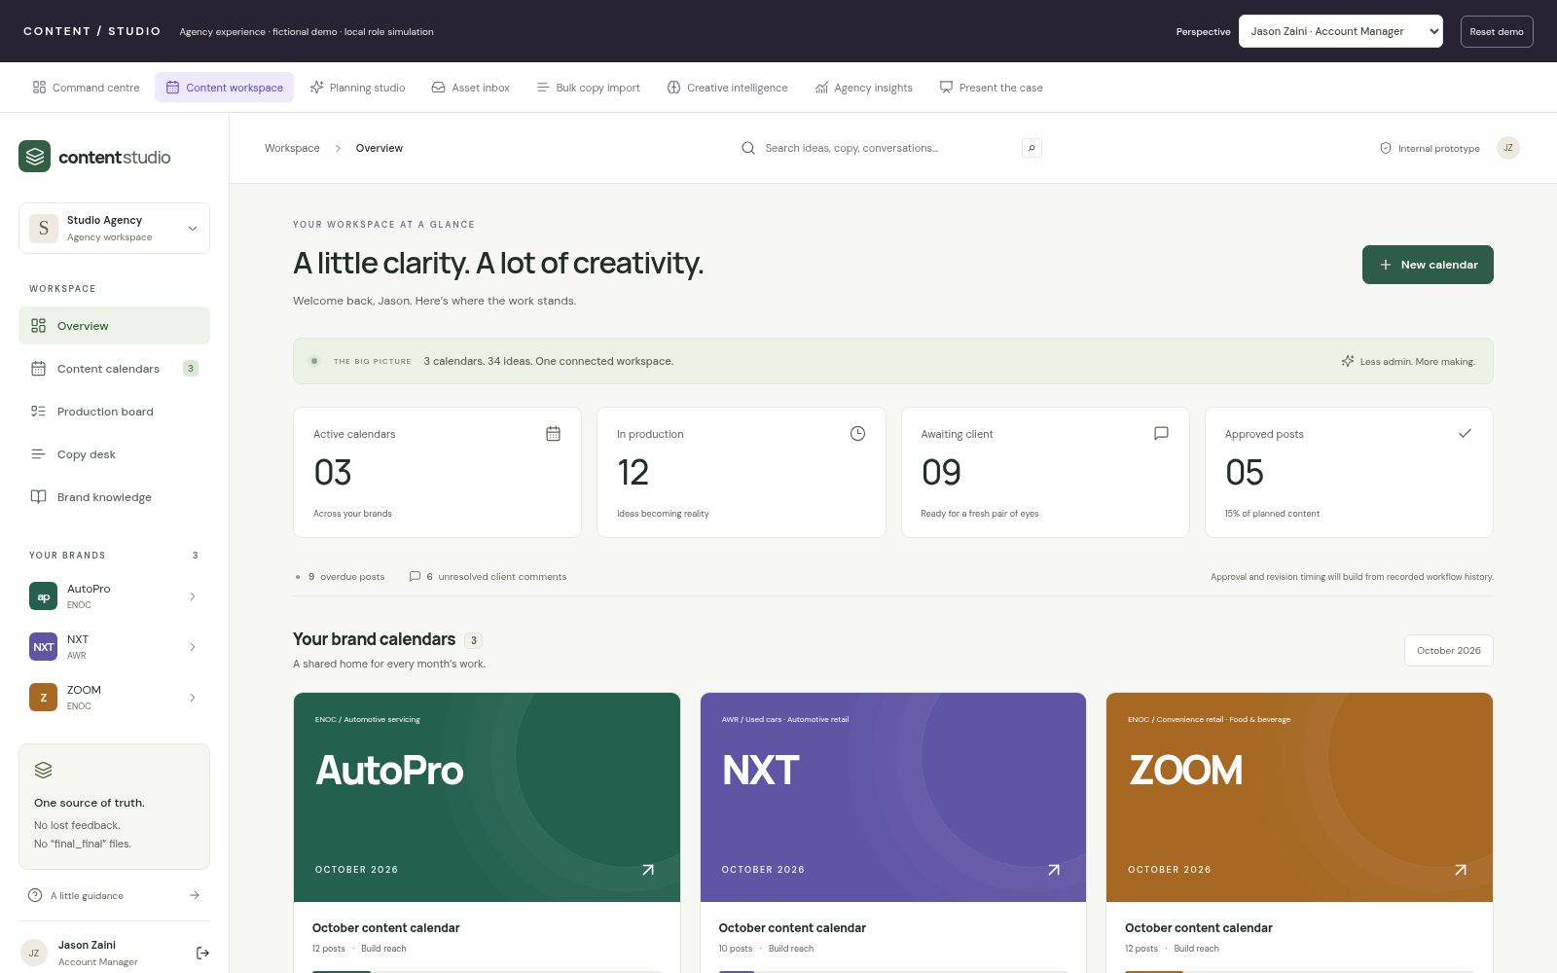
CONTENT / STUDIO · APPENDIX / SCREEN LIBRARY
Workspace dashboard
A familiar workspace overview, alongside the richer command centre.
AGENCY CONTENT OPERATIONS / MANAGEMENT CASE / 08 OCTOBER 2026
24
Notes:
Optional deep dive. A familiar workspace overview, alongside the richer command centre.
Captured from the fictional local demo: 11-workspace-dashboard.png. No production capability should be inferred beyond the maturity map on slide 21. All tab-level screens are covered in the core presentation; this appendix provides additional detail.

Slide 25
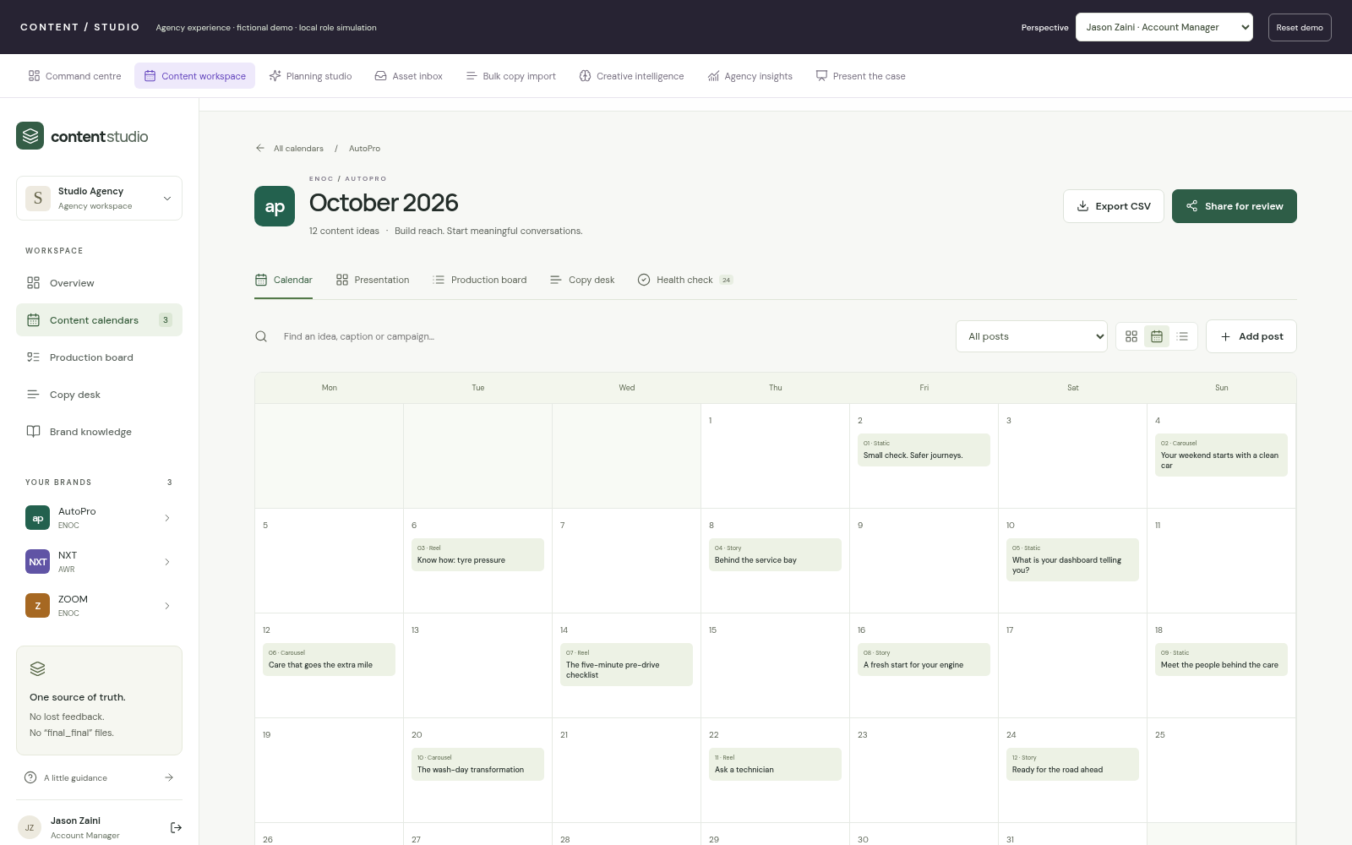
CONTENT / STUDIO · APPENDIX / SCREEN LIBRARY
Month view
Content timing and publishing dates in a traditional monthly grid.
AGENCY CONTENT OPERATIONS / MANAGEMENT CASE / 08 OCTOBER 2026
25
Notes:
Optional deep dive. Content timing and publishing dates in a traditional monthly grid.
Captured from the fictional local demo: 13-month-view.png. No production capability should be inferred beyond the maturity map on slide 21. All tab-level screens are covered in the core presentation; this appendix provides additional detail.

Slide 26
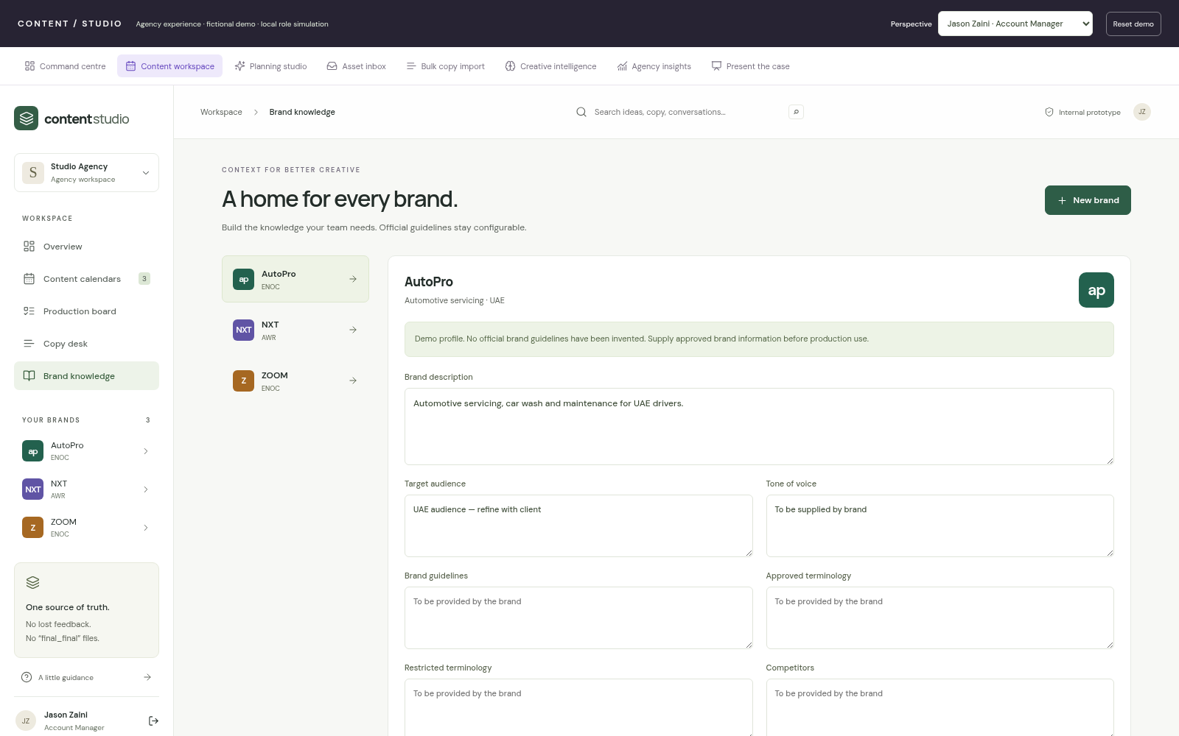
CONTENT / STUDIO · APPENDIX / SCREEN LIBRARY
Brand knowledge base
Configurable profile fields; real guidelines must be entered by the agency.
AGENCY CONTENT OPERATIONS / MANAGEMENT CASE / 08 OCTOBER 2026
26
Notes:
Optional deep dive. Configurable profile fields; real guidelines must be entered by the agency.
Captured from the fictional local demo: 22-brand-profile.png. No production capability should be inferred beyond the maturity map on slide 21. All tab-level screens are covered in the core presentation; this appendix provides additional detail.

Slide 27
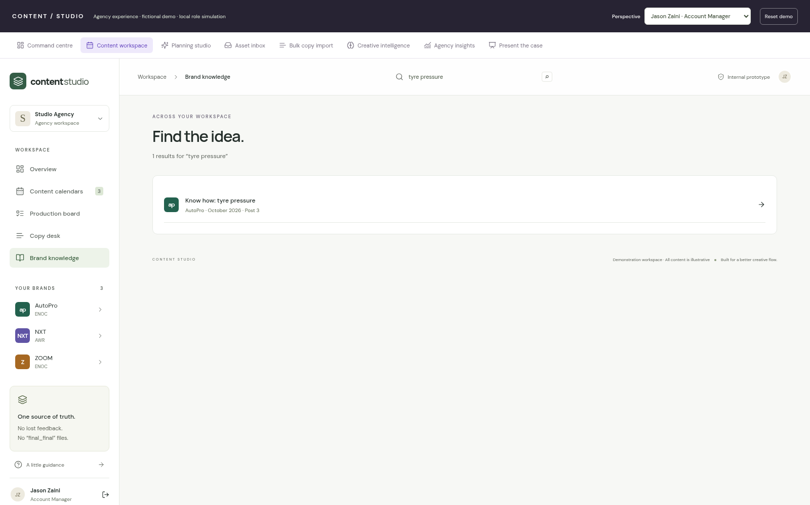
CONTENT / STUDIO · APPENDIX / SCREEN LIBRARY
Search across content
Find a previous idea directly from the global workspace search.
AGENCY CONTENT OPERATIONS / MANAGEMENT CASE / 08 OCTOBER 2026
27
Notes:
Optional deep dive. Find a previous idea directly from the global workspace search.
Captured from the fictional local demo: 23-global-search.png. No production capability should be inferred beyond the maturity map on slide 21. All tab-level screens are covered in the core presentation; this appendix provides additional detail.

Slide 28
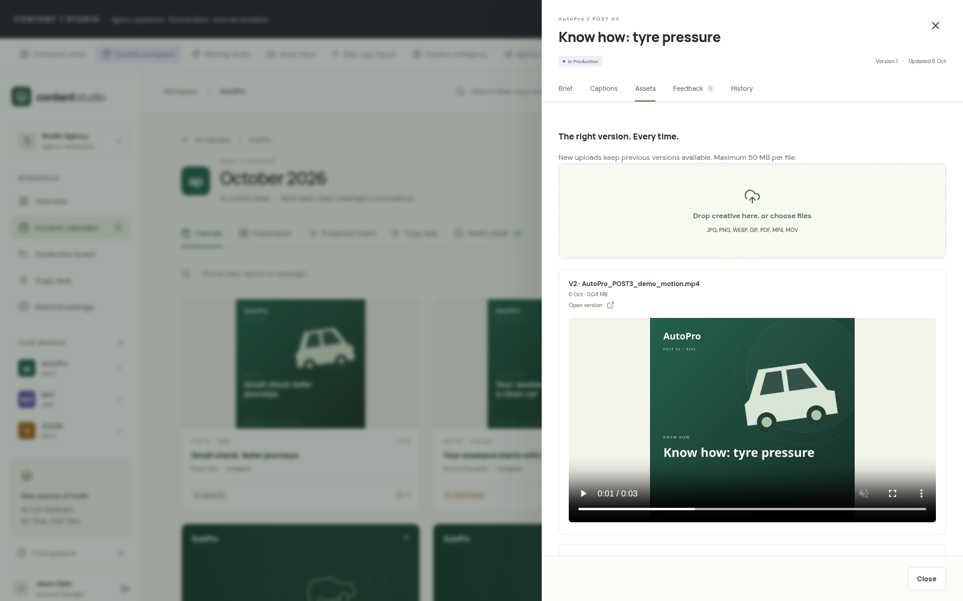
CONTENT / STUDIO · APPENDIX / SCREEN LIBRARY
Asset versions and native video
Review the latest media and keep earlier versions accessible.
AGENCY CONTENT OPERATIONS / MANAGEMENT CASE / 08 OCTOBER 2026
28
Notes:
Optional deep dive. Review the latest media and keep earlier versions accessible.
Captured from the fictional local demo: 19-asset-versions.png. No production capability should be inferred beyond the maturity map on slide 21. All tab-level screens are covered in the core presentation; this appendix provides additional detail.

Slide 29
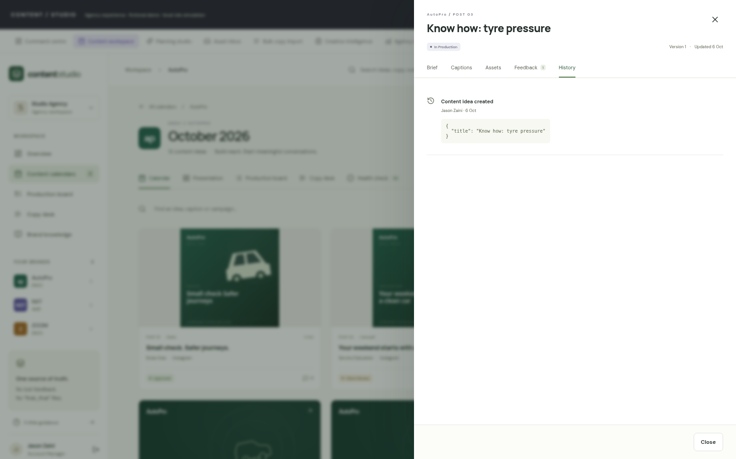
CONTENT / STUDIO · APPENDIX / SCREEN LIBRARY
Change history
Who changed the record, what changed and when it happened.
AGENCY CONTENT OPERATIONS / MANAGEMENT CASE / 08 OCTOBER 2026
29
Notes:
Optional deep dive. Who changed the record, what changed and when it happened.
Captured from the fictional local demo: 20-version-history.png. No production capability should be inferred beyond the maturity map on slide 21. All tab-level screens are covered in the core presentation; this appendix provides additional detail.

Slide 30
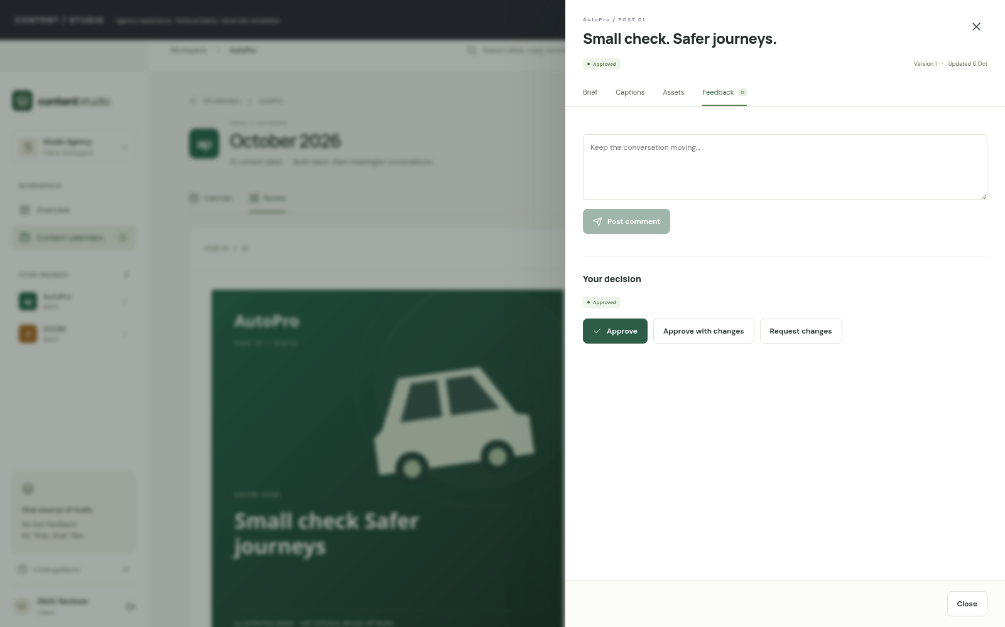
CONTENT / STUDIO · APPENDIX / SCREEN LIBRARY
Client decisions
Client-visible feedback and approval actions attached to a post.
AGENCY CONTENT OPERATIONS / MANAGEMENT CASE / 08 OCTOBER 2026
30
Notes:
Optional deep dive. Client-visible feedback and approval actions attached to a post.
Captured from the fictional local demo: 25-client-approval.png. No production capability should be inferred beyond the maturity map on slide 21. All tab-level screens are covered in the core presentation; this appendix provides additional detail.

Slide 31
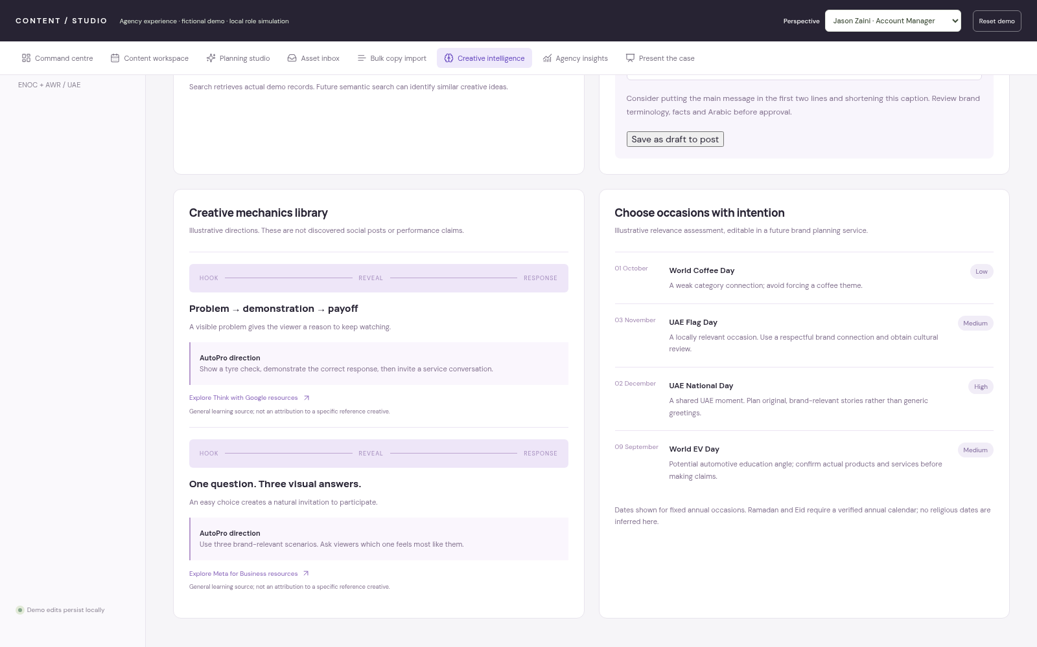
CONTENT / STUDIO · APPENDIX / SCREEN LIBRARY
Occasions and creative mechanics
Illustrative relevance and attributed learning resources, not live research.
AGENCY CONTENT OPERATIONS / MANAGEMENT CASE / 08 OCTOBER 2026
31
Notes:
Optional deep dive. Illustrative relevance and attributed learning resources, not live research.
Captured from the fictional local demo: 07-references-occasions.png. No production capability should be inferred beyond the maturity map on slide 21. All tab-level screens are covered in the core presentation; this appendix provides additional detail.

Slide 32
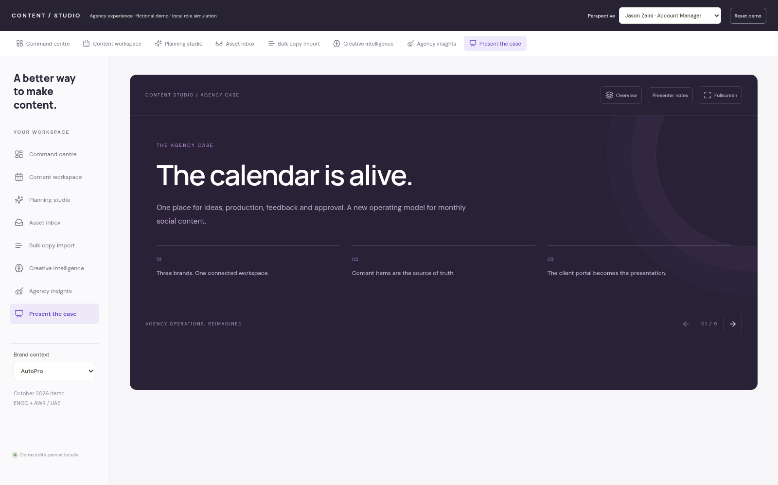
CONTENT / STUDIO · APPENDIX / SCREEN LIBRARY
Built-in case presentation
Browser presentation mode with navigation and presenter support.
AGENCY CONTENT OPERATIONS / MANAGEMENT CASE / 08 OCTOBER 2026
32
Notes:
Optional deep dive. Browser presentation mode with navigation and presenter support.
Captured from the fictional local demo: 10-case-presentation.png. No production capability should be inferred beyond the maturity map on slide 21. All tab-level screens are covered in the core presentation; this appendix provides additional detail.

Slide 33
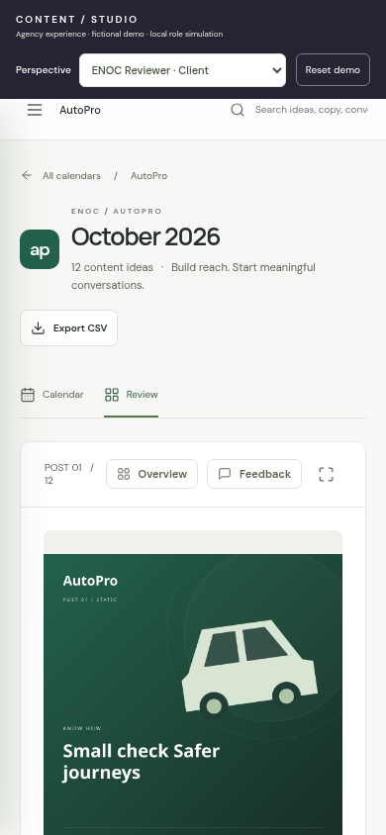
CONTENT / STUDIO · APPENDIX / SCREEN LIBRARY
Mobile client review
A focused client experience on a smaller screen.
AGENCY CONTENT OPERATIONS / MANAGEMENT CASE / 08 OCTOBER 2026
33
Notes:
Optional deep dive. A focused client experience on a smaller screen.
Captured from the fictional local demo: 26-mobile-review.png. No production capability should be inferred beyond the maturity map on slide 21. All tab-level screens are covered in the core presentation; this appendix provides additional detail.

