Slide 1
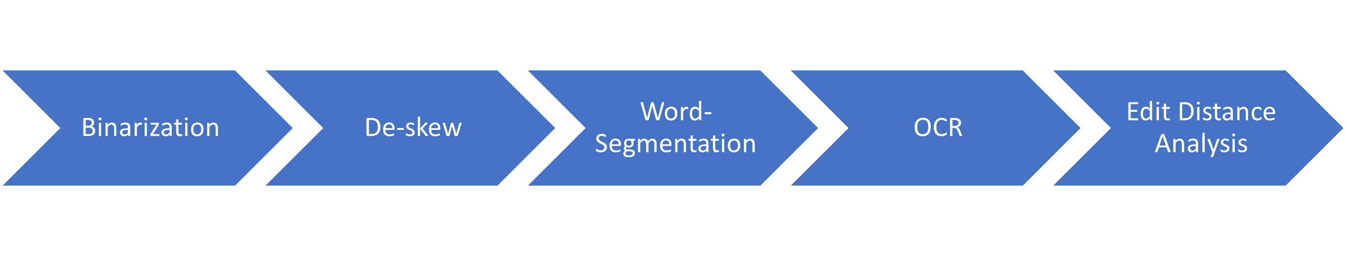
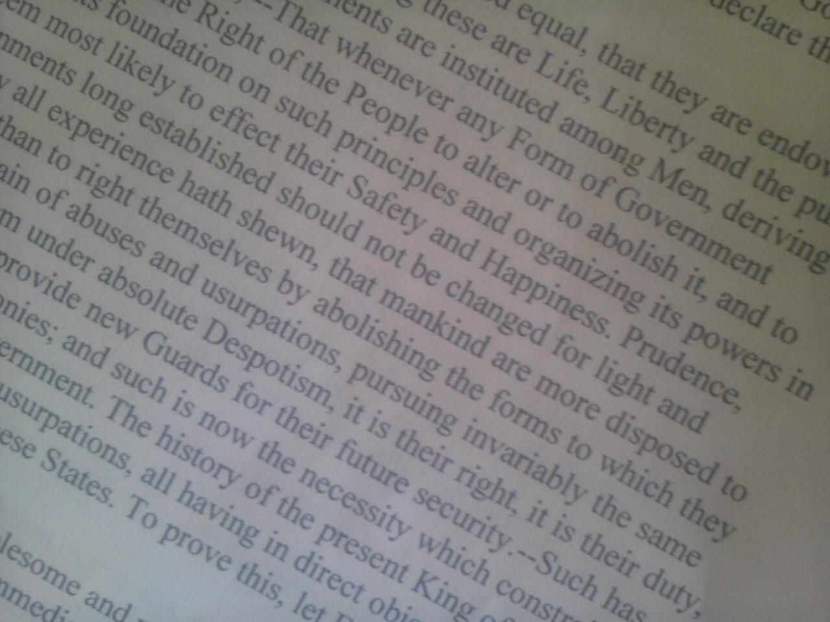
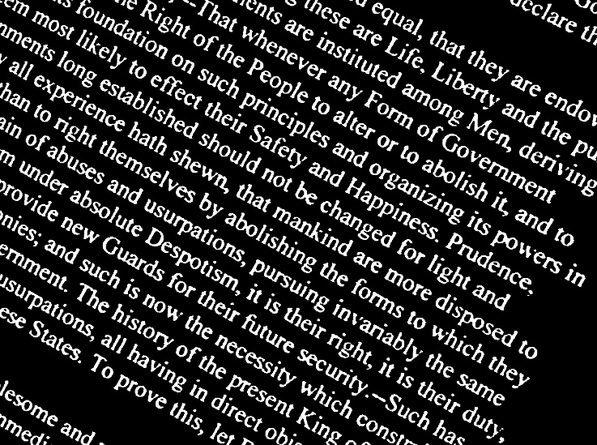
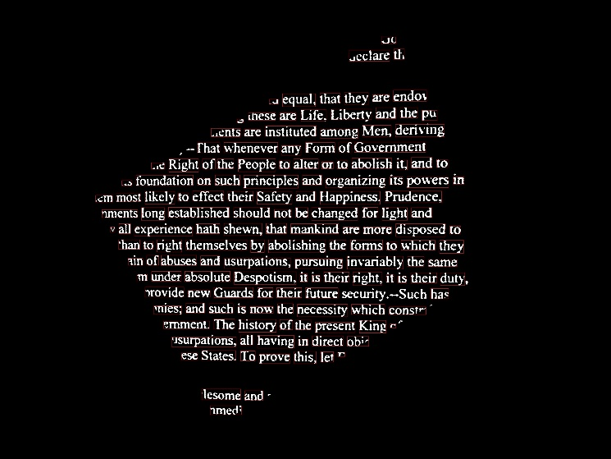
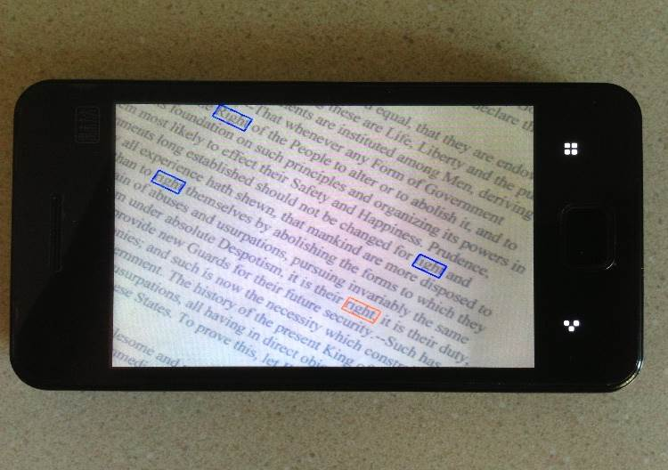
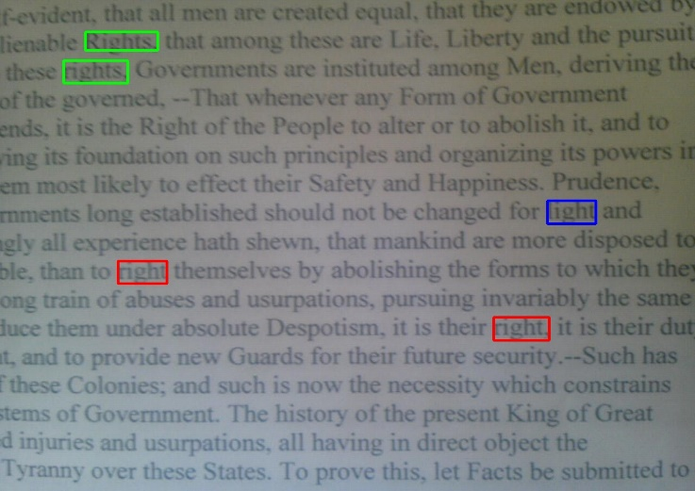
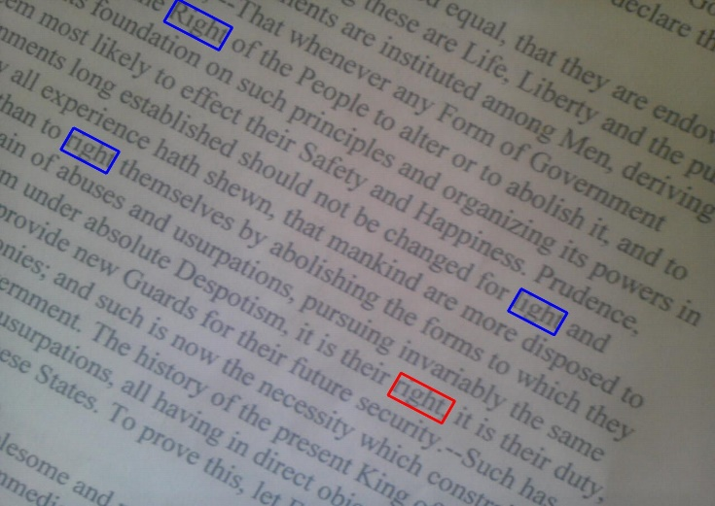
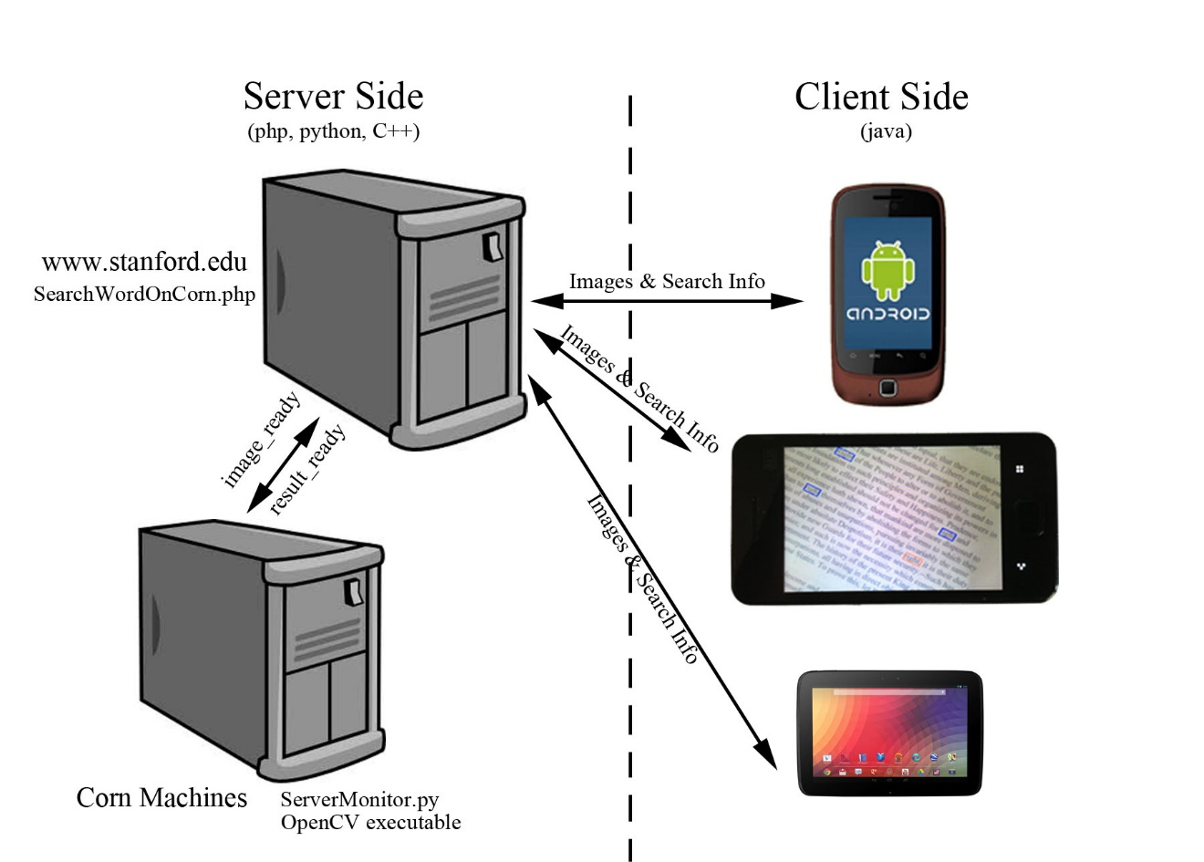
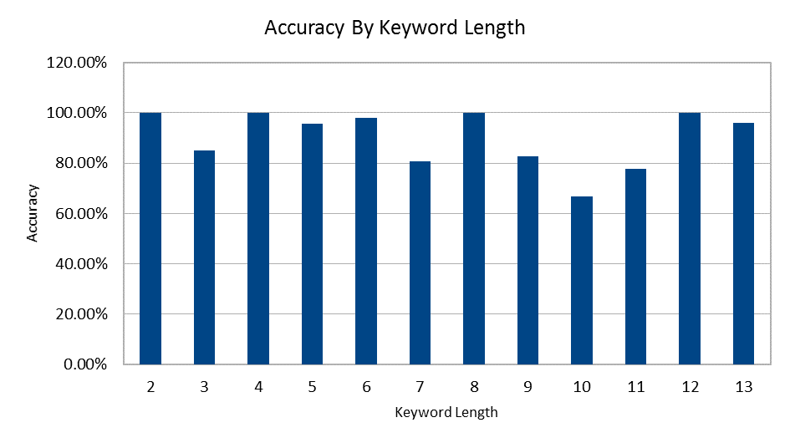
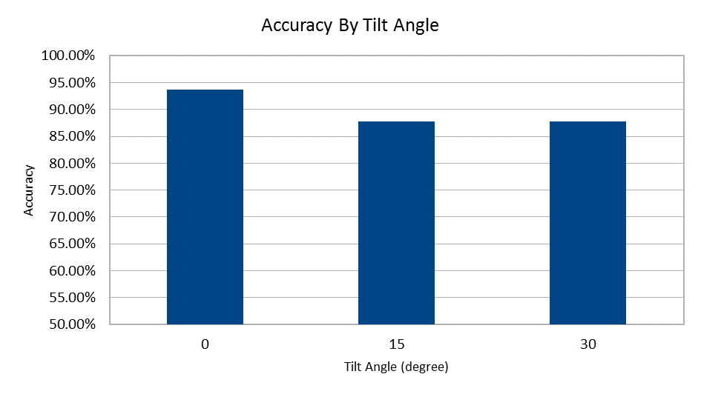
Word Hunter: Image-based Text Search using an Android Phone
Yang Zhao, Shuo Liu, Lingren Zhang
Department of Electrical Engineering, Stanford University
Motivation
Image Processing Flowchart
Have you ever needed to search for a keyword on a textbook when cramming for an exam? If so, this app is here to help! All you need to do is to type the keyword, point and shoot. The app finds any keyword matches in your view frame.
Features and Challenges
Technical Highlight
Automation and Robustness: Automatic word segmentation, de-skew, de-noise, and word recognition.
Fuzzy recognition: Highlights both exact matches and close matches, in case image quality is low
Efficiency: Highlight matched words efficiently (Support both snapshot and scan mode)
Locally Thresholding
Smart Segmentation
Hough Transform
Occurrence-based Size Estimation
Tesseract-tailored Preprocessing
Dynamical Programming
Cloud Computing Flowchart
Experimental Results
Future Work
Use SURF to enable fast recognition in Scan Mode
Integrated voice search
Acknowledgments
Special thanks to David Chen and Sam Tsai for their responsive help
Also thank Prof. Girod for his inspiring lectures throughout the quarter.
Overall accuracy for exact matches is 89.7%.
Result may vary due to uneven line space, different fonts, and image quality
Performance slightly affected by tilt.

