Slide 1
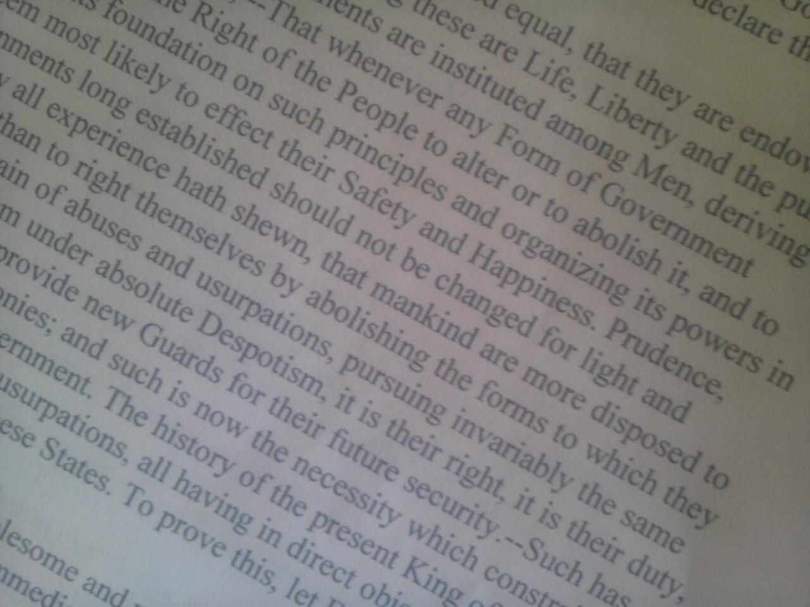
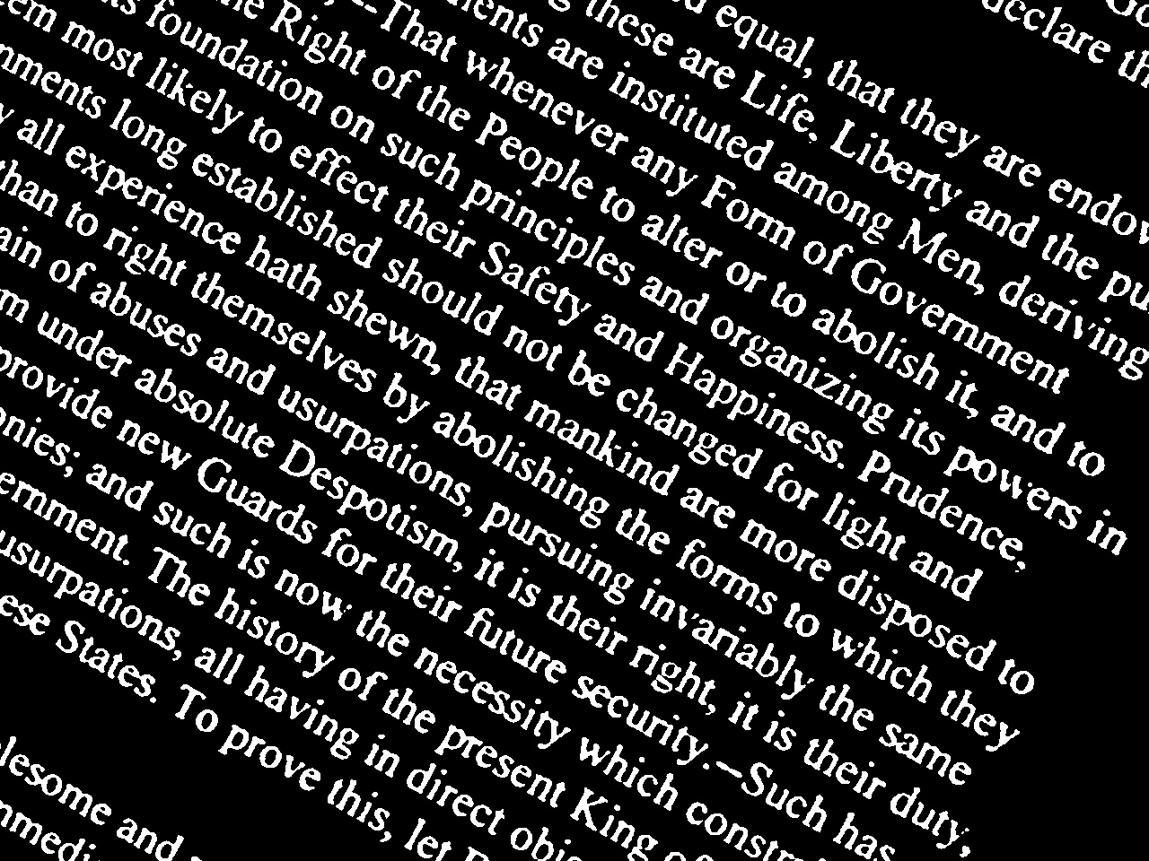
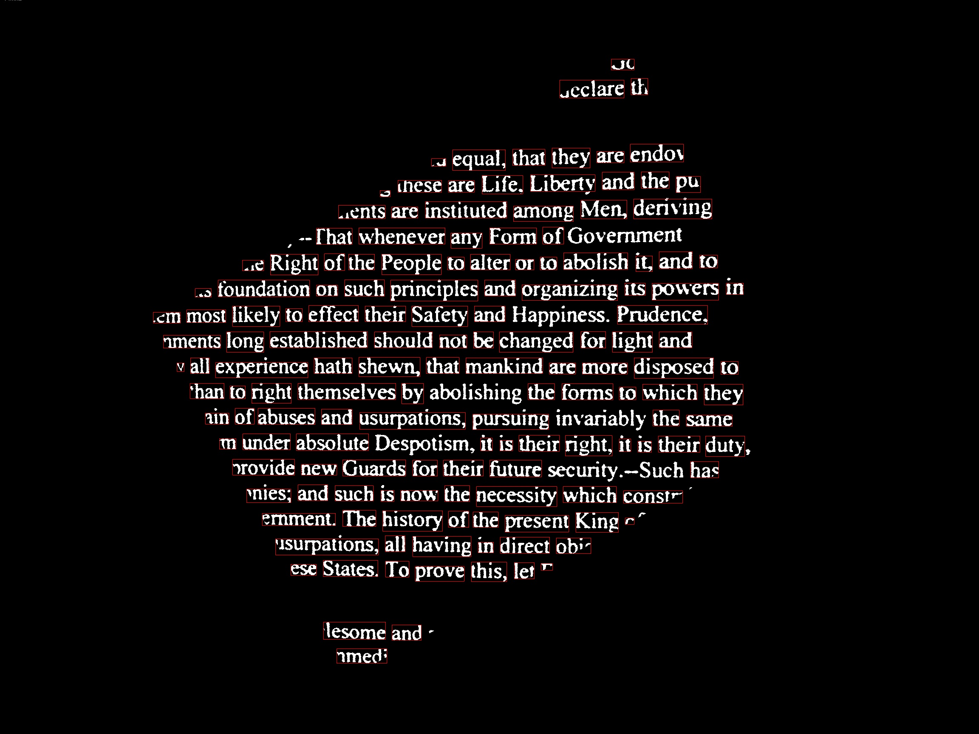
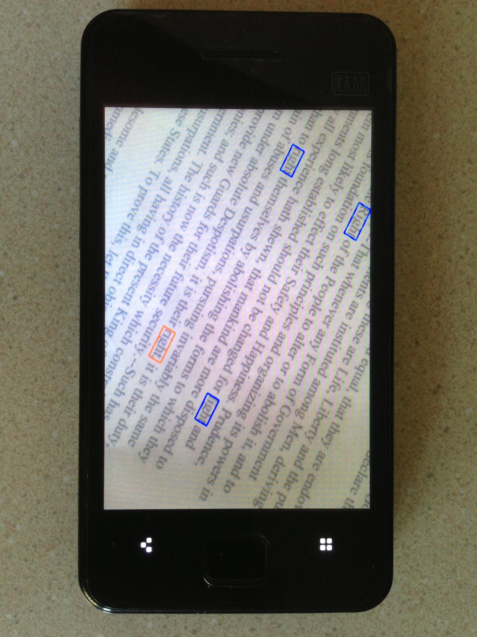
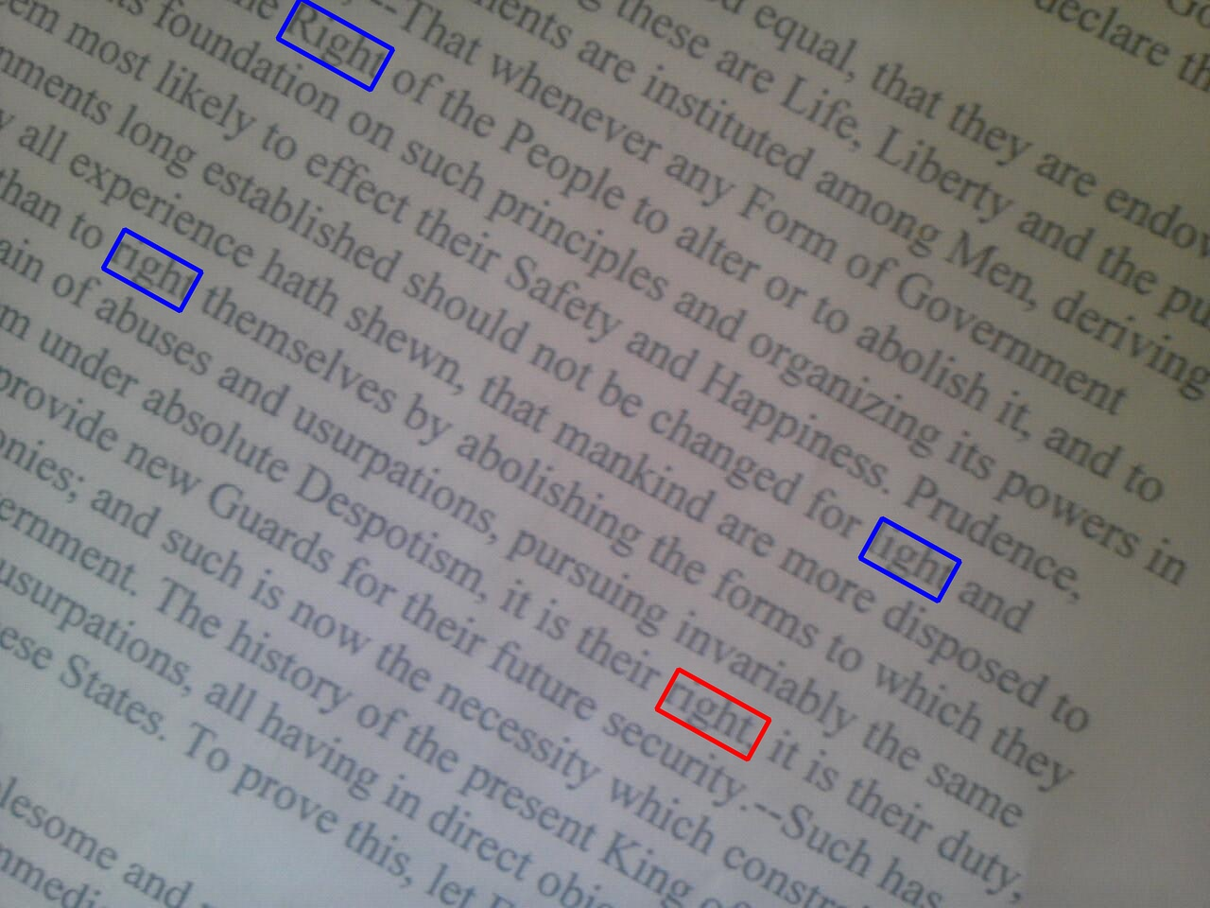
Word Hunter: Text Recognition App On Andriod Platform
Yang Zhao, Shuo Liu, Lingren Zhang
Department of Electrical Engineering, Stanford University
Motivation
Image Processing Flowchart
Have you ever needed to search for a keyword on a textbook when cramming for an exam? If so, this app is here to help! All you need to do is to type the keyword, point and shoot. The app finds any keyword matches in the picture.
Features
Automatic de-skew: Auto-corrects any skewed/tilted image before passing it to OCR.
Fuzzy recognition: Highlights both exact matches and close matches, in case image quality is low.
Cloud Computing Flowchart
Experimental Results
Acknowledgments
Special thanks to David Chen and Sam Tsai for their generous and responsive help on the project.
We would like to also thank Prof. Girod for his inspiring lectures throughout the quarter.

