Slide 1

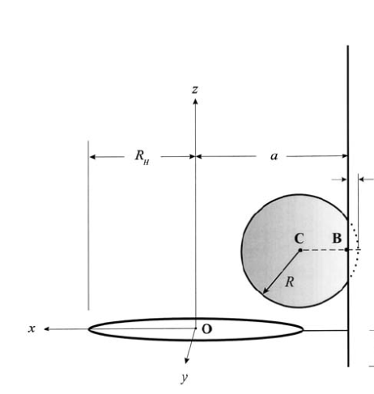
Perfect Shooting
陳新元

Slide 2
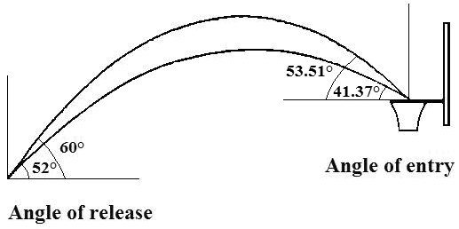
Goal
Simulate basketball player shooting, and find out the perfect angle and spin under fix random error
https://www.researchgate.net/figure/The-Ball-Release-Angle-of-a-Basketball-Shot-is-Positively-Related-to-the-Angle-of-Ball_fig1_269922632

Slide 3
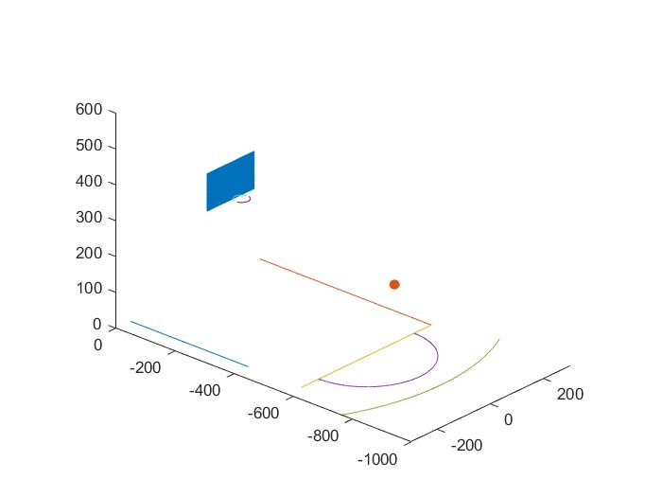
Background
Board position: x = -90~90
y = -120
z = 290~395
(cm)
Rim position: center: (0,-157.5,305)
radius: 22.5
(cm)
Basketball start position:
center: (0,-675,230)
radius: 12.3
(cm)
Timestep:
dt = 0.00001s (in the air)
dt = 0.000004s (after coliision)

Slide 4
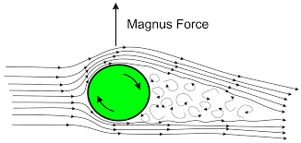
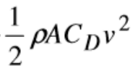

Ball in the air
F = Fg + Fdrag + Fm
Fg = mg(gravity force)
Fdrag = (drag force)
F magnus =
https://www.researchgate.net/publication/245372854_Numerical_Analysis_of_the_Basketball_Shot
http://www.uphysicsc.com/2011-GM-B-379.PDF
https://www.grc.nasa.gov/WWW/K-12/airplane/balllift.html

Slide 5
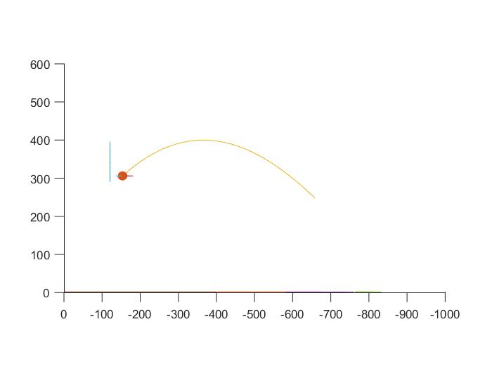
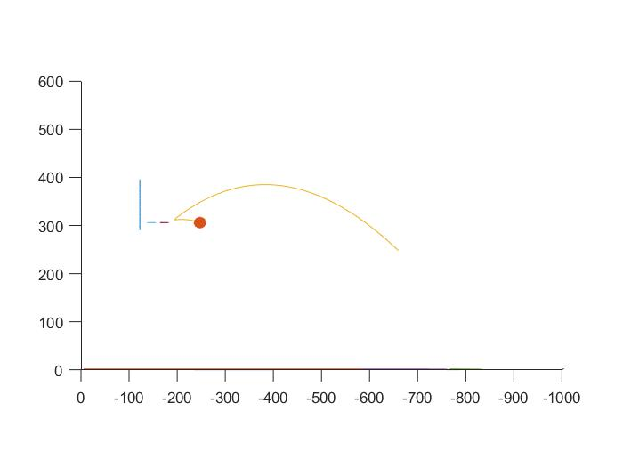
Magnus Force
with magnus force
without magnus force

Slide 6
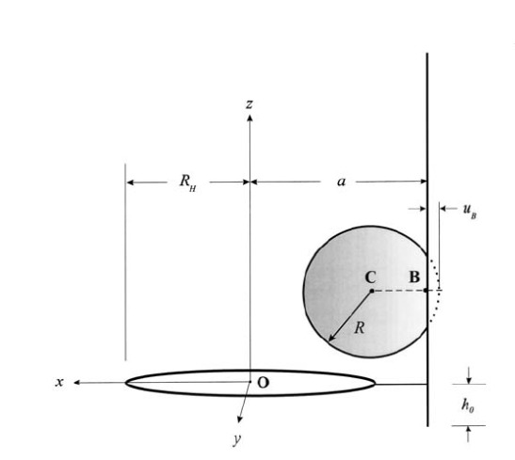

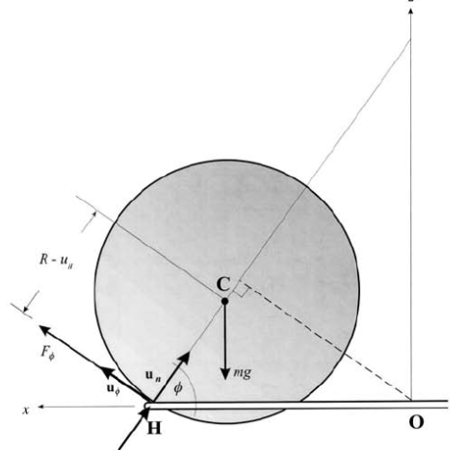

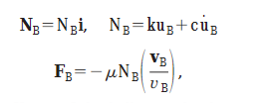
Ball hitting backboard and rim
https://www.researchgate.net/publication/245372854_Numerical_Analysis_of_the_Basketball_Shot

Slide 7
Sample
1000 sample per angle/spin pair
Random coefficient between [0.95,1.05]

Slide 8
Finding Ideal Initial Speed Magnitude
Fix angle and spin
Adjusting initial speed until the center of the ball and the center of the rim are closer than 0.01cm

Slide 9
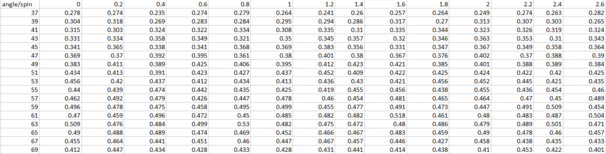
Result
2pi*rad/s

Slide 10
Incremet sample number
degree=47

Slide 11
Summary
Spinning doesn't have big relation with hit rate
The highest hit rate appear in 60~66°.

Slide 12
Future Work
Take more sample number
2D -> 3D
More accurate computation of the force between rim and basketball

Slide 13
END Thank you~~

