Slide 1
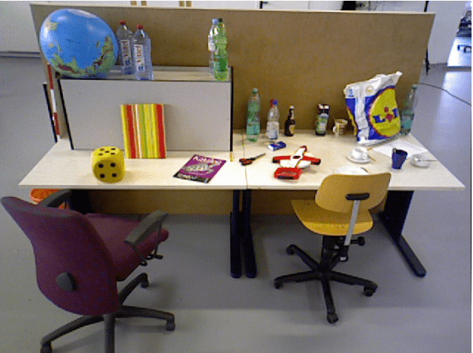

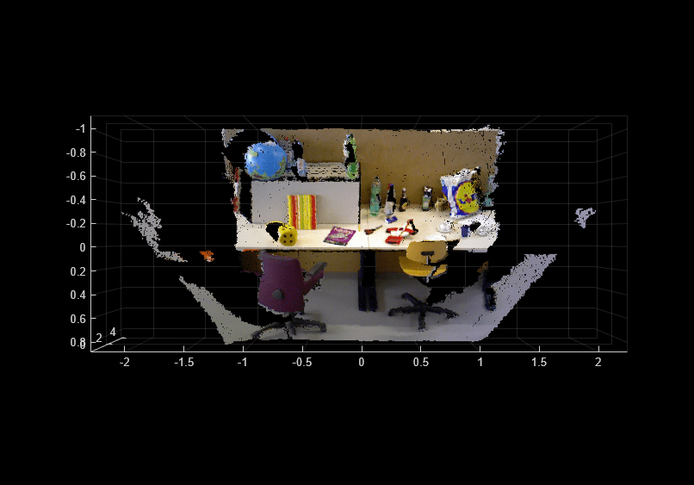
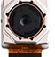
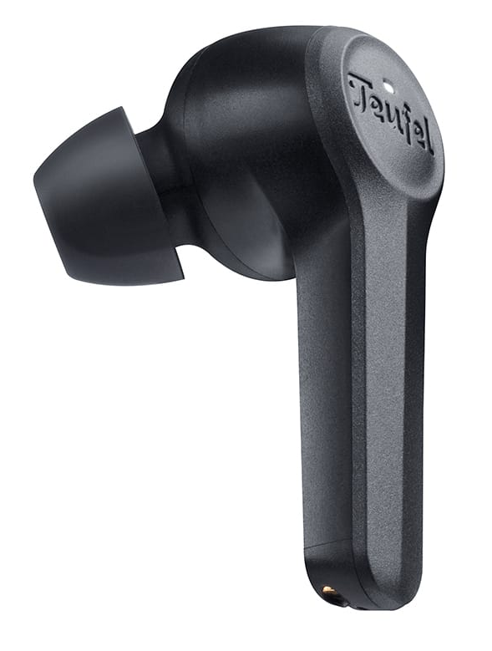
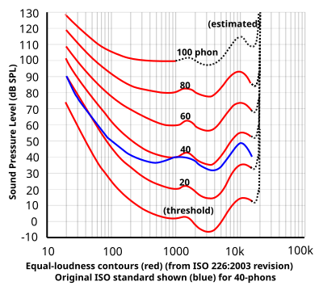
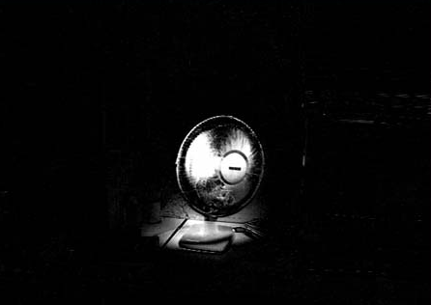

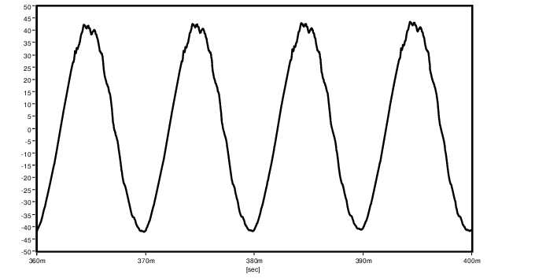
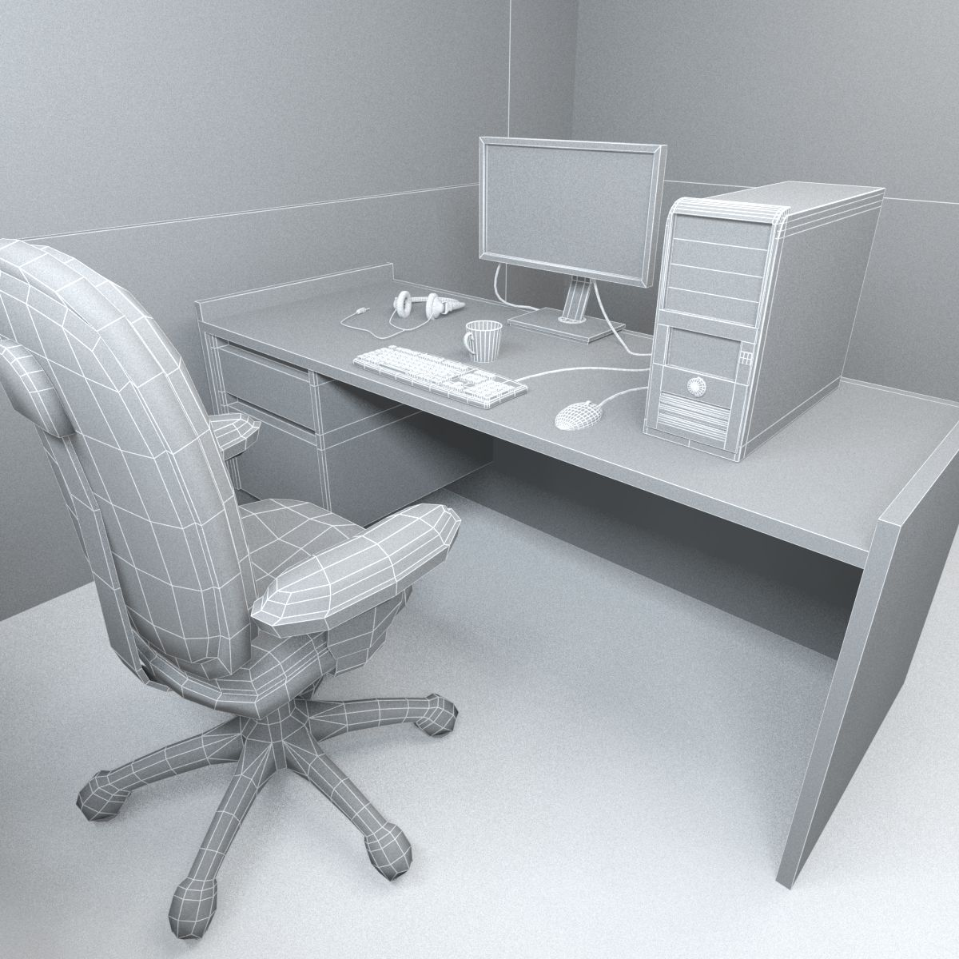
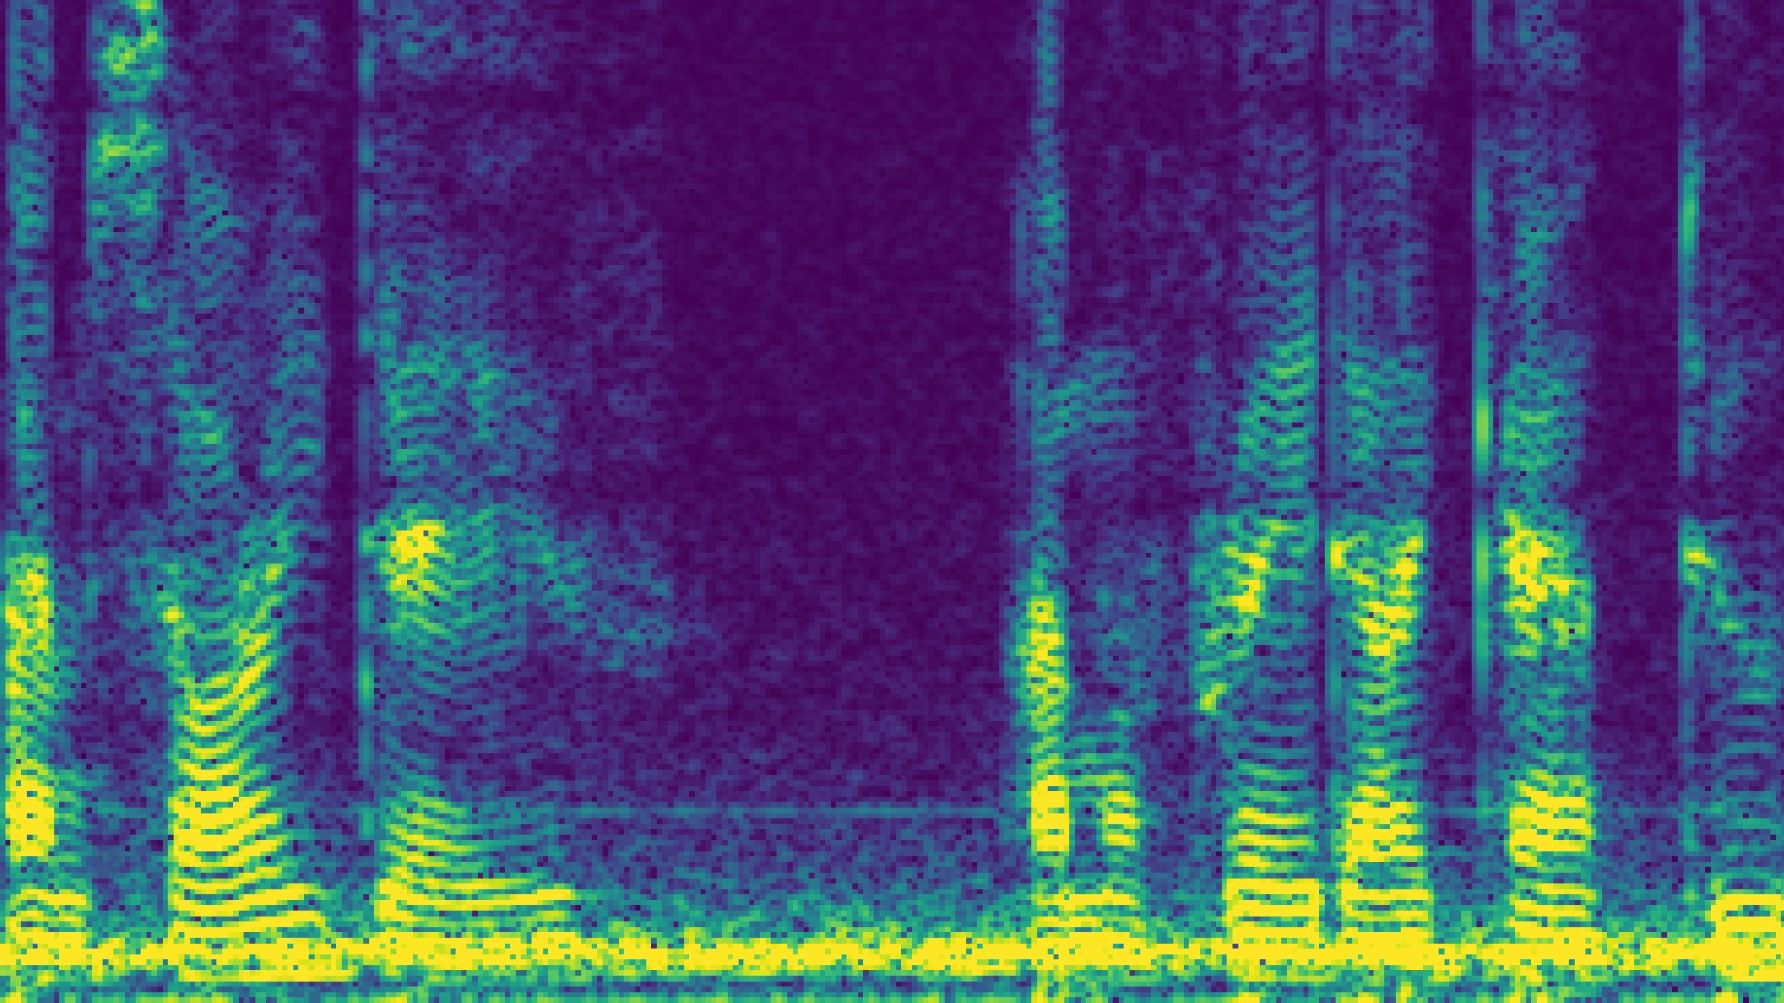
STEP#2
Depth Calculation
STEP#3
Point Projection
STEP#1
Capturing
steroRectify()
reprojectImageto3D()
Environment
OV5640 5MP 160°
Camera
Depth Map
Point Cloud
STEP#9 Speaker
STEP#4
STEP#7
Scaling and fitting
Equal-loudness contour
Earphones
STEP#5
changes
Changed heatmaps
Reconstructed Waveform (Binaural/two-channeled)
STEP#6
STEP#8
Environmental Priority
iSTFT/iFFT addition
Person
Spectrogram
Virtual Environment

