Slide 1
Intro to Psychology – Q&A and practice exam
Introduction to Psychology – Lucia Rugeroni Artificial Intelligence First Year Programme

Slide 2

Welcome!
AI Second Year
Argentinian
Lived in 4 different countries in the last 6 years
Lucia Rugeroni

Slide 3
Structure

Slide 4

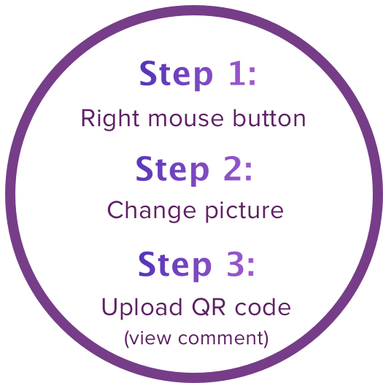
WhatsApp

Slide 5
How is the exam going to be
56 multiple choice questions
Need a 5.5 to pass → You need 35/56 correct

Slide 6
What am I going to do today
Q&A
13 questions from the mock exam (available on canvas)
8 questions for psychology
5 questions for methods

Slide 7
Any Questions?

Slide 8
Practice Exam
Questions

Slide 9
Question
1. Variability within one species is a(n) ...... evolutionary change.
A. unwanted byproduct of
B. essential condition for
C. barrier to
D. precursor of

Slide 10
Answer
1. Variability within one species is a(n) ...... evolutionary change.
A. unwanted byproduct of
B. essential condition for
C. barrier to
D. precursor of
Variability is one of the three conditions for evolution, those are:
- There is variation among individuals of a population
- Individuals with a certain trait survive and reproduce at higher rates than others
- The trait associated with this advantage is passed from parents to offspring

Slide 11
Question
2. When a property is recessively inherited, then
A. it is a detrimental feature.
B. this property is determined by sex-linked chromosomes.
C. the property must be passed by both parents to express itself in the phenotype.
D. only parents who have this feature can pass it to their children.

Slide 12
Answer
2. When a property is recessively inherited, then
A. it is a detrimental feature.
B. this property is determined by sex-linked chromosomes.
C. the property must be passed by both parents to express itself in the phenotype.
D. only parents who have this feature can pass it to their children.
For a property that’s recessively inherited to show, there must be no dominant allele that can stop that property from showing, since, even if there’s only one dominant allele, it will always take priority, therefore, it would be necessary to have two recessive alleles for the property to show.

Slide 13
Question
3. The two parts of the peripheral nervous system are
A. the brain and spinal cord.
B. the somatic and the autonomous nervous system.
C. the sympathetic and the parasympathetic nervous system.
D. the autonomous and sympathetic nervous system.

Slide 14
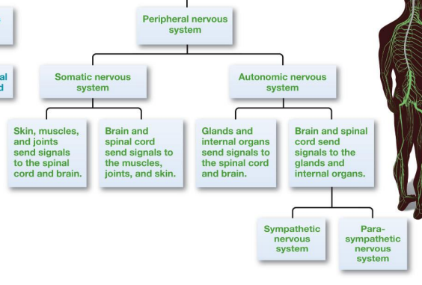
Answer
3. The two parts of the peripheral nervous system are
A. the brain and spinal cord.
B. the somatic and the autonomous nervous system.
C. the sympathetic and the parasympathetic nervous system.
D. the autonomous and sympathetic nervous system.

Slide 15
Question
4. During a brain operation, a part of the primary motor projection area is stimulated in a patient. As a result of this stimulation, the left leg of the patient moves. The most likely place of stimulation was the part of the ... lobe.
A. left Frontal
B. right Frontal
C. left Parietal
D. right Parietal

Slide 16
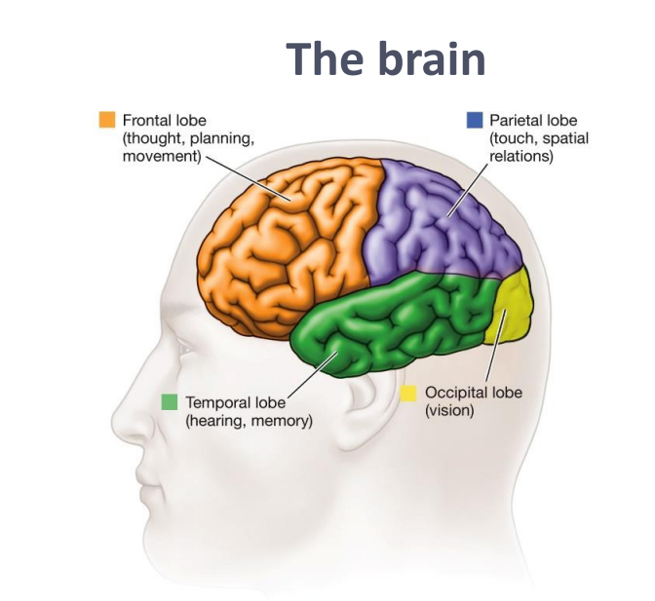
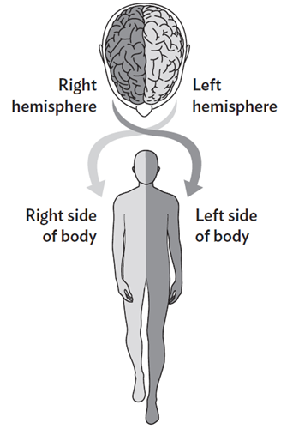
Answer
4. During a brain operation, a part of the primary motor projection area is stimulated in a patient. As a result of this stimulation, the left leg of the patient moves. The most likely place of stimulation was the part of the ... lobe.
A. left Frontal
B. right Frontal
C. left Parietal
D. right Parietal
The Frontal lobe is in charge of movement, and the right side of the brain controls the left side of the body. So, with the leg moving, the Frontal lobe is stimulated, and by it being the left leg, we know that it is the right side of the Frontal lobe.

Slide 17
Question
5. Which of the following statements is true?
A. The density of cones and rods in the retina increases from the fovea to the periphery.
B. In the fovea there are mainly rods, while the cones are mostly in the periphery.
C. In the retina there are no cones and rods where the optic nerve exits the eye.
D. All of the above options are correct.

Slide 18
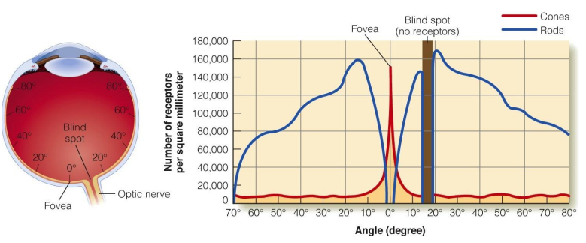
Answer
5. Which of the following statements is true?
A. The density of cones and rods in the retina increases from the fovea to the periphery.
B. In the fovea there are mainly rods, while the cones are mostly in the periphery.
C. In the retina there are no cones and rods where the optic nerve exits the eye.
D. All of the above options are correct.
Rods → Sensitive to light and motion
Cones → Sensitive to colour and detail
Optic nerve → The spot where the optic nerve leaves the eye has no photoreceptors (rods or cones), creating a blind spot

Slide 19
Question
6. Suppose the distance between the eyes can be increased. This would have the following effect:
A. an increase in binocular disparity.
B. a decrease in binocular disparity.
C. an increase in the effect of motion parallax.
D. a reduction in the effect of motion parallax.

Slide 20
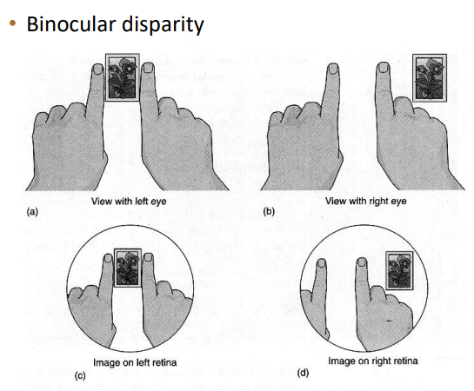
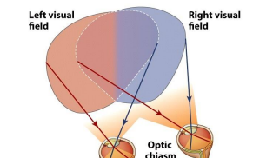
Answer
6. Suppose the distance between the eyes can be increased. This would have the following effect:
A. an increase in binocular disparity.
B. a decrease in binocular disparity.
C. an increase in the effect of motion parallax.
D. a reduction in the effect of motion parallax.

Slide 21
Question
7. In classical conditioning an animal learns the relation between ... .; In instrumental conditioning, an animal learns the relationship between ....
A. CR and US; Stimulus and response
B. CS and UR; Stimulus and response
C. CR and UR; Response and reward
D. CS and US; Response and reward

Slide 22
Answer
7. In classical conditioning an animal learns the relation between ... .; In instrumental conditioning, an animal learns the relationship between ....
A. CR and US; Stimulus and response
B. CS and UR; Stimulus and response
C. CR and UR; Response and reward
D. CS and US; Response and reward
Let’s use Pavlov’s dog as an example:
CS = Conditioned stimulus (here it would be the bell)
US = Unconditioned Stimulus (here it is the food)
The dog learns the relation between the conditioned stimulus (bell) and unconditioned stimulus (the food) → Every time Pavlov rings the bell, the dog gets food, he therefore associates the sound of the bell with getting food In Instrumental conditioning (let’s use the pigeons as an example):
The pigeons learn the relationship between their response (pressing a button) and the reward (getting food) → The pigeons now think that every time they press the button, they will get the food.

Slide 23
Question
8. Xena the Warrior Princess was taking a nap after a big lunch. Her companion Gabrielle was attacked nearby. Xena immediately rose up and threw her weapon at the attacker, saving Gabrielle. Which of Xena’s nervous system were activated during this time?
A. Parasympathetic nervous system during the nap; Sympathetic nervous system during the attack
B. Sympathetic nervous system during the nap; Parasympathetic nervous system during the attack
C. Somatic nervous system during the nap; Autonomic nervous system during the attack
D. Autonomic nervous system during the nap; Somatic nervous system during the attack

Slide 24
Answer
8. Xena the Warrior Princess was taking a nap after a big lunch. Her companion Gabrielle was attacked nearby. Xena immediately rose up and threw her weapon at the attacker, saving Gabrielle. Which of Xena’s nervous system were activated during this time?
A. Parasympathetic nervous system during the nap; Sympathetic nervous system during the attack
B. Sympathetic nervous system during the nap; Parasympathetic nervous system during the attack
C. Somatic nervous system during the nap; Autonomic nervous system during the attack
D. Autonomic nervous system during the nap; Somatic nervous system during the attack
Sympathetic nervous system → “fight or flight”
Parasympathetic nervous system → “rest and digest”

Slide 25
Question
9. The variable that is manipulated in an experiment is the
A. dependent variable.
B. independent variable.
C. confounding variable.
D. control variable.

Slide 26
Answer
9. The variable that is manipulated in an experiment is the
A. dependent variable.
B. independent variable.
C. confounding variable.
D. control variable.
Independent variables do not depend on anything else (time of day, mood of participant, weather), these variables are the ones that, in an experiment, are chosen and manipulated. The independent variables depend only on what the researcher decides to do with it, however, dependent variables are the ones that depend on what the researcher did with the Independent variable.

Slide 27
Question
10. A researcher wants to know what the effects are of typeface on the reading speed of people. He performs an experiment with the ... typeface and the ... reading speed. All test subjects are given the task to first reading a paragraph in "Courier" font and then read a paragraph in "CG Times" font. In this experiment, font order is a ....
A. dependent variable; independent variable; confounding variable
B. independent variable; dependent variable; confounding variable
C. dependent variable; independent variable; control variable
D. independent variable; dependent variable; control variable

Slide 28
Answer
10. A researcher wants to know what the effects are of typeface on the reading speed of people. He performs an experiment with the ... typeface and the ... reading speed. All test subjects are given the task to first reading a paragraph in "Courier" font and then read a paragraph in "CG Times" font. In this experiment, font order is a ....
A. dependent variable; independent variable; confounding variable
B. independent variable; dependent variable; confounding variable
C. dependent variable; independent variable; control variable
D. independent variable; dependent variable; control variable
Typeface is the independent variable since the researcher wants to know the effects it has on the reading speed. They control which font the test subjects use.
Reading speed is the dependent variable, since we are testing how it changes depending on the typeface. This variable is therefore dependent on which font the researcher chooses to show the test subjects.
Font order is a confounding variable, since it could influence the results regardless of the typeface or the reading speed (for ex: it could cause habituation of the text and increase the reading speed the second time the subjects read it, no matter which font they’re using, making the second font always faster)

Slide 29
Question
11. A researcher is interested in whether Sorbitol causes cancer in humans. He carries out a well-controlled laboratory experiment in which he uses two identical groups of rats. The experimental group receives a large amount of Sorbitol every day, while the control group receives a placebo every day. The results show that there are significantly more cases of cancer in the experimental group than in the control group. The researcher's conclusion is that intake of Sorbitol causes cancer. This study has a
A. high internal validity and high external validity.
B. high internal validity and low external validity.
C. low internal validity and high external validity.
D. low internal validity and low external validity.

Slide 30
Answer
11. A researcher is interested in whether Sorbitol causes cancer in humans. He carries out a well-controlled laboratory experiment in which he uses two identical groups of rats. The experimental group receives a large amount of Sorbitol every day, while the control group receives a placebo every day. The results show that there are significantly more cases of cancer in the experimental group than in the control group. The researcher's conclusion is that intake of Sorbitol causes cancer. This study has a
A. high internal validity and high external validity.
B. high internal validity and low external validity.
C. low internal validity and high external validity.
D. low internal validity and low external validity.
Internal validity → How significant the results are for the experiment. Here, the results show how, in these rats, Sorbitol caused cancer cells.
External validity → How well the experiment translates to environments outside of the experiment. Here, it worked with the rats, but we don’t know if it works for humans, other animals, or if it works with rats in a different setting, etc.
This experiment has high internal validity, since it works well within the controlled environment, but low external validity, since we don’t know how well it will translate to an outside environment

Slide 31
Question
12. A teacher was interested in the development of problem solving. He conducted an experiment with 100 five-year-olds and 100 seven-year-olds. Each participant had to solve a puzzle problem. Each participant was allowed to take as much time as necessary. 99% of the seven-year-olds and 98% of the five-year-olds were able to solve the puzzle. Since the difference between the two groups was not statistically significant, the teacher concluded that there is no difference between five and seven year olds in the ability to solve puzzle problems. The above results are probably caused by a
A. regression-to-average effect.
B. ceiling effect.
C. floor effect.
D. confounding variable.

Slide 32
Answer
12. A teacher was interested in the development of problem solving. He conducted an experiment with 100 five-year-olds and 100 seven-year-olds. Each participant had to solve a puzzle problem. Each participant was allowed to take as much time as necessary. 99% of the seven-year-olds and 98% of the five-year-olds were able to solve the puzzle. Since the difference between the two groups was not statistically significant, the teacher concluded that there is no difference between five and seven year olds in the ability to solve puzzle problems. The above results are probably caused by a
A. regression-to-average effect.
B. ceiling effect.
C. floor effect.
D. confounding variable.
The ceiling effect happens when the test or measurement is too easy, so everyone scores very high. Here, both the seven year olds and the five year olds have very similar scores (98% and 99%), these scores are so high that it suggests that the puzzle might be too easy, making the differences between their ability to solve puzzles not show.

Slide 33
Question
13. When using a non-equivalent control group, it is important to
A. draw both groups randomly from the population.
B. match both groups with respect to possible contaminating variables.
C. assign the subjects randomly to the groups.
D. All options are correct.

Slide 34
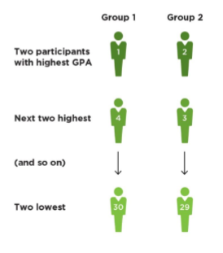
Answer
13. When using a non-equivalent control group, it is important to
A. draw both groups randomly from the population.
B. match both groups with respect to possible contaminating variables.
C. assign the subjects randomly to the groups.
D. All options are correct.
We aim for both groups to be balanced, since the control group is not equivalent, it is best to match the groups based on these variables that could affect the experiment.

Slide 35
Any Questions?

Slide 36
Free vs full

